Slide 1
ECE 5984: Introduction to Machine Learning
Topics:
Decision/Classification Trees
Ensemble Methods: Bagging, Boosting
Readings: Murphy 16.1-16.2; Hastie 9.2; Murphy 16.4
Dhruv Batra
Virginia Tech

Slide 2
Administrativia
HW3
Due: April 14, 11:55pm
You will implement primal & dual SVMs
Kaggle competition: Higgs Boson Signal vs Background classification
https://inclass.kaggle.com/c/2015-Spring-vt-ece-machine-learning-hw3
https://www.kaggle.com/c/higgs-boson

Slide 3
Administrativia
Project Mid-Sem Spotlight Presentations
9 remaining
Resume in class on April 20th
Format
5 slides (recommended)
4 minute time (STRICT) + 1-2 min Q&A
Content
Tell the class what you’re working on
Any results yet?
Problems faced?
Upload slides on Scholar

Slide 4
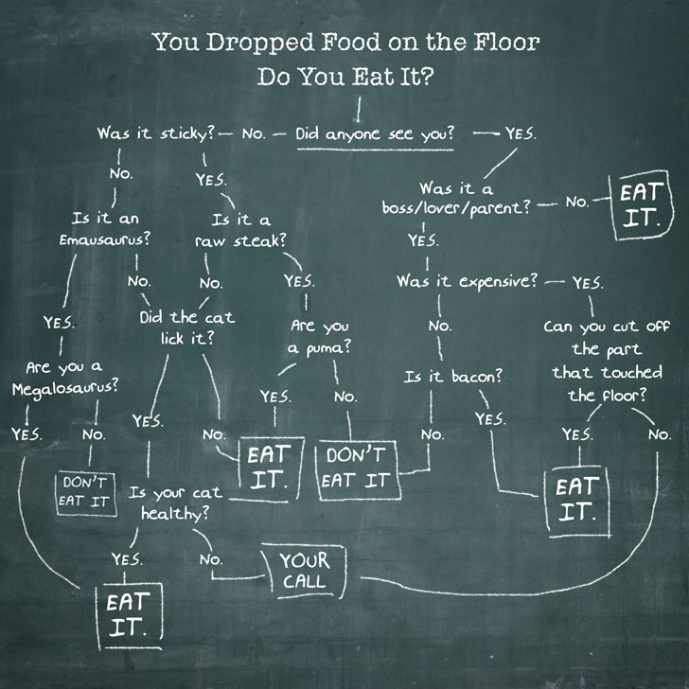
Decision Trees

Slide 5
Pose Estimation
Random Forests!
Multiple decision trees
http://youtu.be/HNkbG3KsY84

Slide 6
Slide Credit: Pedro Domingos, Tom Mitchel, Tom Dietterich

Slide 7
A small dataset: Miles Per Gallon
Suppose we want to predict MPG
40 Records
From the UCI repository (thanks to Ross Quinlan)
Slide Credit: Carlos Guestrin

Slide 8
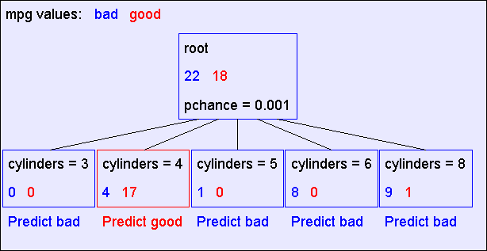
A Decision Stump
Slide Credit: Carlos Guestrin

Slide 9
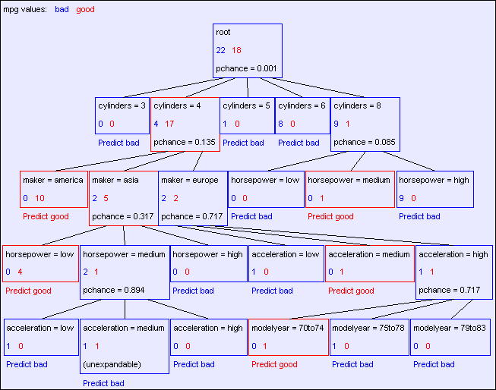
The final tree
Slide Credit: Carlos Guestrin

Slide 10
Comments
Not all features/attributes need to appear in the tree.
A features/attribute X_{i} may appear in multiple branches.
On a path, no feature may appear more than once.
Not true for continuous features. We’ll see later.
Many trees can represent the same concept
But, not all trees will have the same size!
e.g., Y = (A^B) ∨ (¬A^C) (A and B) or (not A and C)

Slide 11
Learning decision trees is hard!!!
Learning the simplest (smallest) decision tree is an NP-complete problem [Hyafil & Rivest ’76]
Resort to a greedy heuristic:
Start from empty decision tree
Split on next best attribute (feature)
Recurse
“Iterative Dichotomizer” (ID3)
C4.5 (ID3+improvements)
Slide Credit: Carlos Guestrin

Slide 12
Recursion Step
Records in which cylinders = 4
Records in which cylinders = 5
Take the
Original
Dataset..
And partition it according
to the value of the attribute we split on
Records in which cylinders = 6
Records in which cylinders = 8
Slide Credit: Carlos Guestrin

Slide 13
Recursion Step
Build tree from
These records..
Build tree from
These records..
Build tree from
These records..
Build tree from
These records..
Records in which cylinders = 8
Records in which cylinders = 6
Records in which cylinders = 4
Records in which cylinders = 5
Slide Credit: Carlos Guestrin

Slide 14
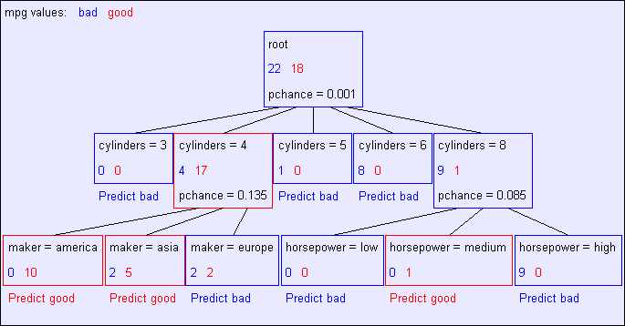
Second level of tree
Recursively build a tree from the seven records in which there are four cylinders and the maker was based in Asia
(Similar recursion in the other cases)
Slide Credit: Carlos Guestrin

Slide 15
The final tree
Slide Credit: Carlos Guestrin

Slide 16
Choosing a good attribute
X₁ | X₂ | Y
T | T | T
T | F | T
T | T | T
T | F | T
F | T | T
F | F | F
F | T | F
F | F | F
Slide Credit: Carlos Guestrin

Slide 17
Measuring uncertainty
Good split if we are more certain about classification after split
Deterministic good (all true or all false)
Uniform distribution bad
1
0.5
0
P(Y=F | X₁= T) = 0 | P(Y=T | X₁= T) = 1
F T
1
0.5
0
P(Y=F | X₂=F) = 1/2 | P(Y=T | X₂=F) = 1/2
F T

Slide 18
Entropy
Entropy H(X) of a random variable Y
More uncertainty, more entropy!
Information Theory interpretation: H(Y) is the expected number of bits needed to encode a randomly drawn value of Y (under most efficient code)
Slide Credit: Carlos Guestrin

Slide 19
Information gain
Advantage of attribute – decrease in uncertainty
Entropy of Y before you split
Entropy after split
Weight by probability of following each branch, i.e., normalized number of records
Information gain is difference
(Technically it’s mutual information; but in this context also referred to as information gain)
Slide Credit: Carlos Guestrin

Slide 20
Learning decision trees
Start from empty decision tree
Split on next best attribute (feature)
Use, for example, information gain to select attribute
Split on
Recurse
Slide Credit: Carlos Guestrin

Slide 21
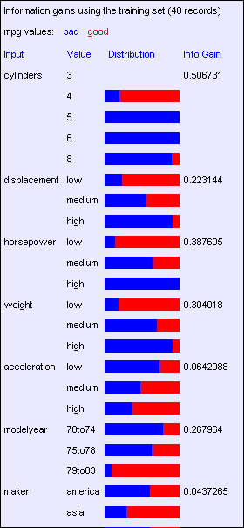
Look at all the information gains…
Suppose we want to predict MPG
Slide Credit: Carlos Guestrin

Slide 22
When do we stop?

Slide 23
Base Case One
Don’t split a node if all matching records have the same output value
Slide Credit: Carlos Guestrin

Slide 24
Base Case Two: No attributes can distinguish
Don’t split a node if none of the attributes can create multiple non-empty children
Slide Credit: Carlos Guestrin

Slide 25
Base Cases
Base Case One: If all records in current data subset have the same output then don’t recurse
Base Case Two: If all records have exactly the same set of input attributes then don’t recurse
Slide Credit: Carlos Guestrin

Slide 26
Base Cases: An idea
Base Case One: If all records in current data subset have the same output then don’t recurse
Base Case Two: If all records have exactly the same set of input attributes then don’t recurse
Proposed Base Case 3:
If all attributes have zero information gain then don’t recurse
Is this a good idea?
Slide Credit: Carlos Guestrin

Slide 27
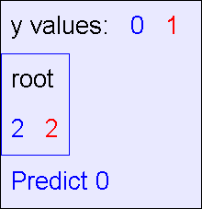
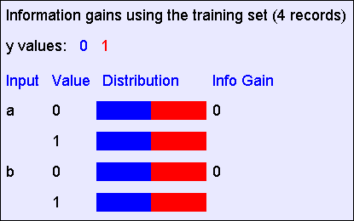
The problem with Base Case 3
y = a XOR b
The resulting decision tree:
The information gains:
Slide Credit: Carlos Guestrin

Slide 28
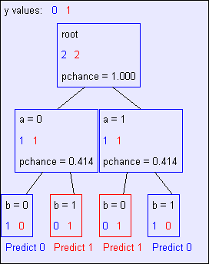
If we omit Base Case 3:
y = a XOR b
The resulting decision tree:
Slide Credit: Carlos Guestrin

Slide 29
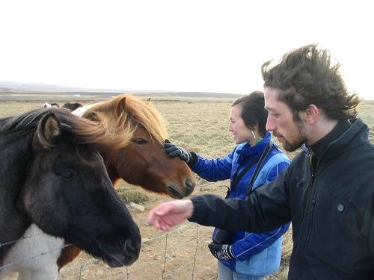
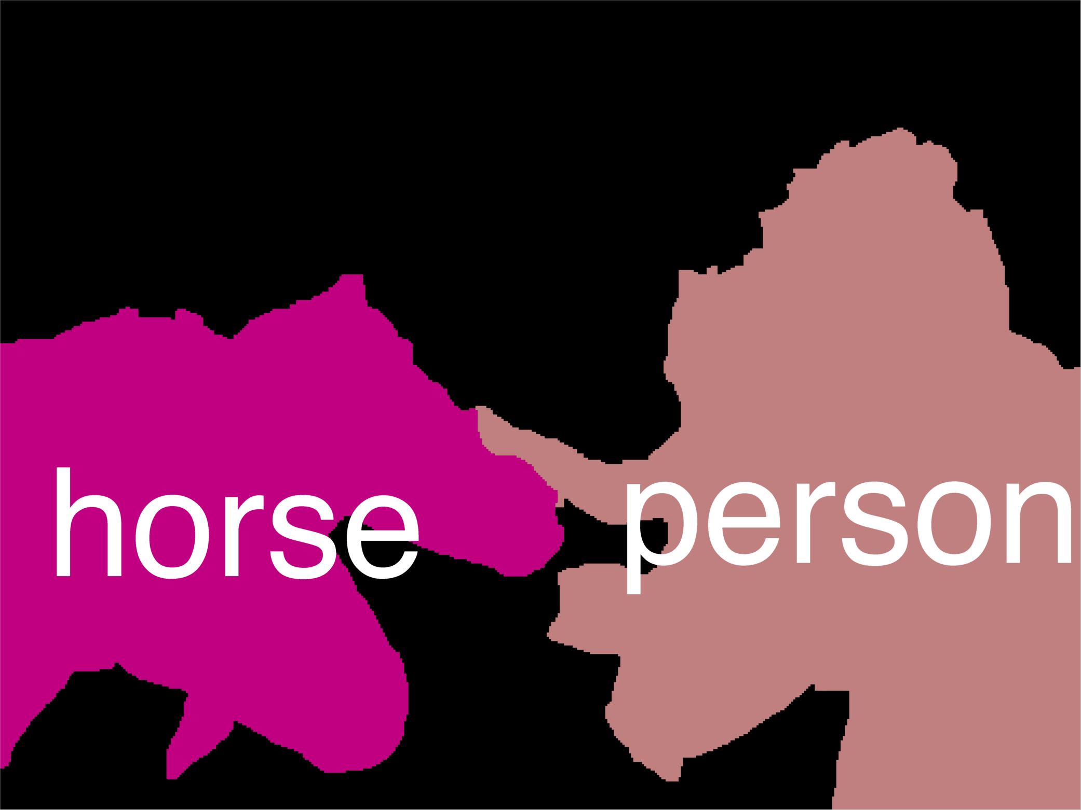
Remember: Error Decomposition
Reality
Modeling Error
model class
Estimation Error
Optimization Error

Slide 30
Basic Decision Tree Building Summarized
BuildTree(DataSet,Output)
If all output values are the same in DataSet, return a leaf node that says “predict this unique output”
If all input values are the same, return a leaf node that says “predict the majority output”
Else find attribute X with highest Info Gain
Suppose X has n_{X} distinct values (i.e. X has arity n_{X}).
Create and return a non-leaf node with n_{X} children.
The i’th child should be built by calling
BuildTree(DS_{i},Output)
Where DS_{i} built consists of all those records in DataSet for which X = ith distinct value of X.
Slide Credit: Carlos Guestrin

Slide 31
Decision trees will overfit
Standard decision trees have no prior
Training set error is always zero!
(If there is no label noise)
Lots of variance
Will definitely overfit!!!
Must bias towards simpler trees
Many strategies for picking simpler trees:
Fixed depth
Fixed number of leaves
Or something smarter… (chi2 tests)
Slide Credit: Carlos Guestrin

Slide 32
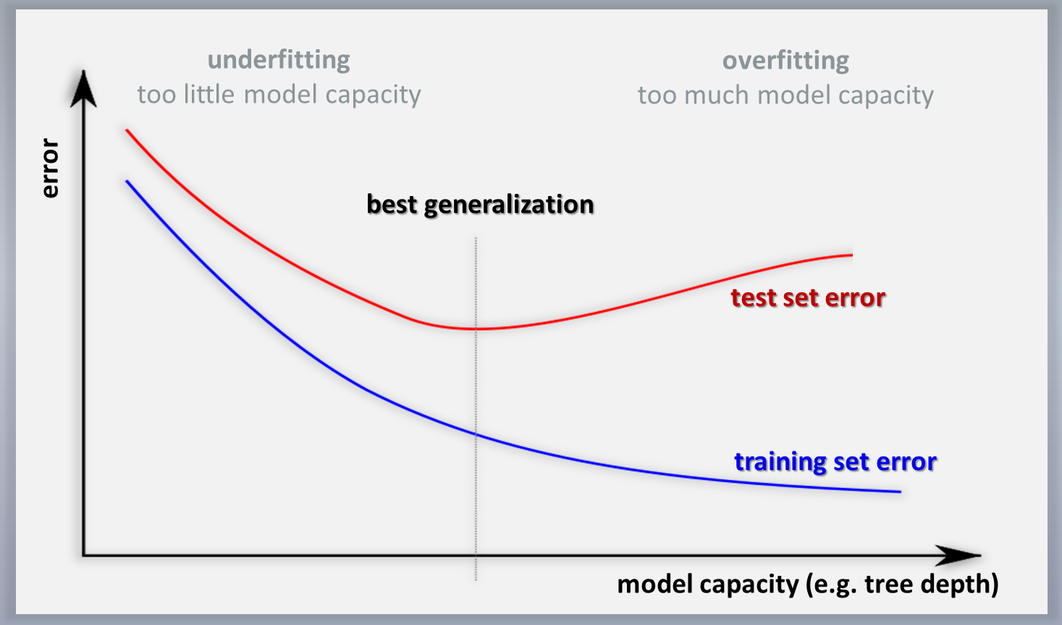
Decision trees will overfit

Slide 33
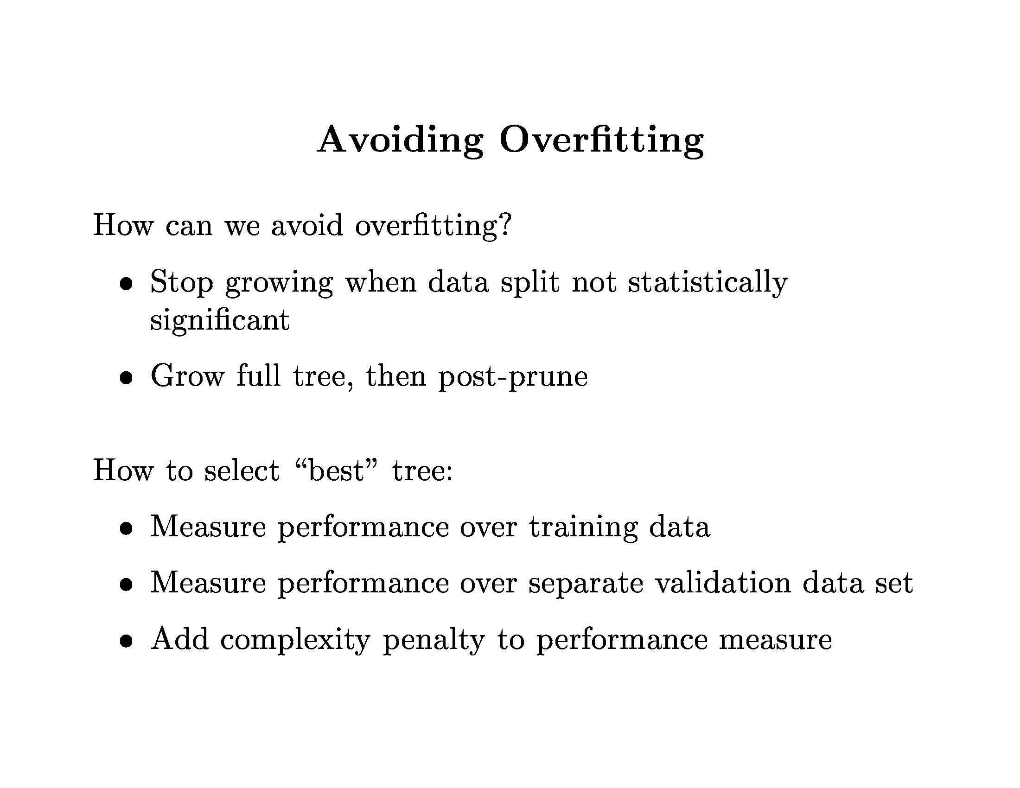
Slide Credit: Pedro Domingos, Tom Mitchel, Tom Dietterich

Slide 34
Slide Credit: Pedro Domingos, Tom Mitchel, Tom Dietterich

Slide 35
Pruning Decision Trees
Demo
http://webdocs.cs.ualberta.ca/~aixplore/learning/DecisionTrees/Applet/DecisionTreeApplet.html

Slide 36
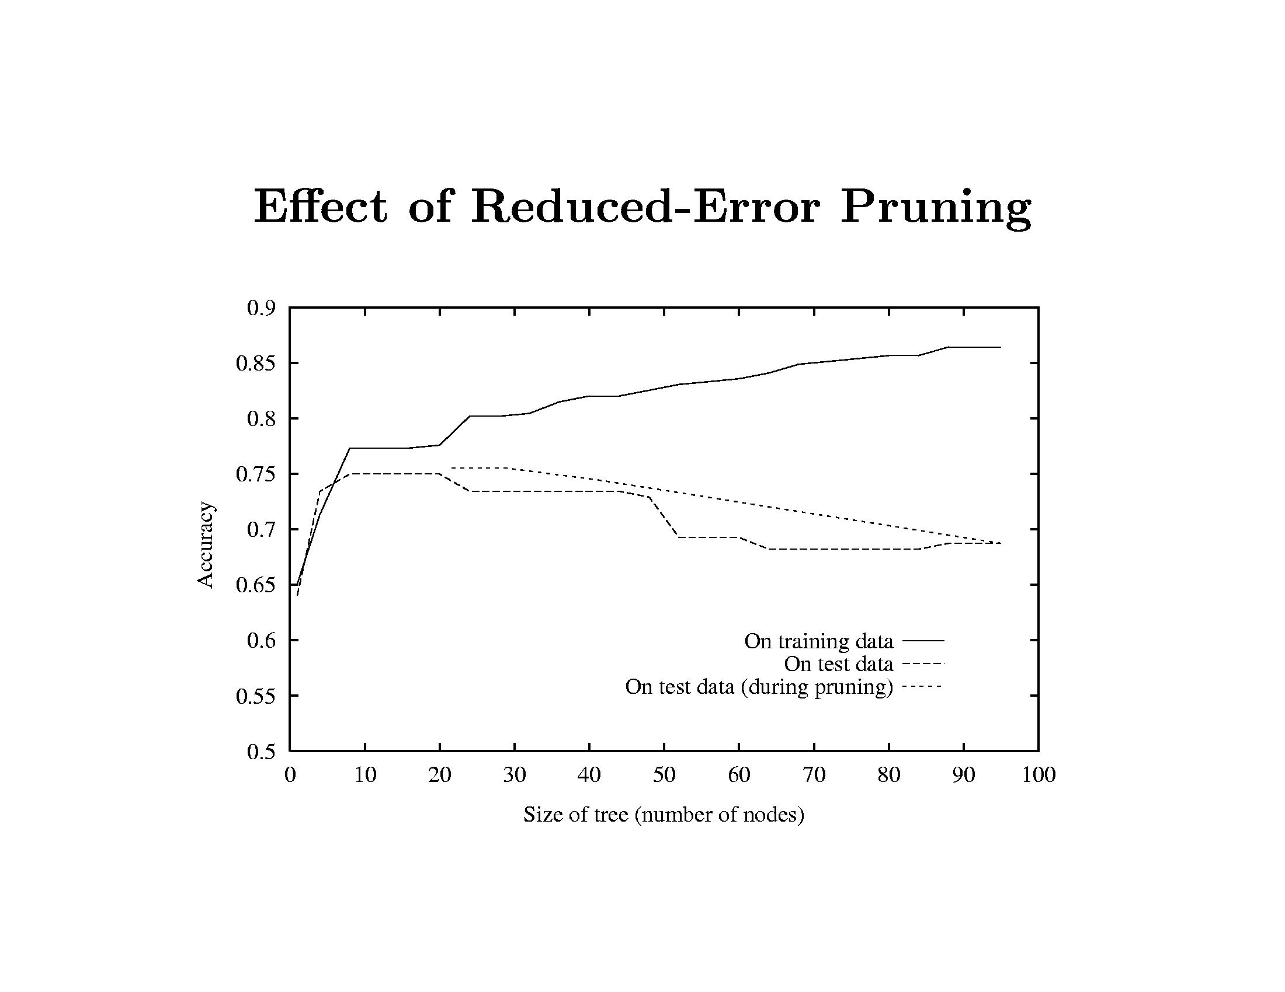
Slide Credit: Pedro Domingos, Tom Mitchel, Tom Dietterich

Slide 37
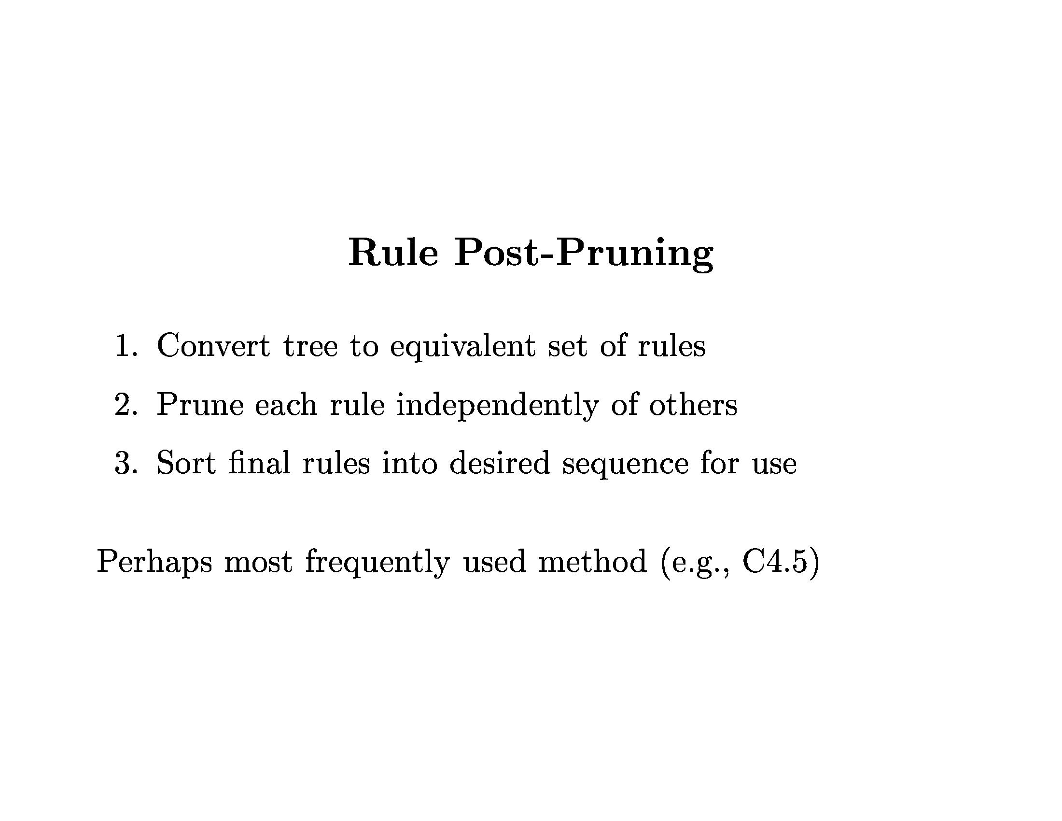
Slide Credit: Pedro Domingos, Tom Mitchel, Tom Dietterich

Slide 38
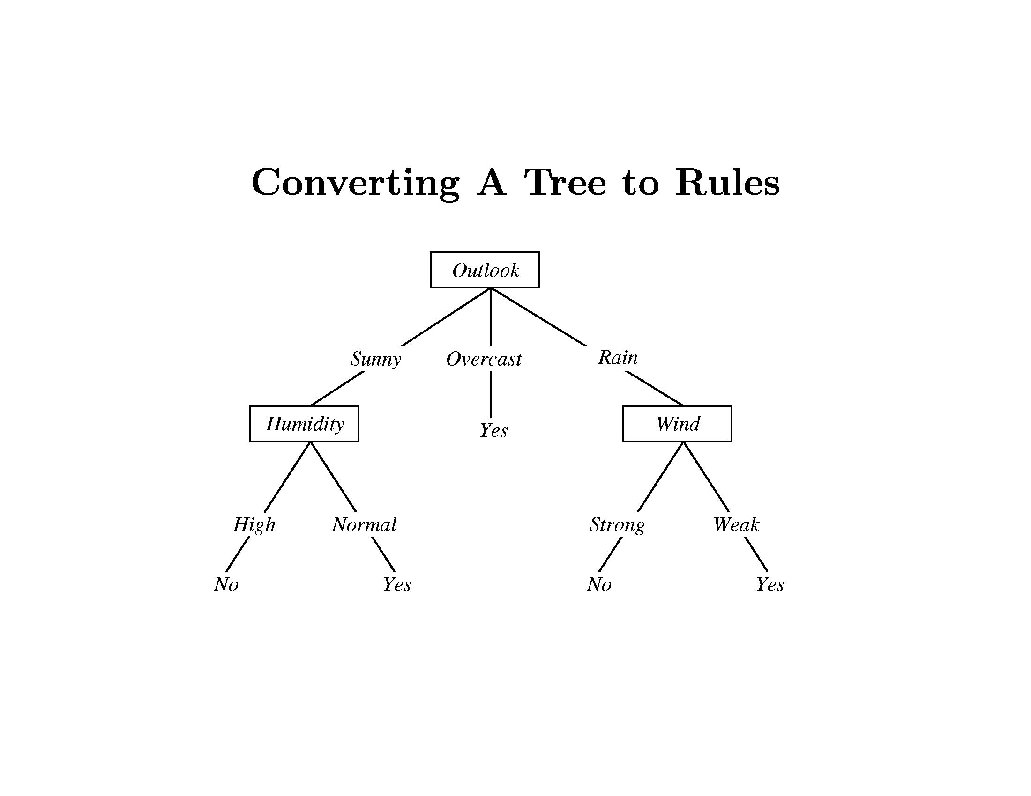
Slide Credit: Pedro Domingos, Tom Mitchel, Tom Dietterich

Slide 39
Slide Credit: Pedro Domingos, Tom Mitchel, Tom Dietterich

Slide 40
Real-Valued inputs
What should we do if some of the inputs are real-valued?
Infinite number of possible split values!!!
Finite dataset, only finite number of relevant splits!
Idea One: Branch on each possible real value
Slide Credit: Carlos Guestrin

Slide 41
“One branch for each numeric value” idea:
Hopeless: with such high branching factor will shatter the dataset and overfit
Slide Credit: Carlos Guestrin

Slide 42
Threshold splits
Binary tree, split on attribute X
One branch: X < t
Other branch: X >= t
Slide Credit: Carlos Guestrin

Slide 43
Choosing threshold split
Binary tree, split on attribute X
One branch: X < t
Other branch: X >= t
Search through possible values of t
Seems hard!!!
But only finite number of t’s are important
Sort data according to X into {x₁,…,x_{n}}
Consider split points of the form x_{i} + (x_{i+1} – x_{i})/2
Slide Credit: Carlos Guestrin

Slide 44
A better idea: thresholded splits
Suppose X is real valued
Define IG(Y|X:t) as H(Y) - H(Y|X:t)
Define H(Y|X:t) =
H(Y|X < t) P(X < t) + H(Y|X >= t) P(X >= t)
IG(Y|X:t) is the information gain for predicting Y if all you know is whether X is greater than or less than t
Then define IG*(Y|X) = max_{t} IG(Y|X:t)
For each real-valued attribute, use IG*(Y|X) for assessing its suitability as a split
Note, may split on an attribute multiple times, with different thresholds
Slide Credit: Carlos Guestrin

Slide 45
Decision Trees
Demo
http://www.cs.technion.ac.il/~rani/LocBoost/

Slide 46
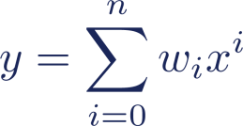
Regression Trees
What do we do at the leaf?
Examples of leaf (predictor) models
Predictor model: constant
Predictor model: polynomial
(note: linear for n=1, constant for n=0)
Image Credit: Jamie Shotton

Slide 47
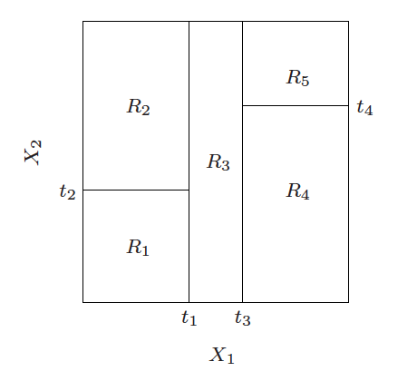
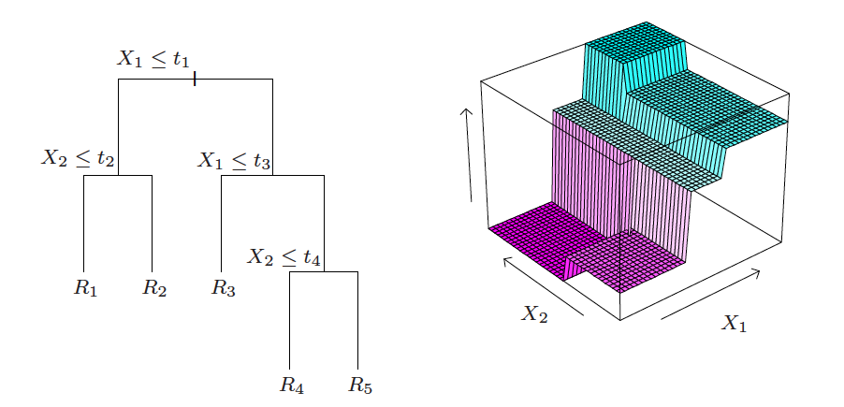
Regression Trees
Image Credit: ESL Book

Slide 48
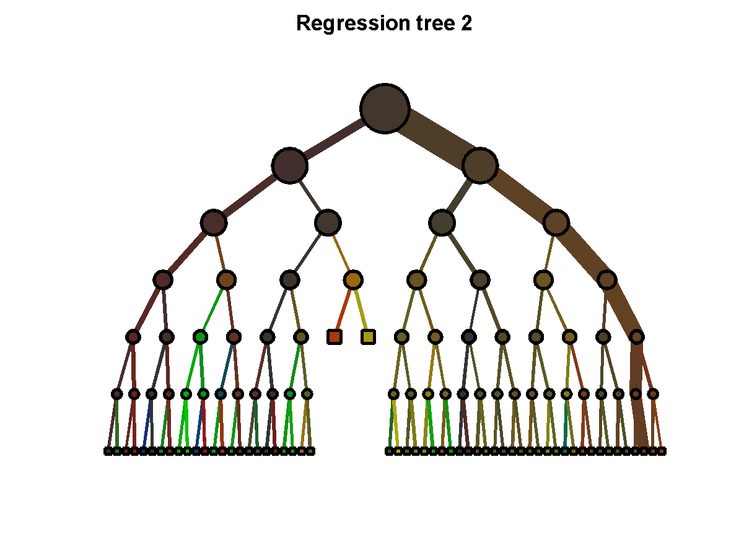
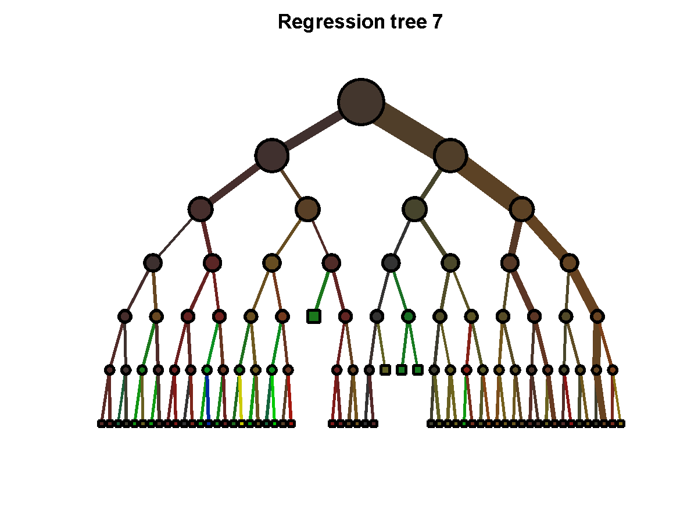
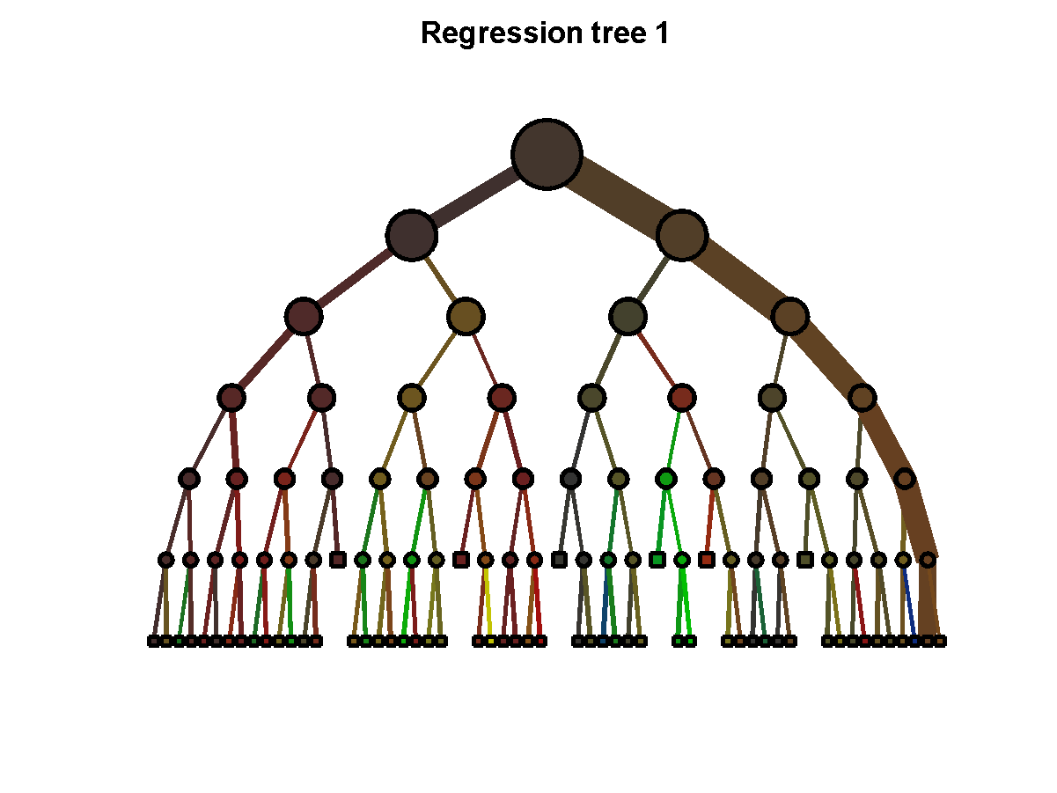
Decision Forests
…
…
Learn many trees & Average Outputs
Will formally visit this in Bagging lecture
Image Credit: Jamie Shotton

Slide 49
What you need to know about decision trees
Decision trees are one of the most popular data mining tools
Easy to understand
Easy to implement
Easy to use
Computationally cheap (to solve heuristically)
Information gain to select attributes (ID3, C4.5,…)
Presented for classification, can be used for regression and density estimation too.
Decision trees will overfit!!!
Zero bias classifier → Lots of variance
Must use tricks to find “simple trees”, e.g.,
Fixed depth/Early stopping
Pruning
Hypothesis testing

Slide 50
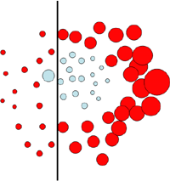
New Topic: Ensemble Methods
Bagging
Boosting
Image Credit: Antonio Torralba

Slide 51
Synonyms
Ensemble Methods
Learning Mixture of Experts/Committees
Boosting types
AdaBoost
L2Boost
LogitBoost
<Your-Favorite-keyword>Boost

Slide 52
A quick look back
So far you have learnt
Regression
Least Squares
Robust Least Squares
Classification
Linear
Naïve Bayes
Logistic Regression
SVMs
Non-linear
Decision Trees
Neural Networks
K-NNs

Slide 53
Recall Bias-Variance Tradeoff
Demo
http://www.princeton.edu/~rkatzwer/PolynomialRegression/

Slide 54
Bias-Variance Tradeoff
Choice of hypothesis class introduces learning bias
More complex class → less bias
More complex class → more variance
Slide Credit: Carlos Guestrin

Slide 55
Fighting the bias-variance tradeoff
Simple (a.k.a. weak) learners
e.g., naïve Bayes, logistic regression, decision stumps (or shallow decision trees)
Good: Low variance, don’t usually overfit
Bad: High bias, can’t solve hard learning problems
Sophisticated learners
Kernel SVMs, Deep Neural Nets, Deep Decision Trees
Good: Low bias, have the potential to learn with Big Data
Bad: High variance, difficult to generalize
Can we make combine these properties
In general, No!!
But often yes…
Slide Credit: Carlos Guestrin

Slide 56
Voting (Ensemble Methods)
Instead of learning a single classifier, learn many classifiers
Output class: (Weighted) vote of each classifier
Classifiers that are most “sure” will vote with more conviction
With sophisticated learners
Uncorrelated errors → expected error goes down
On average, do better than single classifier!
Bagging
With weak learners
each one good at different parts of the input space
On average, do better than single classifier!
Boosting

Slide 57
Bagging
Bagging = Bootstrap Averaging
On board
Bootstrap Demo
http://wise.cgu.edu/bootstrap/

Slide 58
Decision Forests
…
…
Learn many trees & Average Outputs
Will formally visit this in Bagging lecture

