Slide 1
ECE 5984: Introduction to Machine Learning
Topics:
SVM
soft & hard margin
comparison to Logistic Regresion
Readings: Barber 17.5
Dhruv Batra
Virginia Tech

Slide 2
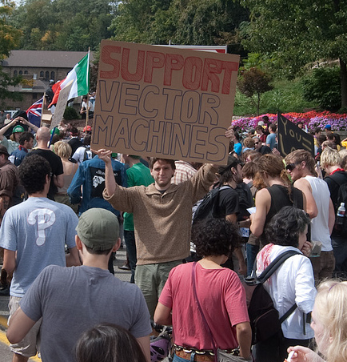
New Topic

Slide 3
Generative vs. Discriminative
Generative Approach (Naïve Bayes)
Estimate p(x|y) and p(y)
Use Bayes Rule to predict y
Discriminative Approach
Estimate p(y|x) directly (Logistic Regression)
Learn “discriminant” function f(x) (Support Vector Machine)

Slide 4
Linear classifiers – Which line is better?
w.x = ∑_{j} w^{(j)} x^{(j)}

Slide 5
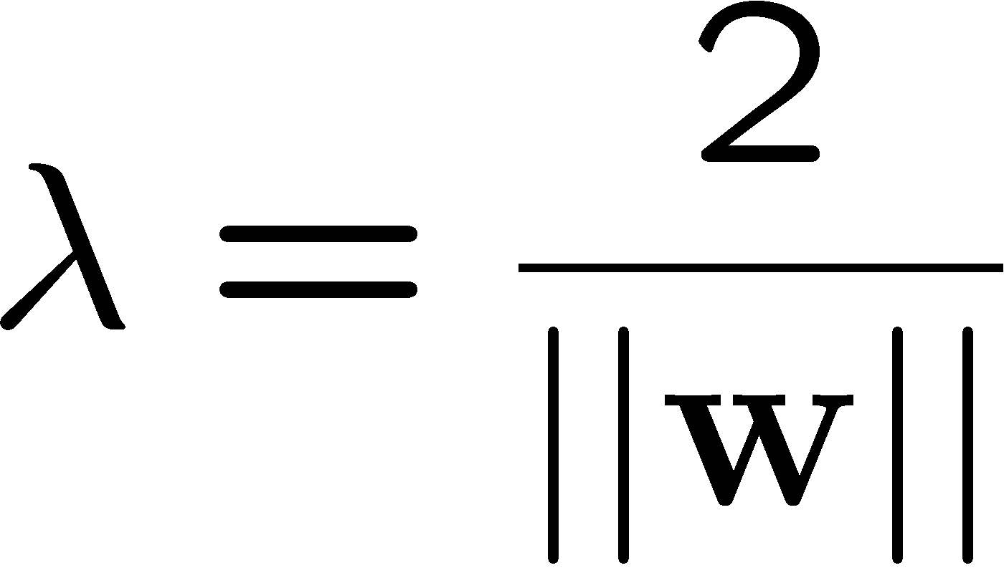
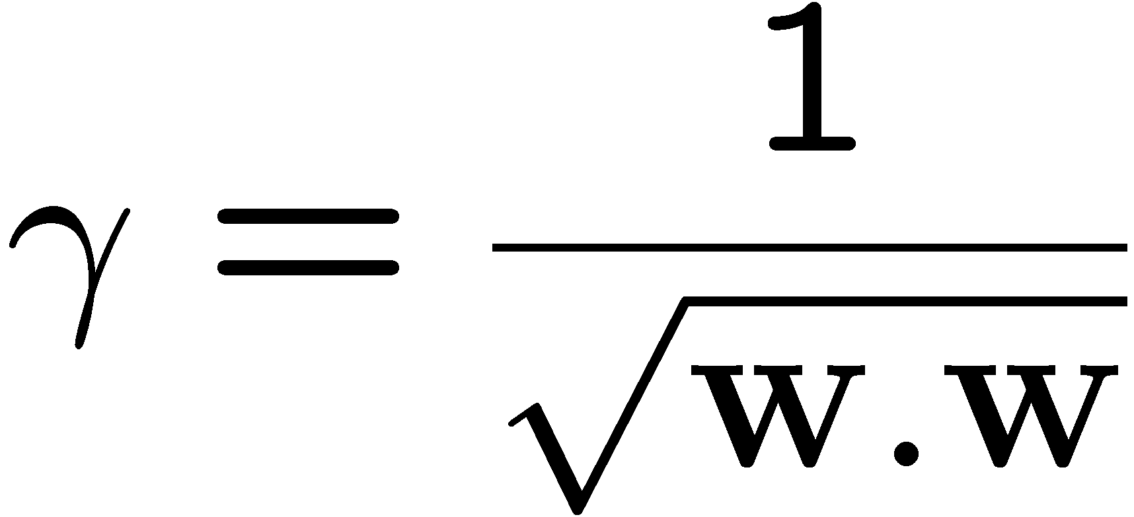
Margin
w.x + b = +1
w.x + b = 0
w.x + b = -1
x⁺
x⁻
margin 2γ
Slide Credit: Carlos Guestrin

Slide 6
Support vector machines (SVMs)
w.x + b = +1
w.x + b = 0
w.x + b = -1
Solve efficiently by quadratic programming (QP)
Well-studied solution algorithms
Hyperplane defined by support vectors
margin 2γ
Slide Credit: Carlos Guestrin

Slide 7
What if the data is not linearly separable?
Slide Credit: Carlos Guestrin

Slide 8
What if the data is not linearly separable?
Minimize w.w and number of training mistakes
0/1 loss
Slack penalty C
Not QP anymore
Also doesn’t distinguish near misses and really bad mistakes
Slide Credit: Carlos Guestrin

Slide 9
Slack variables – Hinge loss
If margin >= 1, don’t care
If margin < 1, pay linear penalty
Slide Credit: Carlos Guestrin

Slide 10
Soft Margin SVM
Effect of C
Matlab demo by Andrea Vedaldi

Slide 11
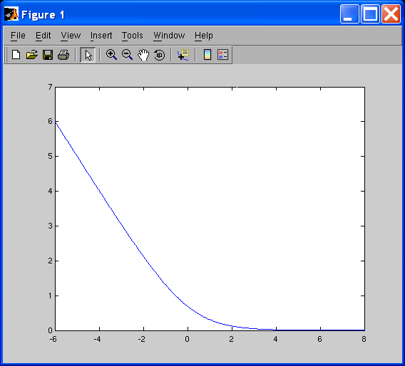
Side note: What’s the difference between SVMs and logistic regression?
SVM:
Logistic regression:
Log loss:
SVM: Hinge Loss
LR: Logistic Loss
Slide Credit: Carlos Guestrin

Slide 12
Slide Credit: Andrew Moore

Slide 13
Slide Credit: Andrew Moore

Slide 14
Slide Credit: Andrew Moore

Slide 15
Does this always work?
In a way, yes
Slide Credit: Blaschko & Lampert

Slide 16
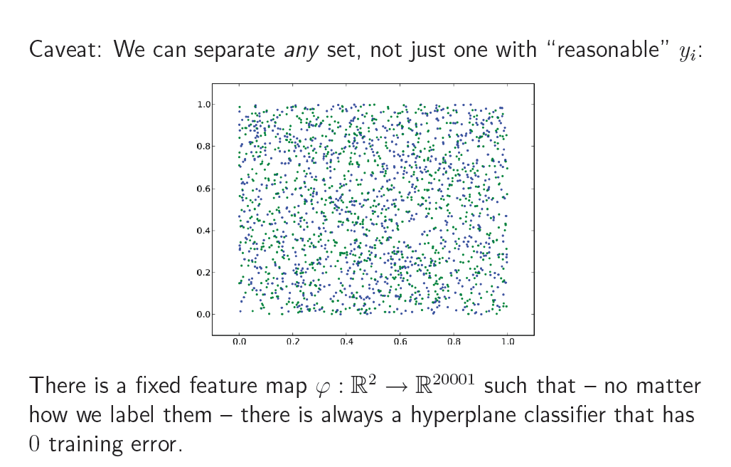
Caveat
Slide Credit: Blaschko & Lampert

Slide 17
Kernel Trick
One of the most interesting and exciting advancement in the last 2 decades of machine learning
The “kernel trick”
High dimensional feature spaces at no extra cost!
But first, a detour
Constrained optimization!
Slide Credit: Carlos Guestrin

