Slide 1
Style Transfer
Sujay Yadawadkar,
Virginia Tech

Slide 2
Agenda:
Style transfer:
Quick overview
Real time performance
Experiment Results

Slide 3
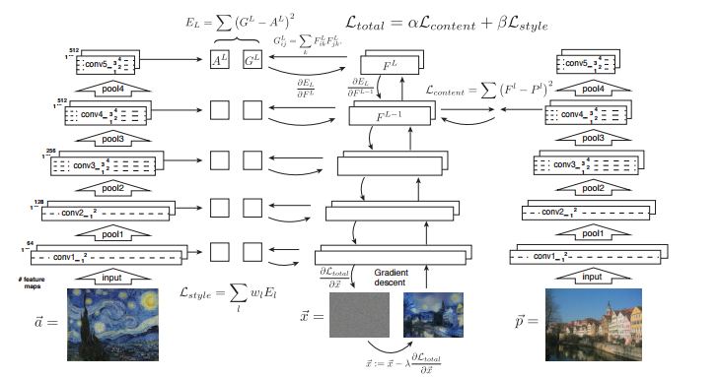
Overview:
Picture Credit: Image style transfer using convolutional neural networks.
L. A. Gatys, A. S. Ecker, M. Bethge, CVPR 2016

Slide 4
Limitation:
Gradient descent for every image.
Can we build a faster style transformation network ..?

Slide 5
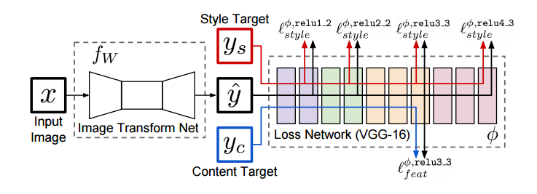
Real Time Style Transfer
Perceptual Losses for Real-Time Style Transfer and Super-Resolution. J. Johnson, A. Alahi, L. Fei-Fei, ECCV

Slide 6
Experiment:
Hardware:
PC with Intel Core-i7 5th Gen.
8gb ram
No GPU used.
Software Dependencies:
Torch
Cuda (optional, not used)
Cudnn (optional, not used)
Procedure:
Use pretrained torch model.

Slide 7
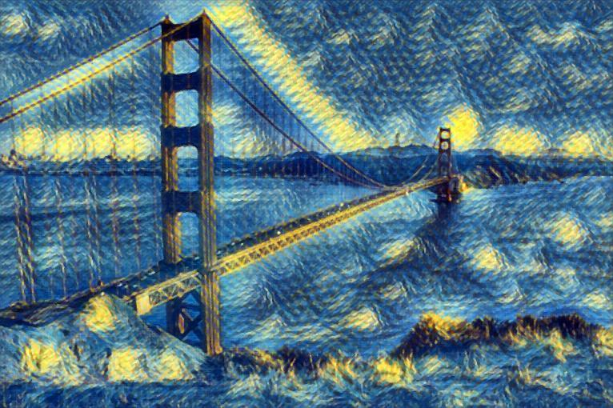
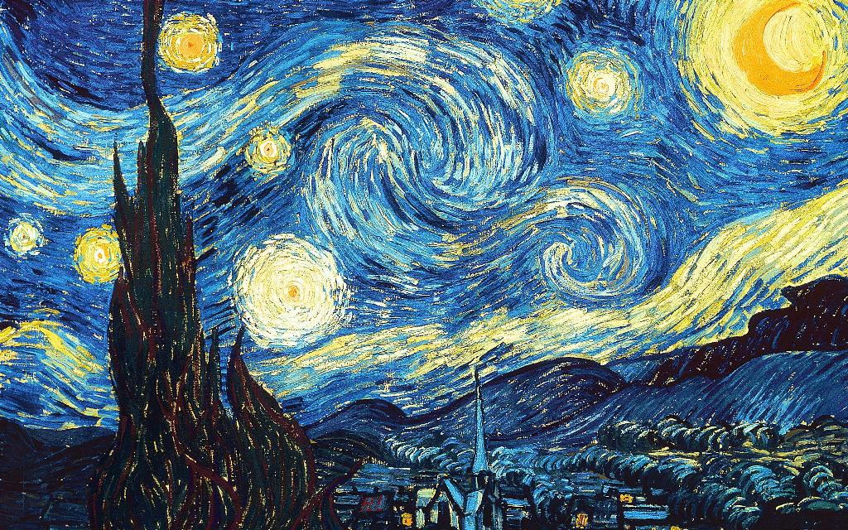
Results:
Input Image
Output
Style Model

Slide 8
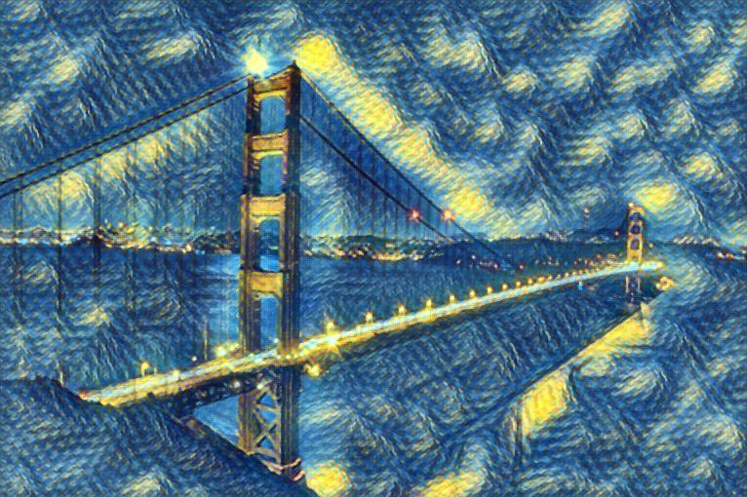

Slide 9
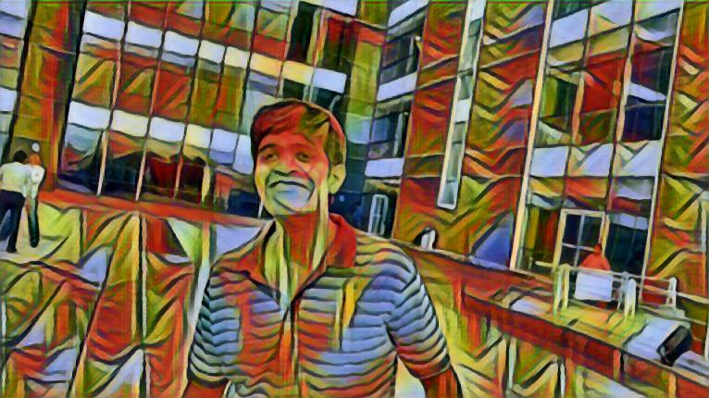
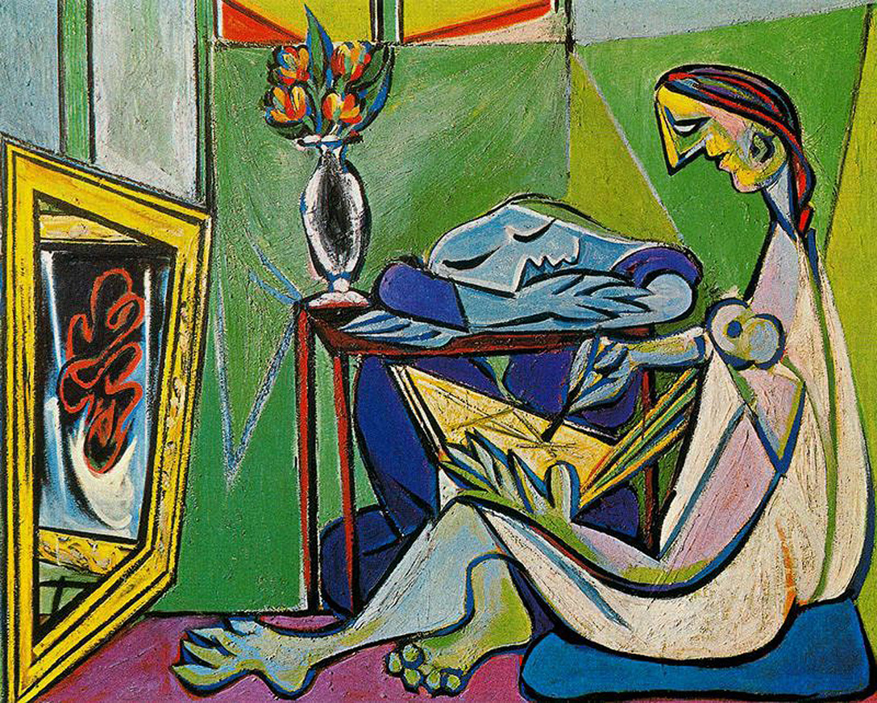

Slide 10
Thank you!

