Slide 1
Deep Reinforcement Learning
Sanket Lokegaonkar
Advanced Computer Vision (ECE 6554)

Slide 2
Outline
The Why?
Gliding Over All : An Introduction
Classical RL
DQN-Era
Playing Atari with Deep Reinforcement Learning [2013]
7 Atari Games
Human-level control through deep reinforcement learning. [2015]
49 Atari Games
Brave New World

Slide 3
The Why? : Task
Learning to behave optimally in a changing world
Characteristics of the Task:
No Supervisor ( Only Rewards)
Delayed Feedback
Non I.I.D data
Previous action affects the next state
RL:
Learning by Interaction and your choices
Time-travelling back to the moment: Only to Live Again
Reminds you of something:
Life - (Time Travelling Part)

Slide 4
The Why?: Hardness
Imagine playing a new game whose rules you don’t know; after a hundred hundred or so moves, your opponent announces, “You lose”.
‐Russell and Norvig
Introduction to Artificial Intelligence

Slide 5
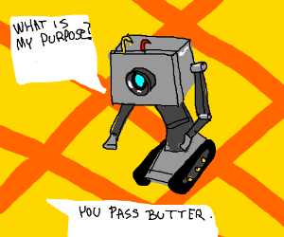
The Why?: Why do RL?
So that we could move away from rule-based systems!!
So that we could train quadcopters to fly and move !
So that you could sip coffee all day and your bot will do the trading for you!
Or Create intelligent robots for dumb tasks

Slide 6
Gliding Over All: An Introduction
Credits: David Silver

Slide 7
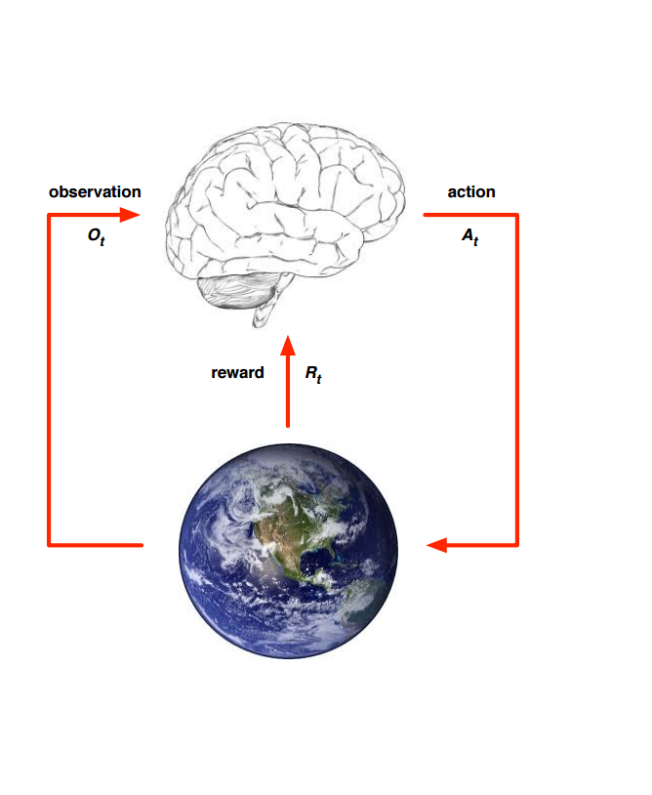
Environment and Agent
At each step t, the agent
Executes action A_{t}
Receives observation O_{t}
Receives scalar reward R_{t}
The environment,
Receives action A_{t}
Emits observation O_{t+1}
Emits scalar reward R_{t+1}
t increments in every step
Credits: David Silver

Slide 8
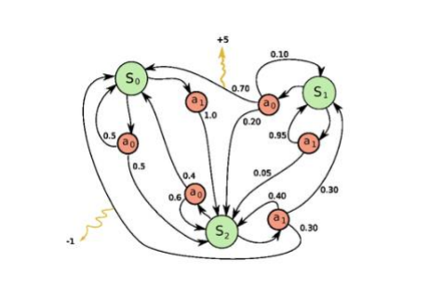
Markov Decision Process
Credits: Andrej Karpathy’s blog

Slide 9
Markov Decision Process (MDP)
Set of states S
Set of actions A
State transition probabilities p(s’ | s, a). This is the probability distribution over the state space given we take action a in state s
Discount factor γ in [0, 1]
Reward function R: S x A -> set of real numbers
For simplicity, assume discrete rewards
Finite MDP if both S and A are finite

Slide 10
State Transition Probabilities
Suppose the reward function is discrete and maps from S x A to W
The state transition probability or probability of transitioning to state s’ given current state s and action a in that state is given by:

Slide 11
Expected Rewards
The expected reward for a given state-action pair is given by:

Slide 12
Policy and Value Function
Policy
Behavior Function
Mapping from state to action
Deterministic Policy : a=\Pi (s)
Stochastic Policy: 𝜋(a |s) = Pr [ A_{t} = a | S_{t} =s]
Value Function
Prediction of total future Reward under a policy
Captures goodness/badness of states
Can be used to greedily select among the actions
v_{𝜋}(s) = E_{𝜋}[R _{t+1} + 𝛾R_{t+2} + 𝛾² R _{t+3} … | S_{t} =s]
Credits: ICML DRL Tutorial

Slide 13
Action-Value Function (Q -function)
Expected Return starting from state s, taking action A and then following policy with 𝛾 as the discounting factor.
Goodness of state given an action a
Credits: ICML DRL Tutorial

Slide 14
Optimal Action-Value Function
Action -Value Function Equivalent Representation (Bellman Equation):
Q^{𝜋} (s,a) = E [ R_{s} + γ Q^{𝜋} (s’,a’) ]
Optimal Value Function:
Q* (s,a) = max_{𝜋} Q^{𝜋} (s,a)
If we know the optimal action-value function, the optimal policy would be:
𝜋*( s) = argmax _{a} Q*(s,a)
Optimal value maximizes over all decisions:
Q* (s,a) = E [ R_{s} + γ max_{a’} Q^{𝜋} (s’,a’) ]
Credits: ICML DRL Tutorial

Slide 15
Bellman Equation (1)
The equation expresses the relationship between the value of a state s and the values of its successor states
The value of the next state must equal the discounted value of the expected next state, plus the reward expected along the way

Slide 16
Bellman Equation (2)
The value of state s is the expected value of the sum of time-discounted rewards (starting at current state) given current state s
This is expected value of r plus the sum of time-discounted rewards (starting at successor state) over all successor states s’ and all next rewards r and over all possible actions a in current state s

Slide 17
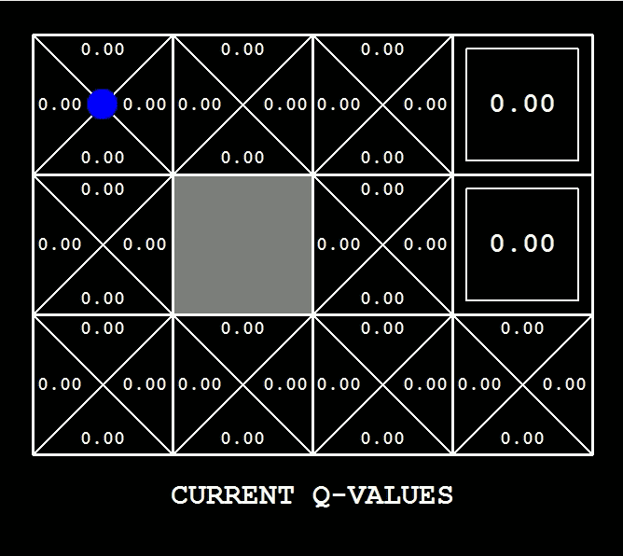
DEMO
http://cs.stanford.edu/people/karpathy/reinforcejs/index.html
Credits: [3]

Slide 18
Approaches in RL
Value -Based RL (Value Iteration) (Model Free)
Estimate the value of optimal value function Q* (s,a)
Policy -Based RL (Policy Iteration) (Model Free)
Search for the optimal policy 𝜋*( s)
Model-Based RL
Learn a model of the environment
Plan using the model
“Deep” networks are used to approximate the functions

Slide 19
Model-free versus Model-based
A model of the environment allows inferences to be made about how the environment will behave
Example: Given a state and an action to be taken while in that state, the model could predict the next state and the next reward
Models are used for planning, which means deciding on a course of action by considering possible future situations before they are experienced
Model-based methods use models and planning. Think of this as modelling the dynamics p(s’ | s, a)
Model-free methods learn exclusively from trial-and-error (i.e. no modelling of the environment)
We focus on model-free methods today:

Slide 20
On-policy versus Off-policy
An on-policy agent learns only about the policy that it is executing
An off-policy agent learns about a policy or policies different from the one that it is executing

Slide 21
What is TD learning?
Temporal-Difference learning = TD learning
The prediction problem is that of estimating the value function for a policy π
The control problem is the problem of finding an optimal policy π*
Given some experience following a policy π, update estimate v of v_{π} for non-terminal states occurring in that experience
Given current step t, TD methods wait until the next time step to update V(S_{t})
Learn from partial returns

Slide 22
Epsilon-greedy Policy
At each time step, the agent selects an action
The agent follows the greedy strategy with probability 1 – epsilon
The agent selects a random action with probability epsilon
With Q-learning, the greedy strategy is the action a that maximises Q given S_{t+1}

Slide 23
Q-learning – Off-policy TD Control
Similar to SARSA but off-policy updates
The learned action-value function Q directly approximates the optimal action-value function q* independent of the policy being followed
In update rule, choose action a that maximises Q given S_{t+1} and use the resulting Q-value (i.e. estimated value given by optimal action-value function) plus the observed reward as the target
This method is off-policy because we do not have a fixed policy that maps from states to actions. This is why A_{t+1} is not used in the update rule

Slide 24
Deep Q-Networks (DQN)
Introduced deep reinforcement learning
It is common to use a function approximator Q(s, a; θ) to approximate the action-value function in Q-learning
Deep Q-Networks is Q-learning with a deep neural network function approximator called the Q-network
Discrete and finite set of actions A
Example: Breakout has 3 actions – move left, move right, no movement
Uses epsilon-greedy policy to select actions

Slide 25
Q-Networks
Core idea: We want the neural network to learn a non-linear hierarchy of features or feature representation that gives accurate Q-value estimates
The neural network has a separate output unit for each possible action, which gives the Q-value estimate for that action given the input state
The neural network is trained using mini-batch stochastic gradient updates and experience replay

Slide 26
State representation
It is difficult to give the neural network a sequence of arbitrary length as input
Use fixed length representation of sequence/history produced by a function ϕ(s_{t})
Example: The last 4 image frames in the sequence of Breakout gameplay

Slide 27
Q-Network Training
Sample random mini-batch of experience tuples uniformly at random from D
Similar to Q-learning update rule but:
Use mini-batch stochastic gradient updates
The gradient of the loss function for a given iteration with respect to the parameter θ_{i} is the difference between the target value and the actual value is multiplied by the gradient of the Q function approximator Q(s, a; θ) with respect to that specific parameter
Use the gradient of the loss function to update the Q function approximator

Slide 28
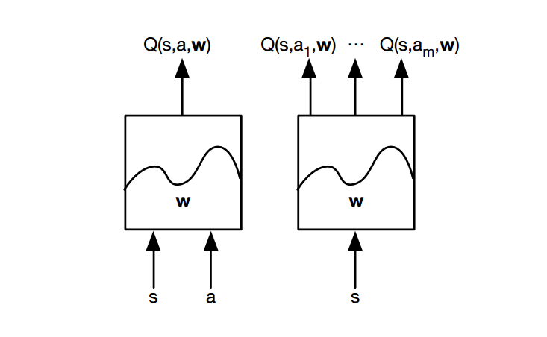
Value-based RL
Q-function is represented as Q-network with weights :
Q(s,a,w) = Q*(s,a)

Slide 29
Playing Atari with Deep Reinforcement Learning
Problem Statement:
Input:
Raw Atari Frames 210 x160 pixel with 128-color pallete
Output:
Possible Action to be taken
Goal /Objective:
Optimal Policy with Maximal Reward

Slide 30
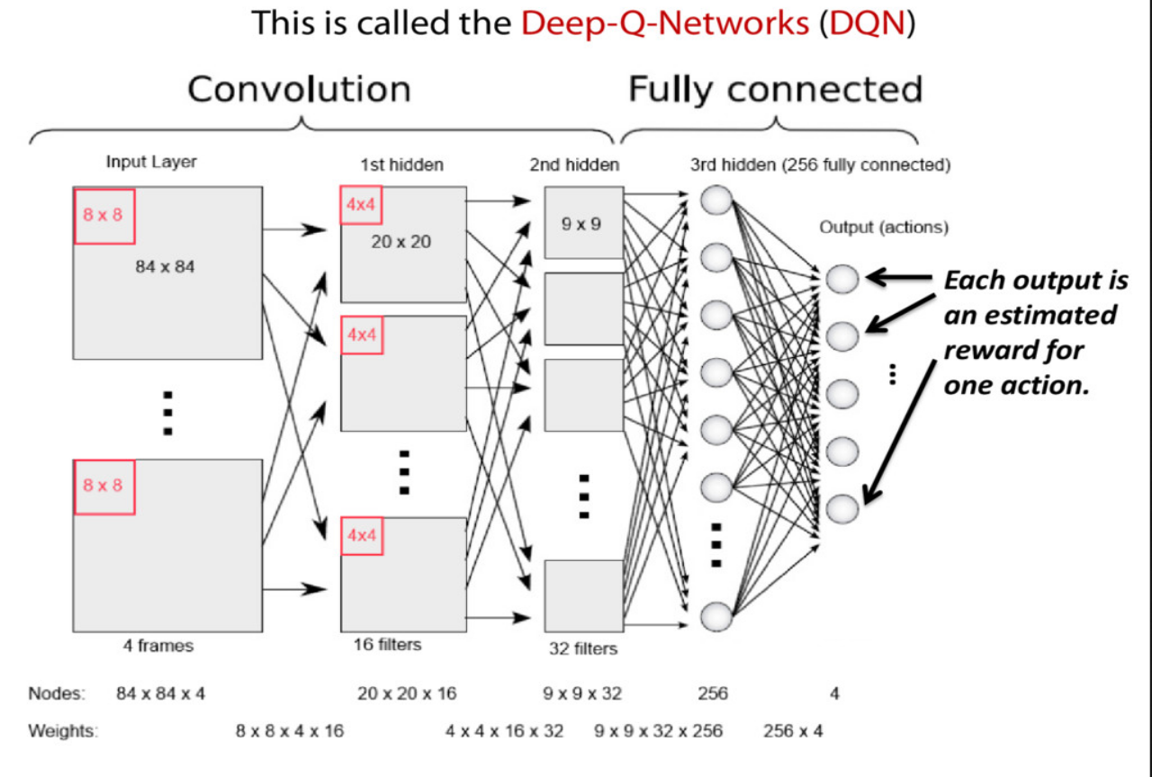
Playing Atari with Deep Reinforcement Learning
Architecture:

Slide 31
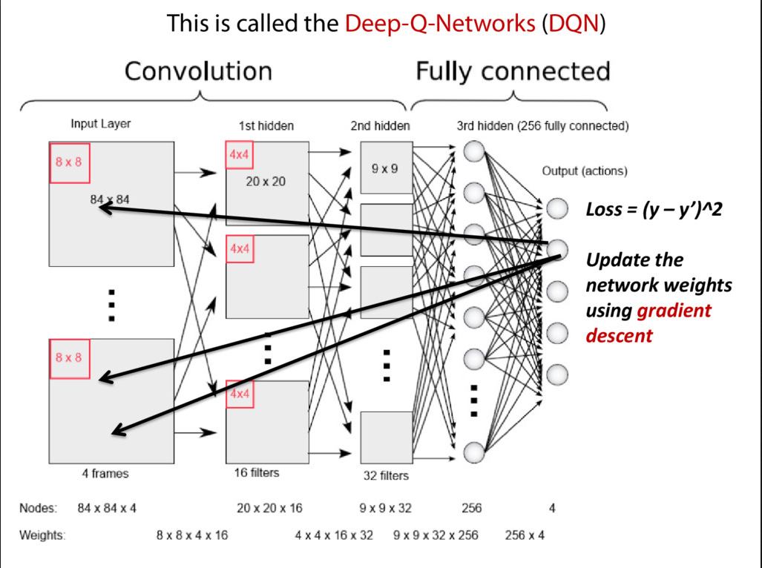
Playing Atari with Deep Reinforcement Learning
Architecture:

Slide 32
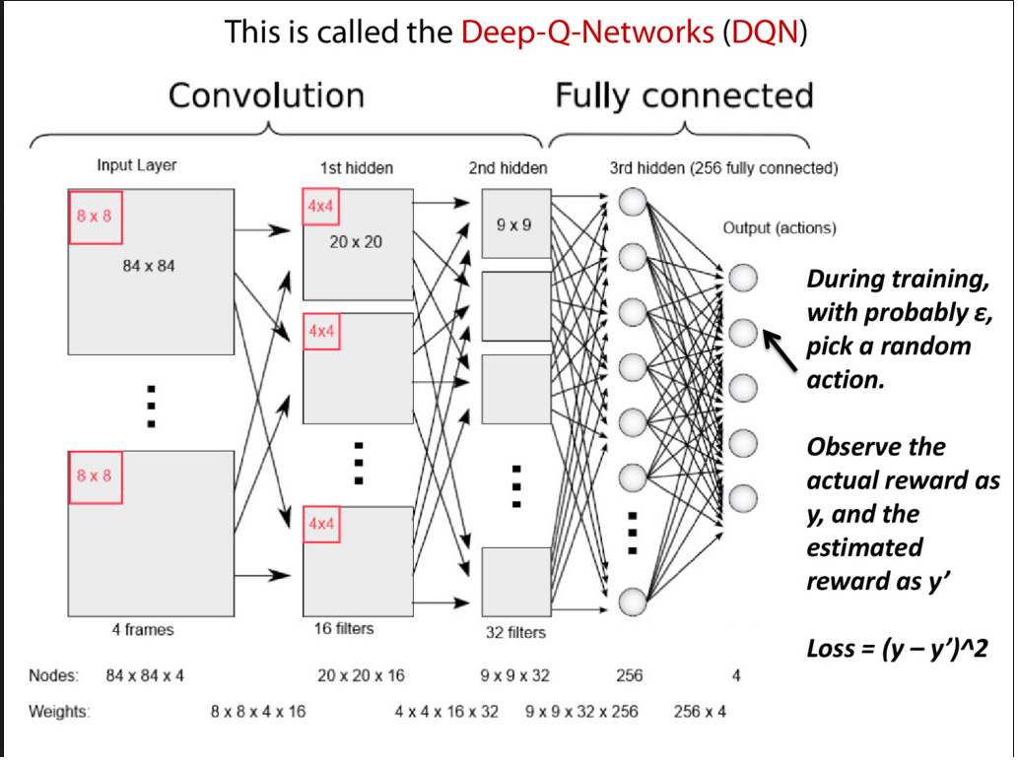
Playing Atari with Deep Reinforcement Learning
Architecture:

Slide 33
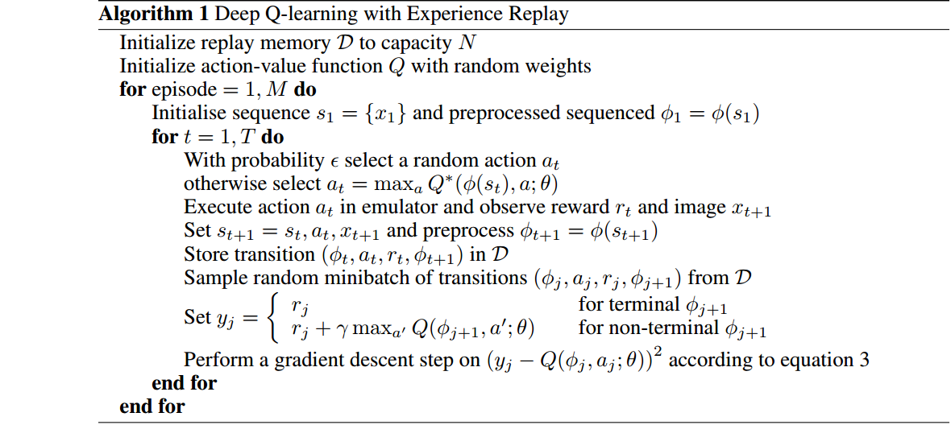
Playing Atari with Deep Reinforcement Learning
Algorithm:

Slide 34
Playing Atari with Deep Reinforcement Learning
MSE Loss with DQN:
Issues with Convergence of DQN:
Non I.I.D data
Oscillating policies with slight variations of Q-values
Gradient descent can be large and unstable

Slide 35
Solutions to the Issues: Non-IID data
Experience Replay (for handling non-iid data)
Build a memory storing N pairs of agent’s experience i.e (s_{t},a_{t},r_{t+1},s_{t+1})
Sample random minibatch experience from the memory
Breaks correlation ~ brings back to iid domain

Slide 36
Solution to the Issues: How to prevent oscillations
Fix parameters used in Q-learning target
Compute Q-learning targets wrt old fixed parameters θ⁻
Loss Minimization Equation between Q-network and Q-learning targets
L(θ) = E_{s,a,r,s’ ~ D} [ r + ᵞ max_{a’} Q(s’,a’,θ) ]
Periodically update fixed parameters θ⁻

Slide 37
Solution to the Issues: Unstable Gradient
Clipping Rewards between [-1,1]
Limits the scale of the derivatives
Easier to use same learning rate over different Atari Games
Disadvantage:
Invariant to different magnitudes of rewards

Slide 38
Evaluations
Atari Games Tried:
Beam Rider
Breakout
Pong
Q*bert
Seaquest
Space Invaders

Slide 39
Evaluations
Metrics:
Average Total Reward Metric
Average action-value
Collect a fixed set of states by running a random policy before training starts
Average of the maximum predicted Q for these states
Optimization:
RMSProp with minibatches of size 32
Behavior policy ϵ greedy (Annealed from 1 to 0.1 and fixed to 0.1 later)

Slide 40
Evaluations

Slide 41
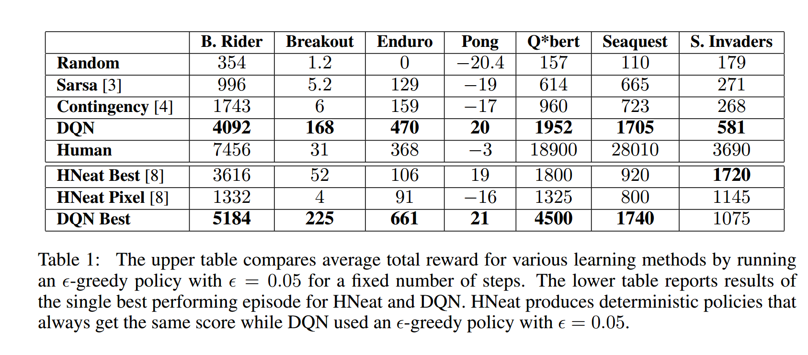
Evaluations
Average Total Reward
Best Performing Episode

Slide 42
Analysis
Strengths:
Q-learning over non-linear function approximators
End-to-End Learning over multiple games
SGD Training
Seminal paper
Weakness:
DQN limited to finite discrete actions
Long Training
Reward Clipping

Slide 43
Human-level control through deep reinforcement learning
Extending the DQN architecture to play 49 Atari 2600 arcade games
No pretraining
No game-specific training
State: Transitions from 4 frames : Experience Replay
Actions -18:
9 directions of joystick
9 directions + button
Reward - Game Score

Slide 44
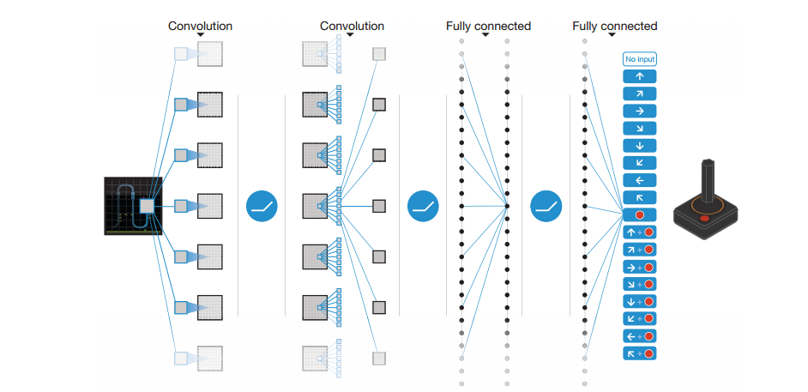
Architecture

Slide 45
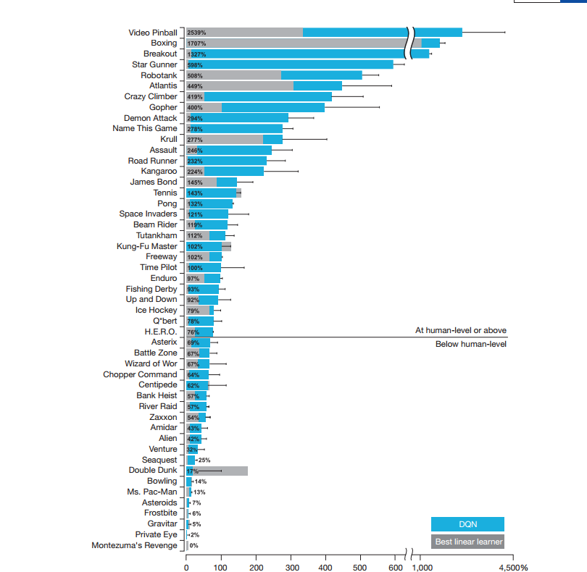
Stats over 49 games

Slide 46
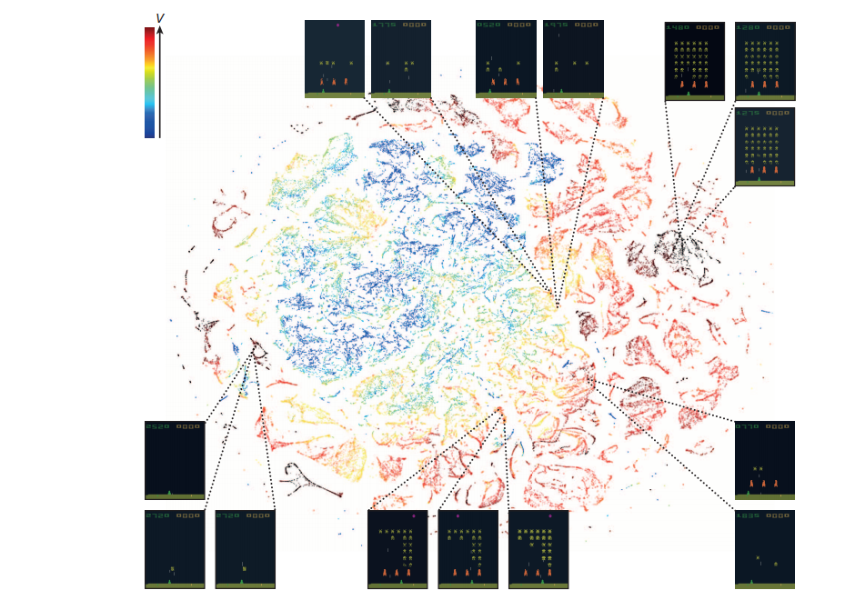
T-SNE Embedding ( Last Hidden Layer)

Slide 47
Analysis
Strengths:
End-to-End Learning over multiple games
Beats human performance on most of the games
Richer Rewards
Weakness:
Long Training
DQN limited to finite discrete actions

Slide 48
Brave New World

Slide 49
Optimizations on DQN Since Then
Double DQN: Remove Upward bias caused by max_{a} Q(s,a, w)
Current Q-network w: Used to select actions
Older Q-network w-: Used to evaluate actions
Prioritized replay : Weight experience according to TD-error (suprise)
Store experience in priority queue according to DQN error
Asynchronous RL
Joint Training using Parameter Sharing on Distributed Scale
GORILA
Credits: ICML DRL Tutorial

Slide 50
What are Policy Gradient Methods?
Before: Learn the values of actions and then select actions based on their estimated action-values. The policy was generated directly from the value function
We want to learn a parameterised policy that can select actions without consulting a value function. The parameters of the policy are called policy weights
A value function may be used to learn the policy weights but this is not required for action selection
Policy gradient methods are methods for learning the policy weights using the gradient of some performance measure with respect to the policy weights
Policy gradient methods seek to maximise performance and so the policy weights are updated using gradient ascent

Slide 51
Policy-based Reinforcement Learning
Search directly for the optimal policy π*
Can use any parametric supervised machine learning model to learn policies π(a |s; θ) where θ represents the learned parameters
Recall that the optimal policy is the policy that achieves maximum future return

Slide 52
Policy-Based RL
Represent policies by deep networks instead of Q-function
a = π( a | s, u) Stochastic Policies
A = π( s, u ) Deterministic Policies
where u is the parameters of the deep network
Objective function for the network
L(u) = E [ r ₁ + γr ₂ + γ²r ₃ | π( . , u ) ]
SGD Optimization
Allows Continuous and Discrete Control
Known to get stuck in Local minima
Credits: ICML DRL Tutorial

Slide 53
Algorithms in Policy-Based RL
REINFORCE
Episodic updates
Maximize the loss of expected reward under the objective
while (true) run_episode(policy) update(policy) end;
Actor-Critic
Updates at each step
Critic approximates the value function
Actor approximates the policy
Asynchronous Advantage Function Actor-Critic
Uses Advantage Function Estimate for state-actuib. A(s,a,w) = Q(s,a,w) -V(s)
Replacing the need of replay memory by using parallel agents running on CPU
Relies on different exploration behavior of the parallel agents
Outperforms the conventional method
Credits: ICML DRL Tutorial

Slide 54
What is Asynchronous Reinforcement Learning?
Use asynchronous gradient descent to optimise controllers
This is useful for deep reinforcement learning where the controllers are deep neural networks, which take a long time to train
Asynchronous gradient descent speeds up the learning process
Can use one multi-core CPU to train deep neural networks asynchronously instead of multiple GPUs

Slide 55
Parallelism (1)
Asynchronously execute multiple agents in parallel on multiple instances of the environment
This parallelism decorrelates the agents’ data into a more stationary process since at any given time-step, the agents will be experiencing a variety of different states
This approach enables a larger spectrum of fundamental on-policy and off-policy reinforcement learning algorithms to be applied robustly and effectively using deep neural networks
Use asynchronous actor-learners (i.e. agents). Think of each actor-learner as a thread
Run everything on a single multi-core CPU to avoid communication costs of sending gradients and parameters

Slide 56
Parallelism (2)
Multiple actor-learners running in parallel are likely to be exploring different parts of the environment
We can explicitly use different exploration policies in each actor-learner to maximise this diversity
By running different exploration policies in different threads, the overall changes made to the parameters by multiple actor-learners applying updates in parallel are less likely to be correlated in time than a single agent applying online updates

Slide 57
No Experience Replay
No need for a replay memory. We instead rely on parallel actors employing different exploration policies to perform the stabilising role undertaken by experience replay in the DQN training algorithm
Since we no longer rely on experience replay for stabilising learning, we are able to use on-policy reinforcement learning methods to train neural networks in a stable way

Slide 58
Video Demo : A3C Labryinth

Slide 59
Video Demo : DQN Doom

Slide 60
Scope / Future
Multi-agent Deep RL
Share Parameters!!! (Naive approach)
Hierarchical Deep Reinforcement Learning
Road to General AI!

Slide 61
Quotes from the Maestro
If intelligence was a cake, unsupervised learning would be the cake, supervised learning would be the icing on the cake, and reinforcement learning would be the cherry on the cake.
-Yann Lecun

Slide 62
Reference Zone
http://www.cs.princeton.edu/~andyz/pacmanRL
ICML Deep RL Tutorial : http://icml.cc/2016/tutorials/deep_rl_tutorial.pdf
Andrej Karpathy’s blog: http://karpathy.github.io/
Playing Atari with Deep Reinforcement Learning. V. Mnih, K. Kavukcuoglu, D. Silver, A. Graves, I. Antonoglou, D. Wierstra, M. Riedmiller, NIPS workshop 2013
Human-level control through deep reinforcement learning. Mnih et al. Nature 2015
https://www.cs.princeton.edu/courses/archive/spring17/cos598F/lectures/RL.pptx

