Slide 1
Mnih, Volodymyr, et al. "Human-level control through deep reinforcement learning." Nature 518.7540 (2015): 529-533.
Experiments by: Ashish Budhiraja
Course: Advanced Computer Vision
Instructor: Jia-Bin Huang

Slide 3
Qlearning

Slide 4
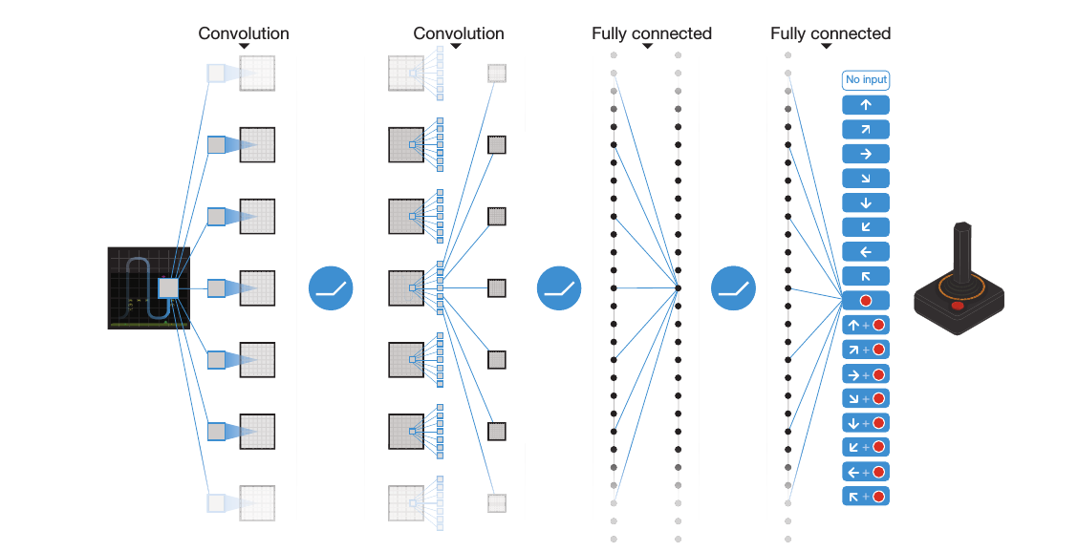

Slide 5
Videos at different Learning Rate (Breakout)
77 epochs
200 epochs

Slide 6
Videos at different Learning Rate (Pong)
141 epochs
200 epochs

Slide 7
Videos at different Learning Rate (Seaquest)
178 epochs
200 epochs

Slide 8
Feature Visualization
file:///home/ashishkb/RL_ACV/neon/simple_dqn/results/breakout.html

Slide 9
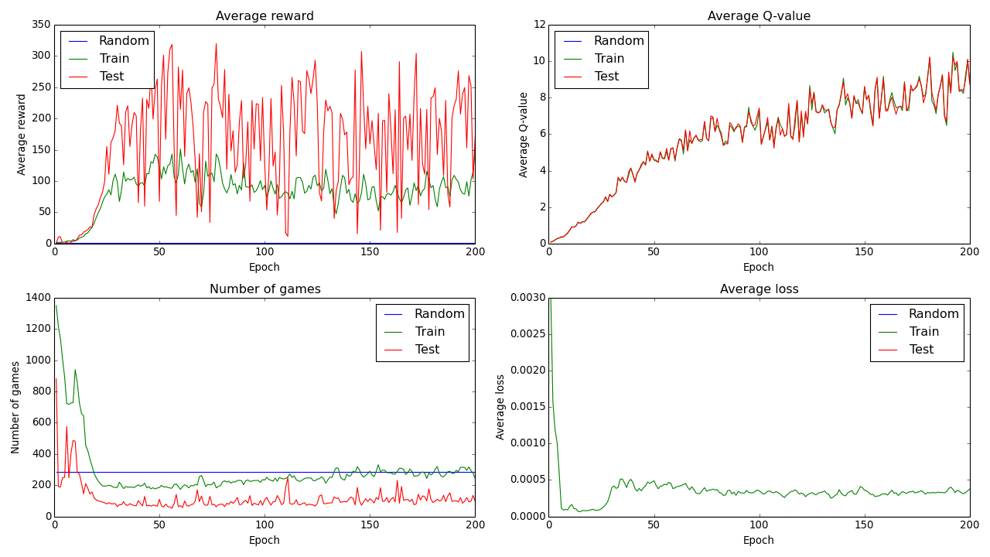
Graphs
Breakout

Slide 10
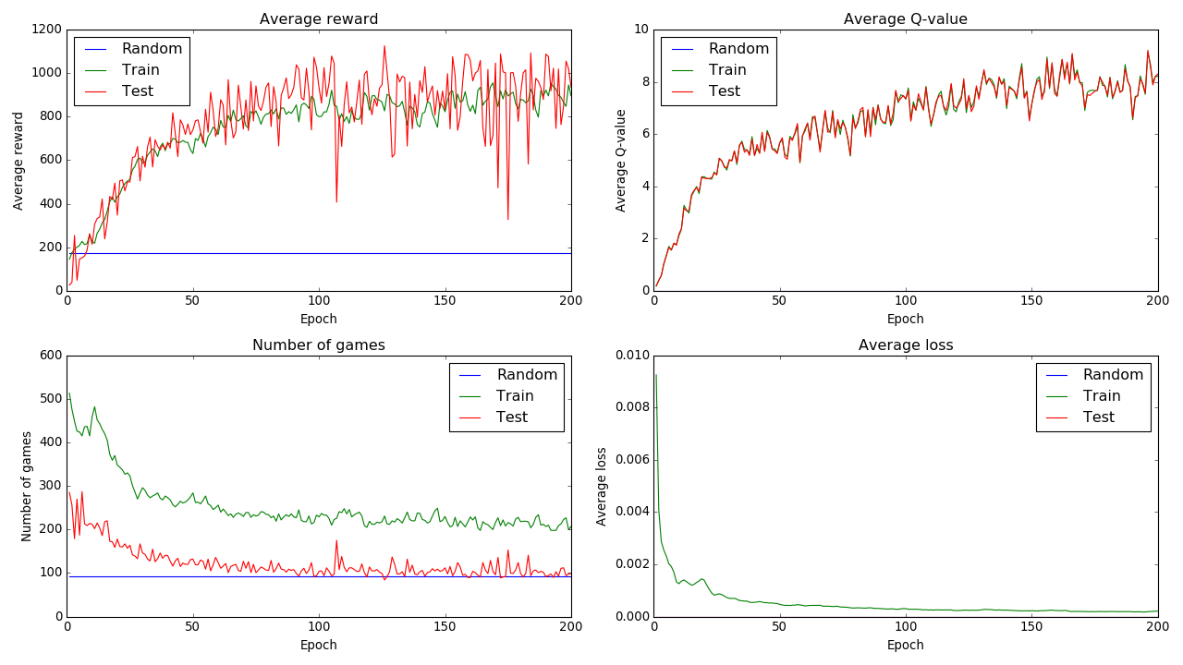
Graphs
Space Invaders

Slide 11
Credits:
Prof. FRED G. MARTIN http://www.cs.uml.edu/ecg/index.php/AIfall16/PS3b
Mnih, Volodymyr, et al. "Human-level control through deep reinforcement learning." Nature 518.7540 (2015): 529-533.
https://github.com/devsisters/DQN-tensorflow
https://github.com/tambetm/simple_dqn

