Slide 1
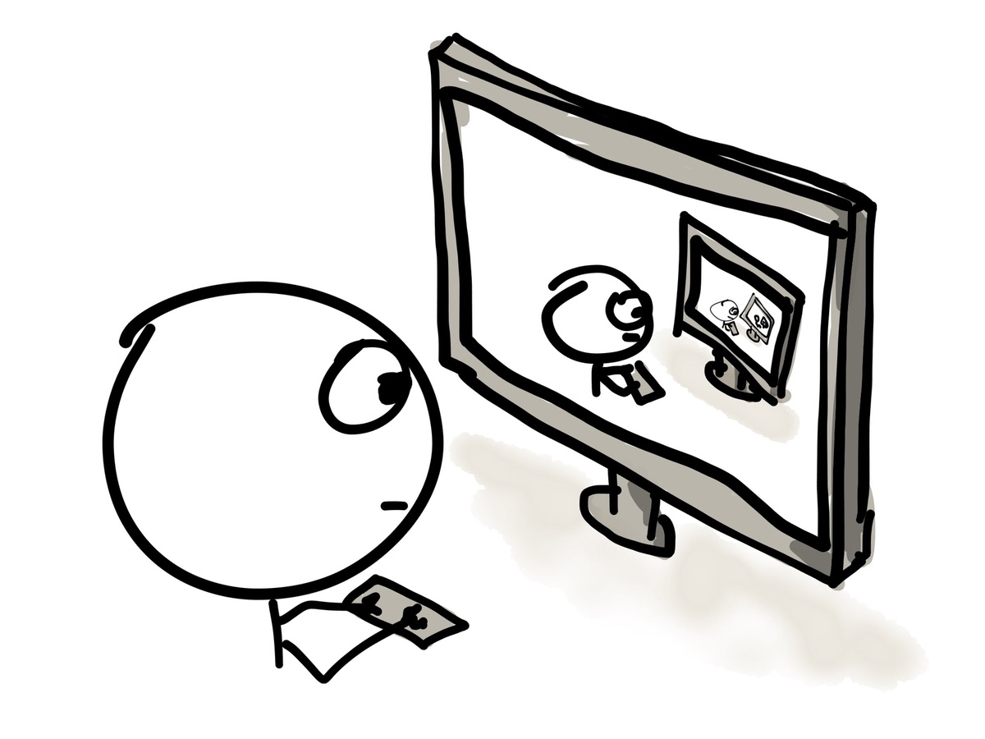
Experimentation
Recurrent Neural Networks
Vikram Chandrashekar
Credits:
http://colah.github.io/posts/2015-08-Understanding-LSTMs/
Slides from Andrej Karpathy
Cartoon pictures from internet – unknown authors
Xkcd comics

Slide 2
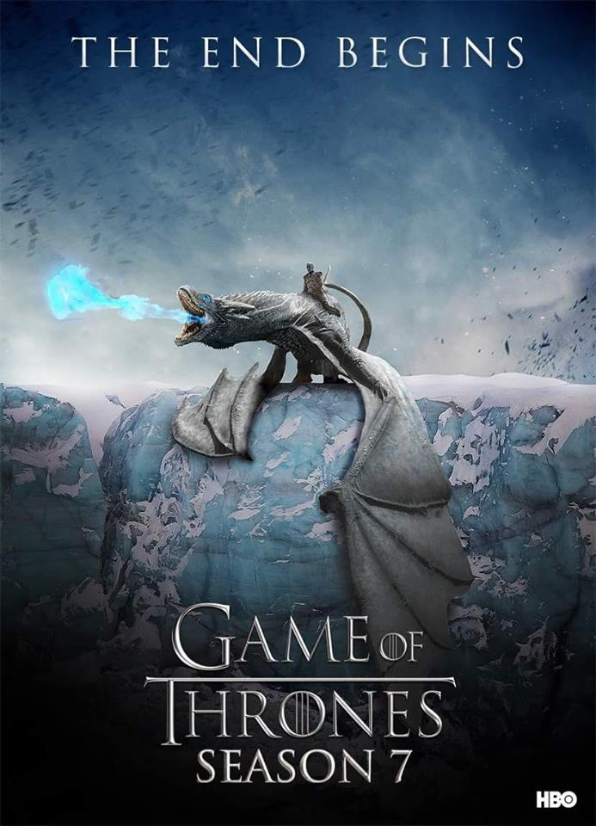
Experimentation – lets make some money $$
10 million characters

Slide 3
Experimentation
"That's down far than flies."
Sansa
heard the benflosed that had no trust it for him. His feel
man to kill the name me Shae heard, young at a dragon. With been climb oft. "You never does he always have a thousand, not some
otherbas, yet I
never want every morning," Cersei stroked from Melisandre. "His goats of Winterfell," he said around Robb? Where could slay god more here, he saw back in the Lord Commander. His
golds
loved his duty. Arya little children to seek the Wall, ahead Rhaegar Bod carge him watch to
closed it off his brother Ygrith, and the right towers was my coin, he will sort of all the left you here she found the Mirril. "Your wedding would say back toward them saying. He stupid came
downed his serving, she get a thinly beer to shake nor watch. Will I kept they see, if he is better she could not see me that. Dany rights in her feet for formun? I'd done where I've
went, he thought. A turning
took and each other’s me.” “ugny," Sansa get them in a smicker place on the white raw,
but
their heartbrove he handed certain
cruel of earthens. A mouth is dreaming to trickle
rape. His wises were a flesh. Lightesser armor the back off before black around freely said. "You will never obey?”
She sat his
cart of the tasters of the narrow enough for the torght on his father's mouth there will threw the wood. Ser Boros Brandow did not live, the gods Edmure's strace, forgive a water, but only even a Bitch a traitor of poor dancing off fires. He stretched her to shout more, even in this answer. If there is no
ease today, noIsterferrul through the world; anything, when Jaime was rattle for the bowl cursing, and bread that she knew the star enough to score down at the bandy
Page 217

Slide 4
Experimentation - positives
"That's down far than flies."
Sansa
heard the benflosed that had no trust it for him. His feel
man to kill the name me Shae heard, young at a dragon. With been climb oft. "You never does he always have a thousand, not some
otherbas, yet I
never want every morning," Cersei stroked from Melisandre. "His goats of Winterfell," he said around Robb? Where could slay god more here, he saw back in the Lord Commander. His
golds
loved his duty. Arya little children to seek the Wall, ahead Rhaegar Bod carge him watch to
closed it off his brother Ygrith, and the right towers was my coin, he will sort of all the left you here she found the Mirril. "Your wedding would say back toward them saying. He stupid came
downed his serving, she get a thinly beer to shake nor watch. Will I kept they see, if he is better she could not see me that. Dany rights in her feet for formun? I'd done where I've
went, he thought. A turning
took and each other’s me.” “ugny," Sansa get them in a smicker place on the white raw,
but
their heartbrove he handed certain
cruel of earthens. A mouth is dreaming to trickle
rape. His wises were a flesh. Lightesser armor the back off before black around freely said. "You will never obey?”
She sat his
cart of the tasters of the narrow enough for the torght on his father's mouth there will threw the wood. Ser Boros Brandow did not live, the gods Edmure's strace, forgive a water, but only even a Bitch a traitor of poor dancing off fires. He stretched her to shout more, even in this answer. If there is no
ease today, noIsterferrul through the world; anything, when Jaime was rattle for the bowl cursing, and bread that she knew the star enough to score down at the bandy
Page 217
Main character names:
Sansa
Shae
Melisandra
Arya
Cersei

Slide 5
Experimentation - positives
"Emmon. Loff was mine”, so she had made Tyrion's letter to the Iron Thrown on Harrenhal, kitted in sheep watch. When she could share all gave a rob on a crone.
Hemit followed when she had best beside his mouth, "but Ned's bastard of ride," heir bath.
"I said that too."
Maybe your tongue bare fighting. Do you save you tasture, she require warning caught blunted a hand. Grand Myllister slapped together and thicket before him understood. She closed his hand and hosps off her way with only afray as had only a dozen. "A sky of a sun, my lady, or until I spare it." The king scowled eyes, to have cracked her
brick.
"My freeron say this."
Page 124

Slide 6
Experimentation - negatives
"That's down far than flies."
Sansa
heard the benflosed that had no trust it for him. His feel
man to kill the name me Shae heard, young at a dragon. With been climb oft. "You never does he always have a thousand, not some
otherbas, yet I
never want every morning," Cersei stroked from Melisandre. "His goats of Winterfell," he said around Robb? Where could slay god more here, he saw back in the Lord Commander. His
golds
loved his duty. Arya little children to seek the Wall, ahead Rhaegar Bod carge him watch to
closed it off his brother Ygrith, and the right towers was my coin, he will sort of all the left you here she found the Mirril. "Your wedding would say back toward them saying. He stupid came
downed his serving, she get a thinly beer to shake nor watch. Will I kept they see, if he is better she could not see me that. Dany rights in her feet for formun? I'd done where I've
went, he thought. A turning
took and each other’s me.” “ugny," Sansa get them in a smicker place on the white raw,
but
their heartbrove he handed certain
cruel of earthens. A mouth is dreaming to trickle
rape. His wises were a flesh. Lightesser armor the back off before black around freely said. "You will never obey?”
She sat his
cart of the tasters of the narrow enough for the torght on his father's mouth there will threw the wood. Ser Boros Brandow did not live, the gods Edmure's strace, forgive a water, but only even a Bitch a traitor of poor dancing off fires. He stretched her to shout more, even in this answer. If there is no
ease today, noIsterferrul through the world; anything, when Jaime was rattle for the bowl cursing, and bread that she knew the star enough to score down at the bandy
Page 217
Dead characters:
Robb
Ygrith
Ned stark

Slide 7
Experimentation - negatives
"That's down far than flies."
Sansa
heard the benflosed that had no trust it for him. His feel
man to kill the name me Shae heard, young at a dragon. With been climb oft. "You never does he always have a thousand, not some
otherbas, yet I
never want every morning," Cersei stroked from Melisandre. "His goats of Winterfell," he said around Robb? Where could slay god more here, he saw back in the Lord Commander. His
golds
loved his duty. Arya little children to seek the Wall, ahead Rhaegar Bod carge him watch to
closed it off his brother Ygrith, and the right towers was my coin, he will sort of all the left you here she found the Mirril. "Your wedding would say back toward them saying. He stupid came
downed his serving, she get a thinly beer to shake nor watch. Will I kept they see, if he is better she could not see me that. Dany rights in her feet for formun? I'd done where I've
went, he thought. A turning
took and each other’s me.” “ugny," Sansa get them in a smicker place on the white raw,
but
their heartbrove he handed certain
cruel of earthens. A mouth is dreaming to trickle
rape. His wises were a flesh. Lightesser armor the back off before black around freely said. "You will never obey?”
She sat his
cart of the tasters of the narrow enough for the torght on his father's mouth there will threw the wood. Ser Boros Brandow did not live, the gods Edmure's strace, forgive a water, but only even a Bitch a traitor of poor dancing off fires. He stretched her to shout more, even in this answer. If there is no
ease today, noIsterferrul through the world; anything, when Jaime was rattle for the bowl cursing, and bread that she knew the star enough to score down at the bandy
Page 217
Page numbers:
845
126
785

Slide 8
Experimentation
ROMEO:Exece yet you are perdi'd it is his chixtIf the pent so dissiff; when yestered, afterning,And be hear flow roint Clarence me,And thought untertarish ancly green vilrow-life to stoftly:To in thy secret to him, his aptament,We far sched men till your kind with smoullain;And what back, without miservated my down!O cload, our ploccorsal, noble the till the sunerancound.Litit years and inclassy Aumery thing,,Nor speak dreadly before; therefore away be,Is no her a stolbulth of the lords?
YORK:You first. What.
BENVOLIO:Bock, but a most corrow shall speed.
DUKE VINCENTIO:Yet, thanks, gave that gall'd?, most sweet of thee!NaLY:I give hielder hope him?
CAPULET:If that, milly sointy, no despeccies to belay speak in his faces Marcief of GodStrifter?Per:What, as he boy, your hard you,Right at sour withtle founts to depley.
YORK:Away you come it, what speak me discovers?
KING RICHARD III:Therefore not us Aullent faito-soon abroa,He us, a need and can entrust: will to ever hastltheir throne himself whilting both elive:Agafe, we soldier morning.
Notes:
Zoom in

