Slide 1
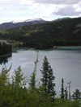
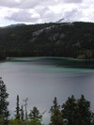
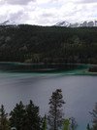
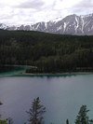
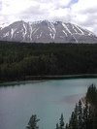
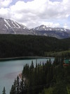
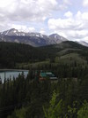
Image Stitching
Add example
Computer Vision
Jia-Bin Huang, Virginia Tech
Many slides from S. Seitz and D. Hoiem

Slide 2
Administrative stuffs
HW 3 will be out Oct 3 (Wed), due Oct 17 (Wed)
Getting help?
Piazza
Jia-Bin’s office hour: 3:30 – 4:30 PM Monday (440 Whittemore Hall)
Accommodation
Send me an email

Slide 3
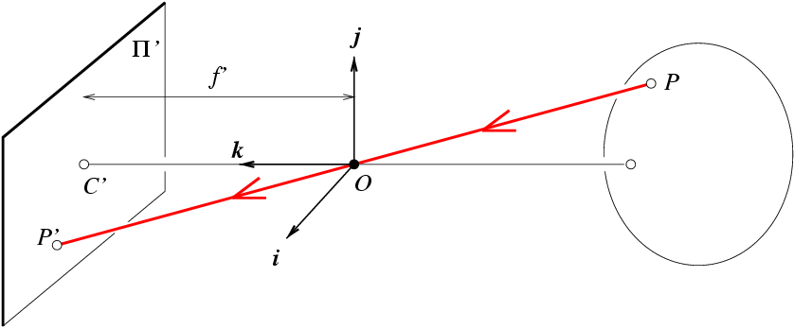
Review: Camera Projection Matrix
R
j_{w}
t
k_{w}
O_{w}
i_{w}
Notes:
As review:
1) Example of my eye and their eye, where both coordinate frames are known. Suppose that I know a 3D point on the board in relation to me, and I want to figure out where that point will appear on their retina. First, I translate from my eye to their eye. Then, I rotate from my orientation to theirs. Finally, I project from 3D onto the 2D visual field.
2) Suppose I know x, K, R, and t. Can I compute X? What can I know about X?

Slide 4
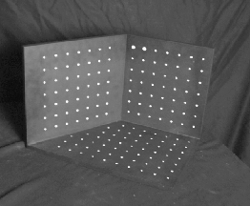
Review: Camera Calibration
Method 1: Use an object (calibration grid) with known geometry
Correspond image points to 3d points
Get least squares solution (or non-linear solution)
Known 2d image coordinates
Known 3d locations
Unknown Camera Parameters

Slide 5
Unknown Camera Parameters
Known 2d image coords
Known 3d locations
Homogeneous linear system. Solve for m’s entries using linear least squares
[U, S, V] = svd(A);
M = V(:,end);
M = reshape(M,[],3)';

Slide 6
Review: Calibration by vanishing points
VP (2D)
VP (3D)
Orthogonality constraints
$$X_{i}^{⊤}X_{j}=0$$
Constraints for $p_{1},p_{2}$, $p_{3}$
Unknown camera parameters $f,{ u}_{0}, v_{0}$
$$p_{i}=KRX_{i}$$
$$K =\left[\begin{matrix}f & 0 & u_{0} \\ 0 & f & v_{0} \\ 0 & 0 & 1\end{matrix}\right]$$
$$X_{i}=R^{−1}K^{−1}p_{i}$$
$$K^{−1}=\left[\begin{matrix}\frac{1}{f} & 0 & −\frac{u_{0}}{f} \\ 0 & \frac{1}{f} & −\frac{v_{0}}{f} \\ 0 & 0 & 1\end{matrix}\right]$$
$$p_{i}^{⊤}{\left(K^{−1}\right)}^{⊤}{\left(R^{−1}\right)}^{⊤}{(R}^{−1}){(K}^{−1})p_{j}=0$$
$p_{1}^{⊤}{\left(K^{−1}\right)}^{⊤}{(K}^{−1})p_{2}$ = 0
$p_{1}^{⊤}{\left(K^{−1}\right)}^{⊤}{(K}^{−1})p_{3}$ = 0
$p_{2}^{⊤}{\left(K^{−1}\right)}^{⊤}{(K}^{−1})p_{3}$ = 0
$\left(x_{1}−u_{0}\right)\left(x_{2}−u_{0}\right)+\left(y_{1}−v_{0}\right)\left(y_{2}−v_{0}\right)+f^{2}=0$ … Eqn (1)
$\left(x_{1}−u_{0}\right)\left(x_{3}−u_{0}\right)+\left(y_{1}−v_{0}\right)\left(y_{3}−v_{0}\right)+f^{2}=0$ … Eqn (2)
$\left(x_{2}−u_{0}\right)\left(x_{3}−u_{0}\right)+\left(y_{2}−v_{0}\right)\left(y_{3}−v_{0}\right)+f^{2}=0$ … Eqn (3)
Eqn (1) – Eqn (2)$⇒\left(x_{1}−u_{0}\right)\left(x_{2}−x_{3}\right)+\left(y_{1}−v_{0}\right)\left(y_{2}−y_{3}\right)=0$
Eqn (2) – Eqn (3)$⇒\left(x_{3}−u_{0}\right)\left(x_{1}−x_{2}\right)+\left(y_{3}−v_{0}\right)\left(y_{1}−y_{2}\right)=0$
Solve for $u_{0}, v_{0}$
$f=\sqrt{−\left(x_{1}−u_{0}\right)\left(x_{2}−u_{0}\right)−\left(y_{1}−v_{0}\right)\left(y_{2}−v_{0}\right)}$

Slide 7
Review: Calibration by vanishing points
Rotation matrix $R=\left[r_{1} r_{2} r_{3}\right]$
$$p_{i}=KRX_{i}$$
Set directions of vanishing points
$$X_{1}={\left[1,0, 0\right]}^{⊤}$$
$$X_{2}={\left[0,1, 0\right]}^{⊤}$$
$$X_{3}={\left[0,0, 1\right]}^{⊤}$$
$$p_{1}=Kr_{1}$$
$$p_{2}=Kr_{2}$$
$$p_{3}=Kr_{3}$$
Unknown camera parameters $R$
Special properties of R
inv(R)=R^{T}
Each row and column of R has unit length
$$r_{1}=K^{−1}p_{1}$$
$$r_{2}=K^{−1}p_{2}$$
$$r_{3}=K^{−1}p_{3}$$

Slide 8
Measuring height
Slide by Steve Seitz
v_{z}
r
vanishing line (horizon)
t₀
t
v_{x}
v
v_{y}
H
R
H
b₀
b
image cross ratio

Slide 9
This class: Image Stitching
Combine two or more overlapping images to make one larger image
Add example
Slide credit: Vaibhav Vaish

Slide 10
Concepts introduced/reviewed in today’s lecture
Camera model (Lecture 11)
Homographies (Lecture 9)
Solving homogeneous systems of linear equations (Lecture 12)
Keypoint-based alignment (Lecture 9)
RANSAC (Lecture 8)
Blending (Lecture 5)
How the iphone stitcher works

Slide 11
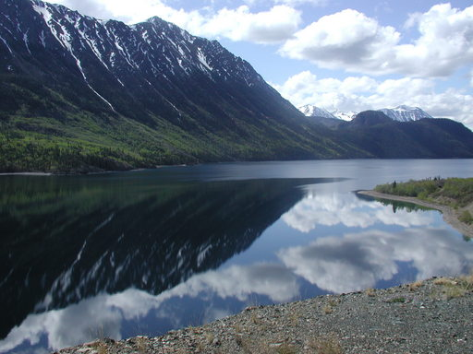
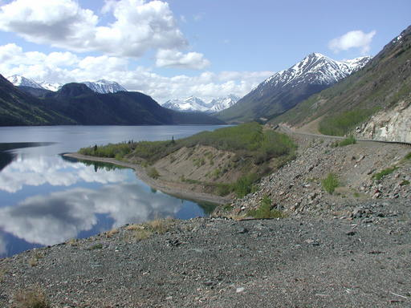
Illustration
Camera Center

Slide 12
Problem set-up
.
X
x = K [R t] X
x' = K' [R' t'] X
t=t'=0
x'=Hx where H = K' R' R⁻¹ K⁻¹
Typically only R and f will change (4 parameters), but, in general, H has 8 parameters
x
x'
f
f'

Slide 13
Homography
Definition
General mathematics:
homography = projective linear transformation
Vision (most common usage):
homography = linear transformation between two image planes
Examples
Project 3D surface into frontal view
Relate two views that differ only by rotation

Slide 14
Homography example: Image rectification
p’
p
To unwarp (rectify) an image solve for homography H given p and p’: wp’=Hp
Notes:
15 min

Slide 15
Homography example: Planar mapping
Freedom HP Commercial

Slide 16
Image Stitching Algorithm Overview
Detect keypoints (e.g., SIFT)
Match keypoints (e.g., 1st/2nd NN < thresh)
Estimate homography with four matched keypoints (using RANSAC)
Combine images

Slide 17
Computing homography
Assume we have four matched points: How do we compute homography H?
Direct Linear Transformation (DLT)

Slide 18
Computing homography
Direct Linear Transform
Apply SVD: UDV^{T} = A
h = V_{smallest} (column of V corr. to smallest singular value)
Matlab
[U, S, V] = svd(A);
h = V(:, end);
Explanations of SVD and solving homogeneous linear systems
Notes:
SVD gives the homogeneous least squares solution constrained to have a norm of 1

Slide 19
Computing homography
Assume we have four matched points: How do we compute homography H?
Normalized DLT
Normalize coordinates for each image
Translate for zero mean
Scale so that average distance to origin is ~sqrt(2)
This makes problem better behaved numerically (see HZ p. 107-108)
Compute using DLT in normalized coordinates
Unnormalize:

Slide 20
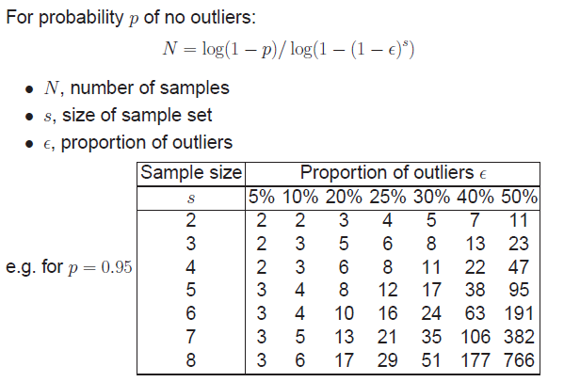
Computing homography
Assume we have matched points with outliers: How do we compute homography H?
Automatic Homography Estimation with RANSAC
Choose number of samples N
HZ Tutorial ‘99

Slide 21
Computing homography
Assume we have matched points with outliers: How do we compute homography H?
Automatic Homography Estimation with RANSAC
Choose number of samples N
Choose 4 random potential matches
Compute H using normalized DLT
Project points from x to x’ for each potentially matching pair:
Count points with projected distance < t
E.g., t = 3 pixels
Repeat steps 2-5 N times
Choose H with most inliers
HZ Tutorial ‘99

Slide 22
Automatic Image Stitching
Compute interest points on each image
Find candidate matches
Estimate homography H using matched points and RANSAC with normalized DLT
Project each image onto the same surface and blend
Matlab: maketform, imtransform

Slide 23
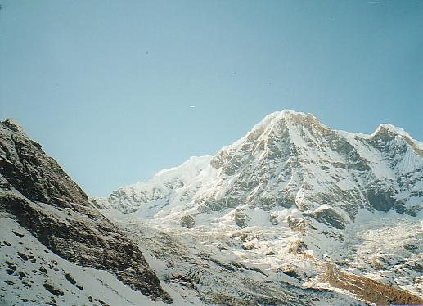
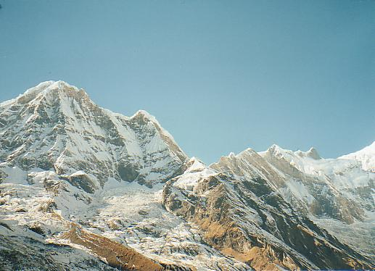
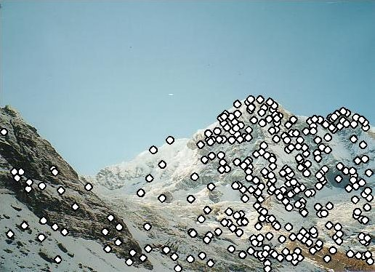
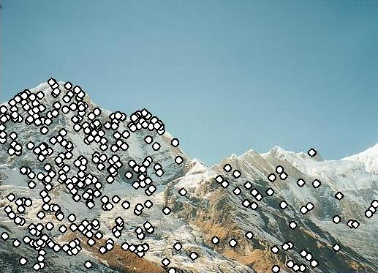
RANSAC for Homography
Initial Matched Points

Slide 24
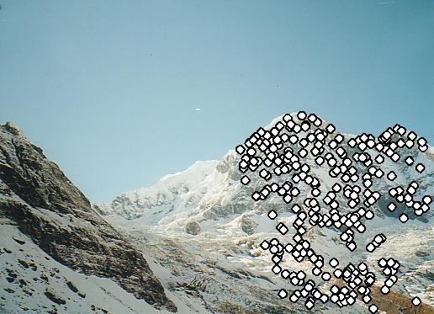
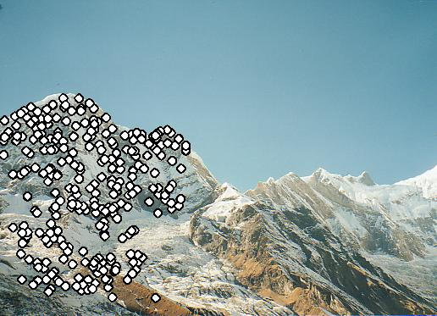
RANSAC for Homography
Final Matched Points

Slide 25
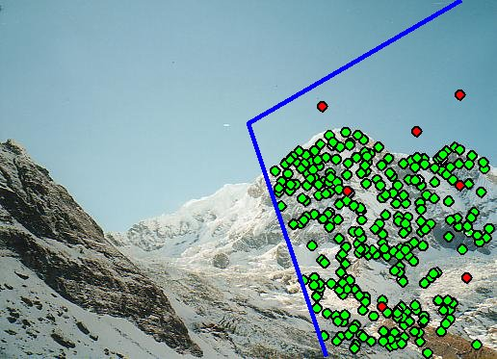
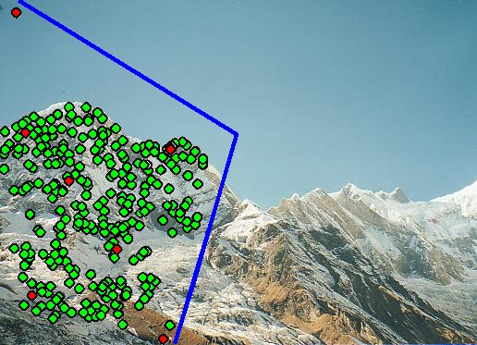
Verification

Slide 26
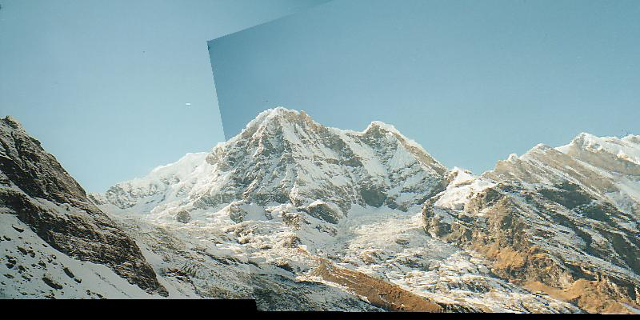
RANSAC for Homography

Slide 27
Choosing a Projection Surface
Many to choose: planar, cylindrical, spherical, cubic, etc.

Slide 28
Planar Mapping
x
x
f
f
For red image: pixels are already on the planar surface
For green image: map to first image plane

Slide 29
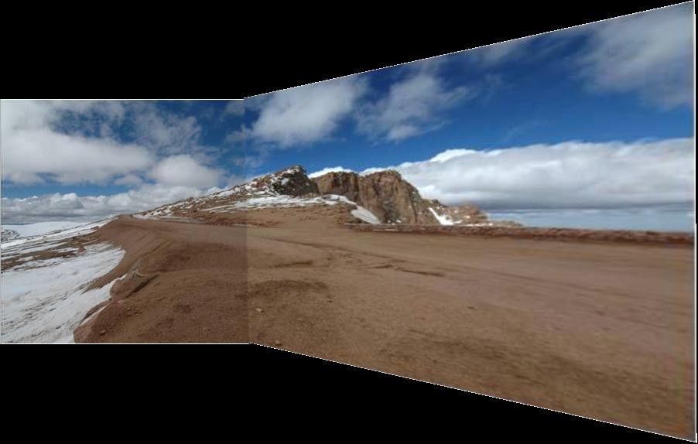
Planar Projection
Planar
Photos by Russ Hewett

Slide 30
Planar Projection
Planar

Slide 31
Cylindrical Mapping
x
x
f
f
For red image: compute h, theta on cylindrical surface from (u, v)
For green image: map to first image plane, than map to cylindrical surface

Slide 32
Cylindrical Projection
Cylindrical

Slide 33
Cylindrical Projection
Cylindrical

Slide 34
Planar
Cylindrical

Slide 35
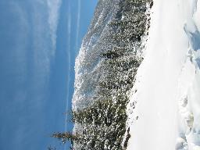
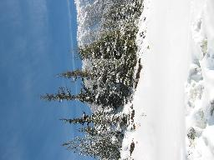
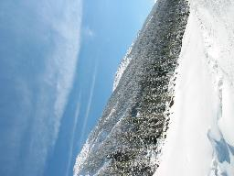
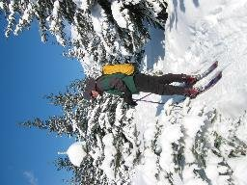
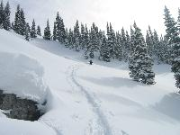
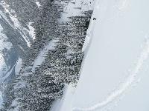
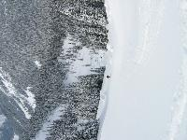
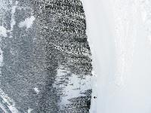
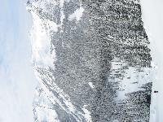
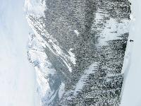
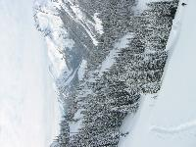
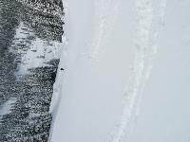
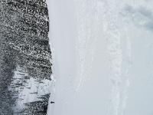
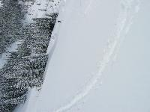
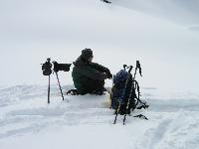
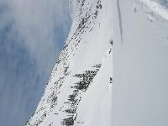
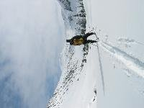
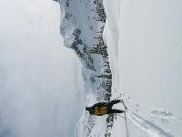
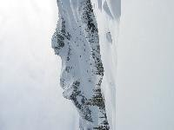
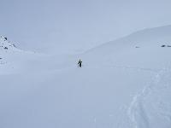
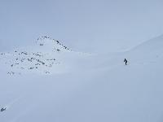
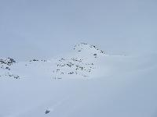
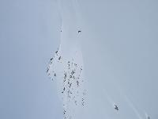
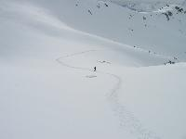
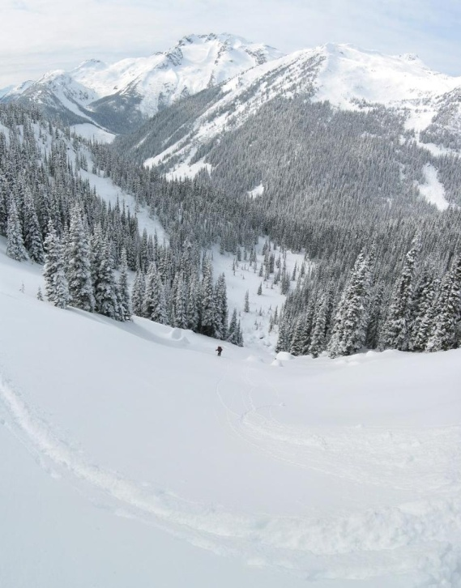
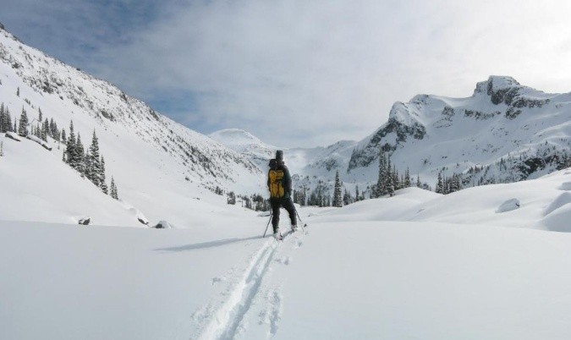
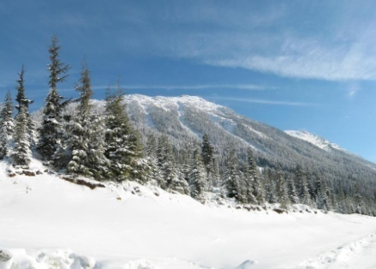
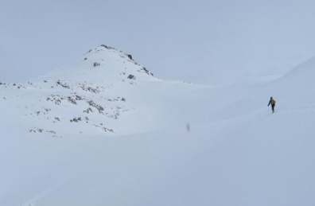
Recognizing Panoramas
Some of following material from Brown and Lowe 2003 talk
Brown and Lowe 2003, 2007

Slide 36
Recognizing Panoramas
Input: N images
Extract SIFT points, descriptors from all images
Find K-nearest neighbors for each point (K=4)
For each image
Select M candidate matching images by counting matched keypoints (m=6)
Solve homography H_{ij} for each matched image

Slide 37
Recognizing Panoramas
Input: N images
Extract SIFT points, descriptors from all images
Find K-nearest neighbors for each point (K=4)
For each image
Select M candidate matching images by counting matched keypoints (m=6)
Solve homography H_{ij} for each matched image
Decide if match is valid (n_{i} > 8 + 0.3 n_{f} )
# keypoints in overlapping area
# inliers

Slide 38
Recognizing Panoramas (cont.)
(now we have matched pairs of images)
Find connected components

Slide 39
Finding the panoramas

Slide 40
Finding the panoramas

Slide 41
Finding the panoramas

Slide 42
Recognizing Panoramas (cont.)
(now we have matched pairs of images)
Find connected components
For each connected component
Perform bundle adjustment to solve for rotation (θ₁, θ₂, θ₃) and focal length f of all cameras
Project to a surface (plane, cylinder, or sphere)
Render with multiband blending

Slide 43
Bundle adjustment for stitching
Non-linear minimization of re-projection error
where H = K’ R’ R⁻¹ K⁻¹
Solve non-linear least squares (Levenberg-Marquardt algorithm)
See paper for details

Slide 44
Bundle Adjustment
New images initialised with rotation, focal length of best matching image

Slide 45
Bundle Adjustment
New images initialised with rotation, focal length of best matching image

Slide 46
Straightening
Rectify images so that “up” is vertical

Slide 47
Details to make it look good
Choosing seams
Blending

Slide 48
Choosing seams
Easy method
Assign each pixel to image with nearest center
im1
im2
x
x
Image 2
Image 1

Slide 49
Choosing seams
Easy method
Assign each pixel to image with nearest center
Create a mask:
mask(y, x) = 1 iff pixel should come from im1
Smooth boundaries (called “feathering”):
mask_sm = imfilter(mask, gausfil);
Composite
imblend = im1_c.*mask + im2_c.*(1-mask);
im1
im2
x
x
Image 2
Image 1

Slide 50
Choosing seams
Better method: dynamic program to find seam along well-matched regions
Illustration: http://en.wikipedia.org/wiki/File:Rochester_NY.jpg

Slide 51
Gain compensation
Simple gain adjustment
Compute average RGB intensity of each image in overlapping region
Normalize intensities by ratio of averages

Slide 52
Multi-band Blending
Burt & Adelson 1983
Blend frequency bands over range ∝ λ

Slide 53
Multiband Blending with Laplacian Pyramid
At low frequencies, blend slowly
At high frequencies, blend quickly
1
0
1
0
1
0
Left pyramid
blend
Right pyramid

Slide 54
Multiband blending
Laplacian pyramids
Compute Laplacian pyramid of images and mask
Create blended image at each level of pyramid
Reconstruct complete image

Slide 55
Blending comparison (IJCV 2007)

Slide 56
Blending Comparison

Slide 57
Further reading
DLT algorithm: HZ p. 91 (alg 4.2), p. 585
Normalization: HZ p. 107-109 (alg 4.2)
RANSAC: HZ Sec 4.7, p. 123, alg 4.6
Rick Szeliski’s alignment/stitching tutorial
Recognising Panoramas: Brown and Lowe, IJCV 2007 (also bundle adjustment)

Slide 58
How does iphone panoramic stitching work?
Capture images at 30 fps
Stitch the central 1/8 of a selection of images
Select which images to stitch using the accelerometer and frame-to-frame matching
Faster and avoids radial distortion that often occurs towards corners of images
Alignment
Initially, perform cross-correlation of small patches aided by accelerometer to find good regions for matching
Register by matching points (KLT tracking or RANSAC with FAST (similar to SIFT) points) or correlational matching
Blending
Linear (or similar) blending, using a face detector to avoid blurring face regions and choose good face shots (not blinking, etc)
http://www.patentlyapple.com/patently-apple/2012/11/apples-cool-iphone-5-panorama-app-revealed-in-5-patents.html

Slide 59
Things to remember
Homography relates rotating cameras
Recover homography using RANSAC and normalized DLT
Bundle adjustment minimizes reprojection error for set of related images
Details to make it look nice (e.g., blending)

Slide 60
See you on Thrusday
Next class: Epipolar Geometry and Stereo Vision

