Slide 1
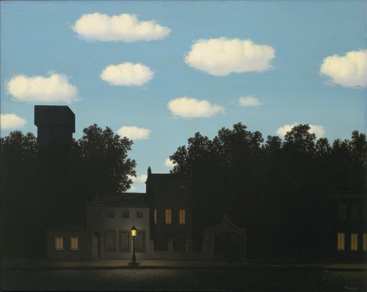
Light and Color
Computer Vision
Jia-Bin Huang, Virginia Tech
Empire of Light, 1950 by Rene Magritte

Slide 2

Administrative stuffs
Search for Teammates!
Signed up Piazza discussion board?
Sample final project ideas posted
Force-add: email ECEADVISE@vt.edu
Reviewed Linear Algebra?
Vote for Chen & Yuliang’s office hour and MATLAB tutorial time slots?
Questions about the course logistics?

Slide 3
Computing resources
ARC NewRiver:
  Allocation name: cv_fall_2018
  MATLAB available
Google cloud platform
  $50 coupon for each student
ECE students
  CVL

Slide 4
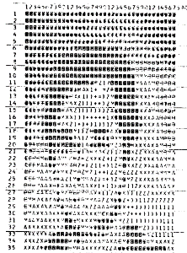
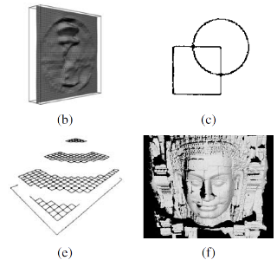
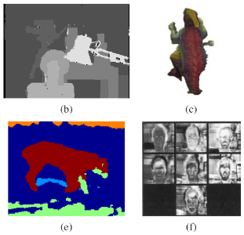
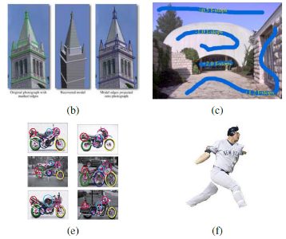
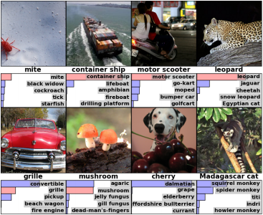
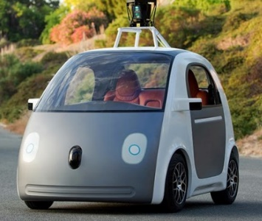
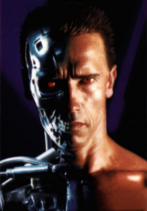
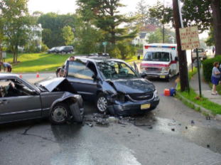
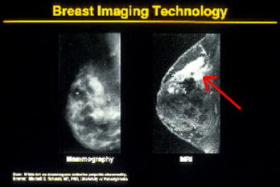
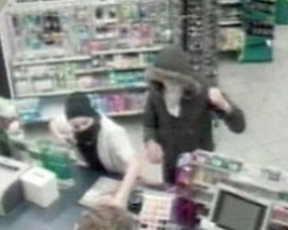
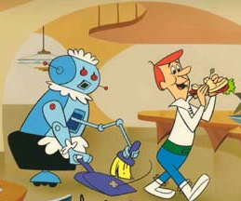
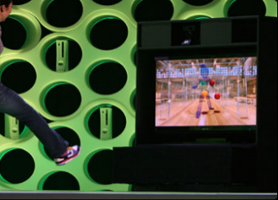
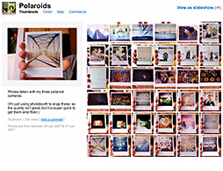
Previous class: Introduction
Overview of computer vision
Examples of computer vision applications
Safety
Health
Security
Comfort
Fun
Access

Slide 5
Today’s class
What determines pixels’ brightness?
What determines pixels’ color?
What can we infer about the scene from pixel intensities?

Slide 6
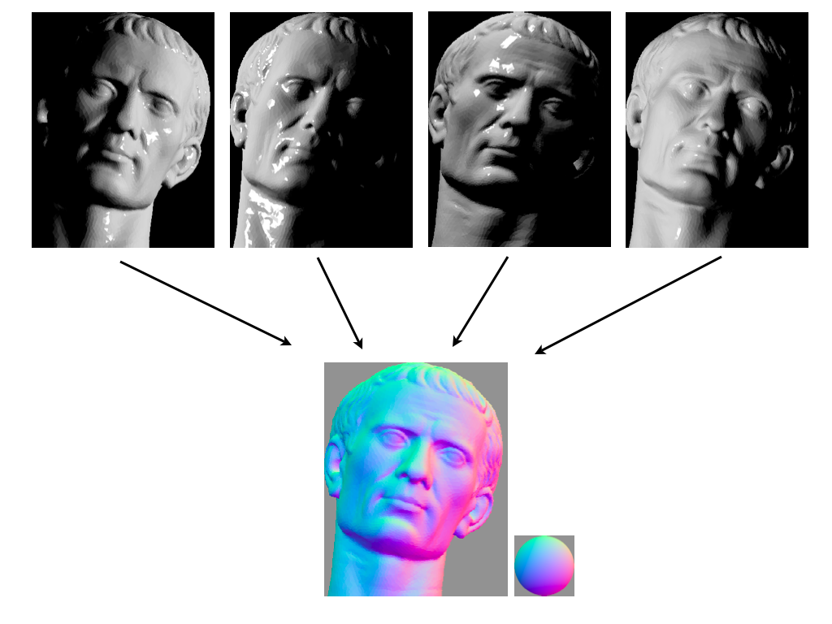
Why should we care?
Photometric Stereo

Slide 7
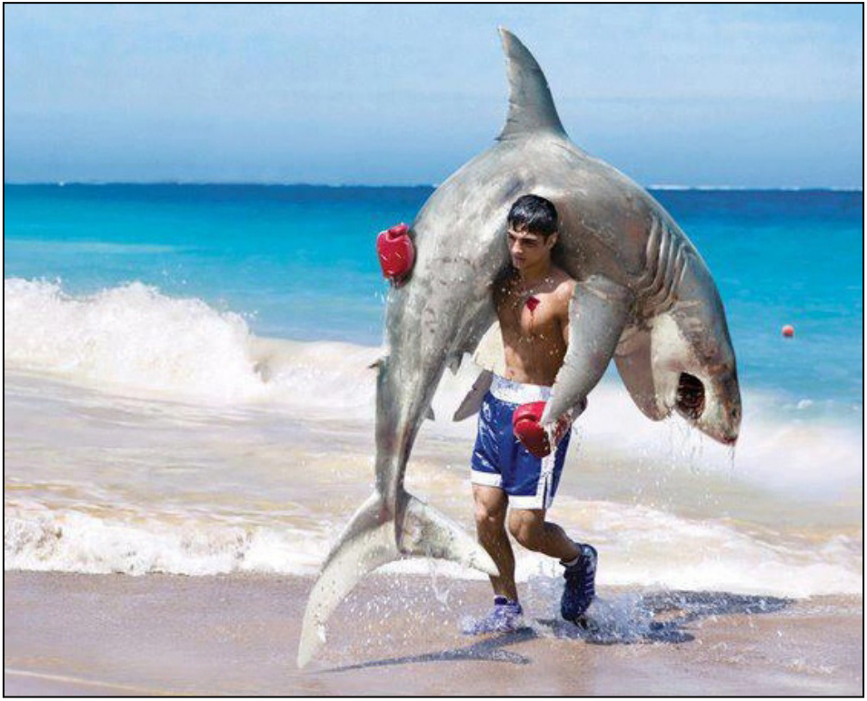
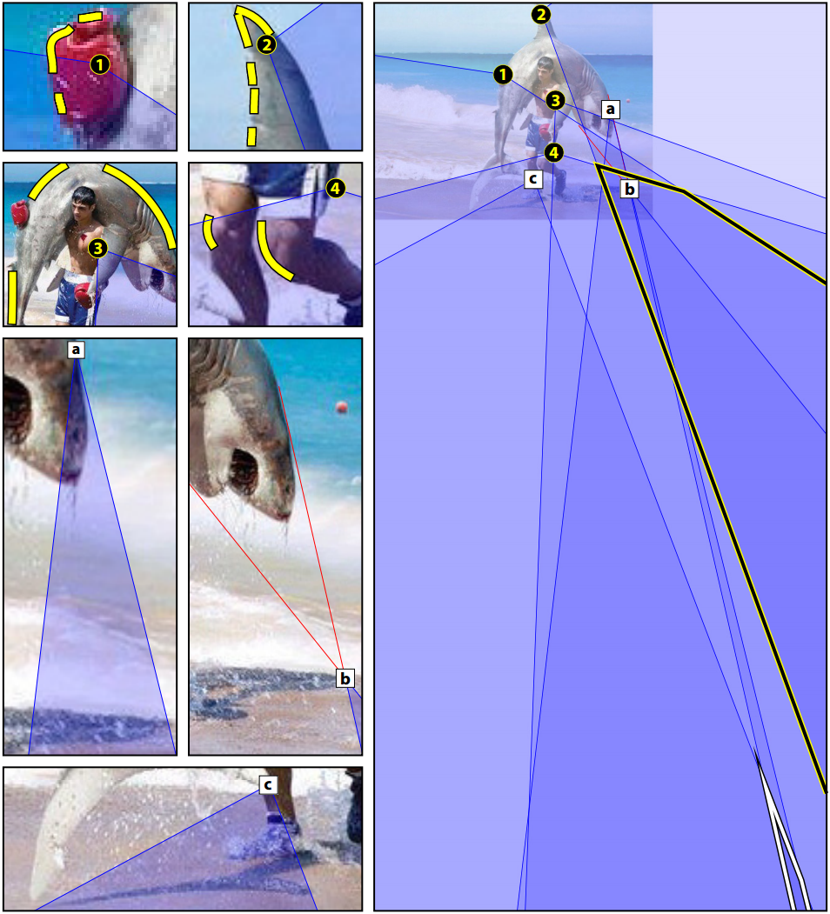
Why should we care?
Exposing Photo Manipulation from Shading and Shadows [Kee et al. TOG 14]

Slide 8
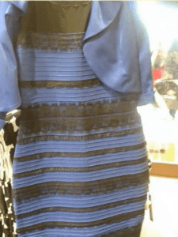

Why should we care?
White and gold?
Or
Black and blue?

Slide 9
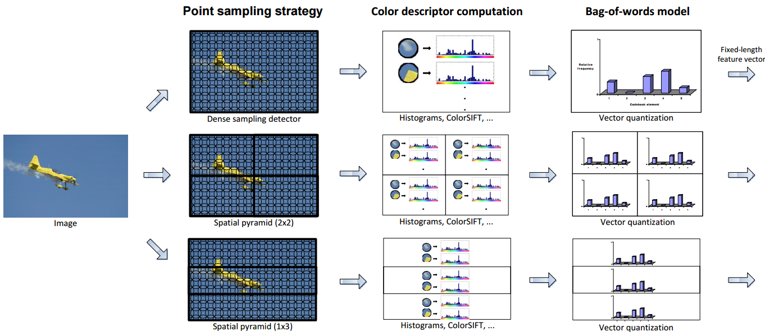
Why should we care?
Object and scene categorization [Sande et al. PAMI 2010]

Slide 10

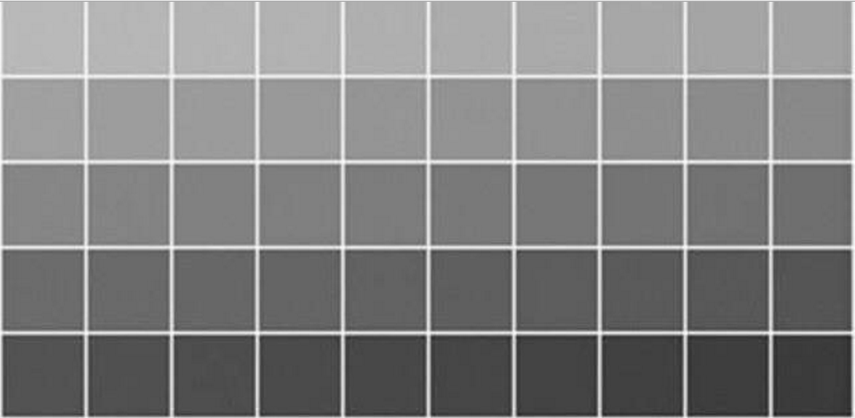

Slide 11

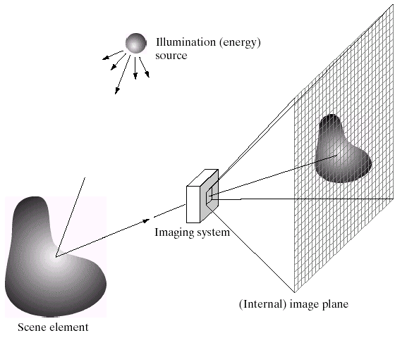
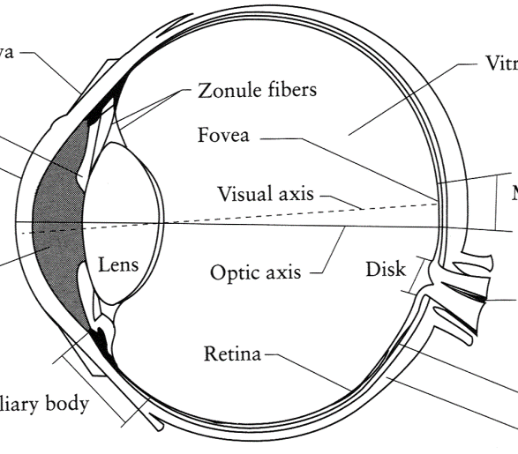
Image Formation
Digital Camera
Film
The Eye

Slide 12
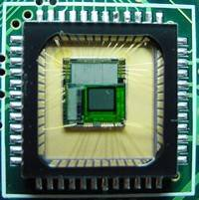
Sensor Array
CMOS sensor

Slide 13

What humans see
Slide credit: Larry Zitnick

Slide 14
What computers see
243 | 239 | 240 | 225 | 206 | 185 | 188 | 218 | 211 | 206 | 216 | 225
242 | 239 | 218 | 110 | 67 | 31 | 34 | 152 | 213 | 206 | 208 | 221
243 | 242 | 123 | 58 | 94 | 82 | 132 | 77 | 108 | 208 | 208 | 215
235 | 217 | 115 | 212 | 243 | 236 | 247 | 139 | 91 | 209 | 208 | 211
233 | 208 | 131 | 222 | 219 | 226 | 196 | 114 | 74 | 208 | 213 | 214
232 | 217 | 131 | 116 | 77 | 150 | 69 | 56 | 52 | 201 | 228 | 223
232 | 232 | 182 | 186 | 184 | 179 | 159 | 123 | 93 | 232 | 235 | 235
232 | 236 | 201 | 154 | 216 | 133 | 129 | 81 | 175 | 252 | 241 | 240
235 | 238 | 230 | 128 | 172 | 138 | 65 | 63 | 234 | 249 | 241 | 245
237 | 236 | 247 | 143 | 59 | 78 | 10 | 94 | 255 | 248 | 247 | 251
234 | 237 | 245 | 193 | 55 | 33 | 115 | 144 | 213 | 255 | 253 | 251
248 | 245 | 161 | 128 | 149 | 109 | 138 | 65 | 47 | 156 | 239 | 255
190 | 107 | 39 | 102 | 94 | 73 | 114 | 58 | 17 | 7 | 51 | 137
23 | 32 | 33 | 148 | 168 | 203 | 179 | 43 | 27 | 17 | 12 | 8
17 | 26 | 12 | 160 | 255 | 255 | 109 | 22 | 26 | 19 | 35 | 24
Slide credit: Larry Zitnick

Slide 15
How does a pixel get its value?
Light emitted
Fraction of light reflects into camera
Lens
Sensor
Slide credit: Derek Hoiem

Slide 16
How does a pixel get its value?
Major factors
  Illumination strength and direction
  Surface geometry
  Surface material
  Nearby surfaces
  Camera gain/exposure
Light emitted
Light reflected to camera
Sensor
Slide credit: Derek Hoiem

Slide 17


Basic models of reflection
Specular: light bounces off at the incident angle
  E.g., mirror
Diffuse: light scatters in all directions
  E.g., brick, cloth, rough wood
specular reflection
incoming light
$$Θ$$
$$Θ$$
diffuse reflection
incoming light
Slide credit: Derek Hoiem

Slide 18



Lambertian reflectance model
Some light is absorbed (function of albedo$ρ$)
Remaining light is scattered (diffuse reflection)
Examples: soft cloth, concrete, matte paints
light source
light source
diffuse reflection
$$ρ$$
absorption
$$(1−ρ)$$
Slide credit: Derek Hoiem
Notes:
albedo is the fraction of light reflected

Slide 19
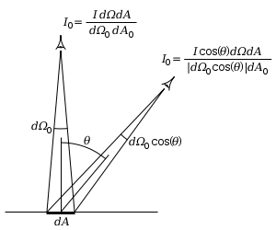
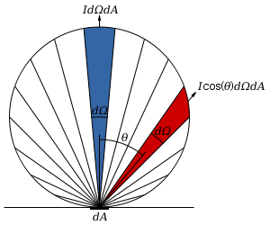

Diffuse reflection: Lambert’s cosine law
Intensity does not depend on viewer angle.
  Amount of reflected light proportional to $cos⁡(θ)$
  Visible solid angle also proportional to $cos⁡(θ)$
Slide credit: Derek Hoiem
http://en.wikipedia.org/wiki/Lambert%27s_cosine_law

Slide 20
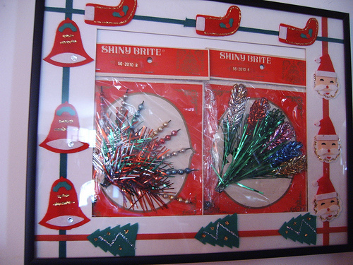
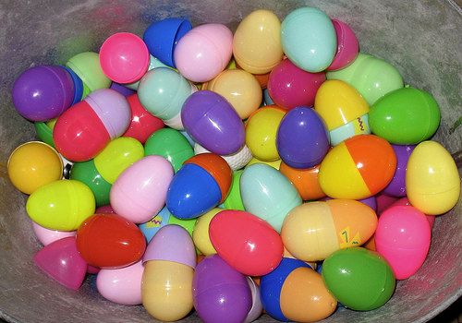


Specular Reflection
Flickr, by suzysputnik
Reflected direction depends on light orientation and surface normal
  E.g., mirrors are fully specular
  Most surfaces can be modeled with a mixture of diffuse and specular components
light source
specular reflection
$$Θ$$
$$Θ$$
Flickr, by piratejohnny
Slide credit: Derek Hoiem

Slide 21
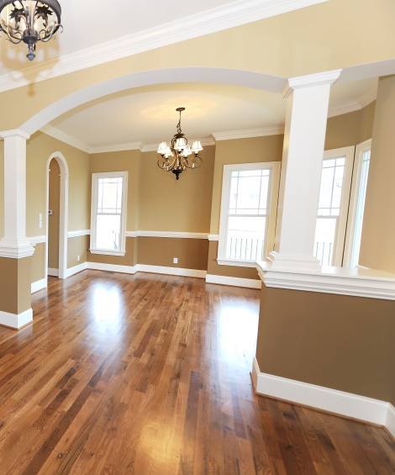
Most surfaces have both specular and diffuse components
Specularity = spot where specular reflection dominates (typically reflects light source)
Typically, specular component is small
Slide credit: Derek Hoiem
Photo: northcountryhardwoodfloors.com

Slide 22
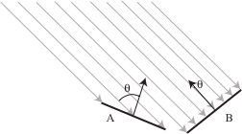
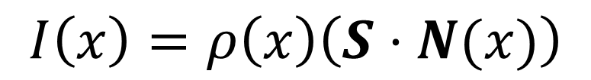

Intensity and Surface Orientation
Intensity depends on illumination angle
Why? Less light comes in at oblique angles.
$ρ=$Albedo: fraction of light that is reflected
$S=$ directional source
$N=$ surface normal
$I=$ reflected intensity
$$I\left(x\right)=ρ\left(x\right)\left(S⋅N(x)\right)$$
Slide credit: David Forsyth

Slide 23
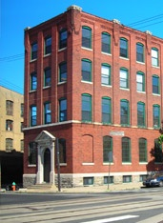
1
2

Slide 24

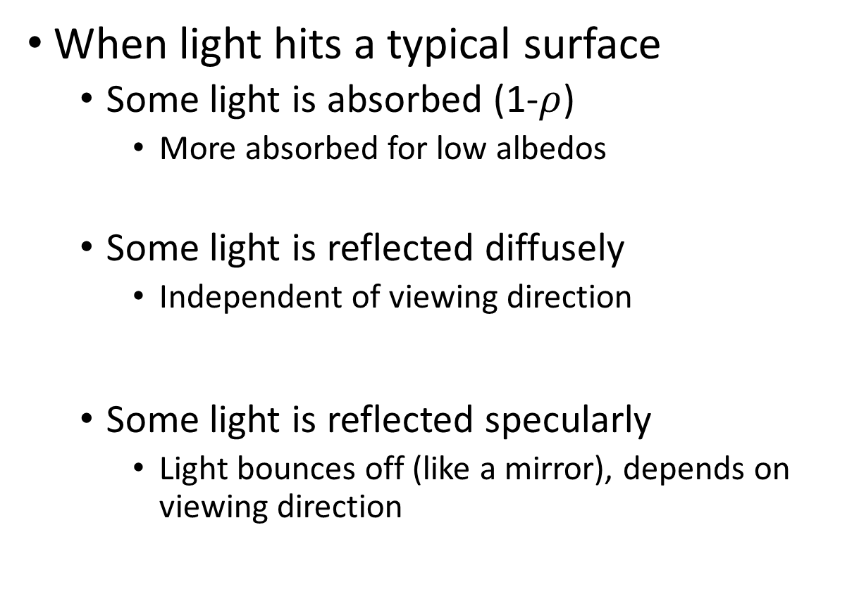

Recap
absorption
When light hits a typical surface
  Some light is absorbed (1-$ρ$)
    More absorbed for low albedos
  Some light is reflected diffusely
    Independent of viewing direction
  Some light is reflected specularly
    Light bounces off (like a mirror), depends on viewing direction
diffuse reflection
specular reflection
$$Θ$$
$$Θ$$
Slide credit: Derek Hoiem

Slide 25
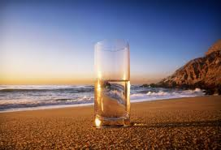
Other possible effects
light source
light source
transparency
refraction
Slide credit: Derek Hoiem

Slide 26
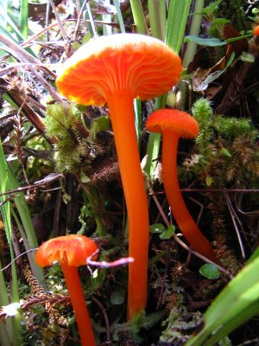
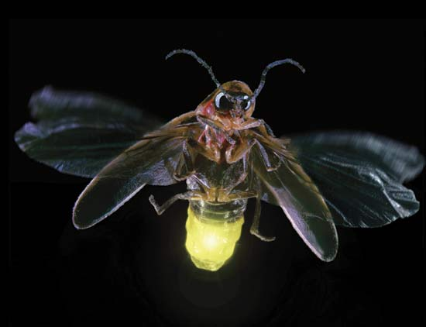
light source
light source
fluorescence
phosphorescence
λ₁
t=1
λ₂
t>1
Slide credit: Derek Hoiem

Slide 27
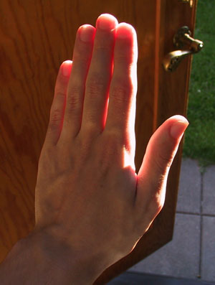
light source
subsurface scattering
λ
Slide credit: Derek Hoiem

Slide 28
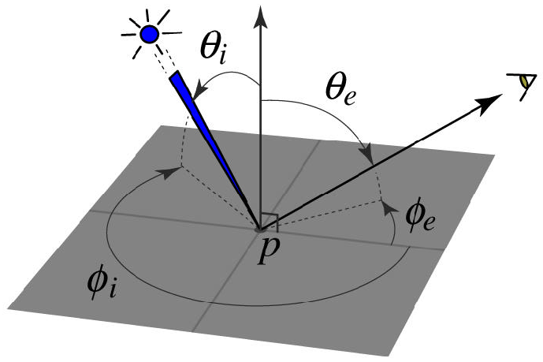
BRDF: Bidirectional Reflectance Distribution Function
Model of local reflection that tells how bright a surface appears when viewed from one direction when light falls on it from another
surface normal
Slide credit: S. Savarese

Slide 29
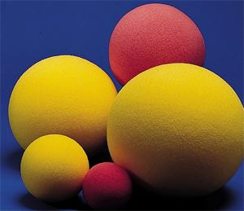
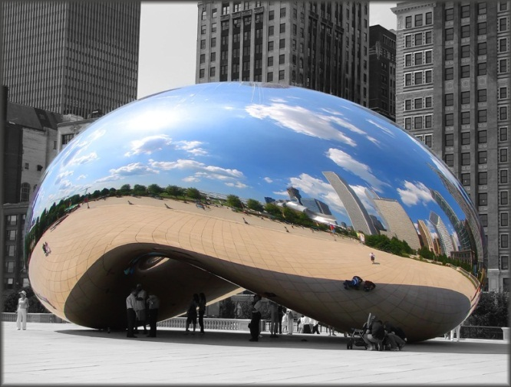
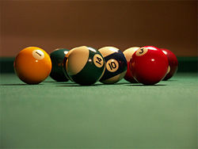
Reflection models
Lambertian: reflection all diffuse
Mirrored: reflection all specular
Glossy: reflection mostly diffuse, some specular

Slide 30
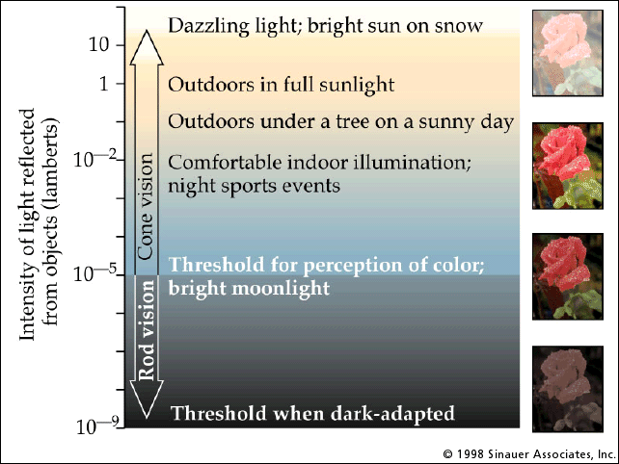
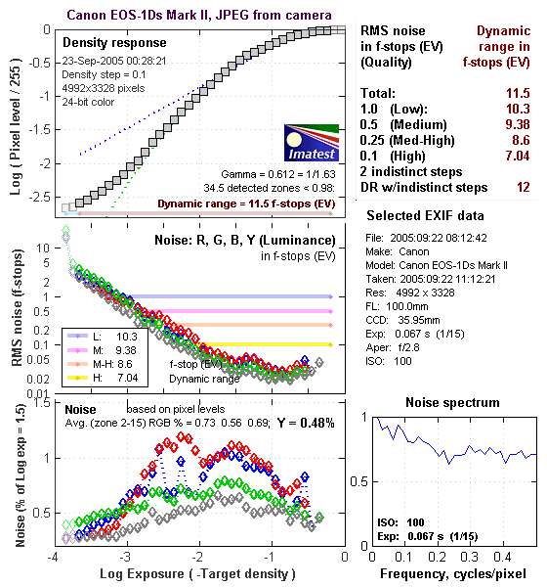
Dynamic range and camera response
Typical scenes have a huge dynamic range
Camera response is roughly linear in the mid range (15 to 240) but non-linear at the extremes
  called saturation or under-saturation

Slide 31

What determines pixels’ color?
https://upload.wikimedia.org/wikipedia/commons/b/b1/Colouring_pencils.jpg

Slide 32
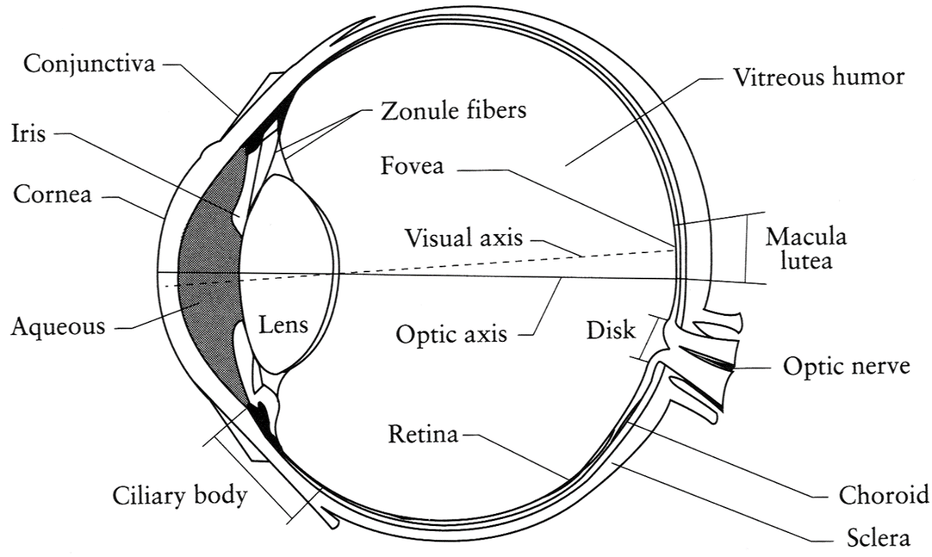
The Eye
The human eye is a camera!
  Iris - colored annulus with radial muscles
  Pupil - the hole (aperture) whose size is controlled by the iris
  What’s the “film”? photoreceptor cells (rods and cones) in the retina
Slide by Steve Seitz

Slide 33
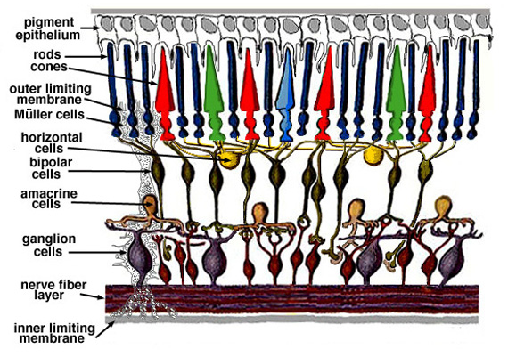
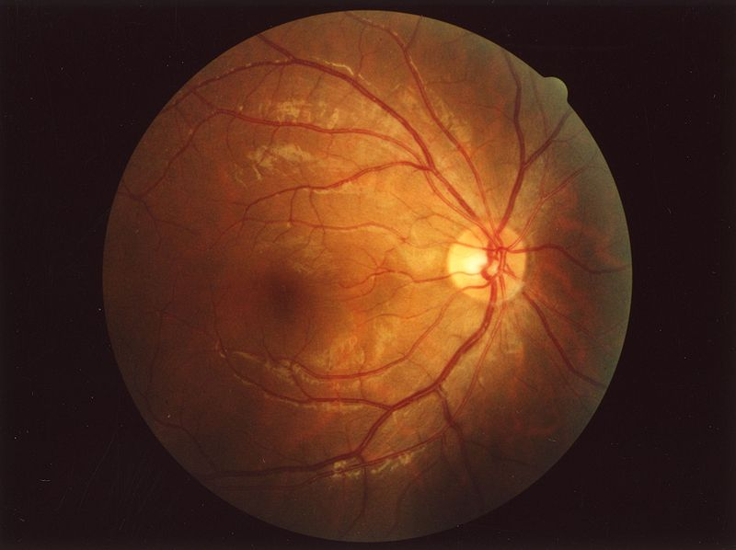
Retina up-close
Light
Notes:
Floaty things in your vision are white blood cells in capillaries. Some animals have two foveas (some birds) and some have none (cats and dogs). 100x sensors than nerve fibers: much processing (e.g., center surround) in retina itself

Slide 34
Two types of light-sensitive receptors
Cones
cone-shaped
less sensitive
operate in high light color vision
Rods
rod-shaped
highly sensitive
operate at night
gray-scale vision
slower to respond
© Stephen E. Palmer, 2002
Slide Credit: Efros

Slide 35
Distribution of Rods and Cones
Night Sky: why are there more stars off-center?
Slide credit: Efros
© Stephen E. Palmer, 2002

Slide 36

Find your blind spot

Slide 37
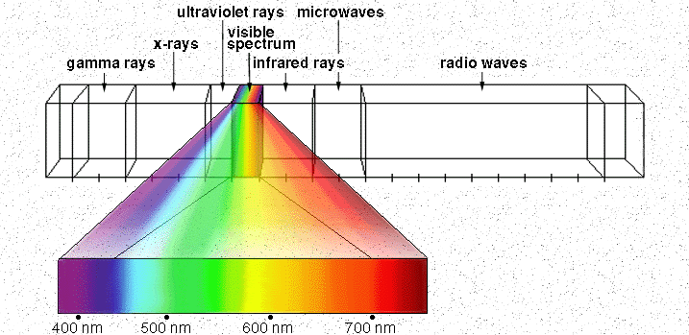

The Physics of Light
Light /līt/: Electromagnetic energy
- Wavelength is between 400 nm and 700 nm. (1 nm = 10 -9 meter)
Human Luminance Sensitivity Function
Slide Credit: Efros
http://www.yorku.ca/eye/photopik.htm
Notes:
At least 3 spectral bands required (e.g. R,G,B)

Slide 38
Visible Light
Why do we see light of these wavelengths?
…because that’s where the
Sun radiates EM energy
© Stephen E. Palmer, 2002

Slide 39
The Physics of Light
Any patch of light can be completely described
physically by its spectrum: the number of photons
(per time unit) at each wavelength 400 - 700 nm.
© Stephen E. Palmer, 2002

Slide 40
The Physics of Light
Some examples of the spectra of light sources
© Stephen E. Palmer, 2002

Slide 41
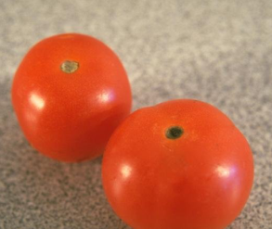







The Physics of Light
Some examples of the reflectance spectra of surfaces
Red
Yellow
Blue
Purple
% Photons Reflected
400 700
400 700
400 700
400 700
Wavelength (nm)
© Stephen E. Palmer, 2002

Slide 42
The Psychophysical Correspondence
There is no simple functional description for the perceived
color of all lights under all viewing conditions, but …...
A helpful constraint:
Consider only physical spectra with normal distributions
mean
area
variance
© Stephen E. Palmer, 2002

Slide 43
The Psychophysical Correspondence
Mean
Hue
# Photons
Wavelength
© Stephen E. Palmer, 2002

Slide 44
The Psychophysical Correspondence
Variance
Saturation
# Photons
Wavelength
© Stephen E. Palmer, 2002

Slide 45
The Psychophysical Correspondence
Area
Brightness
# Photons
Wavelength
© Stephen E. Palmer, 2002

Slide 46
Question: draw a “pink” light
# Photons
Wavelength

Slide 47

Physiology of Color Vision
Three kinds of cones:
Why are M and L cones so close?
Why are there 3?
© Stephen E. Palmer, 2002

Slide 48
Trichromacy
M
L
Power
S
Wavelength
Rods and cones act as filters on the spectrum
  To get the output of a filter, multiply its response curve by the spectrum, integrate over all wavelengths
    Each cone yields one number
  How can we represent an entire spectrum with 3 numbers?
  We can’t! Most of the information is lost
    As a result, two different spectra may appear indistinguishable
      such spectra are known as metamers
Slide by Steve Seitz

Slide 49


Slide 50


Slide 51


Slide 52


Correcting Colorblind?
http://enchroma.com/

Slide 53

Color Constancy
The “photometer metaphor” of color perception:
Color perception is determined by the spectrum of light
on each retinal receptor (as measured by a photometer).
© Stephen E. Palmer, 2002

Slide 54

Color Constancy
The “photometer metaphor” of color perception:
Color perception is determined by the spectrum of light
on each retinal receptor (as measured by a photometer).
© Stephen E. Palmer, 2002

Slide 55

Color Constancy
The “photometer metaphor” of color perception:
Color perception is determined by the spectrum of light
on each retinal receptor (as measured by a photometer).
© Stephen E. Palmer, 2002

Slide 56


Color Constancy
Do we have constancy over
all global color transformations?
60% blue filter
Complete inversion
© Stephen E. Palmer, 2002

Slide 57
Color Constancy
Color Constancy: the ability to perceive the
invariant color of a surface despite ecological
Variations in the conditions of observation.
Another of these hard inverse problems:
Physics of light emission and surface reflection
underdetermine perception of surface color
© Stephen E. Palmer, 2002

Slide 58


Practical Color Sensing: Bayer Grid
Estimate RGB
at ‘G’ cels from neighboring values
http://www.cooldictionary.com/
words/Bayer-filter.wikipedia
Slide by Steve Seitz

Slide 59




Color Image
R
G
B

Slide 60
Images in Matlab
Images represented as a matrix
Suppose we have a NxM RGB image called “im”
  im(1,1,1) = top-left pixel value in R-channel
  im(y, x, b) = y pixels down, x pixels to right in the b^{th} channel
  im(N, M, 3) = bottom-right pixel in B-channel
imread(filename) returns a uint8 image (values 0 to 255)
  Convert to double format (values 0 to 1) with im2double
column
row
R
0.92 | 0.93 | 0.94 | 0.97 | 0.62 | 0.37 | 0.85 | 0.97 | 0.93 | 0.92 | 0.99
0.95 | 0.89 | 0.82 | 0.89 | 0.56 | 0.31 | 0.75 | 0.92 | 0.81 | 0.95 | 0.91
0.89 | 0.72 | 0.51 | 0.55 | 0.51 | 0.42 | 0.57 | 0.41 | 0.49 | 0.91 | 0.92
0.96 | 0.95 | 0.88 | 0.94 | 0.56 | 0.46 | 0.91 | 0.87 | 0.90 | 0.97 | 0.95
0.71 | 0.81 | 0.81 | 0.87 | 0.57 | 0.37 | 0.80 | 0.88 | 0.89 | 0.79 | 0.85
0.49 | 0.62 | 0.60 | 0.58 | 0.50 | 0.60 | 0.58 | 0.50 | 0.61 | 0.45 | 0.33
0.86 | 0.84 | 0.74 | 0.58 | 0.51 | 0.39 | 0.73 | 0.92 | 0.91 | 0.49 | 0.74
0.96 | 0.67 | 0.54 | 0.85 | 0.48 | 0.37 | 0.88 | 0.90 | 0.94 | 0.82 | 0.93
0.69 | 0.49 | 0.56 | 0.66 | 0.43 | 0.42 | 0.77 | 0.73 | 0.71 | 0.90 | 0.99
0.79 | 0.73 | 0.90 | 0.67 | 0.33 | 0.61 | 0.69 | 0.79 | 0.73 | 0.93 | 0.97
0.91 | 0.94 | 0.89 | 0.49 | 0.41 | 0.78 | 0.78 | 0.77 | 0.89 | 0.99 | 0.93
G
0.92 | 0.93 | 0.94 | 0.97 | 0.62 | 0.37 | 0.85 | 0.97 | 0.93 | 0.92 | 0.99
0.95 | 0.89 | 0.82 | 0.89 | 0.56 | 0.31 | 0.75 | 0.92 | 0.81 | 0.95 | 0.91
0.89 | 0.72 | 0.51 | 0.55 | 0.51 | 0.42 | 0.57 | 0.41 | 0.49 | 0.91 | 0.92
0.96 | 0.95 | 0.88 | 0.94 | 0.56 | 0.46 | 0.91 | 0.87 | 0.90 | 0.97 | 0.95
0.71 | 0.81 | 0.81 | 0.87 | 0.57 | 0.37 | 0.80 | 0.88 | 0.89 | 0.79 | 0.85
0.49 | 0.62 | 0.60 | 0.58 | 0.50 | 0.60 | 0.58 | 0.50 | 0.61 | 0.45 | 0.33
0.86 | 0.84 | 0.74 | 0.58 | 0.51 | 0.39 | 0.73 | 0.92 | 0.91 | 0.49 | 0.74
0.96 | 0.67 | 0.54 | 0.85 | 0.48 | 0.37 | 0.88 | 0.90 | 0.94 | 0.82 | 0.93
0.69 | 0.49 | 0.56 | 0.66 | 0.43 | 0.42 | 0.77 | 0.73 | 0.71 | 0.90 | 0.99
0.79 | 0.73 | 0.90 | 0.67 | 0.33 | 0.61 | 0.69 | 0.79 | 0.73 | 0.93 | 0.97
0.91 | 0.94 | 0.89 | 0.49 | 0.41 | 0.78 | 0.78 | 0.77 | 0.89 | 0.99 | 0.93
B
0.92 | 0.93 | 0.94 | 0.97 | 0.62 | 0.37 | 0.85 | 0.97 | 0.93 | 0.92 | 0.99
0.95 | 0.89 | 0.82 | 0.89 | 0.56 | 0.31 | 0.75 | 0.92 | 0.81 | 0.95 | 0.91
0.89 | 0.72 | 0.51 | 0.55 | 0.51 | 0.42 | 0.57 | 0.41 | 0.49 | 0.91 | 0.92
0.96 | 0.95 | 0.88 | 0.94 | 0.56 | 0.46 | 0.91 | 0.87 | 0.90 | 0.97 | 0.95
0.71 | 0.81 | 0.81 | 0.87 | 0.57 | 0.37 | 0.80 | 0.88 | 0.89 | 0.79 | 0.85
0.49 | 0.62 | 0.60 | 0.58 | 0.50 | 0.60 | 0.58 | 0.50 | 0.61 | 0.45 | 0.33
0.86 | 0.84 | 0.74 | 0.58 | 0.51 | 0.39 | 0.73 | 0.92 | 0.91 | 0.49 | 0.74
0.96 | 0.67 | 0.54 | 0.85 | 0.48 | 0.37 | 0.88 | 0.90 | 0.94 | 0.82 | 0.93
0.69 | 0.49 | 0.56 | 0.66 | 0.43 | 0.42 | 0.77 | 0.73 | 0.71 | 0.90 | 0.99
0.79 | 0.73 | 0.90 | 0.67 | 0.33 | 0.61 | 0.69 | 0.79 | 0.73 | 0.93 | 0.97
0.91 | 0.94 | 0.89 | 0.49 | 0.41 | 0.78 | 0.78 | 0.77 | 0.89 | 0.99 | 0.93

Slide 61

Color spaces
How can we represent color?
http://en.wikipedia.org/wiki/File:RGB_illumination.jpg

Slide 62





Color spaces: RGB
Default color space
0,1,0
R
(G=0,B=0)
1,0,0
G
(R=0,B=0)
0,0,1
RGB cube
  Easy for devices
  But not perceptual
  Where do the grays live?
  Where is hue and saturation?
B
(R=0,G=0)
Image from: http://en.wikipedia.org/wiki/File:RGB_color_solid_cube.png

Slide 63


HSV
Hue, Saturation, Value (Intensity)
  RGB cube on its vertex
Decouples the three components (a bit)
Use rgb2hsv() and hsv2rgb() in Matlab
Slide by Steve Seitz

Slide 64




Color spaces: HSV
Intuitive color space
H
(S=1,V=1)
S
(H=1,V=1)
V
(H=1,S=0)

Slide 65




Color spaces: L*a*b*
“Perceptually uniform” color space
L
(a=0,b=0)
a
(L=65,b=0)
b
(L=65,a=0)

Slide 66

So far: light→surface→camera
Called a local illumination model
But much light comes from surrounding surfaces
From Koenderink slides on image texture and the flow of light

Slide 67

Inter-reflection is a major source of light

Slide 68
Inter-reflection affects the apparent color of objects
From Koenderink slides on image texture and the flow of light

Slide 69

Scene surfaces also cause shadows
Shadow: reduction in intensity due to a blocked source

Slide 70



Shadows

Slide 71
Models of light sources
Distant point source
  One illumination direction
  E.g., sun
Area source
  E.g., white walls, diffuser lamps, sky
Ambient light
  Substitute for dealing with interreflections
Global illumination model
  Account for interreflections in modeled scene

Slide 72

Questions
Why is (2) brighter than (1)? Each points to the asphalt.
Why is (4) darker than (3)? (4) points to the marking.
Why is (5) brighter than (3)? Each points to the side of the wooden block.
Why isn’t (6) black, given that there is no direct path from it to the sun?
Why (7) brighter than (8)? Both point to the yellow paints.
Why is (9) green, given that the sun light contains all visible wavelengths?
6
3
8
7
5
9
4
1
2

Slide 73
What does the intensity of a pixel tell us?
im(234, 452) = 0.58
0.92 | 0.93 | 0.94 | 0.97 | 0.62 | 0.37 | 0.85 | 0.97 | 0.93 | 0.92 | 0.99
0.95 | 0.89 | 0.82 | 0.89 | 0.56 | 0.31 | 0.75 | 0.92 | 0.81 | 0.95 | 0.91
0.89 | 0.72 | 0.51 | 0.55 | 0.51 | 0.42 | 0.57 | 0.41 | 0.49 | 0.91 | 0.92
0.96 | 0.95 | 0.88 | 0.94 | 0.56 | 0.46 | 0.91 | 0.87 | 0.90 | 0.97 | 0.95
0.71 | 0.81 | 0.81 | 0.87 | 0.57 | 0.37 | 0.80 | 0.88 | 0.89 | 0.79 | 0.85
0.49 | 0.62 | 0.60 | 0.58 | 0.50 | 0.60 | 0.58 | 0.50 | 0.61 | 0.45 | 0.33
0.86 | 0.84 | 0.74 | 0.58 | 0.51 | 0.39 | 0.73 | 0.92 | 0.91 | 0.49 | 0.74
0.96 | 0.67 | 0.54 | 0.85 | 0.48 | 0.37 | 0.88 | 0.90 | 0.94 | 0.82 | 0.93
0.69 | 0.49 | 0.56 | 0.66 | 0.43 | 0.42 | 0.77 | 0.73 | 0.71 | 0.90 | 0.99
0.79 | 0.73 | 0.90 | 0.67 | 0.33 | 0.61 | 0.69 | 0.79 | 0.73 | 0.93 | 0.97
0.91 | 0.94 | 0.89 | 0.49 | 0.41 | 0.78 | 0.78 | 0.77 | 0.89 | 0.99 | 0.93

Slide 74
The plight of the poor pixel
A pixel’s brightness is determined by
  Light source (strength, direction, color)
  Surface orientation
  Surface material and albedo
  Reflected light and shadows from surrounding surfaces
  Gain on the sensor
A pixel’s brightness tells us nothing by itself

Slide 75


Slide 76

And yet we can interpret images…
Key idea: for nearby scene points, most factors do not change much
The information is mainly contained in local differences of brightness

Slide 77

Darkness = Large Difference in Neighboring Pixels

Slide 78

What is this?

Slide 79


Slide 80


What differences in intensity tell us about shape?
Changes in surface normal
Texture
Proximity
Indents and bumps
Grooves and creases
Photos Koenderink slides on image texture and the flow of light
Notes:
So far, most people have gotten away with just knowing that differences are important and designing features that measure differences.

Slide 81

Shadows as cues
From Koenderink slides on image texture and the flow of light
Slide: Forsyth

Slide 82
Color constancy
Interpret surface in terms of albedo or “true color”, rather than observed intensity
  Humans are good at it
  Computers are not nearly as good

Slide 83

One source of constancy: local comparisons

Slide 84

http://www.echalk.co.uk/amusements/OpticalIllusions/colourPerception/colourPerception.html

Slide 85

Perception of Intensity
from Ted Adelson

Slide 86


Perception of Intensity
from Ted Adelson

Slide 87


Slide 88



Color Correction
Simple idea: multiply R, G, and B values by separate constants
$\left[\begin{matrix}\tilde{r} \\ \tilde{g} \\ \tilde{b}\end{matrix}\right]$=$\left[\begin{matrix}αr & 0 & 0 \\ 0 & αg & 0 \\ 0 & 0 & αb\end{matrix}\right]\left[\begin{matrix}r \\ g \\ b\end{matrix}\right]$
How to choose the constants?
  “White world” assumption: brightest pixel is white
    Divide by largest value
  “Gray world” assumption: average value should be gray
    E.g., multiply r channel by avg(r) /avg((r+g+b)/3)
  White balancing: choose a reference as the white or gray color

Slide 89

Discount the blue side
Discount the gold side

Slide 90



Things to remember
Important terms: diffuse/specular reflectance, albedo
Color vision: physics of light, trichromacy, color consistency, color spaces (RGB, HSV, Lab)
Observed intensity depends on
  light sources,
  geometry/material of reflecting surface,
  surrounding objects,
  camera settings
Objects cast light and shadows on each other
Differences in intensity are primary cues for shape

Slide 91


Thank you
Next class: Image Filters

