Slide 1
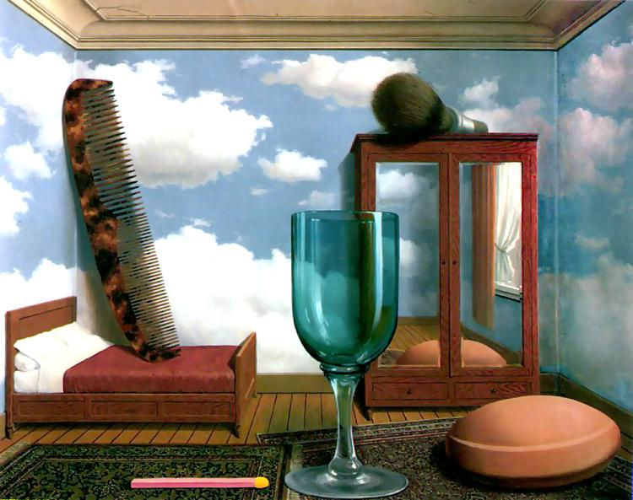
Single-view Metrology and
Camera Calibration
Computer Vision
Jia-Bin Huang, Virginia Tech
Many slides from S. Seitz and D. Hoiem

Slide 2
Administrative stuffs
HW 2 due 11:59 PM on Oct 9th
Ask/discuss questions on Piazza
Office hour

Slide 3
Perspective and 3D Geometry
Projective geometry and camera models
  What’s the mapping between image and world coordiantes?
Single view metrology and camera calibration
  How can we estimate the camera parameters?
  How can we measure the size of 3D objects in an image?
Photo stitching
  What’s the mapping from two images taken without camera translation?
Epipolar Geometry and Stereo Vision
  What’s the mapping from two images taken with camera translation?
Structure from motion
  How can we recover 3D points from multiple images?

Slide 4
Last Class: Pinhole Camera
.
Principal Point (u₀, v₀)
.
.
f
Z
Y
.
v
Camera Center (t_{x}, t_{y}, t_{z})
u

Slide 5

Last Class: Projection Matrix
R
j_{w}
t
k_{w}
O_{w}
i_{w}
Notes:
As review:
1) Example of my eye and their eye, where both coordinate frames are known. Suppose that I know a 3D point on the board in relation to me, and I want to figure out where that point will appear on their retina. First, I translate from my eye to their eye. Then, I rotate from my orientation to theirs. Finally, I project from 3D onto the 2D visual field.
2) Suppose I know x, K, R, and t. Can I compute X? What can I know about X?

Slide 6

Last class: Vanishing Points
Vertical vanishing
point
(at infinity)
Vanishing
line
Vanishing
point
Vanishing
point
Slide from Efros, Photo from Criminisi

Slide 7
This class
How can we calibrate the camera?
How can we measure the size of objects in the world from an image?
What about other camera properties: focal length, field of view, depth of field, aperture, f-number?

Slide 8
How to calibrate the camera?

Slide 9

Calibrating the Camera
Method 1: Use an object (calibration grid) with known geometry
  Correspond image points to 3d points
  Get least squares solution (or non-linear solution)
Known 2d image coordinates
Known 3d locations
Unknown Camera Parameters

Slide 10
Unknown Camera Parameters
Known 2d image coords
Known 3d locations

Slide 11
Unknown Camera Parameters
Known 2d image coords
Known 3d locations
Method 1 – homogeneous linear system. Solve for m’s entries using linear least squares
[U, S, V] = svd(A);
M = V(:,end);
M = reshape(M,[],3)';

Slide 12
Unknown Camera Parameters
Known 2d image coords
Known 3d locations
Method 2 – nonhomogeneous linear system. Solve for m’s entries using linear least squares
Ax=b form
M = A\Y;
M = [M;1];
M = reshape(M,[],3)';

Slide 13
Calibration with linear method
Advantages
  Easy to formulate and solve
  Provides initialization for non-linear methods
Disadvantages
  Doesn’t directly give you camera parameters
  Doesn’t model radial distortion
  Can’t impose constraints, such as known focal length
  Doesn’t minimize projection error
Non-linear methods are preferred
  Define error as difference between projected points and measured points
  Minimize error using Newton’s method or other non-linear optimization

Slide 14
Can we factorize M back to K [R | T]?
Yes!
You can use RQ factorization
  (note – not the more familiar QR factorization).
R (right diagonal) is K, and Q (orthogonal basis) is R. T, the last column of [R | T], is inv(K) * last column of M.
  Need post-processing to make sure that the matrices are valid.
  See http://ksimek.github.io/2012/08/14/decompose/
Slide credit: J. Hays

Slide 15
Calibrating the Camera
Method 2: Use vanishing points
  Find vanishing points corresponding to orthogonal directions
Vertical vanishing
point
(at infinity)
Vanishing
line
Vanishing
point
Vanishing
point

Slide 16


Calibration by orthogonal vanishing points
Intrinsic camera matrix
  Use orthogonality as a constraint
  Model K with only f, u₀, v₀
What if you don’t have three finite vanishing points?
  Two finite VP: solve f, get valid u₀, v₀ closest to image center
  One finite VP: u₀, v₀ is at vanishing point; can’t solve for f
For vanishing points
$$X_{i}=R^{−1}K^{−1}p_{i}$$
$$p_{i}^{⊤}{\left(K^{−1}\right)}^{⊤}(R{)(R}^{−1}){(K}^{−1})p_{i}=0$$

Slide 17

Calibration by vanishing points
Intrinsic camera matrix
Rotation matrix
  Set directions of vanishing points
    e.g., X₁ = [1, 0, 0]
  Each VP provides one column of R
  Special properties of R
    inv(R)=R^{T}
    Each row and column of R has unit length
$$p_{i}=Kr_{i}$$

Slide 18
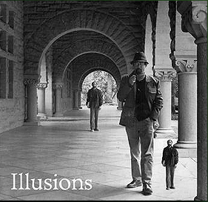
How can we measure the size of 3D objects from an image?
Slide by Steve Seitz

Slide 19
Perspective cues
Slide by Steve Seitz

Slide 20
Perspective cues
Slide by Steve Seitz

Slide 21
Perspective cues
Slide by Steve Seitz

Slide 22
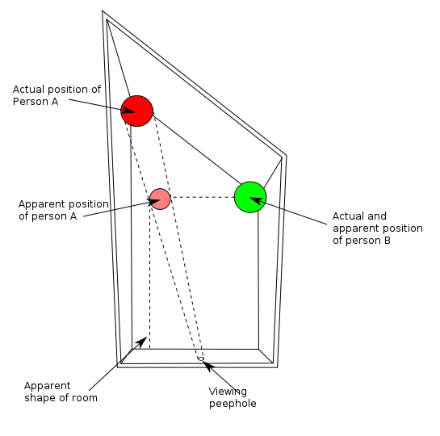
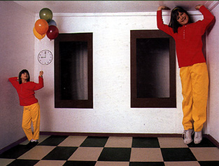
Ames Room

Slide 23
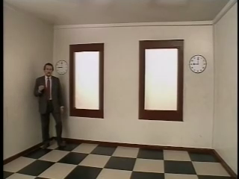

Slide 24
Comparing heights
Slide by Steve Seitz
Vanishing
Point

Slide 25
Measuring height
Slide by Steve Seitz
5.3
5
Camera height
4
3.3
3
2.8
2
1

Slide 26

Which is higher – the camera or the man in the parachute?

Slide 27
The cross ratio
Slide by Steve Seitz
A Projective Invariant
  Does not change under projective transformations
The cross-ratio of 4 collinear points
P₄
P₃
P₂
P₁
Can permute the point ordering
  4! = 24 different orders (but only 6 distinct values)
This is the fundamental invariant of projective geometry

Slide 28
Measuring height
Slide by Steve Seitz
∞
scene cross ratio
T (top of object)
t
r
R (reference point)
C
H
b
R
image cross ratio
v_{Z}
B (bottom of object)
ground plane
scene points represented as
image points as

Slide 29


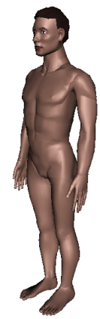
Measuring height
Slide by Steve Seitz
v_{z}
r
vanishing line (horizon)
t₀
t
v_{x}
v
v_{y}
H
R
H
b₀
b
image cross ratio

Slide 30
Measuring height
Slide by Steve Seitz
v_{z}
r
t₀
vanishing line (horizon)
t₀
v_{x}
v
v_{y}
m₀
t₁
b₀
b₁
b
What if the point on the ground plane b₀ is not known?
  Here the guy is standing on the box, height of box is known
  Use one side of the box to help find b₀ as shown above

Slide 31
What about focus, aperture, DOF, FOV, etc?

Slide 32
Adding a lens
“circle of
confusion”
A lens focuses light onto the film
  There is a specific distance at which objects are “in focus”
    other points project to a “circle of confusion” in the image
  Changing the shape of the lens changes this distance

Slide 33

Focal length, aperture, depth of field
F
focal point
optical center
(Center Of Projection)
A lens focuses parallel rays onto a single focal point
  focal point at a distance f beyond the plane of the lens
  Aperture of diameter D restricts the range of rays
Slide source: Seitz

Slide 34
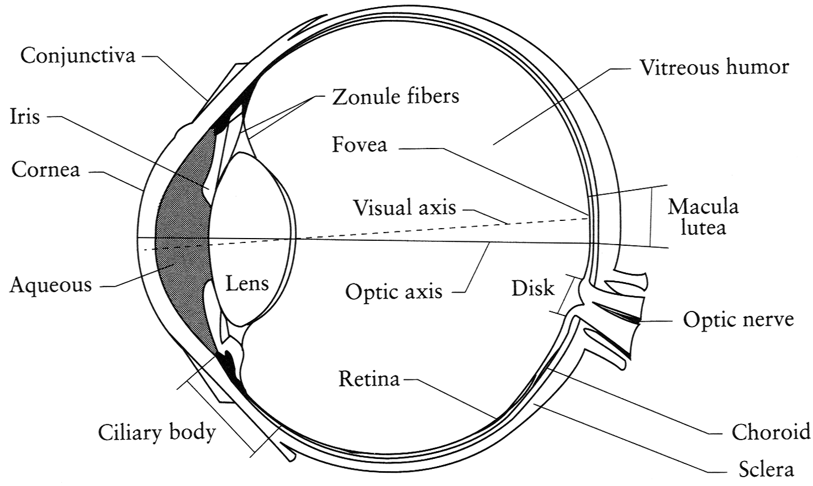
The eye
The human eye is a camera
  Iris - colored annulus with radial muscles
  Pupil (aperture) - the hole whose size is controlled by the iris
  Retina (film): photoreceptor cells (rods and cones)
Slide source: Seitz
Notes:
Note that the retina is curved

Slide 35

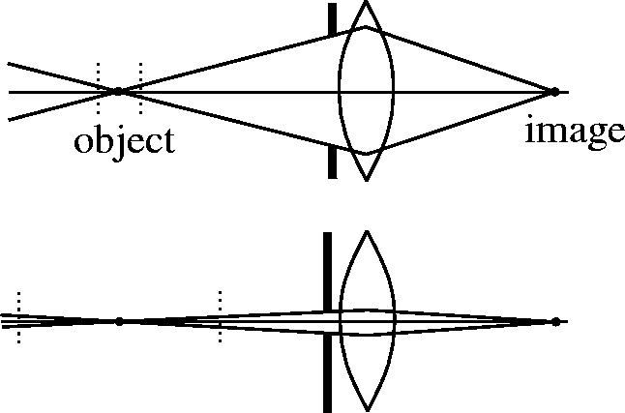

Depth of field
Slide source: Seitz
f / 5.6
f / 32
Changing the aperture size or focal length affects depth of field
Flower images from Wikipedia http://en.wikipedia.org/wiki/Depth_of_field

Slide 36
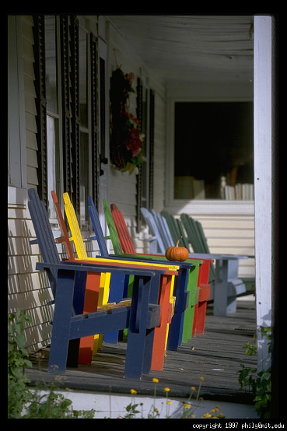
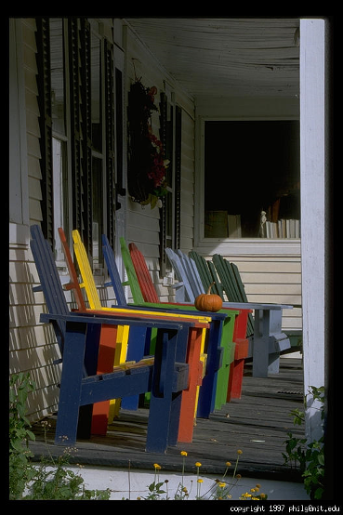
Varying the aperture
Slide from Efros
Large aperture = small DOF
Small aperture = large DOF

Slide 37
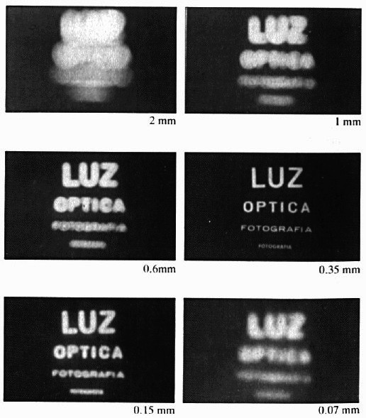
Shrinking the aperture
Why not make the aperture as small as possible?
  Less light gets through
  Diffraction effects
Slide by Steve Seitz

Slide 38
Shrinking the aperture
Slide by Steve Seitz

Slide 39
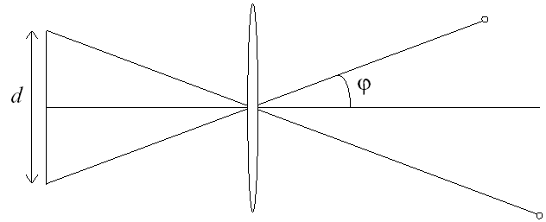
Relation between field of view and focal length
Field of view (angle width)
Film/Sensor Width
Focal length

Slide 40
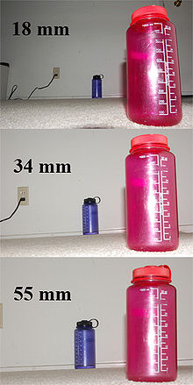
Dolly Zoom or “Vertigo Effect”
http://www.youtube.com/watch?v=NB4bikrNzMk
How is this done?
Zoom in while moving away
http://en.wikipedia.org/wiki/Focal_length

Slide 41
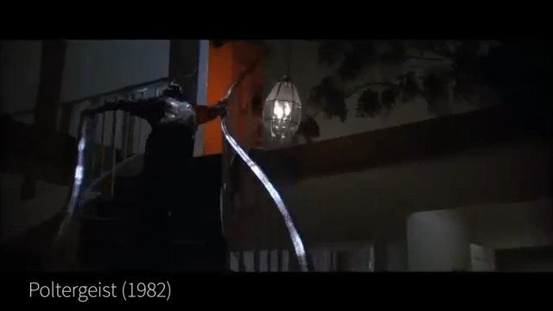

Slide 42
Variables that affect exposure
http://graphics.stanford.edu/courses/cs178-10/applets/exposure.html

Slide 43
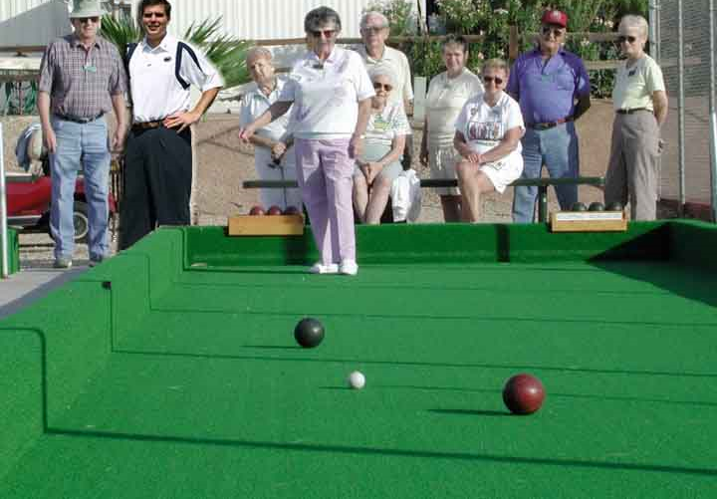
Review
How tall is this woman?
How high is the camera?
What is the camera rotation?
What is the focal length of the camera?
Notes:
Find orthogonal vanishing points
Rotate image so that horizontal axis is in X direction
Draw horizon
Estimate camera height based on the standard size of Bocce balls (107 mm)
Estimate woman’s height based on camera height
Solve for intrinsic parameters and camera rotation from vanishing points

Slide 44
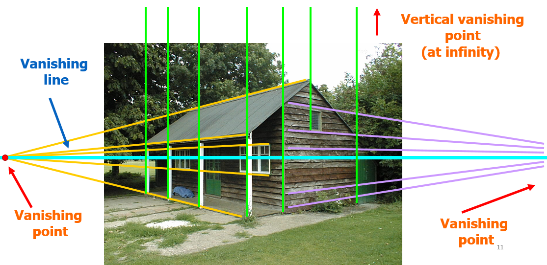
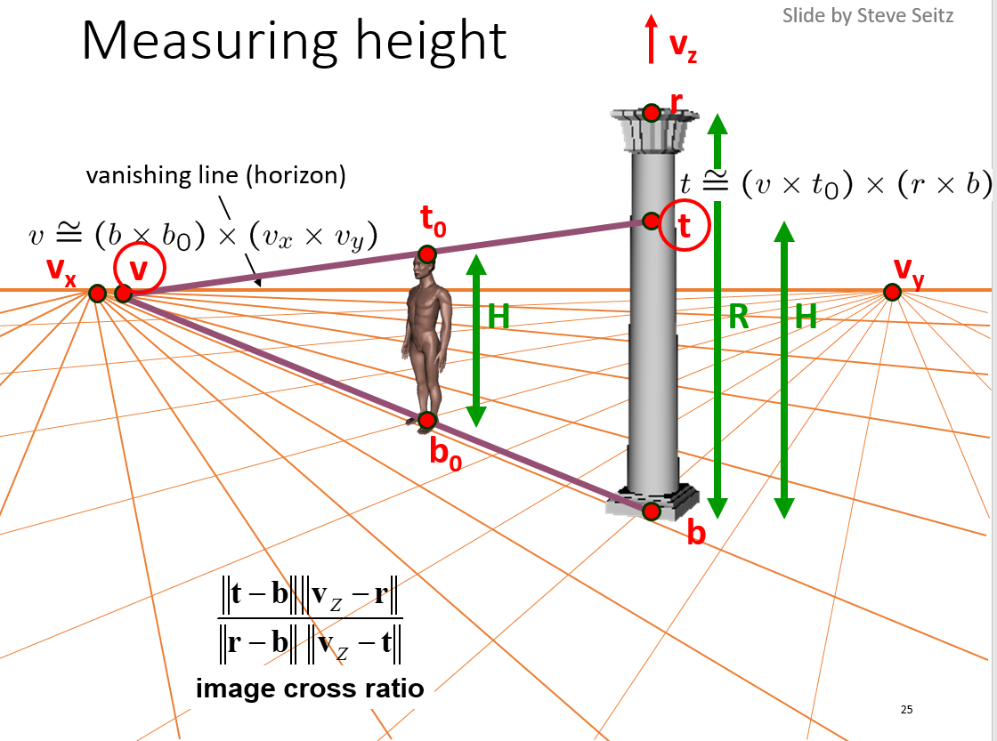

Things to remember
Calibrate the camera?
  Use an object with known geometry
  Use vanishing points
Measure the size of objects in the world from an image?
  Use perspective cues
Camera properties
  focal length,
  field of view,
  depth of field,
  aperture,
  f-number?

Slide 45
Next class
Image stitching
P
Q
Camera Center

