Slide 1
Sequence Prediction Models
Jia-Bin Huang
Virginia Tech
ECE-5424G / CS-5824
Spring 2019

Slide 2
OpenAI Sparse transformer

Slide 3
Google AI assistant

Slide 4
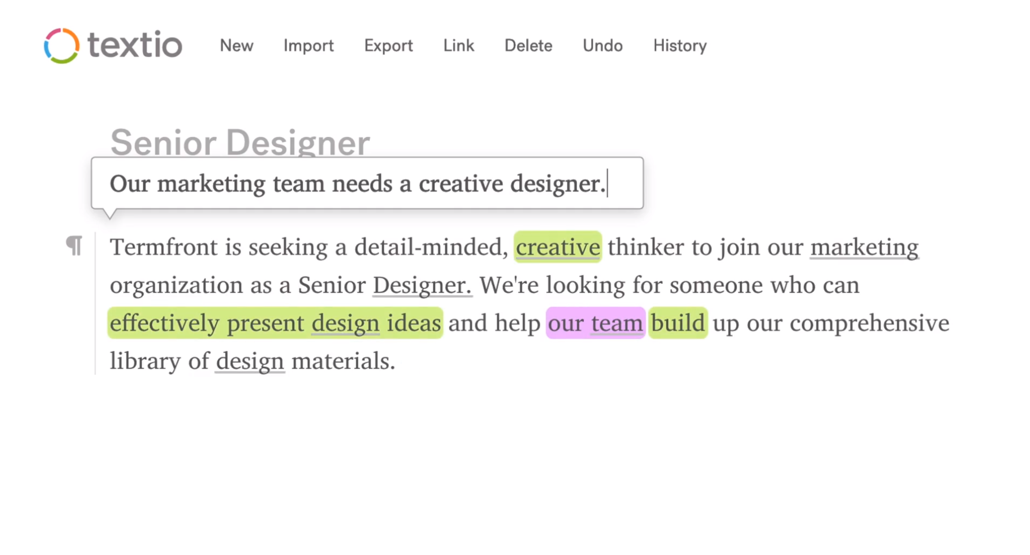
Textio https://textio.com/products/flow/

