Slide 1
Semi-Supervised Learning
Jia-Bin Huang
Virginia Tech
ECE-5424G / CS-5824
Spring 2019

Slide 2
Administrative
HW 4 due April 10

Slide 3
Recommender Systems
Motivation
Problem formulation
Content-based recommendations
Collaborative filtering
Mean normalization

Slide 4
Problem motivation
Movie | Alice (1) | Bob (2) | Carol (3) | Dave (4) | $$x_{1}$$ (romance) | $$x_{2}$$ (action)
Love at last | 5 | 5 | 0 | 0 | 0.9 | 0
Romance forever | 5 | ? | ? | 0 | 1.0 | 0.01
Cute puppies of love | ? | 4 | 0 | ? | 0.99 | 0
Nonstop car chases | 0 | 0 | 5 | 4 | 0.1 | 1.0
Swords vs. karate | 0 | 0 | 5 | ? | 0 | 0.9

Slide 5
Problem motivation
Movie | Alice (1) | Bob (2) | Carol (3) | Dave (4) | $$x_{1}$$ (romance) | $$x_{2}$$ (action)
Love at last | 5 | 5 | 0 | 0 | ? | ?
Romance forever | 5 | ? | ? | 0 | ? | ?
Cute puppies of love | ? | 4 | 0 | ? | ? | ?
Nonstop car chases | 0 | 0 | 5 | 4 | ? | ?
Swords vs. karate | 0 | 0 | 5 | ? | ? | ?
$$θ^{\left(1\right)}=\left[\begin{aligned}0 \\ 5 \\ 0\end{aligned}\right]$$
$$θ^{\left(2\right)}=\left[\begin{aligned}0 \\ 5 \\ 0\end{aligned}\right]$$
$$θ^{\left(3\right)}=\left[\begin{aligned}0 \\ 0 \\ 5\end{aligned}\right]$$
$$θ^{\left(4\right)}=\left[\begin{aligned}0 \\ 0 \\ 5\end{aligned}\right]$$
$$x^{\left(1\right)}=\left[\begin{aligned}? \\ ? \\ ?\end{aligned}\right]$$

Slide 6
Optimization algorithm
Given $θ^{\left(1\right)},θ^{\left(2\right)}, ⋯,θ^{\left(n_{u}\right)}$, to learn $x^{(i)}$:
$$\min_{x^{(i)}}{\frac{1}{2}}\sum_{j:r\left(i,j\right)=1}{{\left({{(θ}^{\left(j\right)})}^{⊤}\left(x^{\left(i\right)}\right)−y^{\left(i,j\right)}\right)}^{2}}+\frac{λ}{2}\sum_{k=1}^{n}{{\left(x_{k}^{(i)}\right)}^{2}}$$
Given $θ^{\left(1\right)},θ^{\left(2\right)}, ⋯,θ^{\left(n_{u}\right)}$, to learn $x^{(1)},x^{(2)}, ⋯,x^{(n_{m})}$:
$$\min_{x^{(1)},x^{(2)}, ⋯,x^{(n_{m})}}{\frac{1}{2}}\sum_{i=1}^{n_{m}}{\sum_{j:r\left(i,j\right)=1}{{\left({{(θ}^{\left(j\right)})}^{⊤}\left(x^{\left(i\right)}\right)−y^{\left(i,j\right)}\right)}^{2}}}+\frac{λ}{2}\sum_{i=1}^{n_{m}}{\sum_{k=1}^{n}{{\left(x_{k}^{(i)}\right)}^{2}}}$$

Slide 7
Collaborative filtering
Given $x^{\left(1\right)},x^{\left(2\right)}, ⋯,x^{\left(n_{m}\right)}$ (and movie ratings),
Can estimate $θ^{\left(1\right)},θ^{\left(2\right)}, ⋯,θ^{\left(n_{u}\right)}$
Given $θ^{\left(1\right)},θ^{\left(2\right)}, ⋯,θ^{\left(n_{u}\right)}$
Can estimate $x^{\left(1\right)},x^{\left(2\right)}, ⋯,x^{\left(n_{m}\right)}$

Slide 8
Collaborative filtering optimization objective
Given $x^{\left(1\right)},x^{\left(2\right)}, ⋯,x^{\left(n_{m}\right)}$, estimate $θ^{\left(1\right)},θ^{\left(2\right)}, ⋯,θ^{\left(n_{u}\right)}$
$$\min_{θ^{\left(1\right)},θ^{\left(2\right)}, ⋯,θ^{\left(n_{u}\right)} } \frac{1}{2}\sum_{j=1}^{n_{u}}{\sum_{i:r\left(i,j\right)=1}{{\left({{(θ}^{\left(j\right)})}^{⊤}\left(x^{\left(i\right)}\right)−y^{\left(i,j\right)}\right)}^{2}}}+\frac{λ}{2}\sum_{j=1}^{n_{u}}{\sum_{k=1}^{n}{{\left(θ_{k}^{\left(j\right)}\right)}^{2}}}$$
Given $θ^{\left(1\right)},θ^{\left(2\right)}, ⋯,θ^{\left(n_{u}\right)}$, estimate $x^{\left(1\right)},x^{\left(2\right)}, ⋯,x^{\left(n_{m}\right)}$
$$\min_{x^{(1)},x^{(2)}, ⋯,x^{(n_{m})}}{\frac{1}{2}}\sum_{i=1}^{n_{m}}{\sum_{j:r\left(i,j\right)=1}{{\left({{(θ}^{\left(j\right)})}^{⊤}\left(x^{\left(i\right)}\right)−y^{\left(i,j\right)}\right)}^{2}}}+\frac{λ}{2}\sum_{i=1}^{n_{m}}{\sum_{k=1}^{n}{{\left(x_{k}^{(i)}\right)}^{2}}}$$

Slide 9
Collaborative filtering optimization objective
Given $x^{\left(1\right)},x^{\left(2\right)}, ⋯,x^{\left(n_{m}\right)}$, estimate $θ^{\left(1\right)},θ^{\left(2\right)}, ⋯,θ^{\left(n_{u}\right)}$
$$\min_{θ^{\left(1\right)},θ^{\left(2\right)}, ⋯,θ^{\left(n_{u}\right)} } \frac{1}{2}\sum_{j=1}^{n_{u}}{\sum_{i:r\left(i,j\right)=1}{{\left({{(θ}^{\left(j\right)})}^{⊤}\left(x^{\left(i\right)}\right)−y^{\left(i,j\right)}\right)}^{2}}}+\frac{λ}{2}\sum_{j=1}^{n_{u}}{\sum_{k=1}^{n}{{\left(θ_{k}^{\left(j\right)}\right)}^{2}}}$$
Given $θ^{\left(1\right)},θ^{\left(2\right)}, ⋯,θ^{\left(n_{u}\right)}$, estimate $x^{\left(1\right)},x^{\left(2\right)}, ⋯,x^{\left(n_{m}\right)}$
$$\min_{x^{(1)},x^{(2)}, ⋯,x^{(n_{m})}}{\frac{1}{2}}\sum_{i=1}^{n_{m}}{\sum_{j:r\left(i,j\right)=1}{{\left({{(θ}^{\left(j\right)})}^{⊤}\left(x^{\left(i\right)}\right)−y^{\left(i,j\right)}\right)}^{2}}}+\frac{λ}{2}\sum_{i=1}^{n_{m}}{\sum_{k=1}^{n}{{\left(x_{k}^{(i)}\right)}^{2}}}$$
Minimize $x^{\left(1\right)},x^{\left(2\right)}, ⋯,x^{\left(n_{m}\right)}$ and $θ^{\left(1\right)},θ^{\left(2\right)}, ⋯,θ^{\left(n_{u}\right)}$ simultaneously
$$J={\frac{1}{2}}\sum_{r\left(i,j\right)=1}{{\left({{(θ}^{\left(j\right)})}^{⊤}\left(x^{\left(i\right)}\right)−y^{\left(i,j\right)}\right)}^{2}}+\frac{λ}{2}\sum_{j=1}^{n_{u}}{\sum_{k=1}^{n}{{\left(θ_{k}^{\left(j\right)}\right)}^{2}}}+ \frac{λ}{2}\sum_{i=1}^{n_{m}}{\sum_{k=1}^{n}{{\left(x_{k}^{(i)}\right)}^{2}}}$$

Slide 10
Collaborative filtering optimization objective
$$J(x^{\left(1\right)},x^{\left(2\right)}, ⋯,x^{\left(n_{m}\right)}\text{,} θ^{\left(1\right)},θ^{\left(2\right)}, ⋯,θ^{\left(n_{u}\right)})={}$$
$$\frac{1}{2}\sum_{r\left(i,j\right)=1}{{\left({{(θ}^{\left(j\right)})}^{⊤}\left(x^{\left(i\right)}\right)−y^{\left(i,j\right)}\right)}^{2}}+\frac{λ}{2}\sum_{j=1}^{n_{u}}{\sum_{k=1}^{n}{{\left(θ_{k}^{\left(j\right)}\right)}^{2}}}+ \frac{λ}{2}\sum_{i=1}^{n_{m}}{\sum_{k=1}^{n}{{\left(x_{k}^{(i)}\right)}^{2}}}$$

Slide 11
Collaborative filtering algorithm
Initialize $x^{\left(1\right)},x^{\left(2\right)}, ⋯,x^{\left(n_{m}\right)}\text{,} θ^{\left(1\right)},θ^{\left(2\right)}, ⋯,θ^{\left(n_{u}\right)}$ to small random values
Minimize $J(x^{\left(1\right)},x^{\left(2\right)}, ⋯,x^{\left(n_{m}\right)}\text{,} θ^{\left(1\right)},θ^{\left(2\right)}, ⋯,θ^{\left(n_{u}\right)})$ using gradient descent (or an advanced optimization algorithm). For every $j=1⋯n_{u}, i=1, ⋯,n_{m}:$
$$x_{k}^{\left(j\right)}≔ x_{k}^{\left(j\right)}−α\left(\sum_{j:r\left(i,j\right)=1}{{(\left(θ^{\left(j\right)}\right)}^{⊤}\left(x^{\left(i\right)}\right)−y^{\left(i,j\right)}) θ_{k}^{\left(i\right)}+λ}x_{k}^{(i)}\right)$$
$$θ_{k}^{\left(j\right)}≔ θ_{k}^{\left(j\right)}−α\left(\sum_{i:r\left(i,j\right)=1}{{(\left(θ^{\left(j\right)}\right)}^{⊤}\left(x^{\left(i\right)}\right)−y^{\left(i,j\right)}) x_{k}^{\left(i\right)}+λ}θ_{k}^{(j)}\right)$$
For a user with parameter $θ$ and movie with (learned) feature $x$, predict a star rating of $θ^{⊤}x$

Slide 12
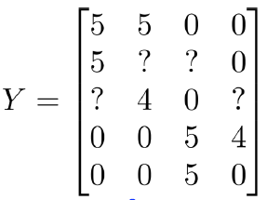
Collaborative filtering
Movie | Alice (1) | Bob (2) | Carol (3) | Dave (4)
Love at last | 5 | 5 | 0 | 0
Romance forever | 5 | ? | ? | 0
Cute puppies of love | ? | 4 | 0 | ?
Nonstop car chases | 0 | 0 | 5 | 4
Swords vs. karate | 0 | 0 | 5 | ?

Slide 13
Collaborative filtering
Predicted ratings:
$$X=\left[\begin{aligned}−{ \left(x^{\left(1\right)}\right)}^{⊤}− \\ −{ \left(x^{\left(2\right)}\right)}^{⊤}− \\ ⋮ \\ −{ \left(x^{\left(n_{m}\right)}\right)}^{⊤}−\end{aligned}\right]$$
$$Θ=\left[\begin{aligned}−{ \left(θ^{\left(1\right)}\right)}^{⊤}− \\ −{ \left(θ^{\left(2\right)}\right)}^{⊤}− \\ ⋮ \\ −{ \left(θ^{\left(n_{u}\right)}\right)}^{⊤}−\end{aligned}\right]$$
$$Y=XΘ^{⊤}$$
Low-rank matrix factorization

Slide 14
Finding related movies/products
For each product $i$, we learn a feature vector $x^{(i)}∈R^{n}$
$x_{1}$: romance, $x_{2}$: action, $x_{3}$: comedy, …
How to find movie $j$ relate to movie $i$?
Small $\left\|x^{(i)}−x^{(j)}\right\|$ movie j and I are “similar”

Slide 15
Recommender Systems
Motivation
Problem formulation
Content-based recommendations
Collaborative filtering
Mean normalization

Slide 16
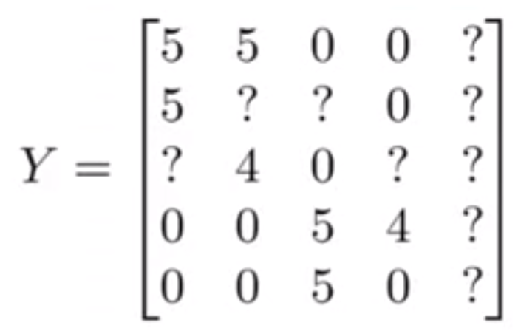
Users who have not rated any movies
Movie | Alice (1) | Bob (2) | Carol (3) | Dave (4) | Eve (5)
Love at last | 5 | 5 | 0 | 0 | ?
Romance forever | 5 | ? | ? | 0 | ?
Cute puppies of love | ? | 4 | 0 | ? | ?
Nonstop car chases | 0 | 0 | 5 | 4 | ?
Swords vs. karate | 0 | 0 | 5 | ? | ?
$$\frac{1}{2}\sum_{r\left(i,j\right)=1}{{\left({{(θ}^{\left(j\right)})}^{⊤}\left(x^{\left(i\right)}\right)−y^{\left(i,j\right)}\right)}^{2}}+\frac{λ}{2}\sum_{j=1}^{n_{u}}{\sum_{k=1}^{n}{{\left(θ_{k}^{\left(j\right)}\right)}^{2}}}+ \frac{λ}{2}\sum_{i=1}^{n_{m}}{\sum_{k=1}^{n}{{\left(x_{k}^{(i)}\right)}^{2}}}$$
$$θ^{(5)}=\left[\begin{aligned}0 \\ 0\end{aligned}\right]$$

Slide 17
Users who have not rated any movies
Movie | Alice (1) | Bob (2) | Carol (3) | Dave (4) | Eve (5)
Love at last | 5 | 5 | 0 | 0 | 0
Romance forever | 5 | ? | ? | 0 | 0
Cute puppies of love | ? | 4 | 0 | ? | 0
Nonstop car chases | 0 | 0 | 5 | 4 | 0
Swords vs. karate | 0 | 0 | 5 | ? | 0
$$\frac{1}{2}\sum_{r\left(i,j\right)=1}{{\left({{(θ}^{\left(j\right)})}^{⊤}\left(x^{\left(i\right)}\right)−y^{\left(i,j\right)}\right)}^{2}}+\frac{λ}{2}\sum_{j=1}^{n_{u}}{\sum_{k=1}^{n}{{\left(θ_{k}^{\left(j\right)}\right)}^{2}}}+ \frac{λ}{2}\sum_{i=1}^{n_{m}}{\sum_{k=1}^{n}{{\left(x_{k}^{(i)}\right)}^{2}}}$$
$$θ^{(5)}=\left[\begin{aligned}0 \\ 0\end{aligned}\right]$$

Slide 18
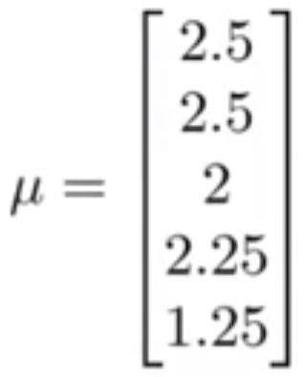
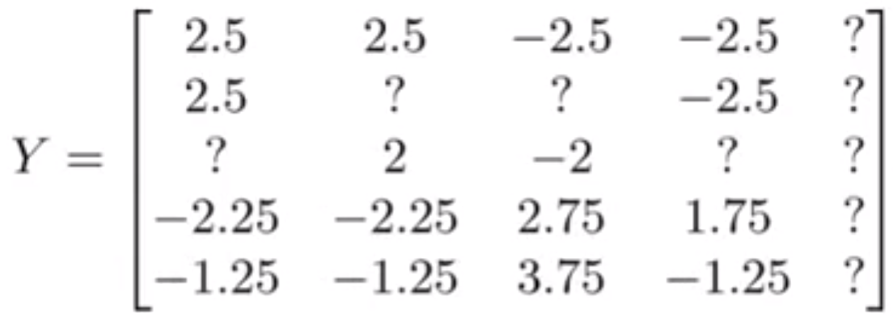
Mean normalization
For user $j$, on movie $i$ predict:
$${\left(θ^{\left(j\right)}\right)}^{⊤}\left(x^{(i)}\right)+μ_{i}$$
User 5 (Eve):
$θ^{\left(5\right)}=\left[\begin{aligned}0 \\ 0\end{aligned}\right]$ ${\left(θ^{\left(5\right)}\right)}^{⊤}\left(x^{(i)}\right)+μ_{i}$
Learn $θ^{(j)}, x^{(i)}$

Slide 19
Recommender Systems
Motivation
Problem formulation
Content-based recommendations
Collaborative filtering
Mean normalization

Slide 20
Review: Supervised Learning
K nearest neighbor
Linear Regression
Naïve Bayes
Logistic Regression
Support Vector Machines
Neural Networks

Slide 21
Review: Unsupervised Learning
Clustering, K-Mean
Expectation maximization
Dimensionality reduction
Anomaly detection
Recommendation system

Slide 22
Advanced Topics
Semi-supervised learning
Probabilistic graphical models
Generative models
Sequence prediction models
Deep reinforcement learning

Slide 23
Semi-supervised Learning
Motivation
Problem formulation
Consistency regularization
Entropy-based method
Pseudo-labeling

Slide 24
Semi-supervised Learning
Motivation
Problem formulation
Consistency regularization
Entropy-based method
Pseudo-labeling

Slide 25
Classic Paradigm Insufficient Nowadays
Modern applications: massive amounts of raw data.
Only a tiny fraction can be annotated by human experts
Protein sequences
Billions of webpages
Images

Slide 26
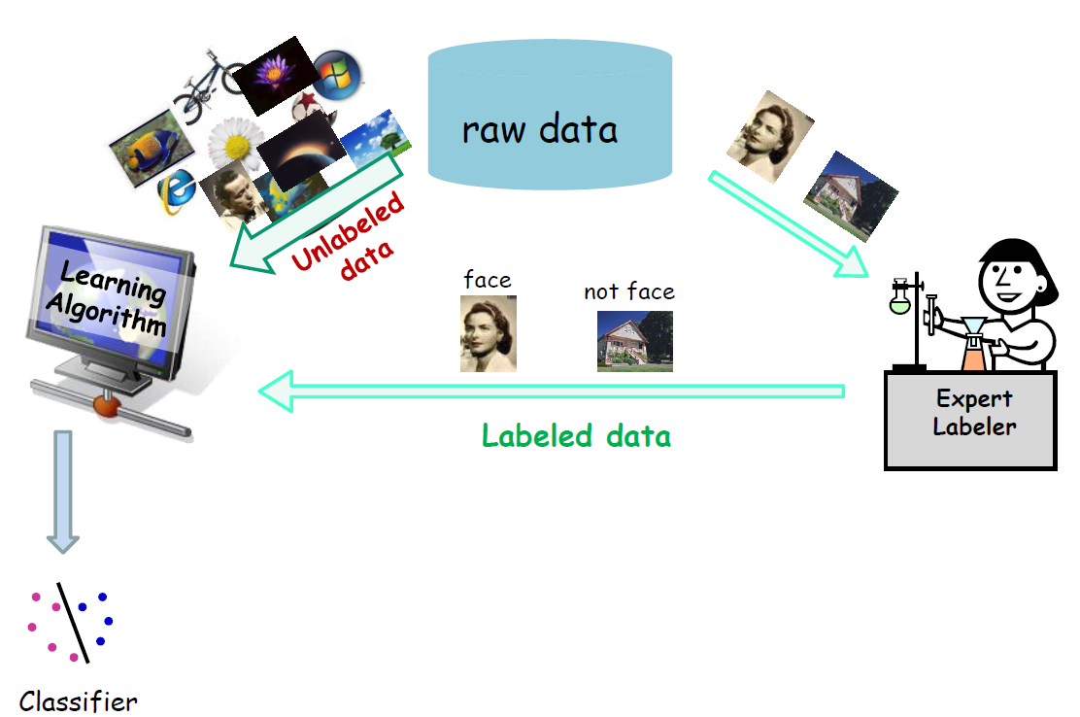
Semi-supervised Learning

Slide 27
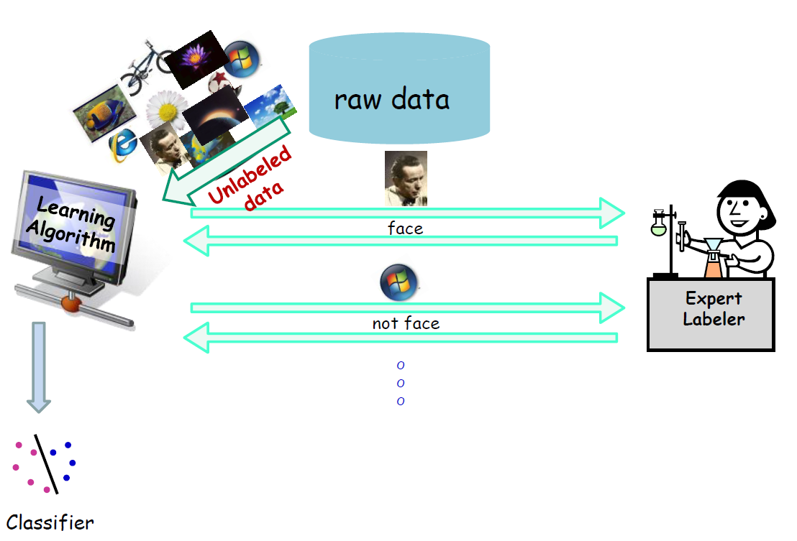
Active Learning

Slide 28
Semi-supervised Learning
Motivation
Problem formulation
Consistency regularization
Entropy-based method
Pseudo-labeling

Slide 29
Semi-supervised Learning Problem Formulation
Labeled data
$$S_{l}=\left\{\left(x^{\left(1\right)}, y^{\left(1\right)}\right),\left(x^{\left(2\right)}, y^{\left(2\right)}\right), ⋯,\left(x^{\left(m_{l}\right)}, y^{\left(m_{l}\right)}\right)\right\}$$
Unlabeled data
$$S_{u}=\left\{\left(x^{\left(1\right)}, y^{\left(1\right)}\right),\left(x^{\left(2\right)}, y^{\left(2\right)}\right), ⋯,\left(x^{\left(m_{u}\right)}, y^{\left(m_{u}\right)}\right)\right\}$$
Goal: Learn a hypothesis $h_{θ}$ (e.g., a classifier) that has small error

Slide 30
Combining labeled and unlabeled data - Classical methods
Transductive SVM [Joachims ’99]
Co-training [Blum and Mitchell ’98]
Graph-based methods [Blum and Chawla ‘01] [Zhu, Ghahramani, Lafferty ‘03]

Slide 31
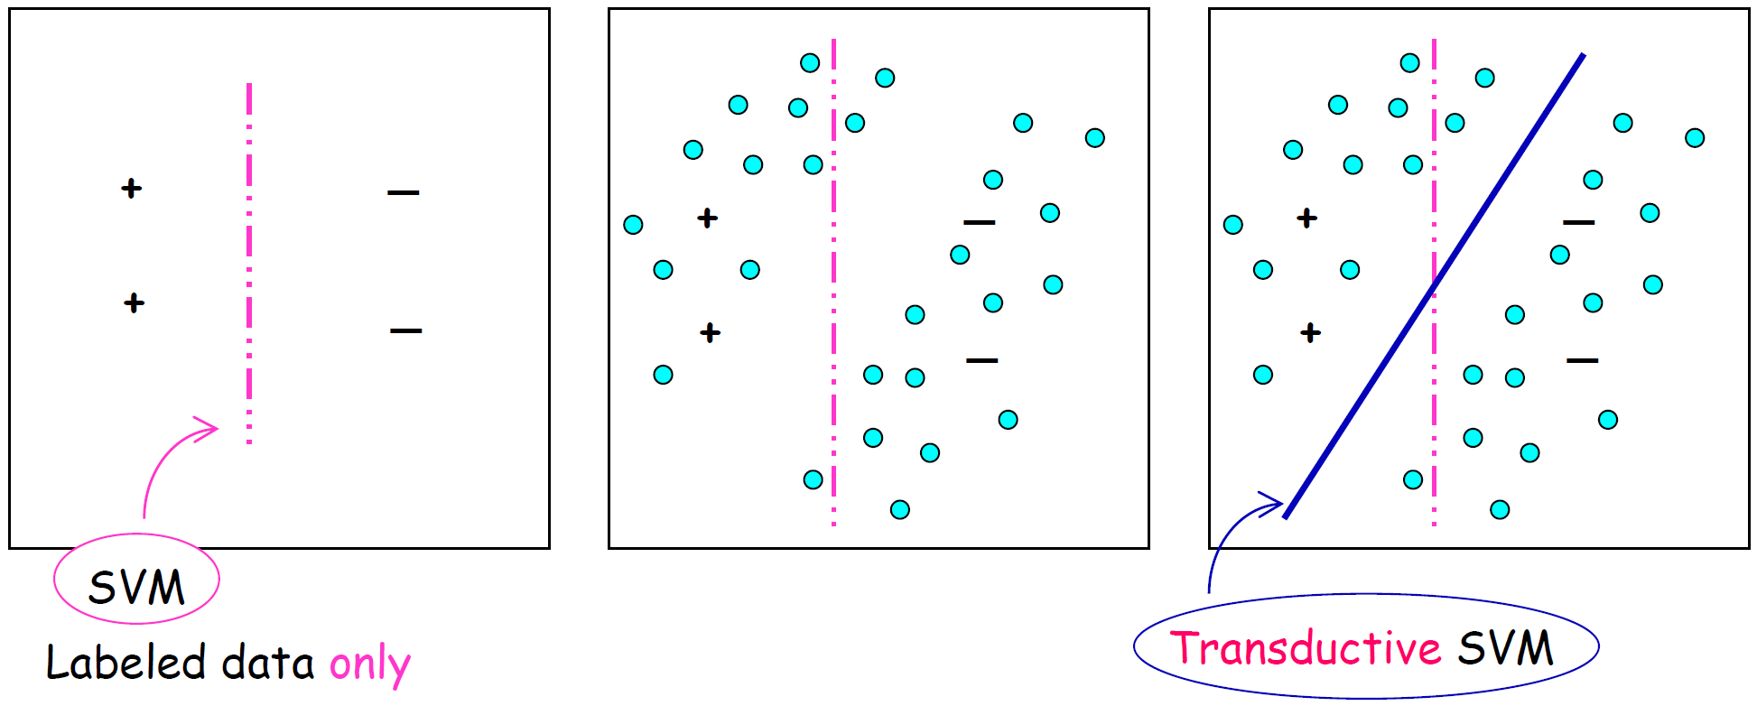
Transductive SVM
The separator goes through low density regions of the space / large margin

Slide 32
SVM
Inputs:
$$\left\{\left(x_{l}^{(i)}, y_{l}^{(i)}\right)\right\}$$
$\min_{θ}$ $\frac{1}{2}\sum_{j=1}^{n}{θ_{j}^{2}}$
$$s.t.{{ y}_{l}^{(i)}θ}^{⊤}x_{l}^{\left(i\right)}≥1$$
Transductive SVM
Inputs:
$$\left\{\left(x_{l}^{(i)}, y_{l}^{(i)}\right)\right\}, \left\{\left(x_{u}^{(i)}, y_{u}^{(i)}\right)\right\}$$
$\min_{θ}$ $\frac{1}{2}\sum_{j=1}^{n}{θ_{j}^{2}}$
$$s.t.{{ y}_{l}^{(i)}θ}^{⊤}x_{l}^{\left(i\right)}≥1$$
$$\hat{y_{u}^{(i)}}θ^{⊤}x^{\left(i\right)}≥1$$
$$\hat{y_{u}^{\left(i\right)}}∈\{−1, 1\}$$

Slide 33
Transductive SVMs
First maximize margin over the labeled points
Use this to give initial labels to unlabeled points based on this separator.
Try flipping labels of unlabeled points to see if doing so can increase margin

Slide 34
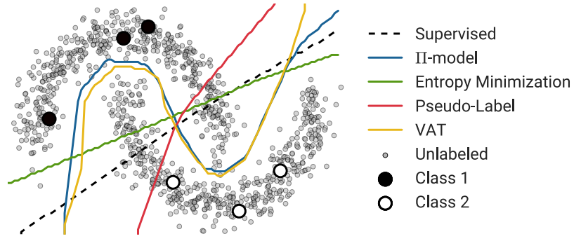
Deep Semi-supervised Learning

Slide 35
Semi-supervised Learning
Motivation
Problem formulation
Consistency regularization
Entropy-based method
Pseudo-labeling

Slide 36
Stochastic Perturbations/Π-Model
Realistic perturbations $x→\hat{x}$of data points $x∈D_{UL}$ should not significantly change the output of $h_{θ}(x)$

Slide 37
Temporal Ensembling

Slide 38
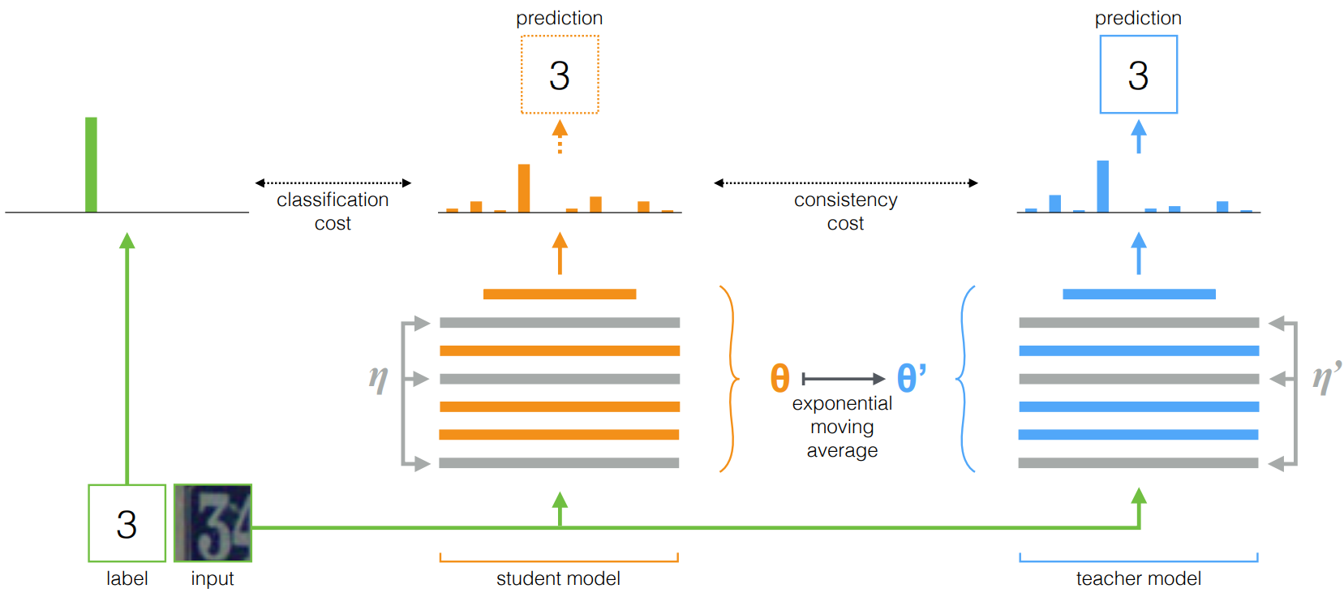
Mean Teacher

Slide 39
Virtual Adversarial Training

Slide 40
Semi-supervised Learning
Motivation
Problem formulation
Consistency regularization
Entropy-based method
Pseudo-labeling

Slide 41
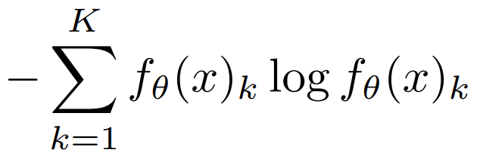
EntMin
Encourages more confident predictions on unlabeled data.

Slide 42
Semi-supervised Learning
Motivation
Problem formulation
Consistency regularization
Entropy-based method
Pseudo-labeling

Slide 43
Comparison

Slide 44
Varying number of labels

Slide 45
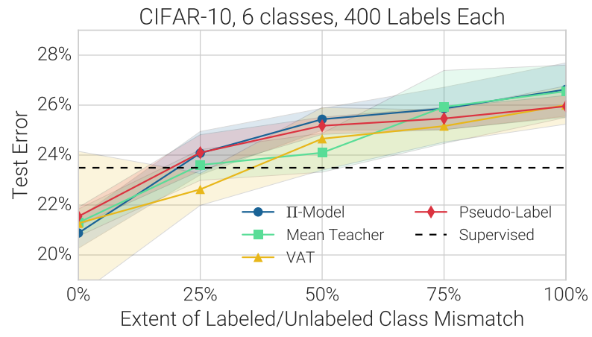
Class mismatch in Labeled/Unlabeled datasets hurts the performance

Slide 46
Lessons
Standardized architecture + equal budget for tuning hyperparameters
Unlabeled data from a different class distribution not that useful
Most methods don’t work well in the very low labeled-data regime
Transferring Pre-Trained Imagenet produces lower error rate
Conclusions based on small datasets though

