Slide 1
Midterm Review
Jia-Bin Huang
Virginia Tech
ECE-5424G / CS-5824
Spring 2019

Slide 2
Administrative
HW 2 due today.
HW 3 release tonight. Due March 25.
Final project
Midterm

Slide 3
HW 3: Multi-Layer Neural Network
1) Forward function of FC and ReLU
2) Backward function of FC and ReLU
3) Loss function (Softmax)
4) Construction of a two-layer network
5) Updating weight by minimizing the loss
6) Construction of a multi-layer network
7) Final prediction and test accuracy

Slide 4
Final project
25% of your final grade
Group: prefer 2-3, but a group of 4 is also acceptable.
Types:
Application project
Algorithmic project
Review and implement a paper

Slide 5
Final project: Example project topics
Defending Against Adversarial Attacks on Facial Recognition Models
Colatron: End-to-end speech synthesis
HitPredict: Predicting Billboard Hits Using Spotify Data
Classifying Adolescent Excessive Alcohol Drinkers from fMRI Data
Pump it or Leave it? A Water Resource Evaluation in Sub-Saharan Africa
Predicting Conference Paper Acceptance
Early Stage Cancer Detector: Identifying Future Lymphoma cases using Genomics Data
Autonomous Computer Vision Based Human-Following Robot
Source: CS229 @ Stanford

Slide 6
Final project breakdown
Final project proposal (10%)
One page: problem statement, approach, data, evaluation
Final project presentation (40%)
Oral or poster presentation. 70% peer-review. 30% instructor/TA/faculty review
Final project report (50%)
NeurlPS conference paper format (in LaTeX)
Up to 8 pages

Slide 7
Midterm logistic
Tuesday, March 6th 2018, 2:30 PM to 3:45 PM
Same lecture classroom
Format: pen and paper
Closed books / laptops/etc.
One paper (two sides) of cheat sheet is allowed.

Slide 8
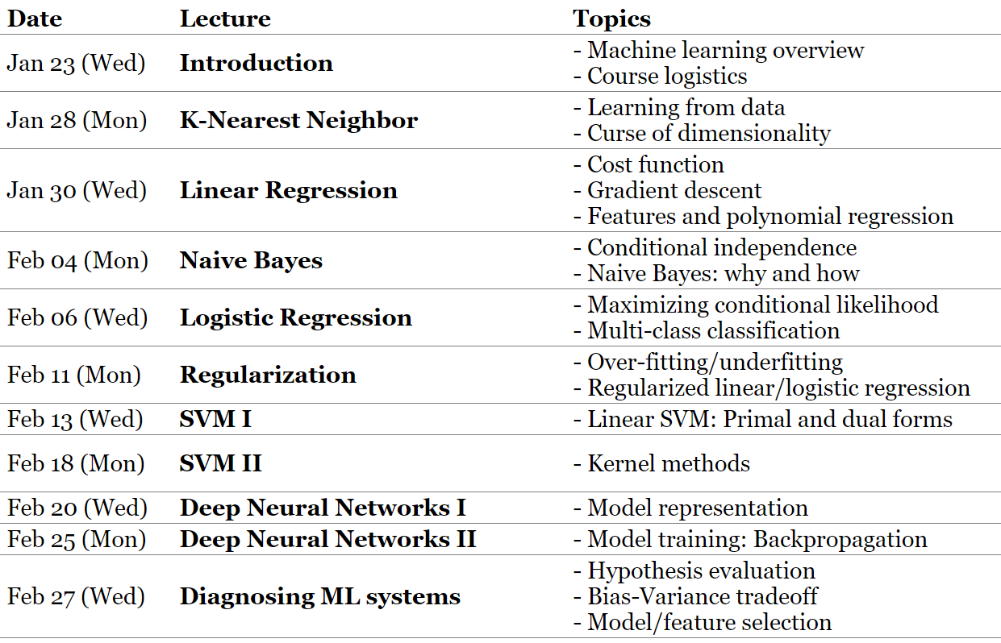
Midterm topics

Slide 9
Sample question (Linear regression)
Consider the following dataset $D$ in one-dimensional space, where $\left\{x^{\left(i\right)},y^{\left(i\right)}\right\}∈R, i∈\{1,2, …, |D|\}$
$$x^{\left(1\right)}=0, { y}^{\left(1\right)}=−1$$
$$x^{\left(2\right)}=1, { y}^{\left(2\right)}= 0$$
$$x^{\left(3\right)}=2, { y}^{\left(3\right)}= 4$$
We optimize the following program
${argmin}_{θ_{0}, θ_{1}} \sum_{\left(x^{\left(i\right)},y^{\left(i\right)}\right)∈D}{{\left(y^{\left(i\right)}−θ_{0}−θ_{1}x^{\left(i\right)}\right)}^{2}}$ (1)
Please find the optimal $θ_{0}^{∗}, θ_{1}^{∗}$ given the dataset above. Show all the work.

Slide 10
Sample question (Naïve Bayes)
F = 1 iff you live in Fox Ridge
S = 1 iff you watched the superbowl last night
D = 1 iff you drive to VT
G = 1 iff you went to gym in the last month
$$P\left(F=1\right)=$$
$$P\left(S=1|F=1\right)=$$
$$P\left(S=1|F=0\right)=$$
$$P\left(D=1|F=1\right)=$$
$$P\left(D=1|F=0\right)=$$
$$P\left(G=1|F=1\right)=$$
$$P\left(G=1|F=0\right)=$$

Slide 11
Sample question (Logistic regression)
Given a dataset of $\{\left(x^{\left(1\right)},y^{\left(1\right)}\right), \left(x^{\left(2\right)},y^{\left(2\right)}\right), ⋯, (x^{\left(m\right)},y^{(m)})\}$, the cost function for logistic regression is
$$J\left(θ\right)=−\frac{1}{m}\left[\sum_{i=1}^{m}{y^{\left(i\right)} log\left(h_{θ}\left(x^{\left(i\right)}\right)\right)+\left(1−y^{\left(i\right)}\right) log\left({1−h}_{θ}\left(x^{\left(i\right)}\right)\right)}\right],$$
where the hypothesis $h_{θ}\left(x\right)=\frac{1}{1+\exp{(−θ^{⊤}x)}}$
Questions:
- gradient of $J\left(θ\right), h_{θ}\left(x\right),$gradient decent rule, gradient with a different loss function

Slide 12
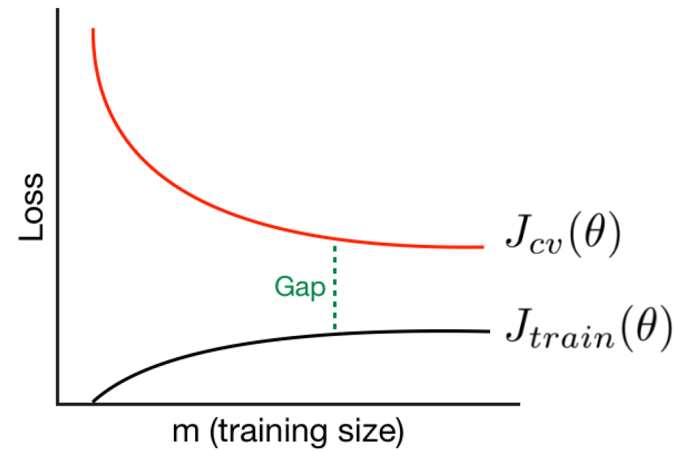
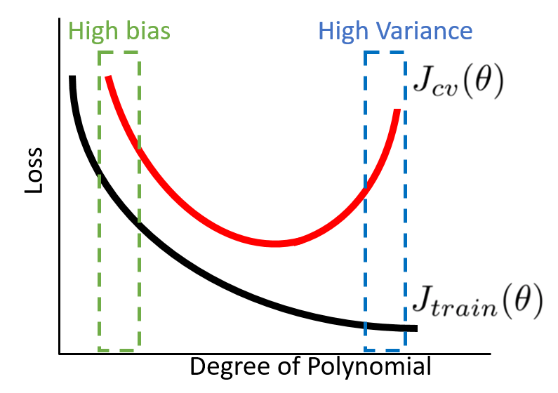
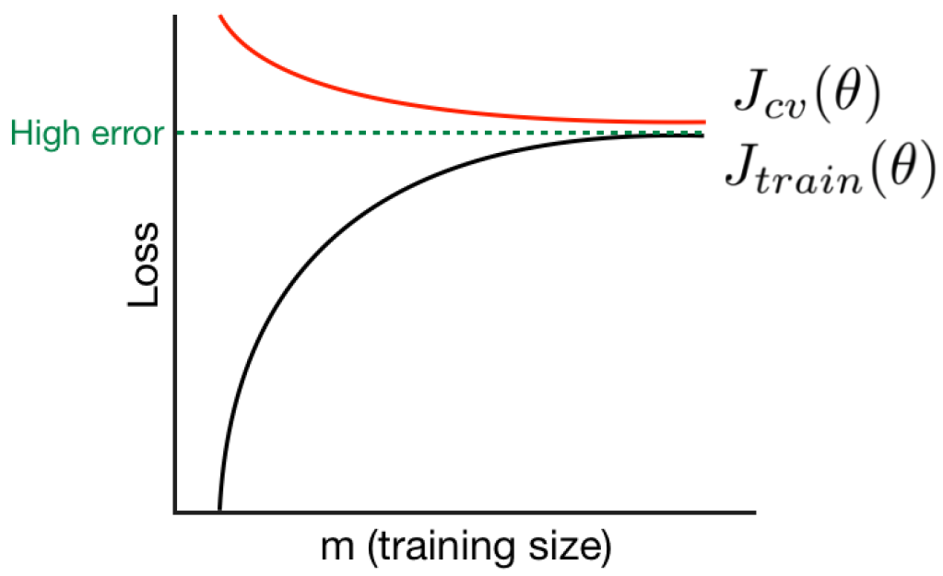
Sample question (Regularization and bias/variance)

Slide 13
Sample question (SVM)
$$x_{2}$$
margin
$$x_{1}$$

Slide 14
Sample question (Neural networks)
Conceptual multi-choice questions
Weight, bias, pre-activation, activation, output
Initialization, gradient descent
Simple back-propagation

Slide 15
How to prepare?
Go over “Things to remember” and make sure that you understand those concepts
Review class materials
Get a good night sleep

Slide 16
k-NN (Classification/Regression)
Model
$$\left(x^{\left(1\right)},y^{\left(1\right)}\right), \left(x^{\left(2\right)},y^{\left(2\right)}\right), ⋯,\left(x^{\left(m\right)},y^{\left(m\right)}\right)$$
Cost function
None
Learning
Do nothing
Inference
$\hat{y}=h\left(x^{test}\right)=y^{(k)}$, where $k={argmin}_{i} D(x^{test}, x^{(i)})$

Slide 17
Know Your Models: kNN Classification / Regression
The Model:
Classification: Find nearest neighbors by distance metric and let them vote.
Regression: Find nearest neighbors by distance metric and average them.
Weighted Variants:
Apply weights to neighbors based on distance (weighted voting/average)
Kernel Regression / Classification
Set k to n and weight based on distance
Smoother than basic k-NN!
Problems with k-NN
Curse of dimensionality: distances in high d not very meaningful
Irrelevant features make distance != similarity and degrade performance
Slow NN search: Must remember (very large) dataset for prediction

Slide 18
Linear regression (Regression)
Model
$$h_{θ}\left(x\right)=θ_{0}+θ_{1}x_{1}+θ_{2}x_{2}+…+θ_{n}x_{n}=θ^{⊤}x$$
Cost function
$$J\left(θ\right)=\frac{1}{2m}\sum_{i=1}^{m}{{\left(h_{θ}\left(x^{\left(i\right)}\right)−y^{\left(i\right)}\right)}^{2}}$$
Learning
1) Gradient descent: Repeat {$θ_{j} ≔θ_{j}−α\frac{1}{m}\sum_{i=1}^{m}{\left(h_{θ}\left(x^{\left(i\right)}\right)−y^{\left(i\right)}\right)}x_{j}^{\left(i\right)}$}
2) Solving normal equation $θ={(X^{⊤}X)}^{−1}X^{⊤}y$
Inference
$$\hat{y}=h_{θ}\left(x^{test}\right)=θ^{⊤}x^{test}$$

Slide 19
Know Your Models: Naïve Bayes Classifier
Generative Model $P\left(X \right|Y) P(Y)$:
Optimal Bayes Classifier predicts ${argmax}_{y} P\left(X \right|Y=y) P(Y=y)$
Naive Bayes assume $P\left(X \right| Y)=\prod{P\left(X_{i}\right| Y) }$i.e. features are conditionally independent in order to make learning $P\left(X \right| Y)$ tractable.
Learning model amounts to statistical estimation of $P\left(X_{i}\right| Y)′s$and $P(Y)$
Many Variants Depending on Choice of Distributions:
Pick a distribution for each $P\left(X_{i} \right| Y=y)$ (Categorical, Normal, etc.)
Categorical distribution on $P(Y)$
Problems with Naïve Bayes Classifiers
Learning can leave 0 probability entries – solution is to add priors!
Be careful of numerical underflow – try using log space in practice!
Correlated features that violate assumption push outputs to extremes
A notable usage: Bag of Words model
Gaussian Naïve Bayes with class-independent variances representationally equivalent to Logistic Regression - Solution differs because of objective function

Slide 20
Naïve Bayes (Classification)
Model
$$h_{θ}\left(x\right)=P(Y|X_{1},X_{2}, ⋯, X_{n})∝P\left(Y\right)Π_{i}P\left(X_{i}\right|Y)$$
Cost function
Maximum likelihood estimation: $J\left(θ\right)=−\log{P\left(Data | θ\right)}$
Maximum a posteriori estimation :$J\left(θ\right)=−\log{P\left(Data | θ\right)P\left(θ\right)}$
Learning
$π_{k}=P(Y=y_{k})$
(Discrete $X_{i}$) $θ_{ijk}=P(X_{i}=x_{ijk}|Y=y_{k})$
(Continuous $X_{i}$) mean $μ_{ik}$, variance $σ_{ik}^{2}$, $P\left(X_{i}\right|Y=y_{k})=𝒩(X_{i}|μ_{ik},σ_{ik}^{2})$
Inference
$$\hat{Y}←\underset{y_{k}}{argmax}{P\left(Y=y_{k}\right)Π_{i}P\left(X_{i}^{test}\right|Y=y_{k})}$$

Slide 21
Know Your Models: Logistic Regression Classifier
Discriminative Model $P\left(Y \right|X)$:
Assume $P\left(Y \right|X=x)=\frac{1}{1+e^{−θ^{T}x}}$ ← sigmoid/logistic function
Learns a linear decision boundary (i.e. hyperplane in higher d)
Other Variants:
Can put priors on weights w just like in ridge regression
Problems with Logistic Regression
No closed form solution. Training requires optimization, but likelihood is concave so there is a single maximum.
Can only do linear fits…. Oh wait! Can use same trick as generalized linear regression and do linear fits on non-linear data transforms!

Slide 22
Logistic regression (Classification)
Model
$h_{θ}\left(x\right)=P\left(Y=1 | X_{1},X_{2}, ⋯, X_{n}\right)=\frac{1}{1+e^{−θ^{⊤}x}}$
Cost function
$$J\left(θ\right)=\frac{1}{m}\sum_{i=1}^{m}{Cost(h_{θ}(x^{\left(i\right)}),y^{(i)}))} Cost(h_{θ}\left(x\right),y)=\left\{\begin{aligned}−log\left(h_{θ}\left(x\right)\right) if y=1 \\ −log\left({1−h}_{θ}\left(x\right)\right) if y=0\end{aligned}\right.$$
Learning
Gradient descent: Repeat {$θ_{j} ≔θ_{j}−α\frac{1}{m}\sum_{i=1}^{m}{\left(h_{θ}\left(x^{\left(i\right)}\right)−y^{\left(i\right)}\right)}x_{j}^{\left(i\right)}$}
Inference
$$\hat{Y}=h_{θ}\left(x^{test}\right)=\frac{1}{1+e^{−θ^{⊤}x^{test}}}$$

Slide 23
Practice: What classifier(s) for this data? Why?
x₁
x₂

Slide 24
Practice: What classifier for this data? Why?
x₁
x₂

Slide 25
Know: Difference between MLE and MAP
Maximum Likelihood Estimate (MLE) Choose $θ$ that maximizes probability of observed data
$${\hat{θ}}^{MLE}=arg\max_{θ}{P(Data|θ)}$$
Maximum a posteriori estimation (MAP) Choose $θ$ that is most probable given prior probability and data
$${\hat{θ}}^{MAP}=arg\max_{θ}{P\left(θ | D\right)= } arg\max_{θ}{\frac{P\left(Data | θ\right)P\left(θ\right)}{P(Data)} }$$

Slide 26
Skills: Be Able to Compare and Contrast Classifiers
K Nearest Neighbors
Assumption: f(x) is locally constant
Training: N/A
Testing: Majority (or weighted) vote of k nearest neighbors
Logistic Regression
Assumption: P(Y|X=x_{i}) = sigmoid( w^{T}x_{i})
Training: SGD based
Test: Plug x into learned P(Y | X) and take argmax over Y
Naïve Bayes
Assumption: P(X₁,..,X_{j} | Y) = P(X₁ | Y)*…* P(X_{j} | Y)
Training: Statistical Estimation of P(X | Y) and P(Y)
Test: Plug x into P(X | Y) and find argmax P(X | Y)P(Y)

Slide 27
Know: Learning Curves

Slide 28
Know: Underfitting & Overfitting
Plot error through training (for models without closed form solutions
More data helps avoid overfitting as do regularizers
Underfitting
Overfitting
Validation Error
Error
Train Error
Training Iters

Slide 29
Know: Train/Val/Test and Cross Validation
Train – used to learn model parameters
Validation – used to tune hyper-parameters of model
Test – used to estimate expected error

Slide 30
Know: SVM, large-margin, soft-margin, kernel
$$x_{2}$$
margin
$$x_{1}$$

Slide 31
Know: Neural networks
Model representation input, hidden layer, pre-activation, activation ReLU, Sigmoid, Softmax Parameters: weight, bias
Model Learning gradient descent, back-propagation, initialization
$${ x}_{0}$$
$${ a}_{0}^{(2)}$$
$${ x}_{1}$$
$${ a}_{1}^{(2)}$$
$${ x}_{2}$$
$${ a}_{2}^{(2)}$$
$$h_{Θ}\left(x\right)$$
$${ x}_{3}$$
$${ a}_{3}^{(2)}$$

