Slide 1
Diagnosing ML System
Shih-Yang Su
Virginia Tech
ECE-5424G / CS-5824
Spring 2019

Slide 2
Today's Lectures
How to fix your learning algorithm
Basically ZERO MATH

Slide 3
Debugging a learning algorithm
You have built you awesome linear regression model predicting price
Work perfectly on you testing data
Source: Andrew Ng

Slide 4
Debugging a learning algorithm
You have built you awesome linear regression model predicting price
Work perfectly on you testing data
Then it fails miserably when you test it on the new data you collected
Source: Andrew Ng

Slide 5
Debugging a learning algorithm
You have built you awesome linear regression model predicting price
Work perfectly on you testing data
Then it fails miserably when you test it on the new data you collected
What to do now?
Source: Andrew Ng

Slide 6
Things You Can Try
Get more data
Try different features
Try tuning your hyperparameter

Slide 7
Things You Can Try
Get more data
Try different features
Try tuning your hyperparameter
But which should I try first?

Slide 8
Diagnosing Machine Learning System
Figure out what is wrong first
Diagnosing your system takes time, but it can save your time as well
Ultimate goal: low generalization error

Slide 9
Diagnosing Machine Learning System
Figure out what is wrong first
Diagnosing your system takes time, but it can save your time as well
Ultimate goal: low generalization error
Source: reddit?

Slide 10
Diagnosing Machine Learning System
Figure out what is wrong first
Diagnosing your system takes time, but it can save your time as well
Ultimate goal: low generalization error
Source: reddit?

Slide 11
Problem: Fail to Generalize
Model does not generalize to unseen data
Fail to predict things that are not in training sample
Pick a model that has lower generalization error

Slide 12
Evaluate Your Hypothesis
Price ($)
Price ($)
Price ($)
Size (ft)
Size (ft)
Size (ft)
Source: Andrew Ng

Slide 13
Evaluate Your Hypothesis
Price ($)
Price ($)
Price ($)
Size (ft)
Size (ft)
Size (ft)
Underfit
Just right
Overfit
Source: Andrew Ng

Slide 14
Evaluate Your Hypothesis
Price ($)
Price ($)
Price ($)
Size (ft)
Size (ft)
Size (ft)
Underfit
Just right
Overfit
What if the feature dimension is too high?
Source: Andrew Ng

Slide 15
Model Selection
Model does not generalize to unseen data
Fail to predict things that are not in training sample
Pick a model that has lower generalization error

Slide 16
Model Selection
Model does not generalize to unseen data
Fail to predict things that are not in training sample
Pick a model that has lower generalization error
How to evaluate generalization error?

Slide 17
Model Selection
Model does not generalize to unseen data
Fail to predict things that are not in training sample
Pick a model that has lower generalization error
How to evaluate generalization error?
Split your data into train, validation, and test set.
Use test set error as an estimator of generalization error

Slide 18
Model Selection
Training error
Validation error
Test error

Slide 19
Model Selection
Training error
Validation error
Test error
Procedure:
Step 1. Train on training set
Step 2. Evaluate validation error
Step 3. Pick the best model based on Step 2.
Step 4. Evaluate the test error

Slide 20
Bias/Variance Trade-off
Price ($)
Price ($)
Price ($)
Size (ft)
Size (ft)
Size (ft)
Underfit
Overfit
Just right
Source: Andrew Ng

Slide 21
Bias/Variance Trade-off
Price ($)
Price ($)
Price ($)
Size (ft)
Size (ft)
Size (ft)
Underfit
High bias
Overfit
High Variance
Just right
Source: Andrew Ng

Slide 22
Bias/Variance Trade-off
Price ($)
Price ($)
Price ($)
Size (ft)
Size (ft)
Size (ft)
Underfit
High bias
Too simple
Overfit
High Variance
Too Complex
Just right
Source: Andrew Ng

Slide 23
Linear Regression with Regularization
Price ($)
Price ($)
Price ($)
Size (ft)
Size (ft)
Size (ft)
Underfit
High bias
Too simple
Too much regularization
Overfit
High Variance
Too Complex
Too little regularization
Just right
Source: Andrew Ng

Slide 24
Bias / Variance Trade-off
Training error
Cross-validation error
Loss
Degree of Polynomial
Source: Andrew Ng

Slide 25
Bias / Variance Trade-off
Training error
Cross-validation error
High bias
High Variance
Loss
Degree of Polynomial

Slide 26
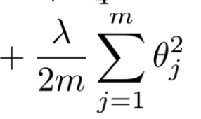
Bias / Variance Trade-off with Regularization
Training error
Cross-validation error
Loss
λ
Source: Andrew Ng

Slide 27
Bias / Variance Trade-off with Regularization
Training error
Cross-validation error
High Variance
High bias
Loss
λ
Source: Andrew Ng

Slide 28
Problem: Fail to Generalize
Should we get more data?

Slide 29
Problem: Fail to Generalize
Should we get more data?
Getting more data does not always help

Slide 30
Problem: Fail to Generalize
Should we get more data?
Getting more data does not always help
How do we know if we should collect more data?

Slide 31
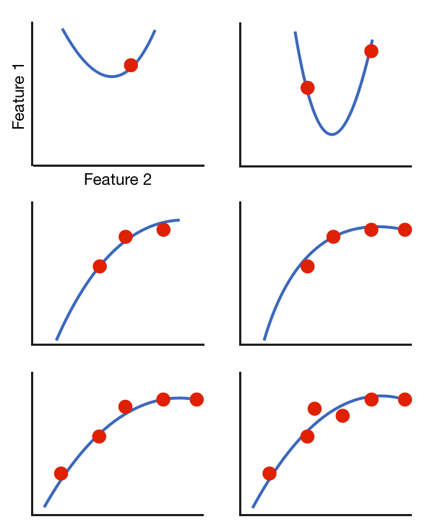
Learning Curve
m=1
m=2
m=3
m=4
m=5
m=6

Slide 32
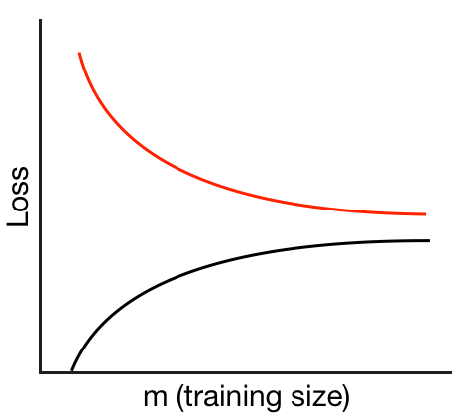
Learning Curve
m=1
m=2
m=3
m=4
m=5
m=6

Slide 33
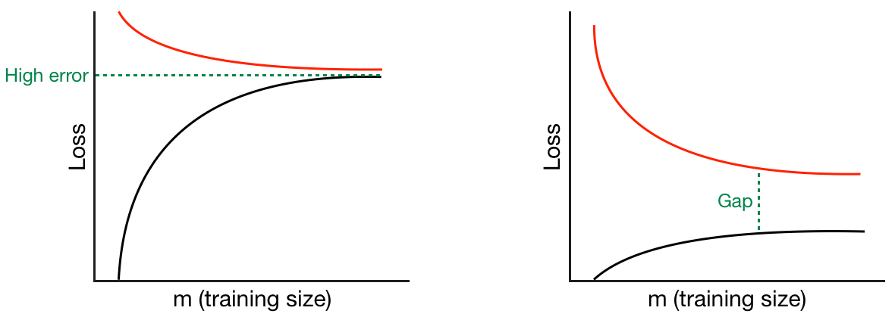
Learning Curve

Slide 34
Learning Curve
Underfit
High bias
Overfit
High Variance

Slide 35
Learning Curve
Does adding more data help?
Price ($)
Size (ft)
Underfit
High bias

Slide 36
Learning Curve
Does adding more data help?
Price ($)
Size (ft)
Underfit
High bias

Slide 37
Learning Curve
Does adding more data help?
Price ($)
Size (ft)
Underfit
High bias

Slide 38
Learning Curve
Does adding more data help?
Price ($)
Price ($)
Size (ft)
Size (ft)
More data doesn't help when your model has high bias

Slide 39
Learning Curve
Does adding more data help?
Price ($)
Size (ft)
Overfit
High Variance

Slide 40
Learning Curve
Does adding more data help?
Price ($)
Size (ft)
Overfit
High Variance

Slide 41
Learning Curve
Does adding more data help?
Price ($)
Price ($)
Size (ft)
Size (ft)
More data is likely to help when your model has high variance

Slide 42
Things You Can Try
Get more data
When you have high variance
Try different features
Adding feature helps fix high bias
Using smaller sets of feature fix high variance
Try tuning your hyperparameter
Decrease regularization when bias is high
Increase regularization when variance is high

Slide 43
Things You Can Try
Get more data
When you have high variance
Try different features
Adding feature helps fix high bias
Using smaller sets of feature fix high variance
Try tuning your hyperparameter
Decrease regularization when bias is high
Increase regularization when variance is high
Analyze your model before you act

