Slide 1
Naïve Bayes
Jia-Bin Huang
Virginia Tech
ECE-5424G / CS-5824
Spring 2019

Slide 2
Administrative
HW 1 out today. Please start early!
Office hours
  Chen: Wed 4pm-5pm
  Shih-Yang: Fri 3pm-4pm
  Location: Whittemore 266

Slide 3
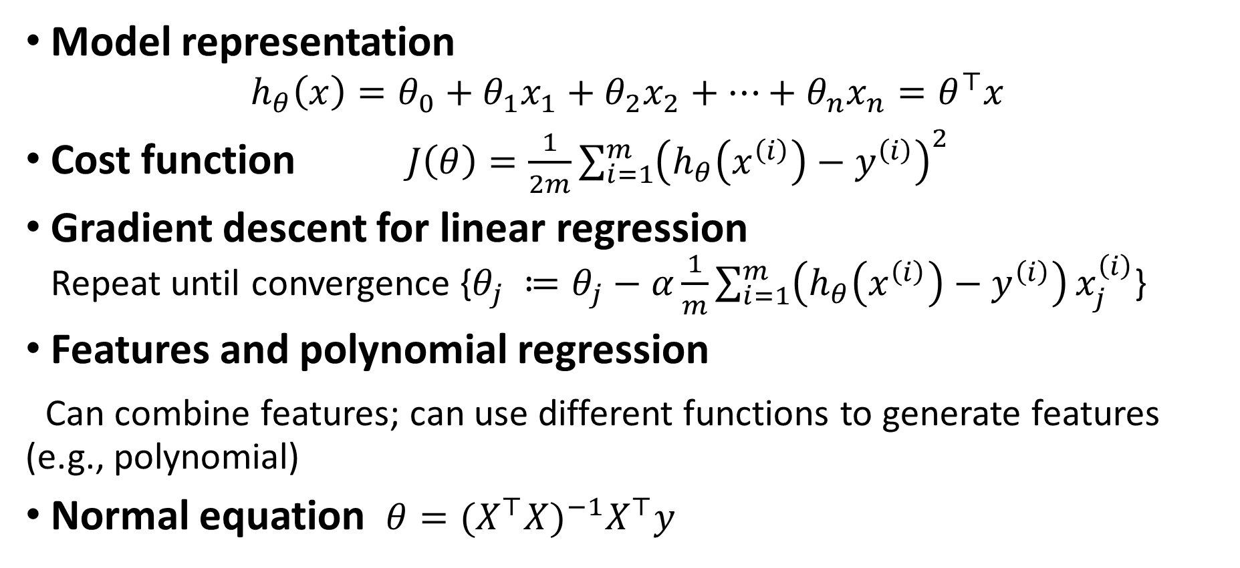
Linear Regression
Model representation
$$h_{θ}\left(x\right)=θ_{0}+θ_{1}x_{1}+θ_{2}x_{2}+…+θ_{n}x_{n}=θ^{⊤}x$$
Cost function $J\left(θ\right)=\frac{1}{2m}\sum_{i=1}^{m}{{\left(h_{θ}\left(x^{\left(i\right)}\right)−y^{\left(i\right)}\right)}^{2}}$
Gradient descent for linear regression
Repeat until convergence {$θ_{j} ≔θ_{j}−α\frac{1}{m}\sum_{i=1}^{m}{\left(h_{θ}\left(x^{\left(i\right)}\right)−y^{\left(i\right)}\right)}x_{j}^{\left(i\right)}$}
Features and polynomial regression
Can combine features; can use different functions to generate features (e.g., polynomial)
Normal equation $θ={(X^{⊤}X)}^{−1}X^{⊤}y$

Slide 4
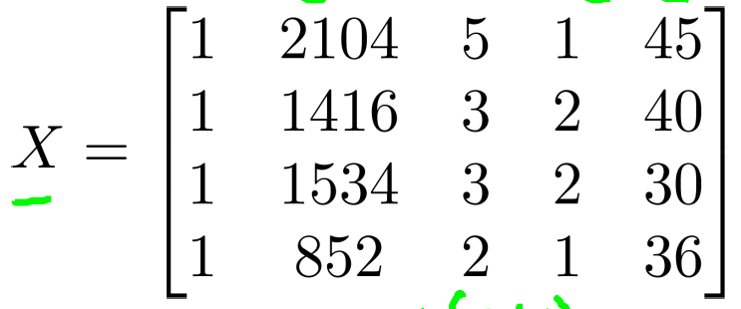
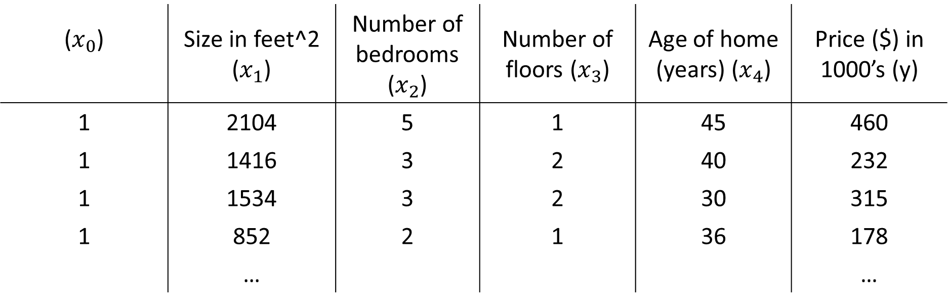
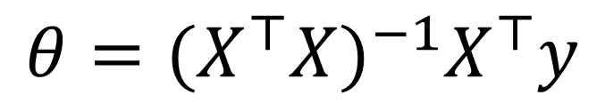

($x_{0}$) | Size in feet^2 ($x_{1}$) | Number of bedrooms ($x_{2}$) | Number of floors ($x_{3}$) | Age of home (years) ($x_{4}$) | Price ($) in 1000’s (y)
1 | 2104 | 5 | 1 | 45 | 460
1 | 1416 | 3 | 2 | 40 | 232
1 | 1534 | 3 | 2 | 30 | 315
1 | 852 | 2 | 1 | 36 | 178
 | … |  |  |  | …
$$y=\left[\begin{aligned}460 \\ 232 \\ 315 \\ 178\end{aligned}\right]$$
$$θ={(X^{⊤}X)}^{−1}X^{⊤}y$$

Slide 5
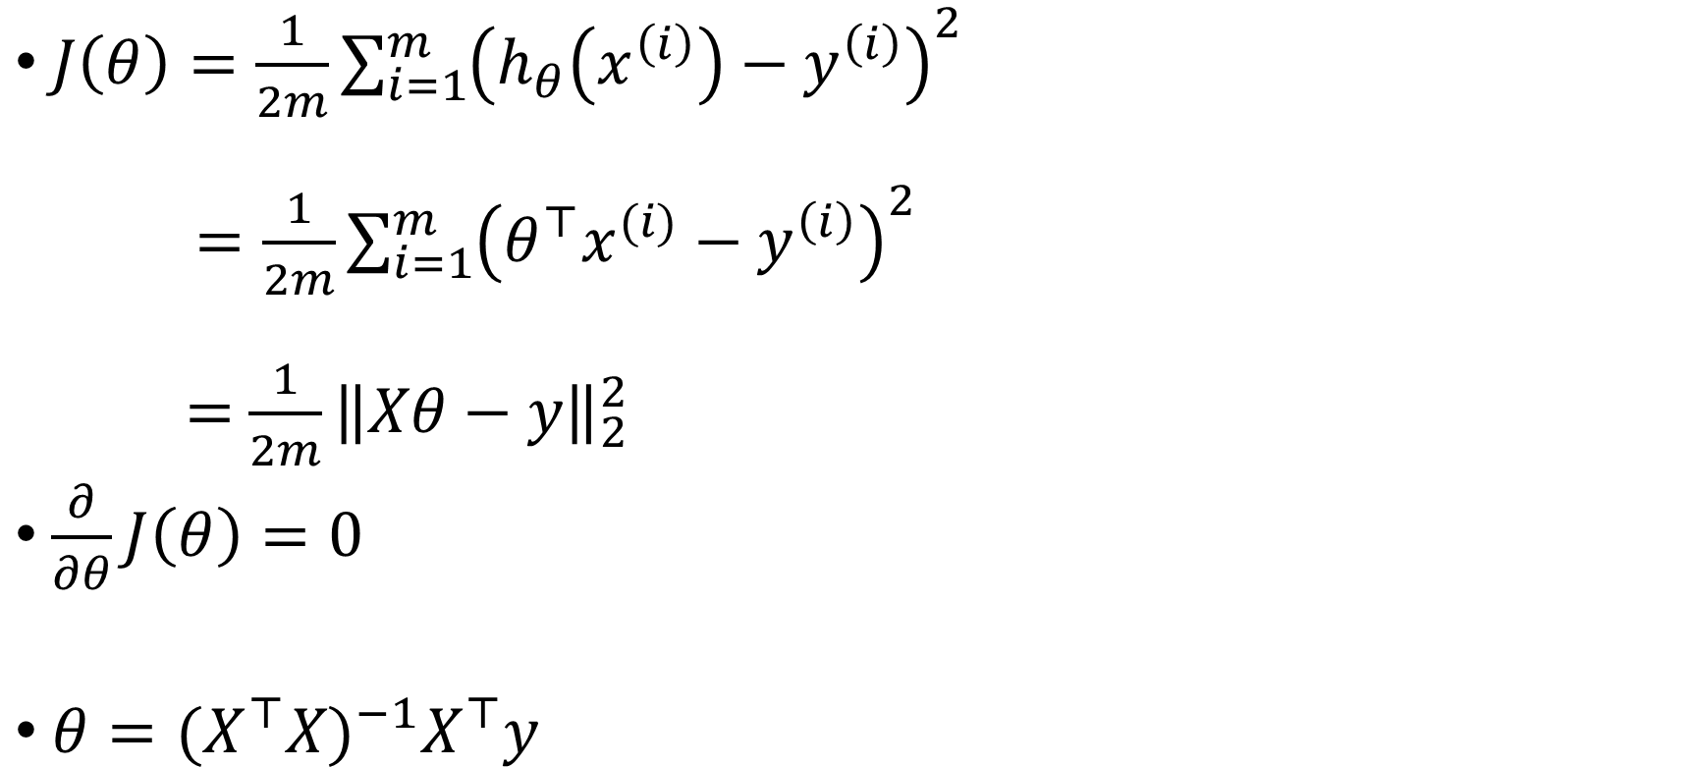
Least square solution
$J\left(θ\right)=\frac{1}{2m}\sum_{i=1}^{m}{{\left(h_{θ}\left(x^{\left(i\right)}\right)−y^{\left(i\right)}\right)}^{2}}$
$=\frac{1}{2m}\sum_{i=1}^{m}{{\left(θ^{⊤}x^{(i)}−y^{\left(i\right)}\right)}^{2}}$
$=$ $\frac{1}{2m}{\left\|Xθ−y\right\|}_{2}^{2}$
$\frac{∂}{∂θ}J\left(θ\right)=0$
$θ={(X^{⊤}X)}^{−1}X^{⊤}y$

Slide 6

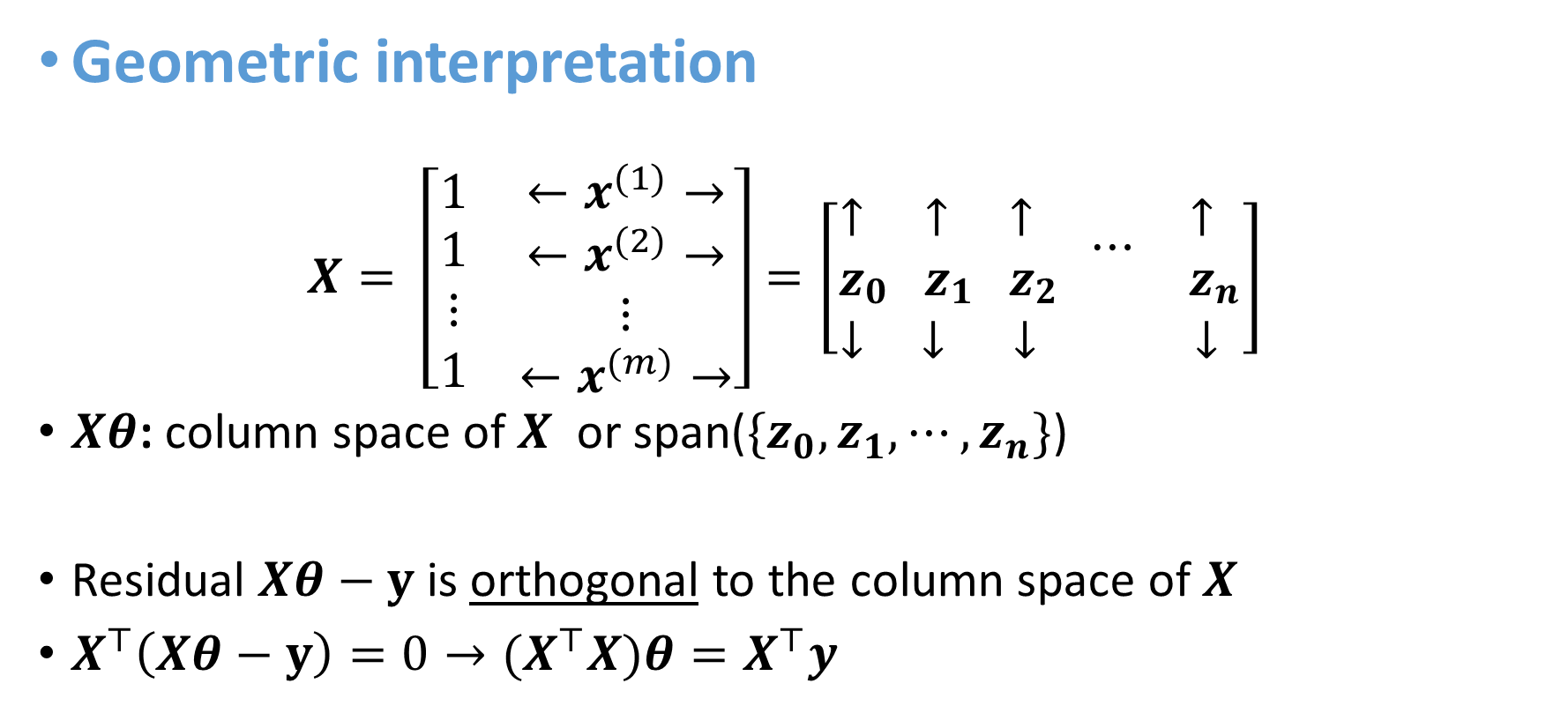


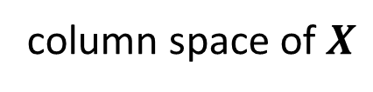
Justification/interpretation 1
$$y$$
$$Xθ−y$$
Geometric interpretation
$$X= \left[\begin{matrix}1 & ←x^{(1)}→ \\ \begin{aligned}1 \\ ⋮ \\ 1\end{aligned} & \begin{aligned}←x^{(2)}→ \\ ⋮ \\ ←x^{(m)}→\end{aligned}\end{matrix}\right]=\left[\begin{aligned}{\begin{aligned}↑ \\ z\end{aligned}}_{0} {\begin{aligned}↑ \\ z\end{aligned}}_{1} {\begin{aligned}↑ \\ z\end{aligned}}_{2} ⋯ {\begin{aligned}↑ \\ z\end{aligned}}_{n} \\ ↓ ↓ ↓ ↓ \end{aligned}\right]$$
$Xθ$: column space of $X$ or span($\{z_{0}, z_{1}, ⋯, z_{n}\}$)
Residual $Xθ−y$ is orthogonal to the column space of $X$
$X^{⊤}\left(Xθ−y\right)=0→{(X}^{⊤}X)θ=X^{⊤}y$
$$Xθ$$
column space of $X$

Slide 7
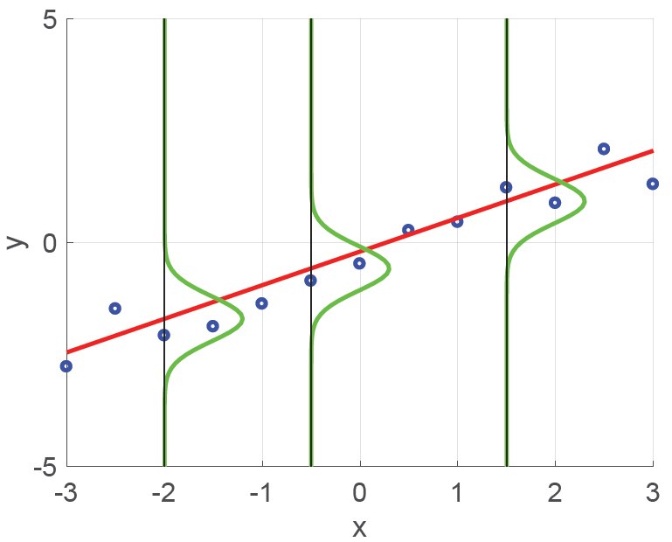
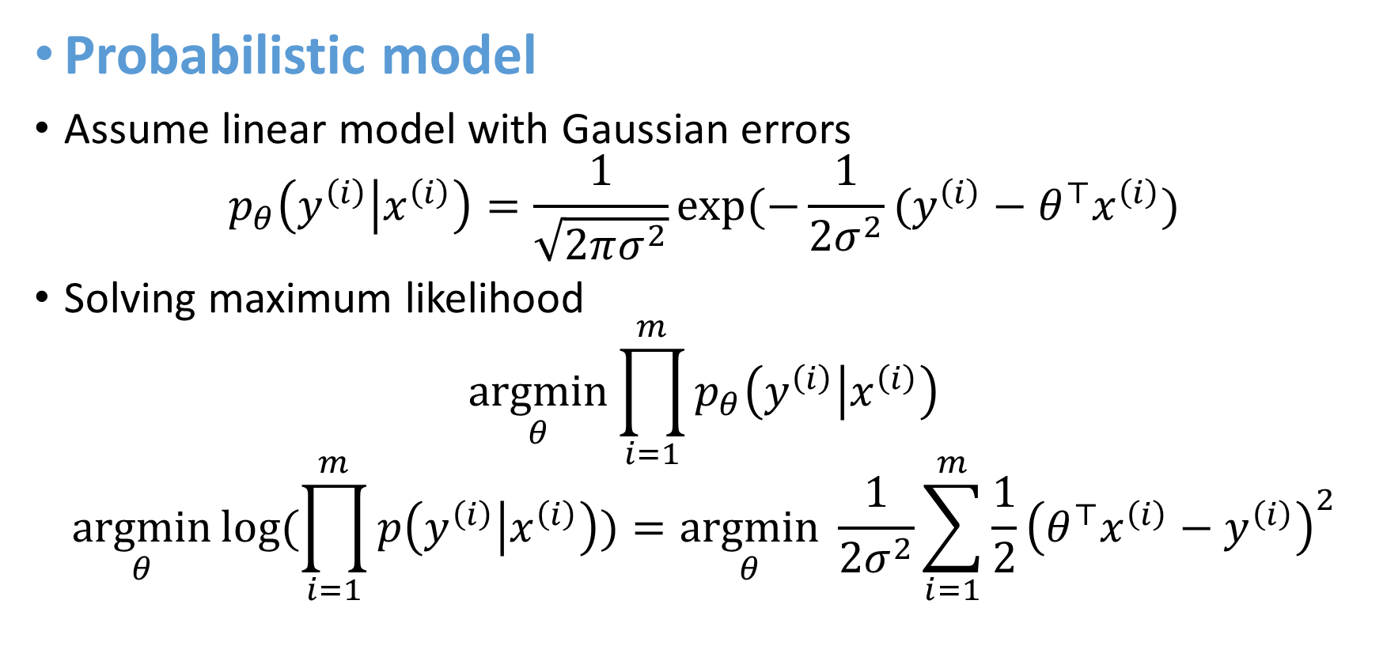
Justification/interpretation 2
Probabilistic model
Assume linear model with Gaussian errors
$$p_{θ}\left(y^{\left(i\right)} | x^{\left(i\right)}\right)=\frac{1}{\sqrt{2πσ^{2}}}exp⁡(−\frac{1}{2σ^{2}}(y^{\left(i\right)}−θ^{⊤}x^{\left(i\right)})$$
Solving maximum likelihood
$$\underset{θ}{argmin}{\prod_{i=1}^{m}{p_{θ}\left(y^{\left(i\right)} | x^{\left(i\right)}\right)}}$$
$$\underset{θ}{argmin}{log⁡(\prod_{i=1}^{m}{p\left(y^{\left(i\right)} | x^{\left(i\right)}\right)})}=\underset{θ}{argmin} \frac{1}{2σ^{2}}\sum_{i=1}^{m}{\frac{1}{2}{\left(θ^{⊤}x^{\left(i\right)}−y^{\left(i\right)}\right)}^{2}}$$

Slide 8
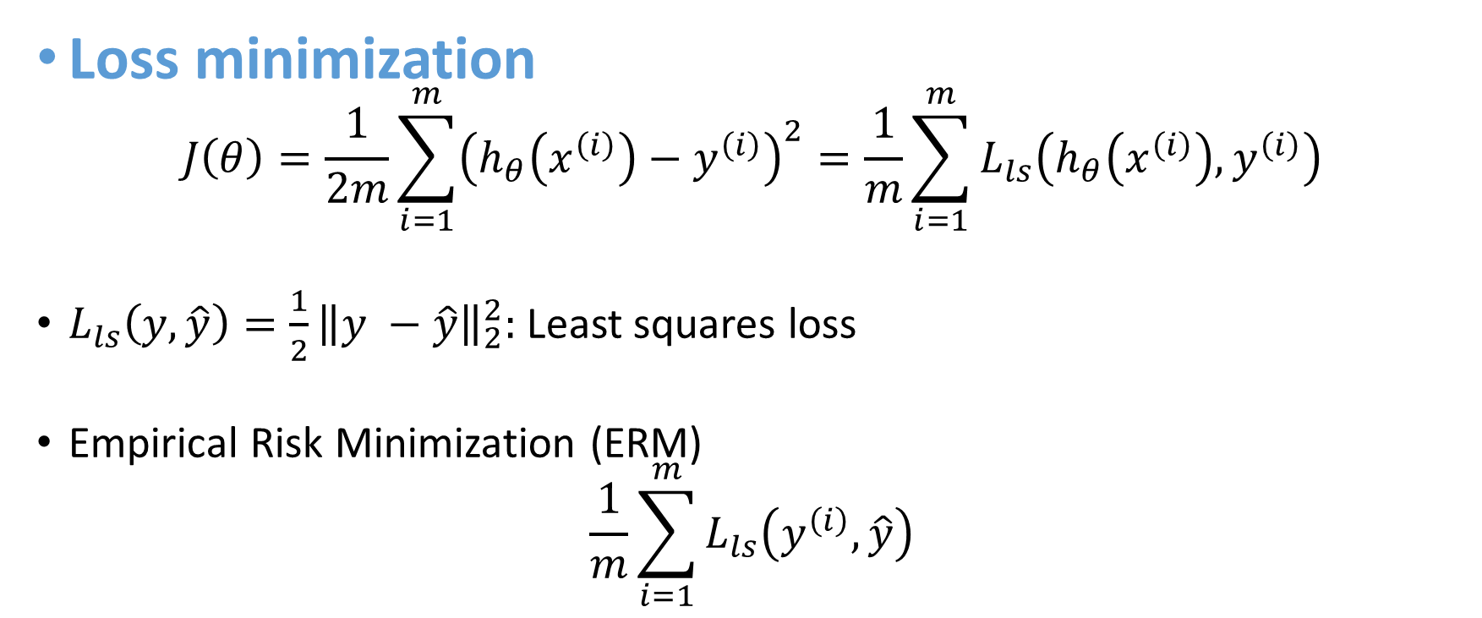
Justification/interpretation 3
Loss minimization
$$J\left(θ\right)=\frac{1}{2m}\sum_{i=1}^{m}{{\left(h_{θ}\left(x^{\left(i\right)}\right)−y^{\left(i\right)}\right)}^{2}}=\frac{1}{m}\sum_{i=1}^{m}{L_{ls}\left(h_{θ}\left(x^{\left(i\right)}\right), y^{\left(i\right)}\right)}$$
$L_{ls}\left(y, \hat{y}\right)=\frac{1}{2}{\left\|y −\hat{y}\right\|}_{2}^{2}:$Least squares loss
Empirical Risk Minimization (ERM)
$$\frac{1}{m}\sum_{i=1}^{m}{L_{ls}\left(y^{\left(i\right)}, \hat{y}\right)}$$

Slide 9
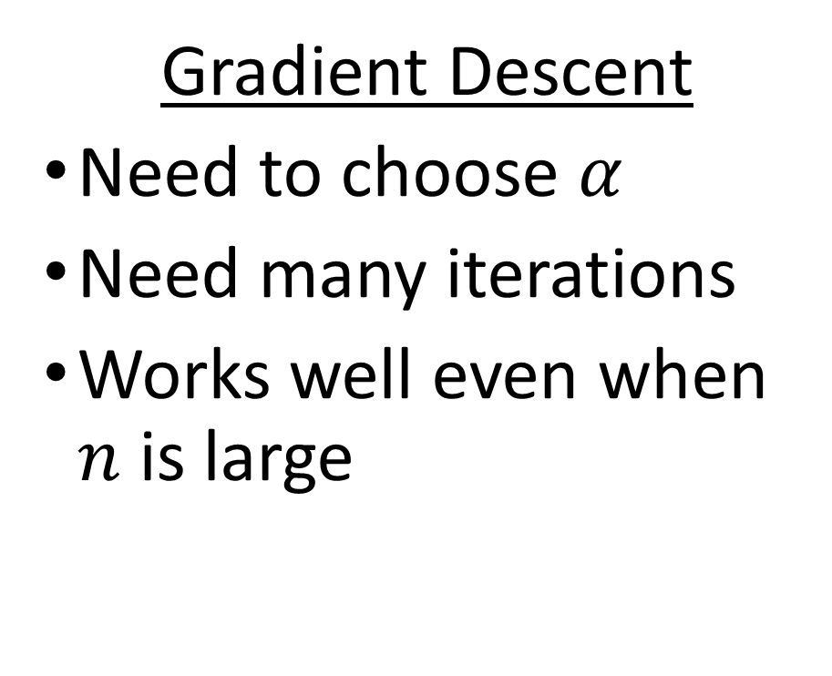
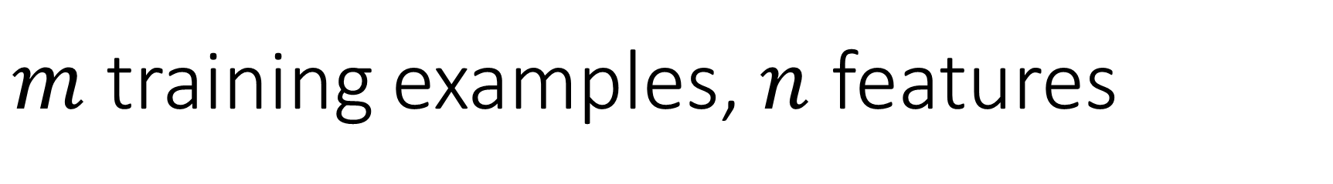
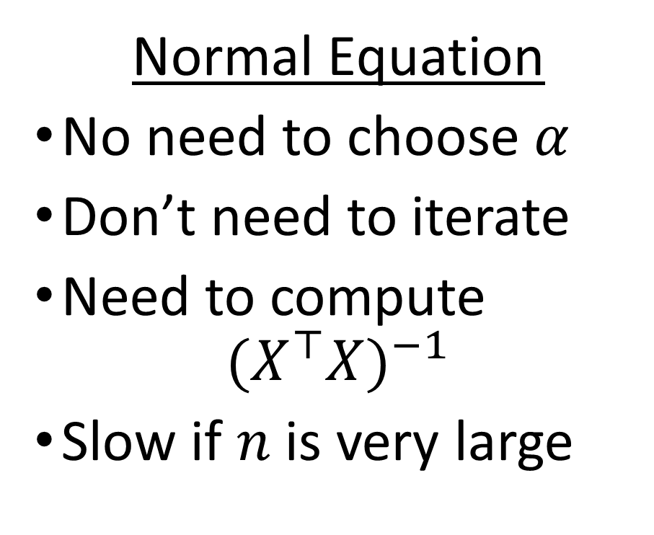
$m$ training examples, $n$ features
Gradient Descent
Need to choose $α$
Need many iterations
Works well even when $n$ is large
Normal Equation
No need to choose $α$
Don’t need to iterate
Need to compute
${(X^{⊤}X)}^{−1}$
Slow if $n$ is very large

Slide 10
Things to remember
Model representation
$$h_{θ}\left(x\right)=θ_{0}+θ_{1}x_{1}+θ_{2}x_{2}+…+θ_{n}x_{n}=θ^{⊤}x$$
Cost function $J\left(θ\right)=\frac{1}{2m}\sum_{i=1}^{m}{{\left(h_{θ}\left(x^{\left(i\right)}\right)−y^{\left(i\right)}\right)}^{2}}$
Gradient descent for linear regression
Repeat until convergence {$θ_{j} ≔θ_{j}−α\frac{1}{m}\sum_{i=1}^{m}{\left(h_{θ}\left(x^{\left(i\right)}\right)−y^{\left(i\right)}\right)}x_{j}^{\left(i\right)}$}
Features and polynomial regression
Can combine features; can use different functions to generate features (e.g., polynomial)
Normal equation $θ={(X^{⊤}X)}^{−1}X^{⊤}y$

Slide 11
Today’s plan
Probability basics
Estimating parameters from data
  Maximum likelihood (ML)
  Maximum a posteriori estimation (MAP)
Naïve Bayes

Slide 12
Today’s plan
Probability basics
Estimating parameters from data
  Maximum likelihood (ML)
  Maximum a posteriori estimation (MAP)
Naive Bayes

Slide 13
Random variables
Outcome space S
  Space of possible outcomes
Random variables
  Functions that map outcomes to real numbers
Event E
  Subset of S

Slide 14
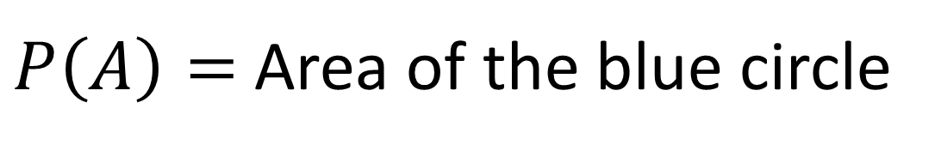

Visualizing probability $P(A)$
Sample space
Area = 1
A is true
A is false
$P\left(A\right)=$Area of the blue circle

Slide 15
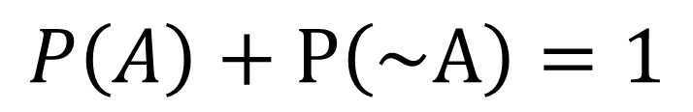

Visualizing probability $P\left(A\right)+P\left(\sim A\right)$
A is true
A is false
$$P\left(A\right)+P\left(\sim A\right)=1$$

Slide 16
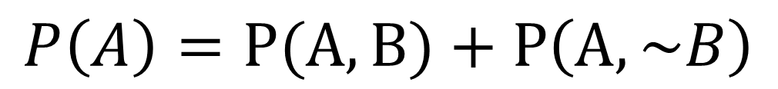

Visualizing probability $P\left(A\right)$
A^B
B
A^~B
$$P\left(A\right)=P(A, B)+P\left(A,\sim B\right)$$

Slide 17

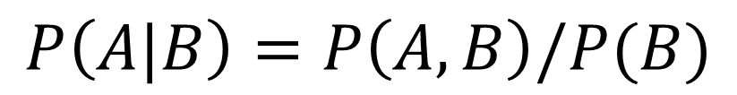
Visualizing conditional probability
A^B
$$P\left(A|B\right)=P\left(A, B\right)/P(B)$$
B
A
Corollary: The chain rule
$$P\left(A, B\right)=P\left(A|B\right)P(B)$$

Slide 18
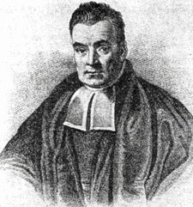
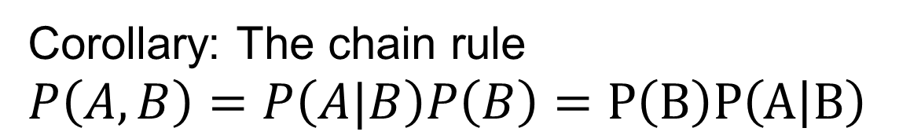

Bayes rule
A^B
B
A
Thomas Bayes
$$P\left(A|B\right)=\frac{P\left(A, B\right)}{P\left(B\right)}$$
$$=\frac{P\left(B | A\right)P\left(A\right)}{P(B)}$$
Corollary: The chain rule
$$P\left(A, B\right)=P\left(A|B\right)P\left(B\right)=P\left(B\right)P\left(A | B\right)$$

Slide 19
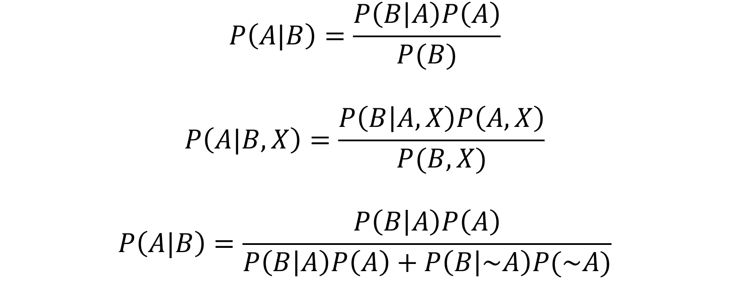
Other forms of Bayes rule
$$P\left(A|B\right)=\frac{P\left(B | A\right)P\left(A\right)}{P(B)}$$
$$P\left(A|B, X\right)=\frac{P\left(B | A,X\right)P\left(A,X\right)}{P(B,X)}$$
$$P\left(A|B\right)=\frac{P\left(B | A\right)P\left(A\right)}{P\left(B | A\right)P\left(A\right)+P\left(B | \sim A\right)P(\sim A)}$$

Slide 20
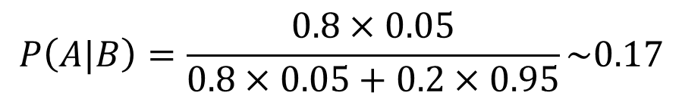
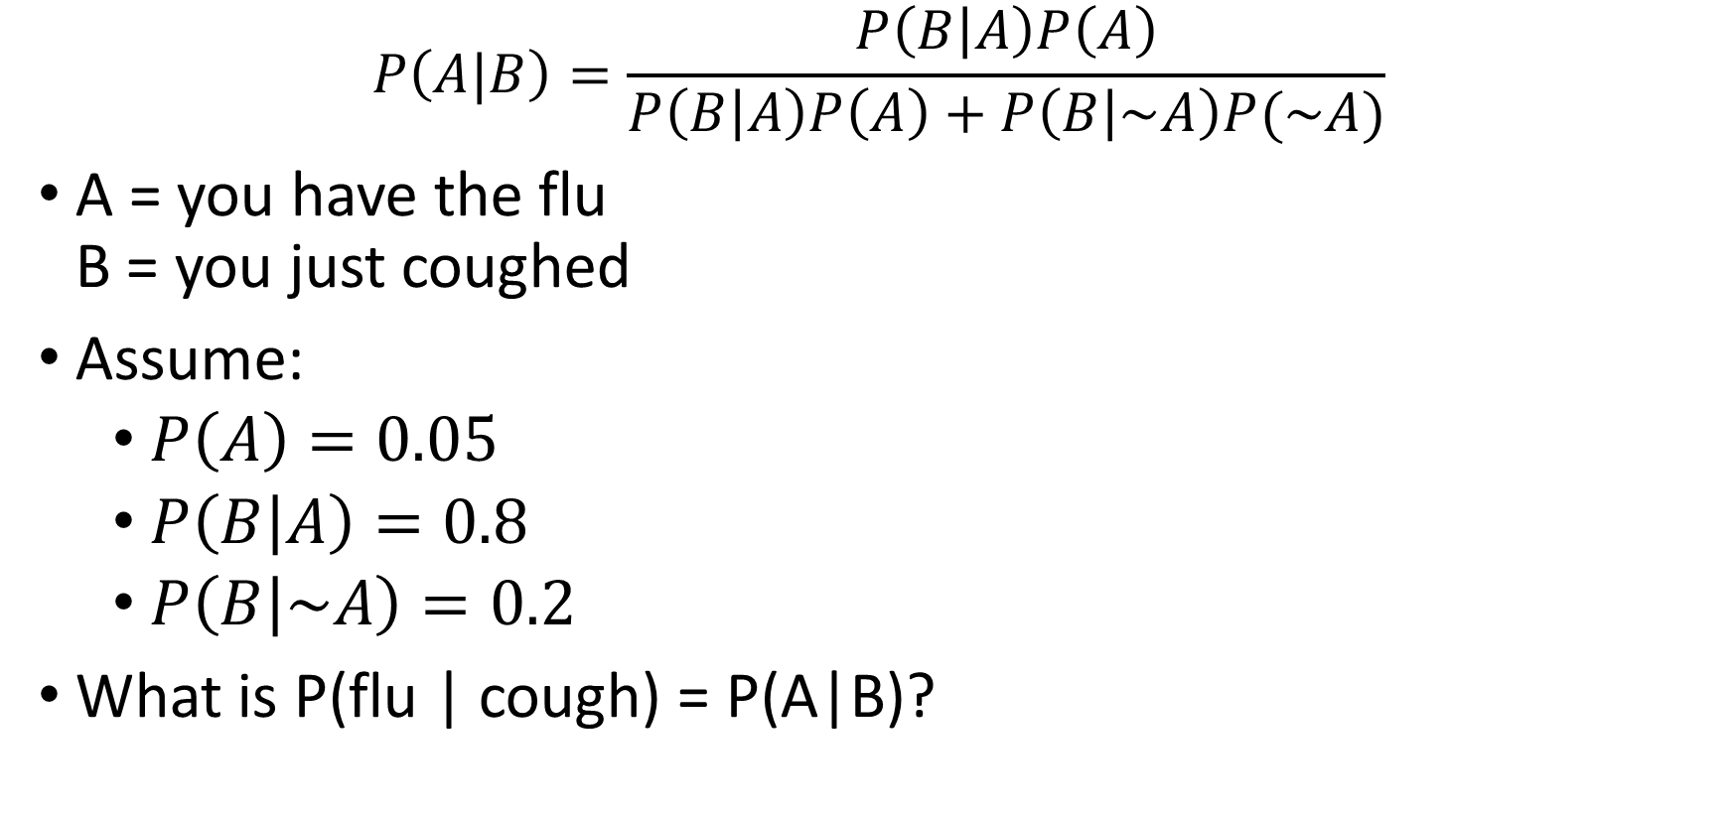
Applying Bayes rule
$$P\left(A|B\right)=\frac{P\left(B | A\right)P\left(A\right)}{P\left(B | A\right)P\left(A\right)+P\left(B | \sim A\right)P(\sim A)}$$
A = you have the flu
B = you just coughed
Assume:
  $P\left(A\right)=0.05$
  $P\left(B | A\right)=0.8$
  $P\left(B | \sim A\right)=0.2$
What is P(flu | cough) = P(A|B)?
$$P\left(A|B\right)=\frac{0.8×0.05}{0.8×0.05+0.2×0.95}\sim 0.17$$

Slide 21





Why we are learning this?
Learn $P\left(Y|X\right)$
$$h$$
$$x$$
$$y$$
Hypothesis

Slide 22
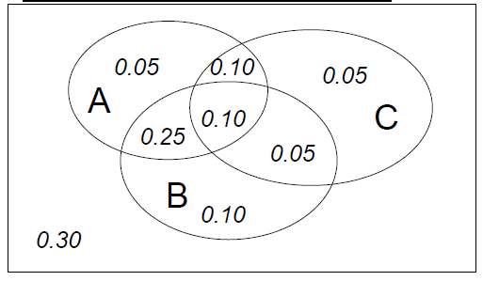
Joint distribution
A | B | C | Prob
0 | 0 | 0 | 0.30
0 | 0 | 1 | 0.05
0 | 1 | 0 | 0.10
0 | 1 | 1 | 0.05
1 | 0 | 0 | 0.05
1 | 0 | 1 | 0.10
1 | 1 | 0 | 0.25
1 | 1 | 1 | 0.10
Making a joint distribution of M variables
Make a truth table listing all combinations
For each combination of values, say how probable it is
Probability must sum to 1

Slide 23
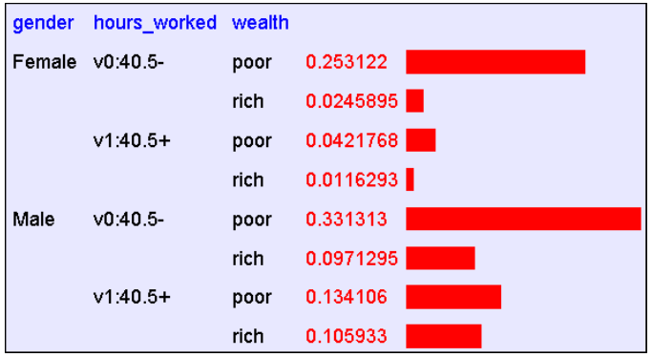
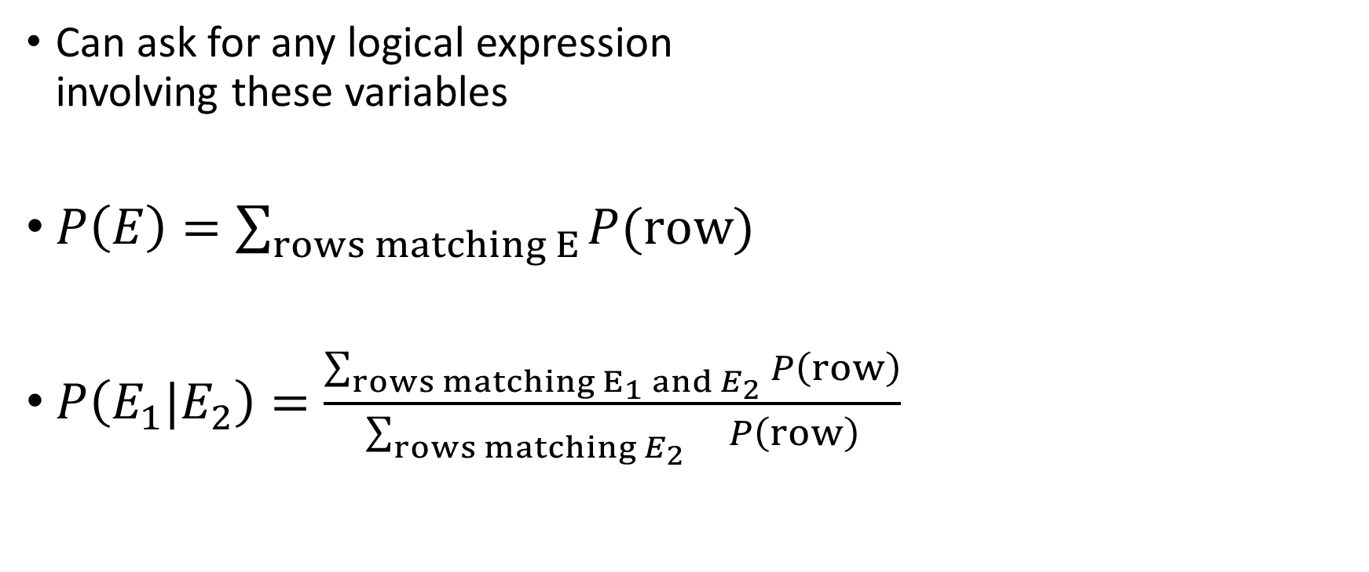
Using joint distribution
Can ask for any logical expression
involving these variables
$P\left(E\right)=\sum_{rows matching E}{P(row)}$
$P\left(E_{1}|E_{2}\right)=\frac{\sum_{rows matching E_{1} and E_{2}}{P\left(row\right)}}{\sum_{rows matching E_{2}}{ P\left(row\right)}}$

Slide 24

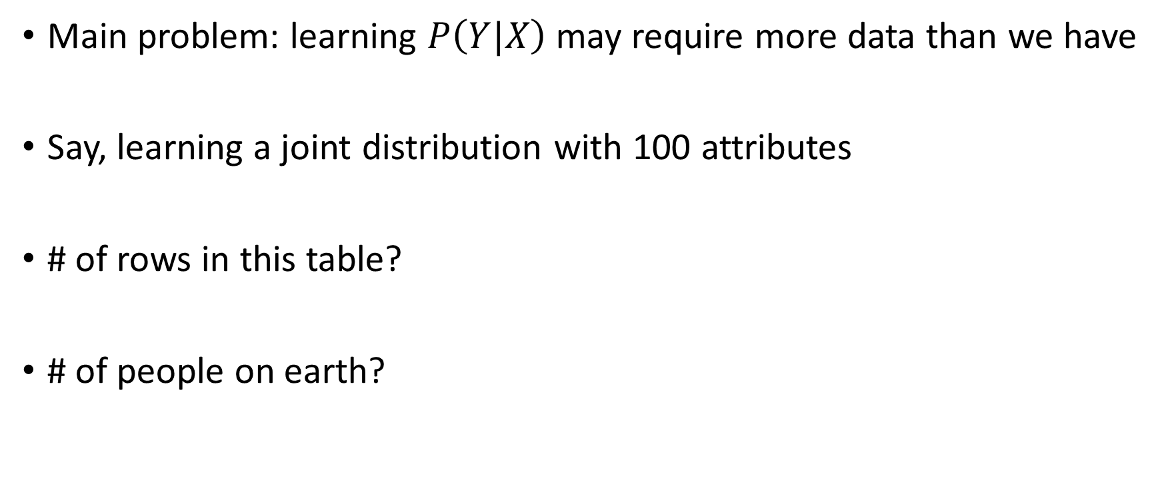



The solution to learn $P\left(Y|X\right)$?
Main problem: learning $P\left(Y|X\right)$ may require more data than we have
Say, learning a joint distribution with 100 attributes
# of rows in this table?
# of people on earth?
$$2^{100}≥{10}^{30}$$
$${10}^{9}$$

Slide 25
What should we do?
Be smart about
how we estimate probabilities from sparse data
  Maximum likelihood estimates (ML)
  Maximum a posteriori estimates (MAP)
Be smart about
how to represent joint distributions
  Bayes network, graphical models (more on this later)

Slide 26
Today’s plan
Probability basics
Estimating parameters from data
  Maximum likelihood (ML)
  Maximum a posteriori (MAP)
Naive Bayes

Slide 27
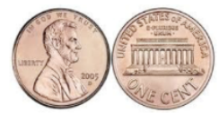
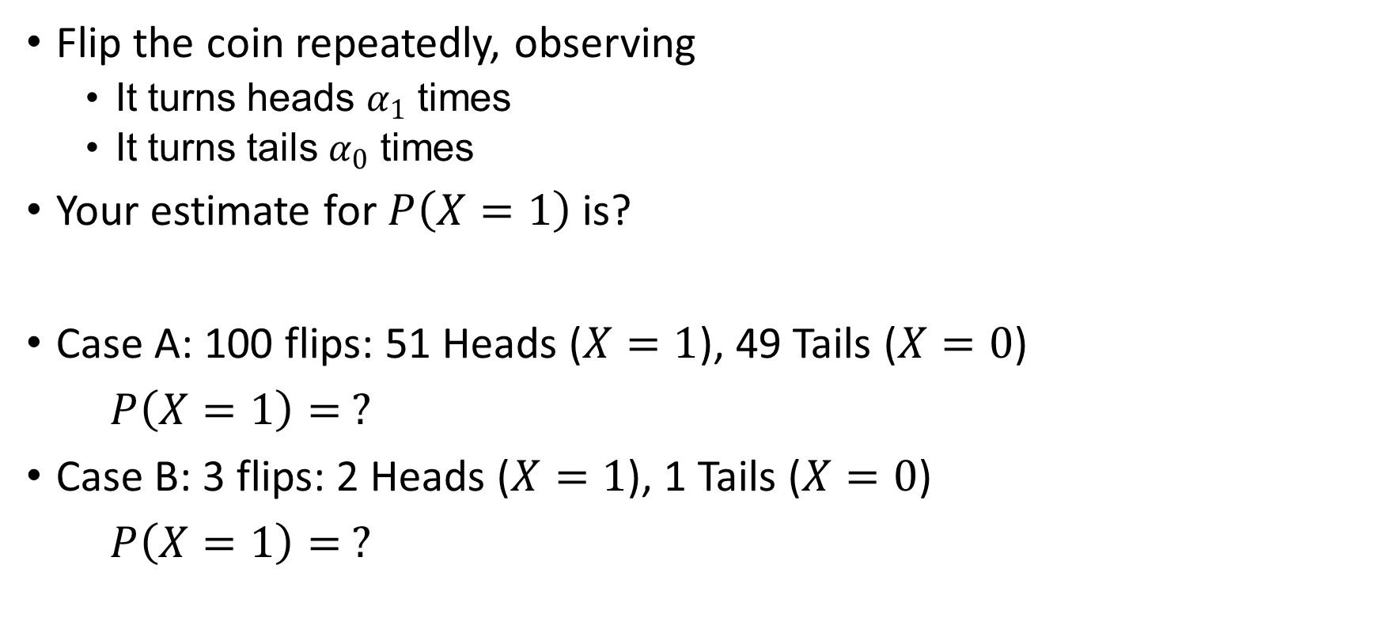
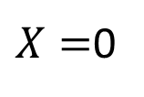

Estimating the probability
$$X=1$$
$X=$0
Flip the coin repeatedly, observing
  It turns heads $α_{1}$ times
  It turns tails $α_{0}$ times
Your estimate for $P\left(X=1\right)$ is?
Case A: 100 flips: 51 Heads ($X=1$), 49 Tails ($X=0$)
$P\left(X=1\right)= ?$
Case B: 3 flips: 2 Heads ($X=1$), 1 Tails ($X=0$)
$P\left(X=1\right)= ?$

Slide 28
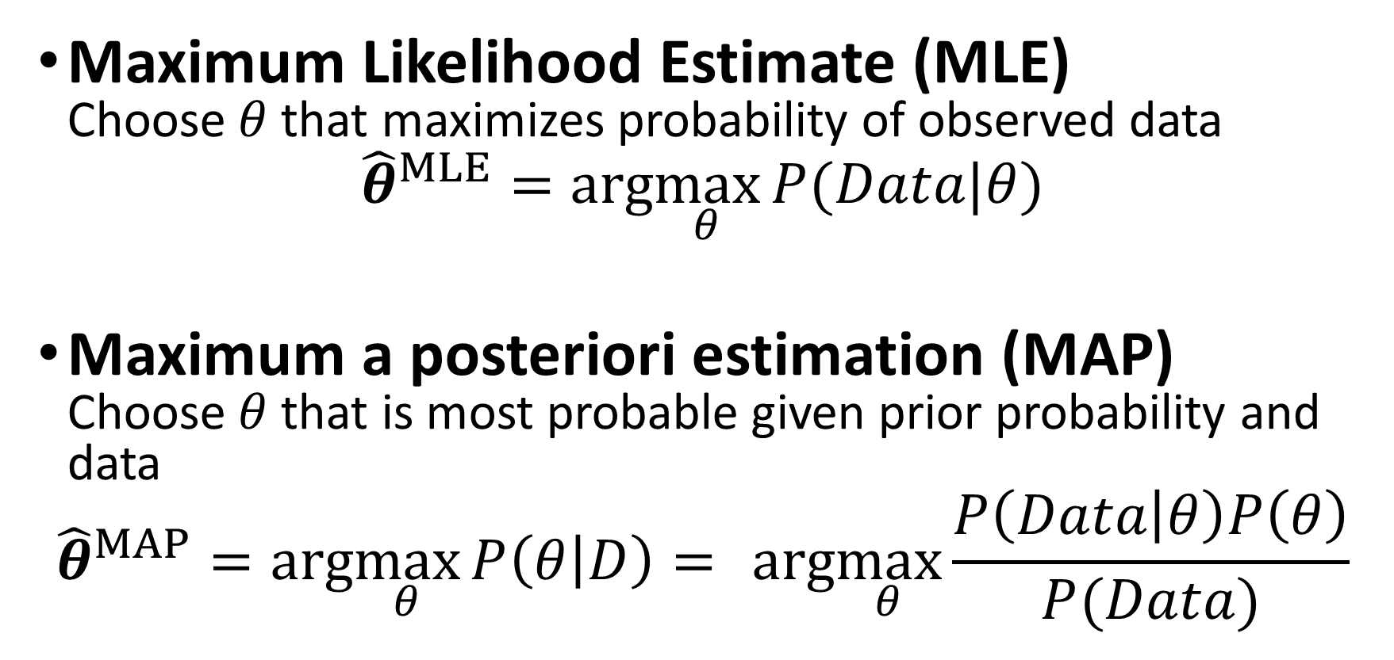
Two principles for estimating parameters
Maximum Likelihood Estimate (MLE)
Choose $θ$ that maximizes probability of observed data
$${\hat{θ}}^{MLE}=arg\max_{θ}{P(Data|θ)}$$
Maximum a posteriori estimation (MAP)
Choose $θ$ that is most probable given prior probability and data
$${\hat{θ}}^{MAP}=arg\max_{θ}{P\left(θ | D\right)= } arg\max_{θ}{\frac{P\left(Data | θ\right)P\left(θ\right)}{P(Data)} }$$

Slide 29
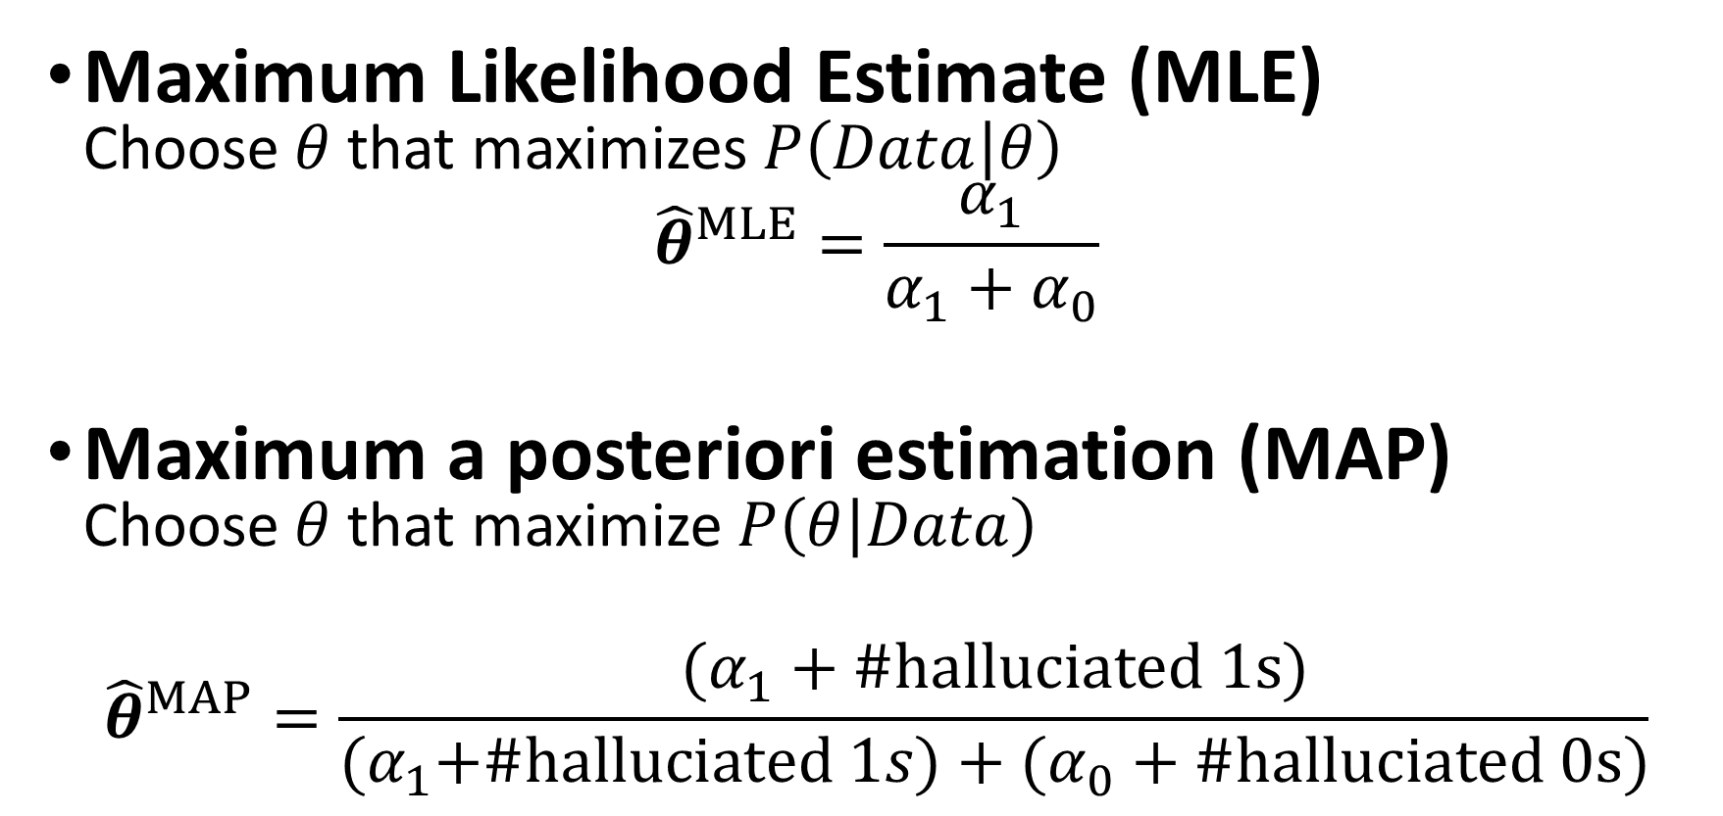
Two principles for estimating parameters
Maximum Likelihood Estimate (MLE)
Choose $θ$ that maximizes $P\left(Data | θ\right)$
$${\hat{θ}}^{MLE}=\frac{α_{1}}{α_{1}+α_{0}}$$
Maximum a posteriori estimation (MAP)
Choose $θ$ that maximize $P\left(θ | Data\right)$
$${\hat{θ}}^{MAP}=\frac{(α_{1}+\#halluciated 1s)}{{(α}_{1}+\#halluciated 1s)+(α_{0}+\#halluciated 0s)}$$

Slide 30
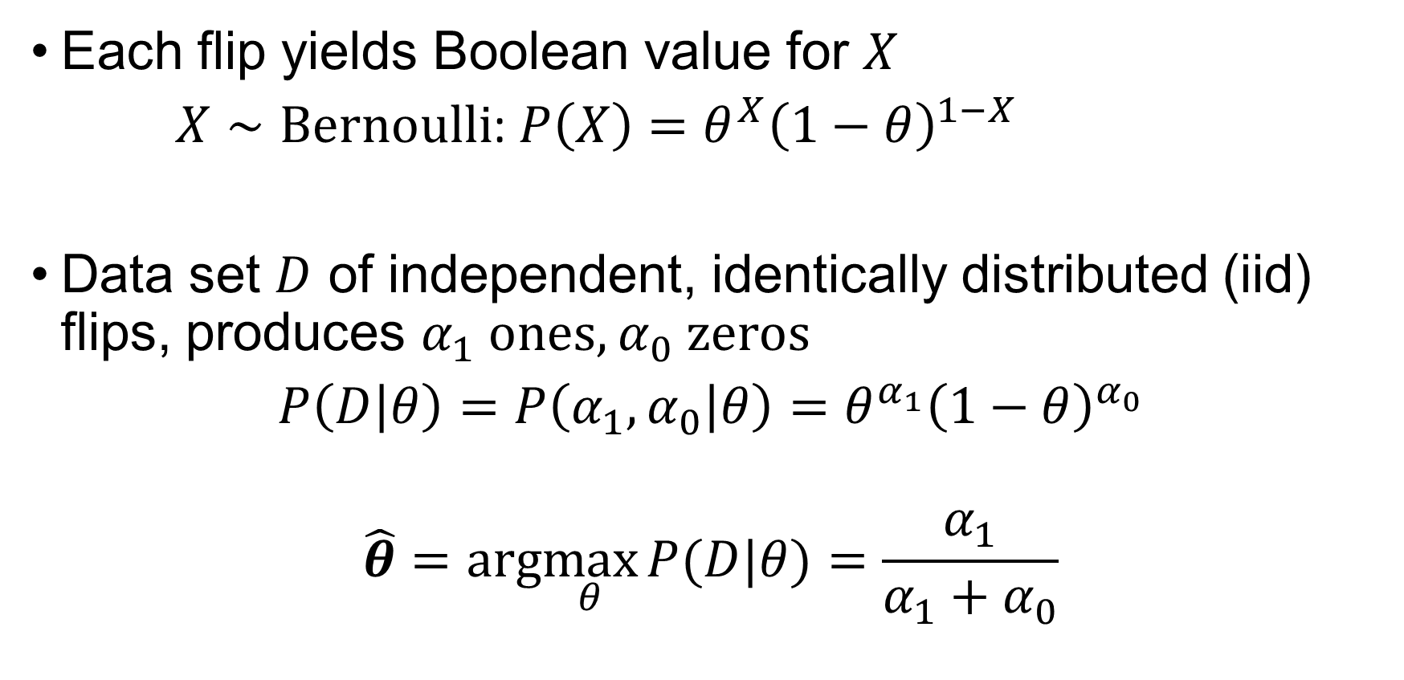
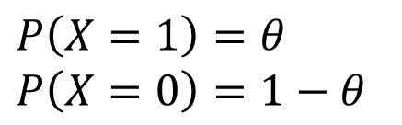
Maximum likelihood estimate
$$X=1$$
$X=$0
Each flip yields Boolean value for $X$
$X∼Bernoulli$: $P\left(X\right)=θ^{X}{\left(1−θ\right)}^{1−X}$
Data set $D$ of independent, identically distributed (iid) flips, produces $α_{1}$ ones, $α_{0}$ zeros
$P\left(D | θ\right)=P\left(α_{1}, α_{0} | θ\right)=θ^{α_{1}}{\left(1−θ\right)}^{α_{0}}$
$$\hat{θ}=arg\max_{θ}{P(D|θ)}=\frac{α_{1}}{α_{1}+α_{0}}$$
$$P\left(X=1\right)=θ$$
$$P\left(X=0\right)=1−θ$$

Slide 31


Beta prior distribution $P\left(θ\right)$
$P\left(θ\right)=Beta\left(β_{1}, β_{0}\right)=\frac{1}{B(β_{1}, β_{0})}θ^{β_{1}−1}{\left(1−θ\right)}^{β_{0}−1}$

Slide 32
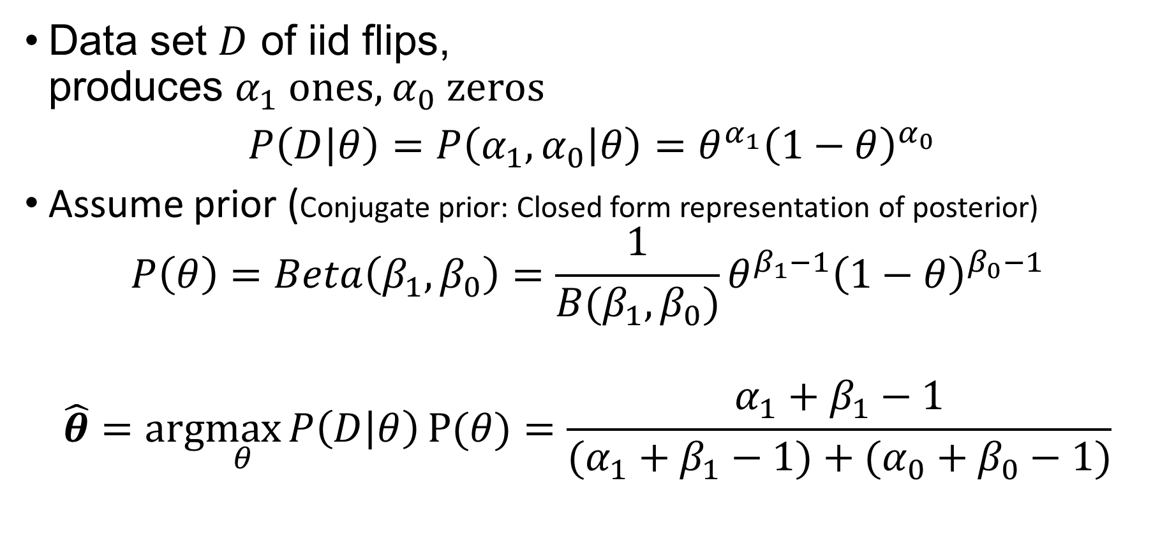
Maximum likelihood estimate
$$X=1$$
$X=$0
Data set $D$ of iid flips,
produces $α_{1}$ ones, $α_{0}$ zeros
$P\left(D | θ\right)=P\left(α_{1}, α_{0} | θ\right)=θ^{α_{1}}{\left(1−θ\right)}^{α_{0}}$
  Assume prior (Conjugate prior: Closed form representation of posterior)
$$P\left(θ\right)=Beta\left(β_{1}, β_{0}\right)=\frac{1}{B(β_{1}, β_{0})}θ^{β_{1}−1}{\left(1−θ\right)}^{β_{0}−1}$$
$$\hat{θ}=arg\max_{θ}{P\left(D | θ\right)}P(θ)=\frac{α_{1}+β_{1}−1}{(α_{1}+β_{1}−1)+(α_{0}+β_{0}−1)}$$

Slide 33
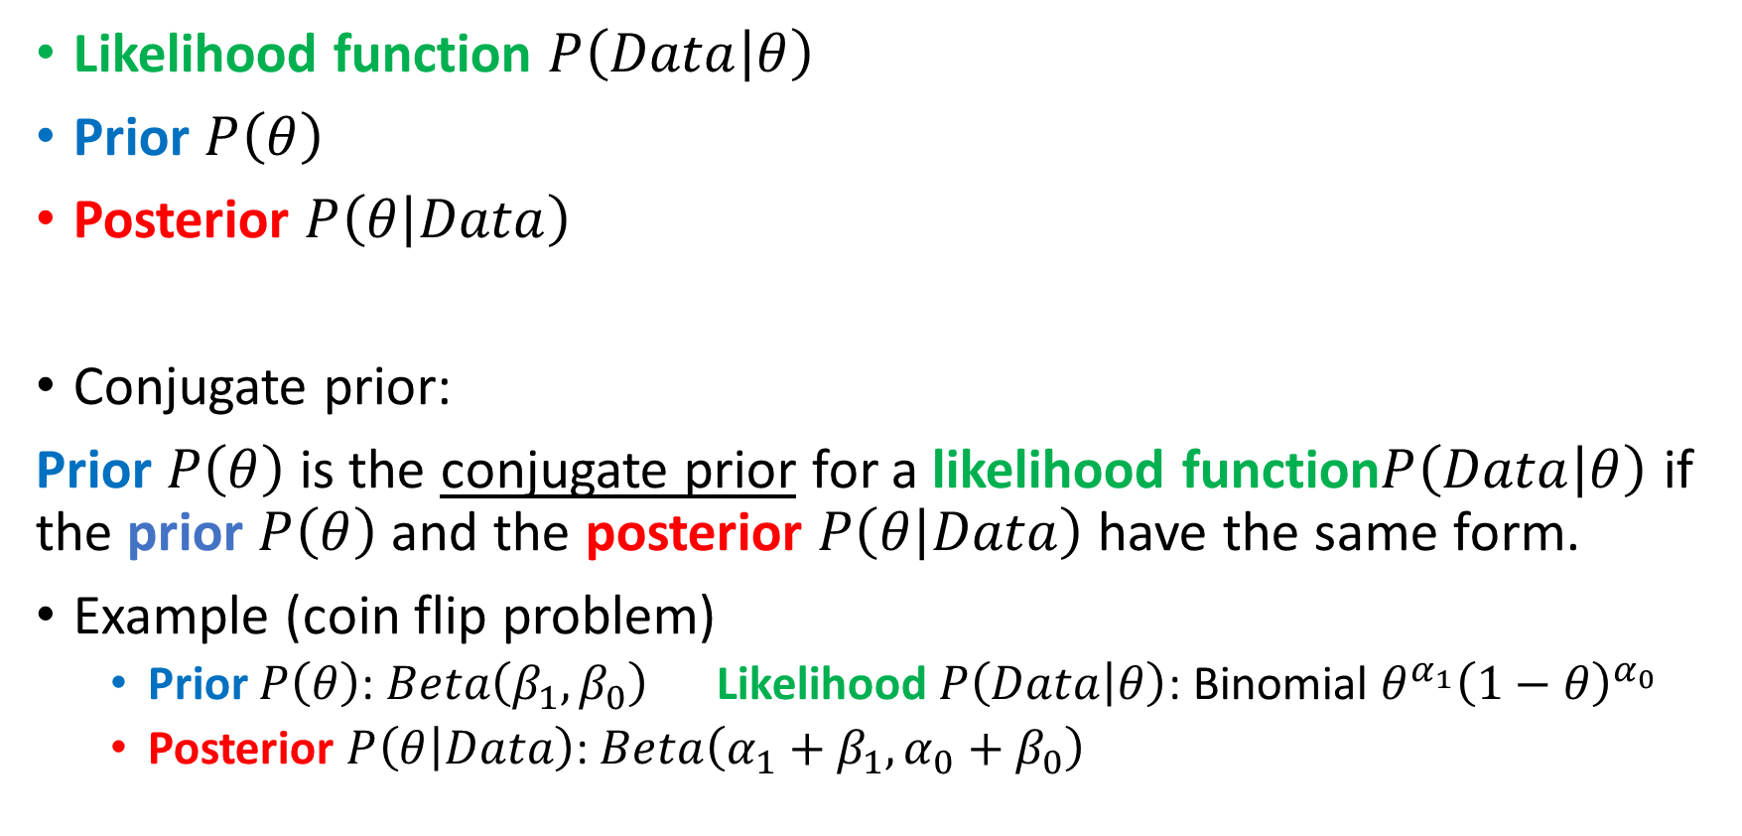
Some terminology
Likelihood function $P\left(Data | θ\right)$
Prior $P\left(θ\right)$
Posterior $P\left(θ | Data\right)$
Conjugate prior:
Prior $P\left(θ\right)$ is the conjugate prior for a likelihood function$P\left(Data | θ\right)$ if
the prior $P\left(θ\right)$ and the posterior $P\left(θ | Data\right)$ have the same form.
Example (coin flip problem)
  Prior $P\left(θ\right)$: $Beta\left(β_{1}, β_{0}\right)$ Likelihood $P\left(Data | θ\right)$: Binomial $θ^{α_{1}}{\left(1−θ\right)}^{α_{0}}$
  Posterior $P\left(θ | Data\right)$: $Beta\left({α_{1}+β}_{1}, {α_{0}+β}_{0}\right)$

Slide 34
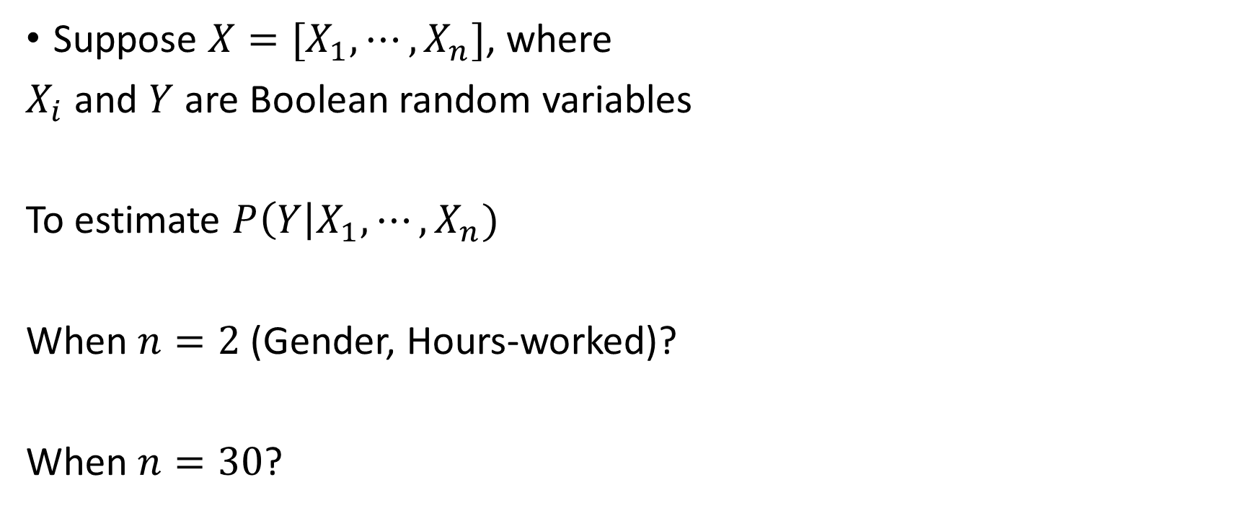
How many parameters?
Suppose $X=[X_{1},⋯,X_{n}]$, where
$X_{i}$ and $Y$ are Boolean random variables
To estimate $P\left(Y\right|X_{1}, ⋯,X_{n})$
When $n=2$(Gender, Hours-worked)?
When $n=30$?

Slide 35
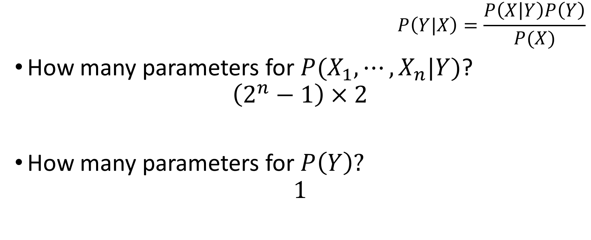
Can we reduce paras using Bayes rule?
$$P\left(Y|X\right)=\frac{P\left(X | Y\right)P\left(Y\right)}{P(X)}$$
How many parameters for $P(X_{1}, ⋯,X_{n}|Y)$?
$$\left(2^{n}−1\right)×2$$
How many parameters for $P\left(Y\right)?$
$$1$$

Slide 36
Today’s plan
Probability basics
Estimating parameters from data
  Maximum likelihood (ML)
  Maximum a posteriori estimation (MAP)
Naive Bayes

Slide 37
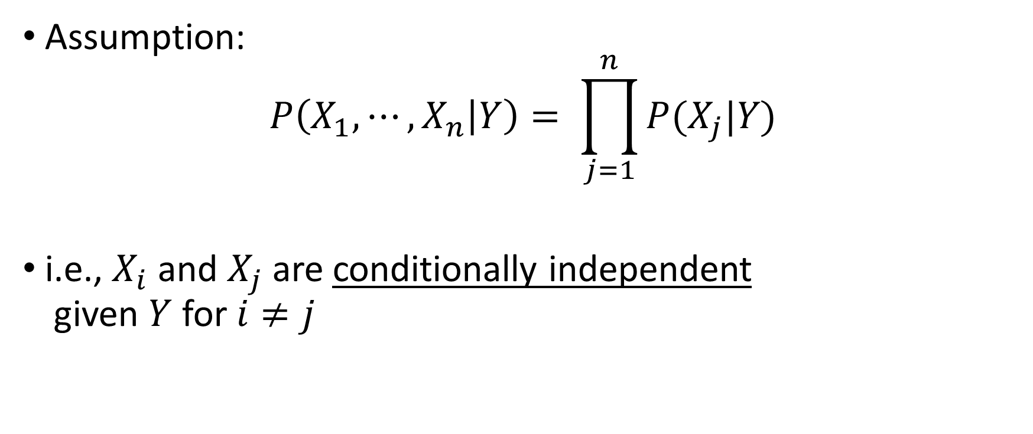
Naïve Bayes
Assumption:
$$P\left(X_{1}, ⋯,X_{n} | Y\right)= \prod_{j=1}^{n}{P(X_{j}|Y)}$$
i.e., $X_{i}$ and $X_{j}$ are conditionally independent
given $Y$ for $i≠j$

Slide 38
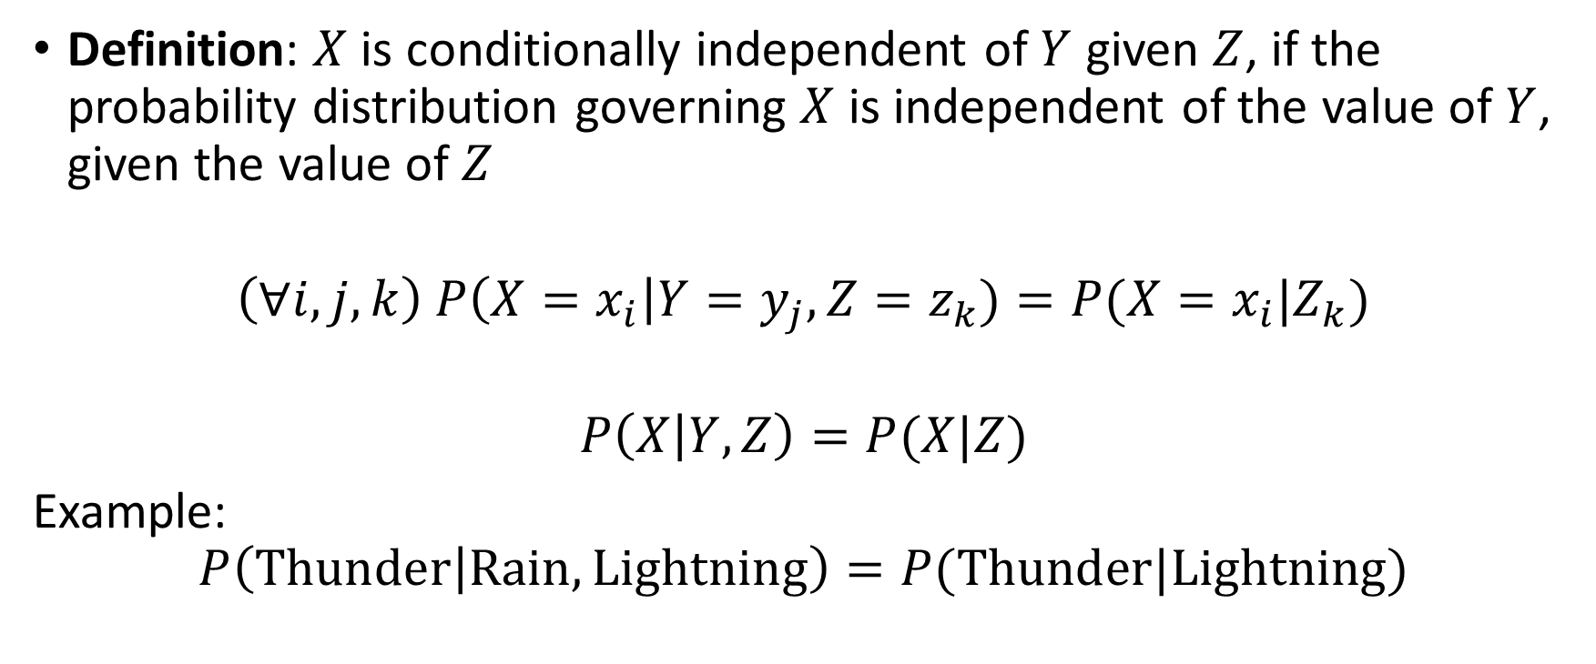
Conditional independence
Definition: $X$ is conditionally independent of $Y$ given $Z$, if the probability distribution governing $X$ is independent of the value of $Y$, given the value of $Z$
$$\left(∀i,j,k\right) P\left(X=x_{i}\right|Y=y_{j}, Z=z_{k})=P(X=x_{i}|Z_{k})$$
$$P\left(X | Y, Z\right)=P(X|Z)$$
Example:
$$P\left(Thunder | Rain, Lightning\right)=P(Thunder|Lightning)$$

Slide 39
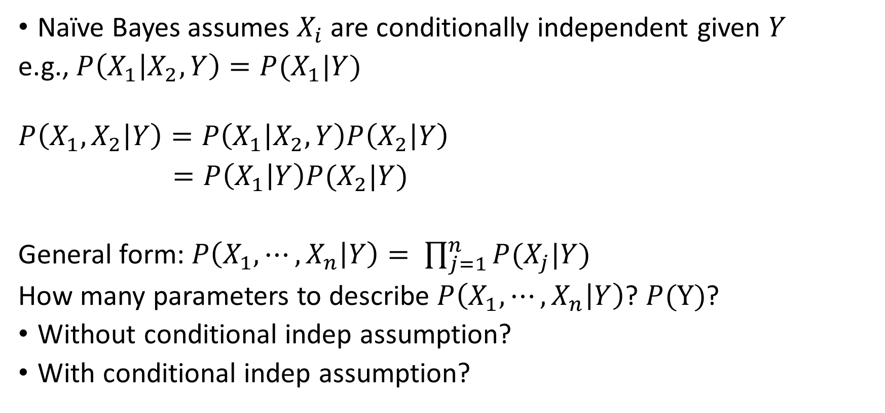
Applying conditional independence
Naïve Bayes assumes $X_{i}$are conditionally independent given $Y$
e.g., $P\left(X_{1} | X_{2}, Y\right)=P(X_{1}|Y)$
$$P\left(X_{1}, X_{2} | Y\right)=P\left(X_{1} | X_{2},Y\right)P\left(X_{2} | Y\right)$$
$=P\left(X_{1} | Y\right)P(X_{2}|Y)$
General form: $P\left(X_{1}, ⋯,X_{n} | Y\right)= \prod_{j=1}^{n}{P(X_{j}|Y)}$
How many parameters to describe $P\left(X_{1}, ⋯,X_{n} | Y\right)$? $P(Y)$?
Without conditional indep assumption?
With conditional indep assumption?

Slide 40
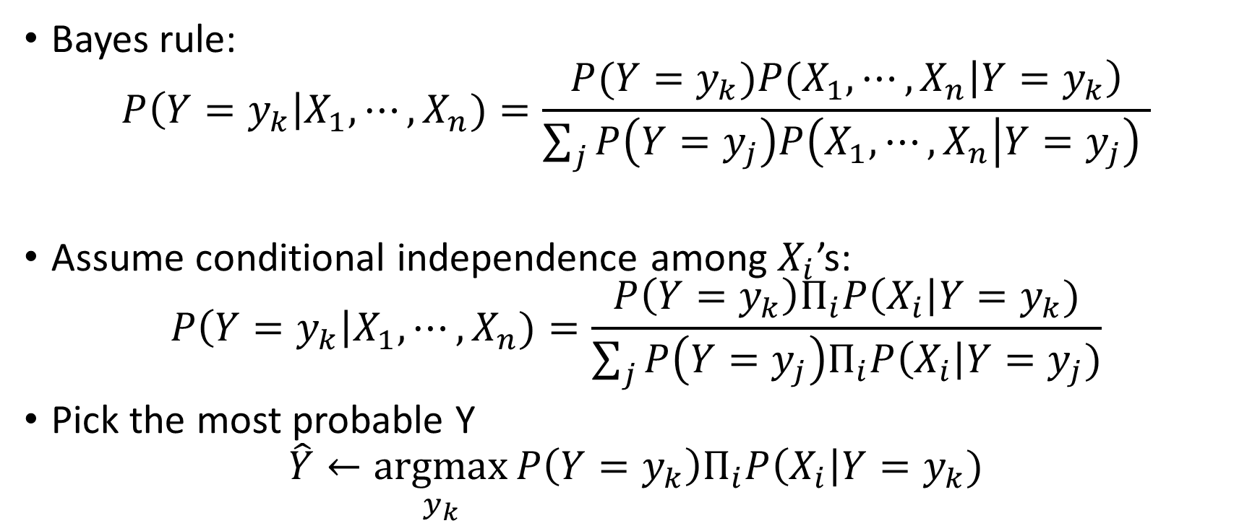
Naïve Bayes classifier
Bayes rule:
$$P\left(Y=y_{k}\right|X_{1}, ⋯,X_{n})=\frac{{P(Y=y_{k})P(X_{1},⋯,X}_{n}\left|Y=y_{k}\right)}{\sum_{j}{P\left(Y=y_{j}\right)P\left(X_{1},⋯, X_{n} | Y=y_{j}\right) }}$$
Assume conditional independence among $X_{i}$’s:
$$P\left(Y=y_{k}\right|X_{1}, ⋯,X_{n})=\frac{P\left(Y=y_{k}\right)Π_{i}P\left(X_{i}\right|Y=y_{k})}{\sum_{j}{P\left(Y=y_{j}\right)Π_{i}P\left(X_{i}\right|Y=y_{j})}}$$
Pick the most probable Y
$$\hat{Y}←\underset{y_{k}}{argmax}{P\left(Y=y_{k}\right)Π_{i}P\left(X_{i}\right|Y=y_{k})}$$

Slide 41
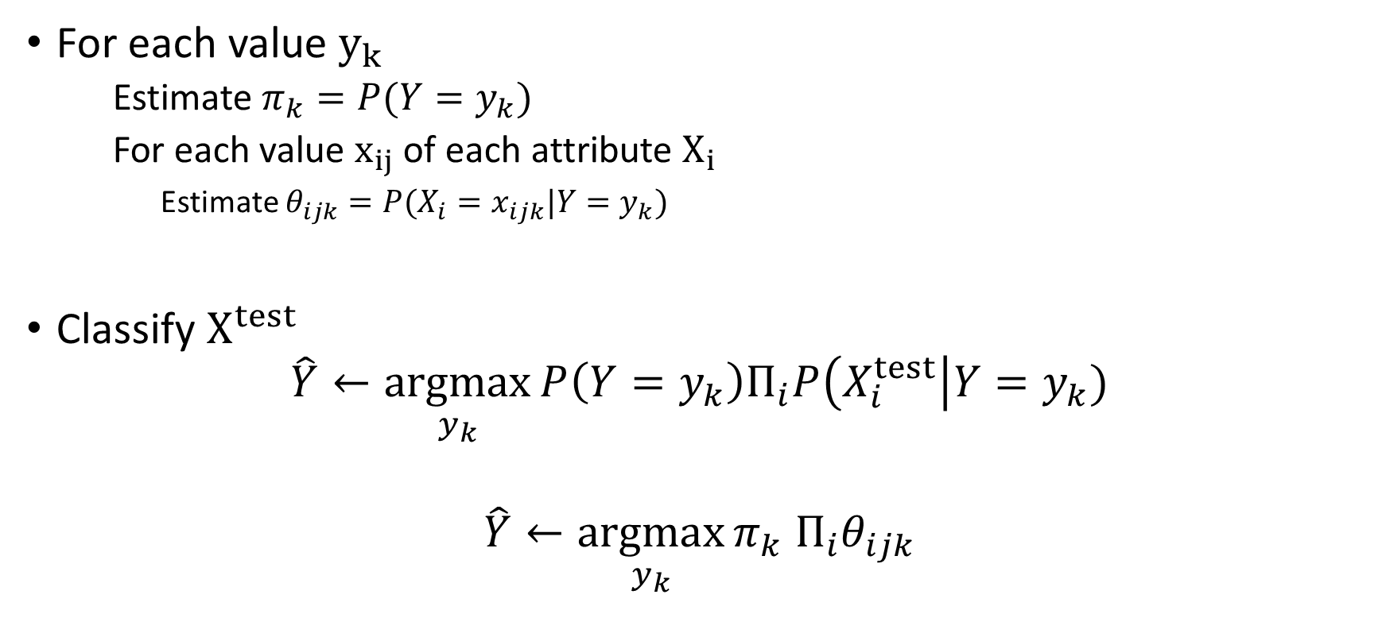

Naïve Bayes algorithm – discrete $X_{i}$
For each value $y_{k}$
  Estimate $π_{k}=P(Y=y_{k})$
  For each value $x_{ij}$ of each attribute $X_{i}$
    Estimate $θ_{ijk}=P(X_{i}=x_{ijk}|Y=y_{k})$
Classify $X^{test}$
$$\hat{Y}←\underset{y_{k}}{argmax}{P\left(Y=y_{k}\right)Π_{i}P\left(X_{i}^{test}\right|Y=y_{k})}$$
$$\hat{Y}←\underset{y_{k}}{argmax}{π_{k} Π_{i}θ_{ijk}}$$

Slide 42


Estimating parameters: discrete $Y, X_{i}$
Maximum likelihood estimates (MLE)
$${\hat{π}}_{k}=\hat{P}\left(Y=y_{k}\right)=\frac{\#D\left\{Y=y_{k}\right\}}{\left|D\right|}$$
$${\hat{θ}}_{ijk}=\hat{P}\left(X_{i}=x_{ij} | Y=y_{k}\right)=\frac{\#D\left\{X_{i}=x_{ij} ^ Y=y_{k}\right\}}{\#D\{Y=y_{k}\}}$$

Slide 43


F = 1 iff you live in Fox Ridge
S = 1 iff you watched the superbowl last night
D = 1 iff you drive to VT
G = 1 iff you went to gym in the last month
$$P\left(F=1\right)=$$
$$P\left(S=1|F=1\right)=$$
$$P\left(S=1|F=0\right)=$$
$$P\left(D=1|F=1\right)=$$
$$P\left(D=1|F=0\right)=$$
$$P\left(G=1|F=1\right)=$$
$$P\left(G=1|F=0\right)=$$
$$P\left(F=0\right)=$$
$$P\left(S=0|F=1\right)=$$
$$P\left(S=0|F=0\right)=$$
$$P\left(D=0|F=1\right)=$$
$$P\left(D=0|F=0\right)=$$
$$P\left(G=0|F=1\right)=$$
$$P\left(G=0|F=0\right)=$$
$$P\left(F|S, D, G\right)=P\left(F\right)P\left(S | F\right)P\left(D | F\right)P(G|F)$$

Slide 44

Naïve Bayes: Subtlety #1
Often the $X_{i}$ are not really conditionally independent
Naïve Bayes often works pretty well anyway
  Often the right classification, even when not the right probability [Domingos & Pazzani, 1996])
What is the effect on estimated $P(Y|X)$?
  What if we have two copies: $X_{i}=X_{k}$
$$P\left(Y=y_{k}\right|X_{1}, ⋯,X_{n})∝P\left(Y=y_{k}\right)Π_{i}P\left(X_{i}\right|Y=y_{k})$$

Slide 45

Naïve Bayes: Subtlety #2
MLE estimate for $P\left(X_{i}\right|Y=y_{k})$ might be zero.
(for example, $X_{i}$ = birthdate. $X_{i}$ = Feb_4_1995)
Why worry about just one parameter out of many?
$$P\left(Y=y_{k}\right|X_{1}, ⋯,X_{n})∝P\left(Y=y_{k}\right)Π_{i}P\left(X_{i}\right|Y=y_{k})$$
What can we do to address this?
  MAP estimates (adding “imaginary” examples)

Slide 46

Estimating parameters: discrete $Y, X_{i}$
Maximum likelihood estimates (MLE)
$${\hat{π}}_{k}=\hat{P}\left(Y=y_{k}\right)=\frac{\#D\left\{Y=y_{k}\right\}}{\left|D\right|}$$
$${\hat{θ}}_{ijk}=\hat{P}\left(X_{i}=x_{ij} | Y=y_{k}\right)=\frac{\#D\left\{X_{i}=x_{ij}, Y=y_{k}\right\}}{\#D\{Y=y_{k}\}}$$
MAP estimates (Dirichlet priors):
$${\hat{π}}_{k}=\hat{P}\left(Y=y_{k}\right)=\frac{\#D\left\{Y=y_{k}\right\}+{(β}_{k}−1)}{\left|D\right|+\sum_{m}{{(β}_{m}−1)}}$$
$${\hat{θ}}_{ijk}=\hat{P}\left(X_{i}=x_{ij} | Y=y_{k}\right)=\frac{\#D\left\{X_{i}=x_{ij}, Y=y_{k}\right\}{+ (β}_{k}−1)}{\#D\{Y=y_{k}\}+\sum_{m}{{(β}_{m}−1)}}$$

Slide 47


What if we have continuous $X_{i}$
Gaussian Naïve Bayes (GNB): assume
$$P\left(X_{i}=x | Y=y_{k}\right)=\frac{1}{\sqrt{2π}σ_{ik}}exp⁡({−\frac{\left(x−μ_{ik}\right)}{2σ_{ik}^{2}}}^{2})$$
Additional assumption on $σ_{ik}$:
  Is independent of $Y$ ($σ_{i}$)
  Is independent of $X_{i}$ ($σ_{k}$)
  Is independent of $X_{i}$ and $Y$ ($σ_{k}$)

Slide 48


Naïve Bayes algorithm – continuous $X_{i}$
For each value $y_{k}$
  Estimate $π_{k}=P(Y=y_{k})$
  For each attribute $X_{i}$ estimate
  Class conditional mean $μ_{ik}$, variance $σ_{ik}$
Classify $X^{test}$
$$\hat{Y}←\underset{y_{k}}{argmax}{P\left(Y=y_{k}\right)Π_{i}P\left(X_{i}^{test}\right|Y=y_{k})}$$
$$\hat{Y}←\underset{y_{k}}{argmax}{π_{k} Π_{i} Normal(X_{i}^{test},μ_{ik},σ_{ik})}$$

Slide 49

Things to remember
Probability basics
Estimating parameters from data
  Maximum likelihood (ML) maximize $P(Data|θ)$
  Maximum a posteriori estimation (MAP) maximize $P(θ|Data)$
Naive Bayes
$$P\left(Y=y_{k}\right|X_{1}, ⋯,X_{n})∝P\left(Y=y_{k}\right)Π_{i}P\left(X_{i}\right|Y=y_{k})$$

Slide 50
Next class
Logistic regression

