Slide 1
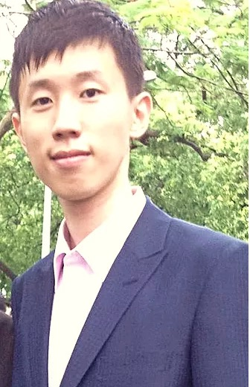
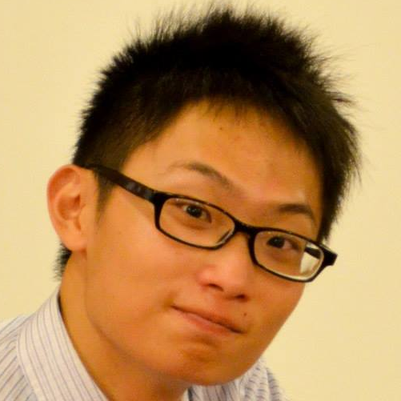
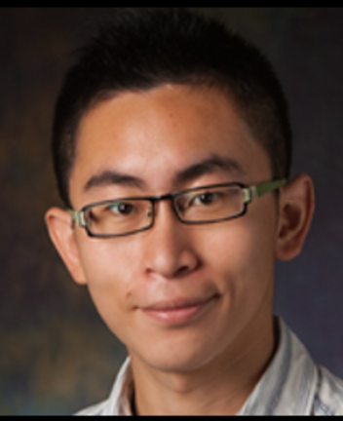
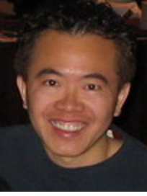
Diverse Image-to-Image Translation via Disentangled Representations
Hsin-Ying Lee*
U.C. Merced
Hung-Yu Tseng*
U.C. Merced
Jia-Bin Huang
Virginia Tech
Maneesh Singh
Verisk Analytics
Ming-Hsuan Yang
U.C. Merced Google Cloud AI

Slide 2
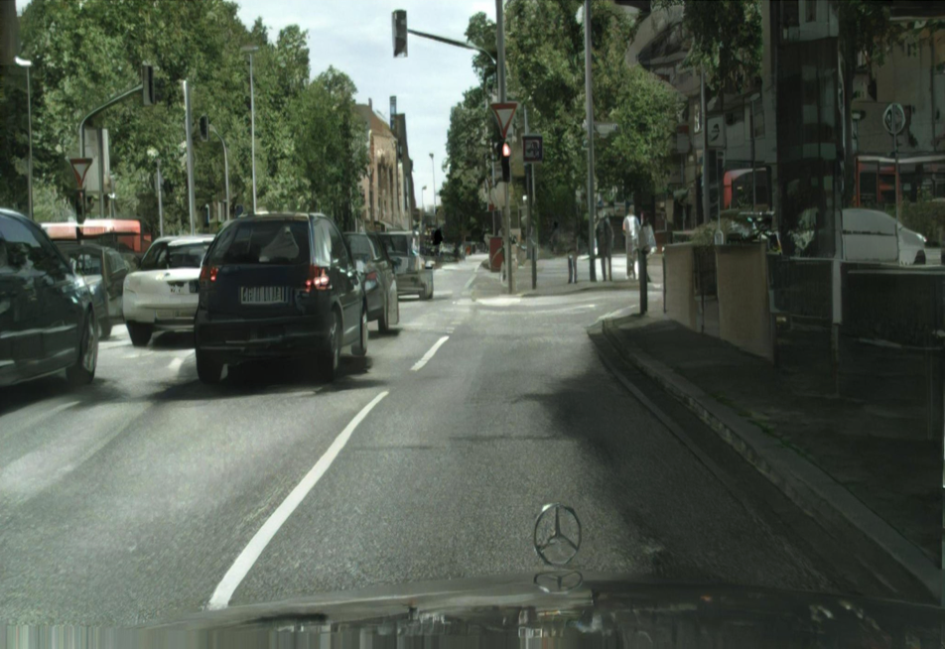
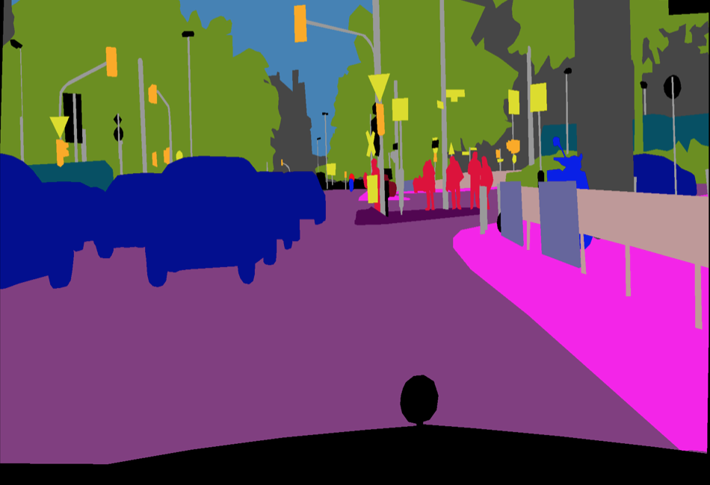
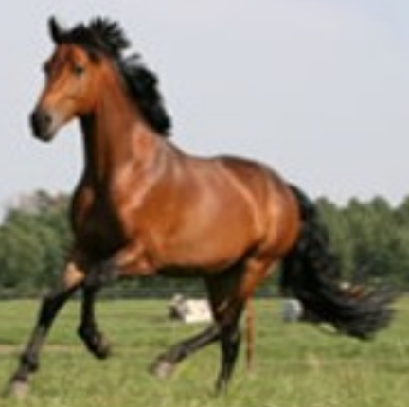
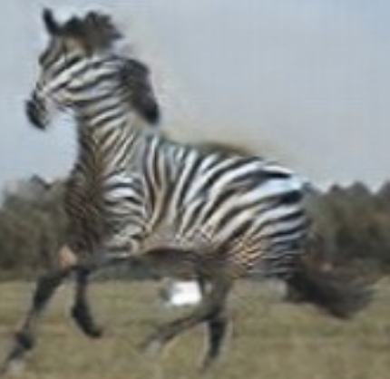
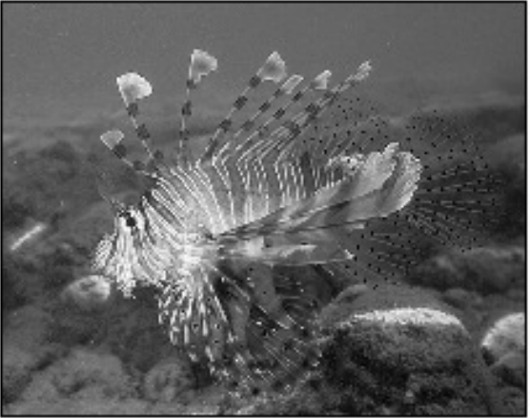
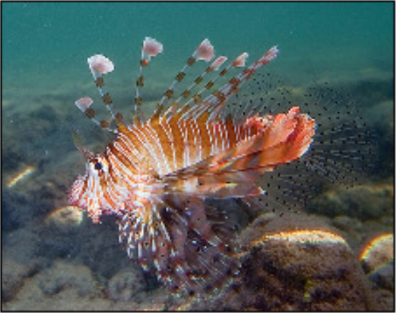
Image-to-Image Translation
Domain A
Domain B
Gray
Label
Horse
Image
Zebra
Color
[Wang et al. CVPR 2018]
[Zhang et al. ECCV 2016]
[Zhu et al. ICCV 2017]
Notes:
Image to image translation aims to learn the mapping between two visual domains.
For ex, colorization, we learn to map gray to color images. Image synthesis, we learn to map semantic label to real image
We can even learn the mapping for two domains that corresponding data does not exist, for ex, horse to zebra

Slide 3
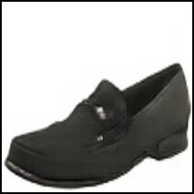
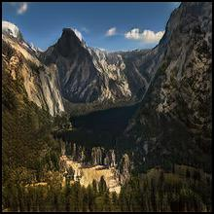
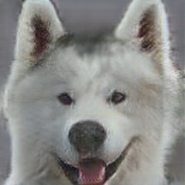
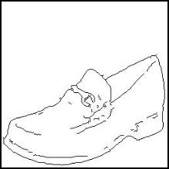
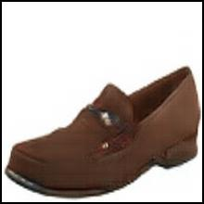
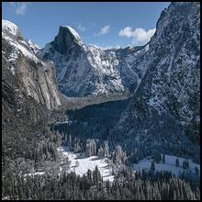
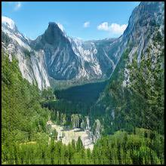
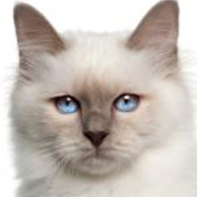
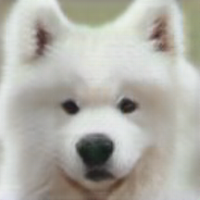
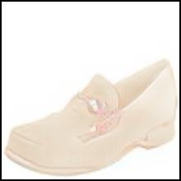
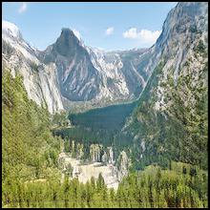
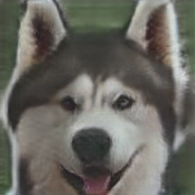
Challenges
1. Paired training data: scarce/not exist
2. Multimodal (one-to-many) mapping
Paired
Scarce
Not Exist
?
{
,
}
{
,
}
{
,
}
…
…
…
Notes:
There are some challenges in image2image translation.
First, although some translation can be learned with paired data, but in most cases, paired training data is scarce, or even does not exist.
Second, no matter the data is paired or not, most translations are in nature multimodal, that is, one-to-many mapping.

Slide 4
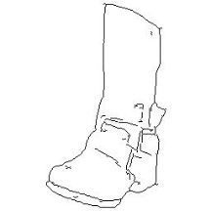
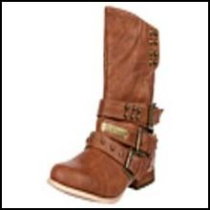
Related Work
Paired data
One-to-one mapping
Source domain
Latent space
Target domain
$$x$$
$$y$$
$$𝒵_{𝒳→𝒴}$$
$$𝒳$$
$$E_{𝒳}$$
$$G_{𝒴}$$
$$𝒴$$
$$E_{𝒳}$$
$$z$$
$$G_{𝒴}$$
$$E_{𝒳}$$
$$x$$
$$z_{𝒳→𝒴}$$
$$y$$
$$D$$
[Pix2pix: Isola et al. 2017]
Real/Fake
Notes:
I will introduce how previous work deals with these two challenges. First, let’s put aside all constraints. Assuming we have paired data, we can ask the model to learn the mapping function. The model can be trained with adversarial loss that a discriminator attempts to discriminate the pair is real or fake. We can illustrate the translation by this. It encodes the source domain onto a latent space, then decodes it to the target domain

Slide 5
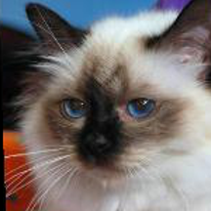
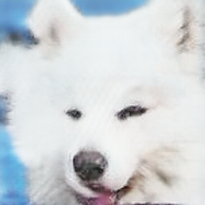
Related Work
Unpaired data
One-to-one mapping
Domain 1
Latent Space
Domain 2
$$x$$
$$y$$
$$𝒵_{𝒳→𝒴}$$
$$z$$
$$E_{𝒳}$$
$$G_{𝒴}$$
$$E_{𝒳}$$
$$G_{𝒴}$$
$$𝒳$$
$$E_{𝒳}$$
$$z_{𝒳→𝒴}$$
$$𝒴$$
$$x$$
$$y$$
Cycle
Consistency
$$G_{𝒳}$$
$$E_{𝒴}$$
$$z_{𝒴→𝒳}$$
$$\hat{x}$$
$$D$$
$$𝒵_{𝒴→𝒳}$$
[DiscoGAN: Kim et al. 2017,
CycleGAN: Zhu et al. 2017]
Real/Fake
$$z$$
$$𝒵$$
$$G_{𝒳}$$
$$E_{𝒴}$$
$$𝒳$$
$$E_{𝒳}$$
$$G_{𝒴}$$
$$𝒴$$
$$x$$
$$G_{𝒳}$$
$$z$$
$$E_{𝒴}$$
$$y$$
[UNIT: Liu et al. NIPS 2017]
Notes:
Now, in many cases, the training data is unpaired. What can we do?
We first perform forward translation just like the previous paired case. And then we perform the backward translation.
we can train the model with cycle consistency, that is, reconstruction loss.
It can be illustrated like this. It includes the forward encoding-decoding, and backward encoding-decoding. Some work makes an assumption that the latent space is shared

Slide 6
Related Work
Paired data
One-to-many mapping
Source domain
Latent space
Target domain
$$x$$
$$𝒵_{𝒳→𝒴}$$
$$E_{𝒳}^{c}$$
$$\hat{y}$$
$$z_{x }^{c}$$
$$z_{x}^{c}$$
$$𝒳$$
$$E_{𝒳}^{c}$$
$$𝒴$$
$$x$$
$$y$$
$$G_{𝒴}$$
$$G_{𝒴}$$
$$y$$
$$E_{𝒴}^{a}$$
$$z_{y}^{a}$$
$$E_{𝒴}^{a}$$
$$z_{𝒴}^{a}$$
[BicycleGAN: Zhu et al. 2017]
$$𝒜_{𝒴}$$
Reconstruction Loss
Augmented Space
Notes:
Now, let’s see how to tackle the multimodal constraints. Assuming we have paired training data.
One domain provides shared information between domains, like contour and shape. The other domain provides style information, like color.
These two components are used to reconstruct the target images. It can be illustrated like this, it augments an additional space for the target domain.

Slide 7
Disentangled Representation I2I (DRIT)
Domain-invariant content space
Domain-specific attribute space
 | Paired data | Unpaired data
Unimodal | Pix2pix [Isola et al.] | DiscoGAN [Kim et al.], CycleGAN [Zhu et al.], UNIT [Liu et al.]
Multimodal | BicycleGAN [Zhu et al.] Pix2pixHD [Wang et al.] | DRIT (Ours)
$$𝒞$$
$$E_{𝒳}^{c}$$
$$z^{c}$$
$$E_{𝒴}^{c}$$
$$𝒳$$
$$𝒴$$
$$x$$
$$y$$
$$z_{𝒳}^{a}$$
$$z_{𝒴}^{a}$$
$$𝒜_{𝒳}$$
$$𝒜_{𝒴}$$
Notes:
Our model combines the advantages of previous methods and deal with the setting that can generate diverse results with unpaired data. We propose to explicitly disentangle the image representation into a domain-invariant content space, and a domain-specific attribute space. We abbreviate our model as DRIT. Note that although some previous work also uses an augmented space, they do not enforce the disjoint of the content and attribute space. In the following I will explain in details how this disentangled representation can help multimodal mapping as well as training with unpaired data.

Slide 8
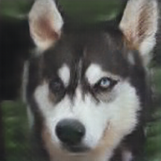
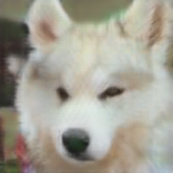
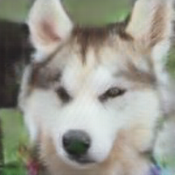
Multimodal Mapping
$$𝒞ontent$$
$$𝒳$$
$$E_{𝒳}^{c}$$
$$𝒴$$
$$G_{𝒴}$$
$${𝒜ttribute}_{𝒴}$$
Notes:
First, let’s revisit the usage of attribute space.
Why can additional attribute space help multimodal translation?
One domain provides the domain-invariant features, and we can randomly sample in the attribute space to generate diverse results.

Slide 9
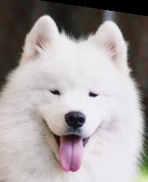
Multimodal Mapping
$$𝒞ontent$$
$$𝒳$$
$$E_{𝒳}^{c}$$
$$𝒴$$
$$G_{𝒴}$$
$$E_{𝒴}^{a}$$
$${𝒜ttribute}_{𝒴}$$
Notes:
With the attribute space, we can also perform example-guided translation.
Given an image with desired attribute, we can perform translation with the mapped attribute representation.

Slide 10
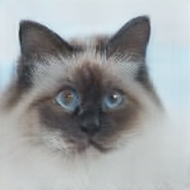
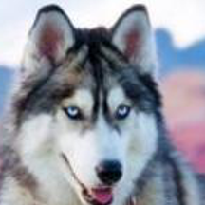
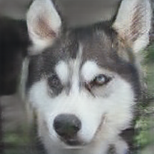
Training with Unpaired Data
Cross-Cycle Consistency
$L_{1}^{cc}$
$$x$$
$$u$$
$$\hat{x}$$
$$E_{𝒳}^{a}$$
$$E_{𝒳}^{a}$$
$$G_{𝒳}$$
$$G_{𝒳}$$
$$E_{𝒳}^{c}$$
$$E_{𝒳}^{c}$$
$$E_{𝒴}^{c}$$
$$E_{𝒴}^{c}$$
$$G_{𝒴}$$
$$G_{𝒴}$$
$$E_{𝒴}^{a}$$
$$E_{𝒴}^{a}$$
$$y$$
$$v$$
$$\hat{y}$$
$L_{1}^{cc}$
Notes:
Next, how can we train the model without paired data with the help of disentangled representation? Given two unpaired images, we encode them into content and attribute features. since the content space is shared between two domains, we can swap the content features.
And then we perform the first translation. The translated results u have y content x style, v have x content y style. We perform the same procedure again, encode, swap and perform the second translation. The results of the second translation should reconstruct the original input images. We call it cross-cycle consistency. Please find the implementation details and other loss functions in the paper or visit us in the poster session.

Slide 11
Content Discriminator
$$x$$
$$E_{𝒳}^{a}$$
$$E_{𝒳}^{c}$$
$L_{\text{adv}}^{content}$
Which domain?
$$E_{𝒴}^{c}$$
$$E_{𝒴}^{a}$$
$$y$$
Notes:
However cross-cycle consistency alone cannot guarantee the disentanglement of content and attribute space.
Therefore, we apply a content discriminator on the encoded content features.
The discriminator aims to discriminate which domain is the content feature from.
With the adversarial training, the content encoder will attempt to encode only the domain-invariant features.

Slide 12
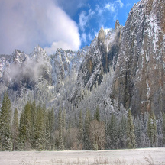
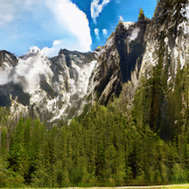
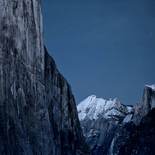
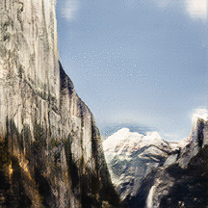
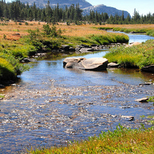
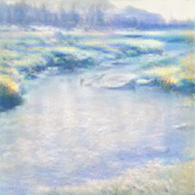
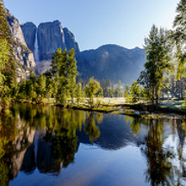
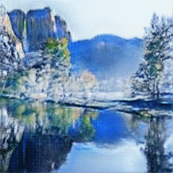
Randomly Sampled Translation: Shape Preserved
Notes:
Here are some generated results of our model, the translations are all multimodal.
We roughly divide translation into two categories: one with only color changes, and one with shape variation.
Our model performs well on both cases.
We first show the color changes cases, including seasonal changes, winter to summer, and translation from real image to artwork.

Slide 13
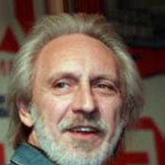
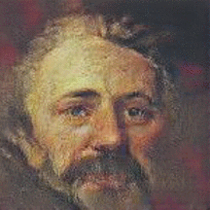
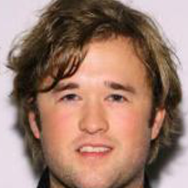
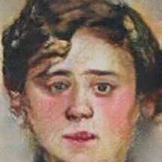
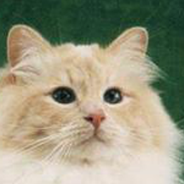
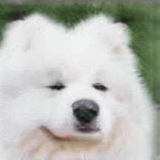
Randomly Sampled Translation: Shape Variation
Notes:
Then we show two shape variations cases.
Photo portrait to artwork portrait.
Cat to dog

Slide 14
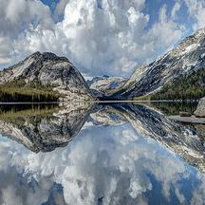
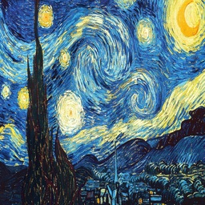
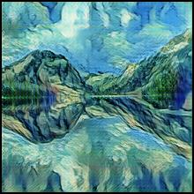
Example-guided Translation: Inter-Domain
Content
Attribute
Output
Notes:
We can perform example-guided translation.
One domain provides content, the other provides attribute.
The translation results will contain desired attribute

Slide 15
Example-guided Translation: Intra-Domain
Content
Attribute
Output
Notes:
Since the content space is shared between two domains, we can even perform translation within the same domain.
one image provides content, the other provides attribute
The content and attribute come from the same domain. Then we perform the translation
Note that we do not include this translation during training.

Slide 16
Visual Comparison
CycleGAN [Zhu et al. ICCV’17] + noise
Input
Ours
CycleGAN+BicycleGAN
[Zhu et al. ICCV’17, Zhu et al. NIPS’17]
Notes:
We compare our method with several baseline. First, inject additional noise vectors into CylcleGAN. However, without explicit constraints on the additional noise vectors, CycleGAN will ignore the additonal vector. Second, we generate pseudo-paired data by CycleGAN and train with BicycleGAN. It does show variation, however, since CycleGAN itself suffers from mode collapse to some extent, the variation is limited. And the quality of the pseudo-groundtruth is not uniformly well, the translation results have some detailed artifacts.

Slide 17
Realism: User Study
Cycle/
Bicycle
UNIT
CycleGAN
Real images
DRIT (ours)
DRIT
Cycle/
Bicycle
UNIT
CycleGAN
Notes:
We evaluate the realism by user study. We provide two images and ask user “which image is more realistic. The left hand side is the comparison of other methods with our model. The bar shows the percentage of preference in comparisons. The right hand side is the comparison with the real image. We perform better than most baseline methods. CycleGAN performs better in quality at the cost of diverisy.

Slide 18
Diversity
LPIPS metric [Zhang et al. 2018]
Notes:
We evaluate diversity with the LPIPS metric.
It can be viewed as the average feature distance within a collection of images.
Our model outperforms the unimodal methods as well as the baseline multimodal methods.

Slide 19
Without Content Discriminator
Ours
DRIT (ours)
DRIT w/o $D^{c}$
Ours w/o content discriminator $D^{C}$
↓
Only global color variation
Notes:
Now, we demonstrate the importance of the content discriminator.
Qualitatively, the model can still generate diverse images without the content discriminator, however, without the help of the content discriminator to disentangle the domain-invariant content and domain-specific attribute, the model fails to capture desirable details, like color of tree and sky, it can only perform global color variation.
Quantitatively, our model is more realistic and more diverse with the help of the content discriminator.

Slide 20
Concurrent Work
MUNIT Multimodal Unsupervised Image-to-Image Translation Huang et al. ECCV 2018
Augmented CycleGAN Augmented CycleGAN: Learning Many-to-Many Mappings from Unpaired Data Almahairi et al. ICML 2018
EG-UNIT Exemplar Guided Unsupervised Image-to-Image Translation Ma et al. ICML 2018
Notes:
Recently, there are some concurrent work proposes similar idea despite some interesting differences.
We encourage everyone to check them up to have better understanding on this topic.

Slide 21
Conclusion
Diverse image-to-image translation with unpaired data
Disentangled representation
Domain-invariant content space
Domain-specific attribute space
Cross-cycle consistency
Notes:
In conclusion, we propose to leverage disentangled representation with the help of cross-cycle consistency to achieve diverse image-to-image translation with unpaired data.

Slide 22
Code and data available at http://bit.ly/DRIT-ECCV18
Notes:
Thank you for your attention.
Code and data are available.
Please visit us in the poster session, our poster number is 89

