Slide 1
Convolutional Neural Networks
(CNNs)
Michael Cogswell
Machine Learning and Perception Lab
Slides: Myself, Larry Zitnick, Devi Parikh, others

Slide 2
Outline
Image Classification with CNNs
  Approach 1: previous methods
  Approach 2: CNNs
Broader Impact on Computer Vision

Slide 3
Part 1:
Image Classification with CNNs

Slide 4
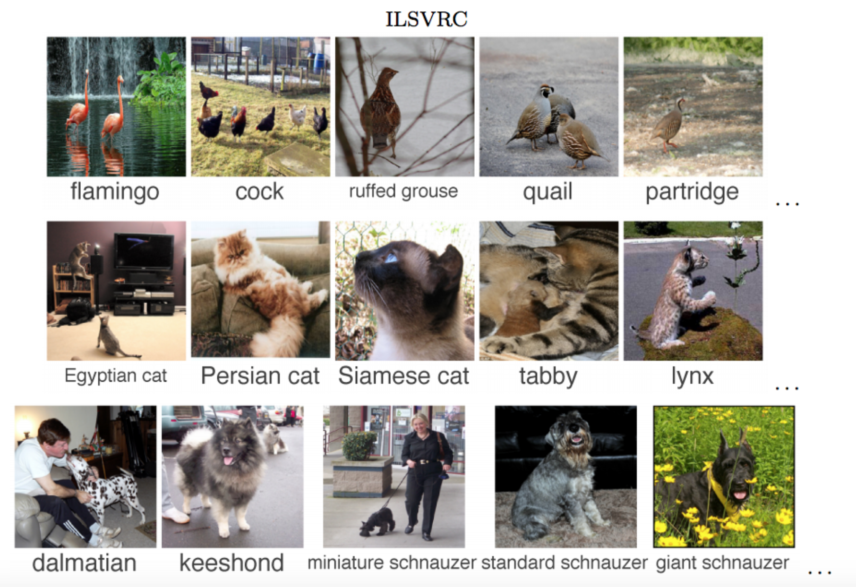
Image Classification - ImageNet
Russakovsky et. al.; IJCV 2015

Slide 5
2012 ImageNet Challenge

Slide 6
2012 ImageNet Challenge

Slide 7
2015 ImageNet Challenge
Current Error Rate: 4.9%
  Ioffe, Sergey, and Christian Szegedy. "Batch Normalization: Accelerating Deep Network Training by Reducing Internal Covariate Shift." arXiv preprint arXiv:1502.03167 (2015).

Slide 8
2015 ImageNet Challenge
Current Error Rate: 4.9%
  Ioffe, Sergey, and Christian Szegedy. "Batch Normalization: Accelerating Deep Network Training by Reducing Internal Covariate Shift." arXiv preprint arXiv:1502.03167 (2015).
Human Error Rate: 6.4%
  Russakovsky, Olga, et al. "Imagenet large scale visual recognition challenge."arXiv preprint arXiv:1409.0575 (2014).

Slide 9
Approach 1
Hand Engineered Features + Simple Classifier

Slide 10
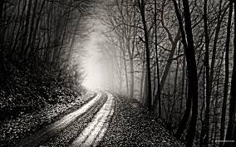
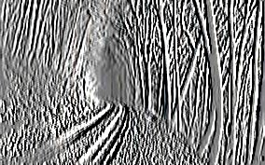
Convolutions / Linear Filters
Demo
-1 0 1
-1 0 1
-1 0 1
=
*
Slide Credit: Marc'Aurelio Ranzato

Slide 11
Convolutions / Linear Filters
-1 0 1
-1 0 1
-1 0 1
=
*
Slide Credit: Marc'Aurelio Ranzato

Slide 12
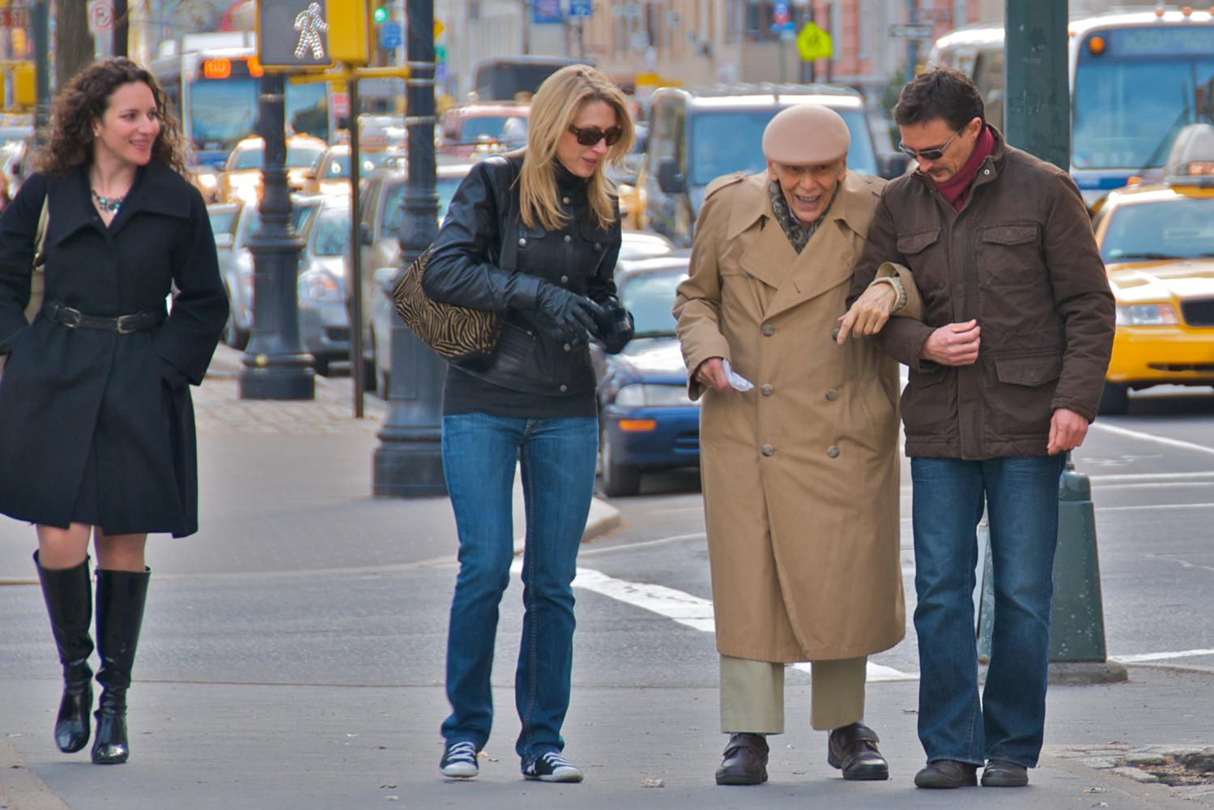
Hand Engineered Features

Slide 13
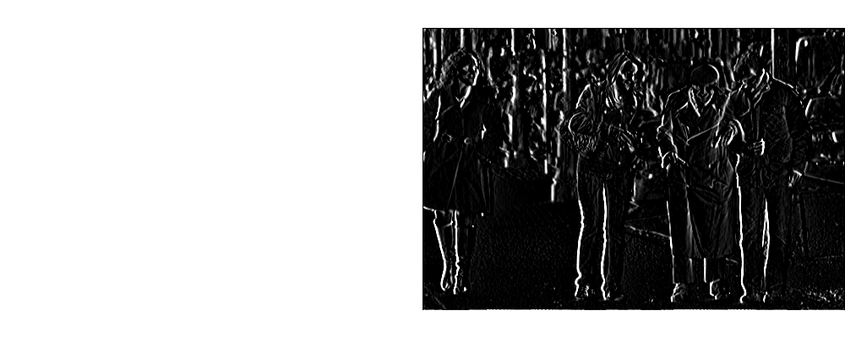
Hand Engineered Features

Slide 14
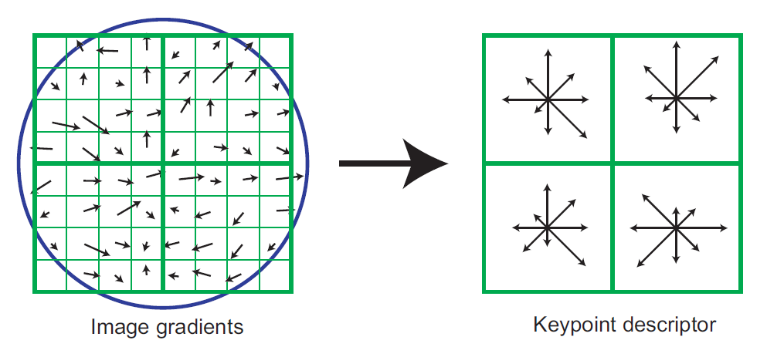
Hand Engineered Features
Histograms of oriented gradients for human detection, Dalal and Triggs, CVPR 2005.

Slide 15
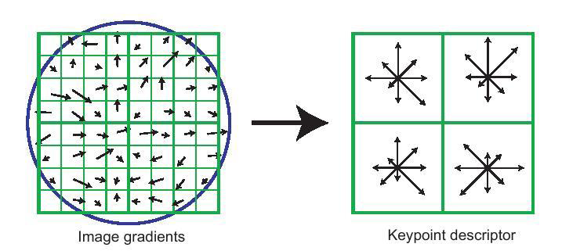
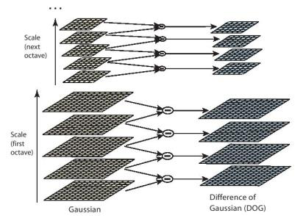
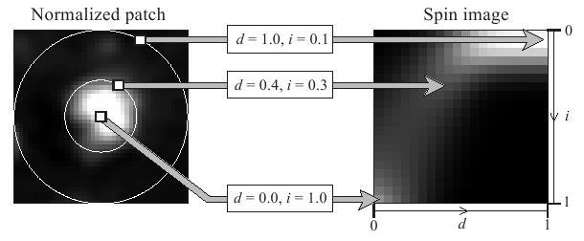
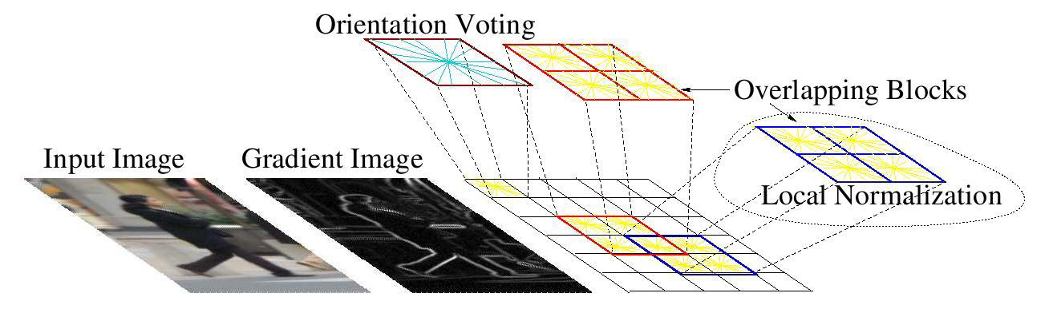
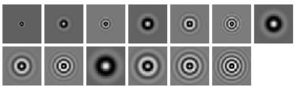
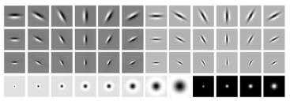
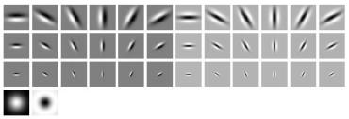
Hand Engineered Features
SIFT
Spin Images
HoG
Textons
and many many more….

Slide 16
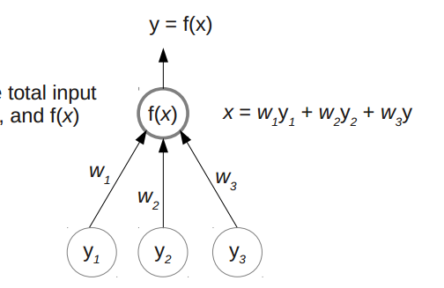
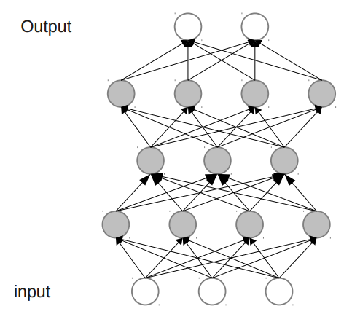
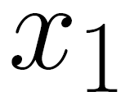
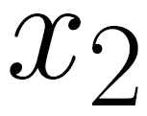
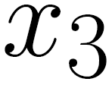
Simple Classifier
0.98 dog
0.001 cat

Slide 17
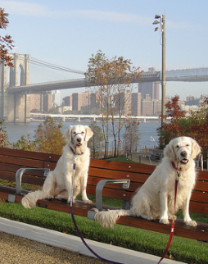
Approach 1 - Pipeline
Hand Engineered Features
Classifier
“dog”
fixed
learned

Slide 18
Approach 2: CNNs
Built-in Features w/ Deep Classifier

Slide 19

Deep Classifier
0.98 dog
0.001 cat
* non-linearities

Slide 20
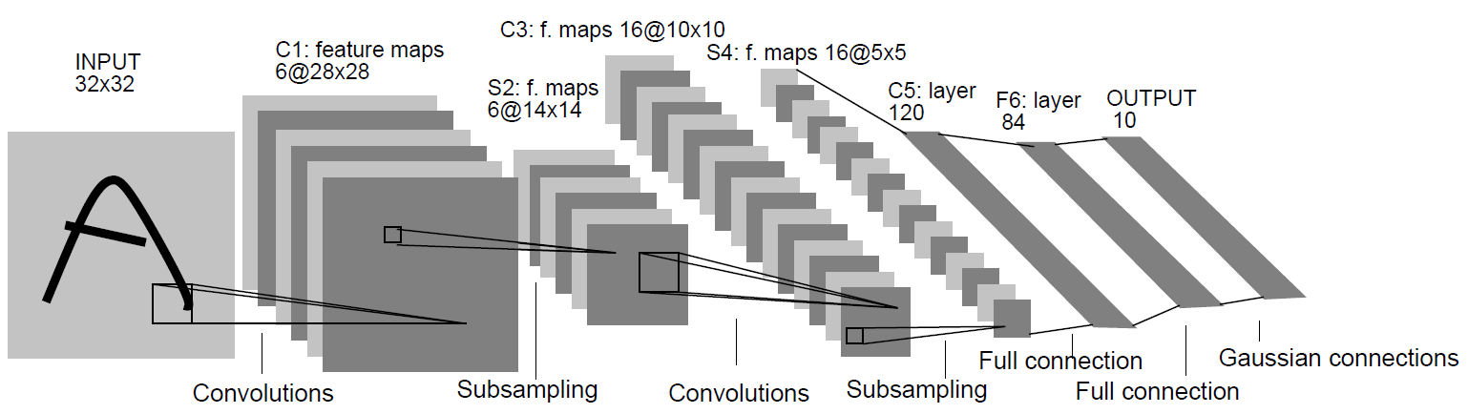
Features
Raw pixel inputs… how?
  Convolutions
  Shrinking
learned!
http://setosa.io/ev/image-kernels/
[Figure: LeCun et. al.]

Slide 21
Approach 2 - Pipeline
Learned
Features
…
Learned
Features
Learned
Features
Classifier
“dog”

Slide 22
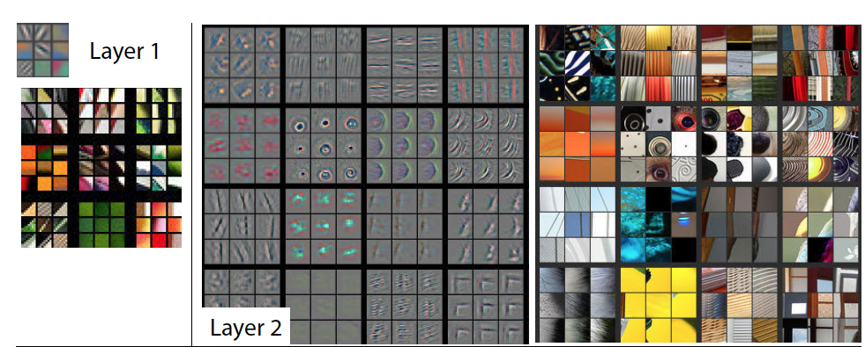
Learned
Features
…
Learned
Features
Learned
Features
Classifier
“dog”
Figure Credit: [Zeiler & Fergus ECCV14]
Figure Credit: [Zeiler & Fergus ECCV14]

Slide 23
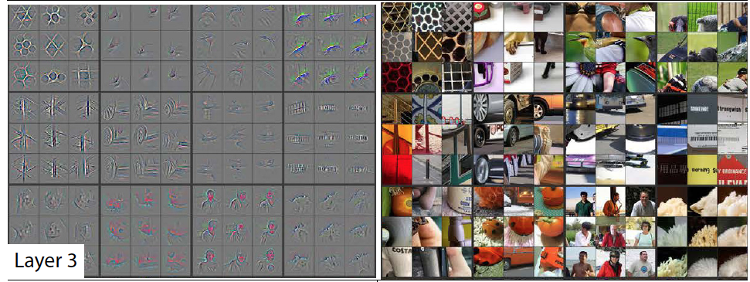
Learned
Features
…
Learned
Features
Learned
Features
Classifier
“dog”
Figure Credit: [Zeiler & Fergus ECCV14]
Figure Credit: [Zeiler & Fergus ECCV14]

Slide 24
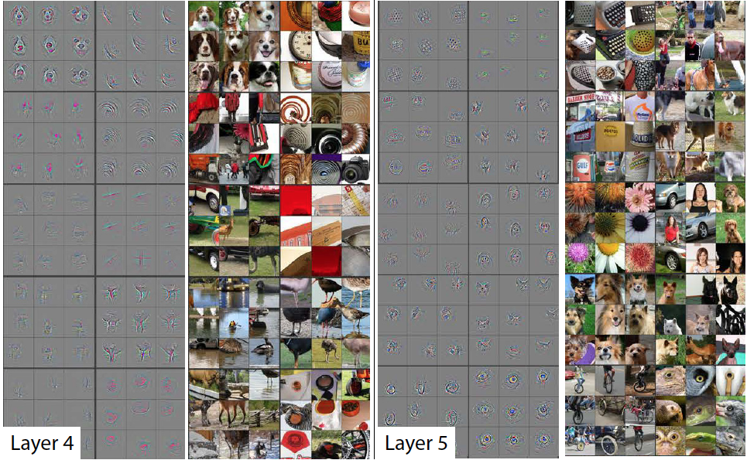
Learned
Features
…
Learned
Features
Learned
Features
Classifier
“dog”
Figure Credit: [Zeiler & Fergus ECCV14]
Figure Credit: [Zeiler & Fergus ECCV14]

Slide 25
Figure Credit: [Zeiler & Fergus ECCV14]

Slide 26
1989
Image
Output
“A”
Backpropagation applied to handwritten zip code recognition, Lecun et al., 1989

Slide 27
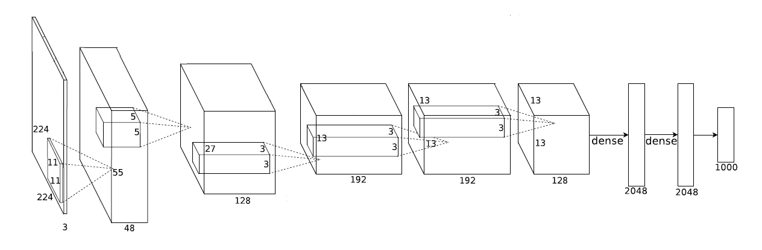
2012
Image
Output
“dog”
Imagenet Classification with Deep Convolutional Neural Networks, Krizhevsky, Sutskever, and Hinton, NIPS 2012

Slide 28
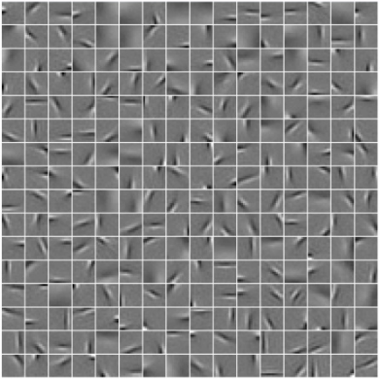
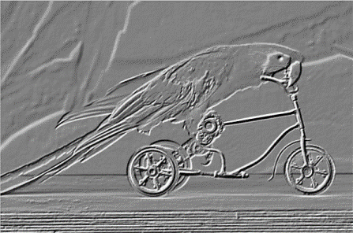
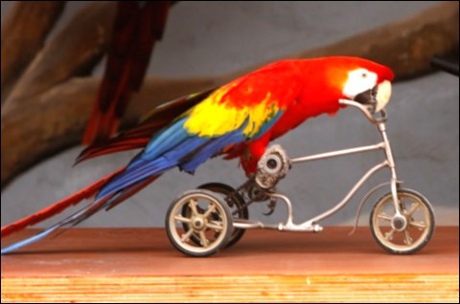
1989
Pooling
Convolution
Image

Slide 29
What Changed?

Slide 30
2012
Algorithms – Deep Learning
“dog”
2009
“dog”
Image
Image
Notes:
Caltech 256 : 256 categories (16)
ImageNet: 22000 categories (148)

Slide 31
Data – Number of (labeled) Images
2009
2012
30K
14M
Caltech 256 vs ImageNet
Notes:
Caltech 256 : 30607 images (173)
ImageNet: 14,197,122 images (3741)

Slide 32
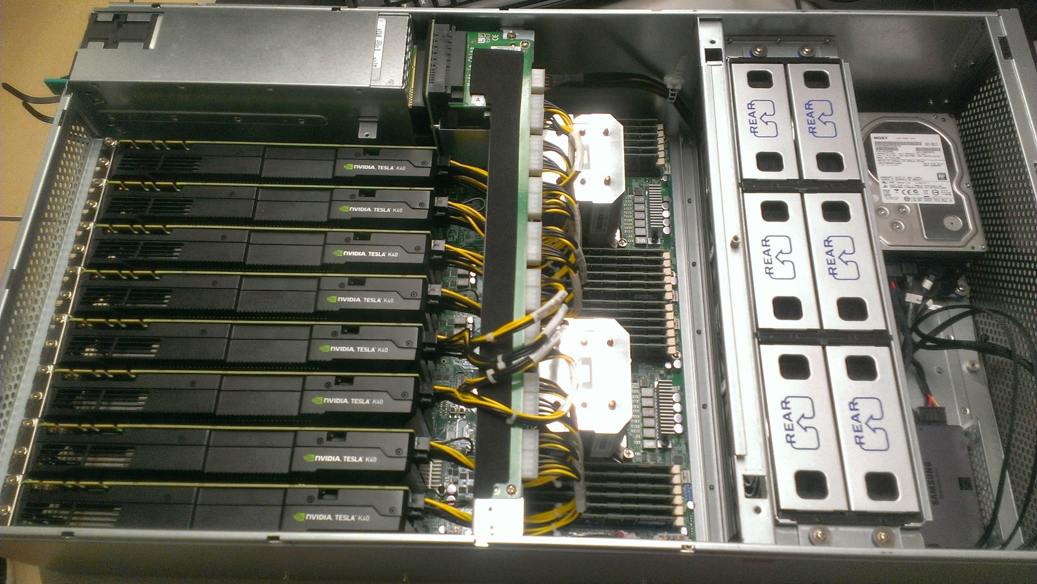
Compute Power - GPUs

Slide 33
Deep Learning
Data
GPUs
+
?

Slide 34
2012 ImageNet 1K (Fall 2012)

Slide 35
2012 ImageNet 1K (Fall 2012)

Slide 36
2015 ImageNet 1K
Current Error Rate: 4.9%
  Ioffe, Sergey, and Christian Szegedy. "Batch Normalization: Accelerating Deep Network Training by Reducing Internal Covariate Shift." arXiv preprint arXiv:1502.03167 (2015).

Slide 37
2015 ImageNet 1K
Current Error Rate: 4.9%
  Ioffe, Sergey, and Christian Szegedy. "Batch Normalization: Accelerating Deep Network Training by Reducing Internal Covariate Shift." arXiv preprint arXiv:1502.03167 (2015).
Human Error Rate: 6.4%
  Russakovsky, Olga, et al. "Imagenet large scale visual recognition challenge."arXiv preprint arXiv:1409.0575 (2014).

Slide 38
Part 2:
What else can a CNN do?

Slide 39
Object Detection

Slide 40
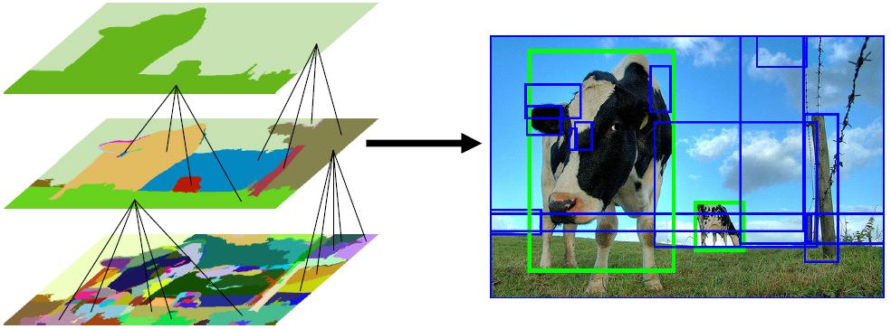
Finding object candidates
Use low-level cues…
Segmentation As Selective Search for Object Recognition,
van de Sande, Uijlings, Gevers, Smeulders, ICCV 2011

Slide 41
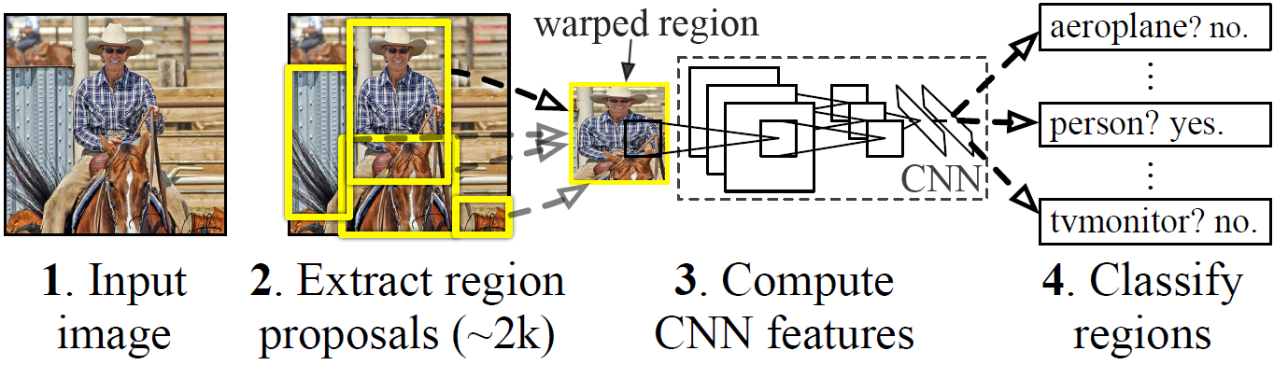
R-CNN
1. Input image
2. Extract region
proposals (~2k)
3. Compute CNN features
4. Classify regions
Rich Feature Hierarchies for Accurate Object Detection and Semantic Segmentation, Girshick, Donahue, Darrell, Malik, CVPR 2014.

Slide 42
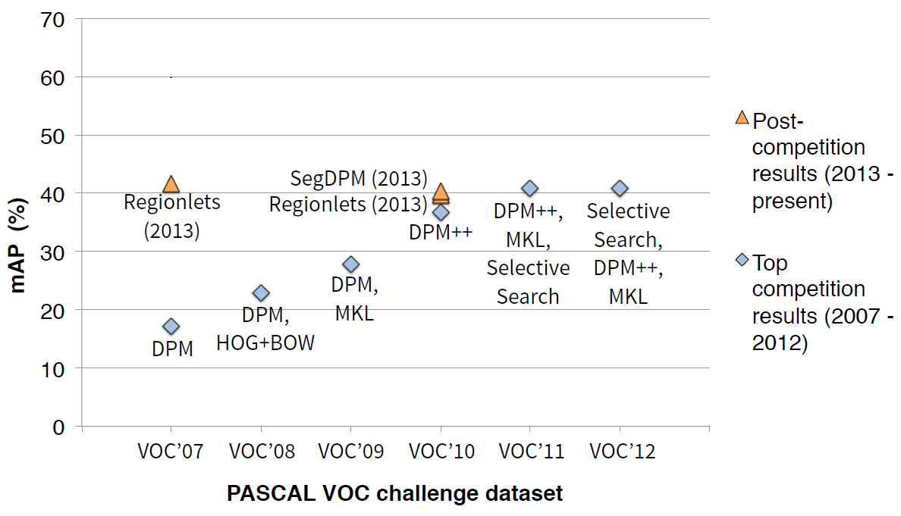

Slide 43
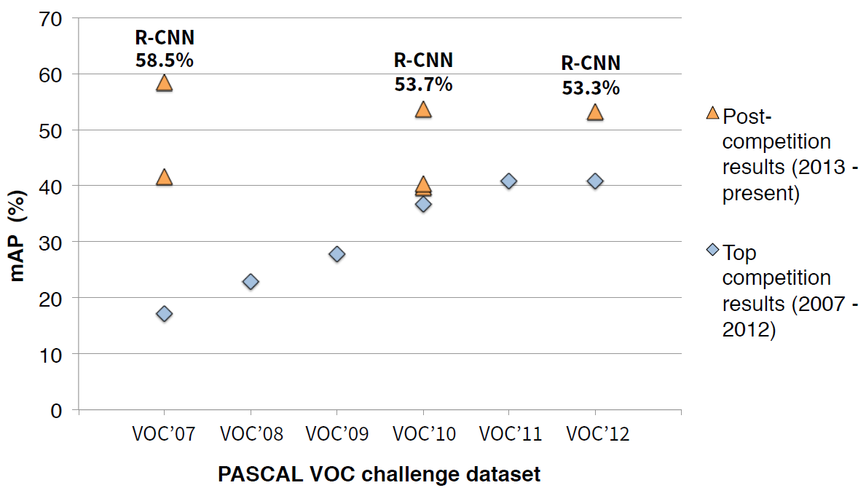
Current mAP: ~70%
  Faster r-cnn: Towards real-time object detection with region proposal networks, Ren, Shaoqing, et al. NIPS 2015

Slide 44
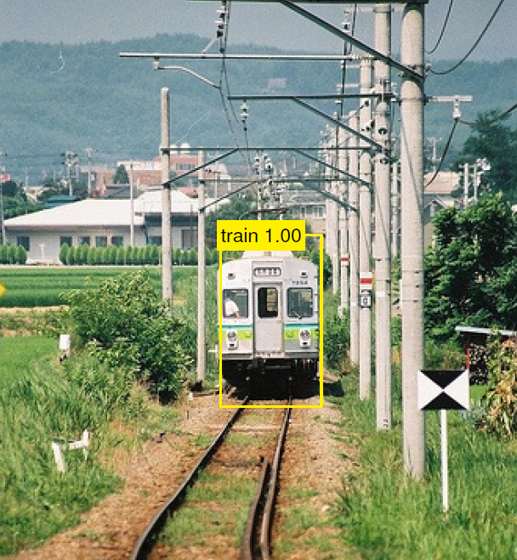

Slide 45
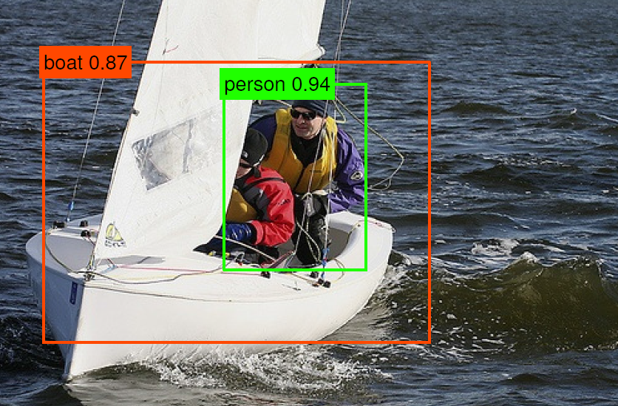

Slide 46
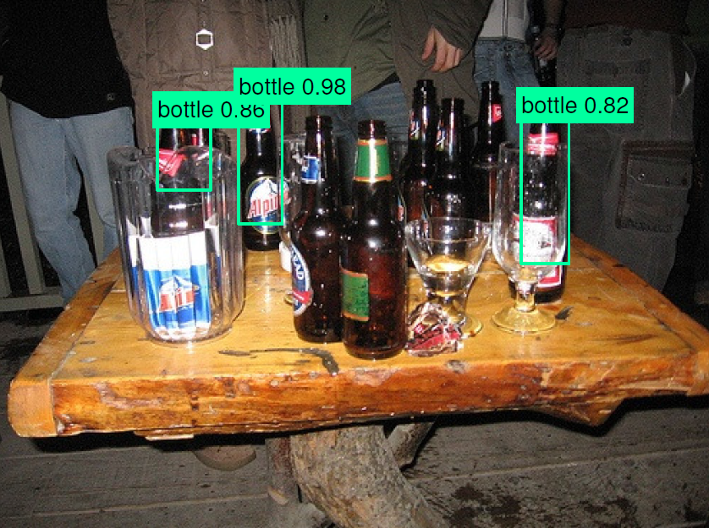

Slide 47
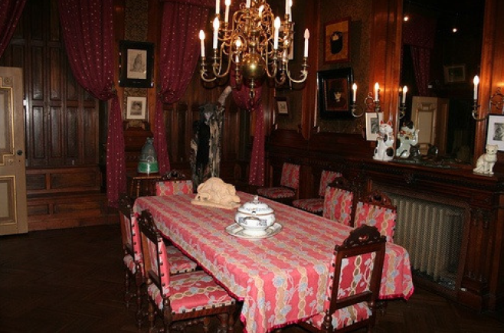

Slide 48
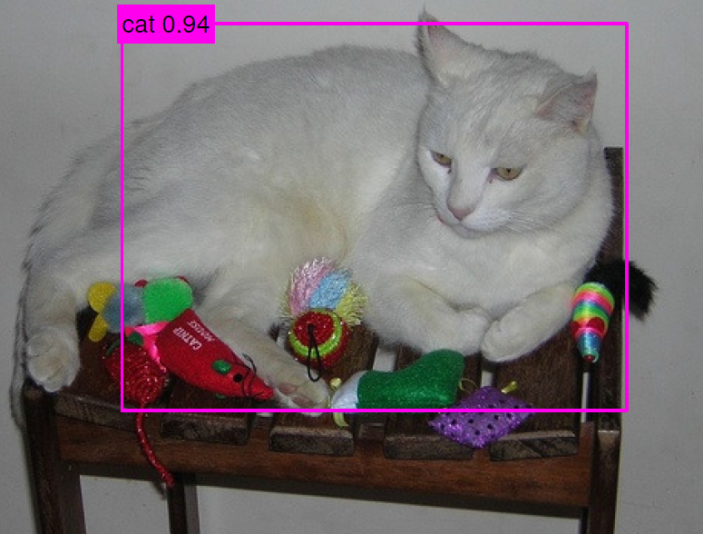

Slide 49
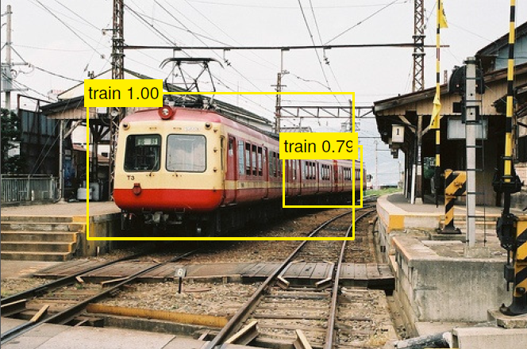

Slide 50
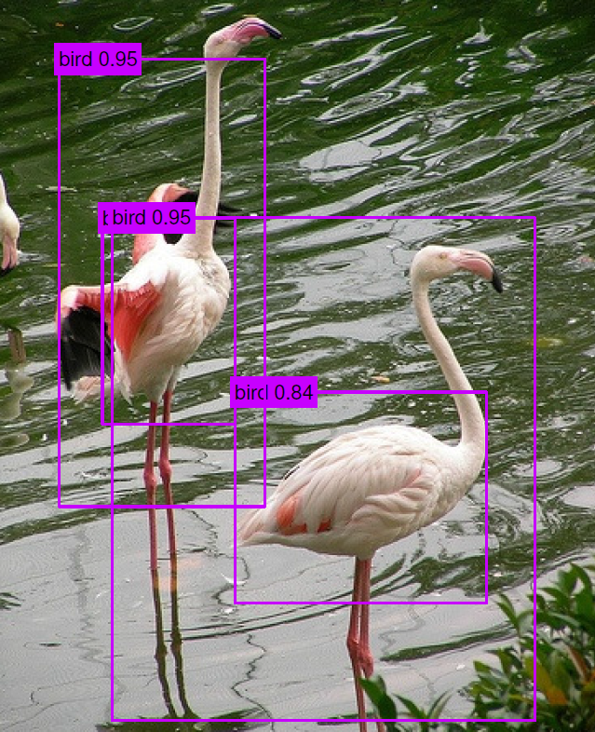

Slide 51
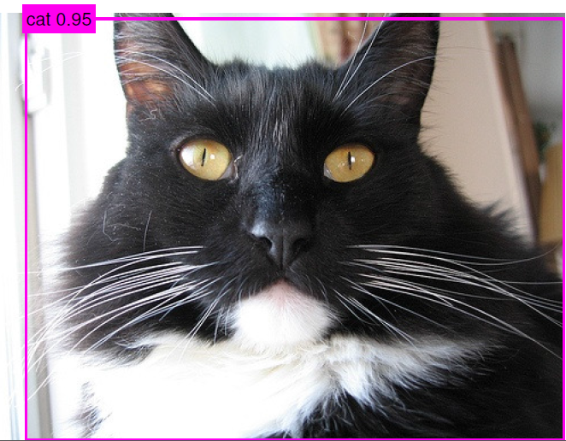

Slide 52
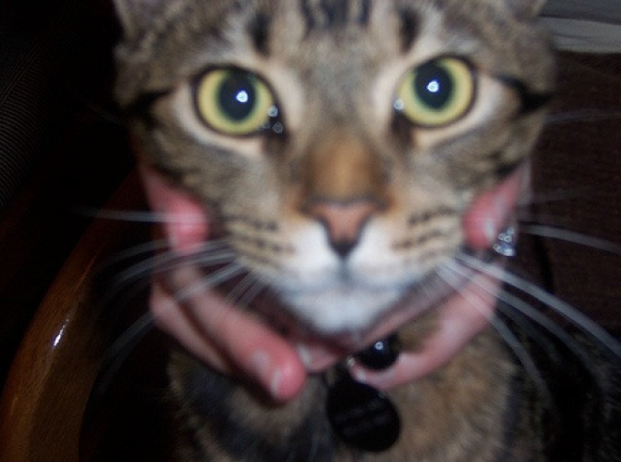

Slide 53
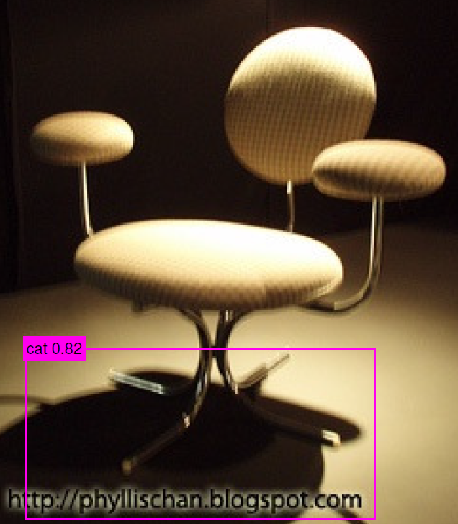

Slide 54
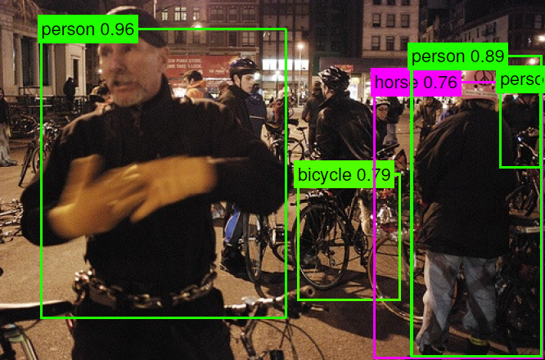

Slide 55
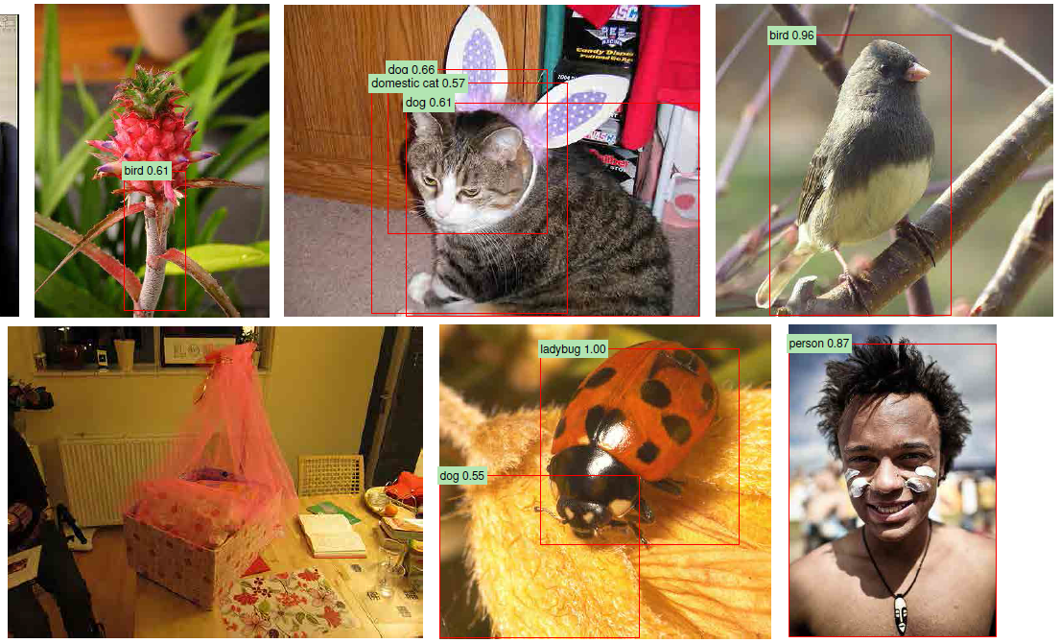
ImageNet (200 categories)

Slide 56
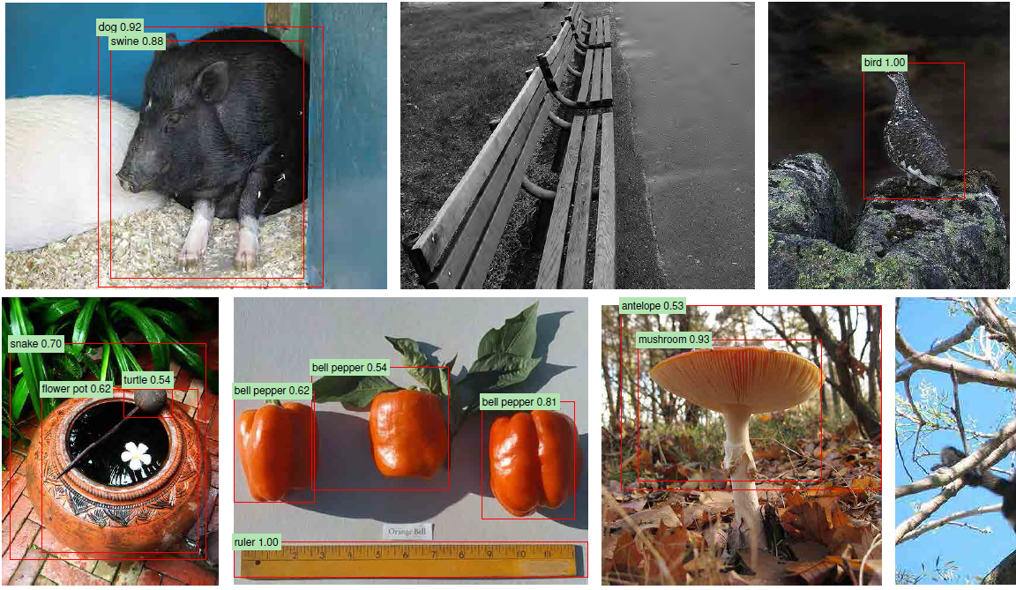
ImageNet (200 categories)

Slide 57
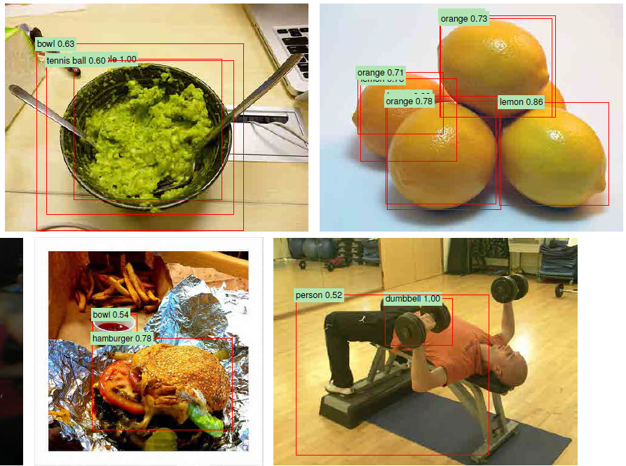

Slide 58
Object Segmentation
Conditional random fields as recurrent neural networks,
Zheng, Shuai, et al. ICCV 2015

Slide 59
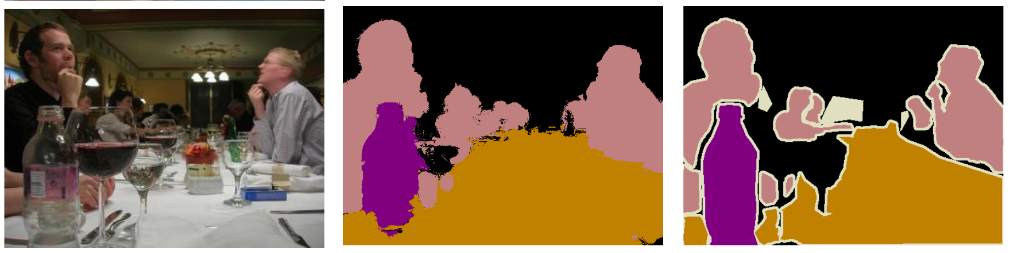
Input
CNN Segmentation
Ground Truth

Slide 60
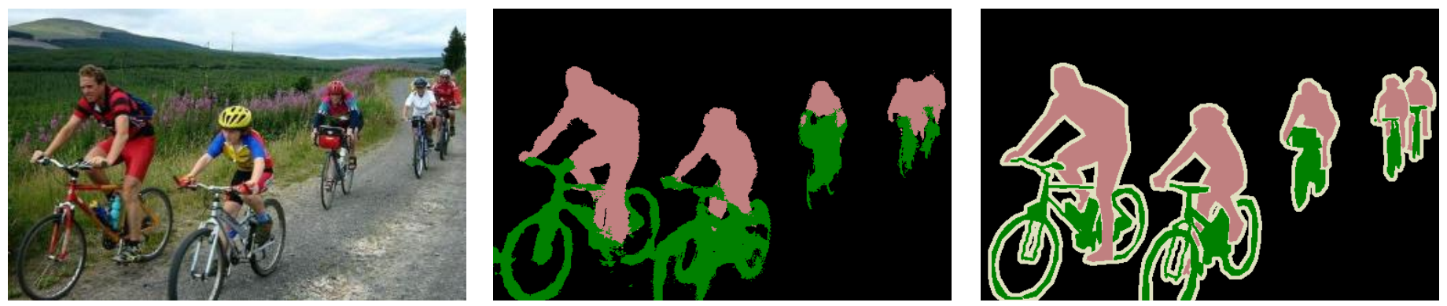
Input
CNN Segmentation
Ground Truth

Slide 61
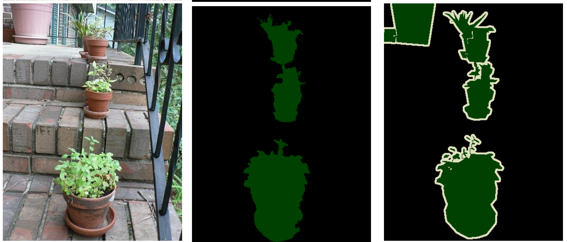
Input
CNN Segmentation
Ground Truth

Slide 62
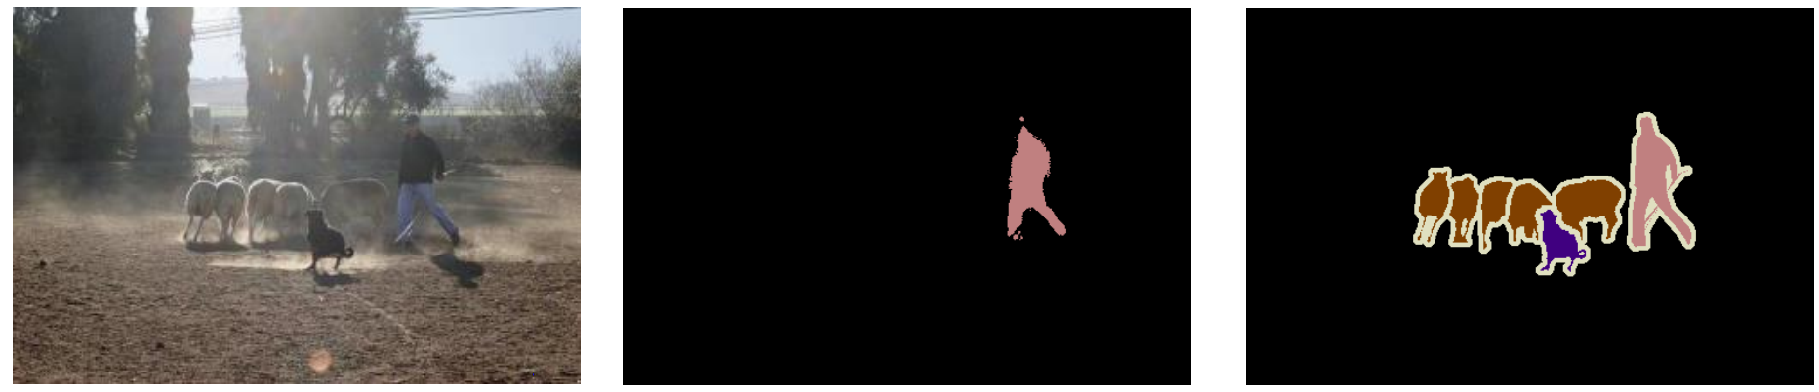
Input
CNN Segmentation
Ground Truth

Slide 63

Input
CNN Segmentation
Ground Truth
Notes:
Cow (green), dog (purple), horse (pink), sheep (brown)

Slide 64
General Features

Slide 65

0.98 beach
0.001 city
Train on ImageNet
Use features for different task
features

Slide 66

CNN Features off-the-shelf: an Astounding Baseline for Recognition.,
Razavian, Ali Sharif, et al. Computer Vision and Pattern Recognition Workshops (CVPRW), 2014

Slide 67
Image Captioning
Deep visual-semantic alignments for generating image descriptions,
Karpathy, Andrej, and Li Fei-Fei. CVPR 2015

Slide 68

Show and tell: A neural image caption generator,
Vinyals, Oriol, et al. CVPR 2015

Slide 69


Slide 70


Slide 71


Slide 72


Slide 73


Slide 74
In summary…
CNNs are great for understanding high level concepts in images.

Slide 75
The End
Thanks for listening!
Questions?

