Slide 1
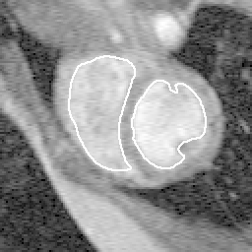
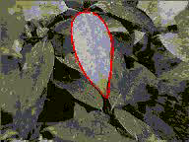
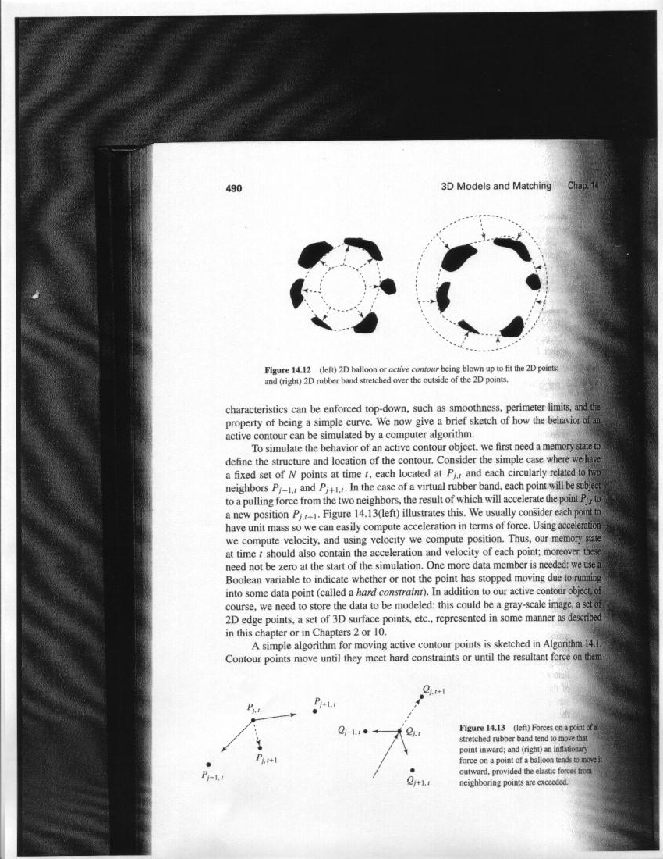
Fitting:
Deformable contours
Tuesday, September 22th 2015
Devi Parikh
Virginia Tech
Disclaimer: Many slides have been borrowed from Kristen Grauman, who may have borrowed some of them from others. Any time a slide did not already have a credit on it, I have credited it to Kristen. So there is a chance some of these credits are inaccurate.
Slide credit: Kristen Grauman

Slide 2
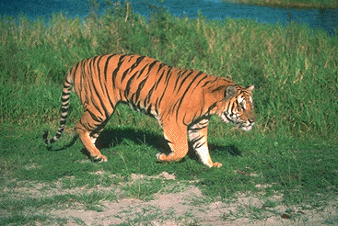
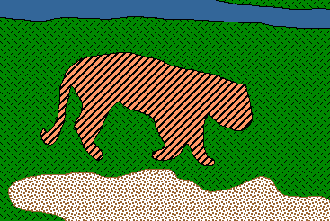
Recap so far:
Grouping and Fitting
Goal: move from array of pixel values (or filter outputs) to a collection of regions, objects, and shapes.
Slide credit: Kristen Grauman

Slide 3
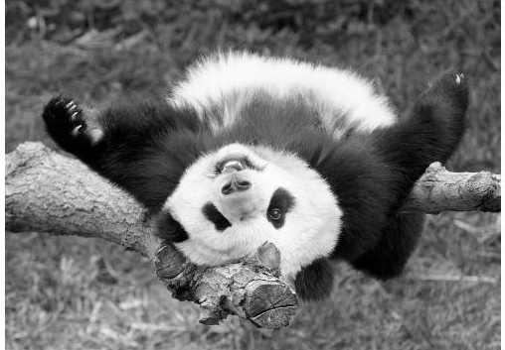
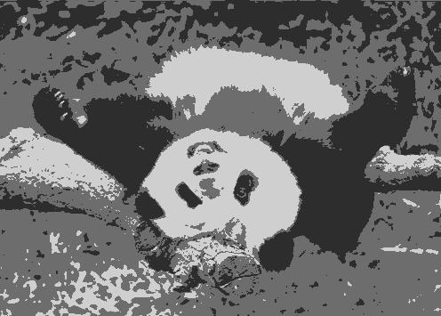

Grouping: Pixels vs. regions
By grouping pixels based on Gestalt-inspired attributes, we can map the pixels into a set of regions.
Each region is consistent according to the features and similarity metric we used to do the clustering.
image
clusters on intensity
image
clusters on color
Kristen Grauman

Slide 4
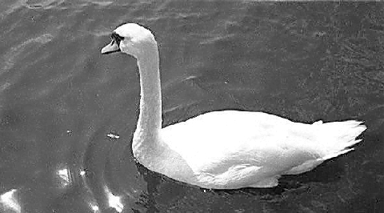
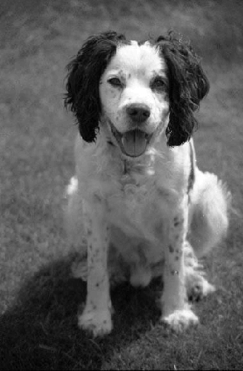
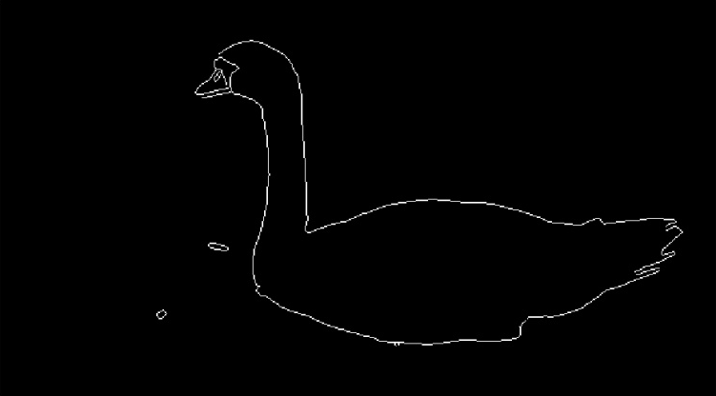
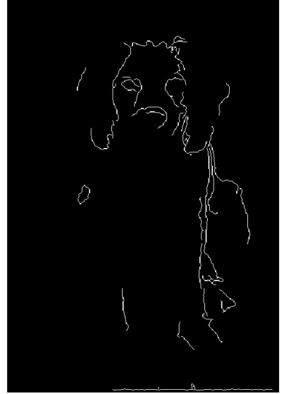
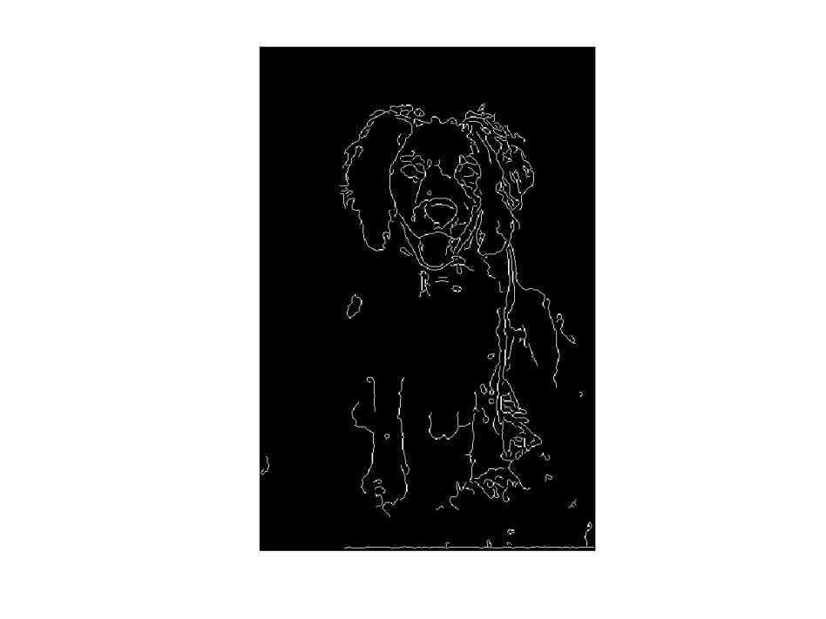
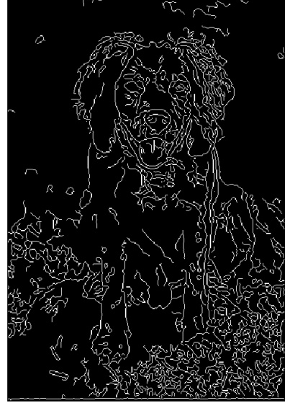
Fitting: Edges vs. boundaries
Edges useful signal to indicate occluding boundaries, shape.
Here the raw edge output is not so bad…
…but quite often boundaries of interest are fragmented, and we have extra “clutter” edge points.
Images from D. Jacobs
Kristen Grauman

Slide 5

Announcements
Project proposals
  Due in a week
  Teams of > 2
  Look at class webpage for guidelines
PS2 out
  Due October 5th
  Regarding detecting circles
    Origin in MATLAB vs. math
    Consider trying code on a simple image first
Slide credit: Adapted by Devi Parikh from Kristen Grauman

Slide 6
Topics overview
Features & filters
Grouping & fitting
  Segmentation and clustering
  Hough transform
  Deformable contours
  Alignment and 2D image transformations
Multiple views and motion
Recognition
Video processing
Slide credit: Kristen Grauman

Slide 7
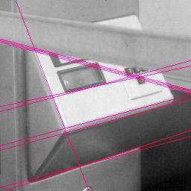
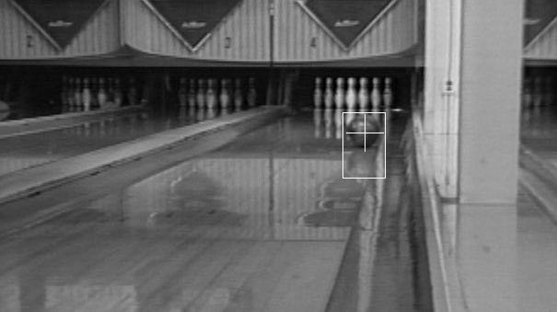
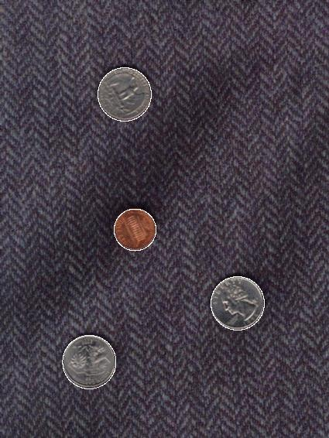
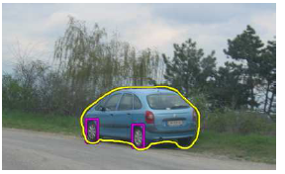
Fitting: Edges vs. boundaries
Given a model of interest, we can overcome some of the missing and noisy edges using fitting techniques.
With voting methods like the Hough transform, detected points vote on possible model parameters.
Kristen Grauman

Slide 8
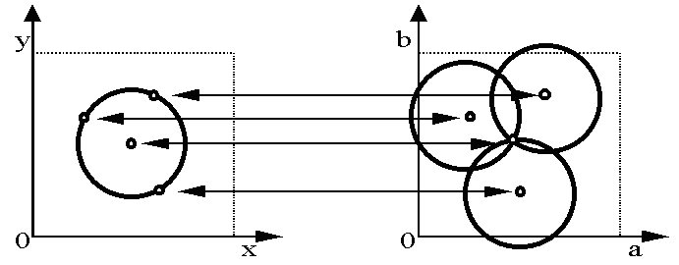
Voting with Hough transform
Hough transform for fitting lines, circles, arbitrary shapes
b
y
(x₁, y₁)
y₀
(x₀, y₀)
x₀
x
m
image space
Hough space
In all cases, we know the explicit model to fit.
Kristen Grauman

Slide 9
Hough transform for circles
Circle: center (a,b) and radius r
Equation of circle?
For a fixed radius r
Equation of set of circles that all pass through a point?
Image space
Hough space
Adapted by Devi Parikh from: Kristen Grauman

Slide 10
Hough transform for circles
Circle: center (a,b) and radius r
For a fixed radius r
Intersection: most votes for center occur here.
Image space
Hough space
Kristen Grauman

Slide 11
Hough transform for circles
Circle: center (a,b) and radius r
For an unknown radius r
r
?
b
a
Image space
Hough space
Kristen Grauman

Slide 12
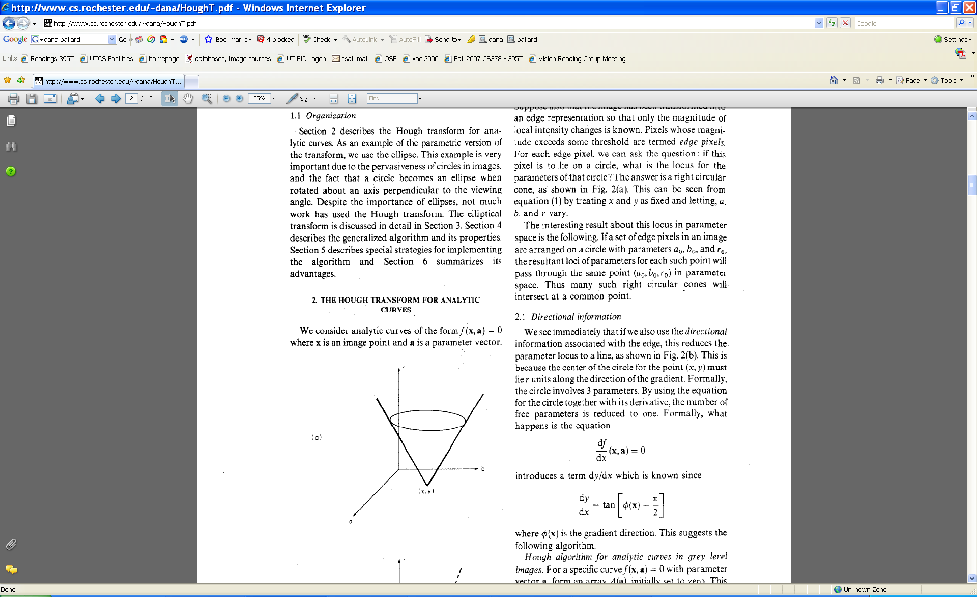
Hough transform for circles
Circle: center (a,b) and radius r
For an unknown radius r
r
b
a
Image space
Hough space
Kristen Grauman

Slide 13
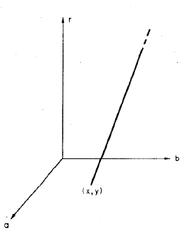
Hough transform for circles
Recall:
Circle: center (a,b) and radius r
x_i = a + r cos (theta)
y_i = b - r sin(theta)
x
θ
Image space
Hough space
Adapted by Devi Parikh from Kristen Grauman

Slide 14
Hough transform for circles
For every edge pixel (x,y) :
For each possible radius value r:
For each possible gradient direction θ:
// or use estimated gradient at (x,y)
a = x – r cos(θ) // column
b = y + r sin(θ) // row
H[a,b,r] += 1
end
end
Time complexity per edgel?
Check out online demo : http://www.markschulze.net/java/hough/
Kristen Grauman

Slide 15
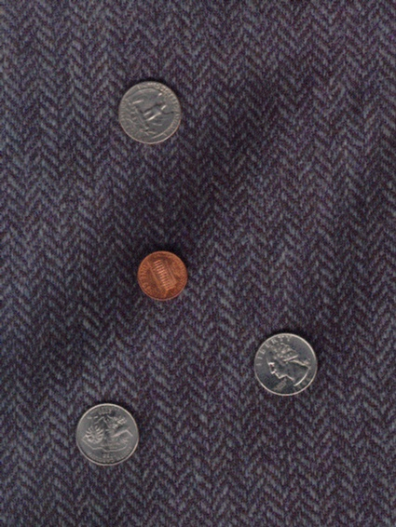
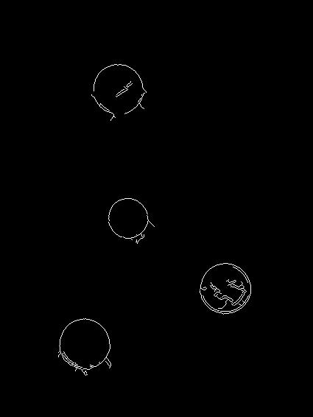
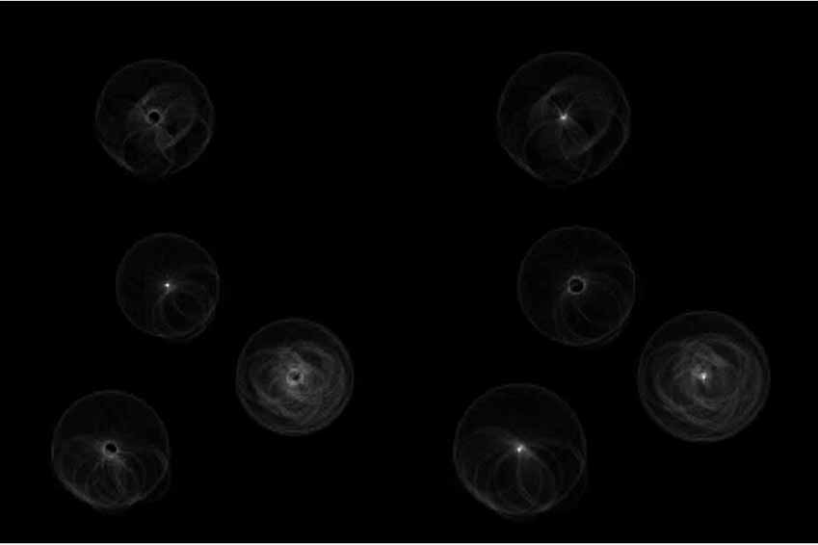
Example: detecting circles with Hough
Original
Edges
Votes: Penny
Note: a different Hough transform (with separate accumulators) was used for each circle radius (quarters vs. penny).
Slide credit: Kristen Grauman

Slide 16
Example: detecting circles with Hough
Original
Combined detections
Edges
Votes: Quarter
Slide credit: Kristen Grauman
Coin finding sample images from: Vivek Kwatra

Slide 17

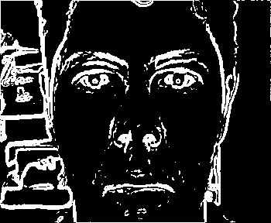
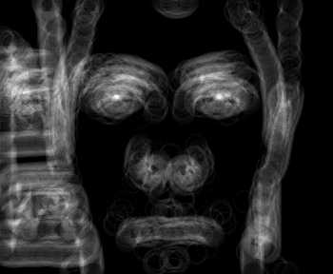

Example: iris detection
Gradient+threshold
Hough space (fixed radius)
Max detections
Hemerson Pistori and Eduardo Rocha Costa http://rsbweb.nih.gov/ij/plugins/hough-circles.html
Kristen Grauman

Slide 18
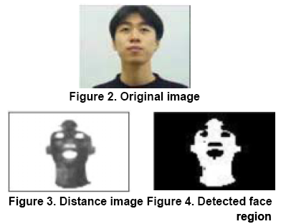
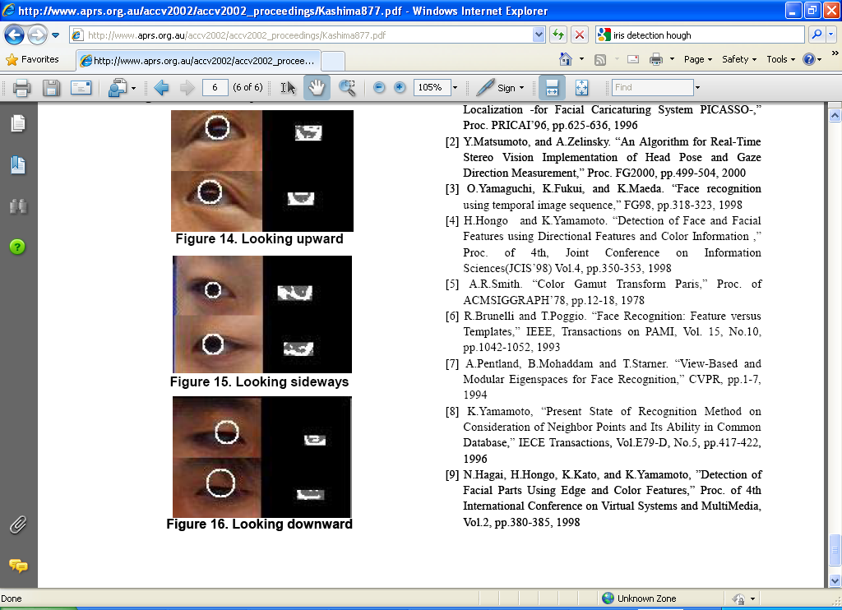
Example: iris detection
An Iris Detection Method Using the Hough Transform and Its Evaluation for Facial and Eye Movement, by Hideki Kashima, Hitoshi Hongo, Kunihito Kato, Kazuhiko Yamamoto, ACCV 2002.
Kristen Grauman

Slide 19
Voting: practical tips
Minimize irrelevant tokens first
Choose a good grid / discretization
Vote for neighbors, also (smoothing in accumulator array)
Use direction of edge to reduce parameters by 1
To read back which points voted for “winning” peaks, keep tags on the votes.
Too fine
?
Too coarse
Kristen Grauman

Slide 20
Hough transform: pros and cons
Pros
All points are processed independently, so can cope with occlusion, gaps
Some robustness to noise: noise points unlikely to contribute consistently to any single bin
Can detect multiple instances of a model in a single pass
Cons
Complexity of search time increases exponentially with the number of model parameters
Non-target shapes can produce spurious peaks in parameter space
Quantization: can be tricky to pick a good grid size
Kristen Grauman

Slide 21
Generalized Hough Transform
What if we want to detect arbitrary shapes?
Intuition:
Displacement vectors
x
x
x
Ref. point
x
x
Model image
Novel image
Vote space
Now suppose those colors encode gradient directions…
Kristen Grauman

Slide 22
Generalized Hough Transform
Define a model shape by its boundary points and a reference point.
Offline procedure:
x
a
At each boundary point, compute displacement vector: r = a – p_{i}.
Store these vectors in a table indexed by gradient orientation θ.
θ
θ
p₁
p₂
Model shape
θ
…
θ
…
…
[Dana H. Ballard, Generalizing the Hough Transform to Detect Arbitrary Shapes, 1980]
Kristen Grauman

Slide 23
Generalized Hough Transform
Detection procedure:
x
For each edge point:
Use its gradient orientation θ to index into stored table
Use retrieved r vectors to vote for reference point
x
θ
x
x
x
θ
θ
p₁
θ
θ
Novel image
θ
…
θ
…
…
Assuming translation is the only transformation here, i.e., orientation and scale are fixed.
Kristen Grauman

Slide 24

Generalized Hough for object detection
Instead of indexing displacements by gradient orientation, index by matched local patterns.
“visual codeword” with
displacement vectors
training image
B. Leibe, A. Leonardis, and B. Schiele, Combined Object Categorization and Segmentation with an Implicit Shape Model, ECCV Workshop on Statistical Learning in Computer Vision 2004
Source: L. Lazebnik

Slide 25
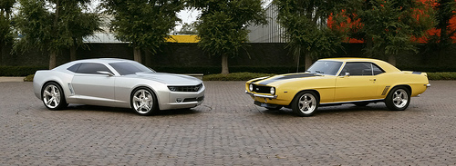
Generalized Hough for object detection
Instead of indexing displacements by gradient orientation, index by “visual codeword”
test image
B. Leibe, A. Leonardis, and B. Schiele, Combined Object Categorization and Segmentation with an Implicit Shape Model, ECCV Workshop on Statistical Learning in Computer Vision 2004
Source: L. Lazebnik

Slide 26
Summary
  Grouping/segmentation useful to make a compact representation and merge similar features
    associate features based on defined similarity measure and clustering objective
Fitting problems require finding any supporting evidence for a model, even within clutter and missing features.
  associate features with an explicit model
Voting approaches, such as the Hough transform, make it possible to find likely model parameters without searching all combinations of features.
  Hough transform approach for lines, circles, …, arbitrary shapes defined by a set of boundary points, recognition from patches.
Kristen Grauman

Slide 27
Topics overview
Features & filters
Grouping & fitting
  Segmentation and clustering
  Hough transform
  Deformable contours
  Alignment and 2D image transformations
Multiple views and motion
Recognition
Video processing
Slide credit: Kristen Grauman

Slide 28
Today
Fitting an arbitrary shape with “active” deformable contours
Slide credit: Kristen Grauman

Slide 29

Deformable contours
a.k.a. active contours, snakes
Given: initial contour (model) near desired object
Slide credit: Kristen Grauman
[Snakes: Active contour models, Kass, Witkin, & Terzopoulos, ICCV1987]
Figure credit: Yuri Boykov

Slide 30
Deformable contours
a.k.a. active contours, snakes
Given: initial contour (model) near desired object
Goal: evolve the contour to fit exact object boundary
Main idea: elastic band is iteratively adjusted so as to
be near image positions with high gradients, and
satisfy shape “preferences” or contour priors
Slide credit: Kristen Grauman
[Snakes: Active contour models, Kass, Witkin, & Terzopoulos, ICCV1987]
Figure credit: Yuri Boykov

Slide 31
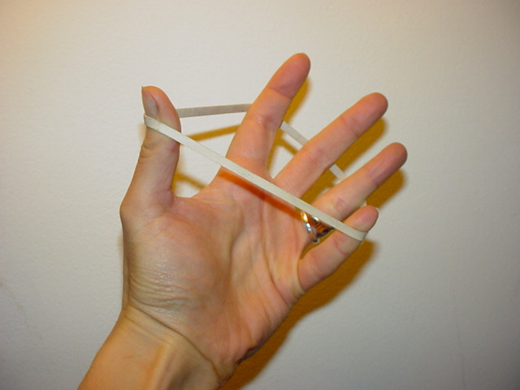
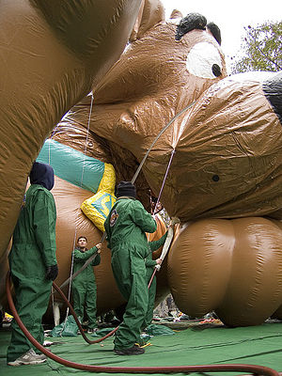
Deformable contours: intuition
Image from http://www.healthline.com/blogs/exercise_fitness/uploaded_images/HandBand2-795868.JPG
Kristen Grauman

Slide 32
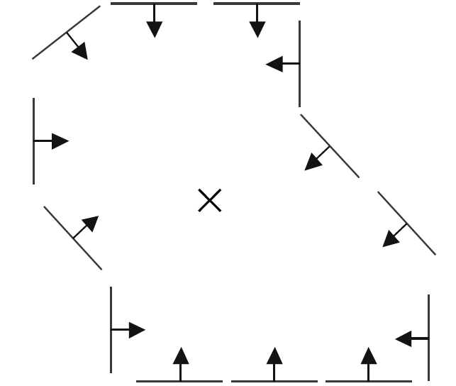
Deformable contours vs. Hough
Like generalized Hough transform, useful for shape fitting; but
initial
intermediate
final
Hough
Rigid model shape
Single voting pass can detect multiple instances
Deformable contours
Prior on shape types, but shape iteratively adjusted (deforms)
Requires initialization nearby
One optimization “pass” to fit a single contour
Kristen Grauman

Slide 33
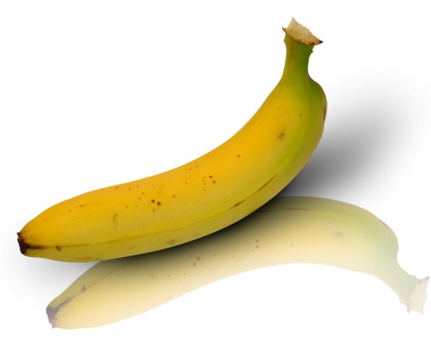
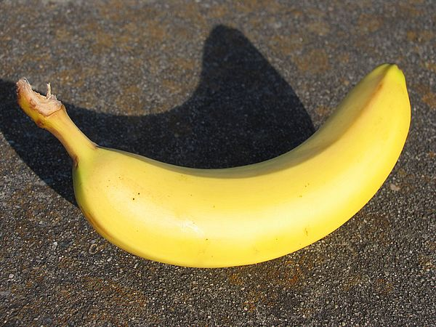
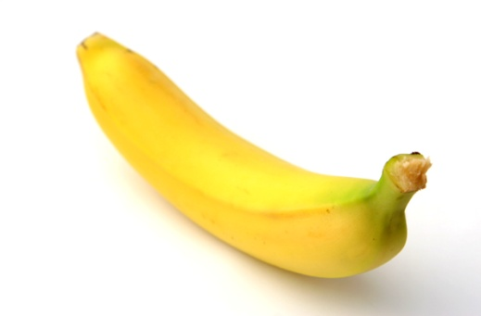
Why do we want to fit deformable shapes?
Some objects have similar basic form but some variety in the contour shape.
Kristen Grauman

Slide 34
Why do we want to fit deformable shapes?
Non-rigid, deformable objects can change their shape over time, e.g. lips, hands…
Figure from Kass et al. 1987
Kristen Grauman

Slide 35

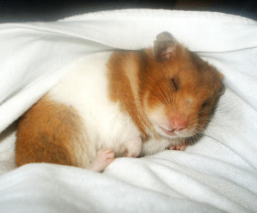
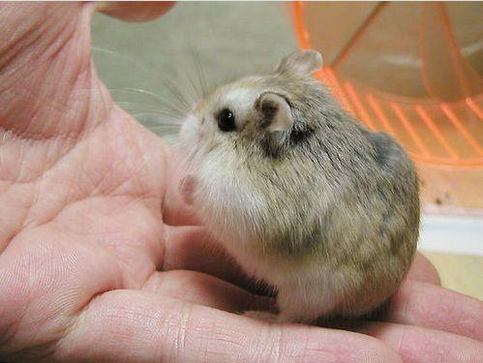
Why do we want to fit deformable shapes?
Non-rigid, deformable objects can change their shape over time, e.g. lips, hands…
Kristen Grauman

Slide 36
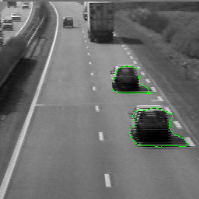
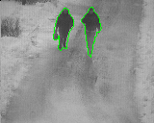
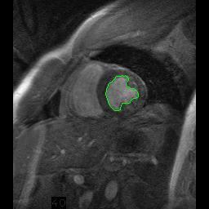
Why do we want to fit deformable shapes?
Non-rigid, deformable objects can change their shape over time.
Figure credit: Julien Jomier
Kristen Grauman

Slide 37
Aspects we need to consider
Representation of the contours
Defining the energy functions
  External
  Internal
Minimizing the energy function
Extensions:
  Tracking
  Interactive segmentation
Kristen Grauman

Slide 38
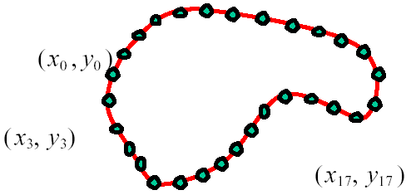
Representation
We’ll consider a discrete representation of the contour, consisting of a list of 2d point positions (“vertices”).
for
At each iteration, we’ll have the option to move each vertex to another nearby location (“state”).
Kristen Grauman

Slide 39
Fitting deformable contours
How should we adjust the current contour to form the new contour at each iteration?
Define a cost function (“energy” function) that says how good a candidate configuration is.
Seek next configuration that minimizes that cost function.
initial
intermediate
final
Slide credit: Kristen Grauman

Slide 40
Energy function
The total energy (cost) of the current snake is defined as:
Internal energy: encourage prior shape preferences: e.g., smoothness, elasticity, particular known shape.
External energy (“image” energy): encourage contour to fit on places where image structures exist, e.g., edges.
A good fit between the current deformable contour and the target shape in the image will yield a low value for this cost function.
Slide credit: Kristen Grauman

Slide 41
External energy: intuition
Measure how well the curve matches the image data
“Attract” the curve toward different image features
  Edges, lines, texture gradient, etc.
Slide credit: Kristen Grauman

Slide 42


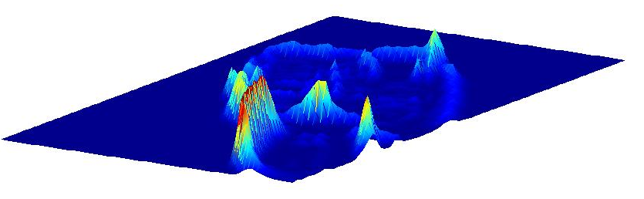
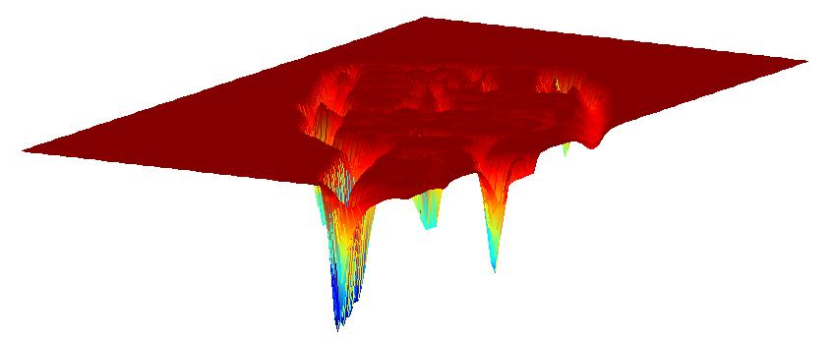
External image energy
How do edges affect “snap” of rubber band?
Think of external energy from image as gravitational pull towards areas of high contrast
Magnitude of gradient
- (Magnitude of gradient)
Slide credit: Kristen Grauman

Slide 43
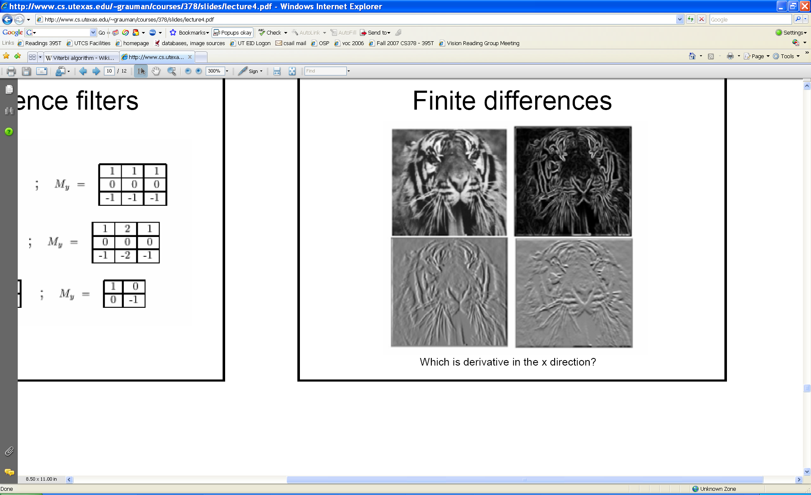
External image energy
Gradient images and
External energy at a point on the curve is:
External energy for the whole curve:
Kristen Grauman

Slide 44
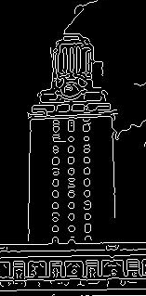
Internal energy: intuition
What are the underlying boundaries in this fragmented edge image?
And in this one?
Kristen Grauman

Slide 45
Internal energy: intuition
A priori, we want to favor smooth shapes, contours with low curvature, contours similar to a known shape, etc. to balance what is actually observed (i.e., in the gradient image).
Kristen Grauman

Slide 46

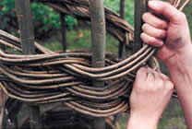
Internal energy
For a continuous curve, a common internal energy term is the “bending energy”.
At some point v(s) on the curve, this is:
Tension,
Elasticity
Stiffness,
Curvature
Kristen Grauman

Slide 47
Internal energy
For our discrete representation,
Internal energy for the whole curve:
…
Note these are derivatives relative to position---not spatial image gradients.
Why do these reflect tension and curvature?
Kristen Grauman

Slide 48


Example: compare curvature
(2,5)
(2,2)
(3,1)
(1,1)
(3,1)
(1,1)
$$\left(3−2\left(2\right)+1\right)2+\left(1−2\left(5\right)+1\right)2$$
$$\left(3−2\left(2\right)+1\right)2+\left(1−2\left(2\right)+1\right)2$$
$$=\left(−8\right)2=64$$
$$=\left(−2\right)2=4$$
Kristen Grauman

Slide 49
Penalizing elasticity
Current elastic energy definition uses a discrete estimate of the derivative:
What is the possible problem with this definition?
Kristen Grauman

Slide 50
Penalizing elasticity
Current elastic energy definition uses a discrete estimate of the derivative:
Instead:
where d is the average distance between pairs of points – updated at each iteration.
Kristen Grauman

Slide 51
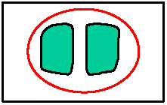
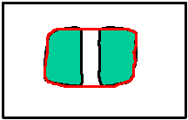
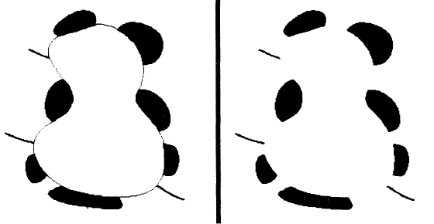
Dealing with missing data
The preferences for low-curvature, smoothness help deal with missing data:
Illusory contours found!
[Figure from Kass et al. 1987]
Slide credit: Kristen Grauman

Slide 52
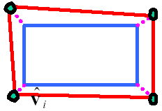
Extending the internal energy: capture shape prior
If object is some smooth variation on a known shape, we can use a term that will penalize deviation from that shape:
    where are the points of the known shape.
Slide credit: Kristen Grauman
Fig from Y. Boykov

Slide 53
Total energy: function of the weights
Slide credit: Kristen Grauman

Slide 54
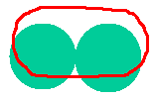


Total energy: function of the weights
e.g., weight controls the penalty for internal elasticity
large
medium
small
Slide credit: Kristen Grauman
Fig from Y. Boykov

Slide 55
Recap: deformable contour
A simple elastic snake is defined by:
  A set of n points,
  An internal energy term (tension, bending, plus optional shape prior)
  An external energy term (gradient-based)
To use to segment an object:
  Initialize in the vicinity of the object
  Modify the points to minimize the total energy
Kristen Grauman

Slide 56
Energy minimization
Several algorithms have been proposed to fit deformable contours.
We’ll look at two:
  Greedy search
  Dynamic programming (for 2d snakes)
Slide credit: Kristen Grauman

Slide 57
Energy minimization: greedy
For each point, search window around it and move to where energy function is minimal
  Typical window size, e.g., 5 x 5 pixels
Stop when predefined number of points have not changed in last iteration, or after max number of iterations
Note:
  Convergence not guaranteed
  Need decent initialization
Kristen Grauman

Slide 58
Energy minimization
Several algorithms have been proposed to fit deformable contours.
We’ll look at two:
  Greedy search
  Dynamic programming (for 2d snakes)
Slide credit: Kristen Grauman

Slide 59
Energy minimization: dynamic programming
With this form of the energy function, we can minimize using dynamic programming, with the Viterbi algorithm.
Iterate until optimal position for each point is the center of the box, i.e., the snake is optimal in the local search space constrained by boxes.
Fig from Y. Boykov
Slide credit: Kristen Grauman
[Amini, Weymouth, Jain, 1990]

Slide 60
Energy minimization: dynamic programming
Possible because snake energy can be rewritten as a sum of pair-wise interaction potentials:
Or sum of triple-interaction potentials.
Slide credit: Kristen Grauman

Slide 61
Snake energy: pair-wise interactions
Re-writing the above with :
where
Kristen Grauman

Slide 62
Viterbi algorithm
Main idea: determine optimal position (state) of predecessor, for each possible position of self. Then backtrack from best state for last vertex.
vertices
states
1
2
…
m
Complexity:
vs. brute force search ____?
Slide credit: Kristen Grauman
Example adapted from Y. Boykov

Slide 63
Energy minimization: dynamic programming
With this form of the energy function, we can minimize using dynamic programming, with the Viterbi algorithm.
Iterate until optimal position for each point is the center of the box, i.e., the snake is optimal in the local search space constrained by boxes.
Fig from Y. Boykov
Slide credit: Kristen Grauman
[Amini, Weymouth, Jain, 1990]

Slide 64
Energy minimization:
dynamic programming
DP can be applied to optimize an open ended snake
For a closed snake, a “loop” is introduced into the total energy.
Work around:
Fix v₁ and solve for rest .
Fix an intermediate node at its position found in (1), solve for rest.
Slide credit: Kristen Grauman

Slide 65
Aspects we need to consider
Representation of the contours
Defining the energy functions
  External
  Internal
Minimizing the energy function
Extensions:
  Tracking
  Interactive segmentation
Slide credit: Kristen Grauman

Slide 66
Tracking via deformable contours
Use final contour/model extracted at frame t as an initial solution for frame t+1
Evolve initial contour to fit exact object boundary at frame t+1
Repeat, initializing with most recent frame.
Tracking Heart Ventricles
(multiple frames)
Kristen Grauman

Slide 67

Tracking via deformable contours
Visual Dynamics Group, Dept. Engineering Science, University of Oxford.
Applications:
Traffic monitoring
Human-computer interaction
Animation
Surveillance
Computer assisted diagnosis in medical imaging
Kristen Grauman
Notes:
http://www.robots.ox.ac.uk/~vdg/dynamics.html

Slide 68

3D active contours
Jörgen Ahlberg
http://www.cvl.isy.liu.se/ScOut/Masters/Papers/Ex1708.pdf
Kristen Grauman

Slide 69
Limitations
May over-smooth the boundary
Cannot follow topological changes of objects
Slide credit: Kristen Grauman

Slide 70

Limitations
External energy: snake does not really “see” object boundaries in the image unless it gets very close to it.
image gradients
are large only directly on the boundary
Slide credit: Kristen Grauman

Slide 71




Distance transform
External image can instead be taken from the distance transform of the edge image.
original
-gradient
distance transform
Value at (x,y) tells how far that position is from the nearest edge point (or other binary mage structure)
>> help bwdist
edges
Kristen Grauman

Slide 72
Deformable contours: pros and cons
Pros:
Useful to track and fit non-rigid shapes
Contour remains connected
Possible to fill in “subjective” contours
Flexibility in how energy function is defined, weighted.
Cons:
Must have decent initialization near true boundary, may get stuck in local minimum
Parameters of energy function must be set well based on prior information
Kristen Grauman

Slide 73
Summary
Deformable shapes and active contours are useful for
  Segmentation: fit or “snap” to boundary in image
  Tracking: previous frame’s estimate serves to initialize the next
Fitting active contours:
  Define terms to encourage certain shapes, smoothness, low curvature, push/pulls, …
  Use weights to control relative influence of each component cost
  Can optimize 2d snakes with Viterbi algorithm.
Image structure (esp. gradients) can act as attraction force for interactive segmentation methods.
Kristen Grauman

Slide 74
Topics overview
Features & filters
Grouping & fitting
  Segmentation and clustering
  Hough transform
  Deformable contours
  Alignment and 2D image transformations
Multiple views and motion
Recognition
Video processing
Slide credit: Kristen Grauman

Slide 75
Questions?
See you Thursday!
Slide credit: Devi Parikh

