Slide 1
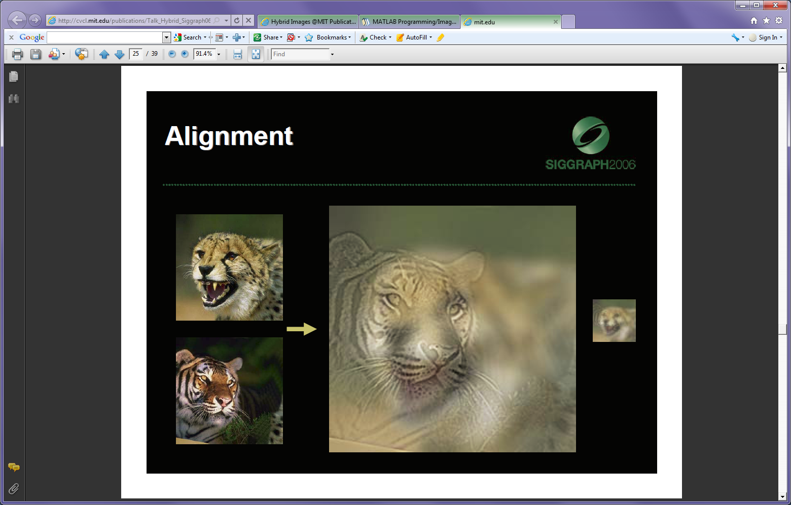
Linear Filters
August 27th 2015
Devi Parikh
Virginia Tech
Disclaimer: Many slides have been borrowed from Kristen Grauman, who may have borrowed some of them from others. Any time a slide did not already have a credit on it, I have credited it to Kristen. So there is a chance some of these credits are inaccurate.
Slide credit: Devi Parikh

Slide 2
Announcements
PS0 due Monday at 11:55 pm.
Poster session 12/3 instead of 12/8
Slide credit: Devi Parikh

Slide 3
Topics overview
Features & filters
Grouping & fitting
Multiple views and motion
Recognition
Video processing
Slide credit: Kristen Grauman

Slide 4
Topics overview
Features & filters
Grouping & fitting
Multiple views and motion
Recognition
Video processing
Slide credit: Kristen Grauman

Slide 5
Topics overview
Features & filters
  Filters
Grouping & fitting
Multiple views and motion
Recognition
Video processing
Slide credit: Kristen Grauman

Slide 6
Topics overview
Features & filters
  Filters
Grouping & fitting
Multiple views and motion
Recognition
Video processing
Neat interactive tool: http://setosa.io/ev/image-kernels/
(thanks to Michael Cogswell)
Slide credit: Kristen Grauman

Slide 7
Plan for today
Image formation
Image noise
Linear filters
  Examples: smoothing filters
Convolution / correlation
Cool application: hybrid images
Slide credit: Modified from Kristen Grauman

Slide 8

Image Formation
Slide credit: Derek Hoiem

Slide 9

Digital camera
A digital camera replaces film with a sensor array
Each cell in the array is light-sensitive diode that converts photons to electrons
http://electronics.howstuffworks.com/digital-camera.htm
Slide credit: Steve Seitz

Slide 10

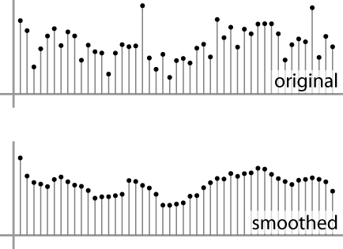
Digital images
Sample the 2D space on a regular grid
Quantize each sample (round to nearest integer)
Image thus represented as a matrix of integer values.
2D
1D
Slide credit: Kristen Grauman, Adapted from Steve Seitz

Slide 11
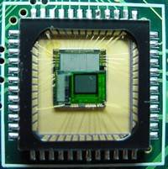

Digital images
Slide credit: Derek Hoiem

Slide 12
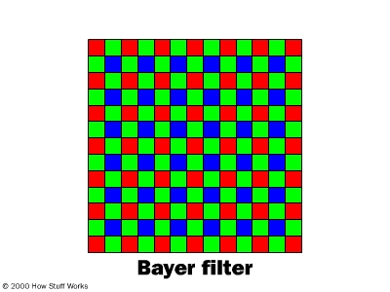
Digital color images
Slide credit: Kristen Grauman

Slide 13
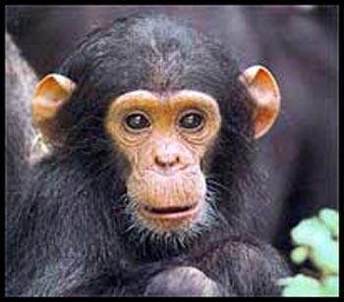
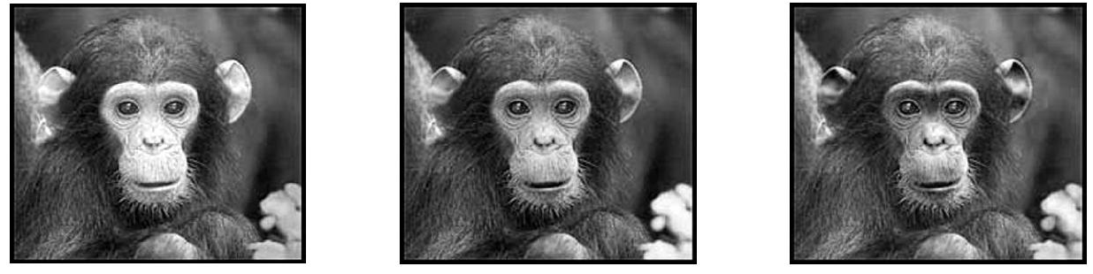
Digital color images
Color images, RGB color space
R
G
B
Slide credit: Kristen Grauman

Slide 14
Images in Matlab
Images represented as a matrix
Suppose we have a NxM RGB image called “im”
  im(1,1,1) = top-left pixel value in R-channel
  im(y, x, b) = y pixels down, x pixels to right in the b^{th} channel
  im(N, M, 3) = bottom-right pixel in B-channel
imread(filename) returns a uint8 image (values 0 to 255)
  Convert to double format (values 0 to 1) with im2double
column
row
R
0.92 | 0.93 | 0.94 | 0.97 | 0.62 | 0.37 | 0.85 | 0.97 | 0.93 | 0.92 | 0.99
0.95 | 0.89 | 0.82 | 0.89 | 0.56 | 0.31 | 0.75 | 0.92 | 0.81 | 0.95 | 0.91
0.89 | 0.72 | 0.51 | 0.55 | 0.51 | 0.42 | 0.57 | 0.41 | 0.49 | 0.91 | 0.92
0.96 | 0.95 | 0.88 | 0.94 | 0.56 | 0.46 | 0.91 | 0.87 | 0.90 | 0.97 | 0.95
0.71 | 0.81 | 0.81 | 0.87 | 0.57 | 0.37 | 0.80 | 0.88 | 0.89 | 0.79 | 0.85
0.49 | 0.62 | 0.60 | 0.58 | 0.50 | 0.60 | 0.58 | 0.50 | 0.61 | 0.45 | 0.33
0.86 | 0.84 | 0.74 | 0.58 | 0.51 | 0.39 | 0.73 | 0.92 | 0.91 | 0.49 | 0.74
0.96 | 0.67 | 0.54 | 0.85 | 0.48 | 0.37 | 0.88 | 0.90 | 0.94 | 0.82 | 0.93
0.69 | 0.49 | 0.56 | 0.66 | 0.43 | 0.42 | 0.77 | 0.73 | 0.71 | 0.90 | 0.99
0.79 | 0.73 | 0.90 | 0.67 | 0.33 | 0.61 | 0.69 | 0.79 | 0.73 | 0.93 | 0.97
0.91 | 0.94 | 0.89 | 0.49 | 0.41 | 0.78 | 0.78 | 0.77 | 0.89 | 0.99 | 0.93
G
0.92 | 0.93 | 0.94 | 0.97 | 0.62 | 0.37 | 0.85 | 0.97 | 0.93 | 0.92 | 0.99
0.95 | 0.89 | 0.82 | 0.89 | 0.56 | 0.31 | 0.75 | 0.92 | 0.81 | 0.95 | 0.91
0.89 | 0.72 | 0.51 | 0.55 | 0.51 | 0.42 | 0.57 | 0.41 | 0.49 | 0.91 | 0.92
0.96 | 0.95 | 0.88 | 0.94 | 0.56 | 0.46 | 0.91 | 0.87 | 0.90 | 0.97 | 0.95
0.71 | 0.81 | 0.81 | 0.87 | 0.57 | 0.37 | 0.80 | 0.88 | 0.89 | 0.79 | 0.85
0.49 | 0.62 | 0.60 | 0.58 | 0.50 | 0.60 | 0.58 | 0.50 | 0.61 | 0.45 | 0.33
0.86 | 0.84 | 0.74 | 0.58 | 0.51 | 0.39 | 0.73 | 0.92 | 0.91 | 0.49 | 0.74
0.96 | 0.67 | 0.54 | 0.85 | 0.48 | 0.37 | 0.88 | 0.90 | 0.94 | 0.82 | 0.93
0.69 | 0.49 | 0.56 | 0.66 | 0.43 | 0.42 | 0.77 | 0.73 | 0.71 | 0.90 | 0.99
0.79 | 0.73 | 0.90 | 0.67 | 0.33 | 0.61 | 0.69 | 0.79 | 0.73 | 0.93 | 0.97
0.91 | 0.94 | 0.89 | 0.49 | 0.41 | 0.78 | 0.78 | 0.77 | 0.89 | 0.99 | 0.93
B
0.92 | 0.93 | 0.94 | 0.97 | 0.62 | 0.37 | 0.85 | 0.97 | 0.93 | 0.92 | 0.99
0.95 | 0.89 | 0.82 | 0.89 | 0.56 | 0.31 | 0.75 | 0.92 | 0.81 | 0.95 | 0.91
0.89 | 0.72 | 0.51 | 0.55 | 0.51 | 0.42 | 0.57 | 0.41 | 0.49 | 0.91 | 0.92
0.96 | 0.95 | 0.88 | 0.94 | 0.56 | 0.46 | 0.91 | 0.87 | 0.90 | 0.97 | 0.95
0.71 | 0.81 | 0.81 | 0.87 | 0.57 | 0.37 | 0.80 | 0.88 | 0.89 | 0.79 | 0.85
0.49 | 0.62 | 0.60 | 0.58 | 0.50 | 0.60 | 0.58 | 0.50 | 0.61 | 0.45 | 0.33
0.86 | 0.84 | 0.74 | 0.58 | 0.51 | 0.39 | 0.73 | 0.92 | 0.91 | 0.49 | 0.74
0.96 | 0.67 | 0.54 | 0.85 | 0.48 | 0.37 | 0.88 | 0.90 | 0.94 | 0.82 | 0.93
0.69 | 0.49 | 0.56 | 0.66 | 0.43 | 0.42 | 0.77 | 0.73 | 0.71 | 0.90 | 0.99
0.79 | 0.73 | 0.90 | 0.67 | 0.33 | 0.61 | 0.69 | 0.79 | 0.73 | 0.93 | 0.97
0.91 | 0.94 | 0.89 | 0.49 | 0.41 | 0.78 | 0.78 | 0.77 | 0.89 | 0.99 | 0.93
Slide credit: Derek Hoiem

Slide 15
Image filtering
Compute a function of the local neighborhood at each pixel in the image
  Function specified by a “filter” or mask saying how to combine values from neighbors.
Uses of filtering:
  Enhance an image (denoise, resize, etc)
  Extract information (texture, edges, etc)
  Detect patterns (template matching)
Slide credit: Kristen Grauman, Adapted from Derek Hoiem

Slide 16
Image filtering
Compute a function of the local neighborhood at each pixel in the image
  Function specified by a “filter” or mask saying how to combine values from neighbors.
Uses of filtering:
  Enhance an image (denoise, resize, etc)
  Extract information (texture, edges, etc)
  Detect patterns (template matching)
Slide credit: Kristen Grauman, Adapted from Derek Hoiem

Slide 17
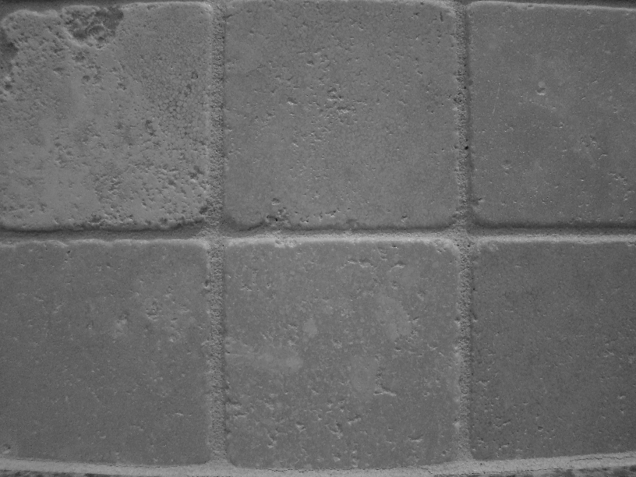
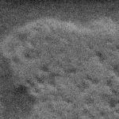

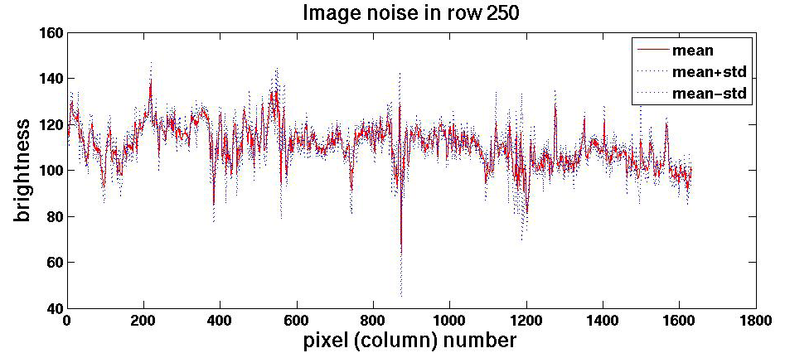
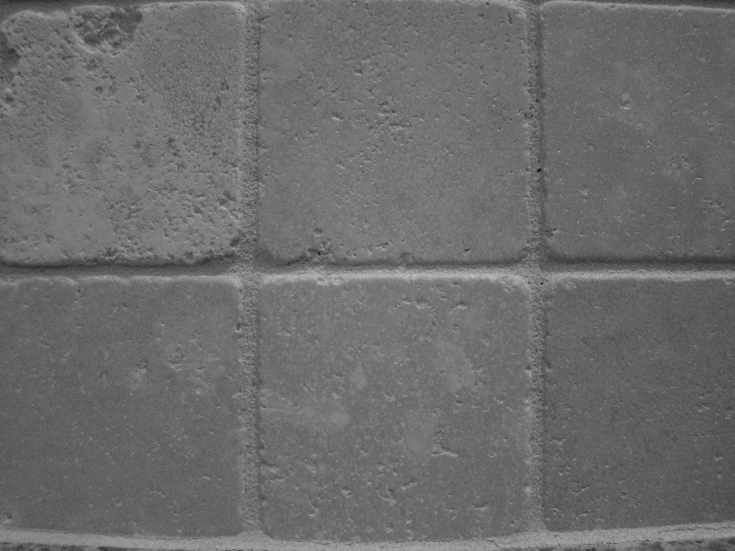
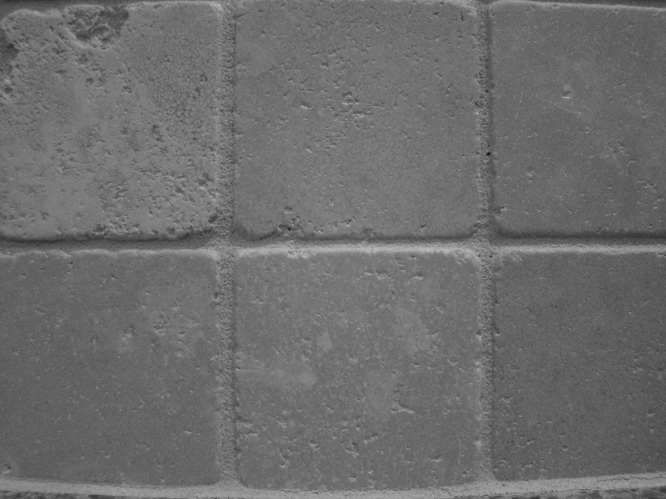


Motivation: noise reduction
Even multiple images of the same static scene will not be identical.
Slide credit: Adapted from Kristen Grauman

Slide 18
Common types of noise
  Salt and pepper noise: random occurrences of black and white pixels
  Impulse noise: random occurrences of white pixels
  Gaussian noise: variations in intensity drawn from a Gaussian normal distribution
Slide credit: Steve Seitz

Slide 19
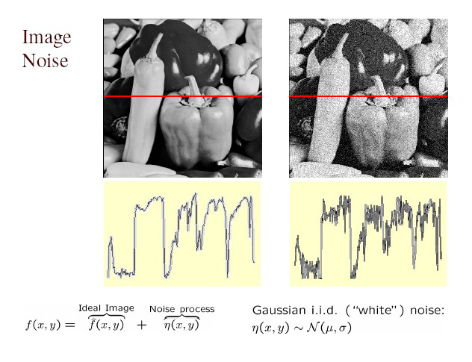
Gaussian noise
>> noise = randn(size(im)).*sigma;
>> output = im + noise;
Slide credit: Kristen Grauman
Figure from Martial Hebert
What is impact of the sigma?

Slide 20
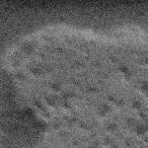
Motivation: noise reduction
Even multiple images of the same static scene will not be identical.
How could we reduce the noise, i.e., give an estimate of the true intensities?
What if there’s only one image?
Slide credit: Kristen Grauman

Slide 21
First attempt at a solution
Let’s replace each pixel with an average of all the values in its neighborhood
Assumptions:
  Expect pixels to be like their neighbors
  Expect noise processes to be independent from pixel to pixel
Slide credit: Kristen Grauman

Slide 22
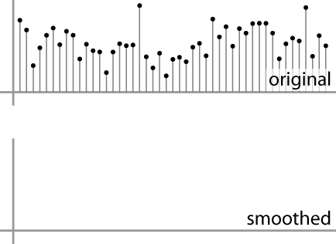
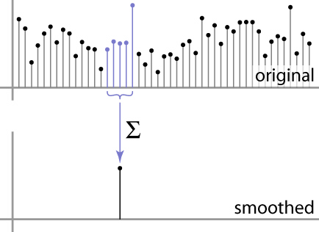
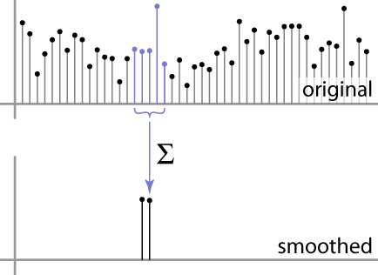
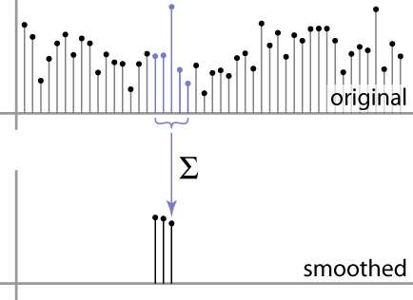
First attempt at a solution
Let’s replace each pixel with an average of all the values in its neighborhood
Moving average in 1D:
Slide credit: S. Marschner

Slide 23
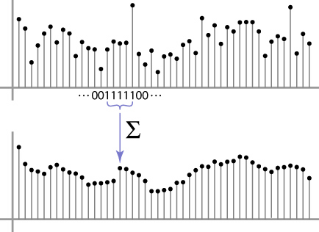
Weighted Moving Average
Can add weights to our moving average
Weights [1, 1, 1, 1, 1] / 5
Slide credit: S. Marschner

Slide 24

Weighted Moving Average
Non-uniform weights [1, 4, 6, 4, 1] / 16
Slide credit: S. Marschner

Slide 25


Moving Average In 2D
0 | 0 | 0 | 0 | 0 | 0 | 0 | 0 | 0 | 0
0 | 0 | 0 | 0 | 0 | 0 | 0 | 0 | 0 | 0
0 | 0 | 0 | 90 | 90 | 90 | 90 | 90 | 0 | 0
0 | 0 | 0 | 90 | 90 | 90 | 90 | 90 | 0 | 0
0 | 0 | 0 | 90 | 90 | 90 | 90 | 90 | 0 | 0
0 | 0 | 0 | 90 | 0 | 90 | 90 | 90 | 0 | 0
0 | 0 | 0 | 90 | 90 | 90 | 90 | 90 | 0 | 0
0 | 0 | 0 | 0 | 0 | 0 | 0 | 0 | 0 | 0
0 | 0 | 90 | 0 | 0 | 0 | 0 | 0 | 0 | 0
0 | 0 | 0 | 0 | 0 | 0 | 0 | 0 | 0 | 0
0 | 0 | 0 | 0 | 0 | 0 | 0 | 0 | 0 | 0
0 | 0 | 0 | 0 | 0 | 0 | 0 | 0 | 0 | 0
0 | 0 | 0 | 90 | 90 | 90 | 90 | 90 | 0 | 0
0 | 0 | 0 | 90 | 90 | 90 | 90 | 90 | 0 | 0
0 | 0 | 0 | 90 | 90 | 90 | 90 | 90 | 0 | 0
0 | 0 | 0 | 90 | 0 | 90 | 90 | 90 | 0 | 0
0 | 0 | 0 | 90 | 90 | 90 | 90 | 90 | 0 | 0
0 | 0 | 0 | 0 | 0 | 0 | 0 | 0 | 0 | 0
0 | 0 | 90 | 0 | 0 | 0 | 0 | 0 | 0 | 0
0 | 0 | 0 | 0 | 0 | 0 | 0 | 0 | 0 | 0
Slide credit: Steve Seitz

Slide 26
Moving Average In 2D
0 | 0 | 0 | 0 | 0 | 0 | 0 | 0 | 0 | 0
0 | 0 | 0 | 0 | 0 | 0 | 0 | 0 | 0 | 0
0 | 0 | 0 | 90 | 90 | 90 | 90 | 90 | 0 | 0
0 | 0 | 0 | 90 | 90 | 90 | 90 | 90 | 0 | 0
0 | 0 | 0 | 90 | 90 | 90 | 90 | 90 | 0 | 0
0 | 0 | 0 | 90 | 0 | 90 | 90 | 90 | 0 | 0
0 | 0 | 0 | 90 | 90 | 90 | 90 | 90 | 0 | 0
0 | 0 | 0 | 0 | 0 | 0 | 0 | 0 | 0 | 0
0 | 0 | 90 | 0 | 0 | 0 | 0 | 0 | 0 | 0
0 | 0 | 0 | 0 | 0 | 0 | 0 | 0 | 0 | 0
 | 0
0 | 0 | 0 | 0 | 0 | 0 | 0 | 0 | 0 | 0
0 | 0 | 0 | 0 | 0 | 0 | 0 | 0 | 0 | 0
0 | 0 | 0 | 90 | 90 | 90 | 90 | 90 | 0 | 0
0 | 0 | 0 | 90 | 90 | 90 | 90 | 90 | 0 | 0
0 | 0 | 0 | 90 | 90 | 90 | 90 | 90 | 0 | 0
0 | 0 | 0 | 90 | 0 | 90 | 90 | 90 | 0 | 0
0 | 0 | 0 | 90 | 90 | 90 | 90 | 90 | 0 | 0
0 | 0 | 0 | 0 | 0 | 0 | 0 | 0 | 0 | 0
0 | 0 | 90 | 0 | 0 | 0 | 0 | 0 | 0 | 0
0 | 0 | 0 | 0 | 0 | 0 | 0 | 0 | 0 | 0
Slide credit: Steve Seitz

Slide 27
Moving Average In 2D
0 | 0 | 0 | 0 | 0 | 0 | 0 | 0 | 0 | 0
0 | 0 | 0 | 0 | 0 | 0 | 0 | 0 | 0 | 0
0 | 0 | 0 | 90 | 90 | 90 | 90 | 90 | 0 | 0
0 | 0 | 0 | 90 | 90 | 90 | 90 | 90 | 0 | 0
0 | 0 | 0 | 90 | 90 | 90 | 90 | 90 | 0 | 0
0 | 0 | 0 | 90 | 0 | 90 | 90 | 90 | 0 | 0
0 | 0 | 0 | 90 | 90 | 90 | 90 | 90 | 0 | 0
0 | 0 | 0 | 0 | 0 | 0 | 0 | 0 | 0 | 0
0 | 0 | 90 | 0 | 0 | 0 | 0 | 0 | 0 | 0
0 | 0 | 0 | 0 | 0 | 0 | 0 | 0 | 0 | 0
 | 0
0 | 0 | 0 | 0 | 0 | 0 | 0 | 0 | 0 | 0
0 | 0 | 0 | 0 | 0 | 0 | 0 | 0 | 0 | 0
0 | 0 | 0 | 90 | 90 | 90 | 90 | 90 | 0 | 0
0 | 0 | 0 | 90 | 90 | 90 | 90 | 90 | 0 | 0
0 | 0 | 0 | 90 | 90 | 90 | 90 | 90 | 0 | 0
0 | 0 | 0 | 90 | 0 | 90 | 90 | 90 | 0 | 0
0 | 0 | 0 | 90 | 90 | 90 | 90 | 90 | 0 | 0
0 | 0 | 0 | 0 | 0 | 0 | 0 | 0 | 0 | 0
0 | 0 | 90 | 0 | 0 | 0 | 0 | 0 | 0 | 0
0 | 0 | 0 | 0 | 0 | 0 | 0 | 0 | 0 | 0
Slide credit: Steve Seitz

Slide 28
Moving Average In 2D
0 | 0 | 0 | 0 | 0 | 0 | 0 | 0 | 0 | 0
0 | 0 | 0 | 0 | 0 | 0 | 0 | 0 | 0 | 0
0 | 0 | 0 | 90 | 90 | 90 | 90 | 90 | 0 | 0
0 | 0 | 0 | 90 | 90 | 90 | 90 | 90 | 0 | 0
0 | 0 | 0 | 90 | 90 | 90 | 90 | 90 | 0 | 0
0 | 0 | 0 | 90 | 0 | 90 | 90 | 90 | 0 | 0
0 | 0 | 0 | 90 | 90 | 90 | 90 | 90 | 0 | 0
0 | 0 | 0 | 0 | 0 | 0 | 0 | 0 | 0 | 0
0 | 0 | 90 | 0 | 0 | 0 | 0 | 0 | 0 | 0
0 | 0 | 0 | 0 | 0 | 0 | 0 | 0 | 0 | 0
 | 0 | 10
0 | 0 | 0 | 0 | 0 | 0 | 0 | 0 | 0 | 0
0 | 0 | 0 | 0 | 0 | 0 | 0 | 0 | 0 | 0
0 | 0 | 0 | 90 | 90 | 90 | 90 | 90 | 0 | 0
0 | 0 | 0 | 90 | 90 | 90 | 90 | 90 | 0 | 0
0 | 0 | 0 | 90 | 90 | 90 | 90 | 90 | 0 | 0
0 | 0 | 0 | 90 | 0 | 90 | 90 | 90 | 0 | 0
0 | 0 | 0 | 90 | 90 | 90 | 90 | 90 | 0 | 0
0 | 0 | 0 | 0 | 0 | 0 | 0 | 0 | 0 | 0
0 | 0 | 90 | 0 | 0 | 0 | 0 | 0 | 0 | 0
0 | 0 | 0 | 0 | 0 | 0 | 0 | 0 | 0 | 0
Slide credit: Steve Seitz

Slide 29
Moving Average In 2D
0 | 0 | 0 | 0 | 0 | 0 | 0 | 0 | 0 | 0
0 | 0 | 0 | 0 | 0 | 0 | 0 | 0 | 0 | 0
0 | 0 | 0 | 90 | 90 | 90 | 90 | 90 | 0 | 0
0 | 0 | 0 | 90 | 90 | 90 | 90 | 90 | 0 | 0
0 | 0 | 0 | 90 | 90 | 90 | 90 | 90 | 0 | 0
0 | 0 | 0 | 90 | 0 | 90 | 90 | 90 | 0 | 0
0 | 0 | 0 | 90 | 90 | 90 | 90 | 90 | 0 | 0
0 | 0 | 0 | 0 | 0 | 0 | 0 | 0 | 0 | 0
0 | 0 | 90 | 0 | 0 | 0 | 0 | 0 | 0 | 0
0 | 0 | 0 | 0 | 0 | 0 | 0 | 0 | 0 | 0
 | 0 | 10
0 | 0 | 0 | 0 | 0 | 0 | 0 | 0 | 0 | 0
0 | 0 | 0 | 0 | 0 | 0 | 0 | 0 | 0 | 0
0 | 0 | 0 | 90 | 90 | 90 | 90 | 90 | 0 | 0
0 | 0 | 0 | 90 | 90 | 90 | 90 | 90 | 0 | 0
0 | 0 | 0 | 90 | 90 | 90 | 90 | 90 | 0 | 0
0 | 0 | 0 | 90 | 0 | 90 | 90 | 90 | 0 | 0
0 | 0 | 0 | 90 | 90 | 90 | 90 | 90 | 0 | 0
0 | 0 | 0 | 0 | 0 | 0 | 0 | 0 | 0 | 0
0 | 0 | 90 | 0 | 0 | 0 | 0 | 0 | 0 | 0
0 | 0 | 0 | 0 | 0 | 0 | 0 | 0 | 0 | 0
Slide credit: Steve Seitz

Slide 30
Moving Average In 2D
0 | 0 | 0 | 0 | 0 | 0 | 0 | 0 | 0 | 0
0 | 0 | 0 | 0 | 0 | 0 | 0 | 0 | 0 | 0
0 | 0 | 0 | 90 | 90 | 90 | 90 | 90 | 0 | 0
0 | 0 | 0 | 90 | 90 | 90 | 90 | 90 | 0 | 0
0 | 0 | 0 | 90 | 90 | 90 | 90 | 90 | 0 | 0
0 | 0 | 0 | 90 | 0 | 90 | 90 | 90 | 0 | 0
0 | 0 | 0 | 90 | 90 | 90 | 90 | 90 | 0 | 0
0 | 0 | 0 | 0 | 0 | 0 | 0 | 0 | 0 | 0
0 | 0 | 90 | 0 | 0 | 0 | 0 | 0 | 0 | 0
0 | 0 | 0 | 0 | 0 | 0 | 0 | 0 | 0 | 0
 | 0 | 10 | 20
0 | 0 | 0 | 0 | 0 | 0 | 0 | 0 | 0 | 0
0 | 0 | 0 | 0 | 0 | 0 | 0 | 0 | 0 | 0
0 | 0 | 0 | 90 | 90 | 90 | 90 | 90 | 0 | 0
0 | 0 | 0 | 90 | 90 | 90 | 90 | 90 | 0 | 0
0 | 0 | 0 | 90 | 90 | 90 | 90 | 90 | 0 | 0
0 | 0 | 0 | 90 | 0 | 90 | 90 | 90 | 0 | 0
0 | 0 | 0 | 90 | 90 | 90 | 90 | 90 | 0 | 0
0 | 0 | 0 | 0 | 0 | 0 | 0 | 0 | 0 | 0
0 | 0 | 90 | 0 | 0 | 0 | 0 | 0 | 0 | 0
0 | 0 | 0 | 0 | 0 | 0 | 0 | 0 | 0 | 0
Slide credit: Steve Seitz

Slide 31
Moving Average In 2D
0 | 0 | 0 | 0 | 0 | 0 | 0 | 0 | 0 | 0
0 | 0 | 0 | 0 | 0 | 0 | 0 | 0 | 0 | 0
0 | 0 | 0 | 90 | 90 | 90 | 90 | 90 | 0 | 0
0 | 0 | 0 | 90 | 90 | 90 | 90 | 90 | 0 | 0
0 | 0 | 0 | 90 | 90 | 90 | 90 | 90 | 0 | 0
0 | 0 | 0 | 90 | 0 | 90 | 90 | 90 | 0 | 0
0 | 0 | 0 | 90 | 90 | 90 | 90 | 90 | 0 | 0
0 | 0 | 0 | 0 | 0 | 0 | 0 | 0 | 0 | 0
0 | 0 | 90 | 0 | 0 | 0 | 0 | 0 | 0 | 0
0 | 0 | 0 | 0 | 0 | 0 | 0 | 0 | 0 | 0
 | 0 | 10 | 20
0 | 0 | 0 | 0 | 0 | 0 | 0 | 0 | 0 | 0
0 | 0 | 0 | 0 | 0 | 0 | 0 | 0 | 0 | 0
0 | 0 | 0 | 90 | 90 | 90 | 90 | 90 | 0 | 0
0 | 0 | 0 | 90 | 90 | 90 | 90 | 90 | 0 | 0
0 | 0 | 0 | 90 | 90 | 90 | 90 | 90 | 0 | 0
0 | 0 | 0 | 90 | 0 | 90 | 90 | 90 | 0 | 0
0 | 0 | 0 | 90 | 90 | 90 | 90 | 90 | 0 | 0
0 | 0 | 0 | 0 | 0 | 0 | 0 | 0 | 0 | 0
0 | 0 | 90 | 0 | 0 | 0 | 0 | 0 | 0 | 0
0 | 0 | 0 | 0 | 0 | 0 | 0 | 0 | 0 | 0
Slide credit: Steve Seitz

Slide 32
Moving Average In 2D
0 | 0 | 0 | 0 | 0 | 0 | 0 | 0 | 0 | 0
0 | 0 | 0 | 0 | 0 | 0 | 0 | 0 | 0 | 0
0 | 0 | 0 | 90 | 90 | 90 | 90 | 90 | 0 | 0
0 | 0 | 0 | 90 | 90 | 90 | 90 | 90 | 0 | 0
0 | 0 | 0 | 90 | 90 | 90 | 90 | 90 | 0 | 0
0 | 0 | 0 | 90 | 0 | 90 | 90 | 90 | 0 | 0
0 | 0 | 0 | 90 | 90 | 90 | 90 | 90 | 0 | 0
0 | 0 | 0 | 0 | 0 | 0 | 0 | 0 | 0 | 0
0 | 0 | 90 | 0 | 0 | 0 | 0 | 0 | 0 | 0
0 | 0 | 0 | 0 | 0 | 0 | 0 | 0 | 0 | 0
 | 0 | 10 | 20 | 30
0 | 0 | 0 | 0 | 0 | 0 | 0 | 0 | 0 | 0
0 | 0 | 0 | 0 | 0 | 0 | 0 | 0 | 0 | 0
0 | 0 | 0 | 90 | 90 | 90 | 90 | 90 | 0 | 0
0 | 0 | 0 | 90 | 90 | 90 | 90 | 90 | 0 | 0
0 | 0 | 0 | 90 | 90 | 90 | 90 | 90 | 0 | 0
0 | 0 | 0 | 90 | 0 | 90 | 90 | 90 | 0 | 0
0 | 0 | 0 | 90 | 90 | 90 | 90 | 90 | 0 | 0
0 | 0 | 0 | 0 | 0 | 0 | 0 | 0 | 0 | 0
0 | 0 | 90 | 0 | 0 | 0 | 0 | 0 | 0 | 0
0 | 0 | 0 | 0 | 0 | 0 | 0 | 0 | 0 | 0
Slide credit: Steve Seitz

Slide 33
Moving Average In 2D
0 | 0 | 0 | 0 | 0 | 0 | 0 | 0 | 0 | 0
0 | 0 | 0 | 0 | 0 | 0 | 0 | 0 | 0 | 0
0 | 0 | 0 | 90 | 90 | 90 | 90 | 90 | 0 | 0
0 | 0 | 0 | 90 | 90 | 90 | 90 | 90 | 0 | 0
0 | 0 | 0 | 90 | 90 | 90 | 90 | 90 | 0 | 0
0 | 0 | 0 | 90 | 0 | 90 | 90 | 90 | 0 | 0
0 | 0 | 0 | 90 | 90 | 90 | 90 | 90 | 0 | 0
0 | 0 | 0 | 0 | 0 | 0 | 0 | 0 | 0 | 0
0 | 0 | 90 | 0 | 0 | 0 | 0 | 0 | 0 | 0
0 | 0 | 0 | 0 | 0 | 0 | 0 | 0 | 0 | 0
 | 0 | 10 | 20 | 30
Slide credit: Steve Seitz

Slide 34
Moving Average In 2D
0 | 0 | 0 | 0 | 0 | 0 | 0 | 0 | 0 | 0
0 | 0 | 0 | 0 | 0 | 0 | 0 | 0 | 0 | 0
0 | 0 | 0 | 90 | 90 | 90 | 90 | 90 | 0 | 0
0 | 0 | 0 | 90 | 90 | 90 | 90 | 90 | 0 | 0
0 | 0 | 0 | 90 | 90 | 90 | 90 | 90 | 0 | 0
0 | 0 | 0 | 90 | 0 | 90 | 90 | 90 | 0 | 0
0 | 0 | 0 | 90 | 90 | 90 | 90 | 90 | 0 | 0
0 | 0 | 0 | 0 | 0 | 0 | 0 | 0 | 0 | 0
0 | 0 | 90 | 0 | 0 | 0 | 0 | 0 | 0 | 0
0 | 0 | 0 | 0 | 0 | 0 | 0 | 0 | 0 | 0
 | 0 | 10 | 20 | 30 | 30
Slide credit: Steve Seitz

Slide 35
Moving Average In 2D
0 | 0 | 0 | 0 | 0 | 0 | 0 | 0 | 0 | 0
0 | 0 | 0 | 0 | 0 | 0 | 0 | 0 | 0 | 0
0 | 0 | 0 | 90 | 90 | 90 | 90 | 90 | 0 | 0
0 | 0 | 0 | 90 | 90 | 90 | 90 | 90 | 0 | 0
0 | 0 | 0 | 90 | 90 | 90 | 90 | 90 | 0 | 0
0 | 0 | 0 | 90 | 0 | 90 | 90 | 90 | 0 | 0
0 | 0 | 0 | 90 | 90 | 90 | 90 | 90 | 0 | 0
0 | 0 | 0 | 0 | 0 | 0 | 0 | 0 | 0 | 0
0 | 0 | 90 | 0 | 0 | 0 | 0 | 0 | 0 | 0
0 | 0 | 0 | 0 | 0 | 0 | 0 | 0 | 0 | 0
 | 0 | 10 | 20 | 30 | 30 | 30 | 20 | 10
 | 0 | 20 | 40 | 60 | 60 | 60 | 40 | 20
 | 0 | 30 | 60 | 90 | 90 | 90 | 60 | 30
 | 0 | 30 | 50 | 80 | 80 | 90 | 60 | 30
 | 0 | 30 | 50 | 80 | 80 | 90 | 60 | 30
 | 0 | 20 | 30 | 50 | 50 | 60 | 40 | 20
 | 10 | 20 | 30 | 30 | 30 | 30 | 20 | 10
 | 10 | 10 | 10 | 0 | 0 | 0 | 0 | 0
Slide credit: Steve Seitz
Notes:
ones, divide by 9

Slide 36
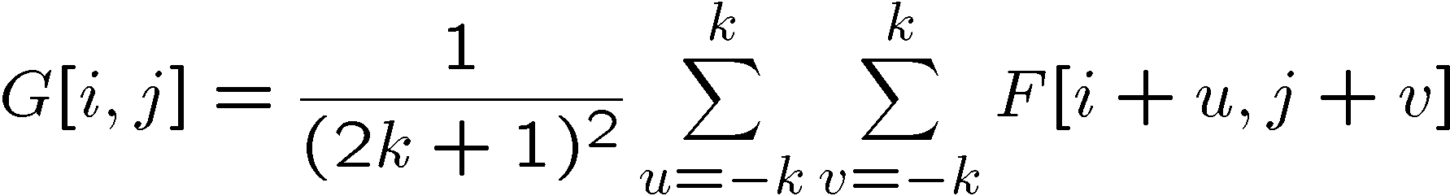
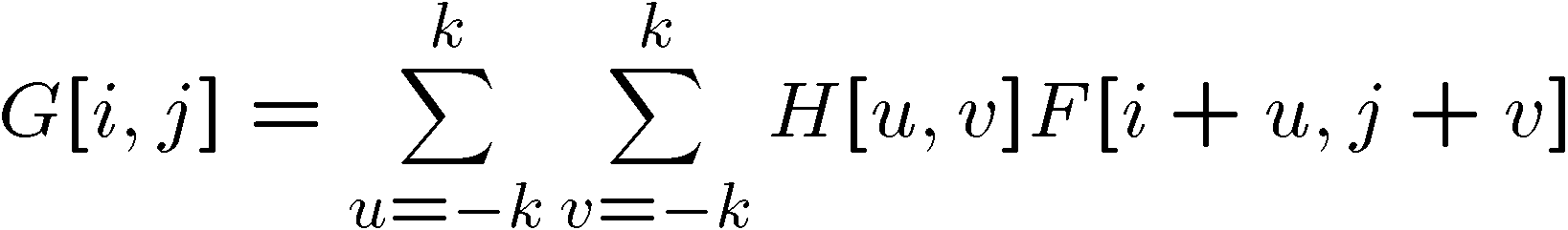
Correlation filtering
Say the averaging window size is 2k+1 x 2k+1:
Attribute uniform weight to each pixel
Loop over all pixels in neighborhood around image pixel F[i,j]
Now generalize to allow different weights depending on neighboring pixel’s relative position:
Non-uniform weights
Slide credit: Kristen Grauman

Slide 37

Correlation filtering
This is called cross-correlation, denoted
Filtering an image: replace each pixel with a linear combination of its neighbors.
The filter “kernel” or “mask” H[u,v] is the prescription for the weights in the linear combination.
Slide credit: Kristen Grauman

Slide 38


Averaging filter
What values belong in the kernel H for the moving average example?
0 | 0 | 0 | 0 | 0 | 0 | 0 | 0 | 0 | 0
0 | 0 | 0 | 0 | 0 | 0 | 0 | 0 | 0 | 0
0 | 0 | 0 | 90 | 90 | 90 | 90 | 90 | 0 | 0
0 | 0 | 0 | 90 | 90 | 90 | 90 | 90 | 0 | 0
0 | 0 | 0 | 90 | 90 | 90 | 90 | 90 | 0 | 0
0 | 0 | 0 | 90 | 0 | 90 | 90 | 90 | 0 | 0
0 | 0 | 0 | 90 | 90 | 90 | 90 | 90 | 0 | 0
0 | 0 | 0 | 0 | 0 | 0 | 0 | 0 | 0 | 0
0 | 0 | 90 | 0 | 0 | 0 | 0 | 0 | 0 | 0
0 | 0 | 0 | 0 | 0 | 0 | 0 | 0 | 0 | 0
 | 0 | 10 | 20 | 30 | 30
1
1
1
1
?
1
1
1
1
1
“box filter”
Slide credit: Kristen Grauman

Slide 39


Smoothing by averaging
depicts box filter:
white = high value, black = low value
original
filtered
What if the filter size was 5 x 5 instead of 3 x 3?
Slide credit: Kristen Grauman

Slide 40
Boundary issues
What is the size of the output?
MATLAB: output size / “shape” options
  shape = ‘full’: output size is sum of sizes of f and g
  shape = ‘same’: output size is same as f
  shape = ‘valid’: output size is difference of sizes of f and g
full
same
valid
g
g
g
g
f
f
f
g
g
g
g
g
g
g
g
Slide credit: Svetlana Lazebnik

Slide 41
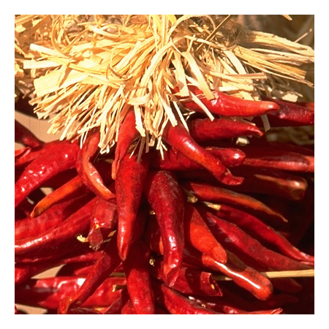
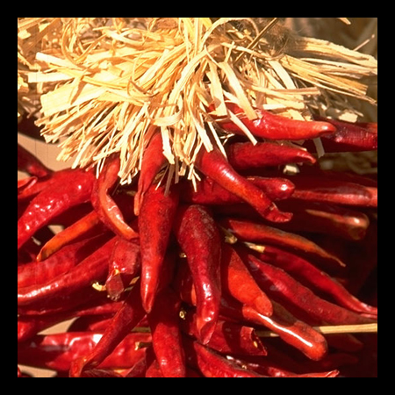

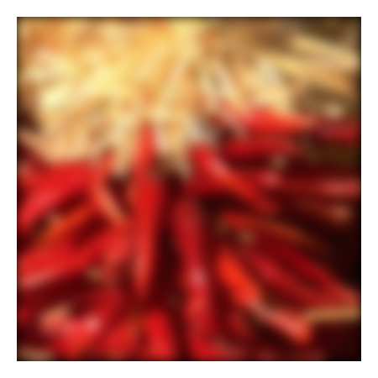


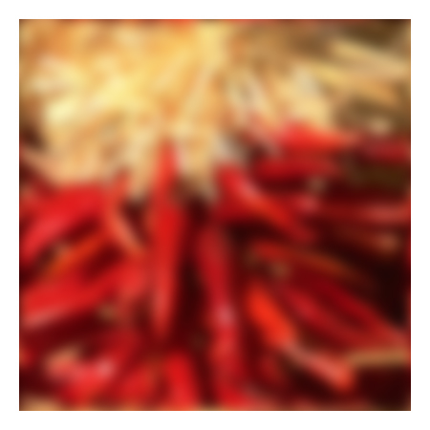



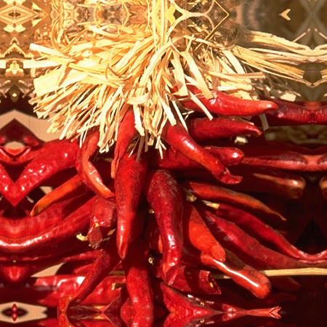


Boundary issues
What about near the edge?
  the filter window falls off the edge of the image
  need to extrapolate
  methods:
    clip filter (black)
    wrap around
    copy edge
    reflect across edge
Slide credit: S. Marschner

Slide 42
Boundary issues
What about near the edge?
  the filter window falls off the edge of the image
  need to extrapolate
  methods (MATLAB):
    clip filter (black): imfilter(f, g, 0)
    wrap around: imfilter(f, g, ‘circular’)
    copy edge: imfilter(f, g, ‘replicate’)
    reflect across edge: imfilter(f, g, ‘symmetric’)
Slide credit: S. Marschner

Slide 43
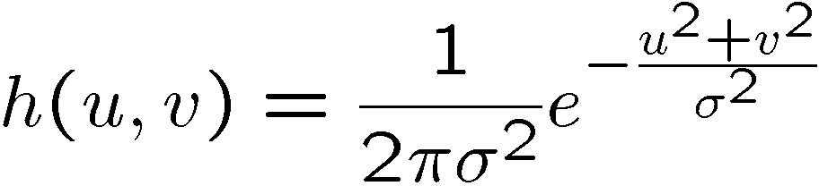
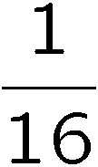
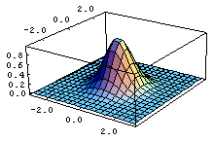
Gaussian filter
What if we want nearest neighboring pixels to have the most influence on the output?
Removes high-frequency components from the image (“low-pass filter”).
This kernel is an approximation of a 2d Gaussian function:
0 | 0 | 0 | 0 | 0 | 0 | 0 | 0 | 0 | 0
0 | 0 | 0 | 0 | 0 | 0 | 0 | 0 | 0 | 0
0 | 0 | 0 | 90 | 90 | 90 | 90 | 90 | 0 | 0
0 | 0 | 0 | 90 | 90 | 90 | 90 | 90 | 0 | 0
0 | 0 | 0 | 90 | 90 | 90 | 90 | 90 | 0 | 0
0 | 0 | 0 | 90 | 0 | 90 | 90 | 90 | 0 | 0
0 | 0 | 0 | 90 | 90 | 90 | 90 | 90 | 0 | 0
0 | 0 | 0 | 0 | 0 | 0 | 0 | 0 | 0 | 0
0 | 0 | 90 | 0 | 0 | 0 | 0 | 0 | 0 | 0
0 | 0 | 0 | 0 | 0 | 0 | 0 | 0 | 0 | 0
1 | 2 | 1
2 | 4 | 2
1 | 2 | 1
Slide credit: Steve Seitz

Slide 44

Smoothing with a Gaussian
Slide credit: Kristen Grauman

Slide 45
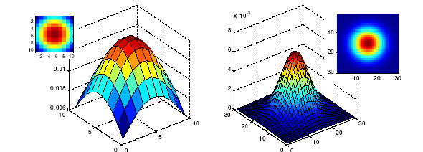
Gaussian filters
What parameters matter here?
Size of kernel or mask
  Note, Gaussian function has infinite support, but discrete filters use finite kernels
σ = 5 with 10 x 10 kernel
σ = 5 with 30 x 30 kernel
Slide credit: Kristen Grauman

Slide 46
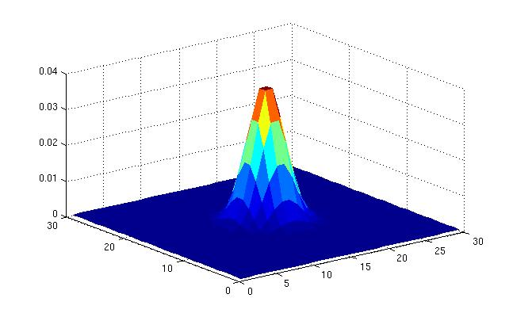
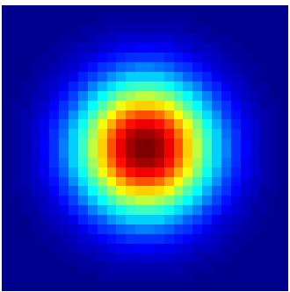
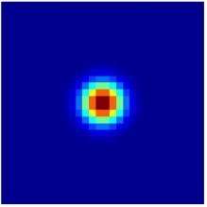
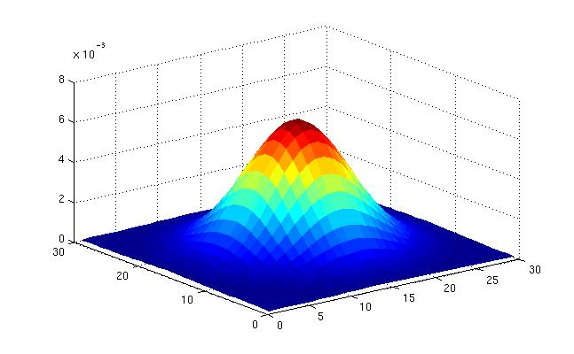
Gaussian filters
What parameters matter here?
Variance of Gaussian: determines extent of smoothing
σ = 2 with 30 x 30 kernel
σ = 5 with 30 x 30 kernel
Slide credit: Kristen Grauman

Slide 47

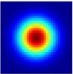
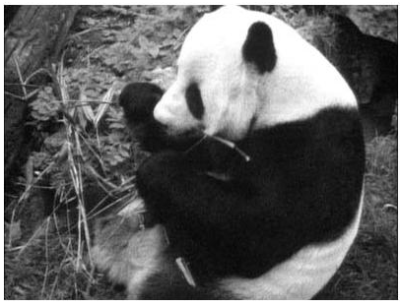
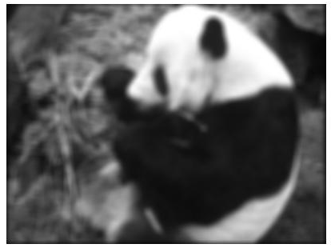
Matlab
>> hsize = 10;
>> sigma = 5;
>> h = fspecial(‘gaussian’, hsize, sigma);
>> mesh(h);
>> imagesc(h);
>> outim = imfilter(im, h); % correlation
>> imshow(outim);
outim
Slide credit: Kristen Grauman
Notes:
In matlab, conv2 does convolution, filter2 does correlation. Imfilter does either if specified, correlation by default (‘conv’, ‘corr’ option)

Slide 48






Smoothing with a Gaussian
Parameter σ is the “scale” / “width” / “spread” of the Gaussian kernel, and controls the amount of smoothing.
…
for sigma=1:3:10
h = fspecial('gaussian‘, hsize, sigma);
out = imfilter(im, h);
imshow(out);
pause;
end
Slide credit: Kristen Grauman

Slide 49
Properties of smoothing filters
Smoothing
  Values positive
  Sum to 1 → constant regions same as input
  Amount of smoothing proportional to mask size
  Remove “high-frequency” components; “low-pass” filter
Slide credit: Kristen Grauman

Slide 50

Filtering an impulse signal
What is the result of filtering the impulse signal (image) F with the arbitrary kernel H?
0 | 0 | 0 | 0 | 0 | 0 | 0
0 | 0 | 0 | 0 | 0 | 0 | 0
0 | 0 | 0 | 0 | 0 | 0 | 0
0 | 0 | 0 | 1 | 0 | 0 | 0
0 | 0 | 0 | 0 | 0 | 0 | 0
0 | 0 | 0 | 0 | 0 | 0 | 0
0 | 0 | 0 | 0 | 0 | 0 | 0
a | b | c
d | e | f
g | h | i
?
Slide credit: Kristen Grauman

Slide 51
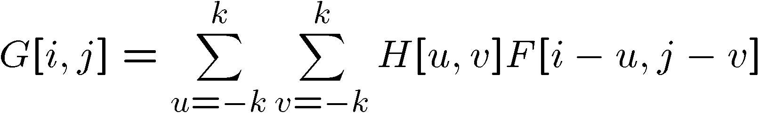
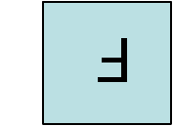

Convolution
Convolution:
  Flip the filter in both dimensions (bottom to top, right to left)
  Then apply cross-correlation
F
H
Notation for convolution operator
Slide credit: Kristen Grauman

Slide 52
Convolution vs. correlation
Convolution
Cross-correlation
For a Gaussian or box filter, how will the outputs differ?
If the input is an impulse signal, how will the outputs differ?
Slide credit: Kristen Grauman

Slide 53

Predict the outputs using correlation filtering
0
0
0
0
0
0
*
= ?
*
= ?
0
1
0
0
0
1
0
0
0
0
0
0
0
0
0
-
1
1
1
*
= ?
0
2
0
1
1
1
0
0
0
1
1
1
Slide credit: Kristen Grauman

Slide 54
Practice with linear filters
0
0
0
?
0
1
0
0
0
0
Original
Slide credit: David Lowe

Slide 55
Practice with linear filters
0
0
0
0
1
0
0
0
0
Original
Filtered
(no change)
Slide credit: David Lowe

Slide 56
Practice with linear filters
0
0
0
?
0
0
1
0
0
0
Original
Slide credit: David Lowe

Slide 57
Practice with linear filters
0
0
0
0
0
1
0
0
0
Original
Shifted left
by 1 pixel with correlation
Slide credit: David Lowe

Slide 58
Practice with linear filters
1
1
1
?
1
1
1
1
1
1
Original
Slide credit: David Lowe

Slide 59
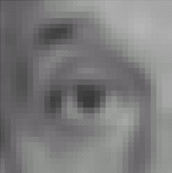
Practice with linear filters
1
1
1
1
1
1
1
1
1
Original
Blur (with a
box filter)
Slide credit: David Lowe

Slide 60
Practice with linear filters
0
0
0
-
1
1
1
?
0
2
0
1
1
1
0
0
0
1
1
1
Original
Slide credit: David Lowe

Slide 61

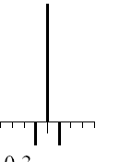
Practice with linear filters
0
0
0
-
1
1
1
0
2
0
1
1
1
0
0
0
1
1
1
Original
Sharpening filter:
  accentuates differences with local average
Slide credit: David Lowe

Slide 62
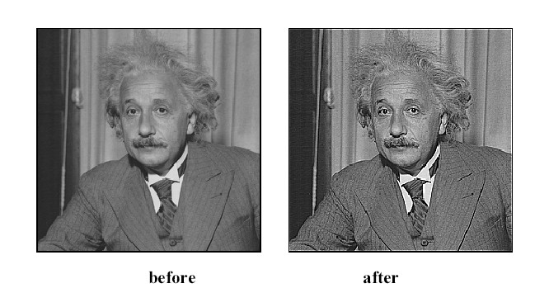
Filtering examples: sharpening
Slide credit: Kristen Grauman

Slide 63
Properties of convolution
Shift invariant:
  Operator behaves the same everywhere, i.e. the value of the output depends on the pattern in the image neighborhood, not the position of the neighborhood.
Superposition:
  h * (f1 + f2) = (h * f1) + (h * f2)
Slide credit: Kristen Grauman

Slide 64
Properties of convolution
Commutative:
  f * g = g * f
Associative
  (f * g) * h = f * (g * h)
Distributes over addition
f * (g + h) = (f * g) + (f * h)
Scalars factor out
kf * g = f * kg = k(f * g)
Identity:
  unit impulse e = […, 0, 0, 1, 0, 0, …]. f * e = f
Slide credit: Kristen Grauman

Slide 65
Separability
In some cases, filter is separable, and we can factor into two steps:
  Convolve all rows
  Convolve all columns
Slide credit: Kristen Grauman

Slide 66
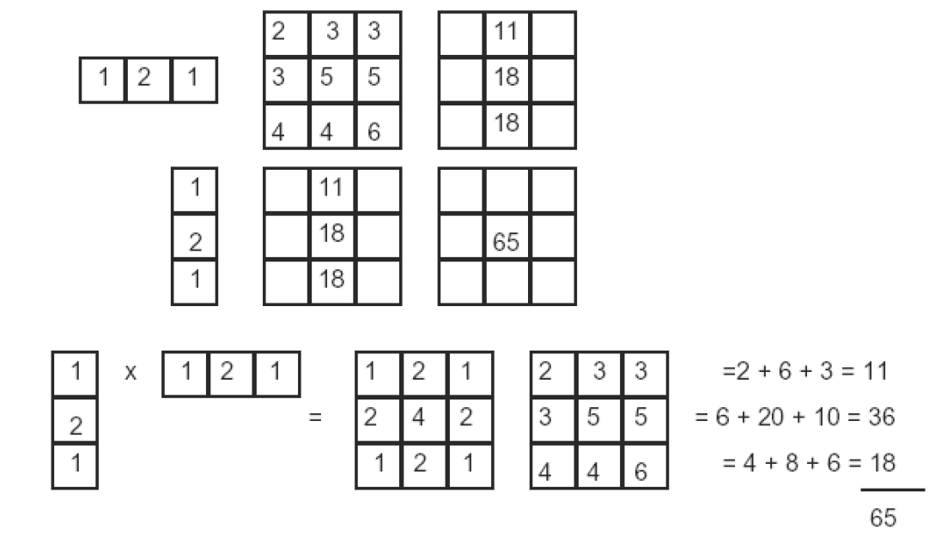
Separability
In some cases, filter is separable, and we can factor into two steps: e.g.,
h
What is the computational complexity advantage for a separable filter of size k x k, in terms of number of operations per output pixel?
g
f
f * (g * h) = (f * g) * h
Slide credit: Kristen Grauman

Slide 67
Effect of smoothing filters
Additive Gaussian noise
Salt and pepper noise
Slide credit: Kristen Grauman

Slide 68
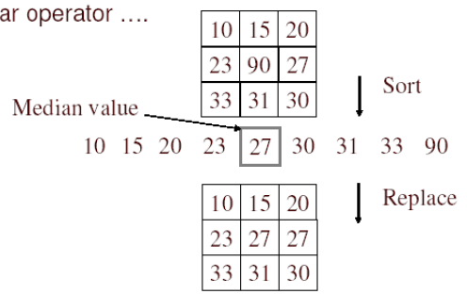
Median filter
No new pixel values introduced
Removes spikes: good for impulse, salt & pepper noise
Non-linear filter
Slide credit: Kristen Grauman

Slide 69
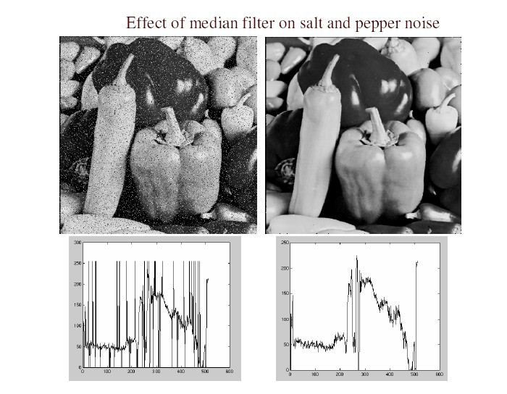
Median filter
Salt and pepper noise
Median filtered
Plots of a row of the image
Matlab: output im = medfilt2(im, [h w]);
Slide credit: Martial Hebert

Slide 70
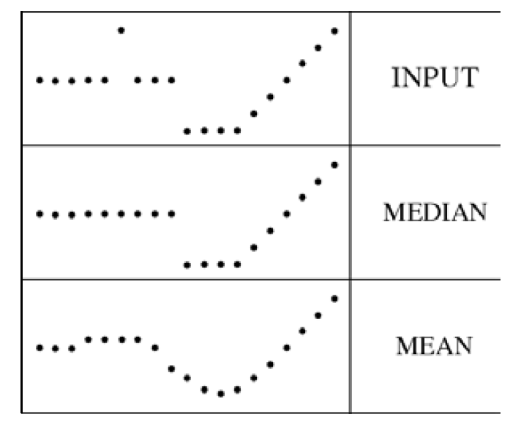
Median filter
Median filter is edge preserving
Slide credit: Kristen Grauman

Slide 71
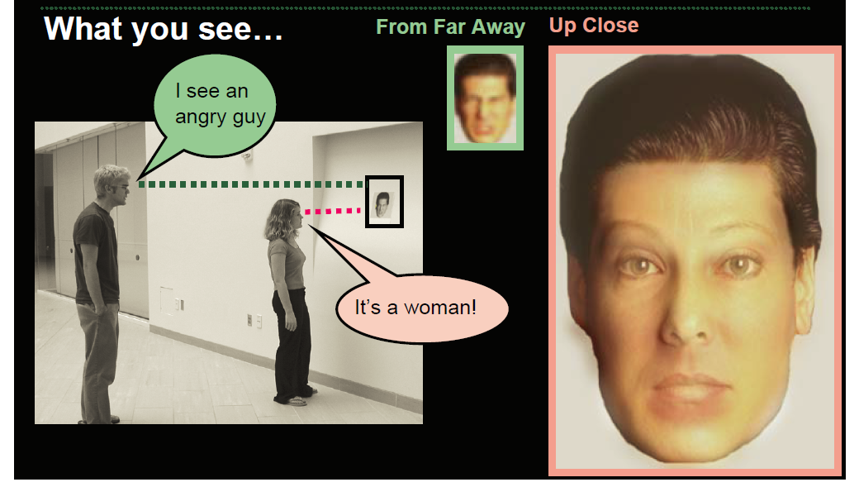
Filtering application: Hybrid Images
Slide credit: Kristen Grauman
Aude Oliva & Antonio Torralba & Philippe G Schyns, SIGGRAPH 2006
Notes:
\

Slide 72




Application: Hybrid Images
A. Oliva, A. Torralba, P.G. Schyns,
“Hybrid Images,” SIGGRAPH 2006
Gaussian Filter
Laplacian Filter
unit impulse
Gaussian
Laplacian of Gaussian
Slide credit: Kristen Grauman

Slide 73
Slide credit: Kristen Grauman
Aude Oliva & Antonio Torralba & Philippe G Schyns, SIGGRAPH 2006

Slide 74
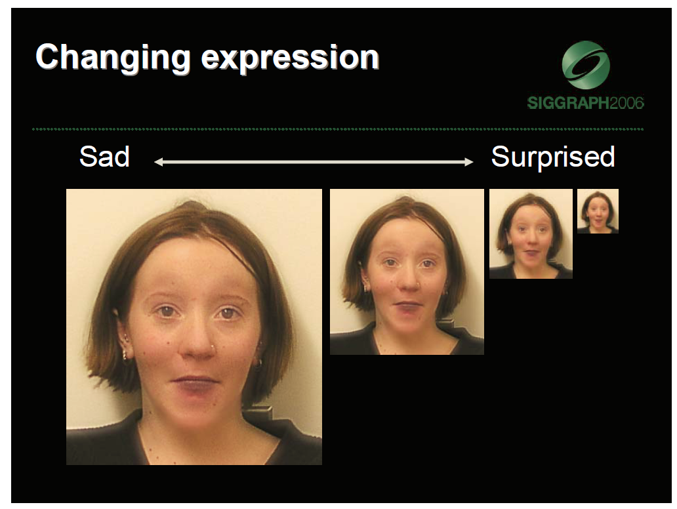
Slide credit: Kristen Grauman
Aude Oliva & Antonio Torralba & Philippe G Schyns, SIGGRAPH 2006

Slide 75
Summary
Image formation
Image “noise”
Linear filters and convolution useful for
  Enhancing images (smoothing, removing noise)
    Box filter
    Gaussian filter
    Impact of scale / width of smoothing filter
  Detecting features (next time)
Separable filters more efficient
Median filter: a non-linear filter, edge-preserving
Slide credit: Kristen Grauman

Slide 76
Coming up
Monday night:
  PS0 is due via scholar, 11:55 PM
Tuesday:
  Filtering part 2: filtering for features

Slide 77
Topics overview
Features & filters
  Filters
  Gradients
  Edges
Grouping & fitting
Multiple views and motion
Recognition
Video processing
Slide credit: Kristen Grauman

Slide 78
Questions?
See you Tuesday!

