Slide 1
Feature Tracking and Optical Flow
11/10/15
Computer Vision
ECE 5554, ECE 4984
Virginia Tech
Devi Parikh
Slides borrowed from Derek Hoiem, who adapted many from Lana Lazebnik, Silvio Saverse, who in turn adapted slides from Steve Seitz, Rick Szeliski, Martial Hebert, Mark Pollefeys, and others

Slide 2
Announcements
PS4 out
Due 11/16
Project expected to be complete by the time report is due
Due 11/21
Template is online
Submit URL to scholar
PS5 out
Due 12/02
No class on Thursday

Slide 3
Topics
Features & filters
Grouping & fitting
Multiple views and motion
Recognition
Video processing
Motion and optical flow
Background subtraction, action recognition
Tracking
Slide credit: Kristen Grauman

Slide 4
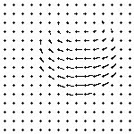
Finally: Motion and tracking
Tracking objects, video analysis, low level motion
Tomas Izo
Slide taken from Kristen Grauman

Slide 5
Topics
Features & filters
Grouping & fitting
Multiple views and motion
Recognition
Video processing
Motion and optical flow
Background subtraction, action recognition
Tracking
Slide credit: Kristen Grauman

Slide 6
Video
A video is a sequence of frames captured over time
Now our image data is a function of space (x, y) and time (t)
Slide taken from Kristen Grauman

Slide 7
Recovering motion
Feature-tracking
Extract visual features (corners, textured areas) and “track” them over multiple frames
Optical flow
Recover image motion at each pixel from spatio-temporal image brightness variations (optical flow)
Two problems, one registration method
B. Lucas and T. Kanade. An iterative image registration technique with an application to
stereo vision. In Proceedings of the International Joint Conference on Artificial Intelligence, pp. 674–679, 1981.

Slide 8
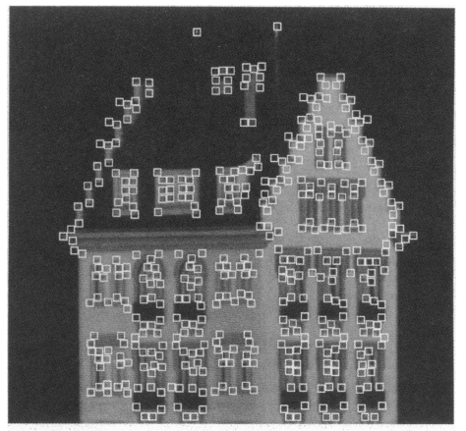
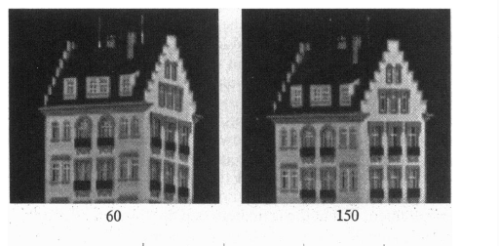
Feature tracking
Many problems, such as structure from motion require matching points
If motion is small, tracking is an easy way to get them

Slide 9
Feature tracking
Challenges
Figure out which features can be tracked
Efficiently track across frames
Some points may change appearance over time (e.g., due to rotation, moving into shadows, etc.)
Drift: small errors can accumulate as appearance model is updated
Points may appear or disappear: need to be able to add/delete tracked points

Slide 10
Feature tracking
I(x,y,t)
I(x,y,t+1)
Given two subsequent frames, estimate the point translation
Key assumptions of Lucas-Kanade Tracker
Brightness constancy: projection of the same point looks the same in every frame
Small motion: points do not move very far
Spatial coherence: points move like their neighbors

Slide 11
The brightness constancy constraint
I(x,y,t)
I(x,y,t+1)
Brightness Constancy Equation:
Take Taylor expansion of I(x+u, y+v, t+1) at (x,y,t) to linearize the right side:
Image derivative along x
Difference over frames
So:
Notes:
Brightness constancy equation is equivalent to minimizing the squared error of I(t) and I(t+1)

Slide 12
The brightness constancy constraint
Can we use this equation to recover image motion (u,v) at each pixel?
How many equations and unknowns per pixel?
One equation (this is a scalar equation!), two unknowns (u,v)
The component of the motion perpendicular to the gradient (i.e., parallel to the edge) cannot be measured
If (u, v) satisfies the equation, so does (u+u’, v+v’ ) if
gradient
(u,v)
(u’,v’)
(u+u’,v+v’)
edge
Notes:
A: u and v are unknown, 1 equation

Slide 13
The aperture problem
Actual motion

Slide 14
The aperture problem
Perceived motion

Slide 15
The barber pole illusion
http://en.wikipedia.org/wiki/Barberpole_illusion

Slide 16
The barber pole illusion
http://en.wikipedia.org/wiki/Barberpole_illusion

Slide 17
Solving the ambiguity…
B. Lucas and T. Kanade. An iterative image registration technique with an application to stereo vision. In Proceedings of the International Joint Conference on Artificial Intelligence, pp. 674–679, 1981.
How to get more equations for a pixel?
Spatial coherence constraint
Assume the pixel’s neighbors have the same (u,v)
If we use a 5x5 window, that gives us 25 equations per pixel

Slide 18
Solving the ambiguity…
Least squares problem:

Slide 19
Matching patches across images
Overconstrained linear system
Least squares solution for d given by
The summations are over all pixels in the K x K window

Slide 20
Conditions for solvability
Optimal (u, v) satisfies Lucas-Kanade equation
When is this solvable? I.e., what are good points to track?
A^{T}A should be invertible
A^{T}A should not be too small due to noise
eigenvalues λ₁ and λ ₂ of A^{T}A should not be too small
A^{T}A should be well-conditioned
λ ₁/ λ ₂ should not be too large (λ ₁ = larger eigenvalue)
Does this remind you of anything?
Criteria for Harris corner detector

Slide 21
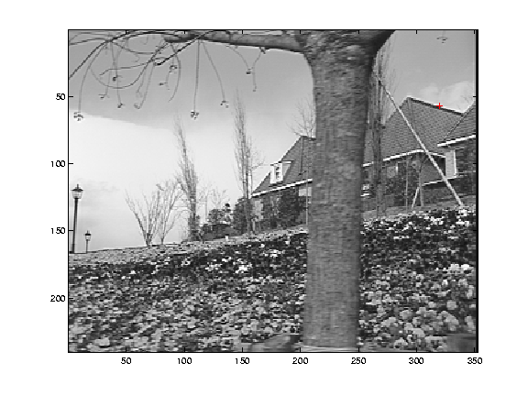
Low-texture region
gradients have small magnitude
small λ₁, small λ₂

Slide 22
Edge
gradients very large or very small
large λ₁, small λ₂

Slide 23
High-texture region
gradients are different, large magnitudes
large λ₁, large λ₂

Slide 24
The aperture problem resolved
Actual motion

Slide 25
The aperture problem resolved
Perceived motion

Slide 26
Dealing with larger movements: Iterative refinement
Original (x,y) position
Initialize (x’,y’) = (x,y)
Compute (u,v) by
Shift window by (u, v): x’=x’+u; y’=y’+v;
Recalculate I_{t}
Repeat steps 2-4 until small change
Use interpolation for subpixel values
I_{t} = I(x’, y’, t+1) - I(x, y, t)
2nd moment matrix for feature patch in first image
displacement

Slide 27
Dealing with larger movements: coarse-to-fine registration
run iterative L-K
upsample
run iterative L-K
.
.
.
image J
image I
image 1
image 2
Gaussian pyramid of image 1 (t)
Gaussian pyramid of image 2 (t+1)

Slide 28
Shi-Tomasi feature tracker
Find good features using eigenvalues of second-moment matrix (e.g., Harris detector or threshold on the smallest eigenvalue)
Key idea: “good” features to track are the ones whose motion can be estimated reliably
Track from frame to frame with Lucas-Kanade
This amounts to assuming a translation model for frame-to-frame feature movement
Check consistency of tracks by affine registration to the first observed instance of the feature
Affine model is more accurate for larger displacements
Comparing to the first frame helps to minimize drift
J. Shi and C. Tomasi. Good Features to Track. CVPR 1994.

Slide 29
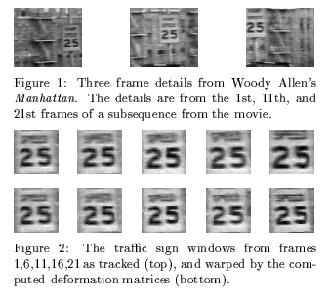
Tracking example
J. Shi and C. Tomasi. Good Features to Track. CVPR 1994.

Slide 30
Summary of KLT tracking
Find a good point to track (harris corner)
Use intensity second moment matrix and difference across frames to find displacement
Iterate and use coarse-to-fine search to deal with larger movements
When creating long tracks, check appearance of registered patch against appearance of initial patch to find points that have drifted

Slide 31
Implementation issues
Window size
Small window more sensitive to noise and may miss larger motions (without pyramid)
Large window more likely to cross an occlusion boundary (and it’s slower)
15x15 to 31x31 seems typical
Weighting the window
Common to apply weights so that center matters more (e.g., with Gaussian)

Slide 32
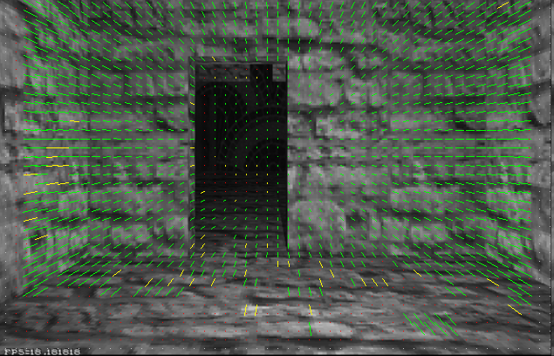
Optical flow
Vector field function of the spatio-temporal image brightness variations
Picture courtesy of Selim Temizer - Learning and Intelligent Systems (LIS) Group, MIT

Slide 33
Motion and perceptual organization
Even “impoverished” motion data can evoke a strong percept
G. Johansson, “Visual Perception of Biological Motion and a Model For Its Analysis", Perception and Psychophysics 14, 201-211, 1973.

Slide 34
Motion and perceptual organization
Even “impoverished” motion data can evoke a strong percept
G. Johansson, “Visual Perception of Biological Motion and a Model For Its Analysis", Perception and Psychophysics 14, 201-211, 1973.

Slide 35
Uses of motion
Estimating 3D structure
Segmenting objects based on motion cues
Learning and tracking dynamical models
Recognizing events and activities
Improving video quality (motion stabilization)

Slide 36
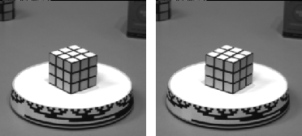
Motion field
The motion field is the projection of the 3D scene motion into the image
What would the motion field of a non-rotating ball moving towards the camera look like?

Slide 37
Motion field + camera motion
Zoom out
Zoom in
Pan right to left

Slide 38
Optical flow
Definition: optical flow is the apparent motion of brightness patterns in the image
Ideally, optical flow would be the same as the motion field
Have to be careful: apparent motion can be caused by lighting changes without any actual motion
Think of a uniform rotating sphere under fixed lighting vs. a stationary sphere under moving illumination

Slide 39
Lucas-Kanade Optical Flow
Same as Lucas-Kanade feature tracking, but for each pixel
As we saw, works better for textured pixels
Operations can be done one frame at a time, rather than pixel by pixel
Efficient

Slide 40
Multi-resolution Lucas Kanade Algorithm

Slide 41
Iterative Refinement
Iterative Lukas-Kanade Algorithm
Estimate displacement at each pixel by solving Lucas-Kanade equations
Warp I(t) towards I(t+1) using the estimated flow field
- Basically, just interpolation
Repeat until convergence
* From Khurram Hassan-Shafique CAP5415 Computer Vision 2003

Slide 42
Coarse-to-fine optical flow estimation
run iterative L-K
warp & upsample
run iterative L-K
.
.
.
image J
image I
image 1
image 2
Gaussian pyramid of image 1 (t)
Gaussian pyramid of image 2 (t+1)

Slide 43
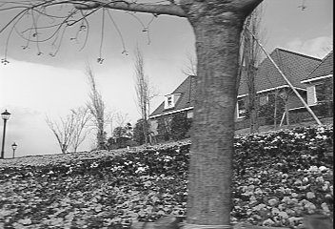
Example
* From Khurram Hassan-Shafique CAP5415 Computer Vision 2003

Slide 44
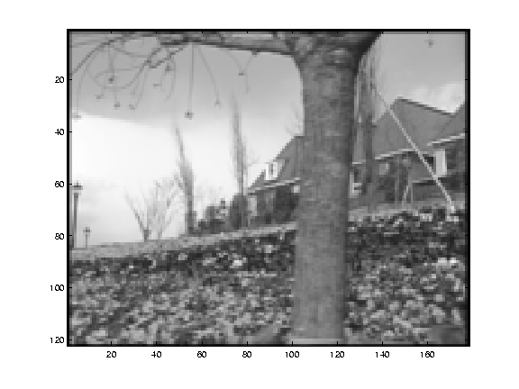
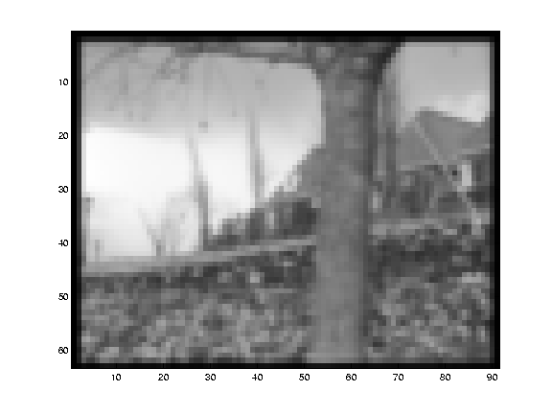
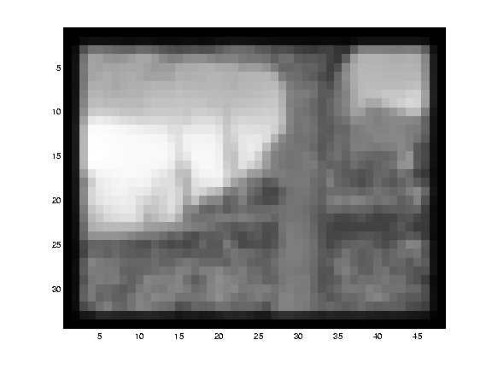
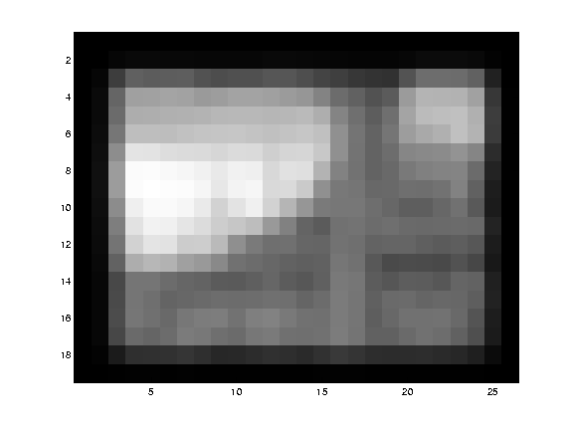
Multi-resolution registration
* From Khurram Hassan-Shafique CAP5415 Computer Vision 2003

Slide 45
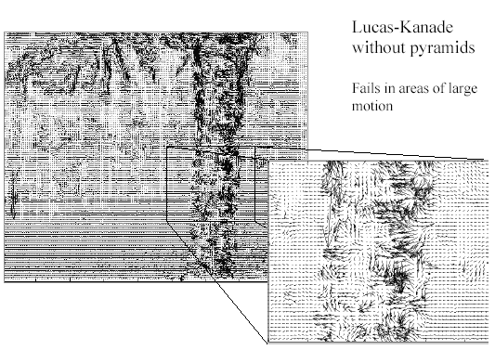
Optical Flow Results
* From Khurram Hassan-Shafique CAP5415 Computer Vision 2003

Slide 46
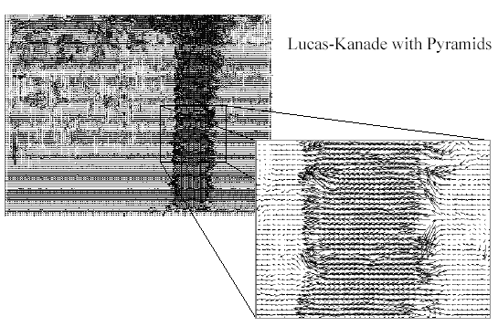
Optical Flow Results

Slide 47
Errors in Lucas-Kanade
The motion is large
Possible Fix: Keypoint matching
A point does not move like its neighbors
Possible Fix: Region-based matching
Brightness constancy does not hold
Possible Fix: Gradient constancy
Notes:
Iterative refinement:
Estimate velocity at each pixel using one iteration of Lucas and Kanade estimation
Warp one image toward the other using the estimated flow field
Refine estimate by repeating the process

Slide 48
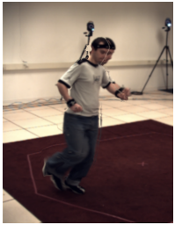
State-of-the-art optical flow
Start with something similar to Lucas-Kanade
+ gradient constancy
+ energy minimization with smoothing term
+ region matching
+ keypoint matching (long-range)
Keypoint-based
Pixel-based
Final
Warped
Slide adapted by Devi Parikh
Large displacement optical flow, Brox et al., CVPR 2009

Slide 49
Motion parallax
http://psych.hanover.edu/KRANTZ/MotionParallax/MotionParallax.html
Slide taken from Kristen Grauman

Slide 50
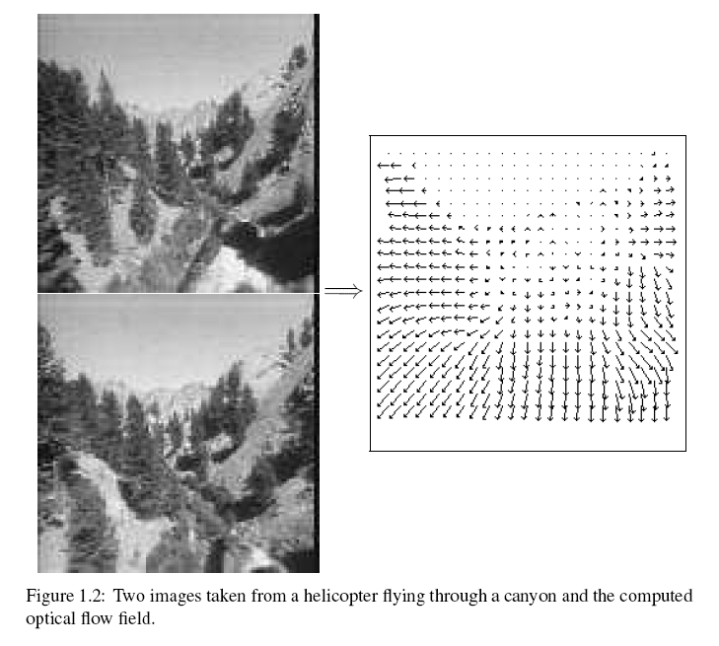
Motion field + camera motion
Length of flow vectors inversely proportional to depth Z of 3d point
points closer to the camera move more quickly across the image plane
Figure from Michael Black, Ph.D. Thesis
Slide taken from Kristen Grauman

Slide 51
Motion estimation techniques
Direct methods
Directly recover image motion at each pixel from spatio-temporal image brightness variations
Dense motion fields, but sensitive to appearance variations
Suitable for video and when image motion is small
Feature-based methods
Extract visual features (corners, textured areas) and track them over multiple frames
Sparse motion fields, but more robust tracking
Suitable when image motion is large (10s of pixels)
Slide taken from Kristen Grauman

Slide 52
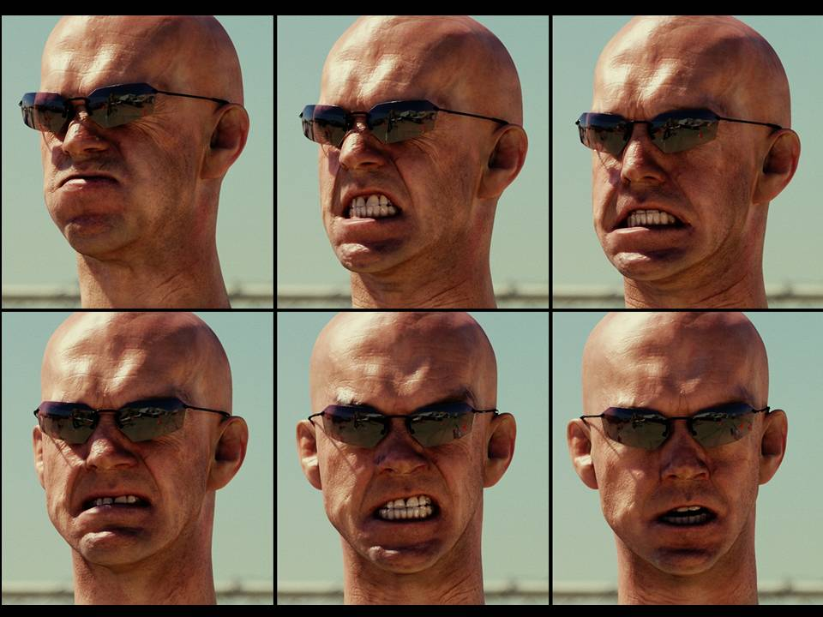
Example use of optical flow: facial animation
http://www.fxguide.com/featured/art_of_optical_flow/
Slide taken from Kristen Grauman, adapted by Devi PArikh

Slide 53
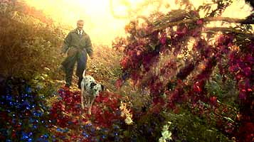
Example use of optical flow: Motion Paint
Use optical flow to track brush strokes, in order to animate them to follow underlying scene motion.
http://vincentwardfilms.com/concepts/motion-painting/optical-flow/
Slide taken from Kristen Grauman, adapted by Devi Parikh

Slide 54
Fun with flow
http://www.youtube.com/watch?v=TbJrc6QCeU0&feature=related
http://www.youtube.com/watch?v=pckFacsIWg4
Slide taken from Kristen Grauman

Slide 55
Using optical flow: recognizing facial expressions
Recognizing Human Facial Expression (1994)
by Yaser Yacoob, Larry S. Davis

Slide 56
Using optical flow: recognizing facial expressions

Slide 57
Motion vs. Stereo: Similarities
Both involve solving
Correspondence: disparities, motion vectors
Reconstruction
Slide taken from Kristen Grauman

Slide 58
Motion vs. Stereo: Differences
Motion:
Uses velocity: consecutive frames must be close to get good approximate time derivative
3d movement between camera and scene not necessarily single 3d rigid transformation
Whereas with stereo:
Could have any disparity value
View pair separated by a single 3d transformation
Slide taken from Kristen Grauman

Slide 59
Summary
Major contributions from Lucas, Tomasi, Kanade
Tracking feature points
Optical flow
Stereo
Structure from motion
Key ideas
By assuming brightness constancy, truncated Taylor expansion leads to simple and fast patch matching across frames
Coarse-to-fine registration

Slide 60
Coming up
Background subtraction, activity recognition, object tracking

Slide 61
Next Class
Features & filters
Grouping & fitting
Multiple views and motion
Recognition
Video processing
Motion and optical flow
Background subtraction, action recognition
Tracking
Slide credit: Kristen Grauman

Slide 62
See you Tuesday!

