Slide 1
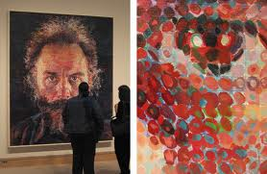
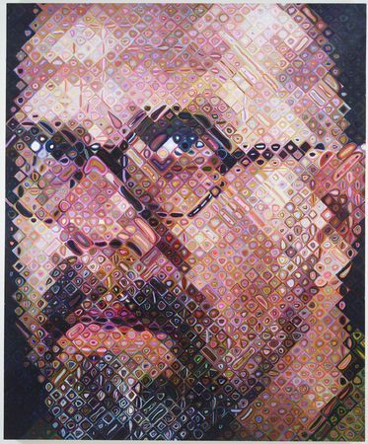
Face Recognition and Feature Subspaces
11/05/15
Lucas by Chuck Close
Chuck Close, self portrait
Devi Parikh
Virginia Tech
Slides borrowed from Derek Hoiem, who borrowed some slides from Lana Lazebnik, Silvio Savarese, Fei-Fei Li

Slide 2
Announcements
PS4 out
  Due 11/16
Project expected to be complete by the time report is due
  Due 11/21
No class on 11/12

Slide 3
Topics overview
Features & filters
Grouping & fitting
Multiple views and motion
Recognition
  Indexing local features and instance recognition
  Introduction to category recognition
  Face detection
  Discriminative classifiers for image recognition
  Parts-based models
  Face recognition
Video processing
Slide credit: Kristen Grauman

Slide 4
Topics overview
Features & filters
Grouping & fitting
Multiple views and motion
Recognition
  Indexing local features and instance recognition
  Introduction to category recognition
  Face detection
  Discriminative classifiers for image recognition
  Parts-based models
  Face recognition
Video processing
Slide credit: Kristen Grauman

Slide 5
This class: face recognition
Two methods: “Eigenfaces” and “Fisherfaces”
  Feature subspaces: PCA and FLD
Look at results from vendor test
Look at interesting findings about human face recognition

Slide 6
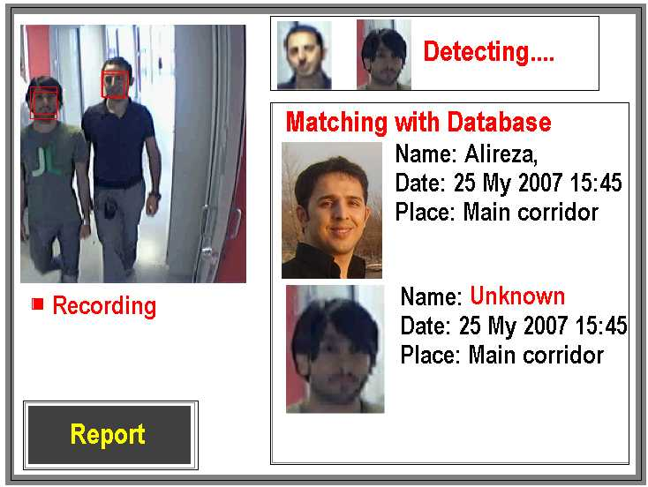
Applications of Face Recognition
Surveillance

Slide 7
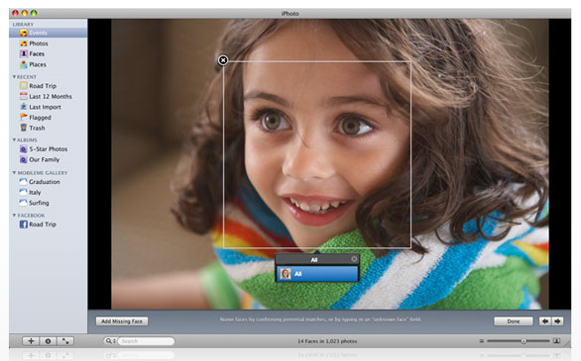
Applications of Face Recognition
Album organization: iPhoto 2009
http://www.apple.com/ilife/iphoto/

Slide 8
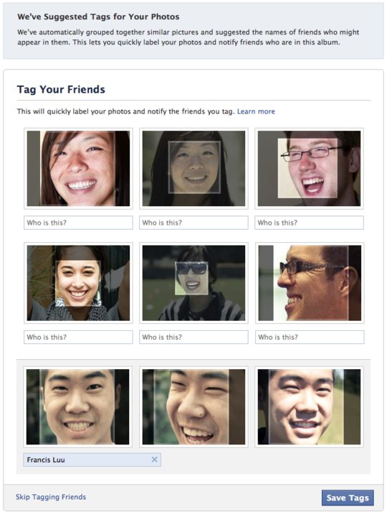
Facebook friend-tagging with auto-suggest

Slide 9


Face recognition: once you’ve detected and cropped a face, try to recognize it
Detection
Recognition
“Sally”

Slide 10
Face recognition: overview
Typical scenario: few examples per face, identify or verify test example
What’s hard: changes in expression, lighting, age, occlusion, viewpoint
Basic approaches (all nearest neighbor)
  Project into a new subspace (or kernel space) (e.g., “Eigenfaces”=PCA)
  Measure face features
  Make 3d face model, compare shape+appearance (e.g., AAM)

Slide 11
Typical face recognition scenarios
Verification: a person is claiming a particular identity; verify whether that is true
  E.g., security
Closed-world identification: assign a face to one person from among a known set
General identification: assign a face to a known person or to “unknown”

Slide 12
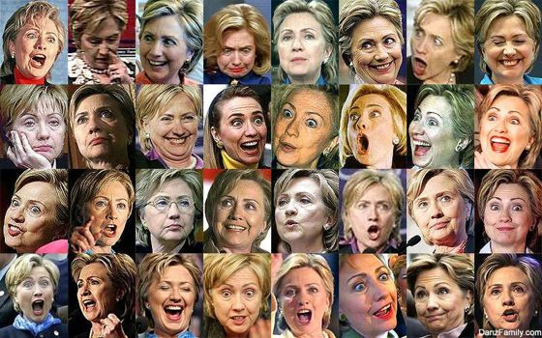
What makes face recognition hard?
Expression

Slide 13




What makes face recognition hard?
Lighting

Slide 14
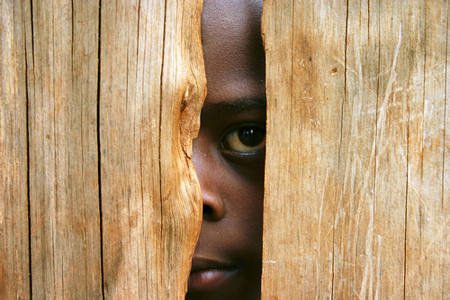
What makes face recognition hard?
Occlusion

Slide 15
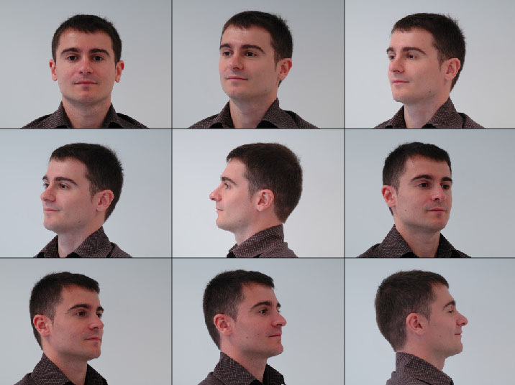
What makes face recognition hard?
Viewpoint

Slide 16

Simple idea for face recognition
Treat face image as a vector of intensities
Recognize face by nearest neighbor in database

Slide 17
The space of all face images
When viewed as vectors of pixel values, face images are extremely high-dimensional
  100x100 image = 10,000 dimensions
  Slow and lots of storage
But very few 10,000-dimensional vectors are valid face images
We want to effectively model the subspace of face images

Slide 18
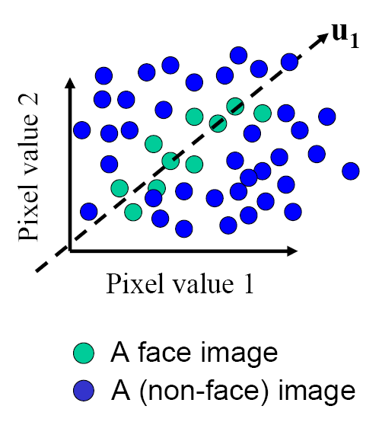
The space of all face images
Eigenface idea: construct a low-dimensional linear subspace that best explains the variation in the set of face images

Slide 19
Principal Component Analysis (PCA)
Given: N data points x₁, … ,x_{N} in R^{d}
We want to find a new set of features that are linear combinations of original ones:
u(x_{i}) = u^{T}(x_{i} – µ)
(µ: mean of data points)
Choose unit vector u in R^{d} that captures the most data variance
Forsyth & Ponce, Sec. 22.3.1, 22.3.2

Slide 20
Principal Component Analysis
Direction that maximizes the variance of the projected data:
N
Maximize
subject to ||u||=1
Projection of data point
N
1/N
Covariance matrix of data = XX^{T}
The direction that maximizes the variance is the eigenvector associated with the largest eigenvalue of Σ

Slide 21
Implementation issue
Covariance matrix is huge (M² for M pixels)
But typically # examples << M
Simple trick
  X is MxN matrix of normalized training data
  Solve for eigenvectors u of X^{T}X instead of XX^{T}
    X^{T}Xu = lu
    XX^{T}Xu = lXu
    (XX^{T})Xu = l(Xu).
  Then Xu is eigenvector of covariance XX^{T}
  Need to normalize each vector of Xu into unit length

Slide 22
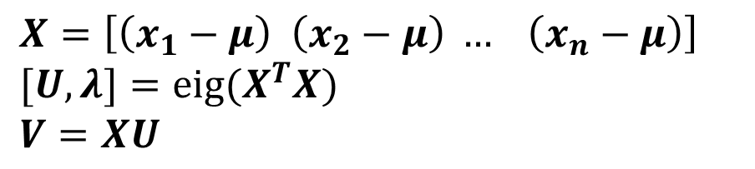


Eigenfaces (PCA on face images)
Compute the principal components (“eigenfaces”) of the covariance matrix
Keep K eigenvectors with largest eigenvalues
Represent all face images in the dataset as linear combinations of eigenfaces
  Perform nearest neighbor on these coefficients
$$X=\left[\left(x_{1}−μ\right) \left(x_{2}−μ\right) … \left(x_{n}−μ\right)\right]$$
$$[U, λ]={eig(X}^{T}X)$$
$$V=XU$$
$$V=V(:, largest_eig)$$
$$Xpca=V{\left(:, {largest}_{eig}\right)}^{T}X$$
M. Turk and A. Pentland, Face Recognition using Eigenfaces, CVPR 1991

Slide 23
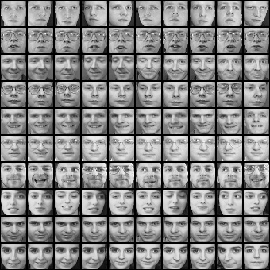
Eigenfaces example
Training images
x₁,…,x_{N}

Slide 24
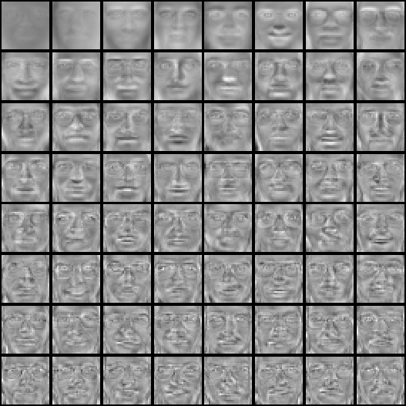
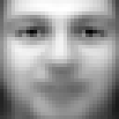
Eigenfaces example
Top eigenvectors: u₁,…u_{k}
Mean: μ

Slide 25

Visualization of eigenfaces
Principal component (eigenvector) u_{k}
μ + 3σ_{k}u_{k}
μ – 3σ_{k}u_{k}

Slide 26

Representation and reconstruction
Face x in “face space” coordinates:
=

Slide 27

Representation and reconstruction
Face x in “face space” coordinates:
Reconstruction:
=
=
+
^
x
=
µ + w₁u₁+w₂u₂+w₃u₃+w₄u₄+ …

Slide 28
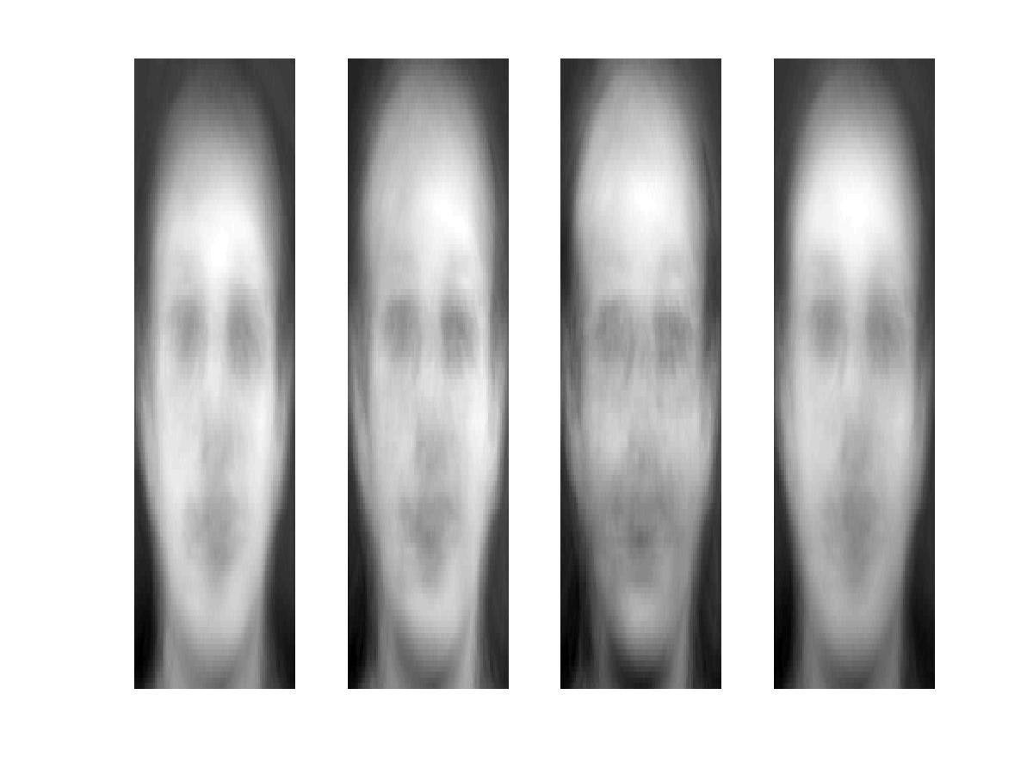
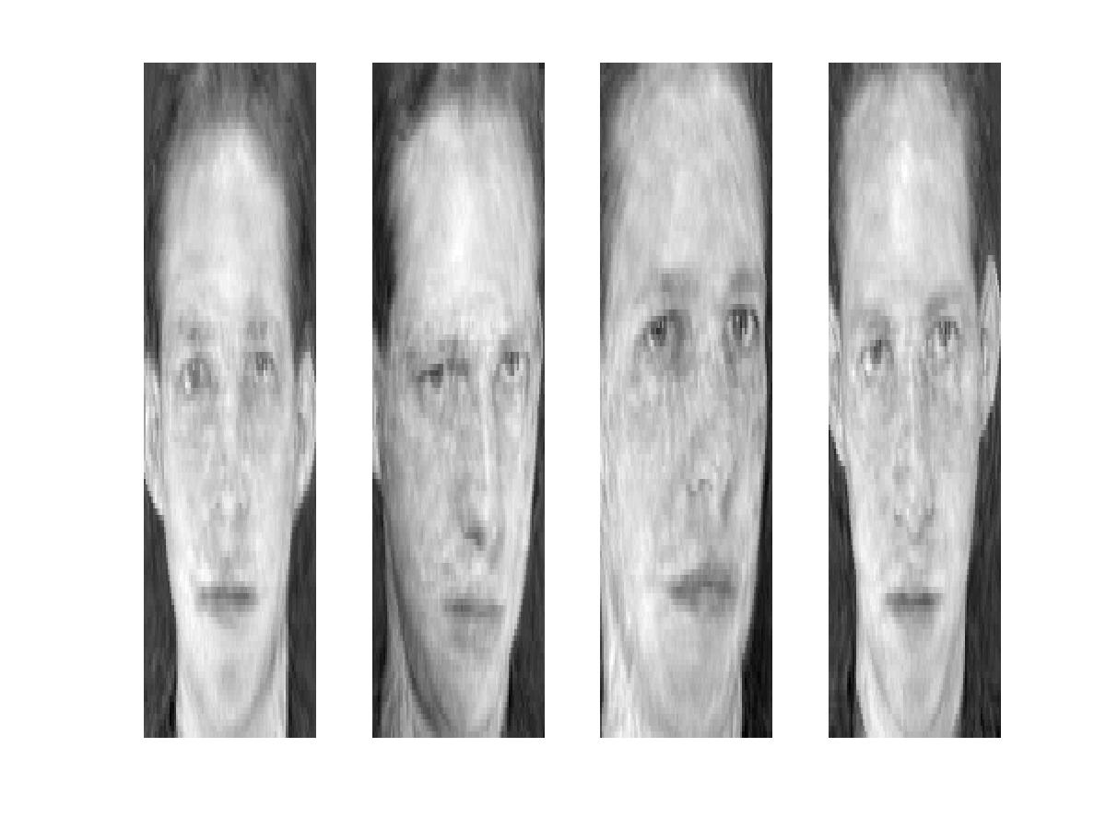
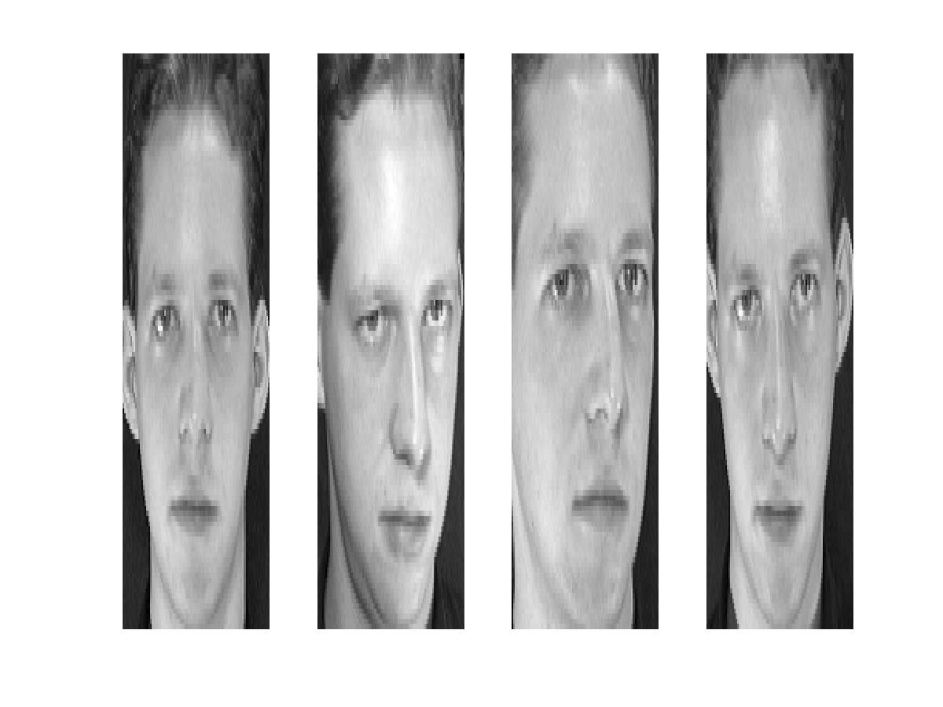
Reconstruction
P = 4
P = 200
P = 400
After computing eigenfaces using 400 face images from ORL face database

Slide 29
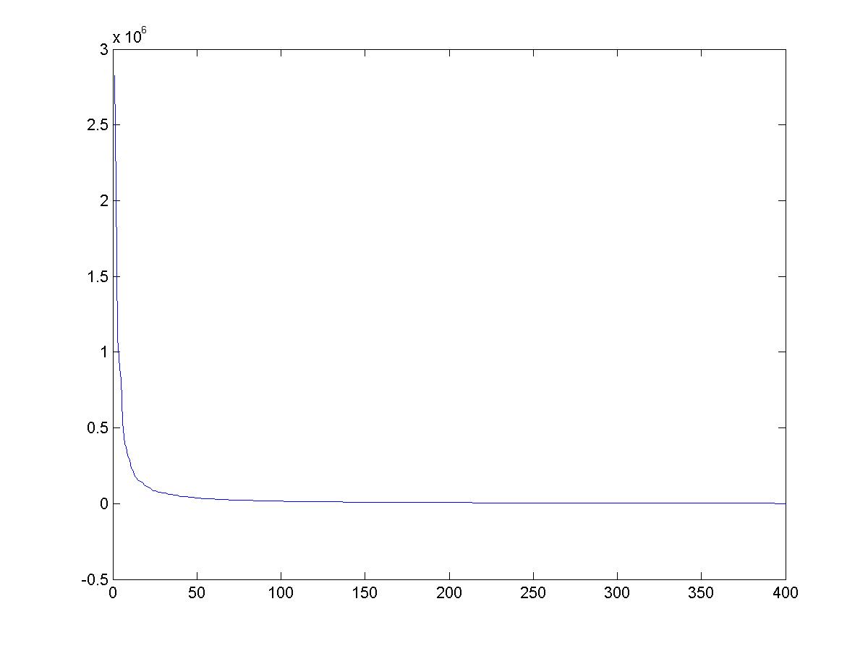
Eigenvalues (variance along eigenvectors)

Slide 30
Note
Preserving variance (minimizing MSE) does not necessarily lead to qualitatively good reconstruction.
P = 200

Slide 31
Recognition with eigenfaces
Process labeled training images
Find mean µ and covariance matrix Σ
Find k principal components (eigenvectors of Σ) u₁,…u_{k}
Project each training image x_{i} onto subspace spanned by principal components:
(w_{i1},…,w_{ik}) = (u₁^{T}(x_{i} – µ), … , u_{k}^{T}(x_{i} – µ))
Given novel image x
Project onto subspace:
(w₁,…,w_{k}) = (u₁^{T}(x – µ), … , u_{k}^{T}(x – µ))
Optional: check reconstruction error x – x to determine whether image is really a face
Classify as closest training face in k-dimensional subspace
^
M. Turk and A. Pentland, Face Recognition using Eigenfaces, CVPR 1991

Slide 32
PCA
General dimensionality reduction technique
Preserves most of variance with a much more compact representation
  Lower storage requirements (eigenvectors + a few numbers per face)
  Faster matching
What are the problems for face recognition?

Slide 33
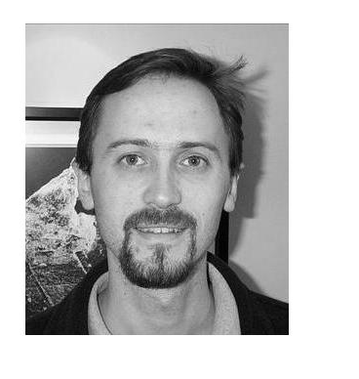
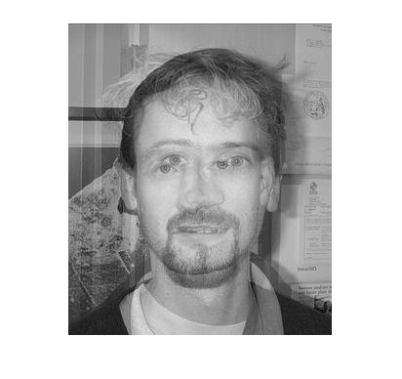
Limitations
Global appearance method: not robust to misalignment, background variation

Slide 34
Limitations
The direction of maximum variance is not always good for classification

Slide 35
A more discriminative subspace: FLD
Fisher Linear Discriminants → “Fisher Faces”
PCA preserves maximum variance
FLD preserves discrimination
  Find projection that maximizes scatter between classes and minimizes scatter within classes
Reference: Eigenfaces vs. Fisherfaces, Belheumer et al., PAMI 1997

Slide 36
Comparing with PCA

Slide 37
Variables
N Sample images:
c classes:
Average of each class:
Average of all data:

Slide 38
Scatter Matrices
Scatter of class i:
Within class scatter:
Between class scatter:

Slide 39
Illustration
x2
Within class scatter
x1
Between class scatter

Slide 40
Mathematical Formulation
After projection
  Between class scatter
  Within class scatter
Objective
Solution: Generalized Eigenvectors
Rank of W_{opt} is limited
  Rank(S_{B}) <= |C|-1
  Rank(S_{W}) <= N-C

Slide 41
Illustration
x2
x1

Slide 42

Recognition with FLD
Use PCA to reduce dimensions to N-C
Compute within-class and between-class scatter matrices for PCA coefficients
Solve generalized eigenvector problem
Project to FLD subspace (c-1 dimensions)
Classify by nearest neighbor
$$W^{T}opt=W^{T}fldW^{T}pca$$
Note: x in step 2 refers to PCA coef; x in step 4 refers to original data

Slide 43
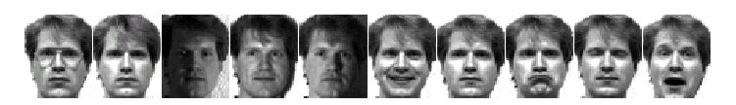
Results: Eigenface vs. Fisherface
Input: 160 images of 16 people
Train: 159 images
Test: 1 image
Variation in Facial Expression, Eyewear, and Lighting
With glasses
Without glasses
3 Lighting conditions
5 expressions
Reference: Eigenfaces vs. Fisherfaces, Belheumer et al., PAMI 1997

Slide 44
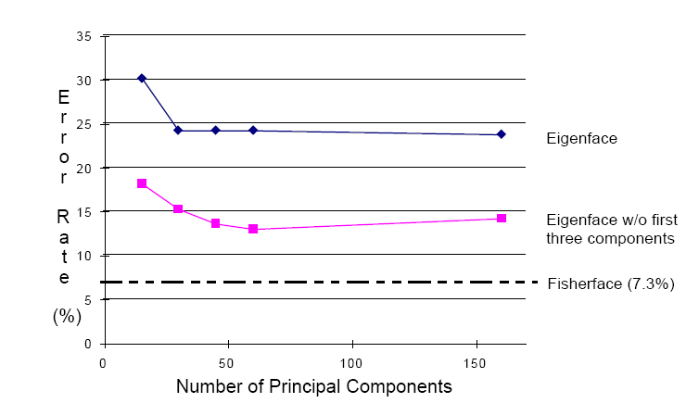
Eigenfaces vs. Fisherfaces
Reference: Eigenfaces vs. Fisherfaces, Belheumer et al., PAMI 1997

Slide 45
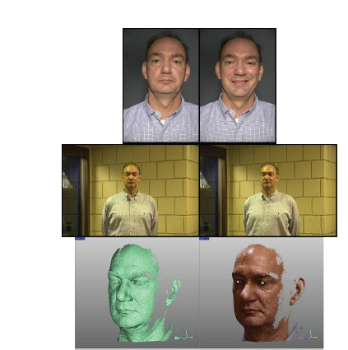
Large scale comparison of methods
FRVT 2006 Report
Not much (or any) information available about methods, but gives idea of what is doable

Slide 46
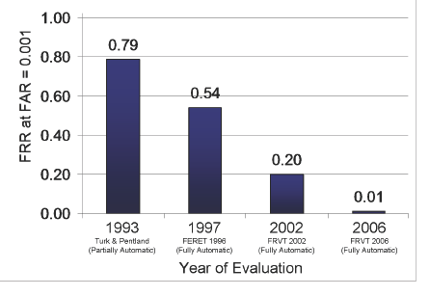
FVRT Challenge
Frontal faces
  FVRT2006 evaluation
False Rejection Rate at False Acceptance Rate = 0.001

Slide 47
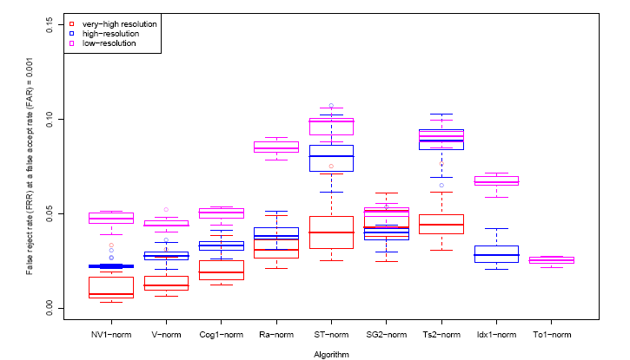
FVRT Challenge
Frontal faces
  FVRT2006 evaluation: controlled illumination

Slide 48
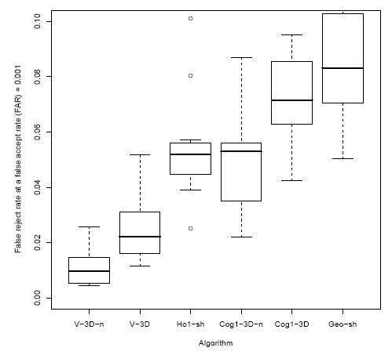
FVRT Challenge
Frontal faces
  FVRT2006 evaluation: uncontrolled illumination

Slide 49
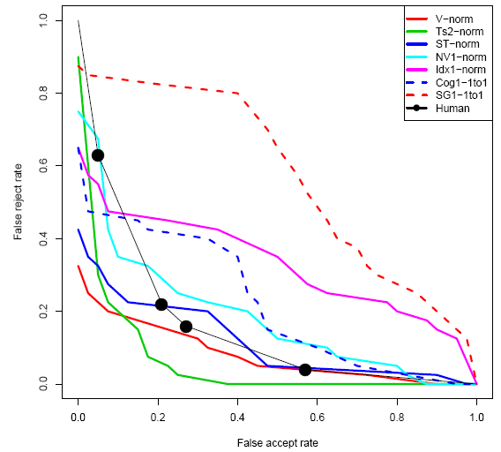
FVRT Challenge
Frontal faces
  FVRT2006 evaluation: computers win!

Slide 50
Face recognition by humans
Face recognition by humans: 20 results (2005)
Slides by Jianchao Yang

Slide 51
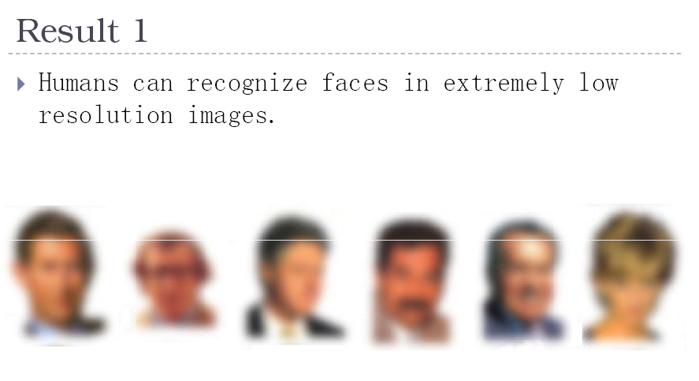

Slide 52
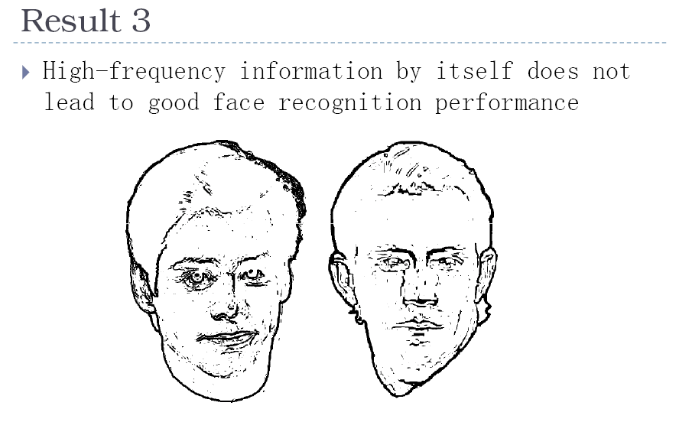

Slide 53
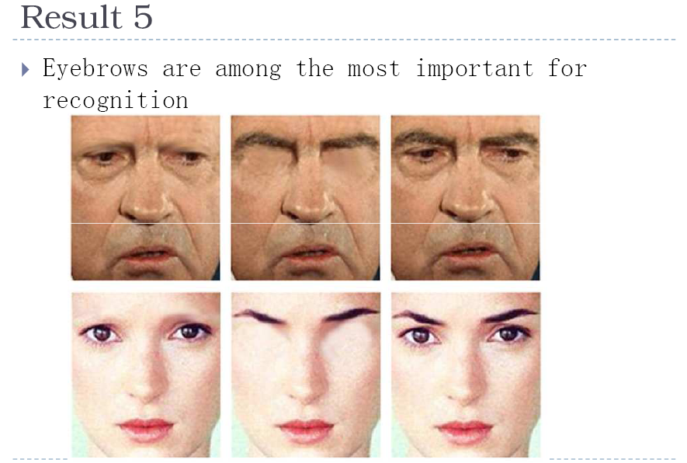

Slide 54
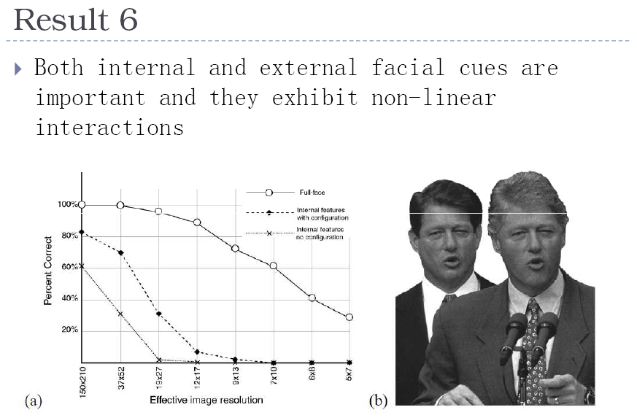

Slide 55
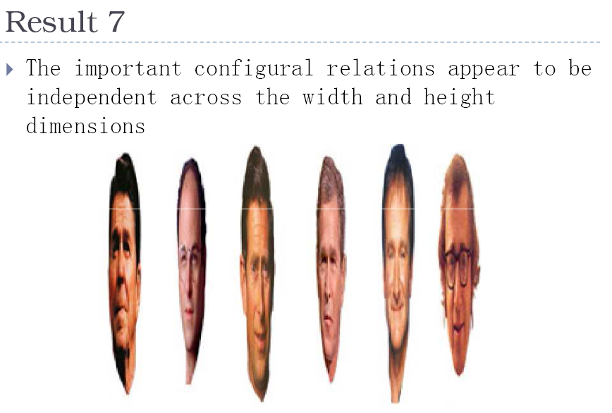

Slide 56
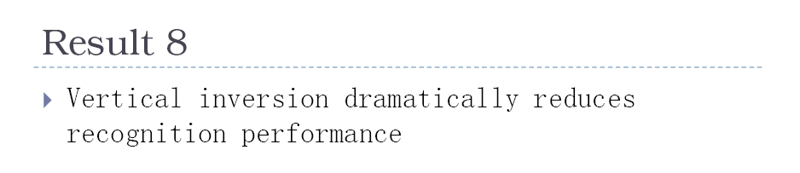
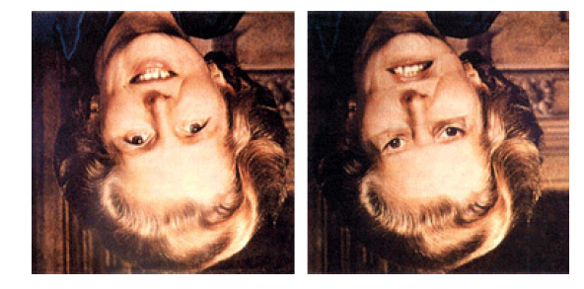
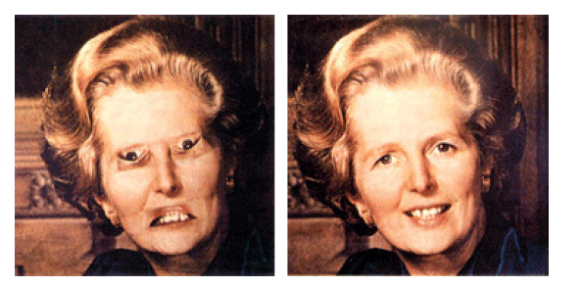

Slide 57
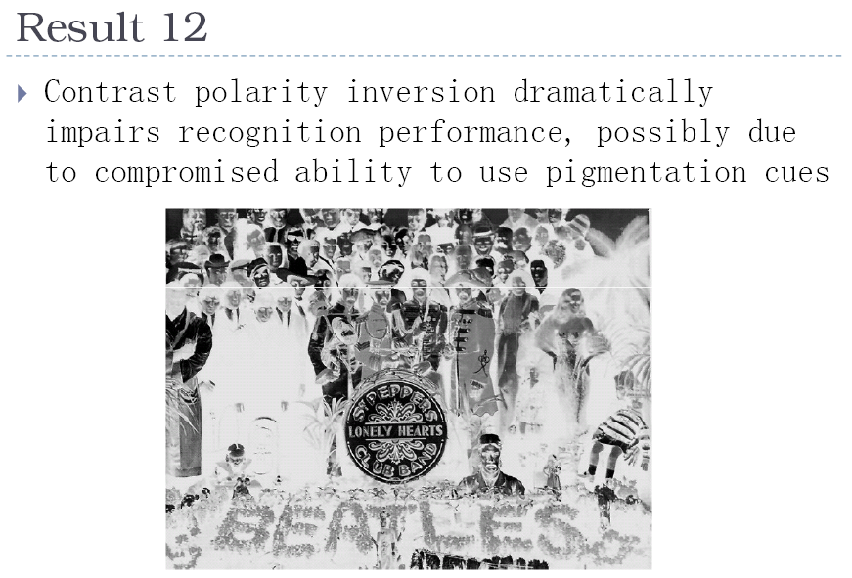
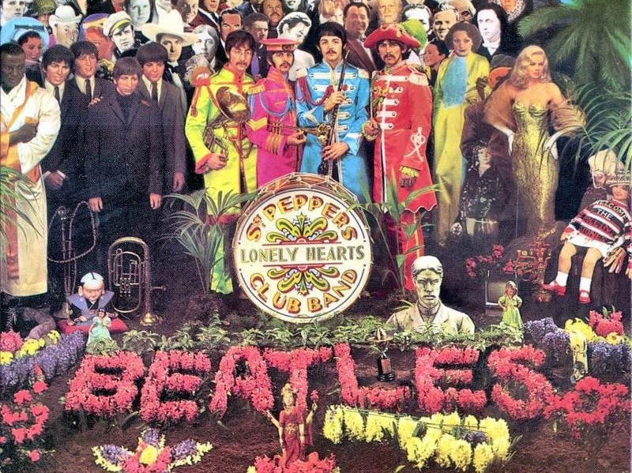

Slide 58
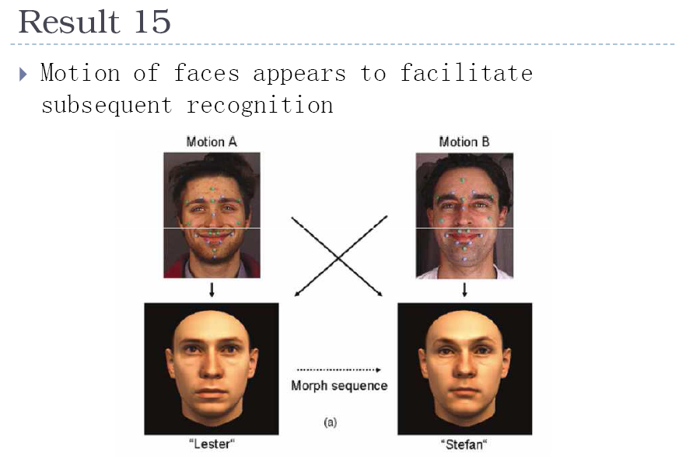

Slide 59
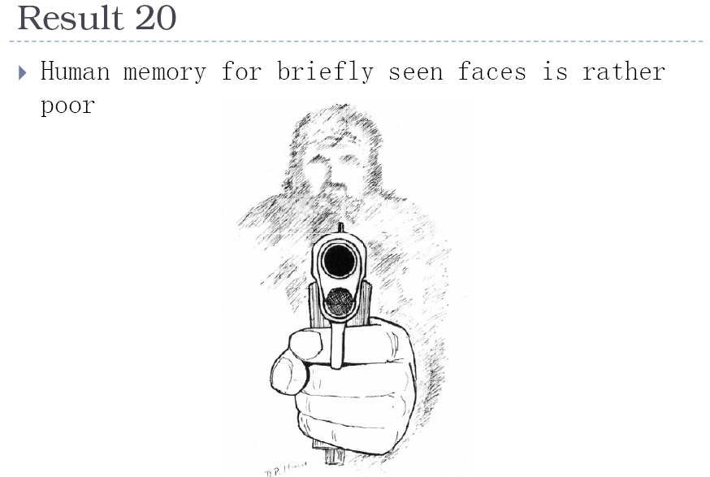

Slide 60
Things to remember
PCA is a generally useful dimensionality reduction technique
  But not ideal for discrimination
FLD better for discrimination, though only ideal under Gaussian data assumptions
Computer face recognition works very well under controlled environments – still room for improvement in general conditions

Slide 61
Topics overview
Features & filters
Grouping & fitting
Multiple views and motion
Recognition
  Indexing local features and instance recognition
  Introduction to category recognition
  Face detection
  Discriminative classifiers for image recognition
  Parts-based models
  Face recognition
Video processing
Slide credit: Kristen Grauman

Slide 62
Next Class
Features & filters
Grouping & fitting
Multiple views and motion
Recognition
Video processing
  Motion and optical flow
  Background subtraction, action recognition
  Tracking
Slide credit: Kristen Grauman

Slide 63
Next class
Video processing

Slide 64
Questions?
See you Tuesday!
Slide credit: Devi Parikh

