Slide 1
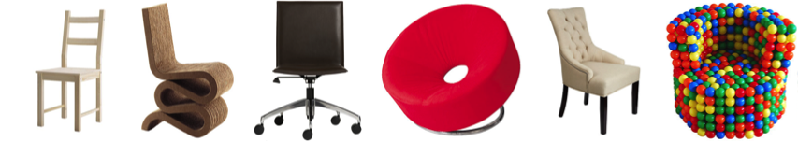
ECE 4984: Introduction to Computer Vision
ECE 5554: Computer Vision
Devi Parikh
Assistant Professor
ECE, Virginia Tech
Disclaimer: Many slides have been borrowed from Kristen Grauman, who may have borrowed some of them from others. Any time a slide did not already have a credit on it, I have credited it to Kristen. So there is a chance some of these credits are inaccurate.

Slide 2
Plan for today
Topic overview
Introductions
  Little bit about me
  Little bit about you
Course overview:
  Logistics and requirements
Coming up
Please interrupt at any time with questions or comments
Slide credit: Devi Parikh

Slide 3
What Is Computer Vision?
Slide credit: Devi Parikh

Slide 4
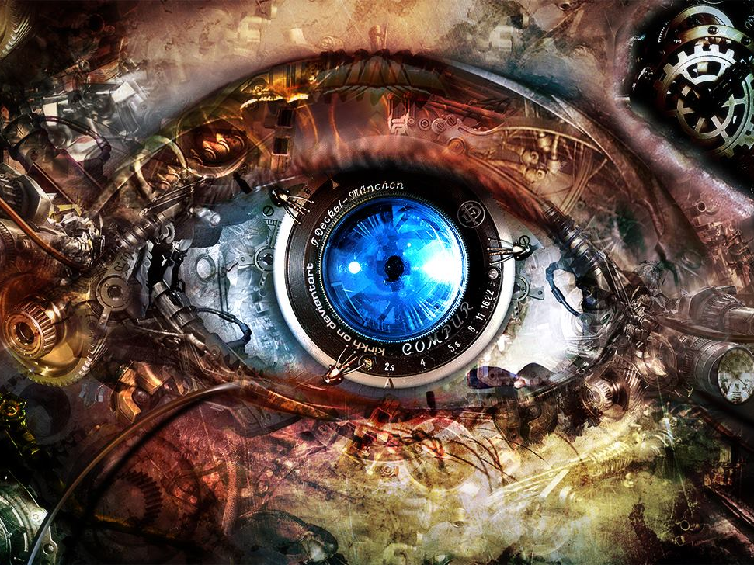
Computer Vision:
Making Computers See
Image from: http://kirkh.deviantart.com/art/BioMech-Eye-168367549

Slide 5
Computer Vision
Automatic understanding of images and video
  Computing properties of the 3D world from visual data (measurement)
Slide credit: Kristen Grauman
Notes:
5

Slide 6
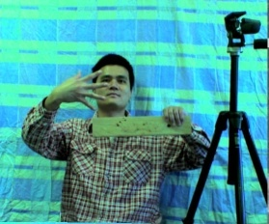
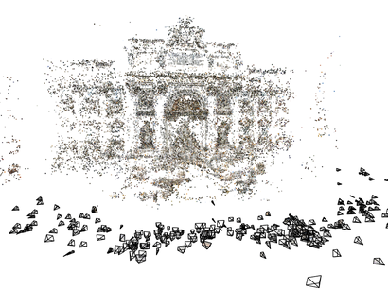
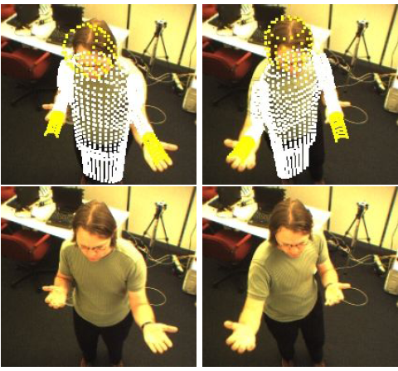
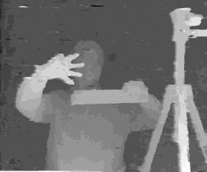
1. Vision for measurement
Real-time stereo
Structure from motion
Tracking
NASA Mars Rover
Snavely et al.
Demirdjian et al.
Wang et al.
Slide credit: Kristen Grauman
Notes:
6

Slide 7
Computer Vision
Automatic understanding of images and video
  Computing properties of the 3D world from visual data (measurement)
  Algorithms and representations to allow a machine to recognize objects, people, scenes, and activities. (perception and interpretation)
Slide credit: Kristen Grauman
Notes:
7

Slide 8
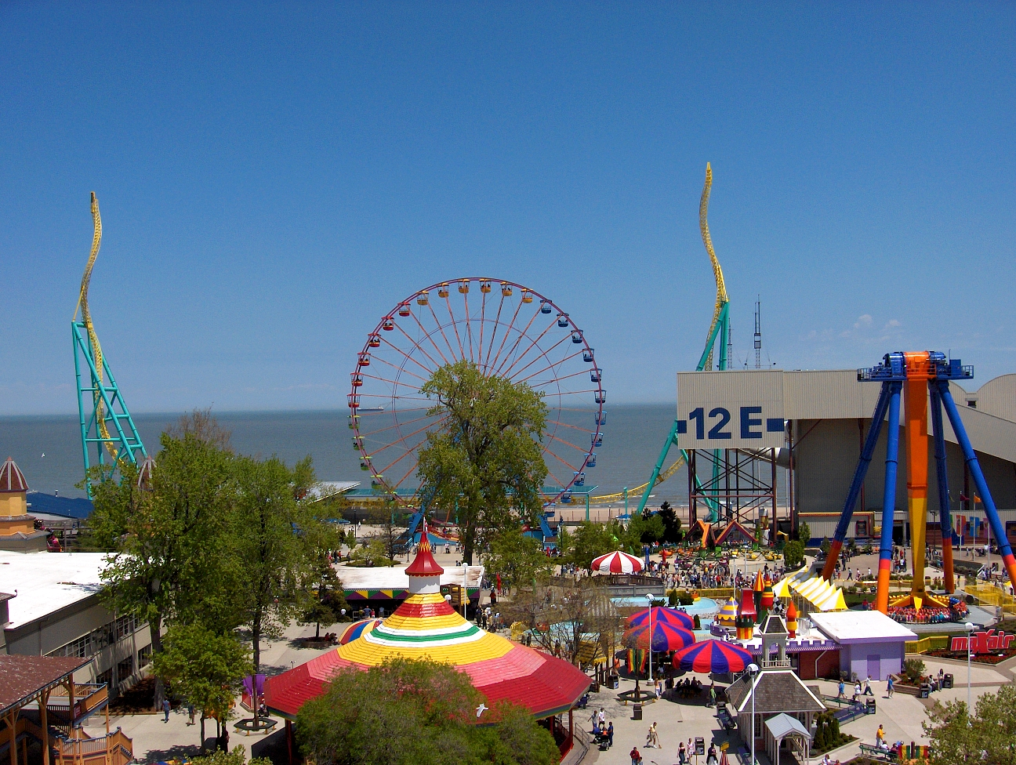
2. Vision for perception, interpretation
amusement park
Objects
Activities
Scenes
Locations
Text / writing
Faces
Gestures
Motions
Emotions…
sky
The Wicked Twister
Cedar Point
ride
Ferris wheel
ride
12 E
Lake Erie
water
ride
tree
tree
people waiting in line
people sitting on ride
umbrellas
tree
maxair
carousel
deck
bench
tree
pedestrians
Slide credit: Kristen Grauman
Notes:
8

Slide 9
Computer Vision
Automatic understanding of images and video
  Computing properties of the 3D world from visual data (measurement)
  Algorithms and representations to allow a machine to recognize objects, people, scenes, and activities. (perception and interpretation)
  Algorithms to mine, search, and interact with visual data (search and organization)
Slide credit: Kristen Grauman
Notes:
9

Slide 10
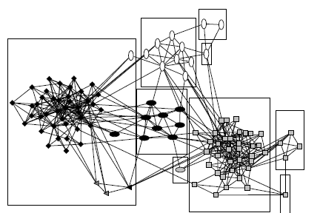
3. Visual search, organization
3
?
2
1
Query
Image or video archives
Relevant content
Slide credit: Kristen Grauman

Slide 11
Related disciplines
Artificial intelligence
Machine learning
Graphics
Computer vision
Image processing
Cognitive science
Algorithms
Slide credit: Kristen Grauman

Slide 12

Vision and graphics
Images
Vision
Model
Graphics
Inverse problems: analysis and synthesis.
Slide credit: Kristen Grauman

Slide 13

What humans see
Slide credit: Larry Zitnick
13

Slide 14
What computers see
243 | 239 | 240 | 225 | 206 | 185 | 188 | 218 | 211 | 206 | 216 | 225
242 | 239 | 218 | 110 | 67 | 31 | 34 | 152 | 213 | 206 | 208 | 221
243 | 242 | 123 | 58 | 94 | 82 | 132 | 77 | 108 | 208 | 208 | 215
235 | 217 | 115 | 212 | 243 | 236 | 247 | 139 | 91 | 209 | 208 | 211
233 | 208 | 131 | 222 | 219 | 226 | 196 | 114 | 74 | 208 | 213 | 214
232 | 217 | 131 | 116 | 77 | 150 | 69 | 56 | 52 | 201 | 228 | 223
232 | 232 | 182 | 186 | 184 | 179 | 159 | 123 | 93 | 232 | 235 | 235
232 | 236 | 201 | 154 | 216 | 133 | 129 | 81 | 175 | 252 | 241 | 240
235 | 238 | 230 | 128 | 172 | 138 | 65 | 63 | 234 | 249 | 241 | 245
237 | 236 | 247 | 143 | 59 | 78 | 10 | 94 | 255 | 248 | 247 | 251
234 | 237 | 245 | 193 | 55 | 33 | 115 | 144 | 213 | 255 | 253 | 251
248 | 245 | 161 | 128 | 149 | 109 | 138 | 65 | 47 | 156 | 239 | 255
190 | 107 | 39 | 102 | 94 | 73 | 114 | 58 | 17 | 7 | 51 | 137
23 | 32 | 33 | 148 | 168 | 203 | 179 | 43 | 27 | 17 | 12 | 8
17 | 26 | 12 | 160 | 255 | 255 | 109 | 22 | 26 | 19 | 35 | 24
Slide credit: Larry Zitnick
14

Slide 15
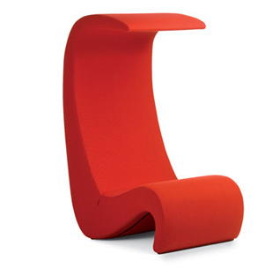

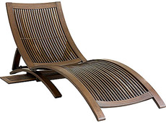
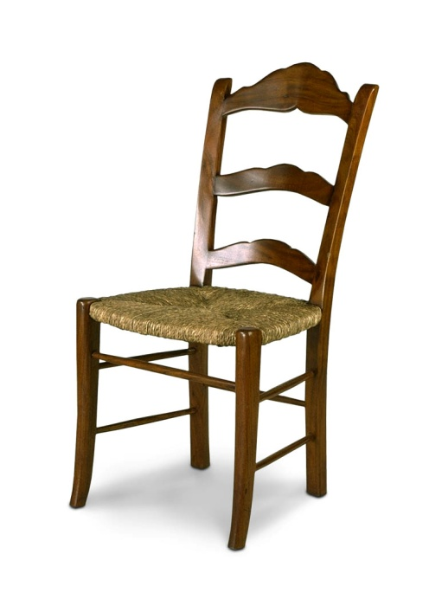
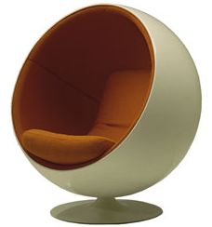
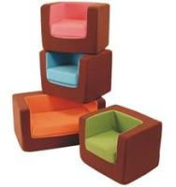
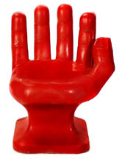
What do humans see?
Slide credit: Larry Zitnick
15

Slide 16
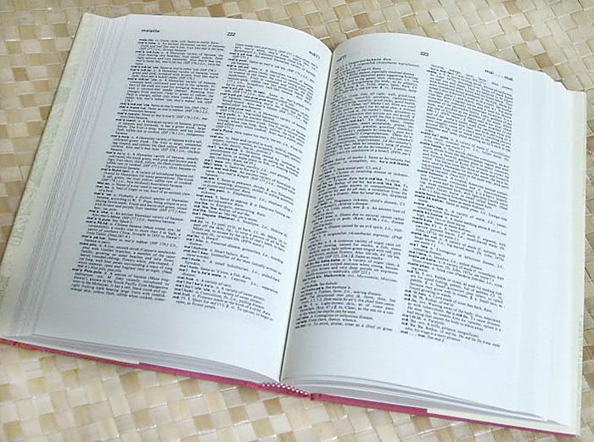

How many object categories are there?
~10,000 to 30,000
Biederman 1987
Slide credit: Fei-Fei, Fergus, Torralba CVPR07 Short Course

Slide 17
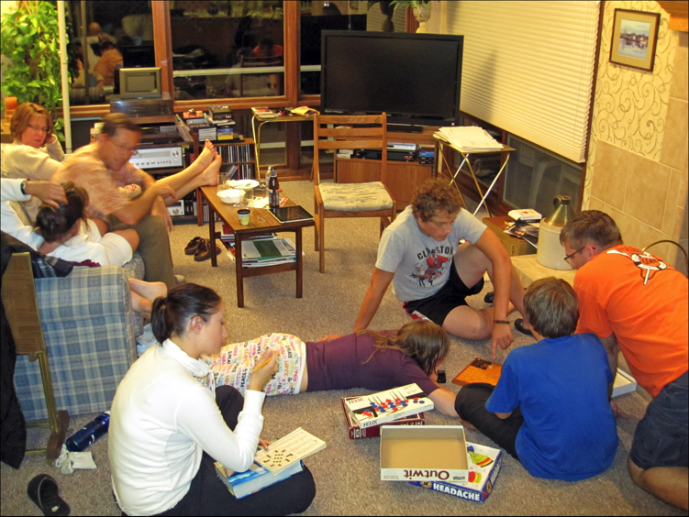
Slide credit: Devi Parikh

Slide 18
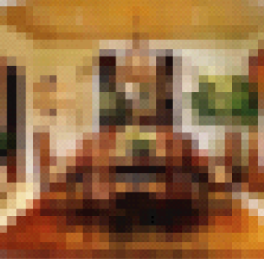
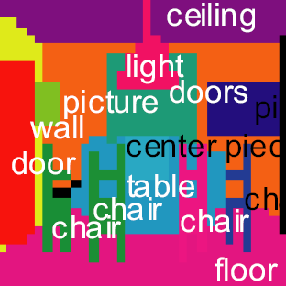
What do humans see?
Torralba et al. PAMI 2008
Slide credit: Larry Zitnick
18

Slide 19




What do humans see?
chair
light
picture
table setting
Torralba et al. PAMI 2008
Slide credit: Larry Zitnick

Slide 20
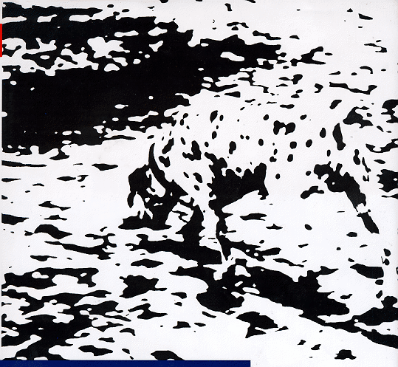
What do humans see?
Slide credit: Larry Zitnick
20

Slide 21
Why is vision difficult?
Ill-posed problem: real world much more complex than what we can measure in images
  3D → 2D
Impossible to literally “invert” image formation process
Slide credit: Kristen Grauman

Slide 22
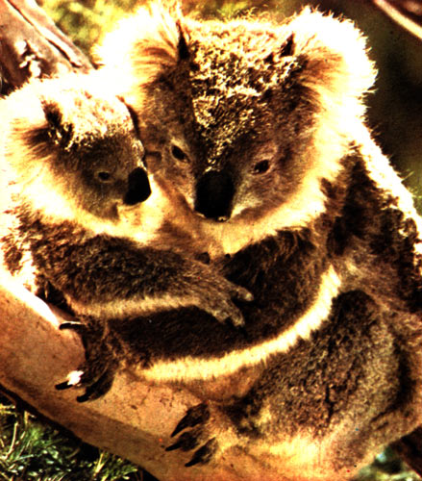
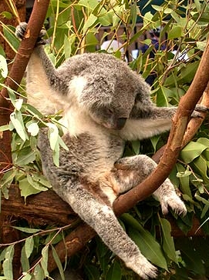
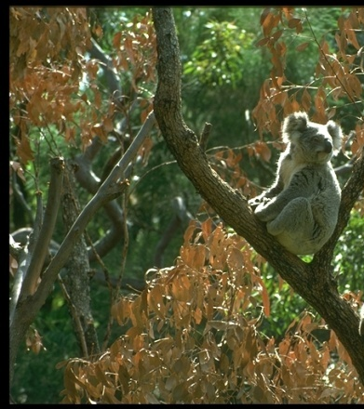
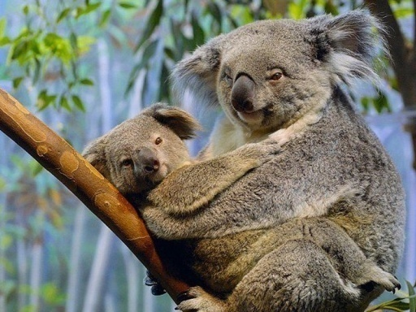

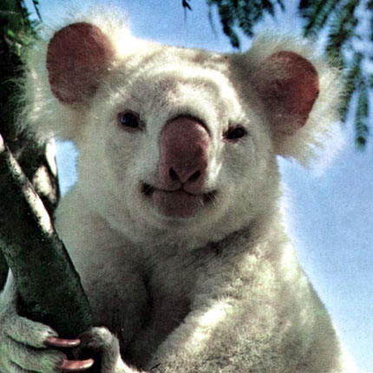

Challenges: many nuisance parameters
Illumination
Object pose
Clutter
Occlusions
Intra-class appearance
Viewpoint
Slide credit: Kristen Grauman

Slide 23


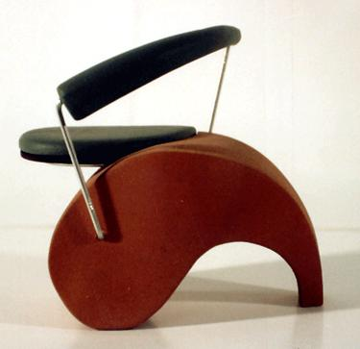
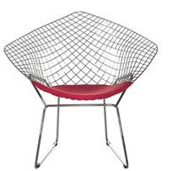


Challenges: intra-class variation
Slide credit: Fei-Fei, Fergus & Torralba

Slide 24


Challenges: importance of context
Slide credit: Fei-Fei, Fergus & Torralba

Slide 25
Challenges: complexity
Thousands to millions of pixels in an image
3,000-30,000 human recognizable object categories
30+ degrees of freedom in the pose of articulated objects (humans)
Billions of images indexed by Google Image Search
18 billion+ prints produced from digital camera images in 2004
295.5 million camera phones sold in 2005
About half of the cerebral cortex in primates is devoted to processing visual information [Felleman and van Essen 1991]
Slide credit: Kristen Grauman

Slide 26
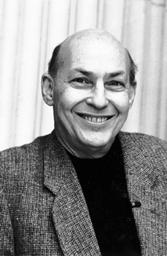
How hard is computer vision?
“spend the summer linking a camera to a
computer and getting the computer to describe what it saw”
Marvin Minsky (1966), MIT
Turing Award (1969)
… ~50 years later
Slide credit: Devi Parikh

Slide 27
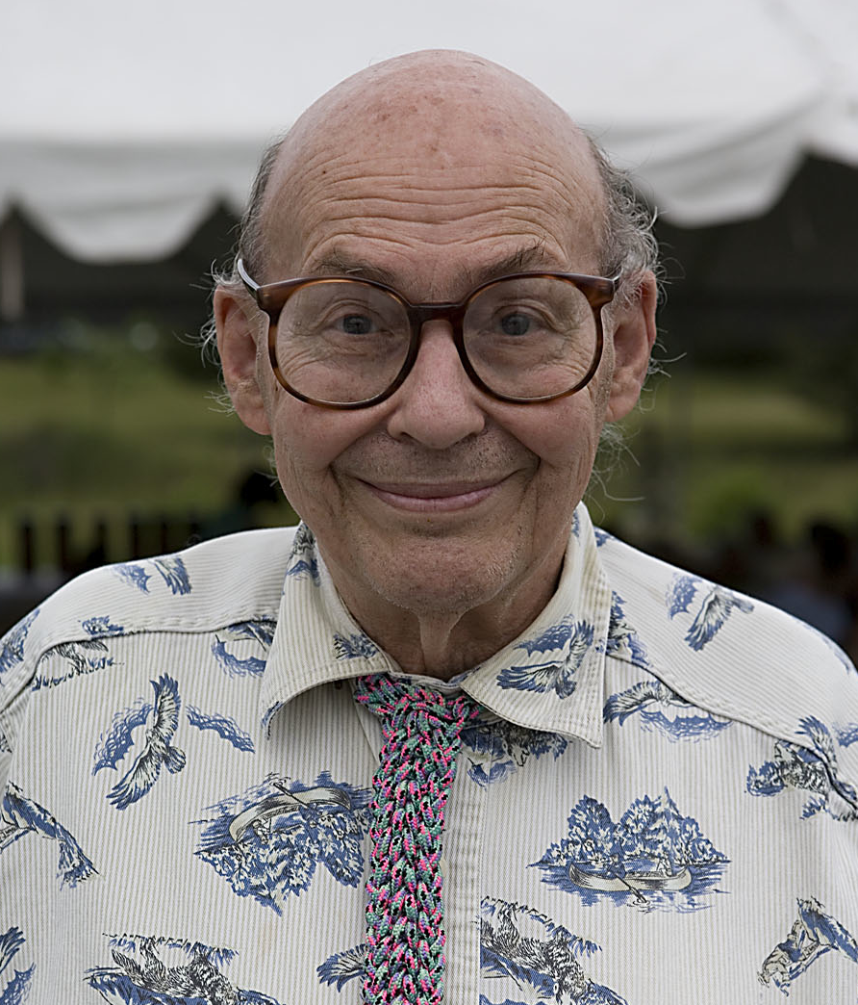
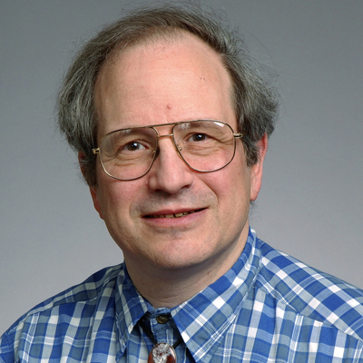
How hard is computer vision?
Gerald Sussman, MIT
“You’ll notice that Sussman never worked in vision again!” – Berthold Horn
Slide credit: Devi Parikh
27

Slide 28
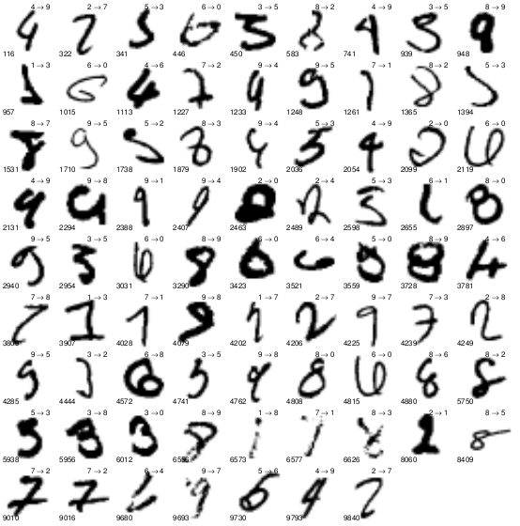
Progress so far…
Slide credit: Devi Parikh

Slide 29
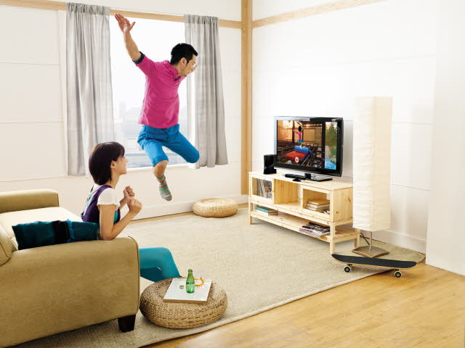
Progress so far…
Slide credit: Devi Parikh

Slide 30
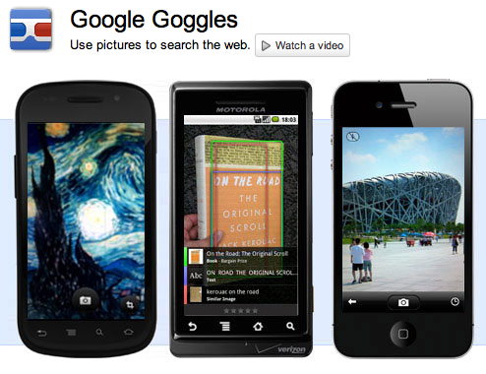
Progress so far…
Slide credit: Devi Parikh

Slide 31
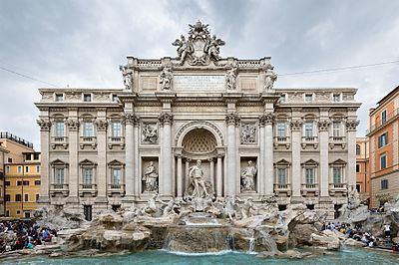
Progress so far…
Slide credit: Devi Parikh

Slide 32
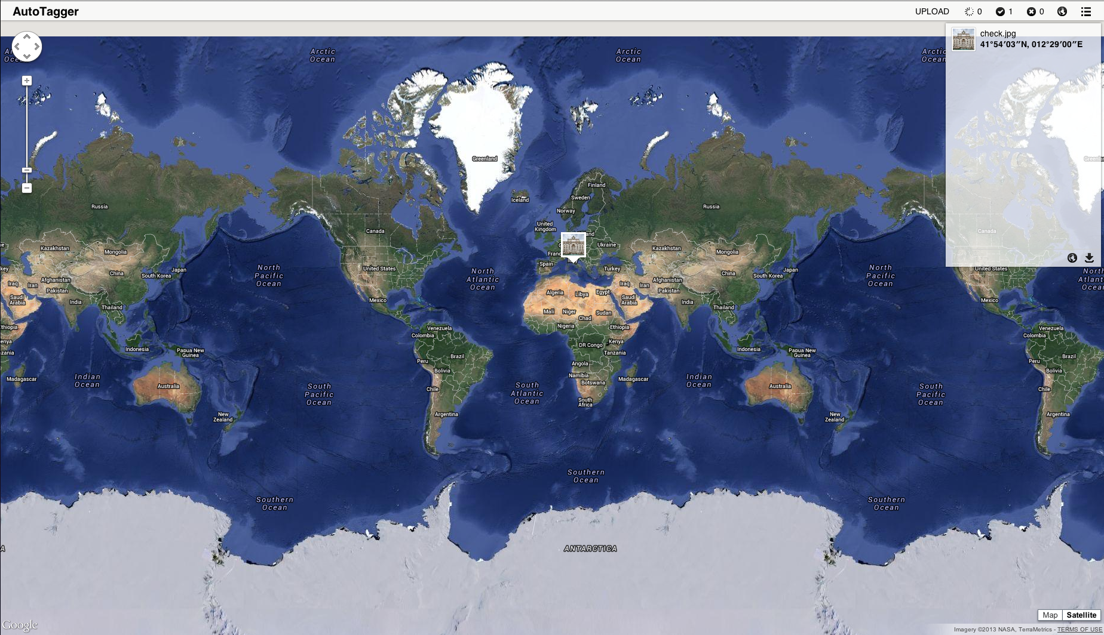
Location
AutoTagger: Yunpeng Li, Noah Snavely, Dan Huttenlocher and Pascal Fua
Slide credit: Devi Parikh

Slide 33
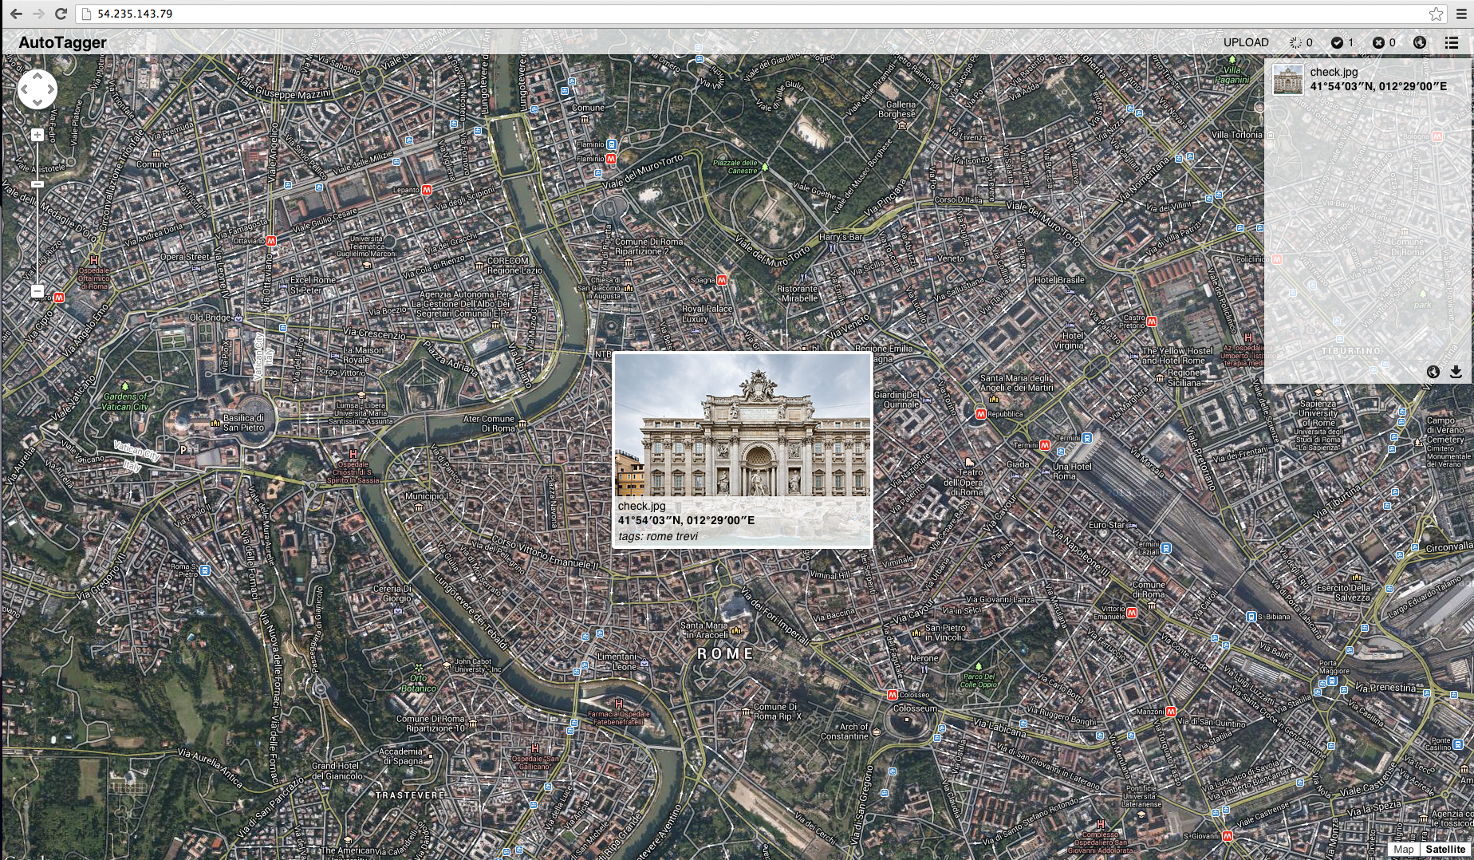
AutoTagger: Yunpeng Li, Noah Snavely, Dan Huttenlocher and Pascal Fua
Slide credit: Devi Parikh

Slide 34

3D Models
“Rome”
2 million photos
“Dubrovnik”
58 thousand photos
Slide credit: Devi Parikh

Slide 35
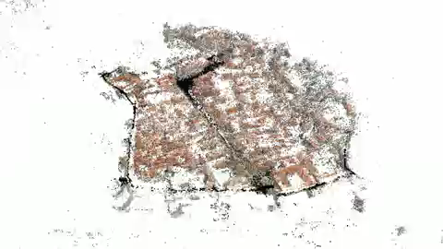
Dubrovnik
AutoTagger: Yunpeng Li, Noah Snavely, Dan Huttenlocher and Pascal Fua
Slide credit: Devi Parikh

Slide 36
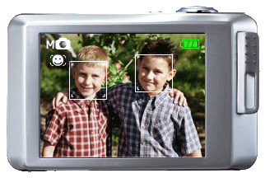
Progress so far…
Slide credit: Devi Parikh

Slide 37
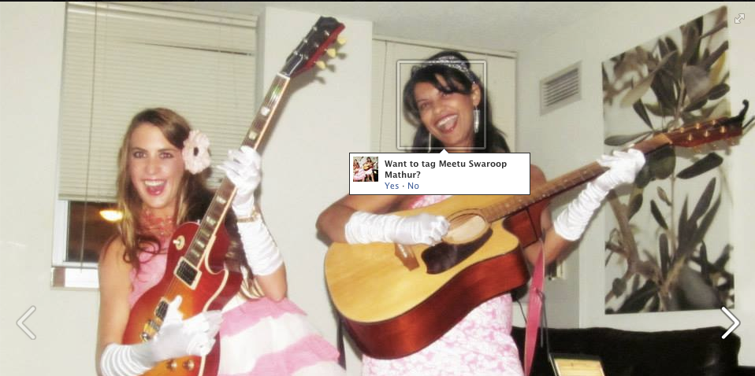

Progress so far…
Slide credit: Devi Parikh

Slide 38
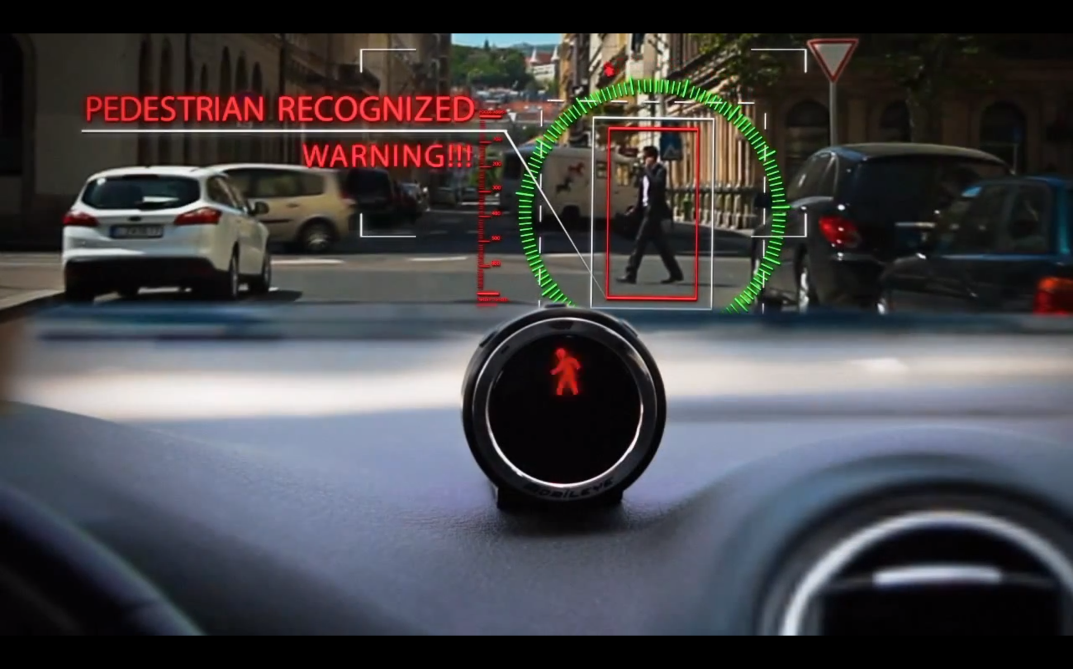
Progress so far…
Slide credit: Devi Parikh

Slide 39
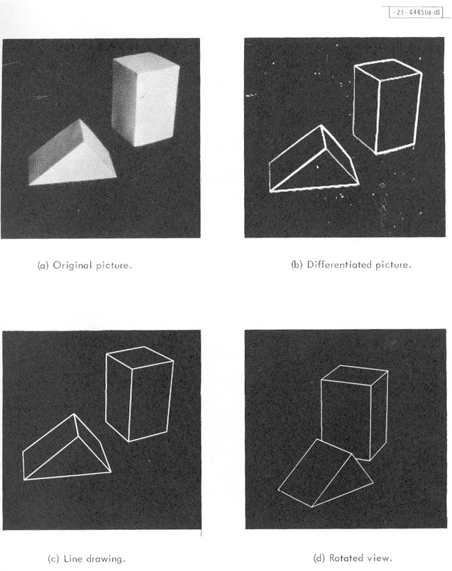
Visual data in 1963
L. G. Roberts, Machine Perception of Three Dimensional Solids, Ph.D. thesis, MIT Department of Electrical Engineering, 1963.
Slide credit: Kristen Grauman

Slide 40
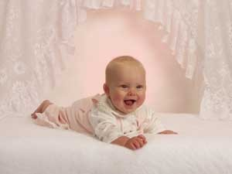
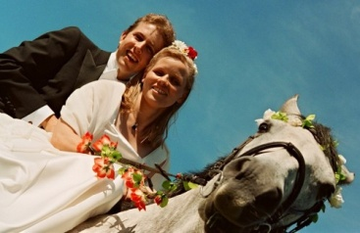
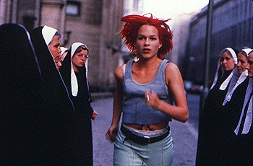
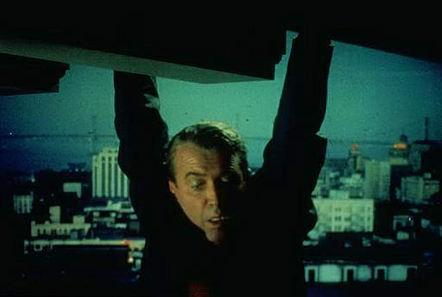
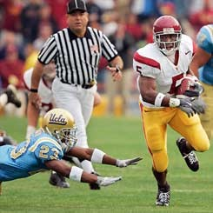


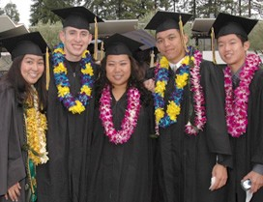
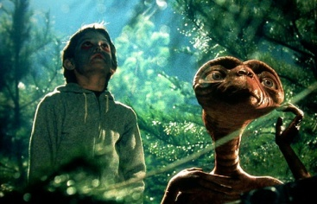
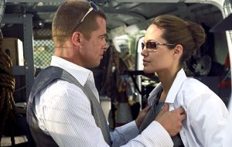
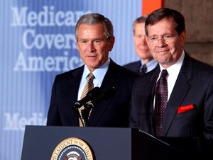
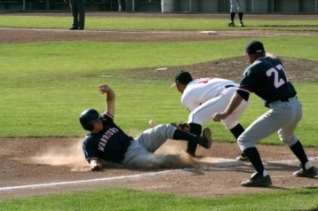




















Visual data in 2015
Personal photo albums
Movies, news, sports
Surveillance and security
Medical and scientific images
Slide credit: Svetlana Lazebnik
Notes:
40

Slide 41
Why vision?
As image sources multiply, so do applications
  Relieve humans of boring, easy tasks
  Enhance human abilities
  Advance human-computer interaction, visualization
  Perception for robotics / autonomous agents
  Organize and give access to visual content
Slide credit: Kristen Grauman

Slide 42
Applications
Law enforcement
Post-disaster family reunification
Surveillance
Robotics
Autonomous driving
Medical imaging
Photo organization
Image search
E-commerce
… cell phone cameras, social media, wearable computing devices, etc.
Slide credit: Devi Parikh

Slide 43
Summary
Computer Vision is a hard problem.
Lots of cool and important applications.
A growing and exciting field.
New teams in existing companies, new companies, etc.
Slide credit: Devi Parikh

Slide 44
Introductions
Instructor
  Devi Parikh
  parikh@vt.edu
  Joined ECE, Virginia Tech in January 2013
  Research Assistant Professor at TTI-Chicago for 3.5 years
  Ph.D. from Carnegie Mellon University in 2009
  Research area: Computer Vision
    Semantic Scene Understanding
Slide credit: Devi Parikh

Slide 45

Introductions
TA:
  Jiasen Lu
  jiasenlu@vt.edu
  Ph.D. student in ECE at VT
  M.S. in CSE from SUNY Buffalo
Will likely be assisted by a grader: TBD
Slide credit: Devi Parikh

Slide 46
Introductions
You
  Department?
  What are you hoping to get out of this course?
  Do you have any experience in computer vision?
Slide credit: Devi Parikh

Slide 47
This course
ECE 4984 and ECE 5554
TR 3:30 pm to 4:45 pm
Goodwin Hall (GOODW) 135
My office hours: F 3:00 pm to 4:00 pm
  starting 9/11/15
Jiasen’s office hours:
  M 10:00 am to 11:30 am
  W 1:30 pm to 3:00 pm
Course webpage:
http://filebox.ece.vt.edu/~F15ECE5554ECE4984/
(Google me → My homepage → Teaching)
Slide credit: Devi Parikh
Notes:
47

Slide 48
This course
Introductory Computer Vision course
Basics and fundamentals
Hands-on assignments and projects
Views of vision as a research area
Slide credit: Devi Parikh
Notes:
48

Slide 49
Other courses
Advanced Computer Vision
  Devi Parikh
  Typically Spring semesters
Introduction to Machine Learning and Perception
  Dhruv Batra and/or Bert Huang
  Typically Fall semesters
Advanced Machine Learning / Deep Learning / Graphical Models
  Dhruv Batra and/or Bert Huang
  Typically Spring semesters
Also see: https://filebox.ece.vt.edu/~dbatra/faq.html
Slide credit: Devi Parikh
Notes:
49

Slide 50
Topics overview
Features & filters
Grouping & fitting
Multiple views and motion
Recognition
Video processing
Focus is on algorithms, rather than specific systems.
Slide credit: Kristen Grauman

Slide 51








Features and filters
Transforming and describing images; textures, colors, edges
Slide credit: Kristen Grauman

Slide 52




Grouping & fitting
Clustering, segmentation, fitting; what parts belong together?
[fig from Shi et al]
Slide credit: Kristen Grauman

Slide 53




Multiple views and motion
Multi-view geometry, matching, invariant features, stereo vision
Lowe
Hartley and Zisserman
Fei-Fei Li
Slide credit: Kristen Grauman

Slide 54





Recognition and learning
Recognizing objects and categories, learning techniques
Slide credit: Kristen Grauman

Slide 55



Video processing
Tracking objects, video analysis, low level motion, optical flow
Tomas Izo
Slide credit: Kristen Grauman

Slide 56

Textbooks
Recommended book:
  Computer Vision:
  Algorithms and Applications
  By Rick Szeliski
  http://szeliski.org/Book/
Lecture slides will be posted online
Slide credit: Kristen Grauman

Slide 57
Requirements / Grading
Problem sets (55%)
Project (25%)
Final exam (15%)
Class participation, including attendance (5%)
Slide credit: Devi Parikh

Slide 58
Problem sets
Some short answer concept questions
Programming problems
  Implementation
  Explanation, results
Follow instructions. Points will be deducted if can’t run your code on our data, can’t run our code on your data, etc.
Ask questions on Scholar forum first
Code in Matlab (possibly also Python)
These assignments are substantial.
They will take significant time to do.
Start early.
Slide credit: Kristen Grauman

Slide 59

Matlab
Built-in toolboxes for low-level image processing, visualization
Compact programs
Intuitive interactive debugging
Widely used in engineering
Slide credit: Kristen Grauman

Slide 60
PS0
PS0: Matlab (and python) warmup + basic image manipulation
Out today, due in ~ a week (Monday night)
Slide credit: Kristen Grauman

Slide 61


Digital images
Images as matrices
Slide credit: Kristen Grauman

Slide 62
Digital images
width 520
j=1
Intensity : [0,255]
i=1
500 height
im[176][201] has value 164
im[180][213] has value 37
Slide credit: Kristen Grauman

Slide 63


Color images, RGB color space
R
G
B
Slide credit: Kristen Grauman

Slide 64




Preview of some problem sets
resize: castle squished
crop: castle cropped
content aware resizing:
seam carving
Slide credit: Devi Parikh

Slide 65


Preview of some problem sets
Grouping
Slide credit: Kristen Grauman

Slide 66
Preview of some problem sets
Image mosaics / stitching
Slide credit: Kristen Grauman, Image from: Fei-Fei Li
Notes:
66

Slide 67




Preview of some problem sets
Object search and recognition
Slide credit: Kristen Grauman
Notes:
67

Slide 68


Preview of some problem sets
Tracking, activity recognition
Slide credit: Kristen Grauman
Notes:
68

Slide 69
Assignment deadlines
Assignments in by 11:55 PM the day before class
  Follow submission instructions given in assignment
  Submit to scholar
  No hard copy submissions
  Deadlines are firm. We’ll use scholar timestamp. Even 1 minute late is late. No emails asking for exceptions will be honored.
4 total free late days for the semester
Use them wisely: first two assignments are easier than others
If your program doesn’t work, clean up the code, comment it well, explain what you have, and still submit. Draw our attention to this in your answer sheet.
Slide adapted from Kristen Grauman

Slide 70
Projects
Possibilities:
  Apply any techniques we studied in class or related to real world problem
  Extend a technique
  Empirically analyze a technique
  Compare approaches
  Design and evaluate a novel approach
  Novel application
  Be creative!
  Publication?
Different expectations from 4984 vs. 5554
Work in a team of >=2 students
Slide credit: Devi Parikh
Notes:
70

Slide 71
Project timeline (tentative)
Project proposals (1 page) [10%]
  September 29th
Project report (webpage) [50%]
  November 21st
Poster presentations [40%]
  December 3rd
Slide credit: Devi Parikh
Notes:
71

Slide 72
Collaboration policy
All responses and code must be written individually.
Students submitting answers or code found to be identical or substantially similar (due to inappropriate collaboration) risk failing the course.
Slide adapted from Kristen Grauman

Slide 73
Miscellaneous
After class
All slides are posted online
Check class website regularly
Use TA’s (and my) office hours!
No laptops, cell phones, etc. in class please.
Please interrupt with questions at any time.
Email from me?
Access to scholar?
Slide credit: Devi Parikh

Slide 74
Coming up
Now: read the class webpage carefully
Now: check out MATLAB/Python tutorials online
Now: PS0 is out
Thursday August 27th : first lecture on linear filters
Monday August 31st : PS0 due
Slide credit: Devi Parikh

Slide 75
Questions?
See you Thursday!

Slide 76
Example: Big triangles vs. Little triangles
Big triangles
Little triangles
?
Slide credit: Devi Parikh
76

Slide 77
Example: Big triangles vs. Little triangles
Slide credit: Devi Parikh
77

Slide 78
Example: Big triangles vs. Little triangles
0
0
0
0
0
0
0
0
0
0
0
0
0
0
0
0
0
0
0
0
0
0
0
0
0
0
0
0
0
0
0
0
0
0
0
0
0
0
0
0
0
0
0
0
0
0
0
0
0
1
0
0
0
0
0
0
0
0
0
0
0
0
0
0
0
0
0
1
1
0
0
0
0
0
0
0
0
0
0
0
0
0
0
0
0
0
0
0
0
0
0
0
1
1
1
0
0
0
0
0
0
0
0
0
0
0
0
0
0
0
0
0
0
0
0
0
0
0
0
0
0
0
0
0
0
0
0
0
0
0
0
0
0
0
0
1
1
1
1
1
0
0
0
0
0
0
0
0
0
0
0
0
0
0
0
0
0
0
0
0
0
0
0
0
0
0
0
0
1
0
0
0
0
0
0
0
0
0
1
1
1
1
1
1
1
0
0
0
0
0
0
0
0
1
0
0
0
0
0
0
0
0
0
0
0
0
0
0
0
0
0
0
1
1
0
0
0
0
0
0
0
0
0
0
0
0
0
0
0
0
0
0
0
0
0
0
0
1
1
0
0
0
0
0
0
0
0
0
0
0
0
0
0
0
0
0
0
0
0
0
0
0
0
0
0
0
0
0
0
0
0
0
0
0
0
0
0
0
0
0
1
1
1
1
0
0
0
0
0
0
0
0
0
0
0
0
0
0
0
0
0
0
0
0
0
0
0
0
0
0
0
0
0
0
0
0
0
0
0
0
0
0
0
1
1
1
1
1
1
0
0
0
0
0
0
0
0
0
0
0
0
0
0
0
0
0
0
0
0
0
0
0
Sum = 16
Sum = 13
Sum = 2
Sum = 3
0
0
0
0
0
0
0
0
0
0
0
0
0
0
0
0
0
0
0
0
0
0
Rule
If sum > 10
Answer = Big triangle
Else
Answer = Little triangle
0
0
0
0
0
0
0
0
0
0
0
0
0
0
0
1
0
0
0
0
0
0
0
0
0
0
1
0
0
0
0
0
0
0
0
0
0
0
0
0
0
0
0
0
0
0
0
0
0
0
0
0
0
0
0
0
0
0
0
0
0
0
0
0
0
0
Little triangle
?
Sum = 2
Slide credit: Devi Parikh
78

