Slide 1

Window-based models for generic object detection
Tuesday, October 27th 2015
Devi Parikh
Virginia Tech
These slides have been borrowed from Kristen Grauman, who borrowed some from others.

Slide 2
Announcements
PS3 grades out soon
PS4 out
  Due 11/16
Project expected to be complete by the time report is due
  Due 11/21

Slide 3
Previously
Instance recognition
  Local features: detection and description
  Local feature matching, scalable indexing
  Spatial verification
Intro to generic object recognition
Supervised classification
  Main idea
  Skin color detection example

Slide 4
Topics overview
Features & filters
Grouping & fitting
Multiple views and motion
Recognition
  Indexing local features and instance recognition
  Introduction to category recognition
  Face detection
  Discriminative classifiers for image recognition
  Parts-based models
  Face recognition
Video processing
Slide credit: Kristen Grauman

Slide 5
Today
Window-based generic object detection
  basic pipeline
  boosting classifiers
  face detection as case study

Slide 6
Generic category recognition: basic framework
Build/train object model
  Choose a representation
  Learn or fit parameters of model / classifier
Generate candidates in new image
Score the candidates

Slide 7


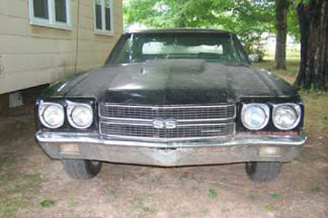
Generic category recognition: representation choice
Window-based
Part-based

Slide 8
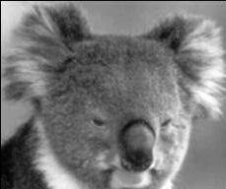
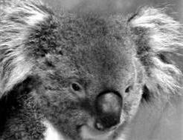
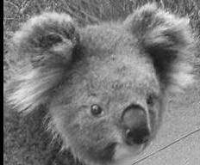
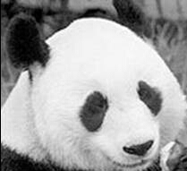
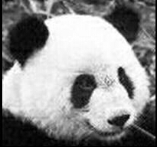
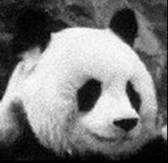
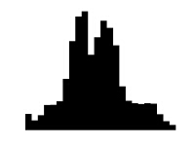
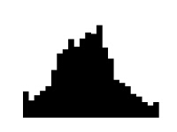
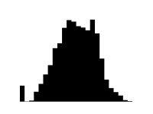
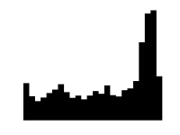
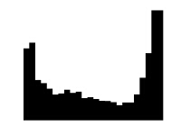
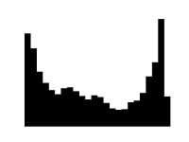
Window-based models
Building an object model
Simple holistic descriptions of image content
  grayscale / color histogram
  vector of pixel intensities
Kristen Grauman

Slide 9
Window-based models
Building an object model
Pixel-based representations sensitive to small shifts
Color or grayscale-based appearance description can be sensitive to illumination and intra-class appearance variation
Kristen Grauman

Slide 10
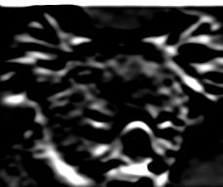
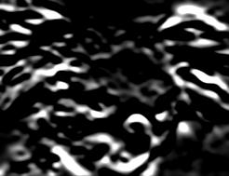
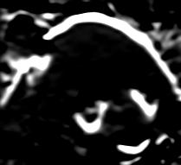
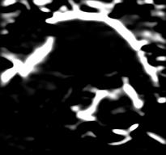
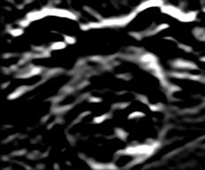
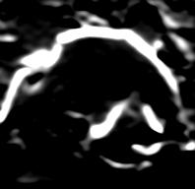
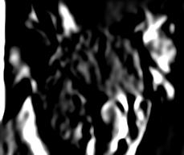
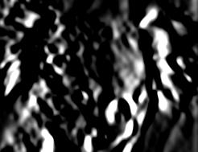
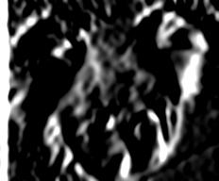
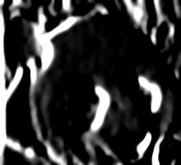
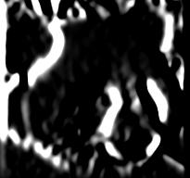
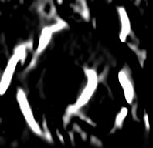
Window-based models
Building an object model
Consider edges, contours, and (oriented) intensity gradients
Kristen Grauman

Slide 11
Window-based models
Building an object model
Consider edges, contours, and (oriented) intensity gradients
Summarize local distribution of gradients with histogram
  Locally orderless: offers invariance to small shifts and rotations
  Contrast-normalization: try to correct for variable illumination
Kristen Grauman

Slide 12
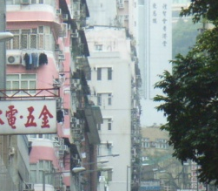

Window-based models
Building an object model
Given the representation, train a binary classifier
Car/non-car Classifier
Yes, car.
No, not a car.
Kristen Grauman

Slide 13



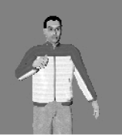




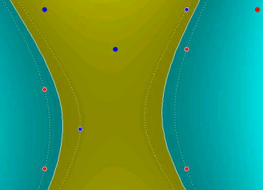
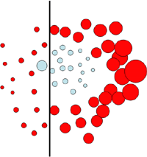
Discriminative classifier construction
Nearest neighbor
Neural networks
10⁶ examples
Shakhnarovich, Viola, Darrell 2003
Berg, Berg, Malik 2005...
LeCun, Bottou, Bengio, Haffner 1998
Rowley, Baluja, Kanade 1998
…
Support Vector Machines
Boosting
Conditional Random Fields
Guyon, Vapnik
Heisele, Serre, Poggio, 2001,…
Viola, Jones 2001, Torralba et al. 2004, Opelt et al. 2006,…
McCallum, Freitag, Pereira 2000; Kumar, Hebert 2003
…
Slide adapted from Antonio Torralba

Slide 14
Generic category recognition: basic framework
Build/train object model
  Choose a representation
  Learn or fit parameters of model / classifier
Generate candidates in new image
Score the candidates

Slide 15


Window-based models
Generating and scoring candidates
Car/non-car Classifier
Kristen Grauman

Slide 16
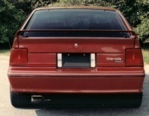
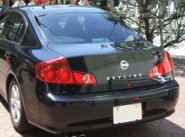

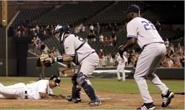
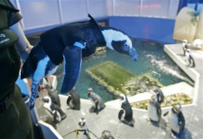
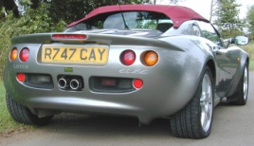
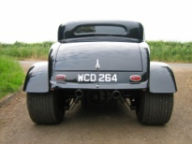

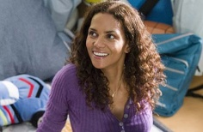


Window-based object detection: recap
Training:
Obtain training data
Define features
Define classifier
Given new image:
Slide window
Score by classifier
Training examples
Car/non-car Classifier
Feature extraction
Kristen Grauman

Slide 17
Discriminative classifier construction
Nearest neighbor
Neural networks
10⁶ examples
Shakhnarovich, Viola, Darrell 2003
Berg, Berg, Malik 2005...
LeCun, Bottou, Bengio, Haffner 1998
Rowley, Baluja, Kanade 1998
…
Support Vector Machines
Boosting
Conditional Random Fields
Guyon, Vapnik
Heisele, Serre, Poggio, 2001,…
Viola, Jones 2001, Torralba et al. 2004, Opelt et al. 2006,…
McCallum, Freitag, Pereira 2000; Kumar, Hebert 2003
…
Slide adapted from Antonio Torralba

Slide 18
Boosting intuition
Weak
Classifier 1
Slide credit: Paul Viola

Slide 19
Boosting illustration
Weights
Increased

Slide 20
Boosting illustration
Weak
Classifier 2

Slide 21
Boosting illustration
Weights
Increased

Slide 22
Boosting illustration
Weak
Classifier 3

Slide 23
Boosting illustration
Final classifier is
a combination of weak classifiers

Slide 24
Boosting: training
Initially, weight each training example equally
In each boosting round:
  Find the weak learner that achieves the lowest weighted training error
  Raise weights of training examples misclassified by current weak learner
Compute final classifier as linear combination of all weak learners (weight of each learner is directly proportional to its accuracy)
Exact formulas for re-weighting and combining weak learners depend on the particular boosting scheme (e.g., AdaBoost)
Slide credit: Lana Lazebnik

Slide 25
Boosting: pros and cons
Advantages of boosting
  Integrates classification with feature selection
  Flexibility in the choice of weak learners, boosting scheme
  Testing is fast
  Easy to implement
Disadvantages
  Needs many training examples
  Often found not to work as well as an alternative discriminative classifier, support vector machine (SVM)
    especially for many-class problems
Slide credit: Lana Lazebnik

Slide 26
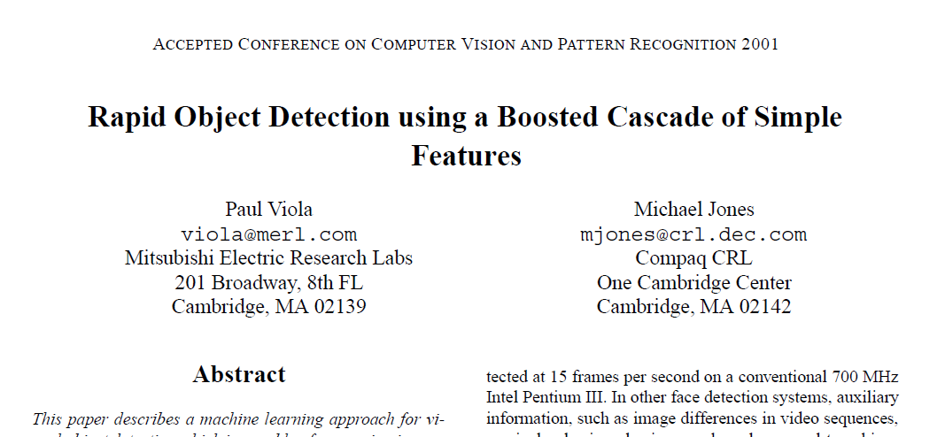
Viola-Jones face detector

Slide 27
Viola-Jones face detector
Main idea:
  Represent local texture with efficiently computable “rectangular” features within window of interest
  Select discriminative features to be weak classifiers
  Use boosted combination of them as final classifier
  Form a cascade of such classifiers, rejecting clear negatives quickly
Kristen Grauman

Slide 28


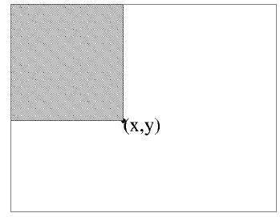
Viola-Jones detector: features
“Rectangular” filters
  Feature output is difference between adjacent regions
Value at (x,y) is sum of pixels above and to the left of (x,y)
  Efficiently computable with integral image: any sum can be computed in constant time.
Integral image
Kristen Grauman

Slide 29
Computing sum within a rectangle
Let A,B,C,D be the values of the integral image at the corners of a rectangle
Then the sum of original image values within the rectangle can be computed as:
  sum = A – B – C + D
Only 3 additions are required for any size of rectangle!
D
B
C
A
Lana Lazebnik

Slide 30
Viola-Jones detector: features
“Rectangular” filters
  Feature output is difference between adjacent regions
Value at (x,y) is sum of pixels above and to the left of (x,y)
  Efficiently computable with integral image: any sum can be computed in constant time
  Avoid scaling images → scale features directly for same cost
Integral image
Kristen Grauman

Slide 31
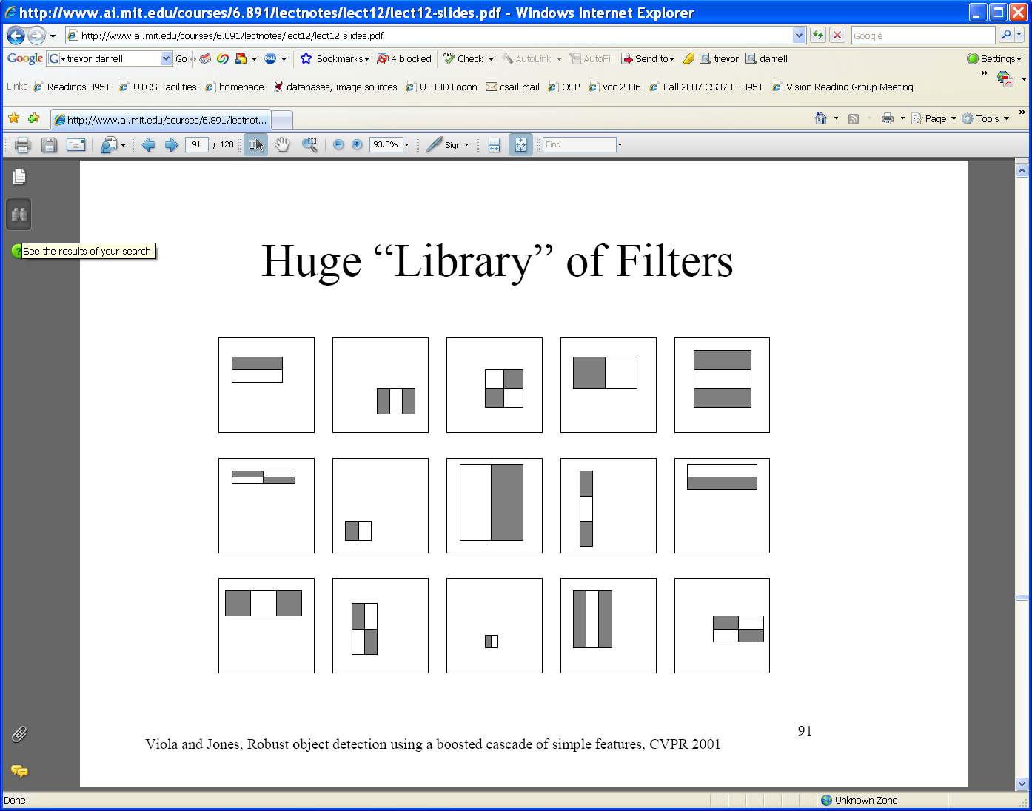
Viola-Jones detector: features
  Considering all possible filter parameters: position, scale, and type:
180,000+ possible features associated with each 24 x 24 window
Which subset of these features should we use to determine if a window has a face?
Use AdaBoost both to select the informative features and to form the classifier
Kristen Grauman

Slide 32
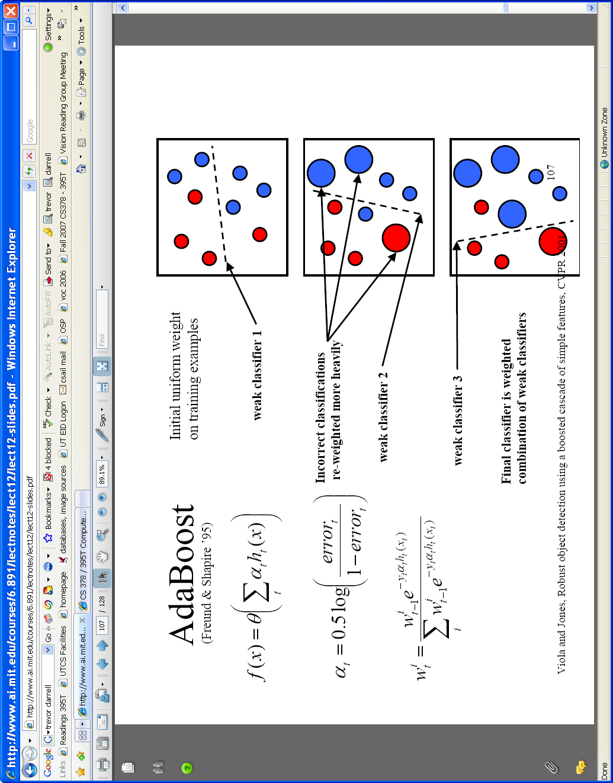
Viola-Jones detector: AdaBoost
Want to select the single rectangle feature and threshold that best separates positive (faces) and negative (non-faces) training examples, in terms of weighted error.
Resulting weak classifier:
For next round, reweight the examples according to errors, choose another filter/threshold combo.
…
Outputs of a possible rectangle feature on faces and non-faces.
Kristen Grauman

Slide 33
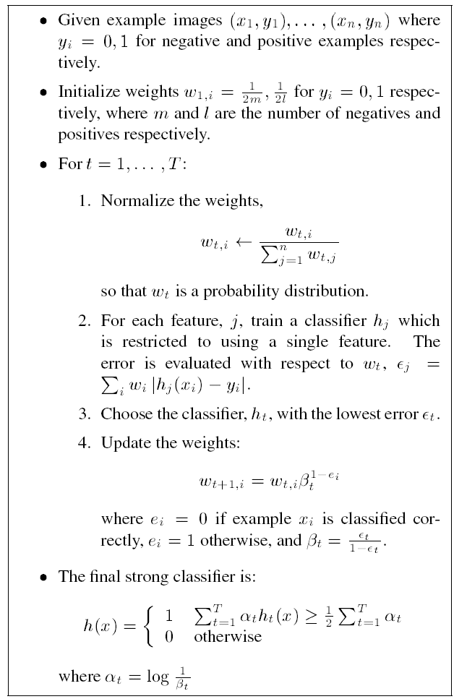
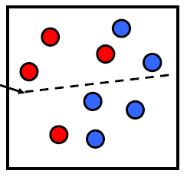
AdaBoost Algorithm
Start with uniform weights on training examples
{x₁,…x_{n}}
For T rounds
Evaluate weighted error for each feature, pick best.
Re-weight the examples:
Incorrectly classified -> more weight
Correctly classified -> less weight
Final classifier is combination of the weak ones, weighted according to error they had.
Freund & Schapire 1995
Notes:
33

Slide 34

Viola-Jones Face Detector: Results
First two features selected

Slide 35
Even if the filters are fast to compute, each new image has a lot of possible windows to search.
How to make the detection more efficient?

Slide 36
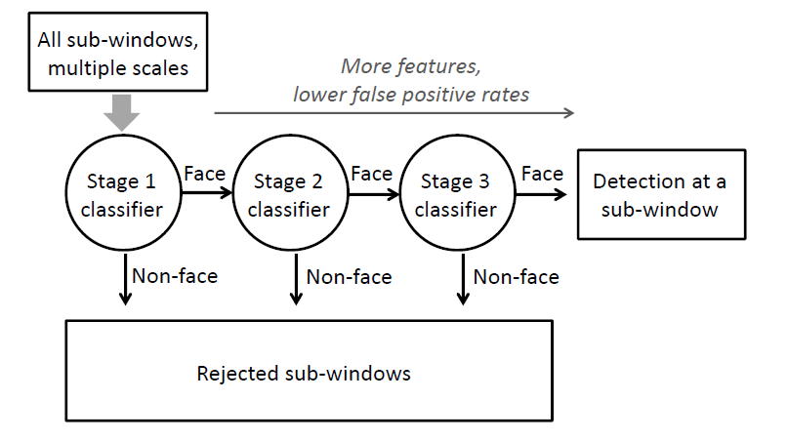
Cascading classifiers for detection
Form a cascade with low false negative rates early on
Apply less accurate but faster classifiers first to immediately discard windows that clearly appear to be negative
Kristen Grauman

Slide 37
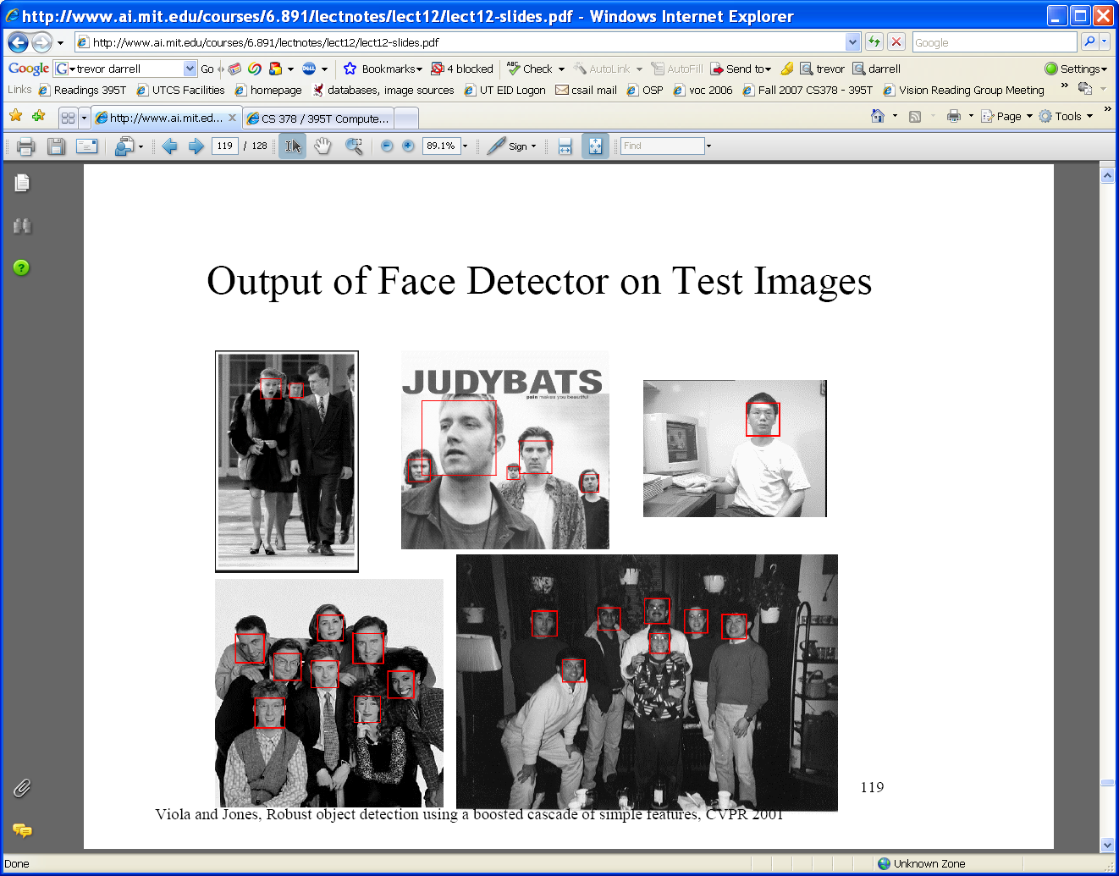
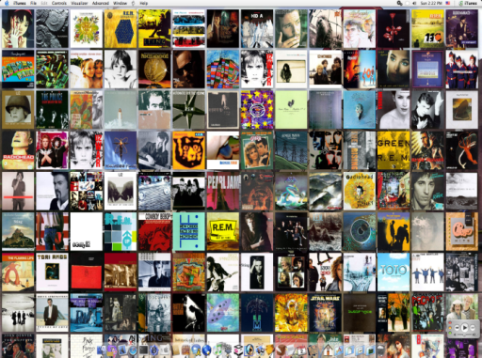




Viola-Jones detector: summary
Train cascade of classifiers with AdaBoost
Apply to each subwindow
Faces
New image
Selected features, thresholds, and weights
Non-faces
Train with 5K positives, 350M negatives
Real-time detector using 38 layer cascade
6061 features in all layers
[Implementation available in OpenCV: http://www.intel.com/technology/computing/opencv/]
Kristen Grauman

Slide 38
Viola-Jones detector: summary
A seminal approach to real-time object detection
Training is slow, but detection is very fast
Key ideas
  Integral images for fast feature evaluation
  Boosting for feature selection
  Attentional cascade of classifiers for fast rejection of non-face windows
P. Viola and M. Jones. Rapid object detection using a boosted cascade of simple features. CVPR 2001.
P. Viola and M. Jones. Robust real-time face detection. IJCV 57(2), 2004.

Slide 39
Viola-Jones Face Detector: Results
Notes:
39

Slide 40
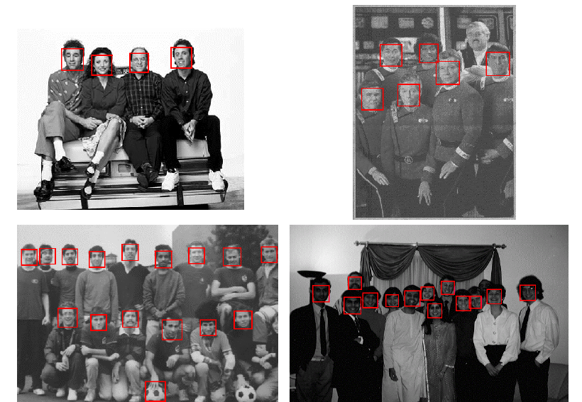
Viola-Jones Face Detector: Results
Notes:
40

Slide 41
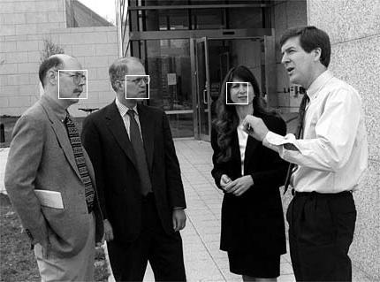
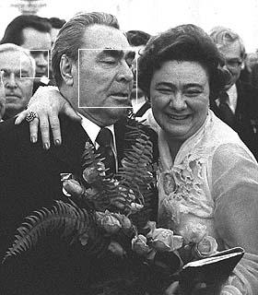
Viola-Jones Face Detector: Results

Slide 42
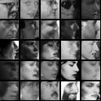
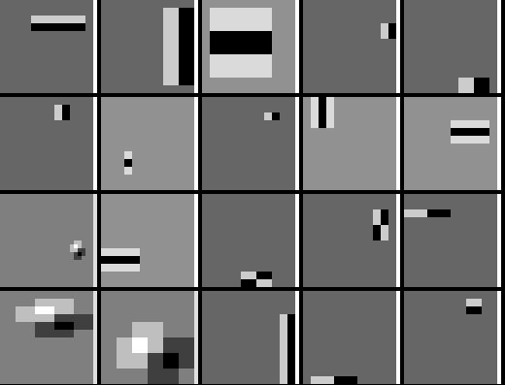
Detecting profile faces?
Can we use the same detector?

Slide 43



Viola-Jones Face Detector: Results
Paul Viola, ICCV tutorial

Slide 44

Example using Viola-Jones detector
Frontal faces detected and then tracked, character names inferred with alignment of script and subtitles.
Everingham, M., Sivic, J. and Zisserman, A.
"Hello! My name is... Buffy" - Automatic naming of characters in TV video,
BMVC 2006. http://www.robots.ox.ac.uk/~vgg/research/nface/index.html
Notes:
44

Slide 45

Example using Viola-Jones detector
Frontal and profile faces detected and then tracked, character names inferred with alignment of script and subtitles.
Everingham, M., Sivic, J. and Zisserman, A.
"Hello! My name is... Buffy" - Automatic naming of characters in TV video,
BMVC 2006. http://www.robots.ox.ac.uk/~vgg/research/nface/index.html
Notes:
45

Slide 46


Slide 47

Consumer application: iPhoto 2009
http://www.apple.com/ilife/iphoto/
Slide credit: Lana Lazebnik

Slide 48

Consumer application: iPhoto 2009
Things iPhoto thinks are faces
Slide credit: Lana Lazebnik

Slide 49


Consumer application: iPhoto 2009
Can be trained to recognize pets!
http://www.maclife.com/article/news/iphotos_faces_recognizes_cats
Slide credit: Lana Lazebnik

Slide 50
What other categories are amenable to window-based representation?

Slide 51



Pedestrian detection
Detecting upright, walking humans also possible using sliding window’s appearance/texture; e.g.,
SVM with Haar wavelets [Papageorgiou & Poggio, IJCV 2000]
Space-time rectangle features [Viola, Jones & Snow, ICCV 2003]
SVM with HoGs [Dalal & Triggs, CVPR 2005]
Kristen Grauman

Slide 52
Window-based detection: strengths
Sliding window detection and global appearance descriptors:
  Simple detection protocol to implement
  Good feature choices critical
  Past successes for certain classes
Kristen Grauman

Slide 53
Window-based detection: Limitations
High computational complexity
  For example: 250,000 locations x 30 orientations x 4 scales = 30,000,000 evaluations!
  If training binary detectors independently, means cost increases linearly with number of classes
With so many windows, false positive rate better be low
Kristen Grauman

Slide 54


Limitations (continued)
Not all objects are “box” shaped
Kristen Grauman

Slide 55

Limitations (continued)
Non-rigid, deformable objects not captured well with representations assuming a fixed 2d structure; or must assume fixed viewpoint
Objects with less-regular textures not captured well with holistic appearance-based descriptions
Kristen Grauman

Slide 56


Limitations (continued)
If considering windows in isolation, context is lost
Sliding window
Detector’s view
Figure credit: Derek Hoiem
Kristen Grauman

Slide 57

Limitations (continued)
In practice, often entails large, cropped training set (expensive)
Requiring good match to a global appearance description can lead to sensitivity to partial occlusions
Image credit: Adam, Rivlin, & Shimshoni
Kristen Grauman

Slide 58
Summary
Basic pipeline for window-based detection
  Model/representation/classifier choice
  Sliding window and classifier scoring
Boosting classifiers: general idea
Viola-Jones face detector
  Exemplar of basic paradigm
  Plus key ideas: rectangular features, Adaboost for feature selection, cascade
Pros and cons of window-based detection

Slide 59
Questions?
See you Thursday!
Slide credit: Devi Parikh

