Slide 1
Epipolar Geometry and Stereo Vision
10/15/13
Computer Vision
ECE 5554
Virginia Tech
Devi Parikh
These slides have been borrowed from Derek Hoiem and Kristen Grauman. Derek adapted many slides from Lana Lazebnik, Silvio Saverese, Steve Seitz, and took many figures from Hartley & Zisserman.

Slide 2
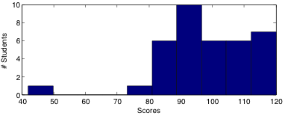
Announcements
PS1 grades are out
  Max: 120
  Min: 42
  Median and Mean: 98
  17 students > 100
PS3 due Monday (10/21) night
Progress on projects
Feedback forms

Slide 3


Recall
Image formation geometry
Vanishing points and vanishing lines
Pinhole camera model and camera projection matrix
Homogeneous coordinates
Vertical vanishing
point
(at infinity)
Vanishing
line
Vanishing
point
Vanishing
point
Slide source: Derek Hoiem

Slide 4
This class: Two-View Geometry
Epipolar geometry
  Relates cameras from two positions
Next time: Stereo depth estimation
  Recover depth from two images

Slide 5
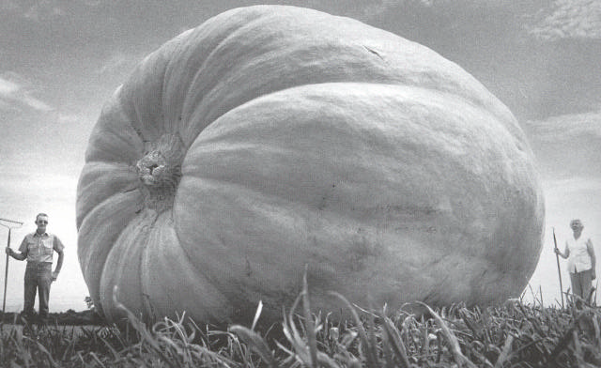
Why multiple views?
Structure and depth are inherently ambiguous from single views.
Slide credit: Kristen Grauman
Images from Lana Lazebnik

Slide 6
Why multiple views?
Structure and depth are inherently ambiguous from single views.
X1
X2
x1’=x2’
Optical center
Slide credit: Kristen Grauman

Slide 7
What cues help us to perceive 3d shape and depth?
Slide credit: Kristen Grauman

Slide 8
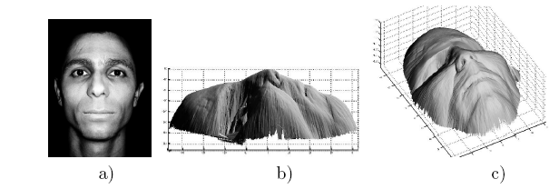
Shading
[Figure from Prados & Faugeras 2006]
Slide credit: Kristen Grauman
Notes:
8

Slide 9
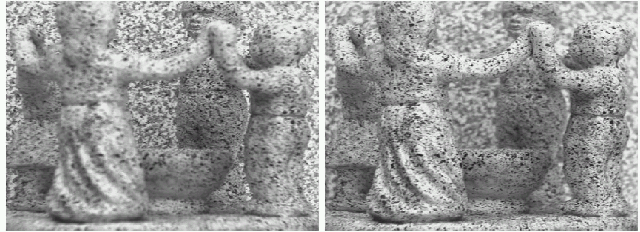
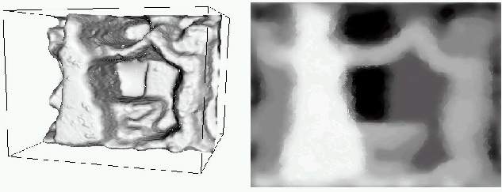
Focus/defocus
Images from same point of view, different camera parameters
3d shape / depth estimates
Slide credit: Kristen Grauman
[figs from H. Jin and P. Favaro, 2002]

Slide 10
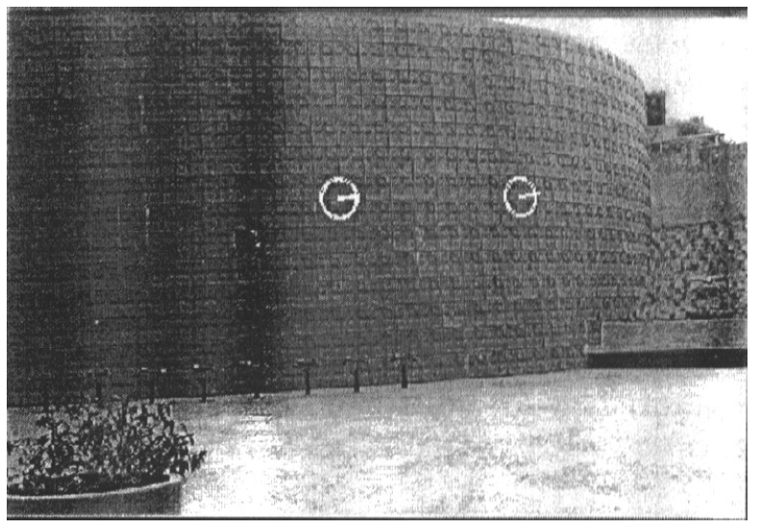
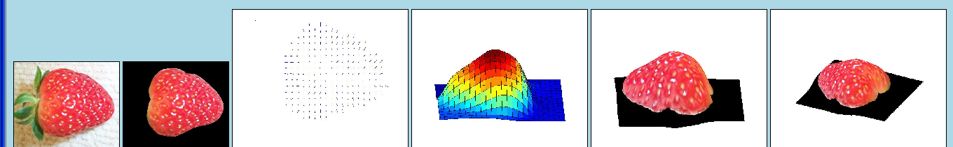
Texture
[From A.M. Loh. The recovery of 3-D structure using visual texture patterns. PhD thesis]
Slide credit: Kristen Grauman
Notes:
10

Slide 11

Perspective effects
Slide credit: Kristen Grauman
Image credit: S. Seitz

Slide 12
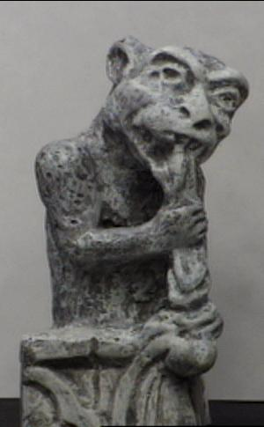
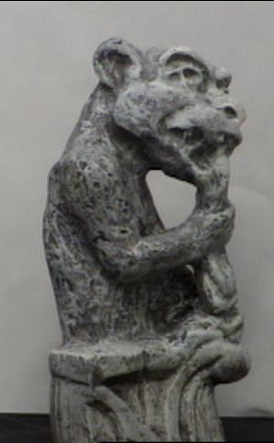
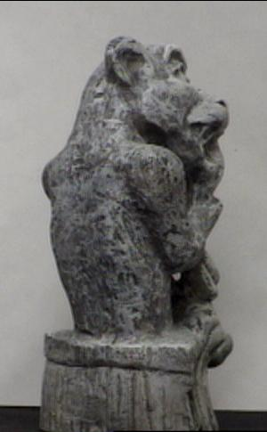
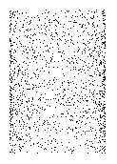
Motion
Figures from L. Zhang
Slide credit: Kristen Grauman
http://www.brainconnection.com/teasers/?main=illusion/motion-shape

Slide 13
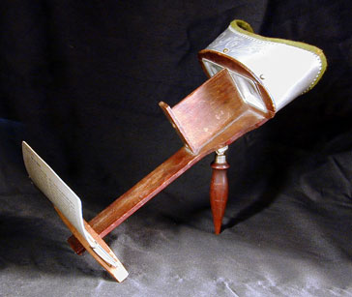
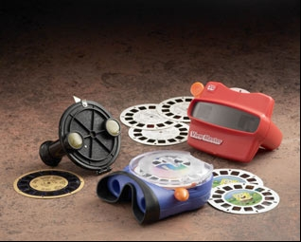
Stereo photography and stereo viewers
Take two pictures of the same subject from two slightly different viewpoints and display so that each eye sees only one of the images.
Image from fisher-price.com
Invented by Sir Charles Wheatstone, 1838
Slide credit: Kristen Grauman

Slide 14
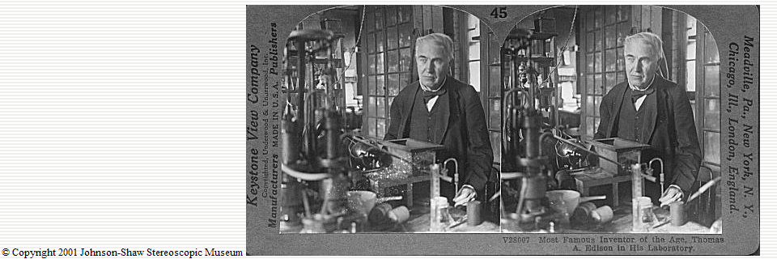
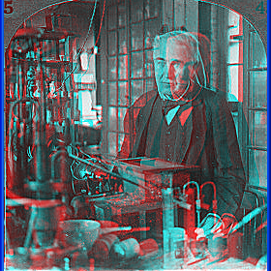
http://www.johnsonshawmuseum.org
Slide credit: Kristen Grauman
Notes:
14

Slide 15
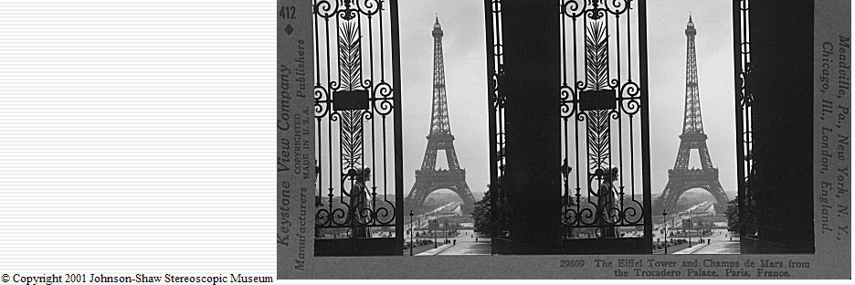
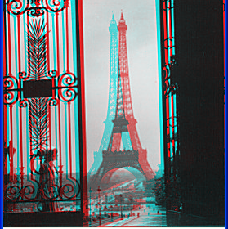
http://www.johnsonshawmuseum.org
Slide credit: Kristen Grauman
Notes:
15

Slide 16
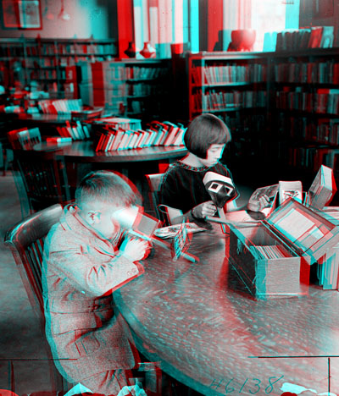

Public Library, Stereoscopic Looking Room, Chicago, by Phillips, 1923
Slide credit: Kristen Grauman
Notes:
16

Slide 17
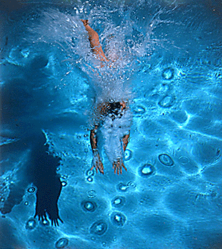
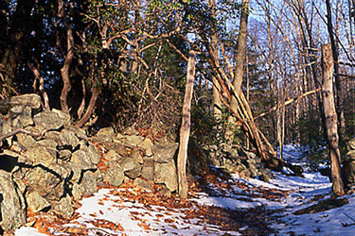
http://www.well.com/~jimg/stereo/stereo_list.html
Slide credit: Kristen Grauman
Notes:
17

Slide 18
Recall: Image Stitching
Two images with rotation/zoom but no translation
.
X
x
x'
f
f'

Slide 19
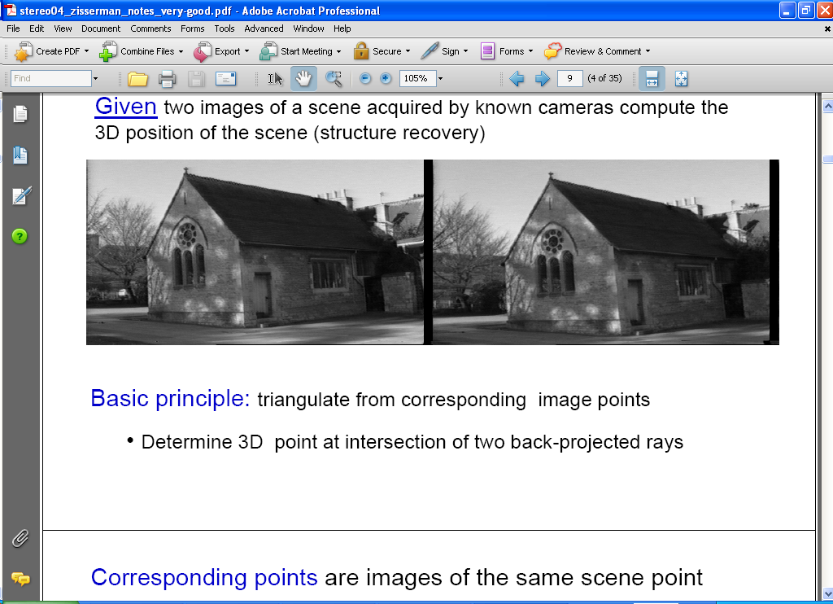
Estimating depth with stereo
Stereo: shape from “motion” between two views
scene point
image plane
optical center
Notes:
19

Slide 20
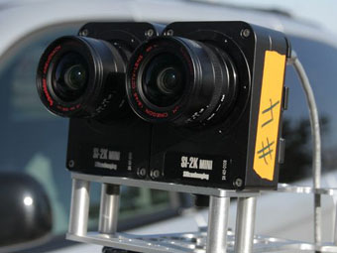
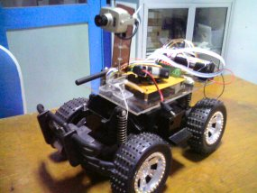
Stereo vision
Two cameras, simultaneous views
Single moving camera and static scene

Slide 21
Depth from Stereo
Goal: recover depth by finding image coordinate x’ that corresponds to x
X
X
x
z
x
x’
x'
f
f
C
Baseline
B
C’
Disparity: Hold up your finger. View it with one eye at a time. Alternate.

Slide 22
Depth from Stereo
Goal: recover depth by finding image coordinate x’ that corresponds to x
Sub-Problems
  Calibration: How do we recover the relation of the cameras (if not already known)?
  Correspondence: How do we search for the matching point x’?
X
x
x'

Slide 23


Correspondence Problem
x
?
We have two images taken from cameras with different intrinsic and extrinsic parameters
How do we match a point in the first image to a point in the second? How can we constrain our search?

Slide 24
Key idea: Epipolar constraint

Slide 25

Key idea: Epipolar constraint
X
X
X
x
x’
x’
x’
Potential matches for x have to lie on the corresponding line l’.
Potential matches for x’ have to lie on the corresponding line l.

Slide 26

Epipolar geometry: notation
X
x
x’
Baseline – line connecting the two camera centers
Epipoles
= intersections of baseline with image planes
= projections of the other camera center
Epipolar Plane – plane containing baseline (1D family)

Slide 27
Epipolar geometry: notation
X
x
x’
Baseline – line connecting the two camera centers
Epipoles
= intersections of baseline with image planes
= projections of the other camera center
Epipolar Plane – plane containing baseline (1D family)
Epipolar Lines - intersections of epipolar plane with image
planes (always come in corresponding pairs)

Slide 28



Example: Converging cameras

Slide 29



Example: Motion parallel to image plane

Slide 30
Example: Forward motion
What would the epipolar lines look like if the camera moves directly forward?

Slide 31
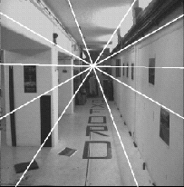
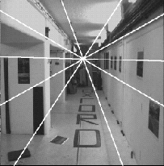
Example: Forward motion
e’
e
Epipole has same coordinates in both images.
Points move along lines radiating from e: “Focus of expansion”

Slide 32
Epipolar constraint: Calibrated case
X
x
x’
Given the intrinsic parameters of the cameras:
  Convert to normalized coordinates by pre-multiplying all points with the inverse of the calibration matrix; set first camera’s coordinate system to world coordinates
3D scene point
Homogeneous 2d point (3D ray towards X)
2D pixel coordinate (homogeneous)
3D scene point in 2nd camera’s 3D coordinates

Slide 33
Epipolar constraint: Calibrated case
X
x
x’
Given the intrinsic parameters of the cameras:
  Convert to normalized coordinates by pre-multiplying all points with the inverse of the calibration matrix; set first camera’s coordinate system to world coordinates
  Define some R and t that relate X to X’ as below

Slide 34
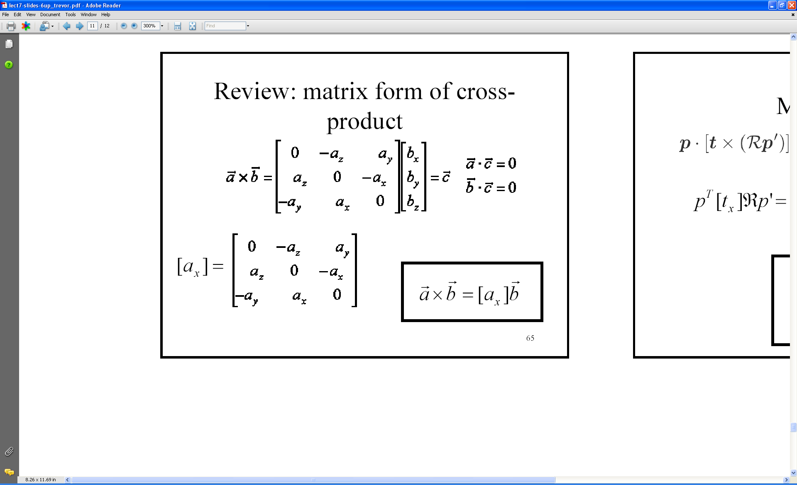
An aside: cross product
Vector cross product takes two vectors and returns a third vector that’s perpendicular to both inputs.
So here, c is perpendicular to both a and b, which means the dot product = 0.
Slide source: Kristen Grauman
Notes:
34

Slide 35
Epipolar constraint: Calibrated case
X
x
x’
Algebraically…
Notes:
X’ is X in the second camera’s coordinate system
We can identify the non-homogeneous 3D vectors X and X’ with the homogeneous coordinate vectors x and x’ of the projections of the two points into the two respective images

Slide 36
Another aside:
Matrix form of cross product
Can be expressed as a matrix multiplication.
Slide source: Kristen Grauman
Notes:
36

Slide 37
Essential matrix
X
x
x’
Essential Matrix
(Longuet-Higgins, 1981)
Notes:
[t]_{x} is the skew symmetric matrix of t

Slide 38
Properties of the Essential matrix
X
x
x’
Drop ^ below to simplify notation
E x’ is the epipolar line associated with x’ (l = E x’)
E^{T}x is the epipolar line associated with x (l’ = E^{T}x)
E e’ = 0 and E^{T}e = 0
E is singular (rank two)
E has five degrees of freedom
  (3 for R, 2 for t because it’s up to a scale)

Slide 39
Epipolar constraint: Uncalibrated case
X
x
x’
If we don’t know K and K’, then we can write the epipolar constraint in terms of unknown normalized coordinates:

Slide 40
The Fundamental Matrix
Without knowing K and K’, we can define a similar relation using unknown normalized coordinates
Fundamental Matrix
(Faugeras and Luong, 1992)

Slide 41
Properties of the Fundamental matrix
X
x
x’
F x’ is the epipolar line associated with x’ (l = F x’)
F^{T}x is the epipolar line associated with x (l’ = F^{T}x)
F e’ = 0 and F^{T}e = 0
F is singular (rank two): det(F)=0
F has seven degrees of freedom: 9 entries but defined up to scale, det(F)=0

Slide 42
Estimating the Fundamental Matrix
8-point algorithm
  Least squares solution using SVD on equations from 8 pairs of correspondences
  Enforce det(F)=0 constraint using SVD on F
7-point algorithm
  Use least squares to solve for null space (two vectors) using SVD and 7 pairs of correspondences
  Solve for linear combination of null space vectors that satisfies det(F)=0
Minimize reprojection error
  Non-linear least squares
Note: estimation of F (or E) is degenerate for a planar scene.

Slide 43
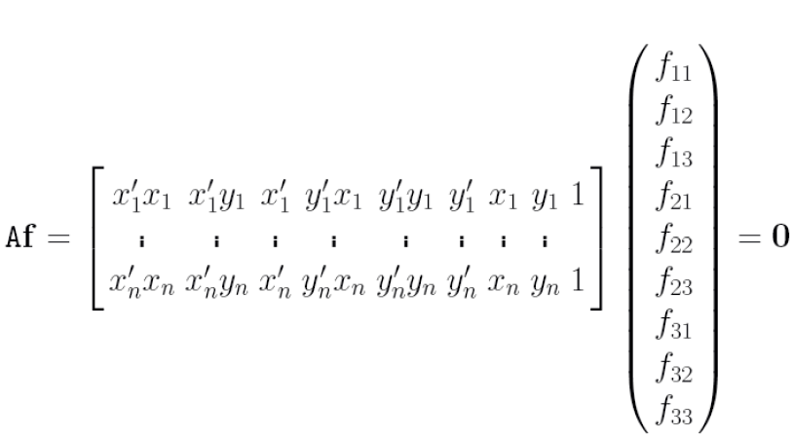
8-point algorithm
Solve a system of homogeneous linear equations
  Write down the system of equations

Slide 44
8-point algorithm
Solve a system of homogeneous linear equations
  Write down the system of equations
  Solve f from Af=0 using SVD
Matlab:
[U, S, V] = svd(A);
f = V(:, end);
F = reshape(f, [3 3])’;

Slide 45
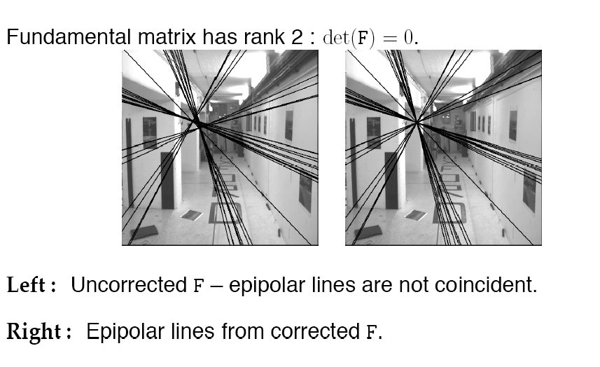
Need to enforce singularity constraint

Slide 46
8-point algorithm
Solve a system of homogeneous linear equations
  Write down the system of equations
  Solve f from Af=0 using SVD
Resolve det(F) = 0 constraint using SVD
Matlab:
[U, S, V] = svd(A);
f = V(:, end);
F = reshape(f, [3 3])’;
Matlab:
[U, S, V] = svd(F);
S(3,3) = 0;
F = U*S*V’;

Slide 47
8-point algorithm
Solve a system of homogeneous linear equations
  Write down the system of equations
  Solve f from Af=0 using SVD
Resolve det(F) = 0 constraint by SVD
Notes:
Use RANSAC to deal with outliers (sample 8 points)
  How to test for outliers?
Solve in normalized coordinates
  mean=0
  standard deviation ~= (1,1,1)
  just like with estimating the homography for stitching
Notes:
Test for outliers by computing distance from epipolar line to corresponding point (NOT by taking square of x^{T}Fx’)

Slide 48
Comparison of homography estimation and the 8-point algorithm
Assume we have matched points x x’ with outliers
Homography (No Translation)
Fundamental Matrix (Translation)

Slide 49
Comparison of homography estimation and the 8-point algorithm
Assume we have matched points x x’ with outliers
Homography (No Translation)
Fundamental Matrix (Translation)
Correspondence Relation
Normalize image coordinates
RANSAC with 4 points
  Solution via SVD
De-normalize:

Slide 50
Comparison of homography estimation and the 8-point algorithm
Assume we have matched points x x’ with outliers
Homography (No Translation)
Fundamental Matrix (Translation)
Correspondence Relation
Normalize image coordinates
RANSAC with 4 points
  Solution via SVD
De-normalize:
Correspondence Relation
Normalize image coordinates
RANSAC with 8 points
  Initial solution via SVD
  Enforce by SVD
De-normalize:

Slide 51
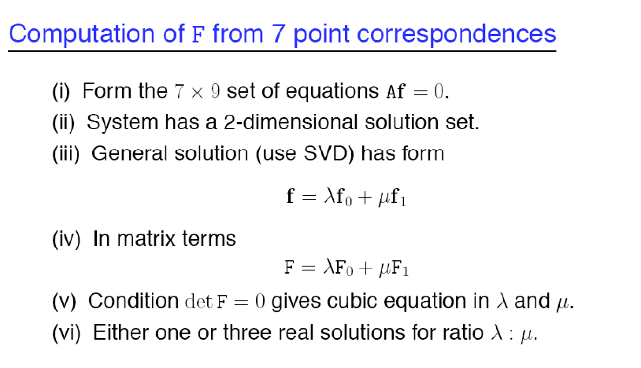
7-point algorithm
Faster (need fewer points) and could be more robust (fewer points), but also need to check for degenerate cases

Slide 52
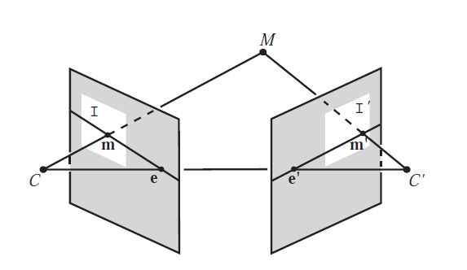
“Gold standard” algorithm
Use 8-point algorithm to get initial value of F
Use F to solve for P and P’ (discussed later)
Jointly solve for 3d points X and F that minimize the squared re-projection error
X
x
x'
See Algorithm 11.2 and Algorithm 11.3 in HZ (pages 284-285) for details

Slide 53
Comparison of estimation algorithms
 | 8-point | Normalized 8-point | Nonlinear least squares
Av. Dist. 1 | 2.33 pixels | 0.92 pixel | 0.86 pixel
Av. Dist. 2 | 2.18 pixels | 0.85 pixel | 0.80 pixel

Slide 54
We can get projection matrices P and P’ up to a projective ambiguity
Code:
function P = vgg_P_from_F(F)
[U,S,V] = svd(F);
e = U(:,3);
P = [-vgg_contreps(e)*F e];
K’*rotation
K’*translation
See HZ p. 255-256
If we know the intrinsic matrices (K and K’), we can resolve the ambiguity

Slide 55
From epipolar geometry to camera calibration
Estimating the fundamental matrix is known as “weak calibration”
If we know the calibration matrices of the two cameras, we can estimate the essential matrix: E = K^{T}FK’
The essential matrix gives us the relative rotation and translation between the cameras, or their extrinsic parameters

Slide 56
Let’s recap…
Fundamental matrix song

Slide 57

Next time: Stereo
Fuse a calibrated binocular stereo pair to produce a depth image
image 1
image 2
Dense depth map

Slide 58
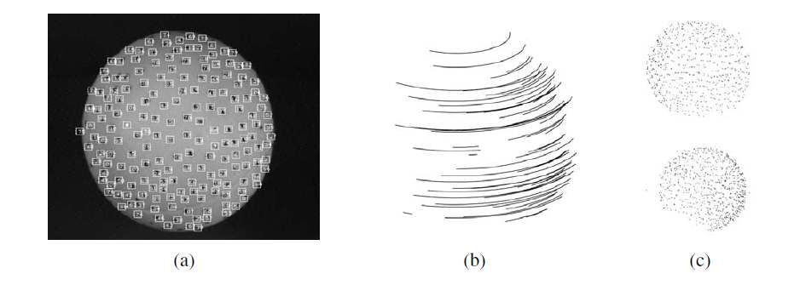
Next class: structure from motion

Slide 59
Questions?
See you Thursday!
Slide credit: Devi Parikh

