Slide 1
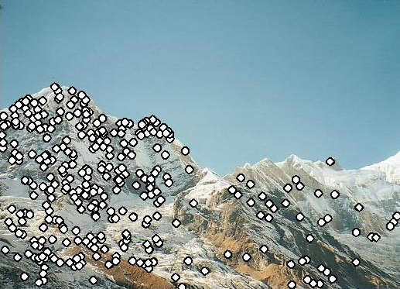
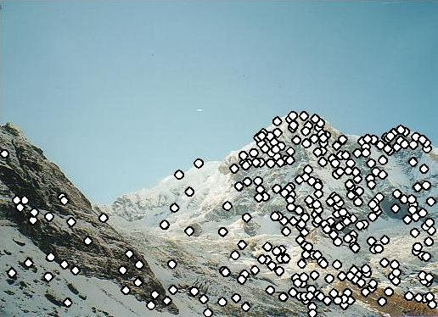
Local invariant features 1
Thursday October 3rd 2013
Neelima Chavali
Virginia Tech

Slide 2
Announcement
PS2 is due Monday midnight.
Relatively short lecture.

Slide 3
Previously..
Image stitching
  Fitting a 2D transformation
    Affine, Homography
  2D image warping
  Computing an image mosaic

Slide 4
Today
How to detect which corresponding points to match?

Slide 5
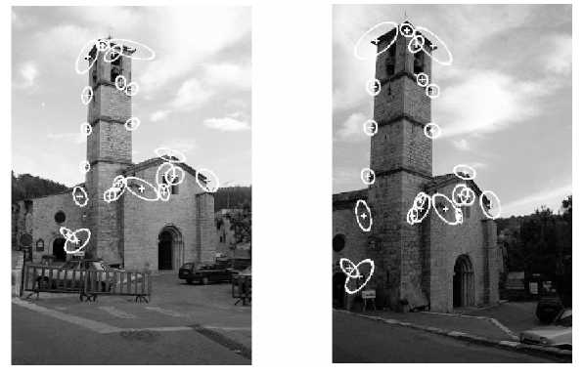
Detecting local interest points
Detection of interest points
  Harris corner detection

Slide 6


Matching interest points
Detection: Identify the interest points
Description:Extract vector /feature/ descriptor surrounding each interest point.
Matching: Determine correspondence between descriptors in two views
Kristen Grauman

Slide 7
Matching invariant points
Detection: Identify the interest points
Description:Extract vector feature descriptor surrounding each interest point.
Matching: Determine correspondence between descriptors in two views

Slide 8
Goal: interest operator repeatability
We want to detect (at least some of) the same points in both images.
Yet we have to be able to run the detection procedure independently per image.
No chance to find true matches!
Notes:
8

Slide 9
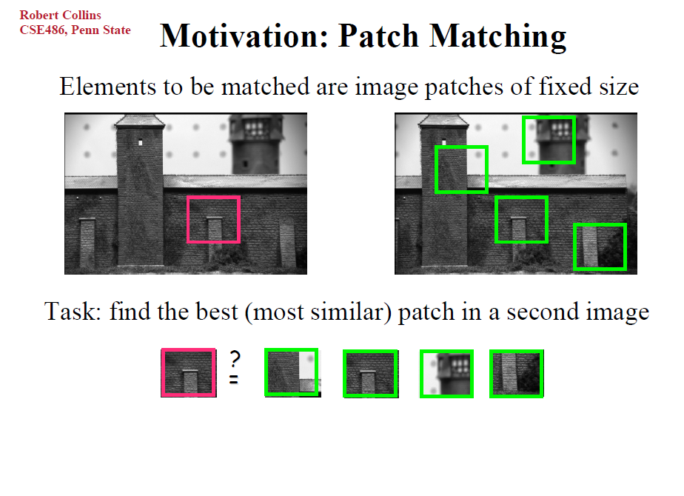

What points would you choose?

Slide 10
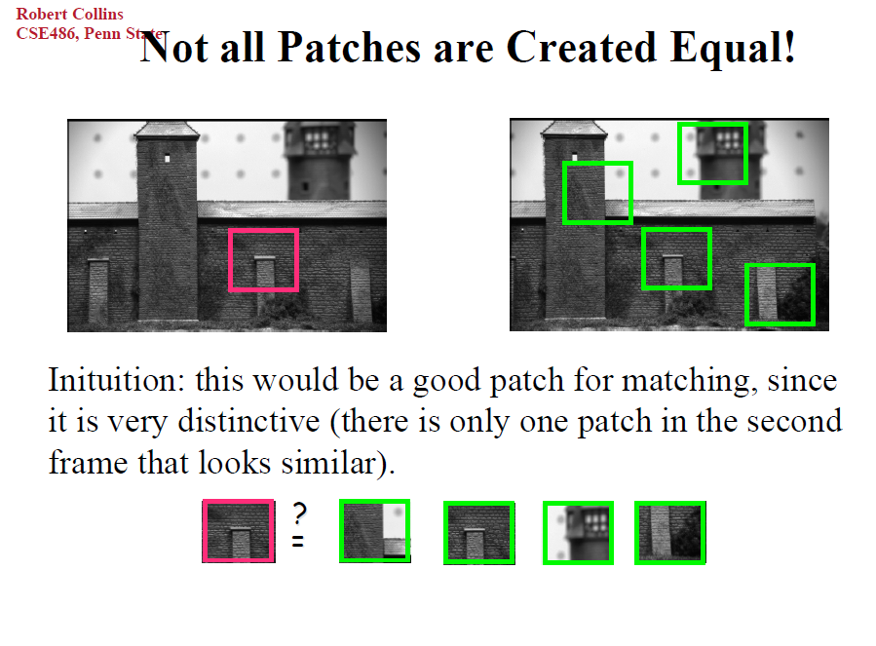

Slide 11
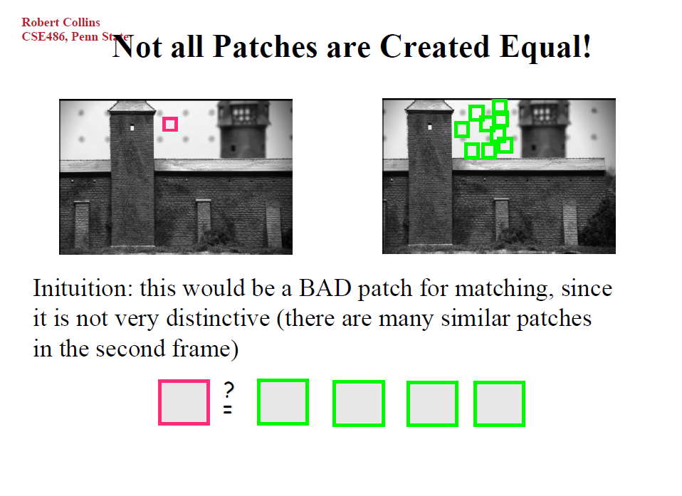

Slide 12
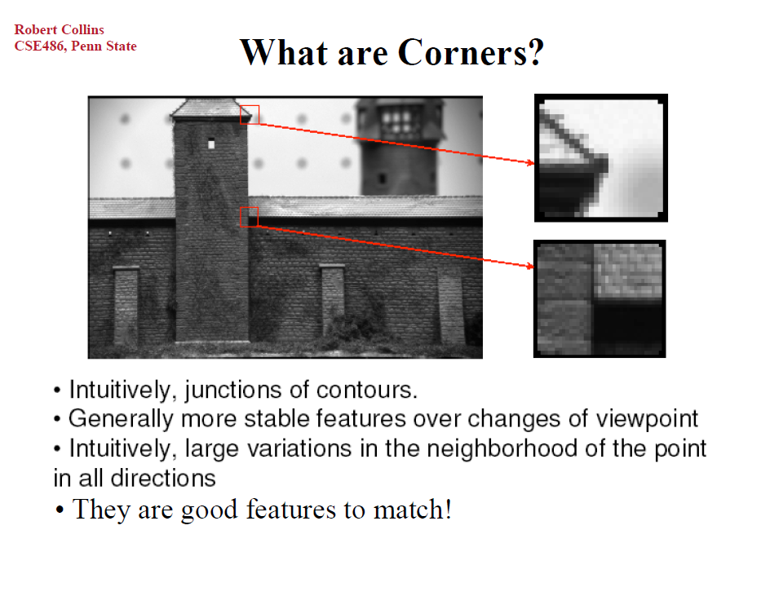

Slide 13

Corners as distinctive interest points
“flat” region:
no change in all directions
“edge”:
no change along the edge direction
“corner”:
significant change in all directions
Slide credit: Alyosha Efros, Darya Frolova, Denis Simakov

Slide 14
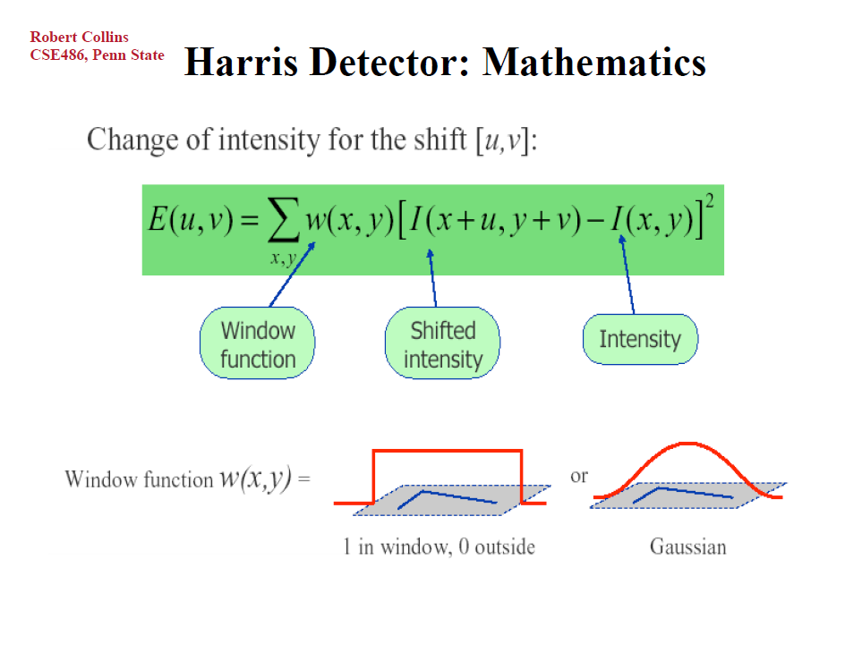

Slide 15
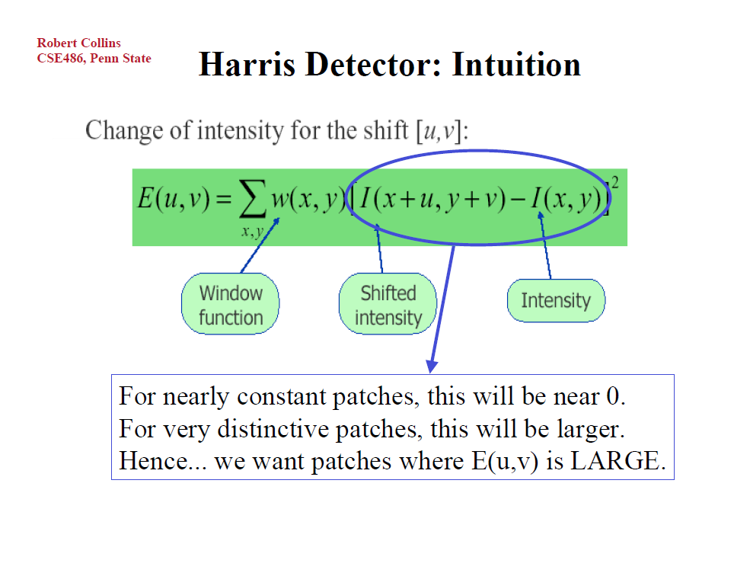

Slide 16
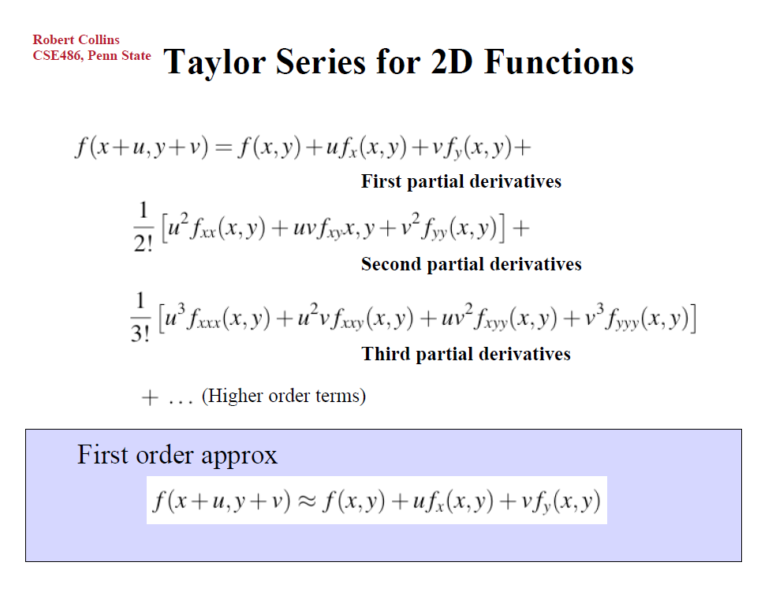

Slide 17
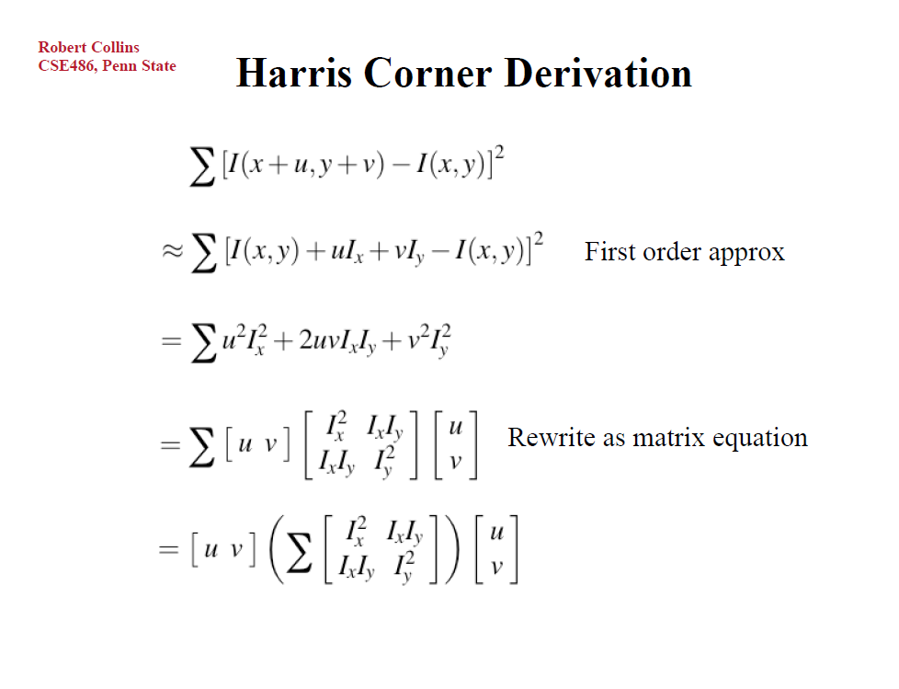

Slide 18
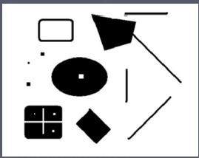
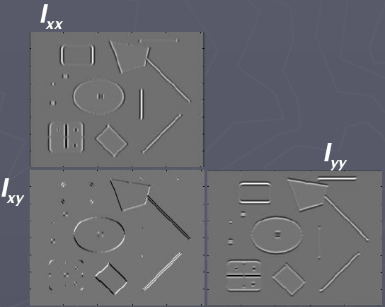
Corners as distinctive interest points
2 x 2 matrix of image derivatives (averaged in neighborhood of a point).
Notation:

Slide 19
What does this matrix reveal?
First, consider an axis-aligned corner:

Slide 20
What does this tell us about M?
This means dominant gradient directions align with x or y axis
Look for locations where both λ’s are large.
If either λ is close to 0, then this is not corner-like.
What if we have a corner that is not aligned with the image axes?

Slide 21
What does this matrix reveal?
Since M is symmetric, we have
The eigenvalues of M reveal the amount of intensity change in the two principal orthogonal gradient directions in the window.

Slide 22
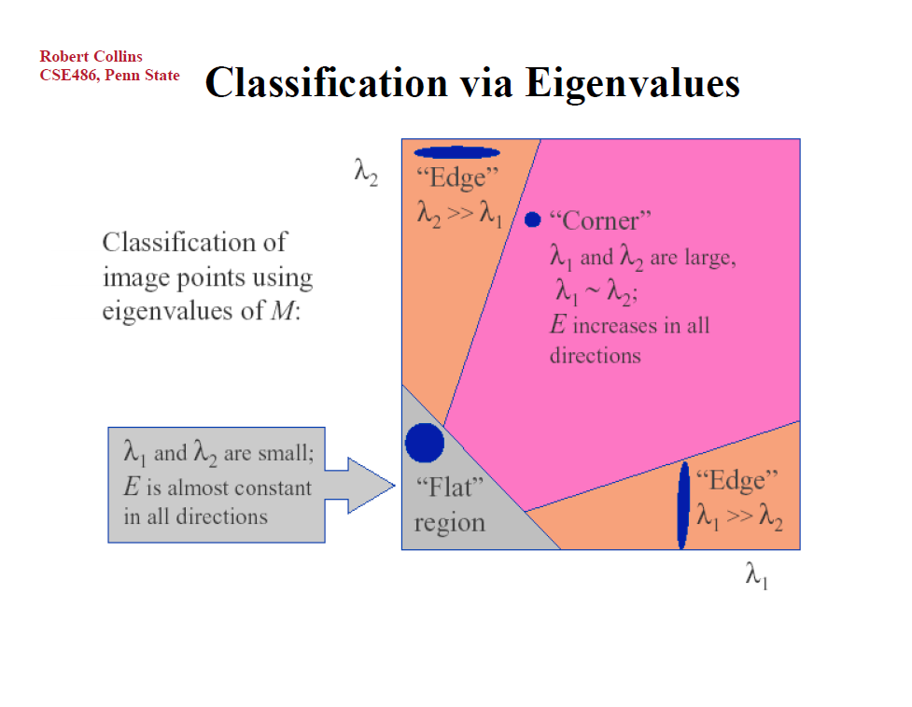

Slide 23
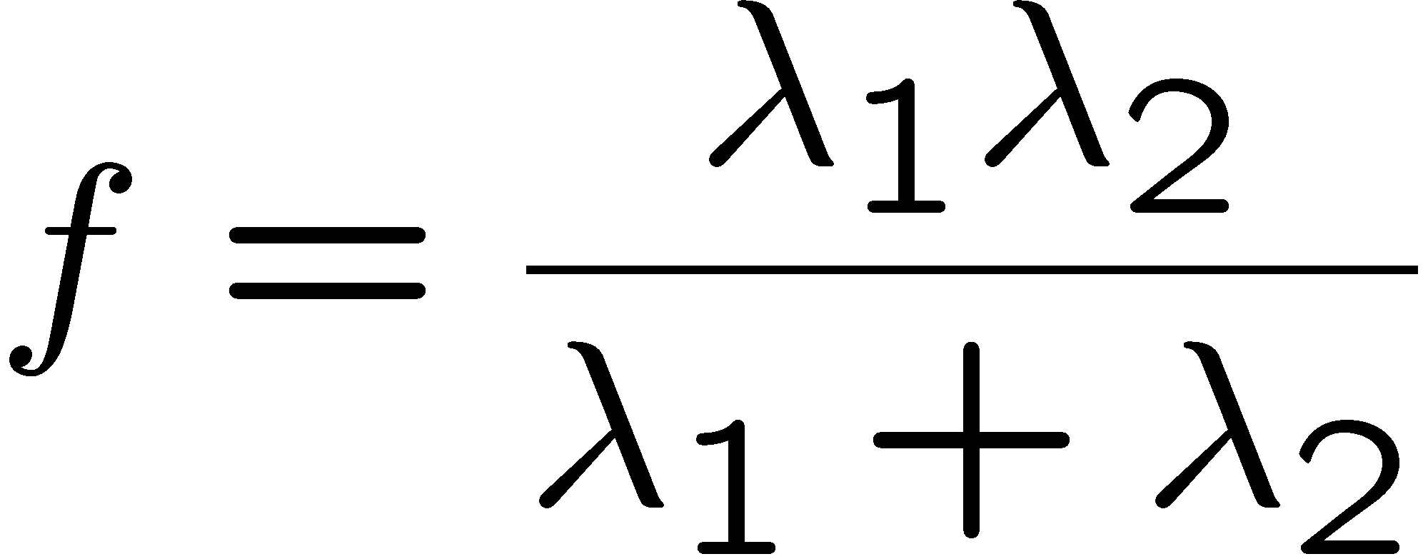
Corner response function
“edge”:
“corner”:
“flat” region
λ₁ >> λ₂
λ₁ and λ₂ are large,
λ₁ ~ λ₂;
λ₁ and λ₂ are small;
λ₂ >> λ₁

Slide 24
Harris corner detector
Compute M matrix for each image window to get their cornerness scores.
Find points whose surrounding window gave large corner response (f> threshold)
Take the points of local maxima, i.e., perform non-maximum suppression
Notes:
24

Slide 25
Example of Harris application
Kristen Grauman

Slide 26
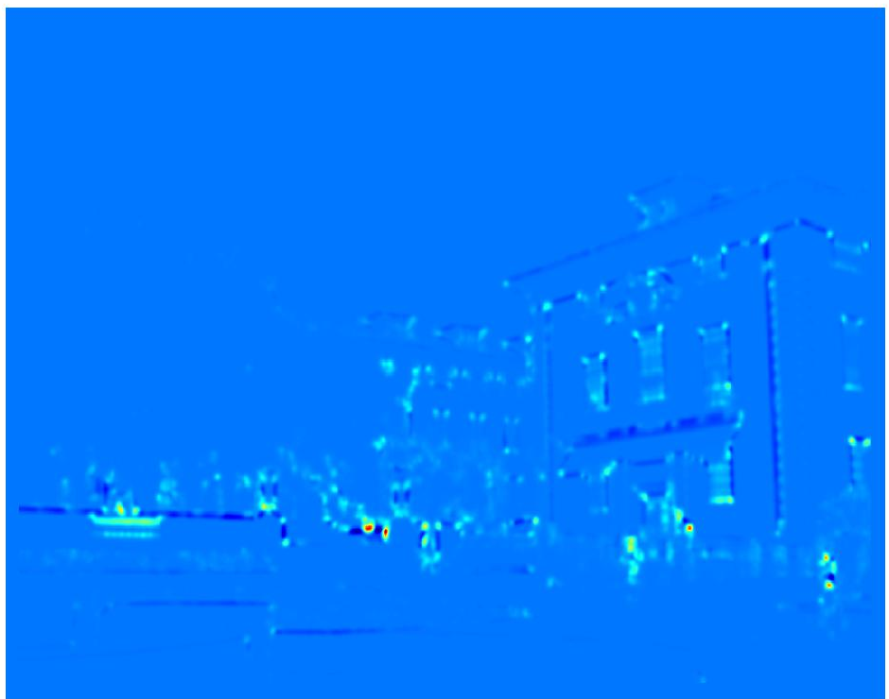
Example of Harris application
Compute corner response at every pixel.
Kristen Grauman

Slide 27
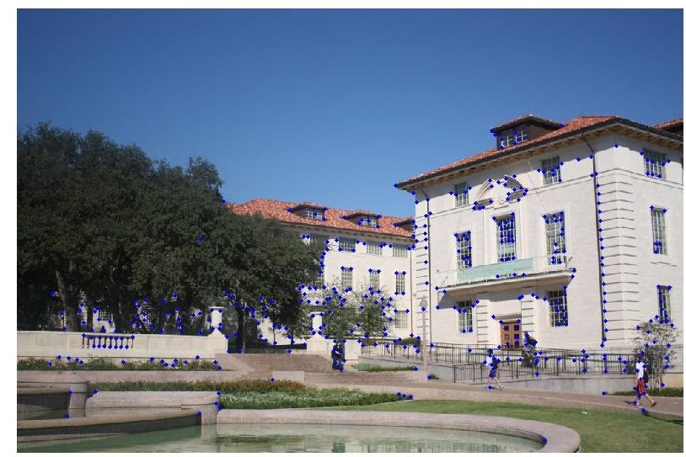
Example of Harris application
Kristen Grauman
Notes:
Only non-maxes exceeding average (thresholded)

Slide 28
Properties of the Harris corner detector
Rotation invariant?
Scale invariant?
Yes

Slide 29
Properties of the Harris corner detector
Scale invariant?
No
All points will be classified as edges
Corner !

Slide 30
Summary
Interest point detection
  Harris corner detector

