Slide 1
ECE 5984: Introduction to
Machine Learning
Topics:
  Regression
Readings: Barber 17.1, 17.2
Dhruv Batra
Virginia Tech

Slide 2
Administrativia
HW1
  Due on Sun 02/15, 11:55pm
  http://inclass.kaggle.com/c/VT-ECE-Machine-Learning-HW1
Project Proposal
  Due: Tue 02/24, 11:55 pm
  <=2pages, NIPS format
HW2
  Out today
  Due on Friday 03/06, 11:55pm
  Please please please please please start early
  Implement linear regression, Naïve Bayes, Logistic Regression

Slide 3
Recap of last time

Slide 4
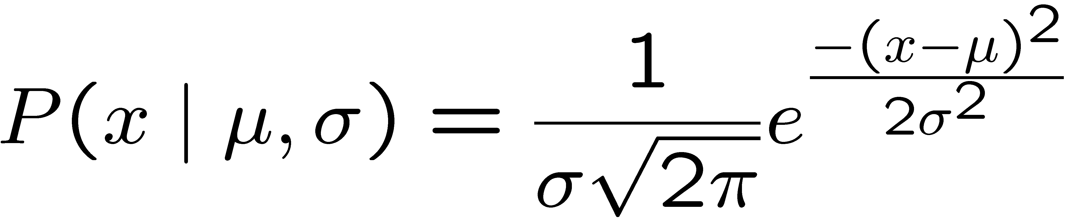
Learning a Gaussian
Collect a bunch of data
  Hopefully, i.i.d. samples
  e.g., exam scores
Learn parameters
  Mean
  Variance

Slide 5
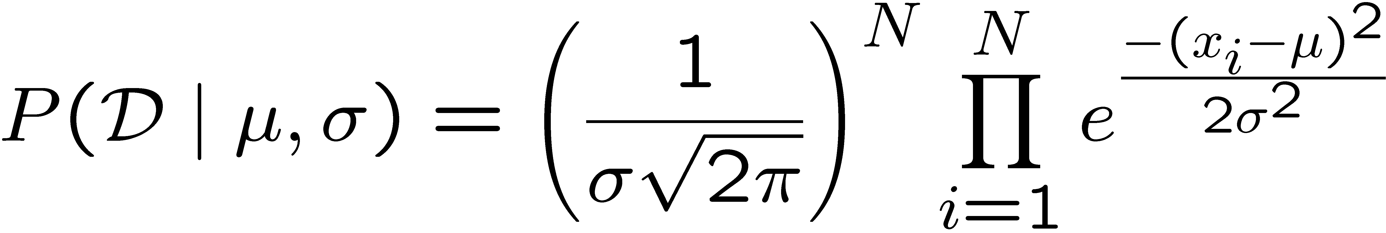
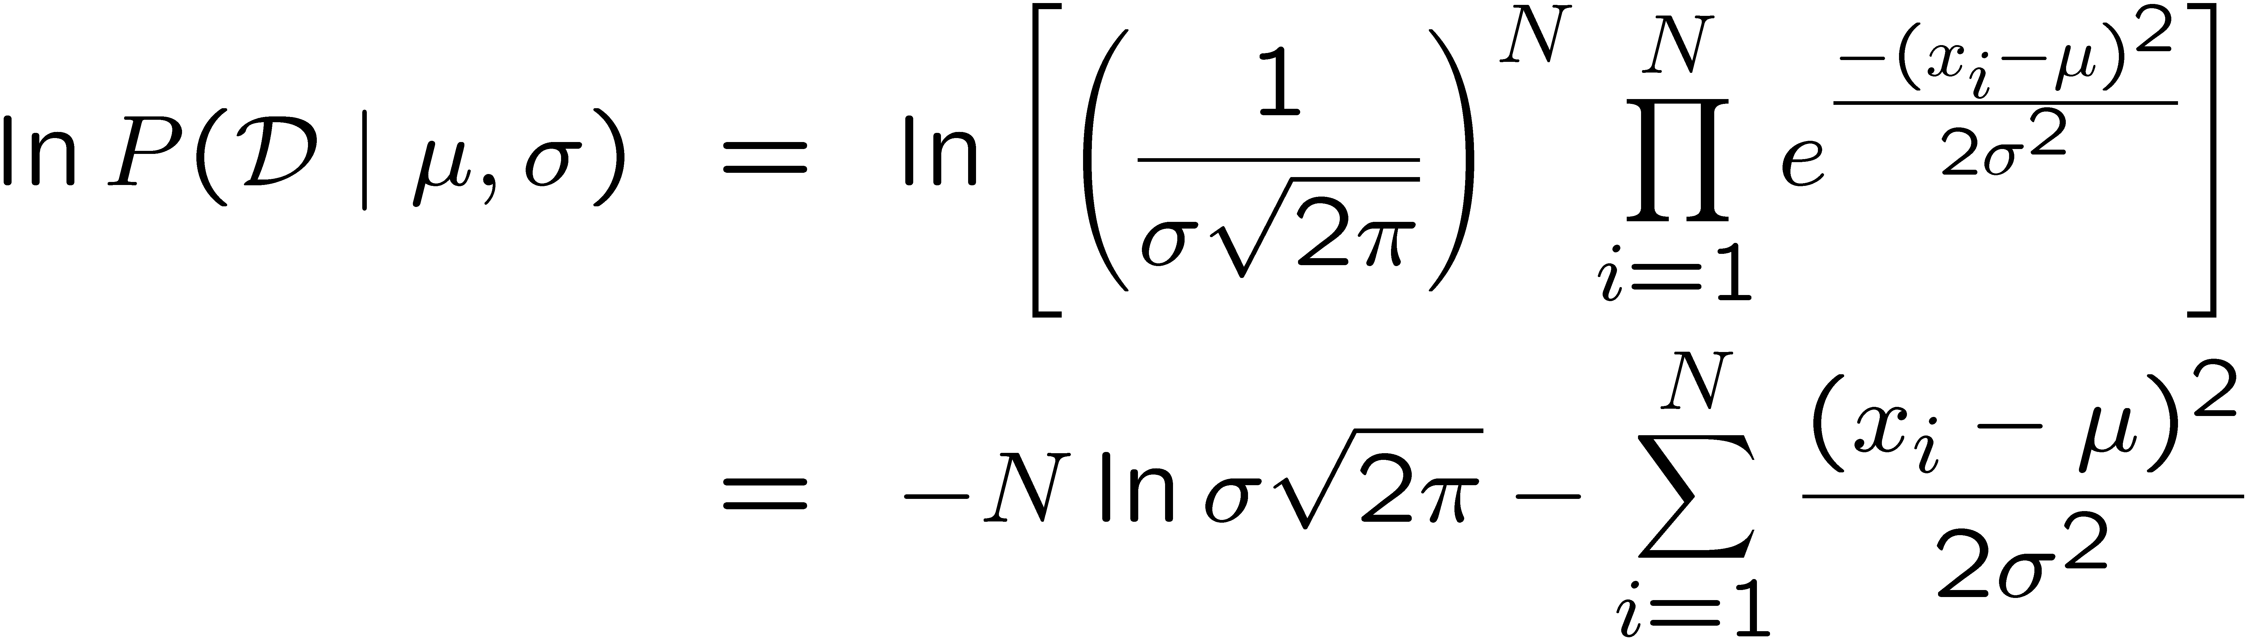
MLE for Gaussian
Prob. of i.i.d. samples D={x₁,…,x_{N}}:
Log-likelihood of data:
Slide Credit: Carlos Guestrin

Slide 6
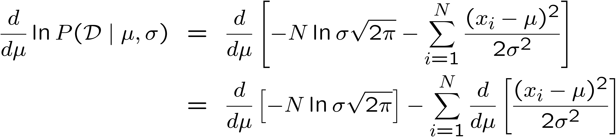
Your second learning algorithm:
MLE for mean of a Gaussian
What’s MLE for mean?
Slide Credit: Carlos Guestrin

Slide 7
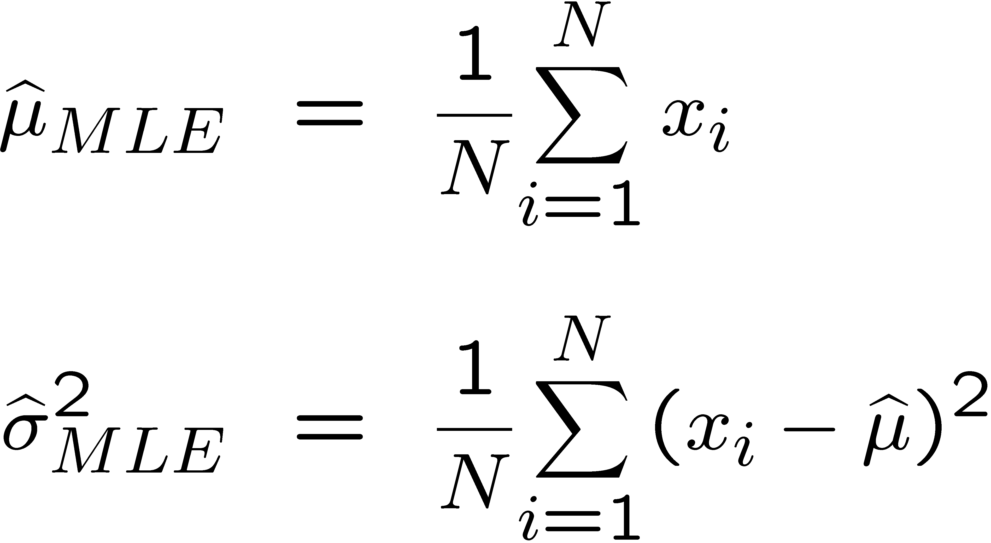
Learning Gaussian parameters
MLE:

Slide 8
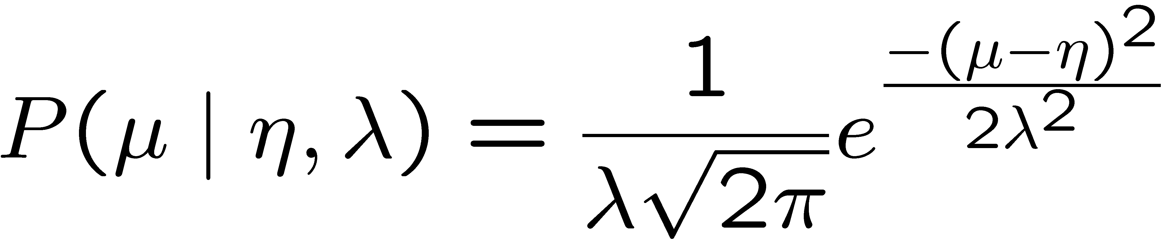
Bayesian learning of Gaussian parameters
Conjugate priors
  Mean: Gaussian prior
  Variance: Inverse Gamma or Wishart Distribution
Prior for mean:
Slide Credit: Carlos Guestrin

Slide 9
MAP for mean of Gaussian
Slide Credit: Carlos Guestrin

Slide 10
Plan for Today
Regression
  Linear Regression
  Connections with Gaussians

Slide 11
New Topic: Regression

Slide 12
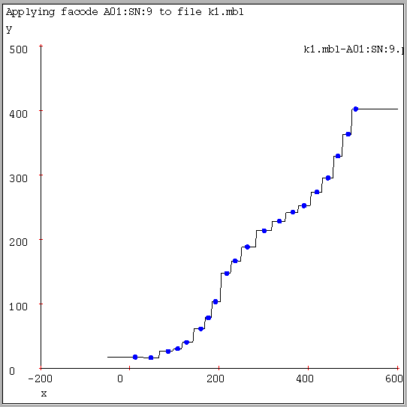
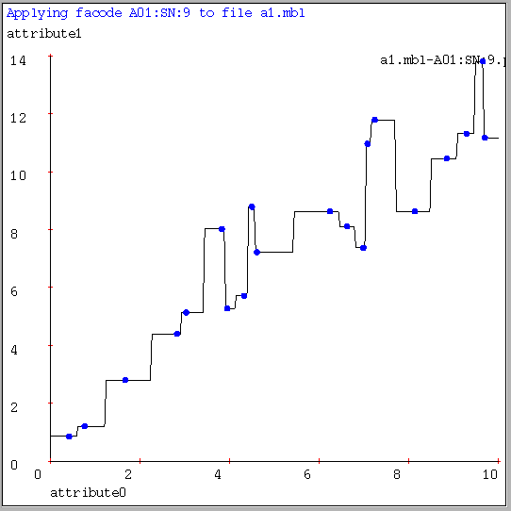
1-NN for Regression
Often bumpy (overfits)
Figure Credit: Andrew Moore

Slide 13
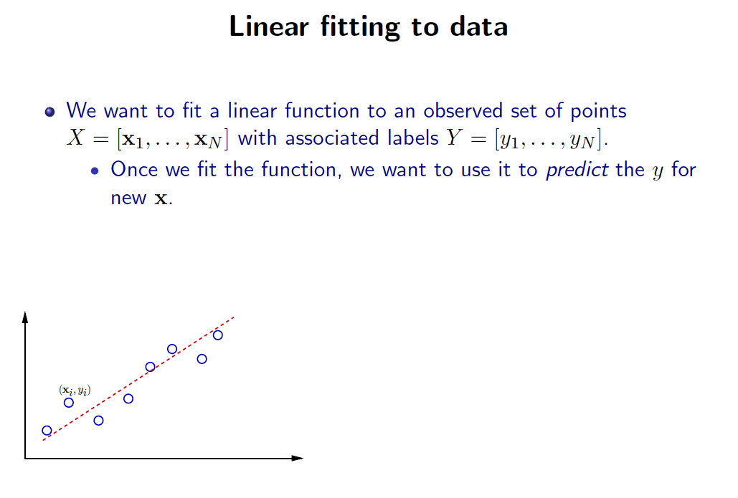
Slide Credit: Greg Shakhnarovich

Slide 14
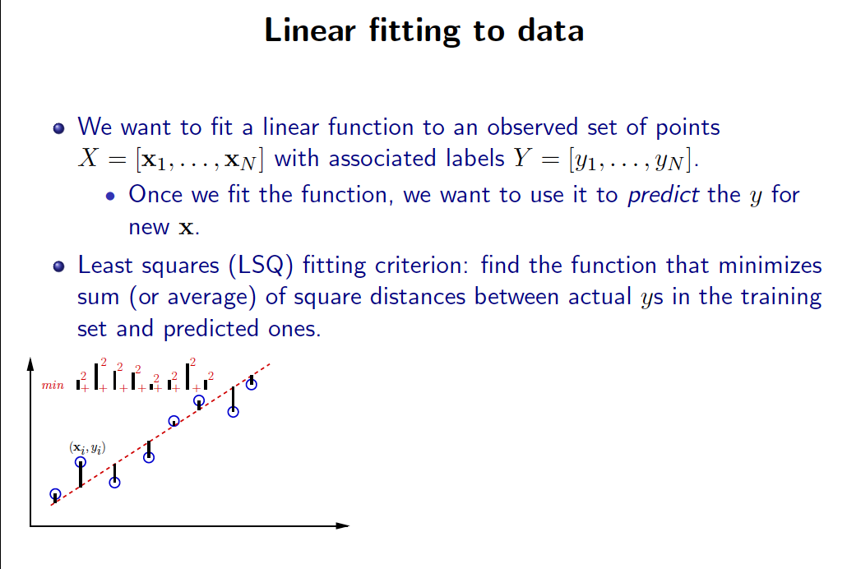
Slide Credit: Greg Shakhnarovich

Slide 15
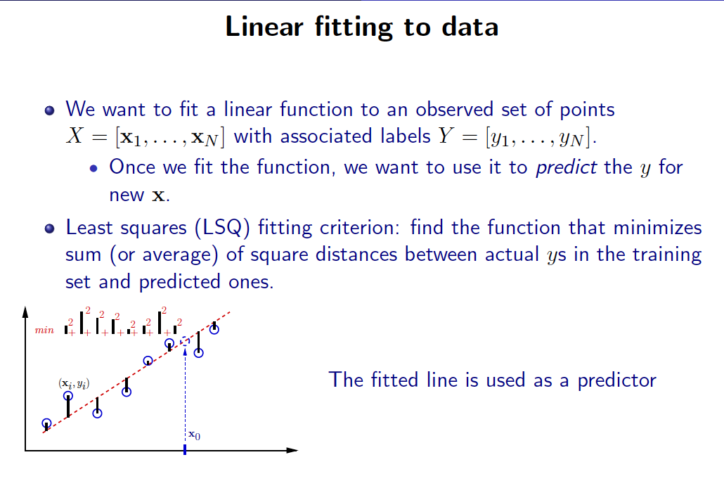
Slide Credit: Greg Shakhnarovich

Slide 16
Linear Regression
Demo
  http://hspm.sph.sc.edu/courses/J716/demos/LeastSquares/LeastSquaresDemo.html

Slide 17
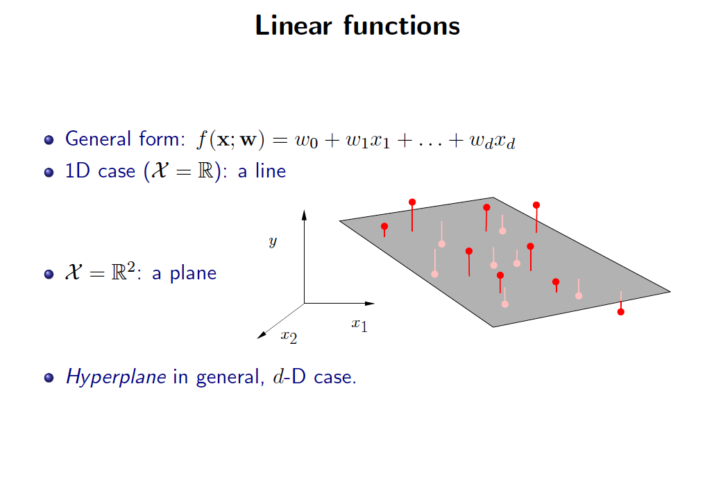
Slide Credit: Greg Shakhnarovich

Slide 18
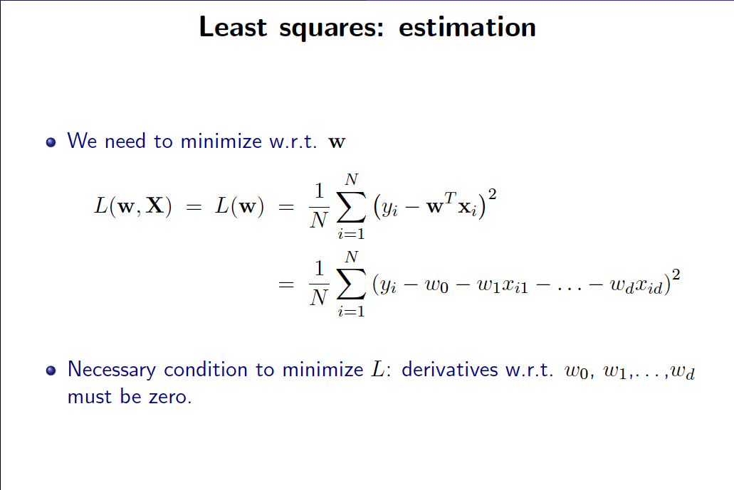
Slide Credit: Greg Shakhnarovich

Slide 19
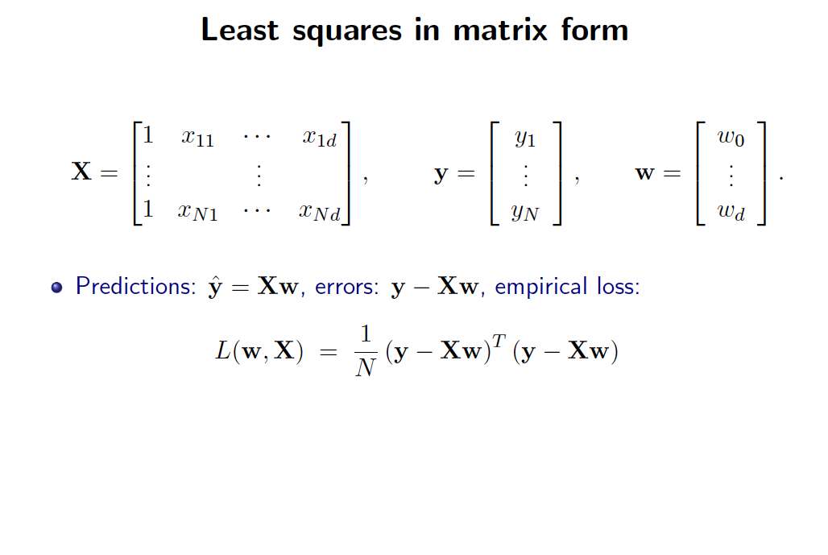
Slide Credit: Greg Shakhnarovich

Slide 20
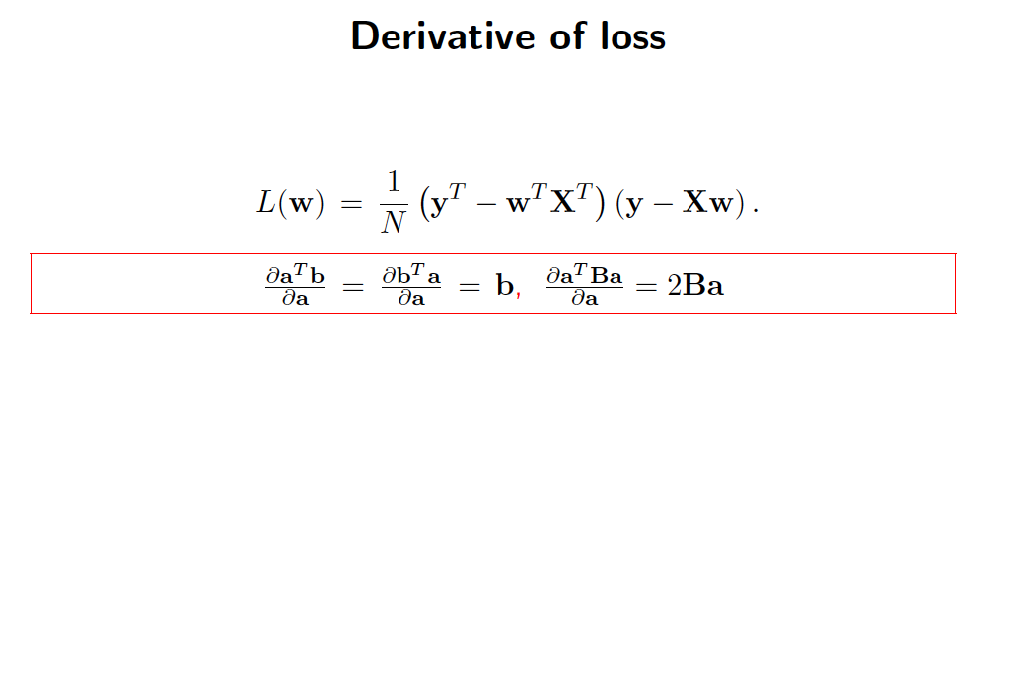
Slide Credit: Greg Shakhnarovich

Slide 21
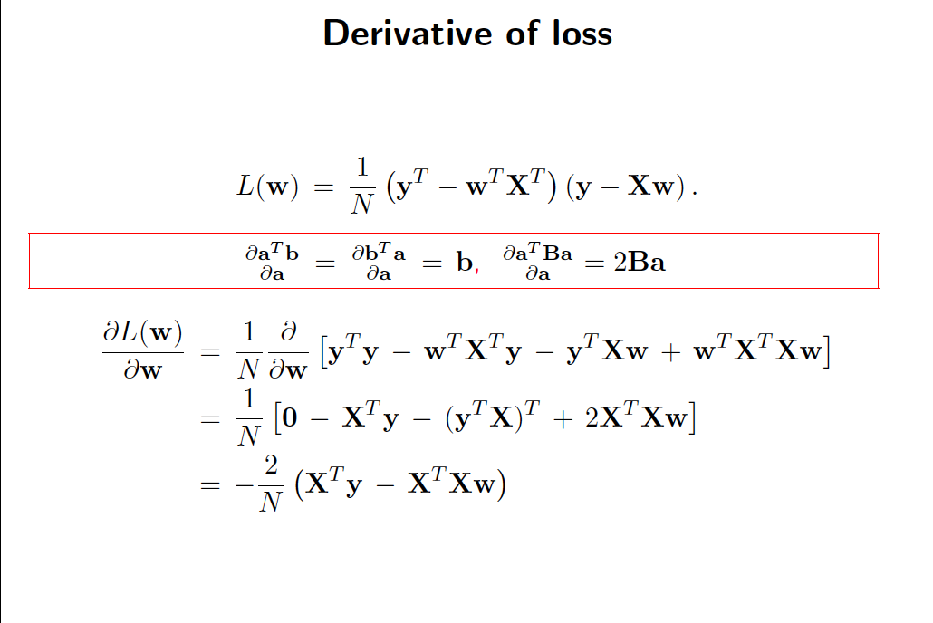
Slide Credit: Greg Shakhnarovich

Slide 22
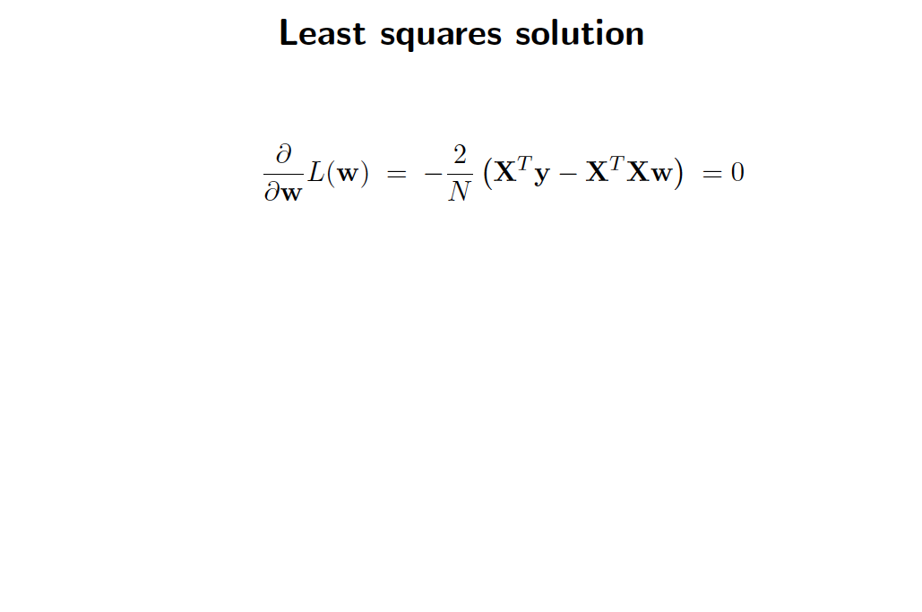
Slide Credit: Greg Shakhnarovich

Slide 23
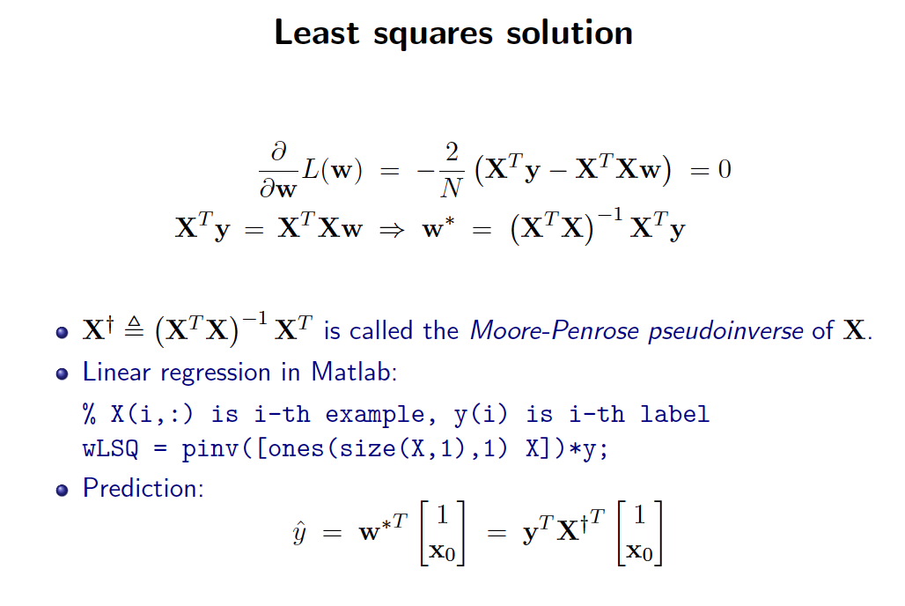
Slide Credit: Greg Shakhnarovich

Slide 24
But, why?
Why sum squared error???
Gaussians, Watson, Gaussians…

Slide 25
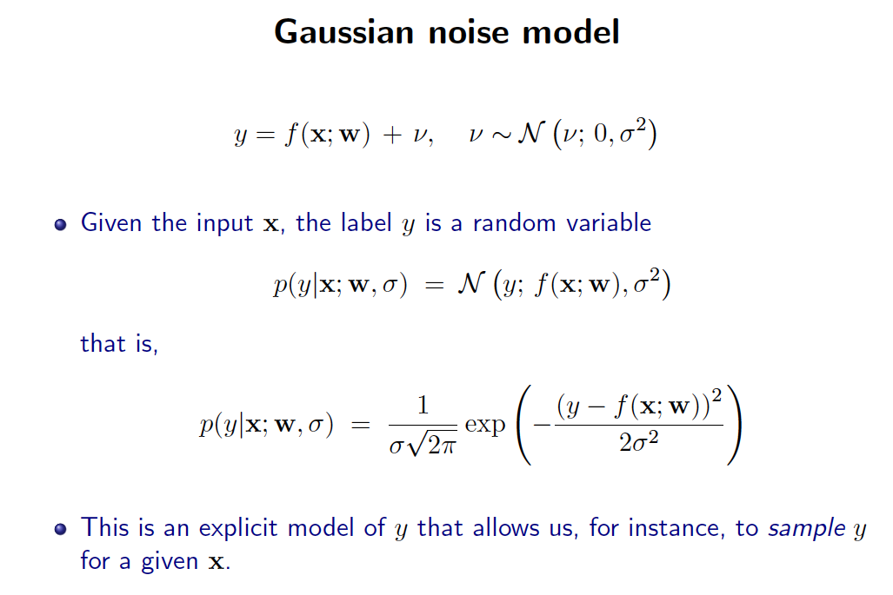
Slide Credit: Greg Shakhnarovich

Slide 26
MLE Under Gaussian Model
On board

Slide 27
Is OLS Robust?
Demo
  http://www.calpoly.edu/~srein/StatDemo/All.html
Bad things happen when the data does not come from your model!
How do we fix this?

Slide 28
Robust Linear Regression
y ~ Lap(w’x, b)
On board

