Slide 1
ECE 5984: Introduction to
Machine Learning
Topics:
  Gaussians
  (Linear) Regression
Readings: Barber 8.4, 17.1, 17.2
Dhruv Batra
Virginia Tech

Slide 2
Administrativia
HW0
  Solutions available
HW1
  Due on Sun 02/15, 11:55pm
  http://inclass.kaggle.com/c/VT-ECE-Machine-Learning-HW1
Project Proposal
  Due: Tue 02/24, 11:55 pm
  <=2pages, NIPS format

Slide 3
Recap of last time

Slide 4
Statistical Estimation
Frequentist Tool
    Maximum Likelihood
Bayesian Tools
    Maximum A Posteriori
    Bayesian Estimation

Slide 5
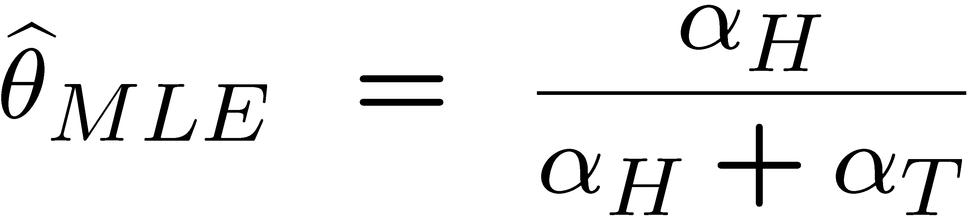
MLE
D₁ = {1,1,1,0,0,0}
D₂ = {1,0,1,0,1,0}
A function of the data ϕ(Y) is a sufficient statistic, if the following is true

Slide 6
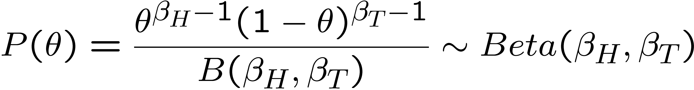
Beta prior distribution – P(θ)
Demo:
  http://demonstrations.wolfram.com/BetaDistribution/
Slide Credit: Carlos Guestrin

Slide 7
MAP for Beta distribution
MAP: use most likely parameter:
Beta prior equivalent to extra W/L matches
As N → inf, prior is “forgotten”
But, for small sample size, prior is important!
Slide Credit: Carlos Guestrin

Slide 8
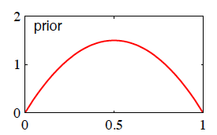
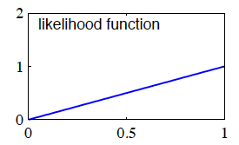
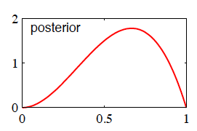
Effect of Prior
Prior = Beta(2,2)
  θ_{prior} = 0.5
Dataset = {H}
  L(θ) = θ
  θ_{MLE} = 1
Posterior = Beta(3,2)
  θ_{MAP} = (3-1)/(3+2-2) = 2/3

Slide 9
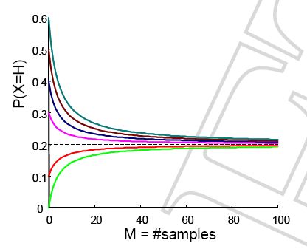
Effect of Prior
Starting from different priors

Slide 10
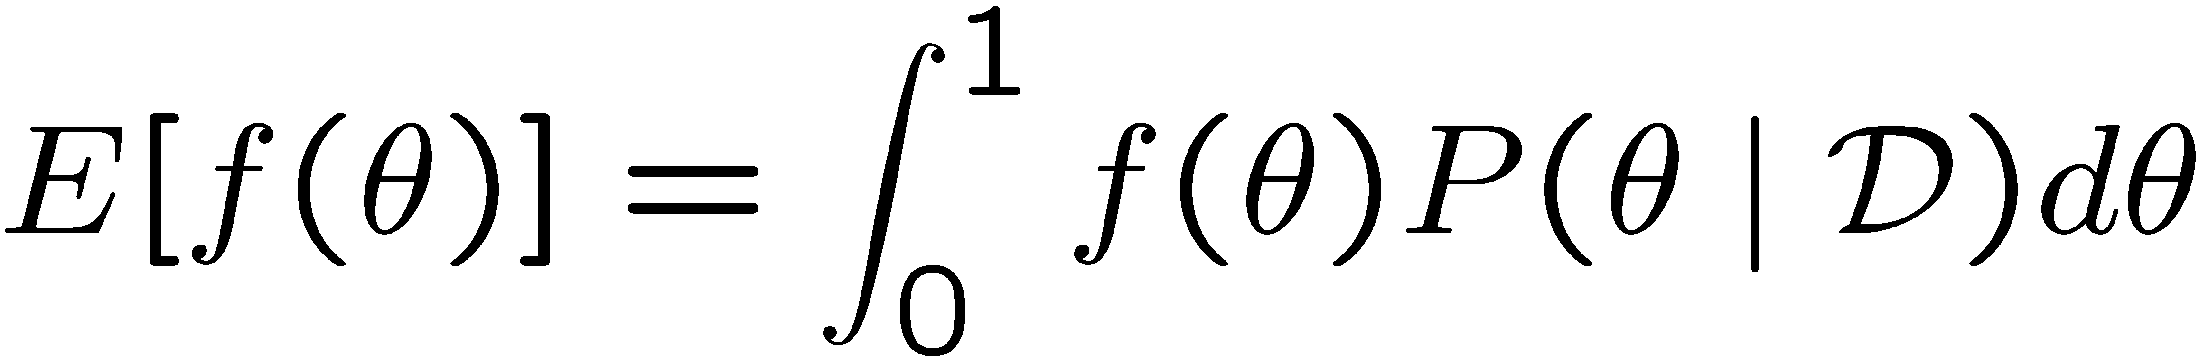
Using Bayesian posterior
Posterior distribution:
Bayesian inference:
  No longer single parameter:
  Integral is often hard to compute
Slide Credit: Carlos Guestrin

Slide 11
Bayesian learning for multinomial
What if you have a k sided coin???
Likelihood function if categorical:
Slide Credit: Carlos Guestrin

Slide 12
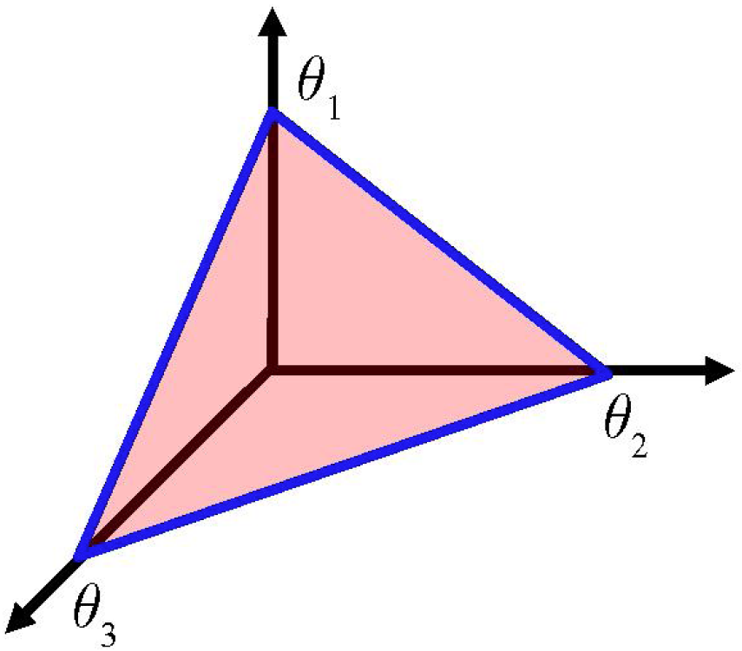

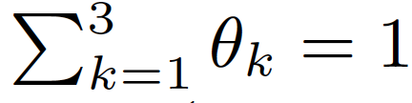
Simplex
Slide Credit: Erik Sudderth

Slide 13
Bayesian learning for multinomial
What if you have a k sided coin???
Likelihood function if categorical:
Conjugate prior for multinomial is Dirichlet:
Slide Credit: Carlos Guestrin

Slide 14
Dirichlet Probability Densities
Mean:
Mode:

Slide 15
Dirichlet Probability Densities
Matlab Demo
  Written by Iyad Obeid

Slide 16
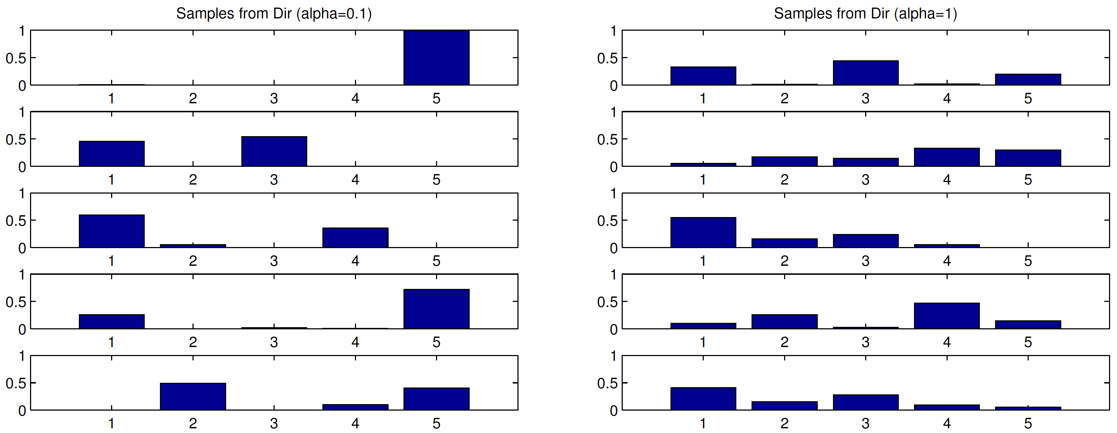
Dirichlet Samples
Slide Credit: Erik Sudderth

Slide 17
Bayesian learning for multinomial
What if you have a k sided coin???
Likelihood function if categorical:
Conjugate prior for multinomial is Dirichlet:
Observe n data points, n_{i} from assignment i, posterior:
Prediction:
Homework 1!!!! ☺

Slide 18
Plan for Today
Gaussians
  PDF
  MLE/MAP estimation of mean
Regression
  Linear Regression
  Connections with Gaussians

Slide 19
Gaussians

Slide 20
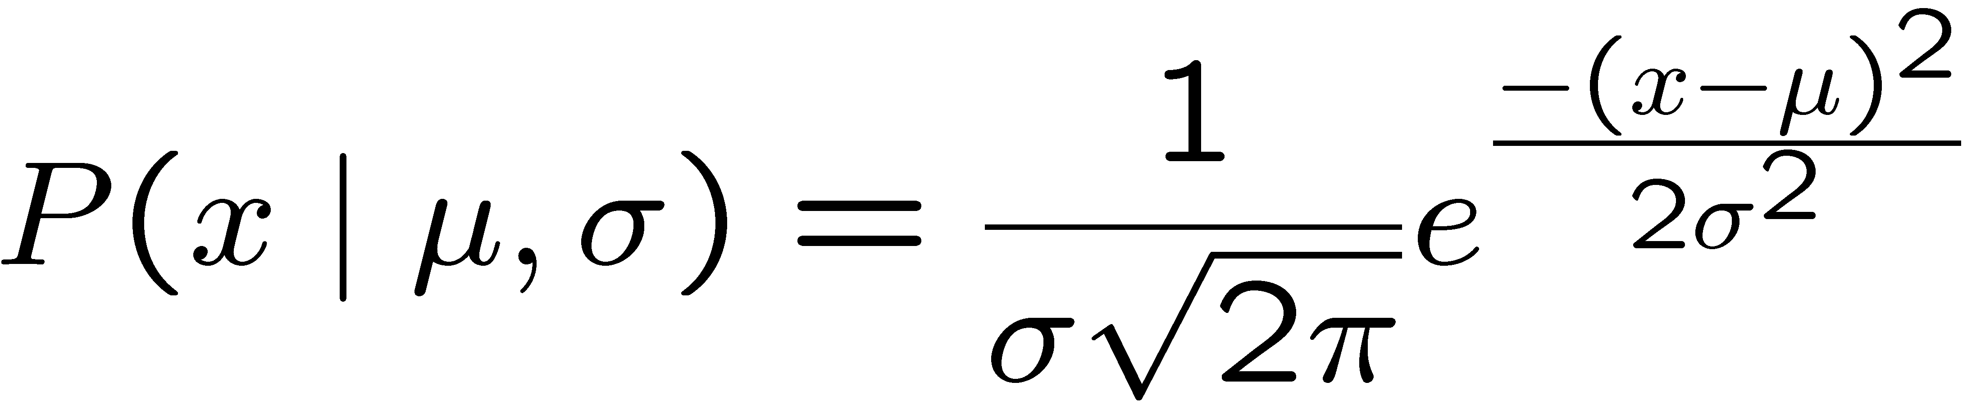
What about continuous variables?
Boss says: If I want to bet on continuous variables, like stock prices, what can you do for me?
You say: Let me tell you about Gaussians…

Slide 21
Why Gaussians?
Why does the entire world seem to always be telling you about Gaussian?
  Central Limit Theorem!

Slide 22
Central Limit Theorem
Simplest Form
  X₁, X₂,…, X_{N} are IID random variables
  Mean μ, variance σ²
  Sample mean S_{N} approaches Gaussian for large N
Demo
  http://www.stat.sc.edu/~west/javahtml/CLT.html

Slide 23
Curse of Dimensionality
Consider: Sphere of radius 1 in d-dims
Consider: an outer ε-shell in this sphere
What is ?

Slide 24
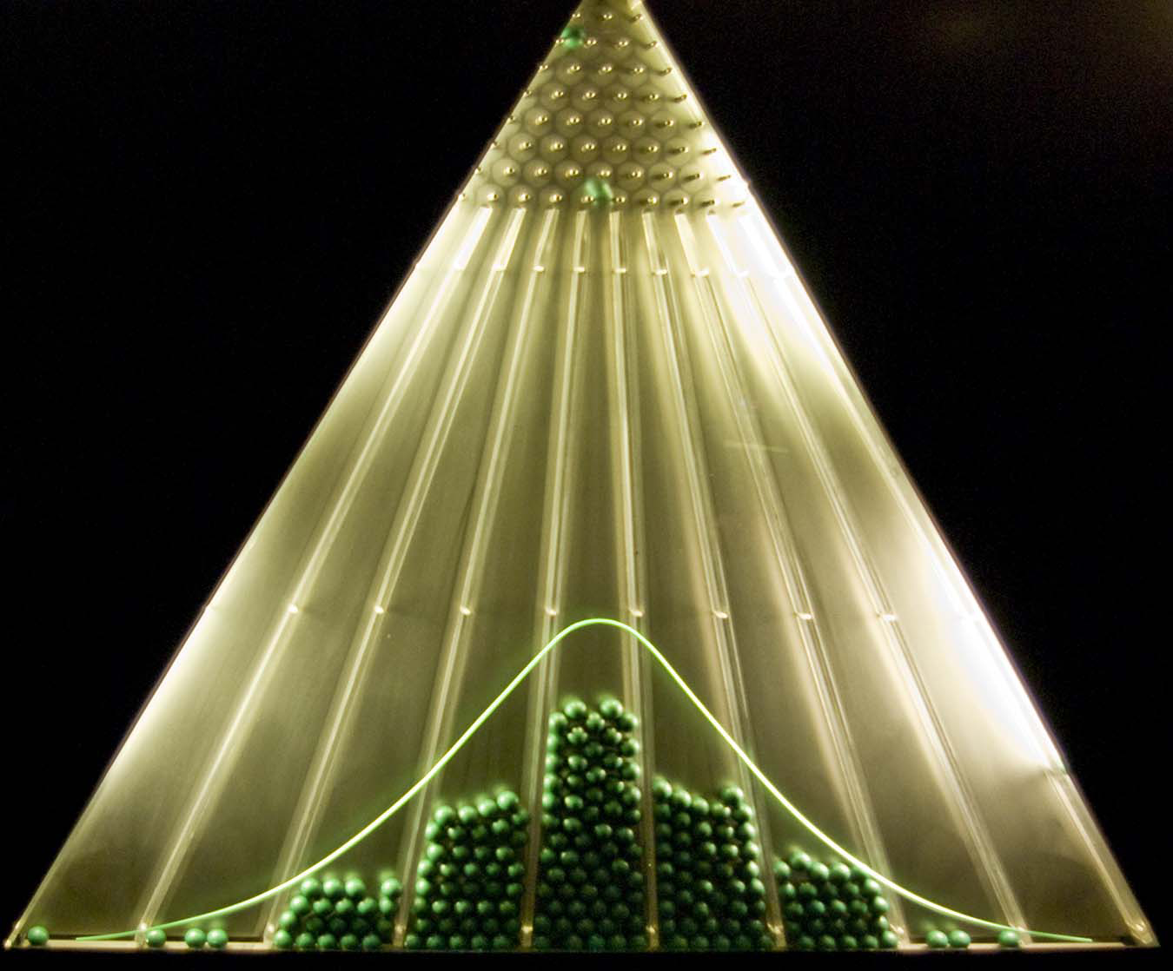
Image Credit: http://en.wikipedia.org/wiki/Bean_machine

Slide 25
Why Gaussians?
Why does the entire world seem to always be harping on about Gaussians?
  Central Limit Theorem!
  They’re easy (and we like easy)
  Closely related to squared loss (will see in regression)
  Mixture of Gaussians are sufficient to approximate many distributions (will see it clustering)

Slide 26
Some properties of Gaussians
Affine transformation
  multiplying by scalar and adding a constant
  X ~ N(μ,σ²)
  Y = aX + b → Y ~ N(aμ+b,a²σ²)
Sum of Independent Gaussians
  X ~ N(μ_{X},σ²_{X})
  Y ~ N(μ_{Y},σ²_{Y})
  Z = X+Y → Z ~ N(μ_{X}+μ_{Y}, σ²_{X}+σ²_{Y})

Slide 27
Learning a Gaussian
Collect a bunch of data
  Hopefully, i.i.d. samples
  e.g., exam scores
Learn parameters
  Mean
  Variance

Slide 28
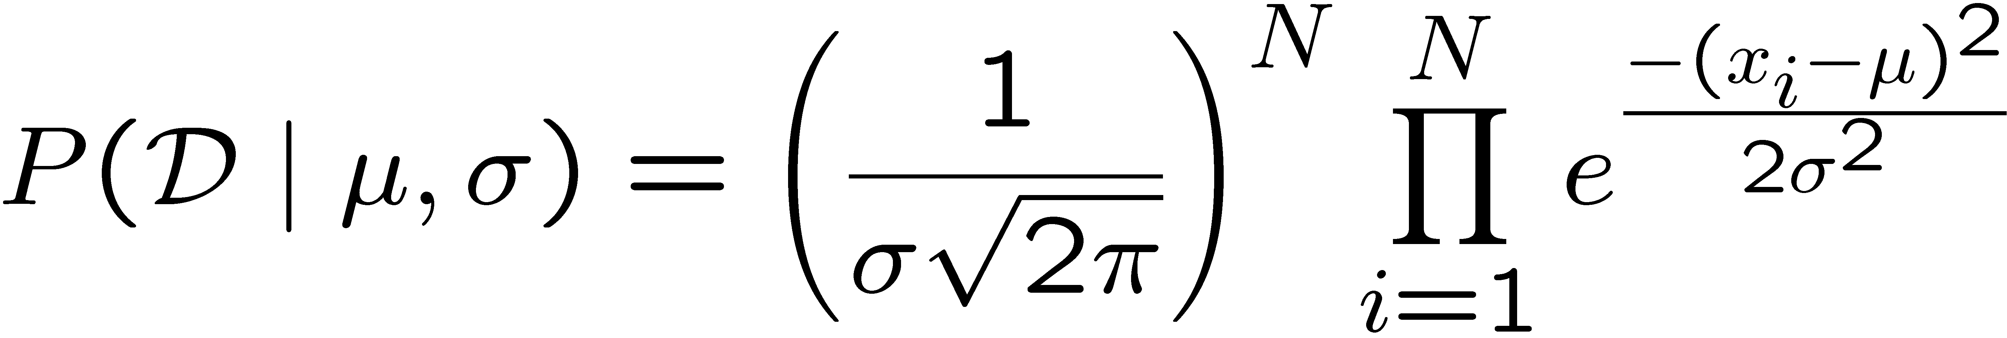
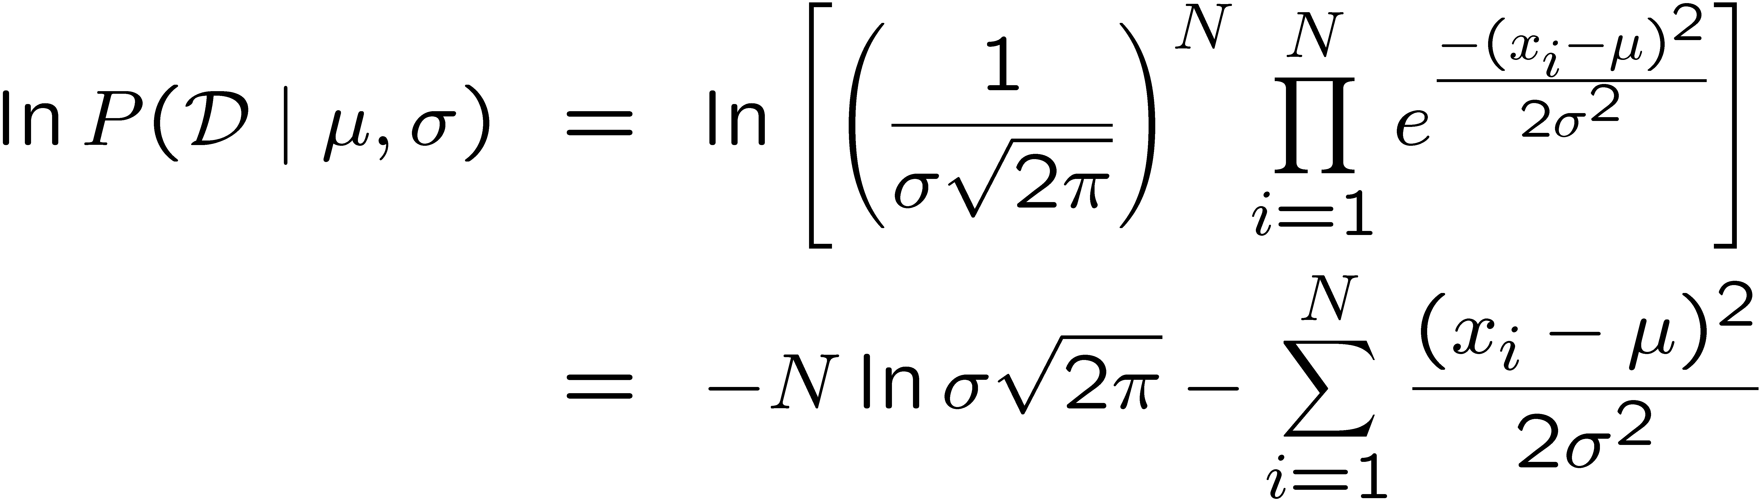
MLE for Gaussian
Prob. of i.i.d. samples D={x₁,…,x_{N}}:
Log-likelihood of data:
Slide Credit: Carlos Guestrin

Slide 29
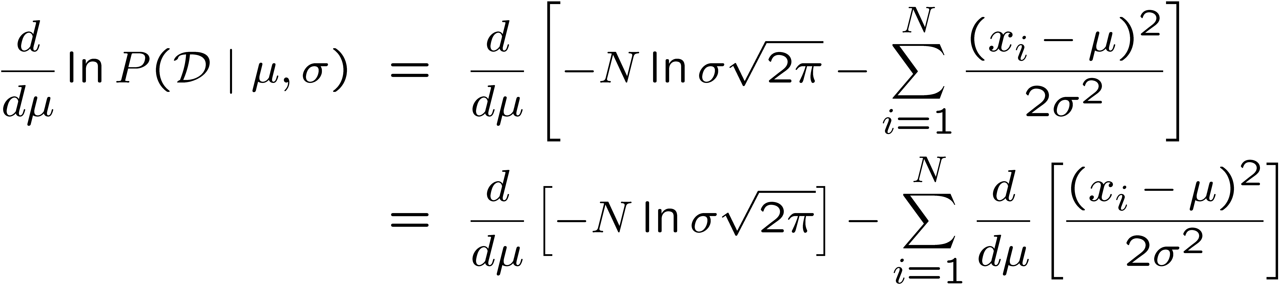
Your second learning algorithm:
MLE for mean of a Gaussian
What’s MLE for mean?
Slide Credit: Carlos Guestrin

Slide 30
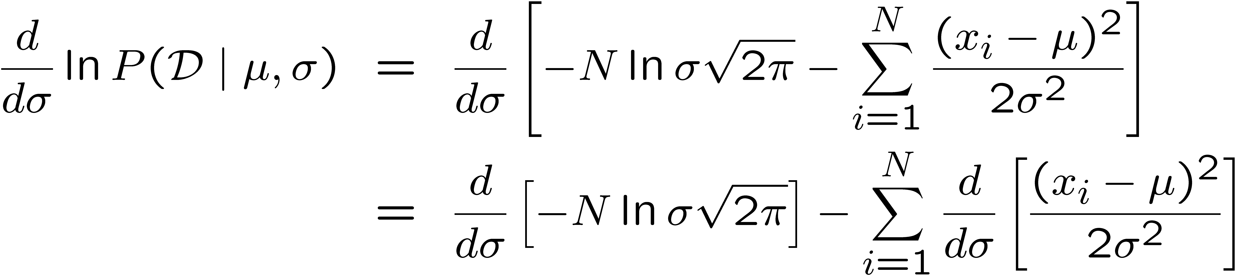
MLE for variance
Again, set derivative to zero:
Slide Credit: Carlos Guestrin

Slide 31
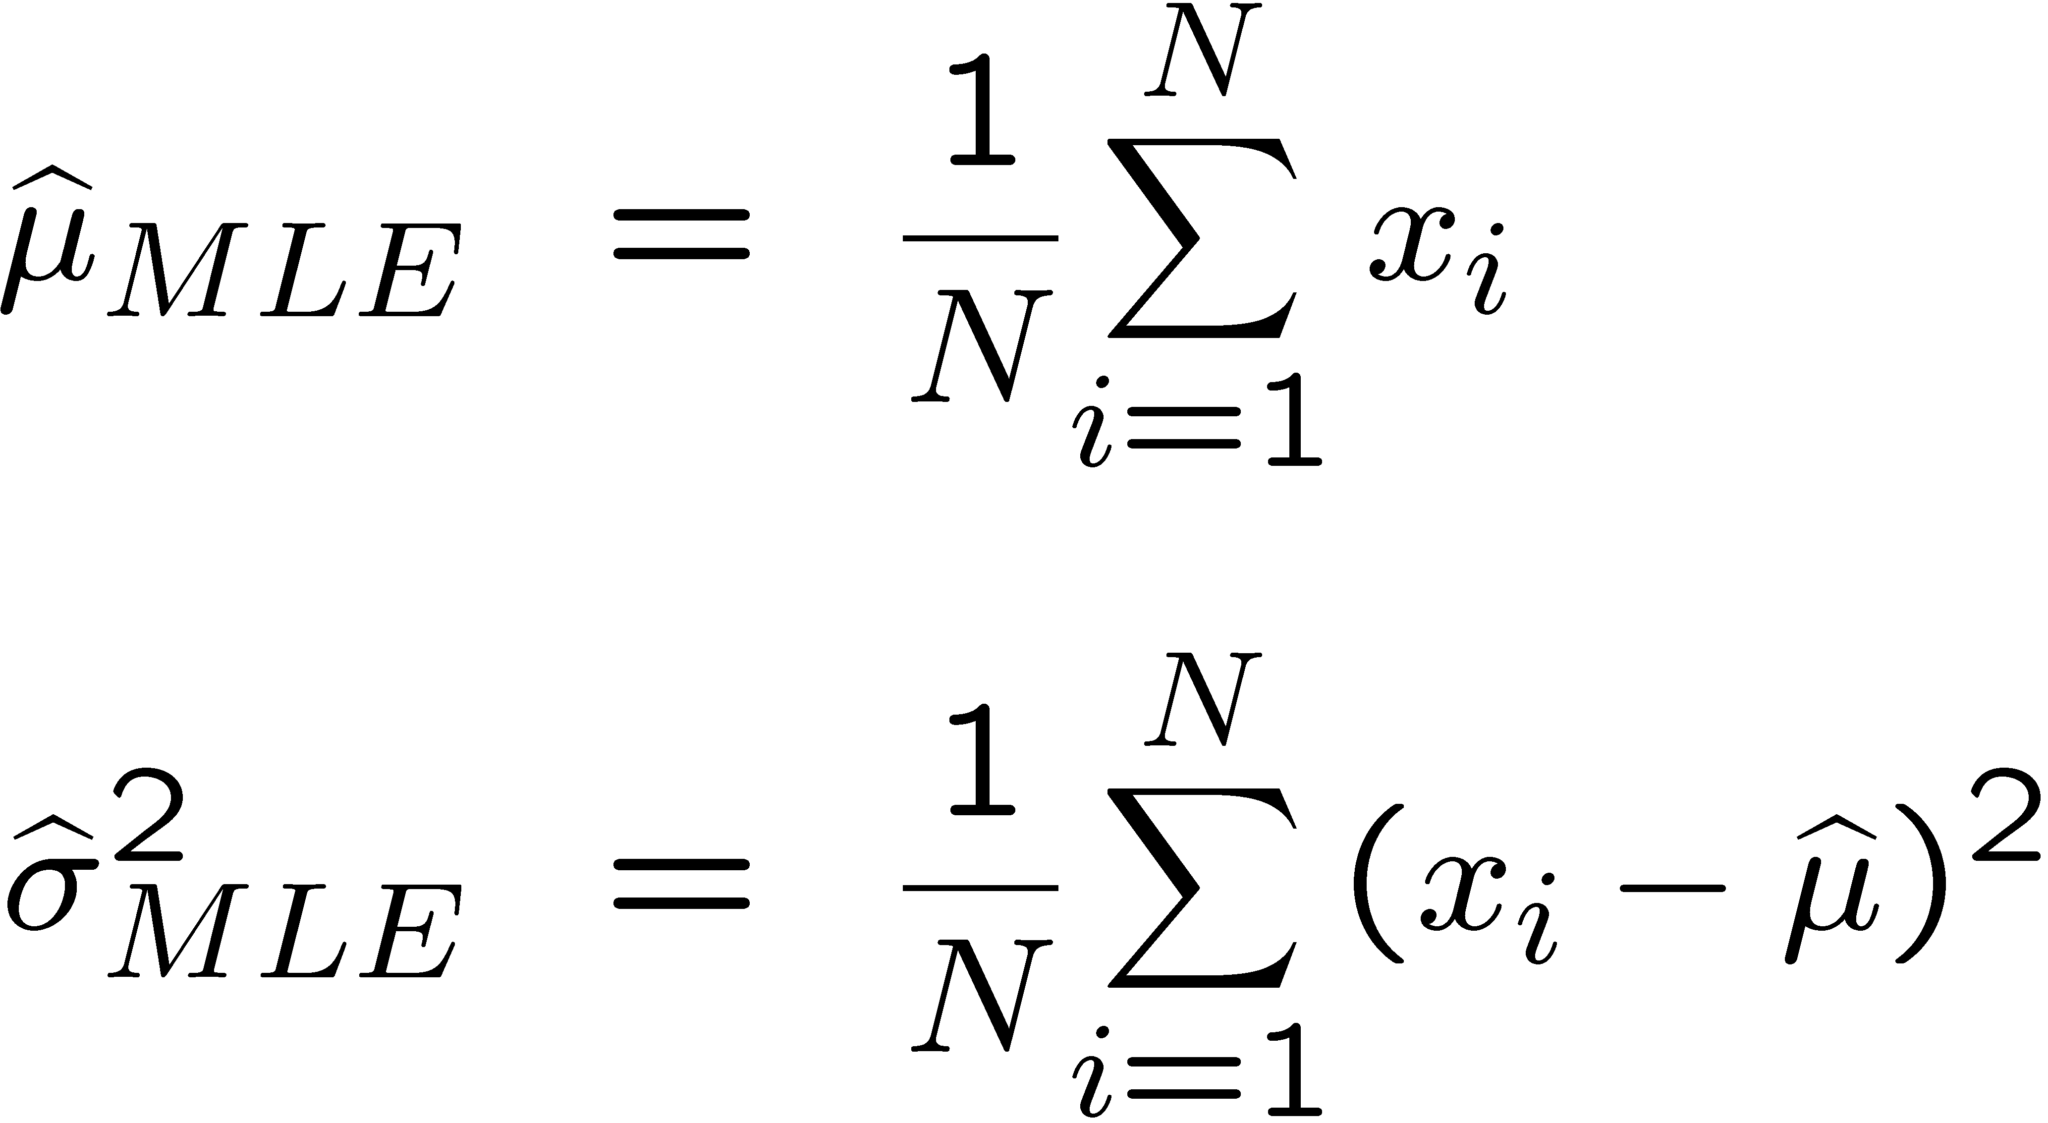
Learning Gaussian parameters
MLE:

Slide 32
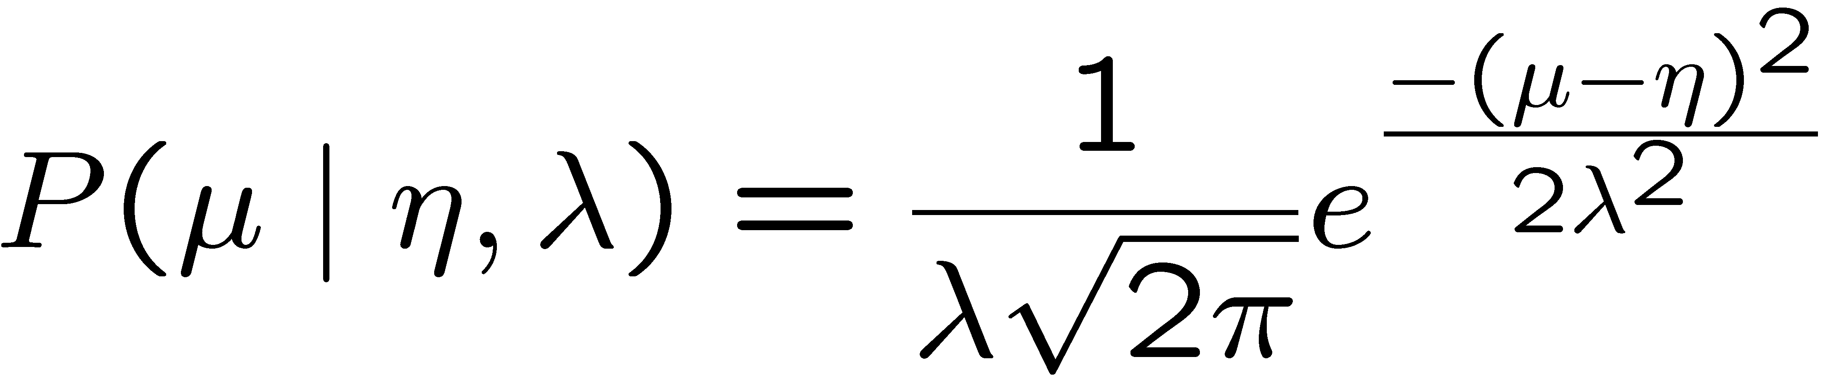
Bayesian learning of Gaussian parameters
Conjugate priors
  Mean: Gaussian prior
  Variance: Inverse Gamma or Wishart Distribution
Prior for mean:
Slide Credit: Carlos Guestrin

Slide 33
MAP for mean of Gaussian
Slide Credit: Carlos Guestrin

Slide 34
New Topic: Regression

Slide 35
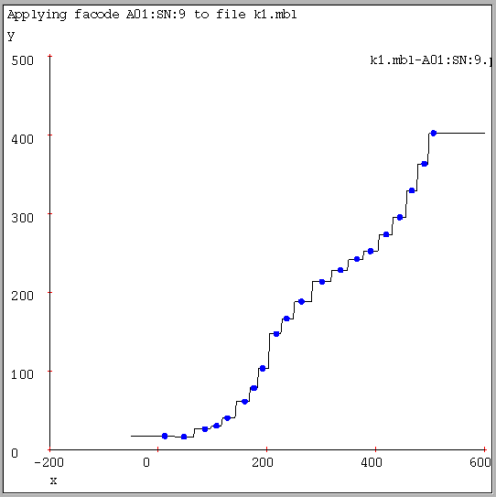
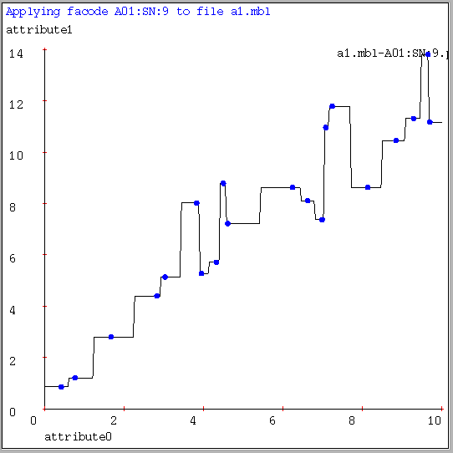
1-NN for Regression
Often bumpy (overfits)
Figure Credit: Andrew Moore

Slide 36
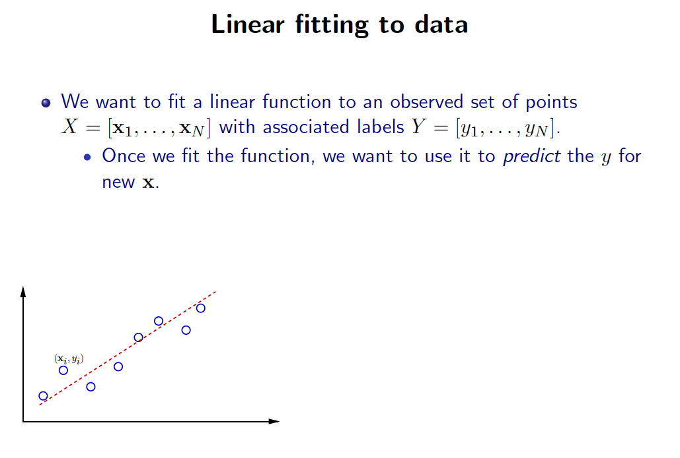
Slide Credit: Greg Shakhnarovich

Slide 37
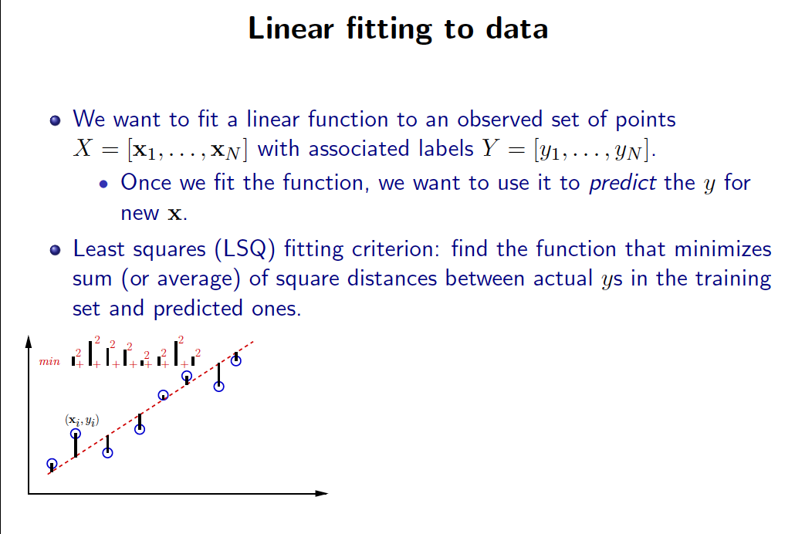
Slide Credit: Greg Shakhnarovich

Slide 38
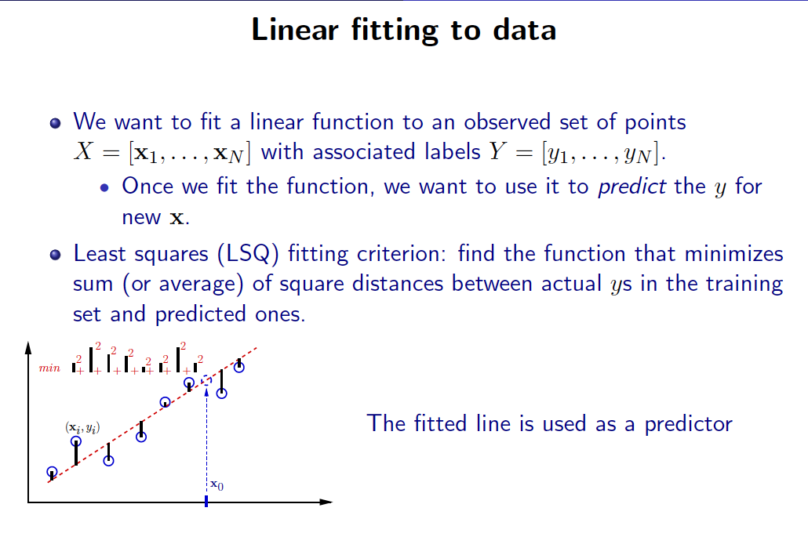
Slide Credit: Greg Shakhnarovich

Slide 39
Linear Regression
Demo
  http://hspm.sph.sc.edu/courses/J716/demos/LeastSquares/LeastSquaresDemo.html

Slide 40
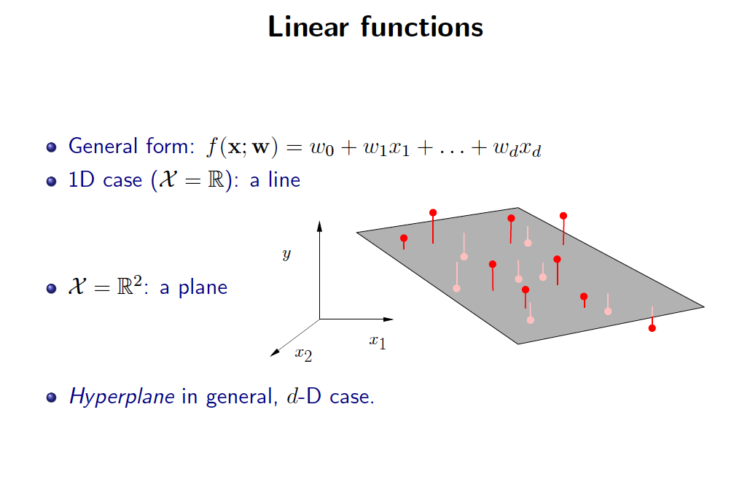
Slide Credit: Greg Shakhnarovich

Slide 41
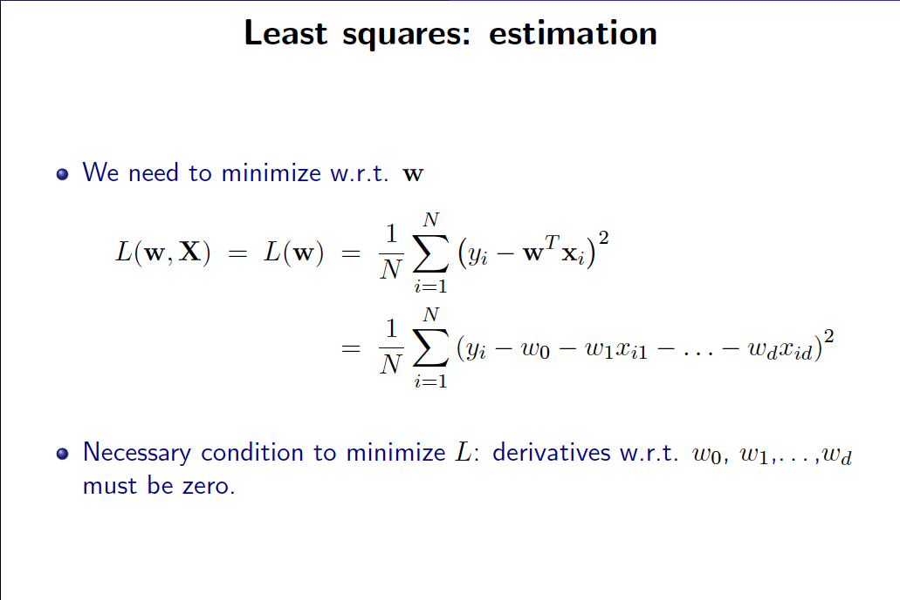
Slide Credit: Greg Shakhnarovich

Slide 42
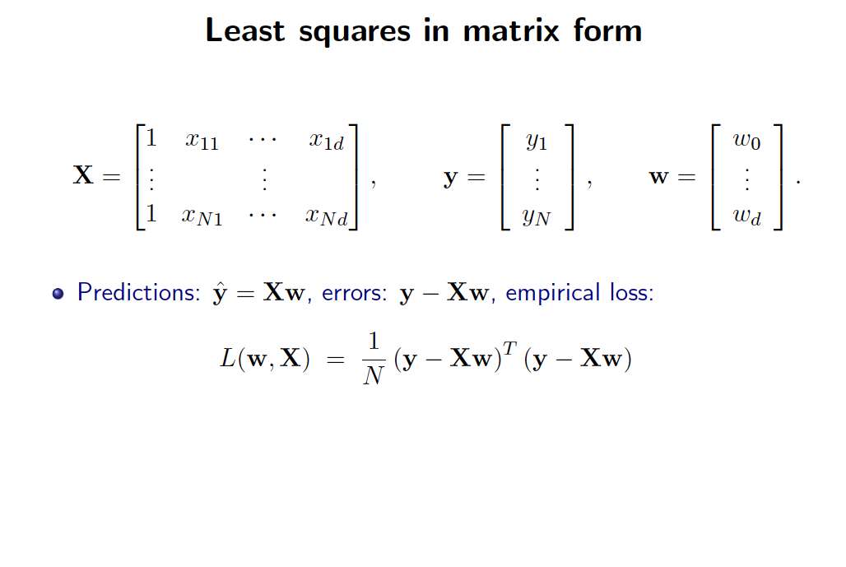
Slide Credit: Greg Shakhnarovich

