Slide 1
ECE 5984: Introduction to Machine Learning
Topics:
SVM
Lagrangian Duality
SVM dual & kernels
Readings: Barber 17.5
Dhruv Batra
Virginia Tech

Slide 2
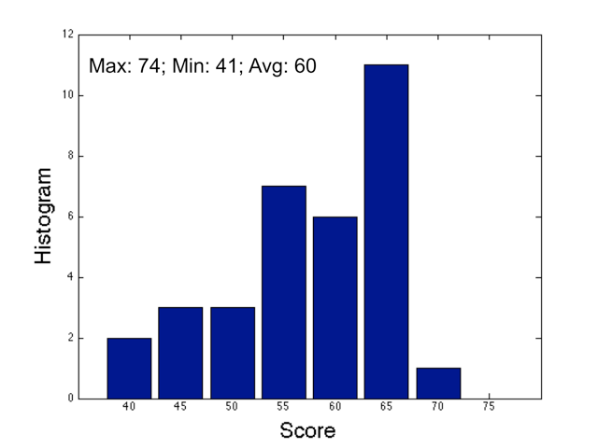
HW1 Graded
Mean 60/55 = 109%

Slide 3
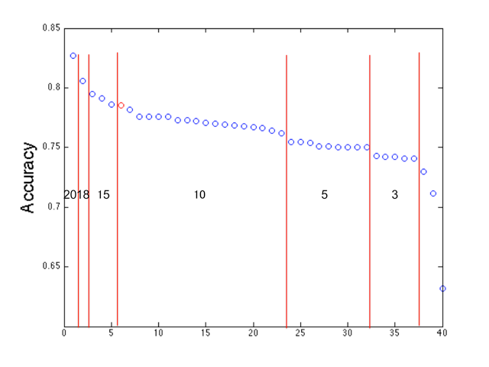
HW1 Extra Credit Distribution

Slide 4
Administrativia
HW2
Due: Friday 03/06, 03/15, 11:55pm
Implement linear regression, Naïve Bayes, Logistic Regression
Solutions available
Kaggle discussion:
http://inclass.kaggle.com/c/2015-Spring-vt-ece-machine-learning-hw2

Slide 5
Administrativia
Mid-term
Solutions available
Feedback on Midterm Exam?
Too hard? Too easy? Just right?
Too long? Too short?

Slide 6
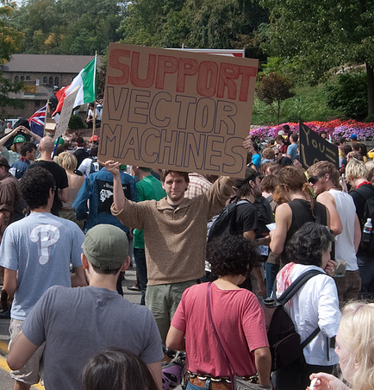
Recap of Last Time

Slide 7
Image Courtesy: Arthur Gretton

Slide 8
Image Courtesy: Arthur Gretton

Slide 9
Image Courtesy: Arthur Gretton

Slide 10
Image Courtesy: Arthur Gretton

Slide 11
Image Courtesy: Arthur Gretton

Slide 12
Generative vs. Discriminative
Generative Approach (Naïve Bayes)
Estimate p(x|y) and p(y)
Use Bayes Rule to predict y
Discriminative Approach
Estimate p(y|x) directly (Logistic Regression)
Learn “discriminant” function f(x) (Support Vector Machine)

Slide 13
Linear classifiers – Which line is better?
w.x = ∑_{j} w^{(j)} x^{(j)}

Slide 14
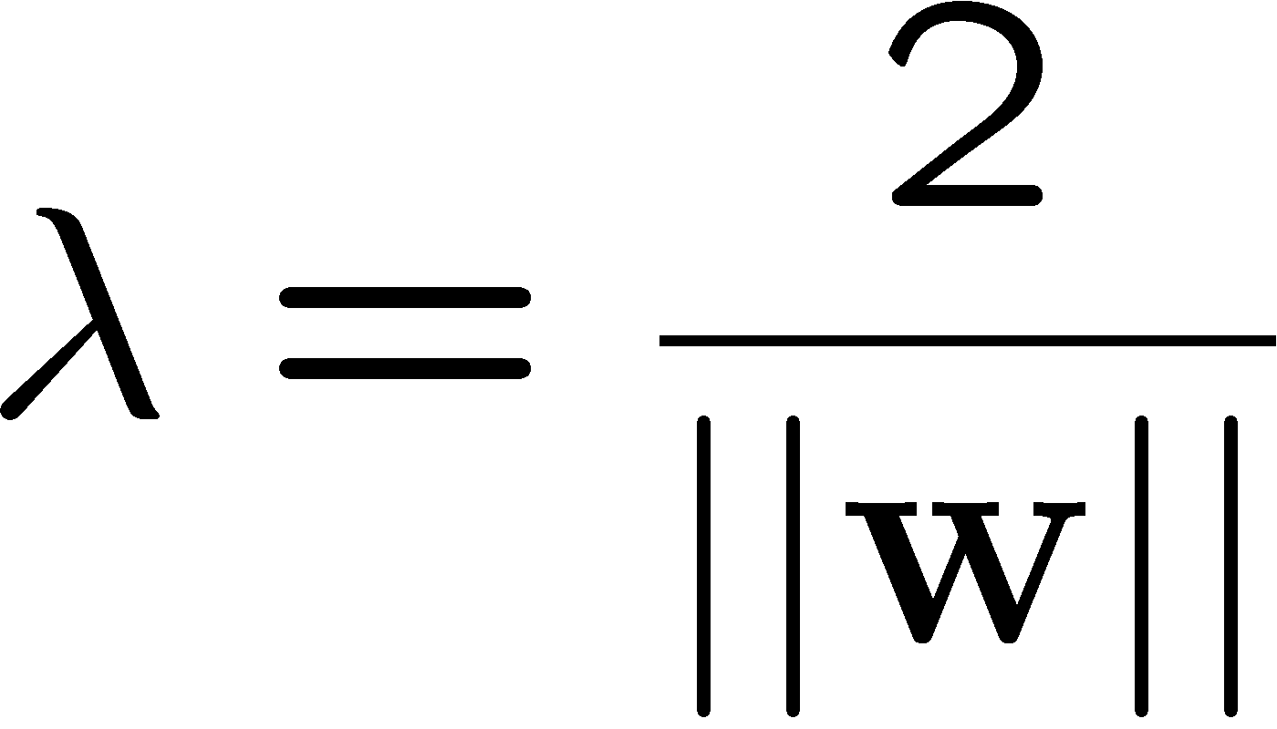
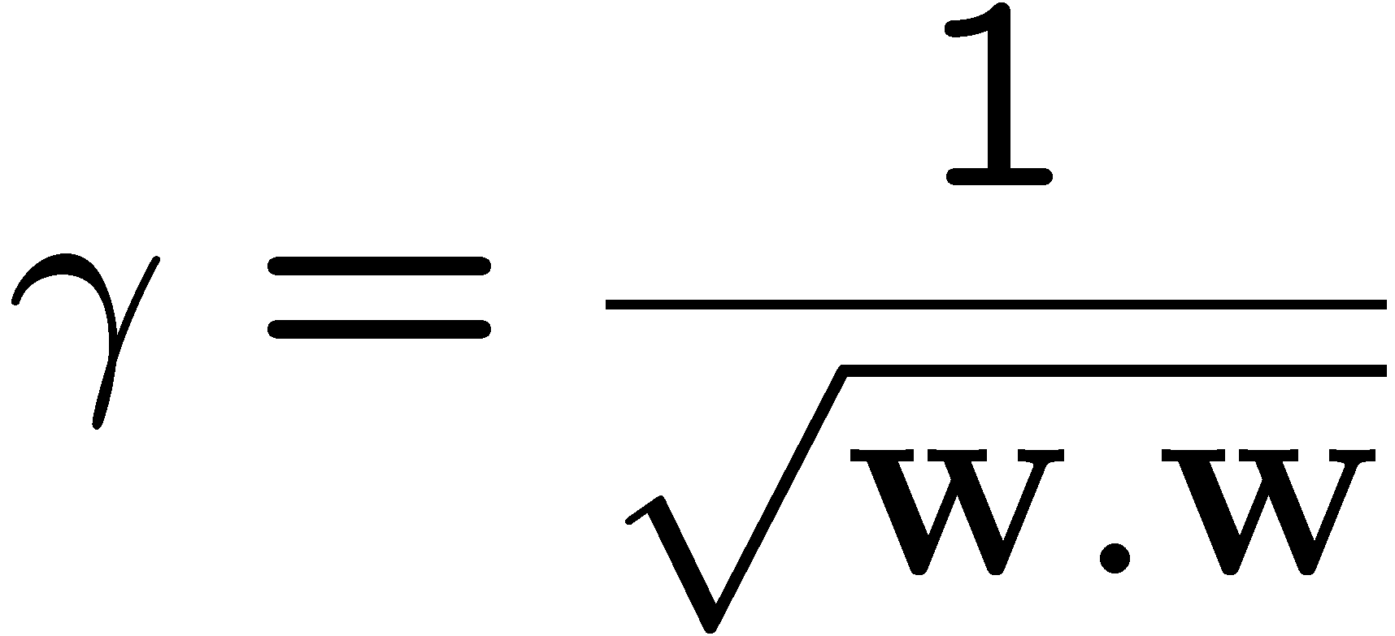
Margin
w.x + b = +1
w.x + b = 0
w.x + b = -1
x⁺
x⁻
margin 2γ
Slide Credit: Carlos Guestrin

Slide 15
Support vector machines (SVMs)
w.x + b = +1
w.x + b = 0
w.x + b = -1
Solve efficiently by quadratic programming (QP)
Well-studied solution algorithms
Hyperplane defined by support vectors
margin 2γ
Slide Credit: Carlos Guestrin

Slide 16
What if the data is not linearly separable?
Slide Credit: Carlos Guestrin

Slide 17
What if the data is not linearly separable?
Minimize w.w and number of training mistakes
0/1 loss
Slack penalty C
Not QP anymore
Also doesn’t distinguish near misses and really bad mistakes
Slide Credit: Carlos Guestrin

Slide 18
Slack variables – Hinge loss
If margin >= 1, don’t care
If margin < 1, pay linear penalty
Slide Credit: Carlos Guestrin

Slide 19
Soft Margin SVM
Effect of C
Matlab demo by Andrea Vedaldi

Slide 20
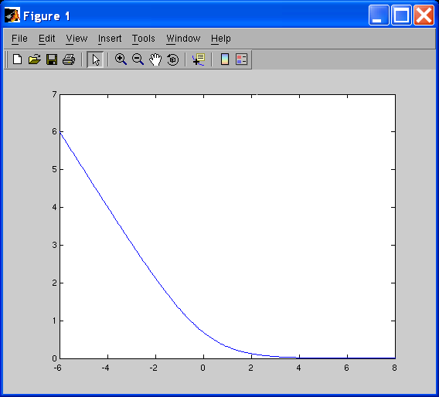
Side note: What’s the difference between SVMs and logistic regression?
SVM:
Logistic regression:
Log loss:
SVM: Hinge Loss
LR: Logistic Loss
Slide Credit: Carlos Guestrin

Slide 21
Slide Credit: Andrew Moore

Slide 22
Slide Credit: Andrew Moore

Slide 23
Slide Credit: Andrew Moore

Slide 24
Does this always work?
In a way, yes
Slide Credit: Blaschko & Lampert

Slide 25
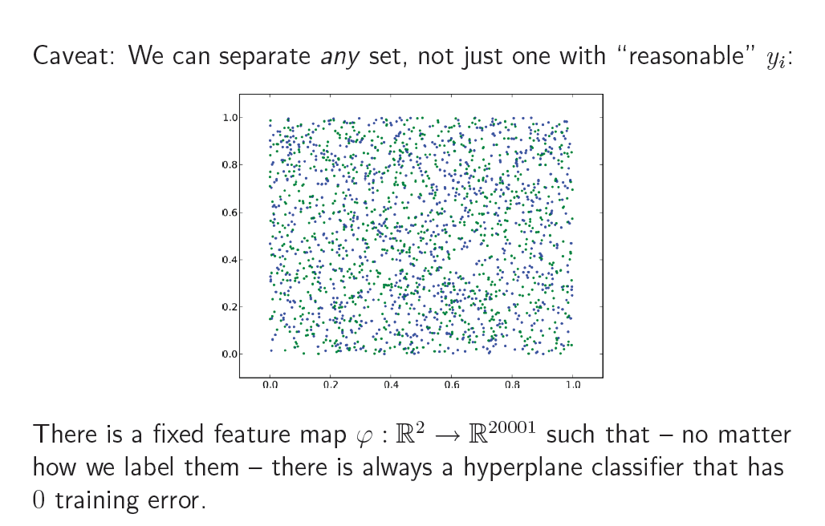
Caveat
Slide Credit: Blaschko & Lampert

Slide 26
Kernel Trick
One of the most interesting and exciting advancement in the last 2 decades of machine learning
The “kernel trick”
High dimensional feature spaces at no extra cost!
But first, a detour
Constrained optimization!
Slide Credit: Carlos Guestrin

Slide 27
Constrained Optimization
Lagrangian Multiplier Method
min f(w)
st h(w) = 0
Define Lagrangian

Slide 28
Intuition
Image Credit: Wikipedia

Slide 29
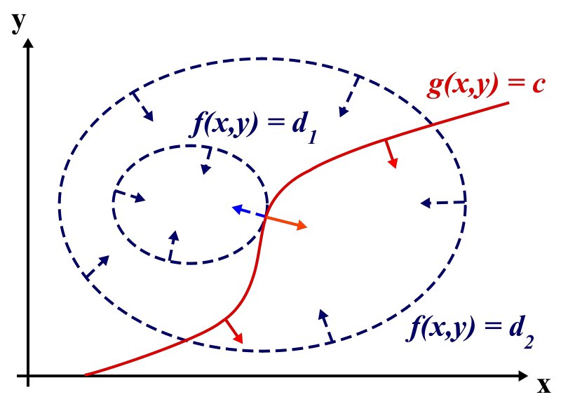
Intuition
Image Credit: Wikipedia

Slide 30
Lagrangian Duality
On paper

