Slide 1
Style and Content
By: Kevin Yu
Ph.D. in Computer Engineering
Notes:
Hello today I will talk about style and content in computer vision

Slide 2
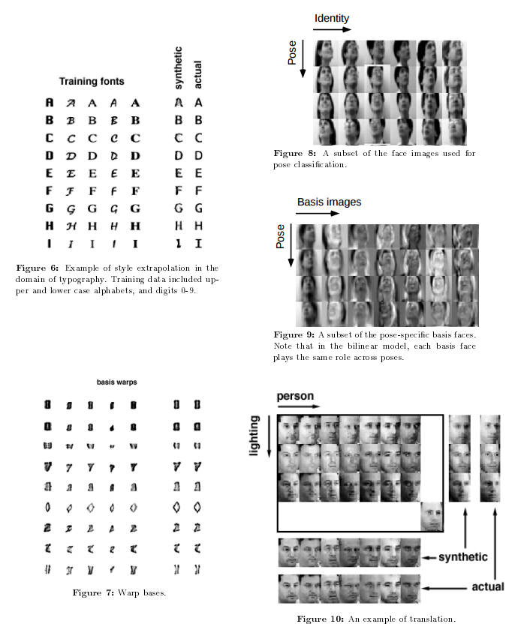
Background of Style and Content
Started off with letters and faces (W. T. Freeman, J. B. Tenenbaum 1996)
Font and the character separation
Face pose and identity separation
Notes:
Initially style and content started off with the simple task of separating a letter with the font that was used for it. In 1997 Freeman and Tenenbaum came out with a paper called, “Learning Bilinear Models for Two-Factor Problems in Vision.” The authors were able to separate the letter from the font and also able to do some separation for faces as well. For letters the authors were able to differentiate between the letter and the font and they were able to generate their own synthetic letters. The authors were also able to differentiate the pose, identity, and lighting for human faces. Once they did this they were also able to create synthetic faces shown in the bottom right.
http://www.merl.com/publications/docs/TR96-37.pdf

Slide 3
High-level Style and Content Manipulation
Goal
Transfer style from one image to another image
Texture transformation : low-level == Style transfer : high-level
Edge detectors, etc. find low-level features
CNN’s are used for high-level features
Notes:
In the work introduced by Freeman and Tenenbaum they were able to use low-level features to create the separation between the style and content. However this is more along the lines of texture transformation instead of style transformation. To truly extract the style of an image you have to use the

Slide 4
A Neural Algorithm of Artistic Style
Deep image representation
VGG Networks
Content representation
Training a CNN on object recognition
Style representation
Style content is obtained using a Gram matrix
Style transfer
Notes:
Image Style Transfer Using Convolutional Neural Networks
Deep Image Representation: The authors use 16 convolutional layers and 5 pooling layers out of the 19-layer VGG network.
Content Representation: High-level content can be obtained from higher layers in the convolutional neural network. At the higher levels of CNN’s you start to become invariant to the precise appearance of the image. Loss function: minimize the squared error loss between the synthesized image and the original image.
Style Representation: Using a Gram matrix we are able to obtain the similarity of two images. The Gram matrix of the neural activations can be seen as the minimization of a specific Maximum Mean Discrepancy. The end goal is to match Gram matrices of the features in the CNN layers. The paper “Demystifying Neural Style Transfer” is a good paper that shows the exact derivation of the Gram matrix into a Maximum Mean Discrepancy and is able to show more on why a Gram matrix is able to show style of an image. Loss function: minimize the squared error loss between the synthesized image and the original image.

Slide 5
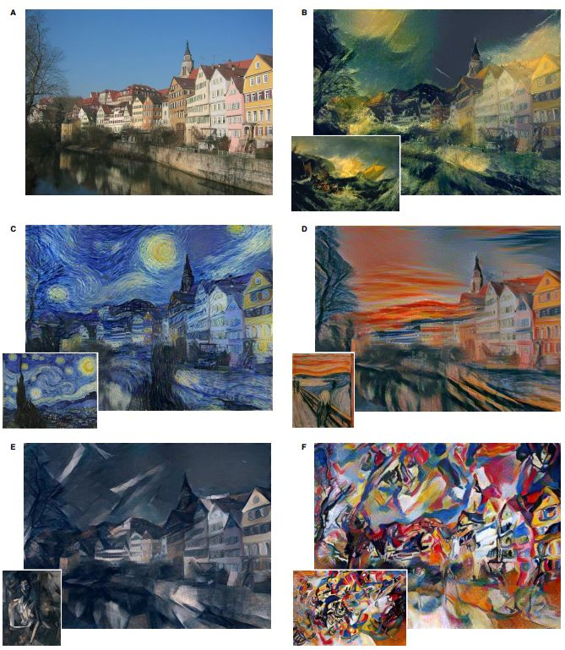
Style Transfer
The content of A is kept while the style of each subimage is implemented on the initial A image.
Below is the loss function they minimize.
Notes:
This slide will show you the overall outputs of many of the experiments that the authors did. They used different alpha over beta values to get these synthesized images. For B: 1e-3, C:8e-4, D: 5e-3, E&F:5e-4.

Slide 6
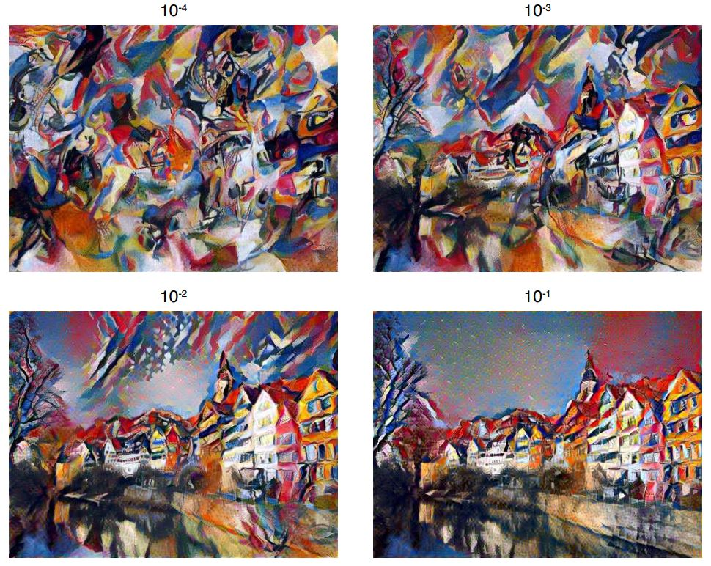
Tradeoffs
Linear combination of loss functions
Resolution is proportional to the speed of the style transfer
Notes:
By having a linear combination of both the loss functions for the content representation and the style representation we can see that there is a direct relationship between either having a synthesized image that has more content or a synthesized image that has more style. Also in this paper the author has an algorithm that doesn’t perform very fast so they also stated that the resolution of the image directly affects the speed of the algorithm.

Slide 7
Initial Conclusion
Content and Style are easily separable using CNN’s
We are able to synthesize an image with the content and style of two separate images
The process is currently slow due to the speed of the algorithm
Notes:
For the first paper that talked about many of the main points within content and style transformation the authors didn’t mainly focus on making the algorithm work fast or having very high quality images at the end, but in the next two papers that I will talk about we will be able to see some of the interesting ways that researchers are able to speed up the algorithm or are able to give higher quality.

Slide 8
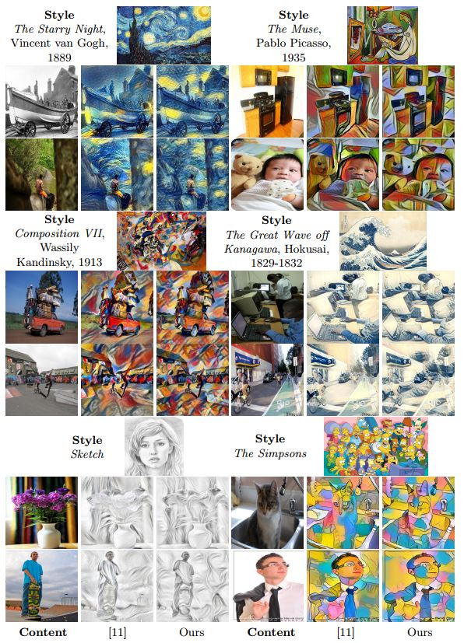
Using Feed-Forward Image Transformation
Three orders of magnitude faster
Using perceptual loss
Notes:
Feedforward image transformation allows us to obtain information on what someone can do right in the future. In image processing that means being able to correctly obtain information that will allow us to implement something right in the future. This is often in contrast to what has been done in the past for the image processing and to increase speed of style and content transformation the authors of the second paper use feed-forward convolutional neural networks to quickly obtain results.
Perceptual loss is better for fine details and edges

Slide 9
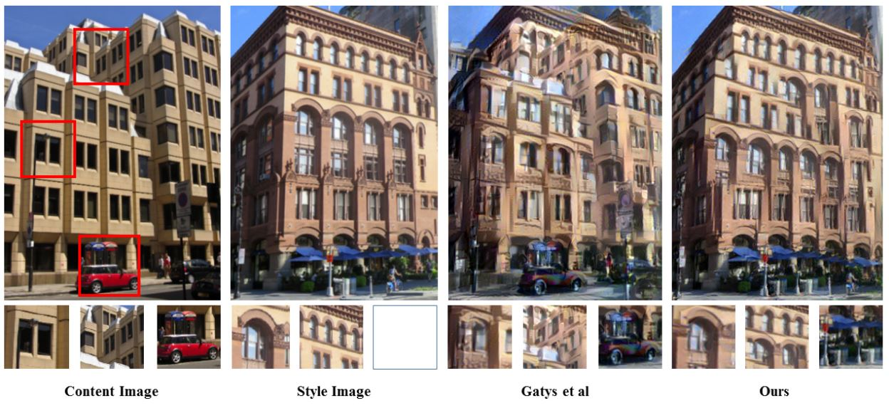
Adding Markov Random Fields
Increased quality of images
Notes:
In the third paper that was listed by C. Li and M. Wand the authors focused on getting better quality out of a synthesized image. Their paper works with Markov Random Fields to get the most relevant statistical dependencies in an image. They do this by considering local image patches of k by k pixels.
By using Markov Random Fields the authors are able to maintain some of the local image statistics, but they also implement some high-level constraints as to also keep the global image statistic. Without these high level constraints the image would end up as a jumble and not like the original content image.

Slide 10
Conclusion
Improvements on texture and content transformation
Feed-Forward CNN’s == Faster synthesis
Markov Random Fields == Higher quality synthesis
Notes:
Overall we are able to look at content and style transformation as the expansion or evolution of content and texture transformation. Initially with texture transformation you would use low-level features of one image and content of another image and synthesize a new image, but with style transformation we use high-level features of one image and content of another image to create a new image.

