Slide 1
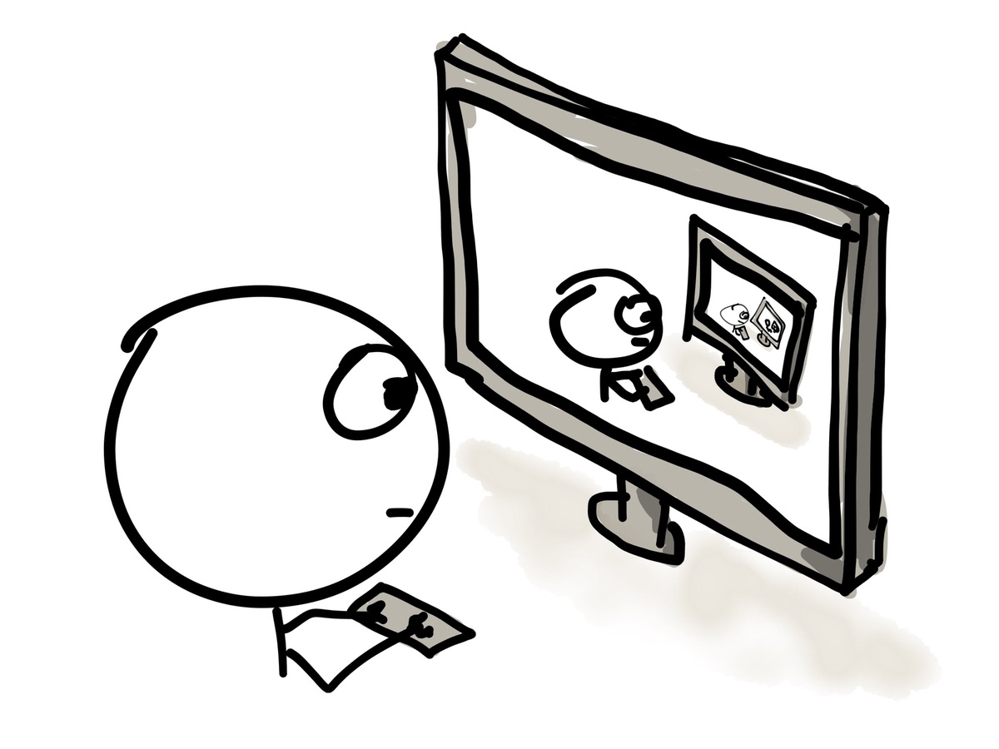
Understanding
Recurrent Neural Networks
Vikram Chandrashekar
Credits:
http://colah.github.io/posts/2015-08-Understanding-LSTMs/
Slides from Andrej Karpathy
Cartoon pictures from internet – unknown authors
Xkcd comics

Slide 2
Why is memory important?

Slide 3
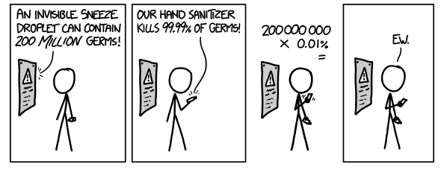
How do we understand these?
John yelled at Mary.
→ But Mary could not hear him.

Slide 4
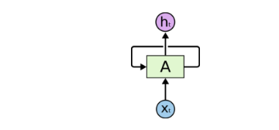
RNN
Simple neural network
rnn
http://colah.github.io/posts/2015-08-Understanding-LSTMs/

Slide 5
Unenrolled RNN

Slide 6
Long term dependency
I had visited New York last week. Saw Manhattan and central park…..
…….
……..
It is really crowded in there.

Slide 7
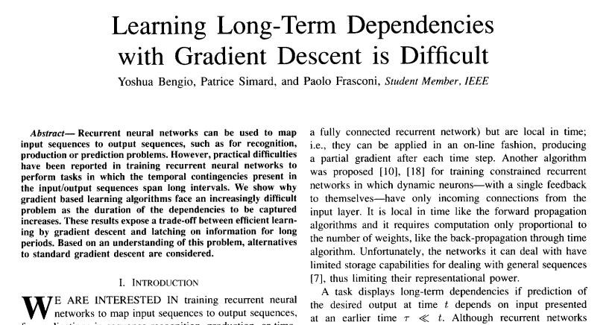
How long?

Slide 8
Long Short Term Memory Networks

Slide 9
LSTM Networks

Slide 10
Inside LSTM
C<t-1>
C<t>
it
ot
ft
C’t
h<t-1>
h<t>

Slide 11
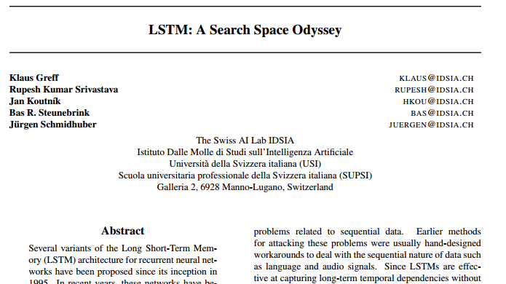
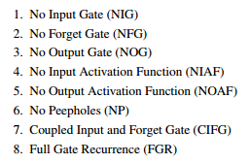
Variants

Slide 12
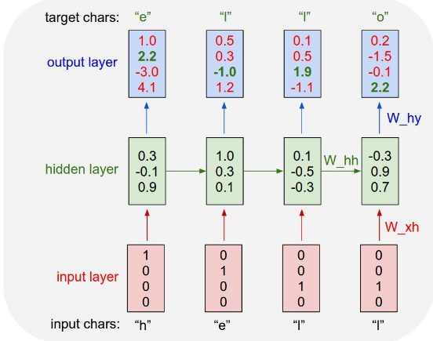
Training and sampling
H
E
L
O
H
E
L
O
H
E
L
O
H
E
L
O
H
E
L
O
H
E
L
O
H
E
L
O
H
E
L
O

Slide 13
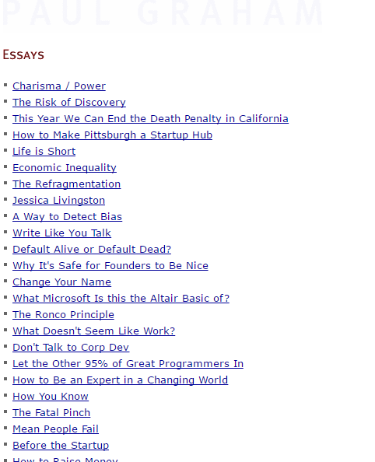
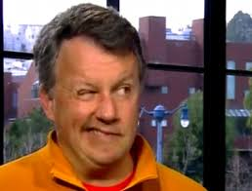
Applications
I did not write that !!

Slide 14
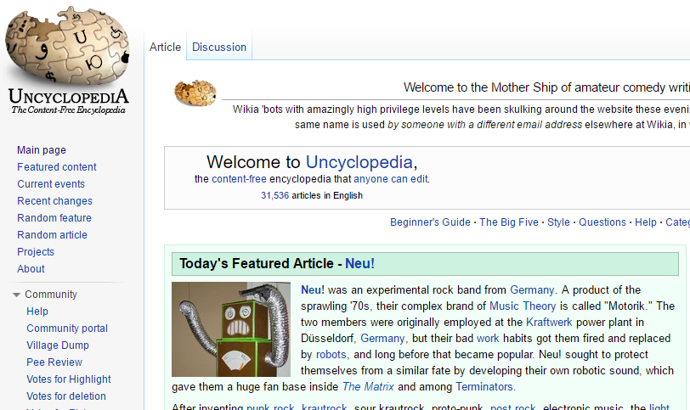
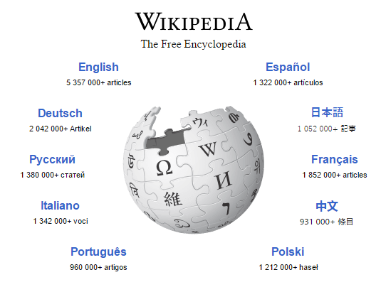
Applications
Naturalism and decision for the majority of Arab countries' capitalide was grounded by the Irish language by [[John Clair]], [[An Imperial Japanese Revolt]], associated with Guangzham's sovereignty. His generals were the powerful ruler of the Portugal in the [[Protestant Immineners]], which could be said to be directly in Cantonese
Communication, which followed a ceremony and set inspired prison, training. The emperor travelled back to [[Antioch, Perth, October 25|21]] to note, the Kingdom
of Costa Rica, unsuccessful fashioned the [[Thrales]], [[Cynth's Dajoard]], known in western [[Scotland]], near Italy to the conquest of India with the conflict.
Copyright was the succession of independence in the slop of Syrian influence that was a famous German movement based on a more popular servicious, non-doctrinal
and sexual power post. Many governments recognize the military housing of the [[Civil Liberalization and Infantry Resolution 265 National Party in Hungary]],
that is sympathetic to be to the [[Punjab Resolution]](PJS)[http://www.humah.yahoo.com/guardian.
cfm/7754800786d17551963s89.htm Official economics Adjoint for the Nazism, Montgomery
was swear to advance to the resources for those Socialism's rule,
was starting to signing a major tripad of aid exile.]]

Slide 15
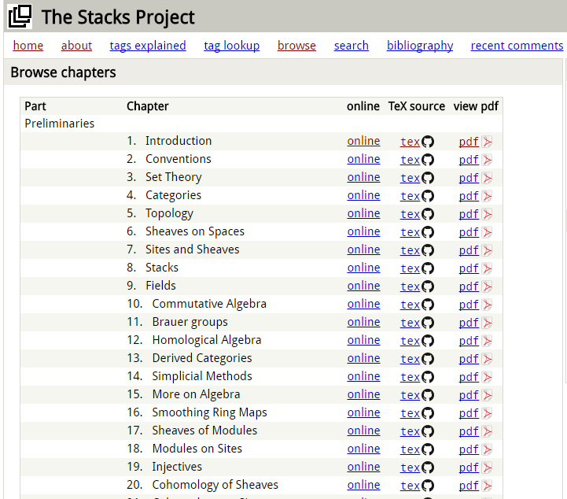
Applications

Slide 16
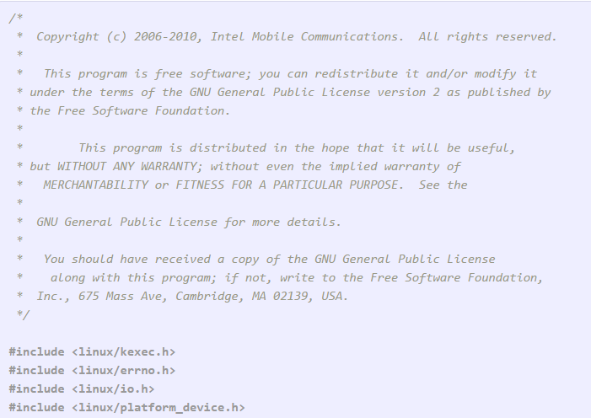
Applications

Slide 17
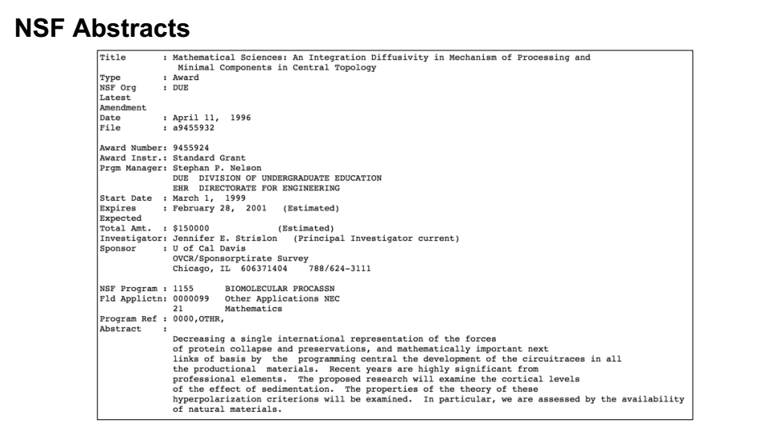
Applications

Slide 18
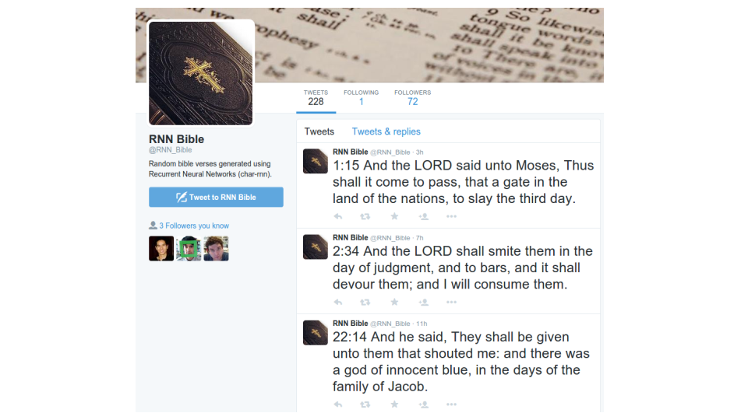
Applications

Slide 19
Applications

Slide 20
Garble → sentences

Slide 21
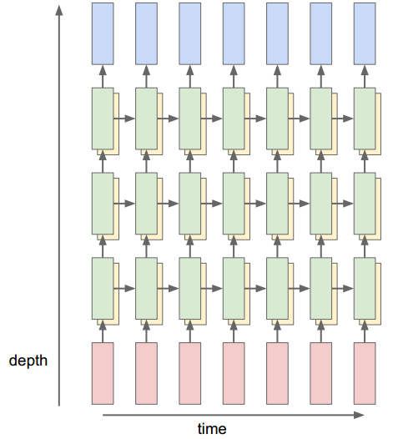
Visualizing RNN working

Slide 27
URL cell

Slide 28
Performance comparison:
LSTM vs n-gram

Slide 29
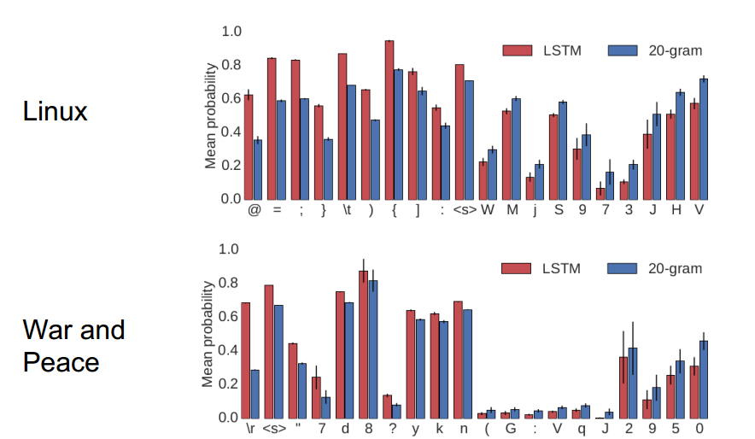
LSTM vs n-gram
LSTM outperforms n-gram in predicting longer memory context characters

Slide 30
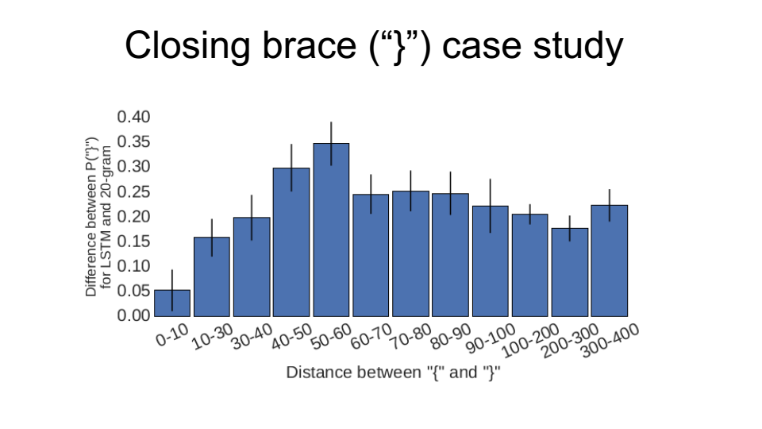
LSTM outperforms n-gram in predicting opening and closing braces for code

Slide 31
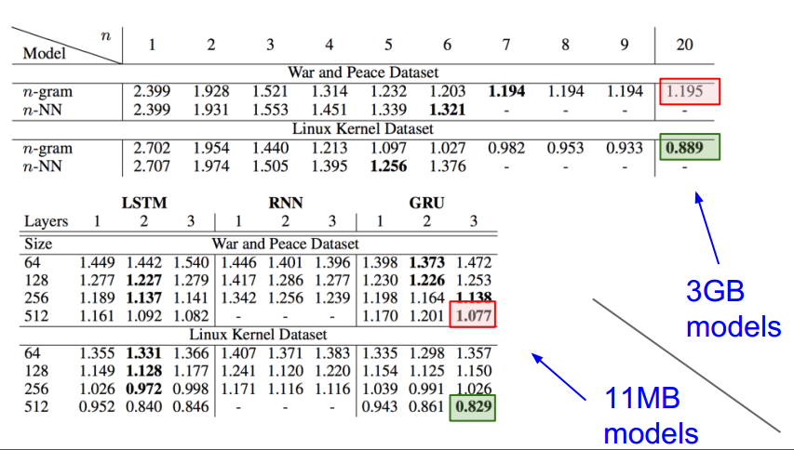
Quantitative analysis
LSTM with smaller footprint can give comparable performance as bigger n-gram

Slide 32
Improvements
18% errors

Slide 33
Improvements
18% errors
6% errors

Slide 34
Improvements
18% errors
6% errors
9% errors

Slide 35
Improvements
18% errors
6% errors
9% errors
37% errors

Slide 36
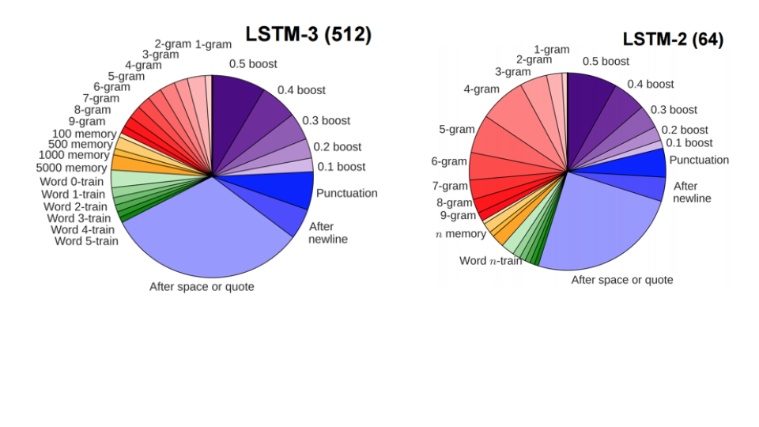
Improvements

