Slide 1
Active Perception
Jia-Bin Huang
Virginia Tech
ECE 6554 Advanced Computer Vision

Slide 2
Today’s class
Review action recognition
Topic presentation by Shruti
Paper discussion
Kevin (“for” discussion lead)
Ashish (“against” discussion lead)
Next lecture: Group of objects by Jia-Bin

Slide 3
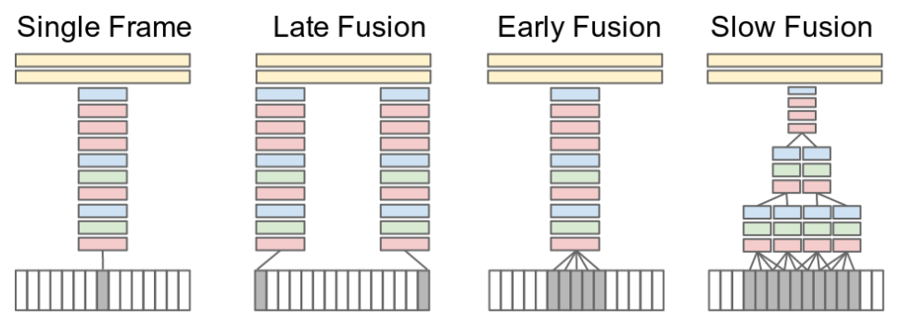
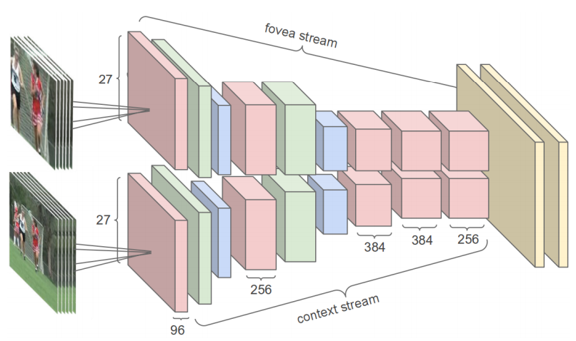
Large-scale Video Classification with Convolutional Neural Networks, CVPR 2014

Slide 4
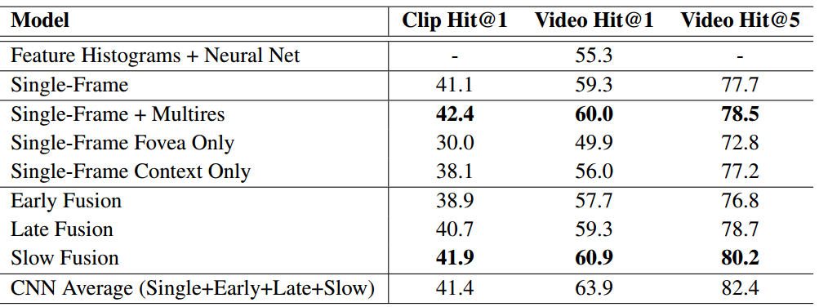
Large-scale Video Classification with Convolutional Neural Networks, CVPR 2014

Slide 5
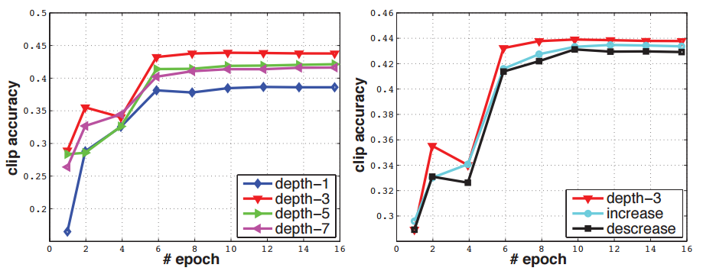
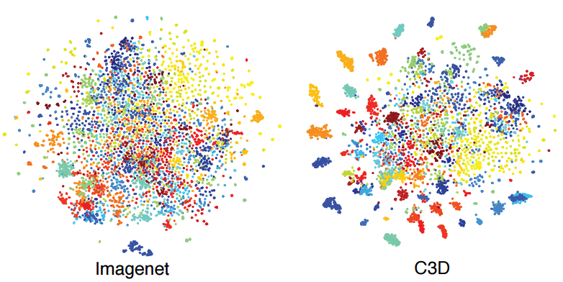
Learning Spatiotemporal Features with 3D Convolutional Networks, ICCV 2015

Slide 6
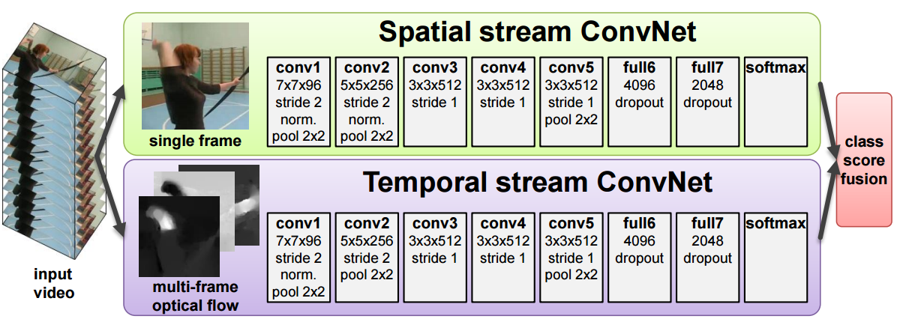
Two-Stream Convolutional Networks for Action Recognition in Videos, NIPS 2014

Slide 7
Two-Stream Convolutional Networks for Action Recognition in Videos, NIPS 2014

Slide 8
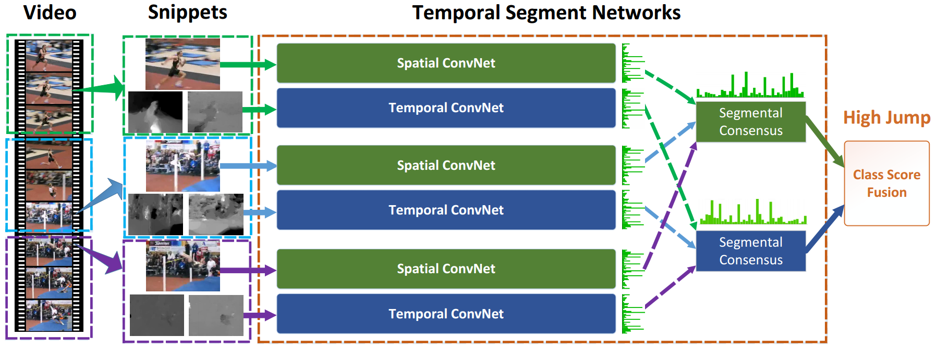
Temporal Segment Networks: Towards Good Practices for Deep Action Recognition, ECCV 2016

Slide 9
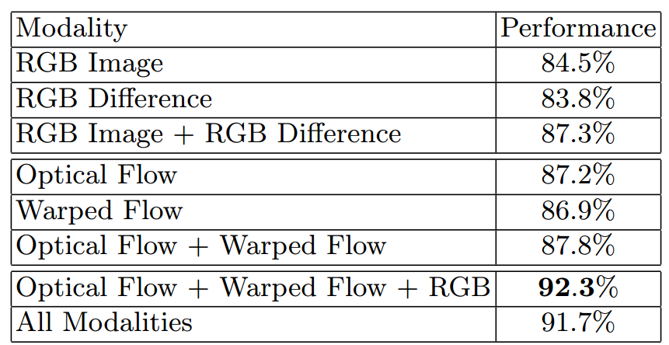
Temporal Segment Networks: Towards Good Practices for Deep Action Recognition, ECCV 2016

Slide 10
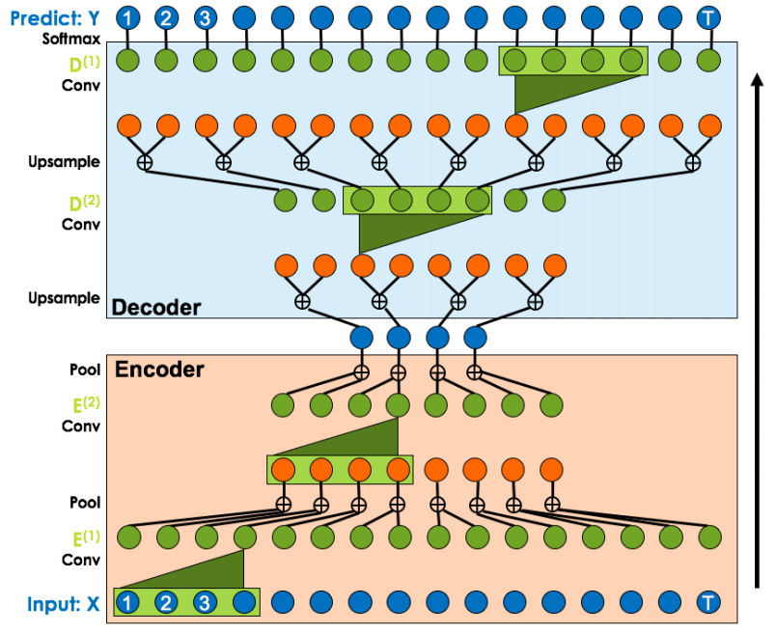
Temporal Convolutional Networks for Action Segmentation and Detection, CVPR 2017

Slide 11
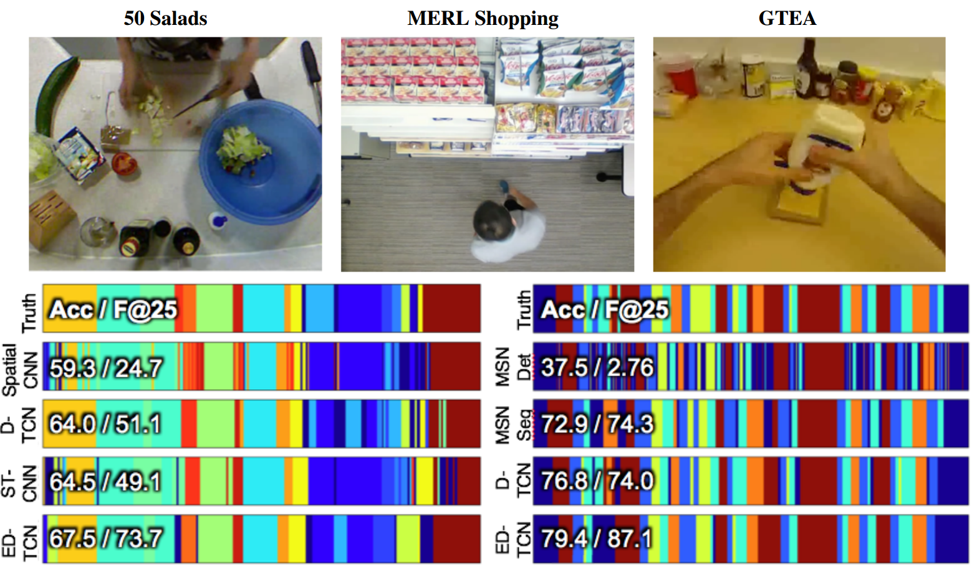
Temporal Convolutional Networks for Action Segmentation and Detection, CVPR 2017

Slide 12
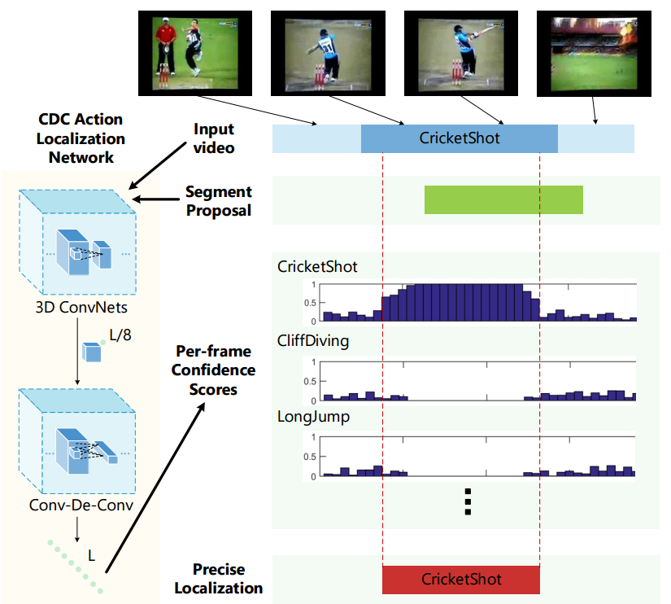
CDC: Convolutional-De-Convolutional Networks for Precise Temporal Action Localization in Untrimmed Videos, CVPR 2017

Slide 13
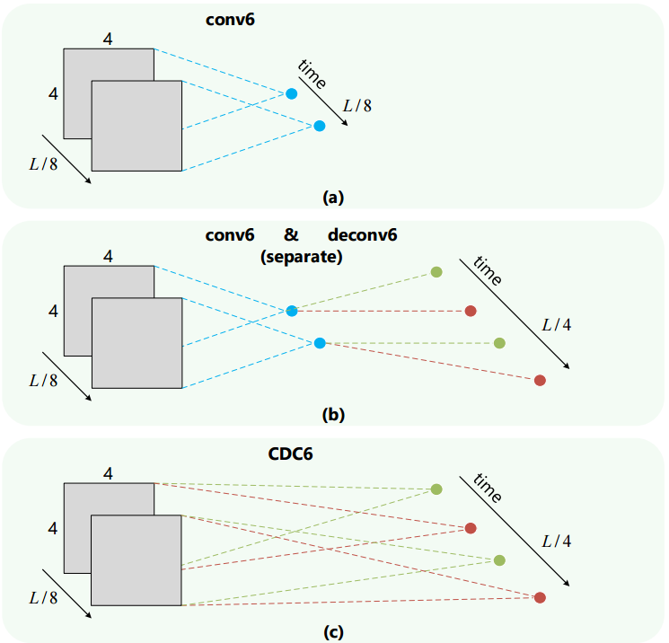
CDC: Convolutional-De-Convolutional Networks for Precise Temporal Action Localization in Untrimmed Videos, CVPR 2017

Slide 14
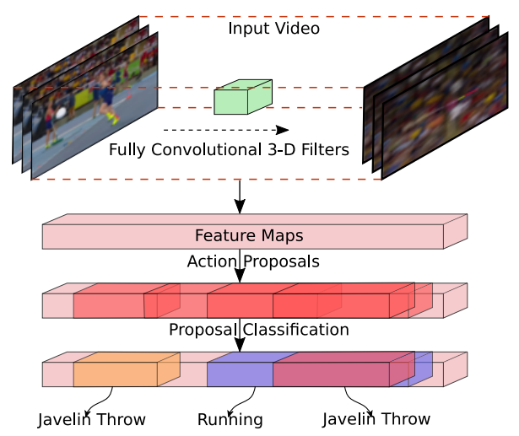
R-C3D: Region Convolutional 3D Network for Temporal Activity Detection, Arxiv 2017

Slide 15
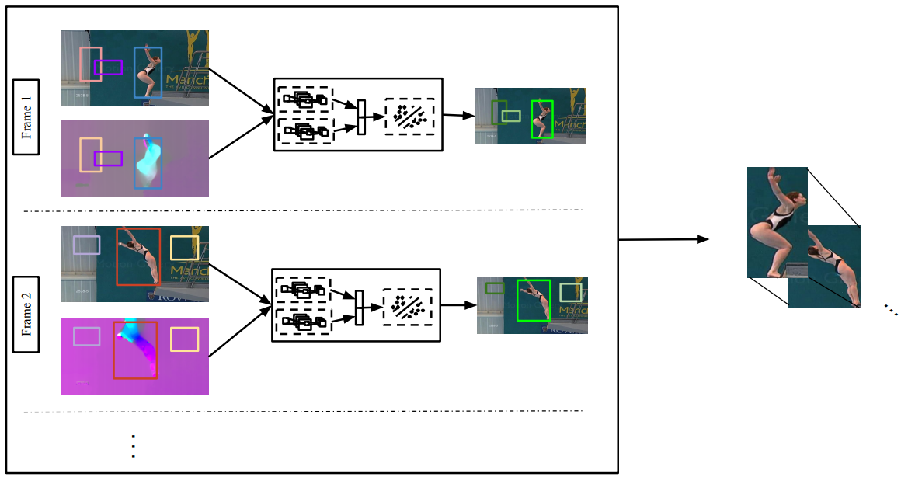
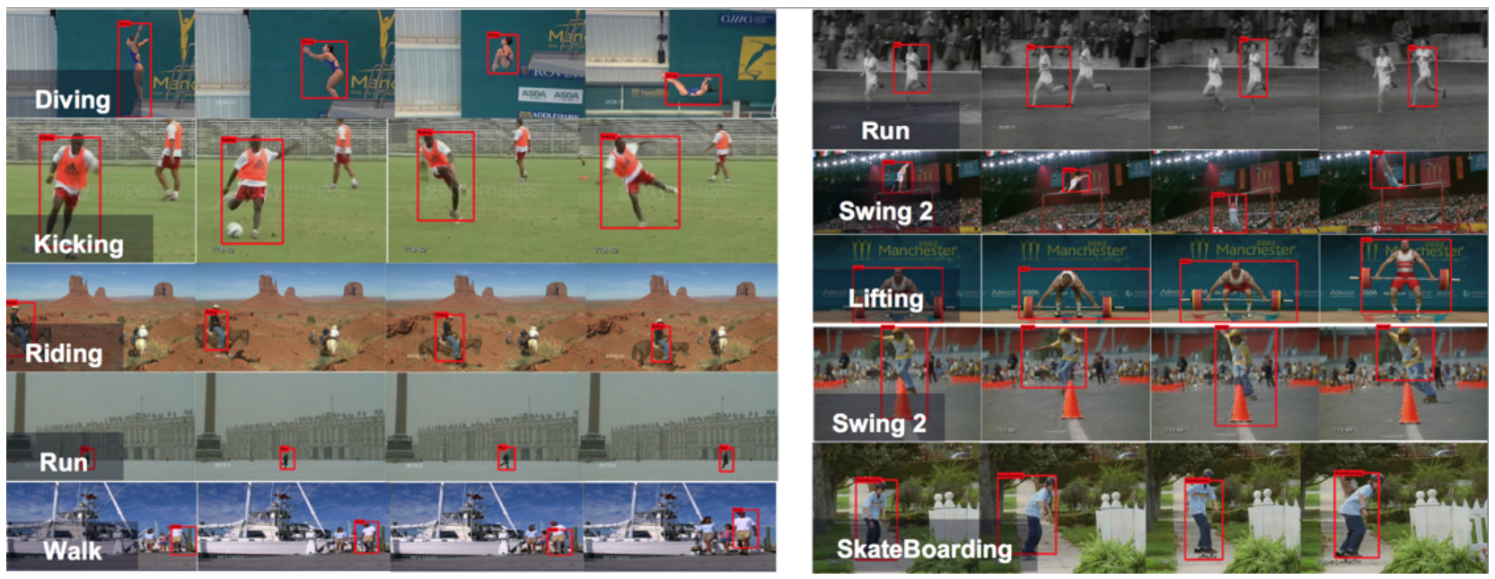
Finding Action Tubes , ICCV 2015

Slide 16
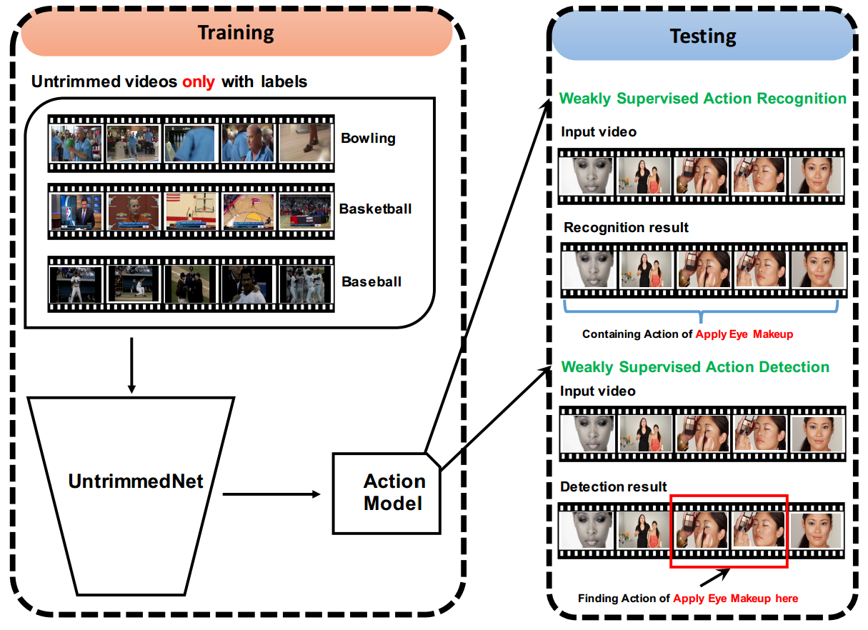
UntrimmedNets for Weakly Supervised Action Recognition and Detection , CVPR 2017

