Slide 1

Action Recognition
Advanced Computer Vision
The Bradley Department of Electrical and Computer Engineering
-Yingzhou Lu

Slide 2
What is action recognition?
Input: video/image
Output: the “action label”
“action”
“activity”
“event”
level of semantics
“walking, pointing,
putting
etc.”
“talking on the phone, drinking tea
etc.”
“a soccer game, a birthday party etc.”
Notes:
What do we want the computer to output?

Slide 3
Why perform action recognition?
Surveillance footage
User-interfaces
Automatic video organization / tagging
Search-by-video?

Slide 4
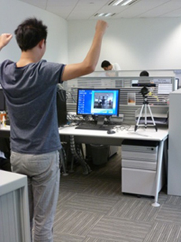
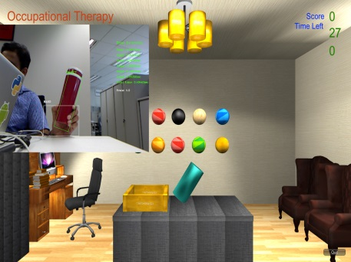
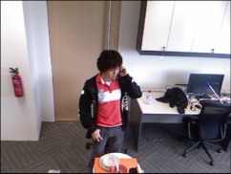
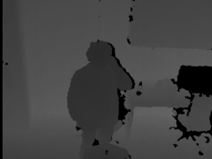
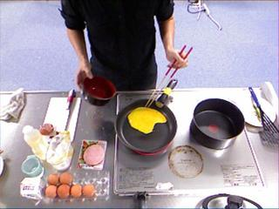
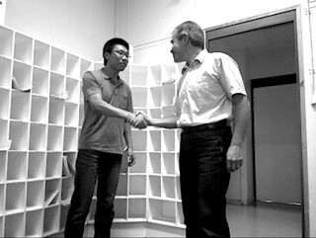
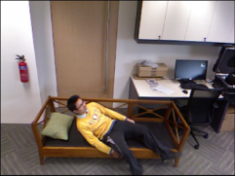
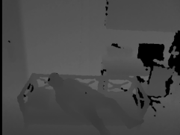
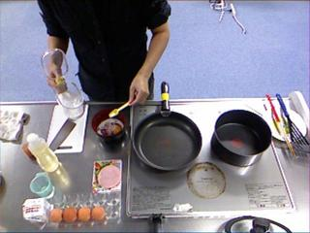
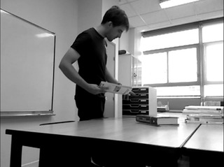
Example Applications
Automatic Tele-Rehabilitation
Fine-grained action recognition
Interactive action recognition
Daily activity recognition
Intelligent Assisted Living and Home Monitoring
credit: Bingbing Ni

Slide 5
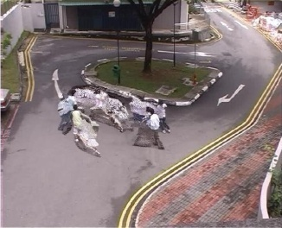
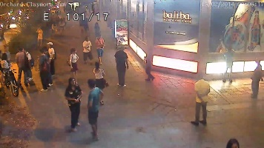
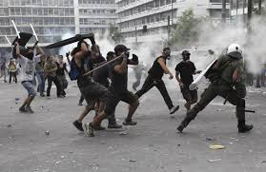
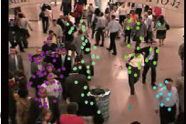
Example Applications
Fighting
loitering
Riot
Crowd congestion
Crowd Behavior/Event Analysis
credit: Bingbing Ni

Slide 6
Example Applications
Fighting
loitering
Riot
Crowd congestion
Crowd Behavior/Event Analysis
credit: Bingbing Ni

Slide 7
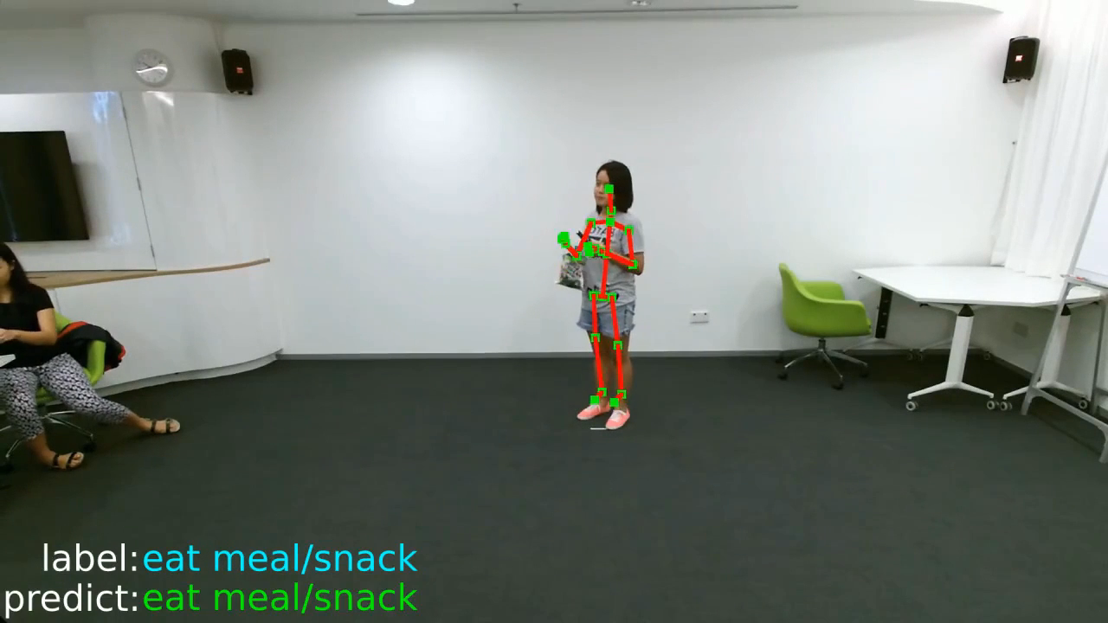
Demo

Slide 8
Why Action Recognition Is Challenging?
Different scales
  People may appear at different scales in different videos, yet perform the same action.
Movement of the camera
  The camera may be a handheld camera, and the person holding it can cause it to shake.
  Camera may be mounted on something that moves.

Slide 9
Why Action Recognition Is Challenging?
Occlusions
  Action may not be fully visible
Figure from Ke et al.

Slide 10
Why Action Recognition Is Challenging?
Background “clutter”
  Other objects/humans present in the video frame.
Human variation
  Humans are of different sizes/shapes
Action variation
  Different people perform different actions in different ways.
Etc…
Notes:
Also, the problem of background cluttering, which means other object/humans present in the video, and human variation and action variation would increases the difficulty of conducting action recognition.

Slide 11
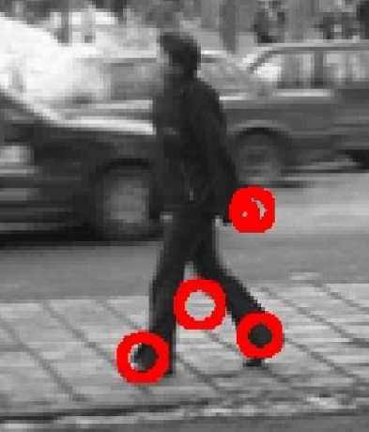
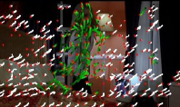
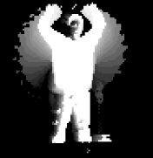
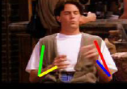
Design good features for action representation
Example features
“space-time interest points”
“dense trajectories”
“body joints”
“motion history images”
Notes:
So what is appropriate approach to realize action recognition. Above all, designing the good feature is pivotal for this problem. By far, several efficient approaches can give us inspiration on this problem.

Slide 12
Paper Overview
Recognizing Human Actions: A Local SVM Approach - Christian Schuldt, Ivan Laptev and Barbara Caputo (ICPR 2004)
  Use local space-time features to represent video sequences that contain actions.
  Classification is done via an SVM. Results are also computed for KNN for comparison.

Slide 13



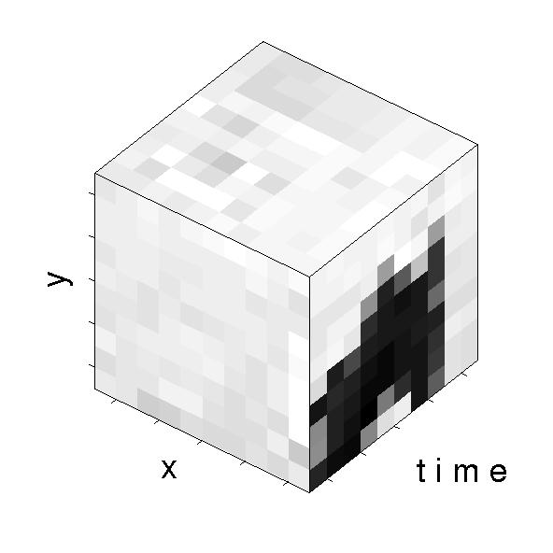
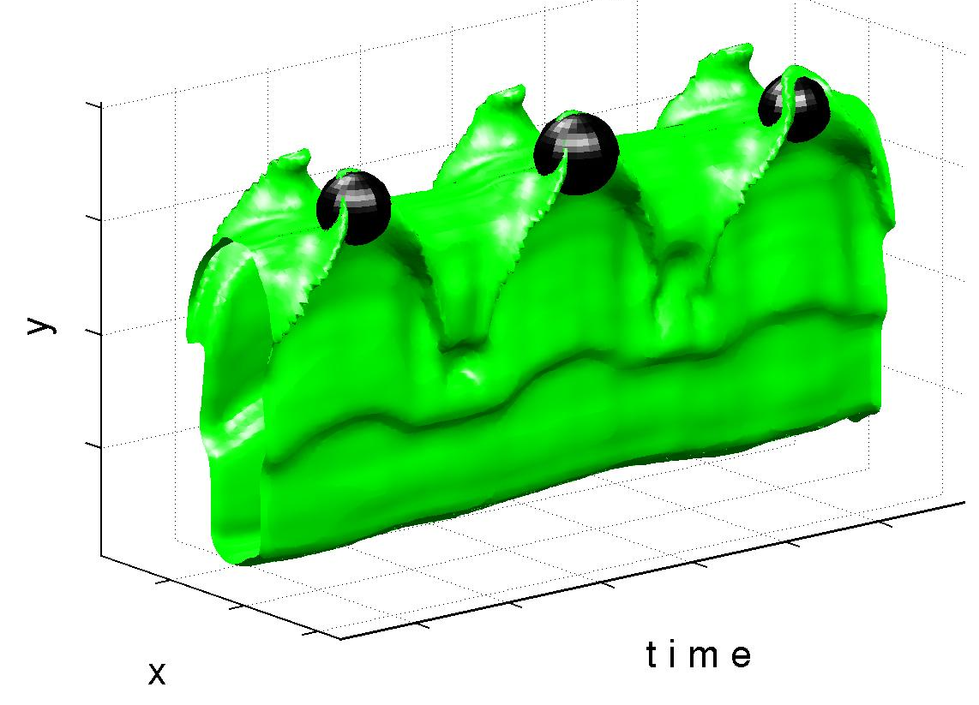
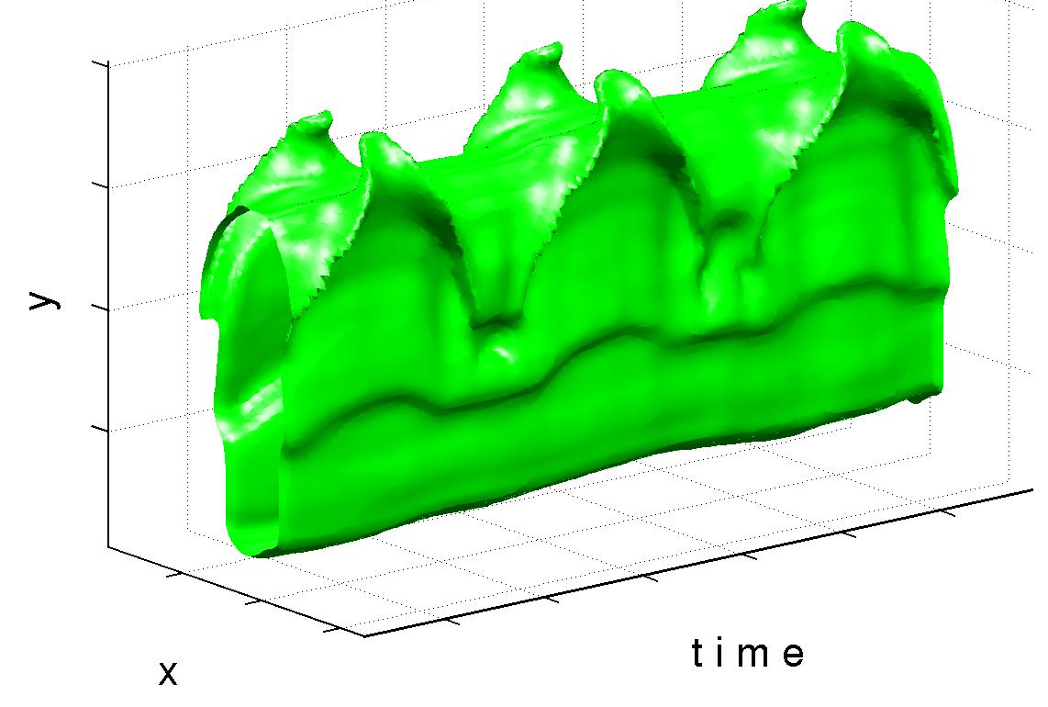
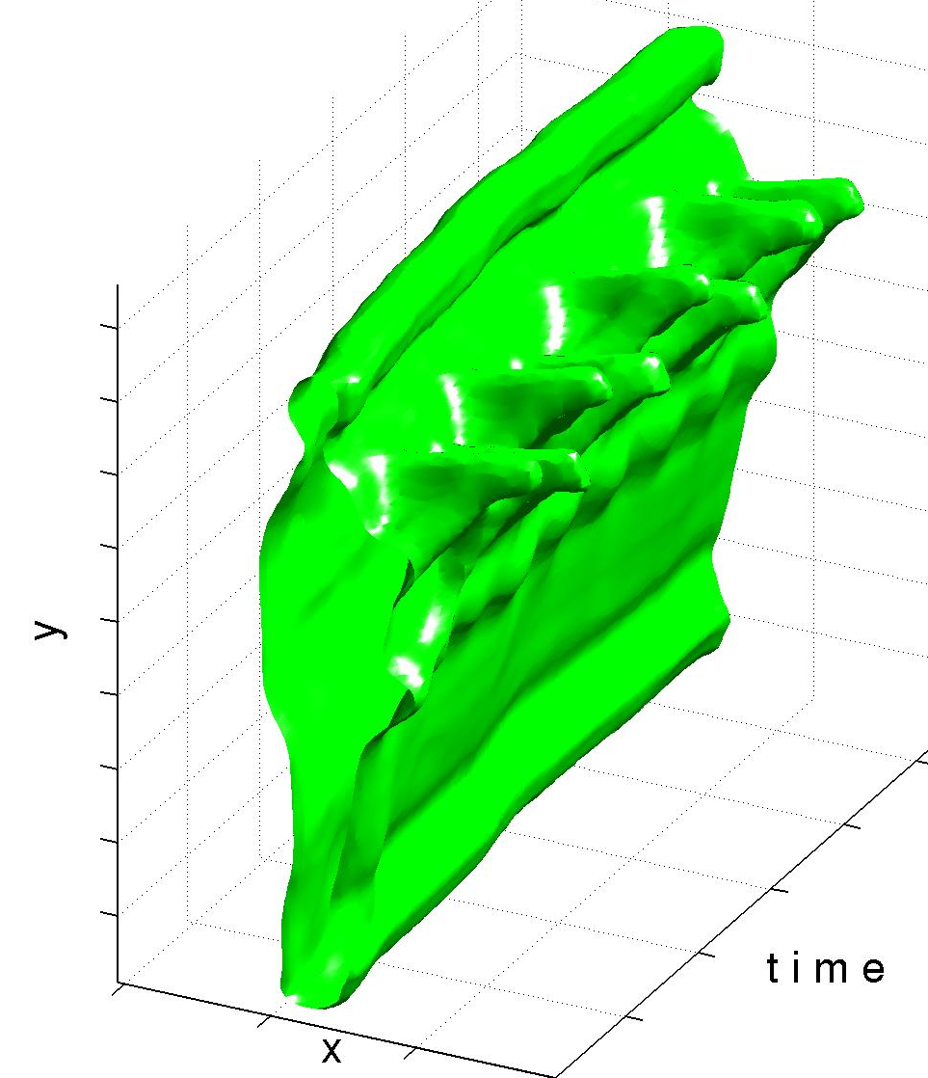
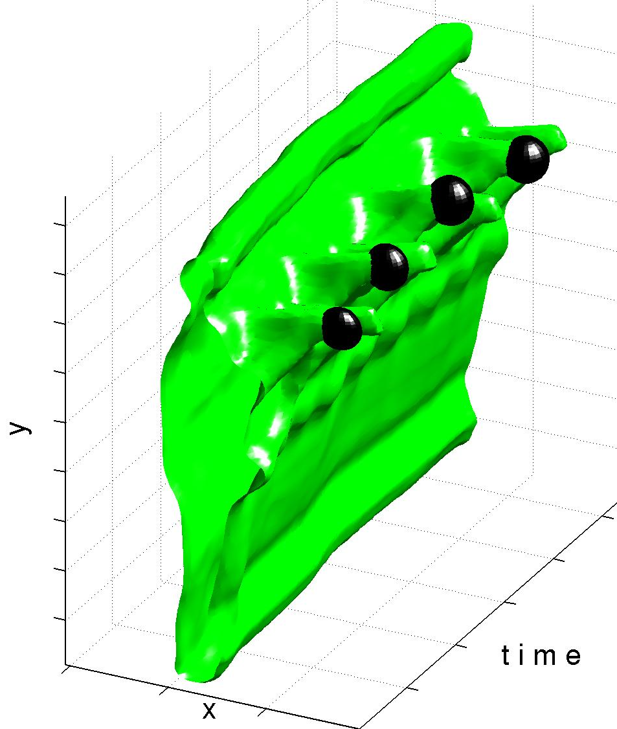
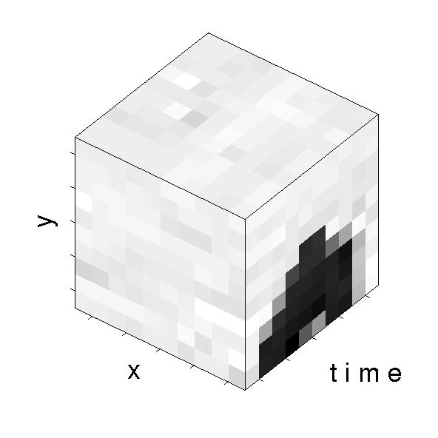
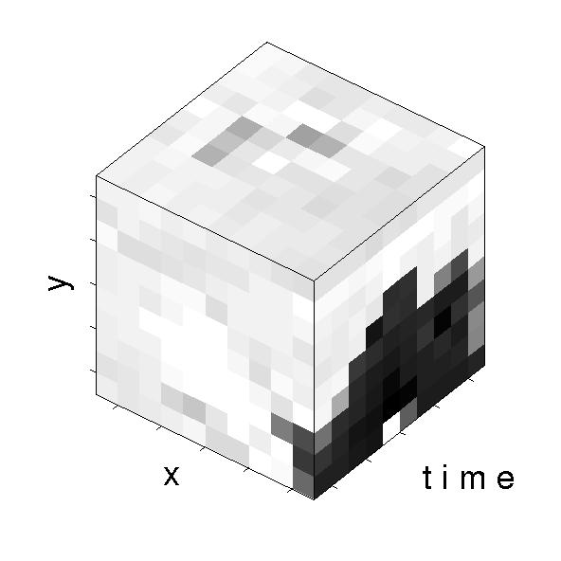
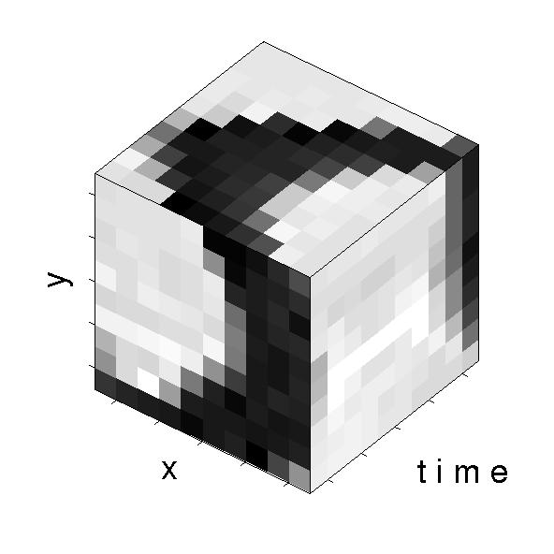
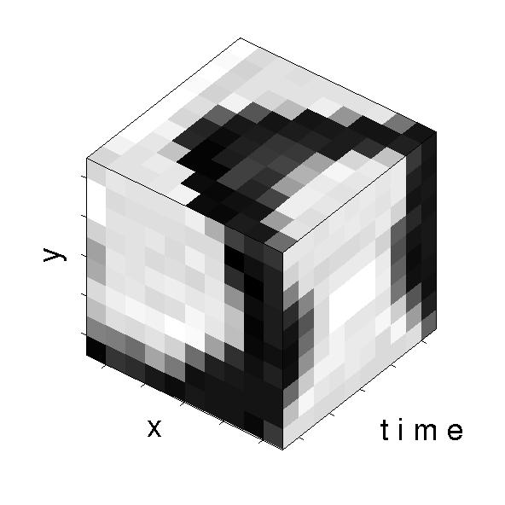
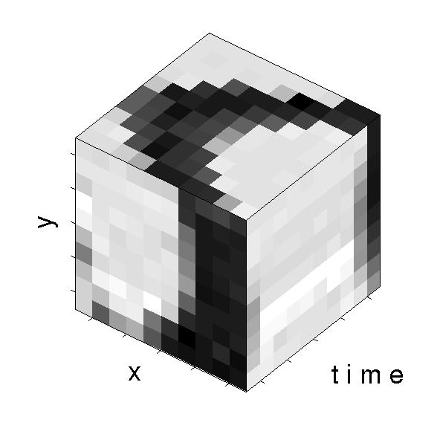
Space-time local features
No global assumptions ⇒
Consider local spatio-temporal neighborhoods
hand waving
boxing

Slide 14
Local Space-time features
Figure from Schuldt et al.

Slide 15
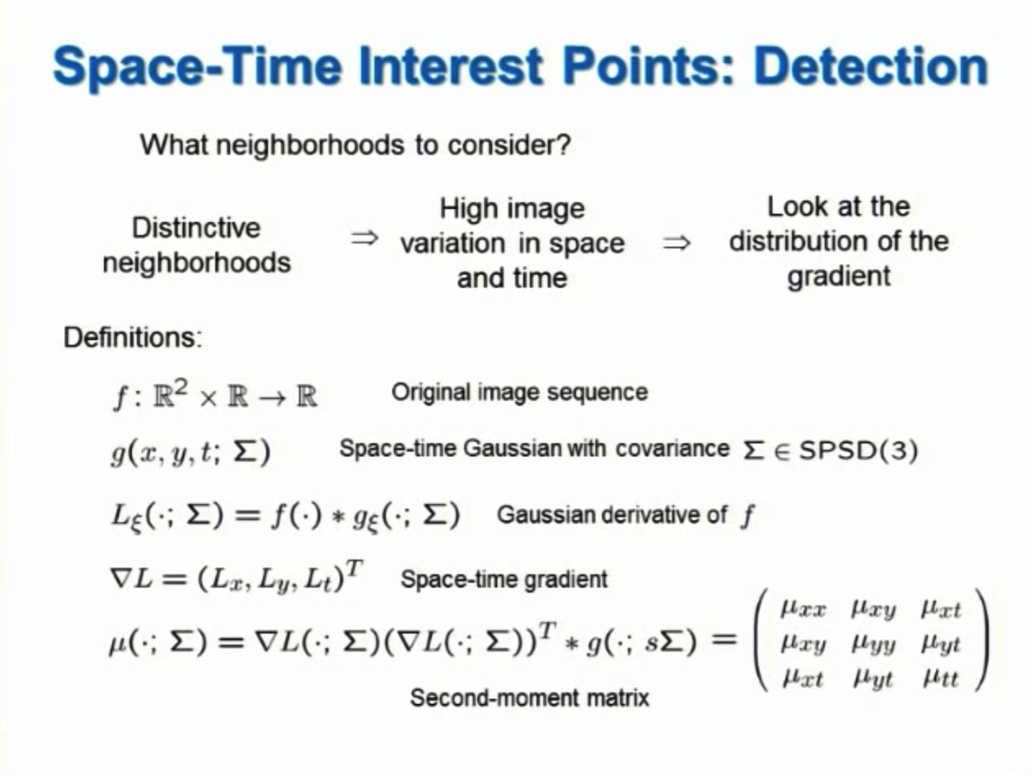

Slide 16
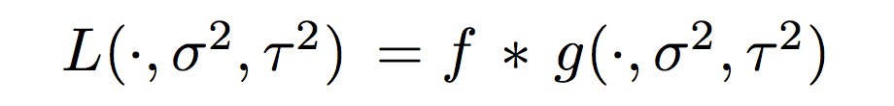
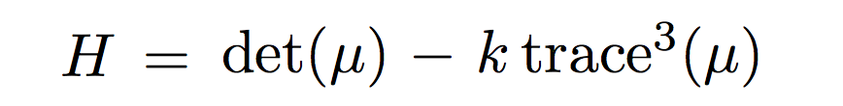
Representation of Features
construct its scale-space representation using Gaussian convolution kernel g
compute the second-moment matrix using spatio-temporal image gradients
define positions of features by local maxima

Slide 17
Representation of Features
Spatial-temporal “jets” (4th order) are computed at each feature center:
Using k-means clustering, a vocabulary consisting of words h_{i} is created from the jet descriptors.
Finally, a given video is represented by a histogram of counts of occurrences of features corresponding to h_{i} in that video:

Slide 18
Recognition Methods
2 representations of data:
  [1] Raw jet descriptors (LF) (“local feature” kernel)
    Wallraven, Caputo, and Graf (2003)
  [2] Histograms (HistLF) (X² kernel)
2 classification methods:
  SVM
  K Nearest Neighbor

Slide 19


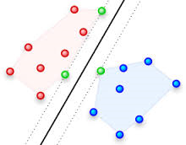







Design good classifiers
Example: Support Vector Machine (SVM) classifier
positive samples “walking”
w: separating hyper-plane
action representation vector x
action representation vector x
negative samples “not walking”
action representation vector x
Linear SVM: y = w^{T}x + b
y>0 : “walking”
y<0 : “not walking”

Slide 20
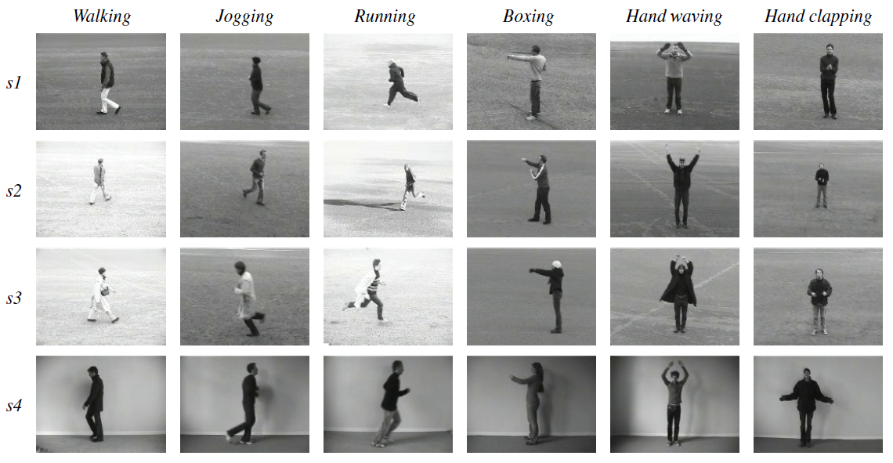
The Dataset
Figure from Schuldt et al.

Slide 21
The Dataset
Video dataset with a few thousand instances.
  25 people each:
    perform 6 different actions
      Walking, jogging, running, boxing, hand waving, clapping
    in 4 different scenarios
      Outdoors, outdoors w/scale variation, outdoors w/different clothes, indoors
    (several times)
Backgrounds are mostly free of clutter.
Only one person performing a single action per video.
credit: Benzaid

Slide 22
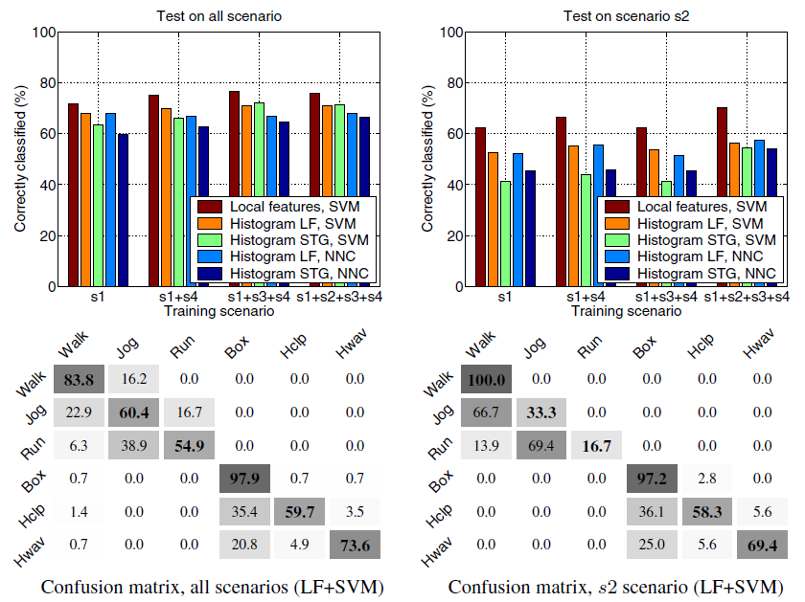
Results
Figure from Schuldt et al.

Slide 23
Results
Experimental results:
  Local Feature (jets) + SVM performs the best
  SVM outperforms NN
  HistLF (histogram of jets) is slightly better than HistSTG (histogram of spatio-temporal gradients)
Average classification accuracy on all scenarios = 71.72%

Slide 24
Analysis
Some categories can be confused with others (running vs. jogging vs. walking / waving vs. boxing) due to different ways that people perform these tasks.
Local Features (raw jet descriptors without histograms) combined with SVMs was the best-performing technique for all tested scenarios.

Slide 25
Paper Overview
Two-Stream Convolutional Networks for Action Recognition in Videos (NIPS 2014)
- propose a two-stream ConvNet architecture Two-stream architecture for video classification
  Temporal stream – motion recognition ConvNet
  Spatial stream – appearance recognition ConvNet

Slide 26
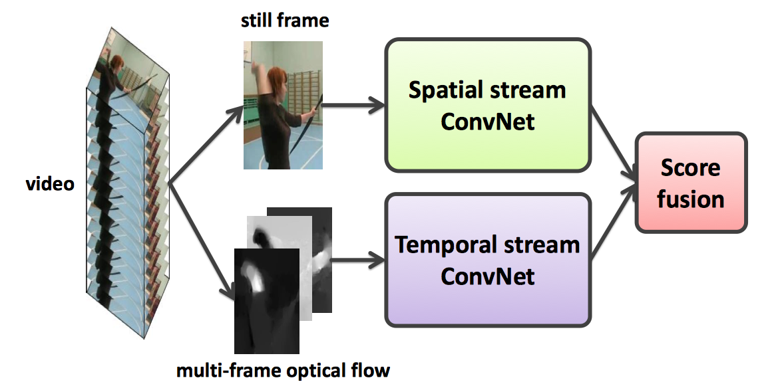
Architecture
Simonyan and Zisserman, Two-Stream Convolutional Networks for Action Recognition in Videos

Slide 27
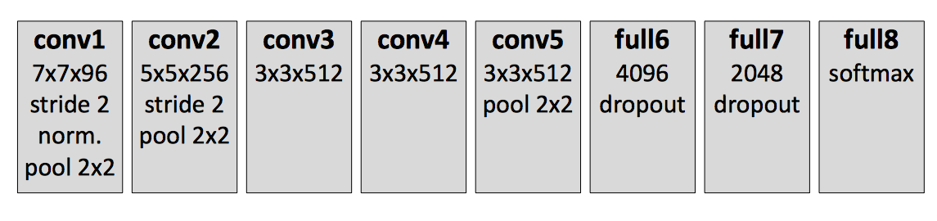
Convnet Layer Conviguration
8 weight layers (5 convolutional and 3 fully-connected)
used for both spatial & temporal streams
Simonyan and Zisserman, Two-Stream Convolutional Networks for Action Recognition in Videos

Slide 28
Spatial Stream
Predicts action from still images – image classification
Input
Individual RGB frames
Training
Leverages large amounts of outside image data by pre-training on ILSVRC (1.2M images, 1000 classes)
Classification layer re-trained on video frames
Evaluation
Applied to 25 evenly sampled frames in each clip
Resulting scores averaged
Simonyan and Zisserman, Two-Stream Convolutional Networks for Action Recognition in Videos

Slide 29
Optical Flow
Displacement vector field between a pair of consecutive frames
Each flow – 2 channels: horizontal & vertical components
Computed using [Brox et al., ECCV 2004]
  based on generic assumptions of constancy and smoothness
  pre-computed on GPU (17fps), JPEG-compressed
Global (camera) motion compensated by mean flow subtraction
Simonyan and Zisserman, Two-Stream Convolutional Networks for Action Recognition in Videos

Slide 30
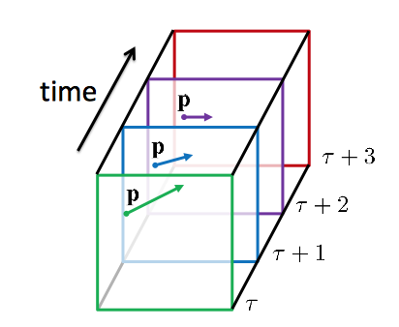
Temporal Stream
Predicts action from motion
Input
Explicitly describes motion in video
Stacked optical flow over several frames
Training
From scratch with high drop-out (90%)
Multi-task learning to reduce over-fitting
Video datasets (UCF-101, HMDB-51) are small
Merging datasets is problematic due to semantic overlap
Multi-task learning: each dataset defines a separate task (loss)
Simonyan and Zisserman, Two-Stream Convolutional Networks for Action Recognition in Videos

Slide 31
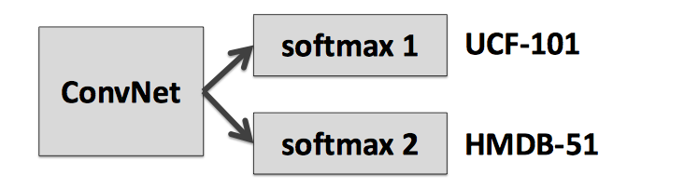
Evaluation
Video action classification datasets
UCF-101 (101 class, 13K videos)
HMDB-51 (51 class, 6.8K videos)

Slide 32
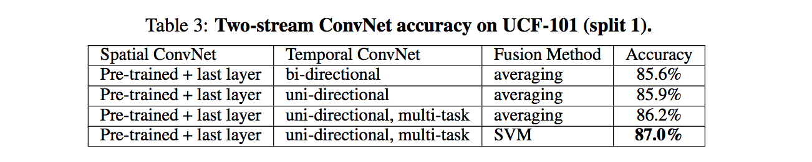
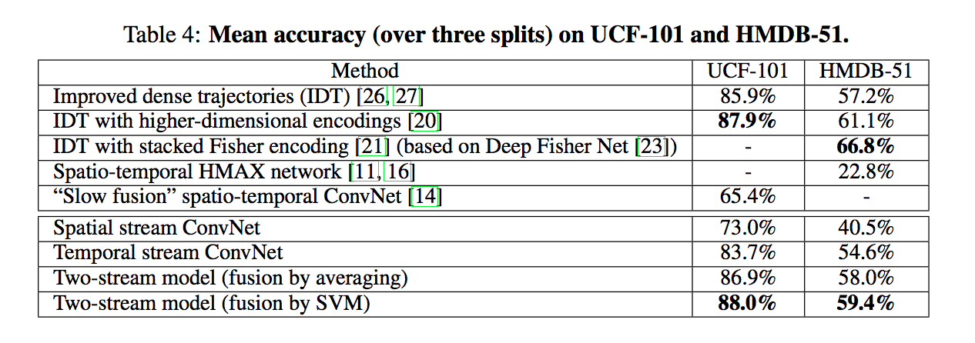
Results

Slide 33
Conclusions
From depth and color image sequences to multi-modal visual analytics
Quality metrics for activity recognition tasks
New features for depth images and for fusion
Machine learning framework
New applications

Slide 34
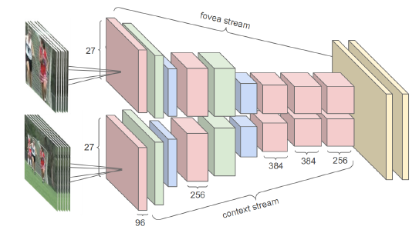
Next Milestone in Action Recognition?
Will CNNs take over existing action recognition methods?
    -What’s a good network architecture?
    -Where to get sufficient training data?
Input frames are fed into two separate streams of processing: a context stream that models low-resolution image and a fovea stream that processes high-resolution center crop. Both streams consist of alternating convolution (red), normalization (green) and pooling (blue) layers. Both streams converge to two fully connected layers (yellow).
[Karpathy et al. 2014]

Slide 35
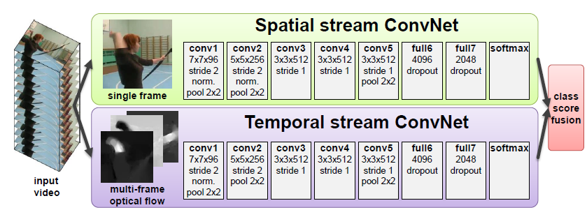
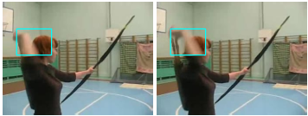
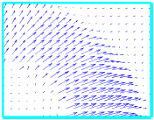
Next Milestone in Action Recognition?
Method | UCF101 | HMDB51
Dense Traj. + IFV | 87.9% | 61.1%
Two Stream ConvNet | 88.0% | 59.4%
two consecutive frames
optic flow
Optical flow as input to deep network, i.e., ConvNet
Spatial stream ConvNet captures shape information
Temporal stream ConvNet captures motion information
Achieve state-of-the-art accuracy

