Slide 1
Action Recognition Experiments
By Kevin Yu

Slide 2
Hardware Setup
Ubuntu 14.04
i7-6700HQ, 8 core
16Gb RAM
CPU only
NVIDIA Tesla K80 GPU

Slide 3
Which experiment to pick
Two-stream convolutional networks for action recognition in videos?
Large-scale video classification with convolutional neural networks?
Learning Spatiotemporal Features with 3D Convolutional Networks?

Slide 4
Installation Guides
Main Website:
https://github.com/facebook/C3D
Installation Instructions:
https://gist.github.com/arundasan91/b432cb011d1c45b65222d0fac5f9232c
http://vra.github.io/2016/03/03/c3d-use/

Slide 5
Legitimacy of C3D

Slide 6
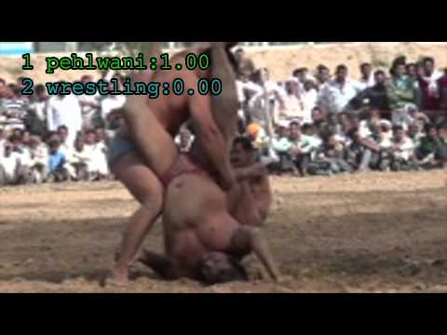
Example Videos

Slide 7
Action Classification
Tested 150 clips

Slide 8
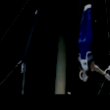
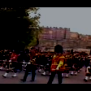
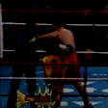
Action Classification Successful
True: Still Rings
Predicted: Still Rings
True: BandMarching
Predicted: BandMarching
True: Punch
Predicted: Punch

Slide 9
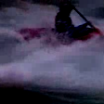
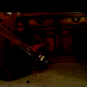
Action Classification Unsuccessful
True: Kayaking
Predicted: Surfing
True: PlayingSitar
Predicted: ShavingBeard
True: HammerThrow
Predicted: PlayingSitar

