Slide 1
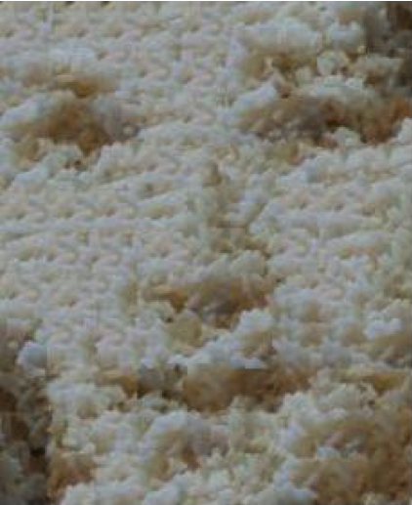
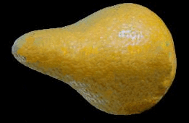
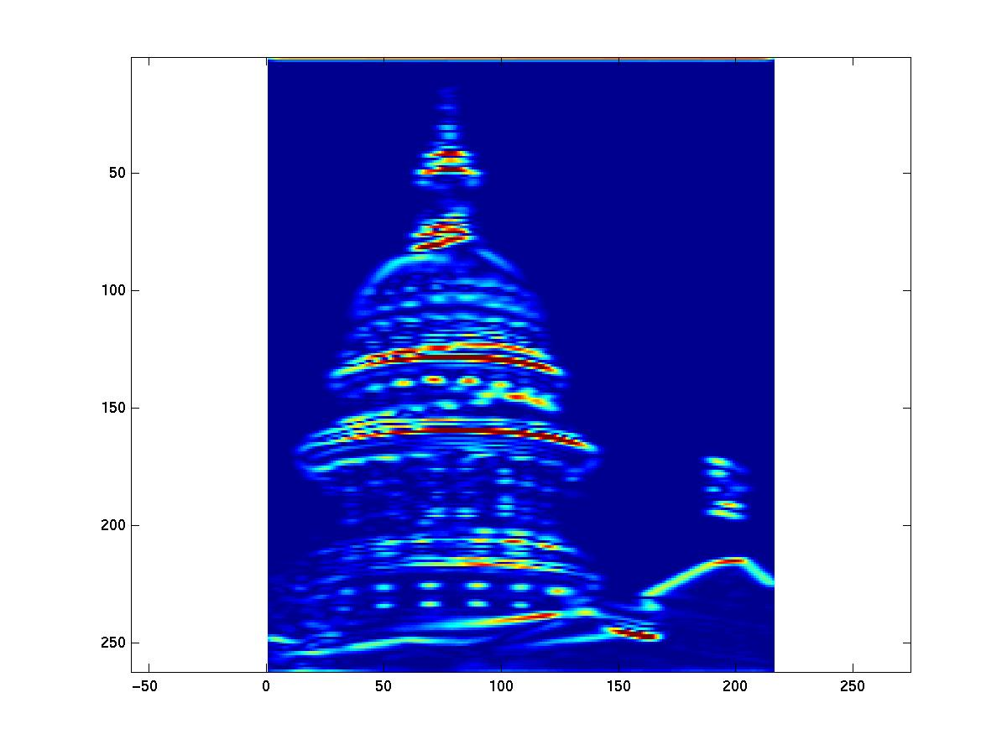
Texture
Tuesday
September 10th 2013
Devi Parikh
Virginia Tech
Disclaimer: Many slides have been borrowed from Kristen Grauman, who may have borrowed some of them from others. Any time a slide did not already have a credit on it, I have credited it to Kristen. So there is a chance some of these credits are inaccurate.
Slide credit: Adapted by Devi Parikh from Kristen Grauman

Slide 2
Announcements
PS1 due September 18th 11:59 pm
PS0
  41% of submissions did not follow instructions completely
    Files incorrectly named, missing files, etc.
  Each file had an issue with 15% of the students on average
Slide credit: Devi Parikh

Slide 3
Review: last time
Edge detection:
  Filter for gradient
  Threshold gradient magnitude, thin
    Non-maximal suppression, Hysteresis thresholding
Chamfer matching to compare shapes (in terms of edge points)
Binary image analysis
  Thresholding
  Morphological operators to “clean up”
  Connected components to find regions
Slide credit: Kristen Grauman

Slide 4
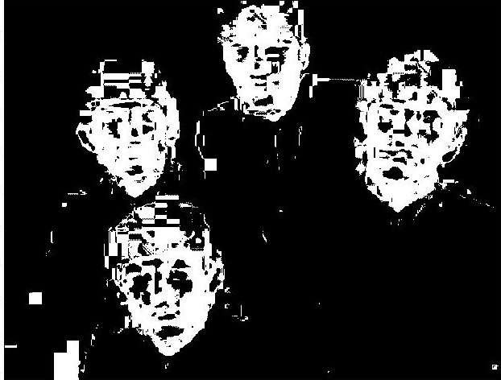
Issues
What to do with “noisy” binary outputs?
  Holes
  Extra small fragments
How to demarcate multiple regions of interest?
  Count objects
  Compute further features per object
Slide credit: Kristen Grauman

Slide 5
Connected components
Various algorithms to compute
  Recursive (in memory)
  Two rows at a time (image not necessarily in memory)
  Parallel propagation strategy
Slide credit: Kristen Grauman

Slide 6
Recursive connected components
Find an unlabeled pixel, assign it a new label
Search to find its neighbors, and recursively repeat to find their neighbors til there are no more
Repeat
Demo http://www.cosc.canterbury.ac.nz/mukundan/covn/Label.html
Slide credit: Kristen Grauman

Slide 7
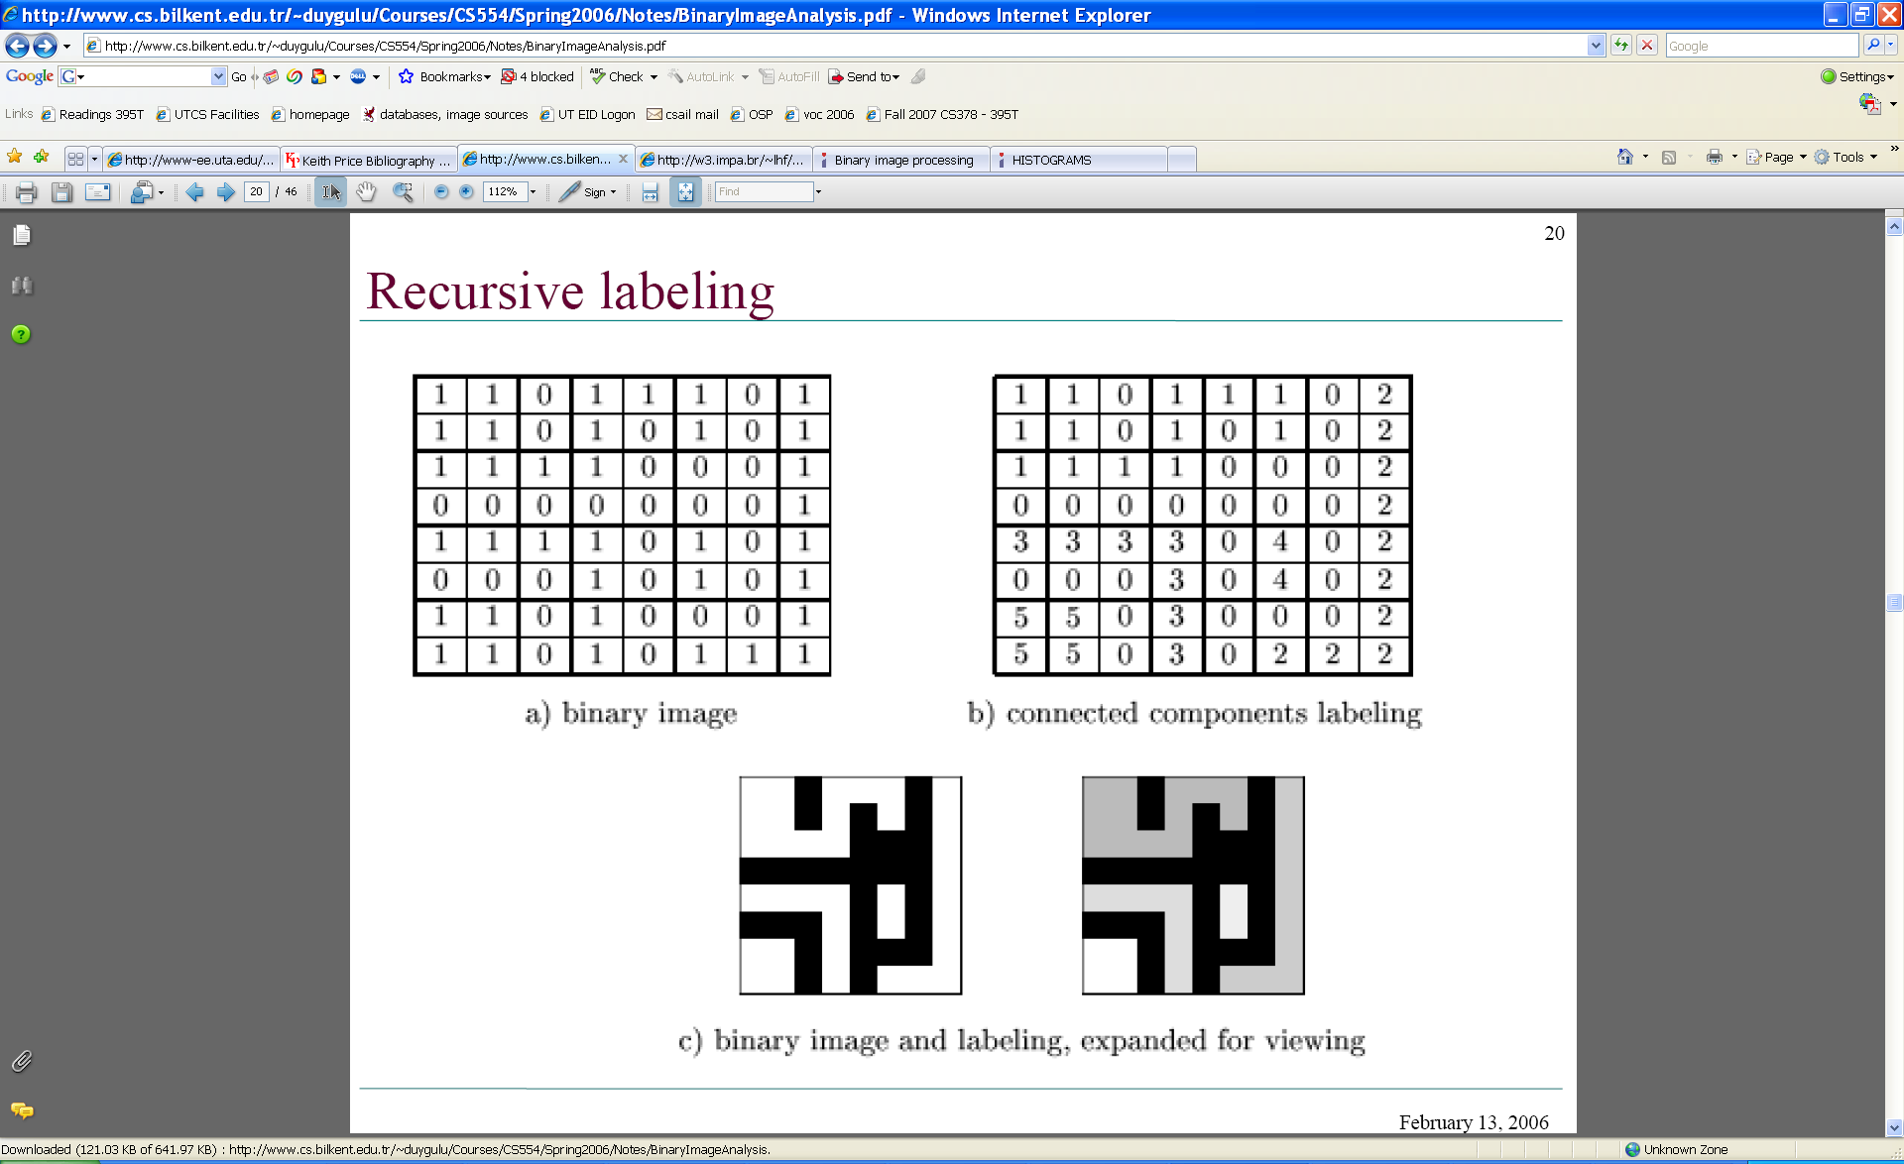
Connected components
Identify distinct regions of “connected pixels”
Slide credit: Shapiro and Stockman

Slide 8
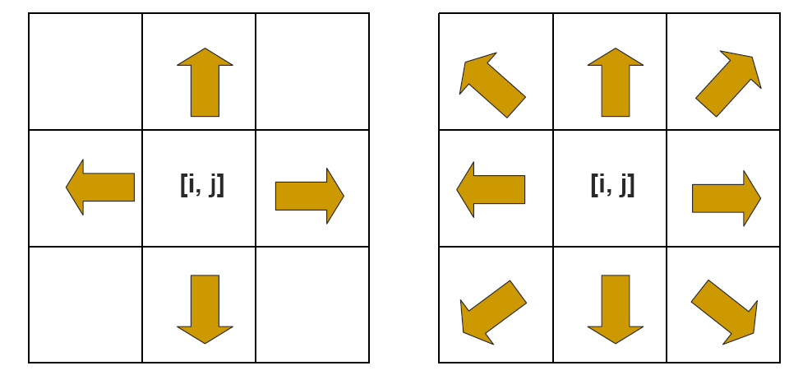
Connectedness
Defining which pixels are considered neighbors
4-connected
8-connected
Slide credit: Chaitanya Chandra

Slide 9
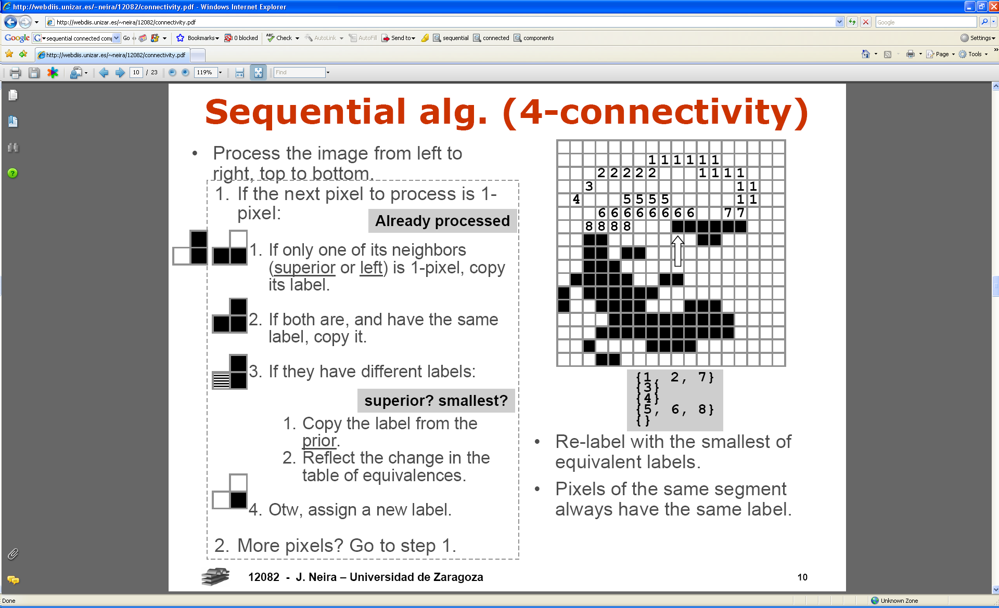
Connected components
We’ll consider a sequential algorithm that requires only 2 passes over the image.
Input: binary image
Output: “label” image, where pixels are numbered per their component
Note: foreground here is denoted with black pixels.
Slide credit: Kristen Grauman

Slide 10
Sequential connected components
Slide credit: Kristen Grauman

Slide 11
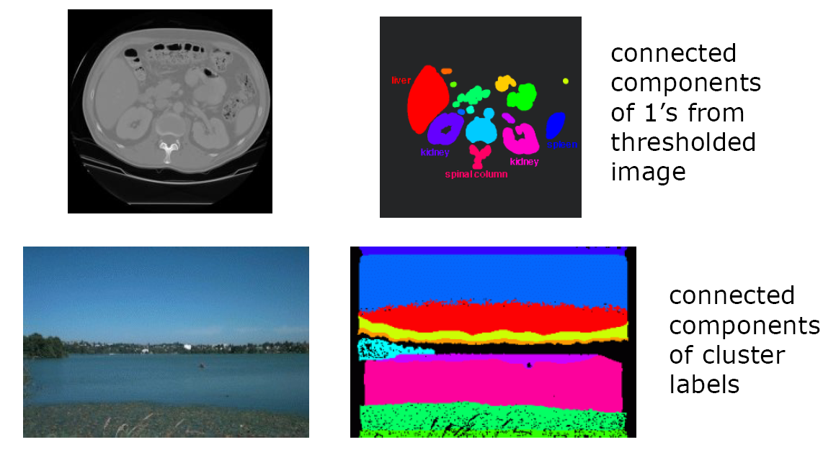
Connected components
Slide credit: Pinar Duygulu

Slide 12
Region properties
Given connected components, can compute simple features per blob, such as:
  Area (num pixels in the region)
  Centroid (average x and y position of pixels in the region)
  Bounding box (min and max coordinates)
  Circularity (ratio of mean dist. to centroid over std)
A2=170
A1=200
Slide credit: Kristen Grauman

Slide 13
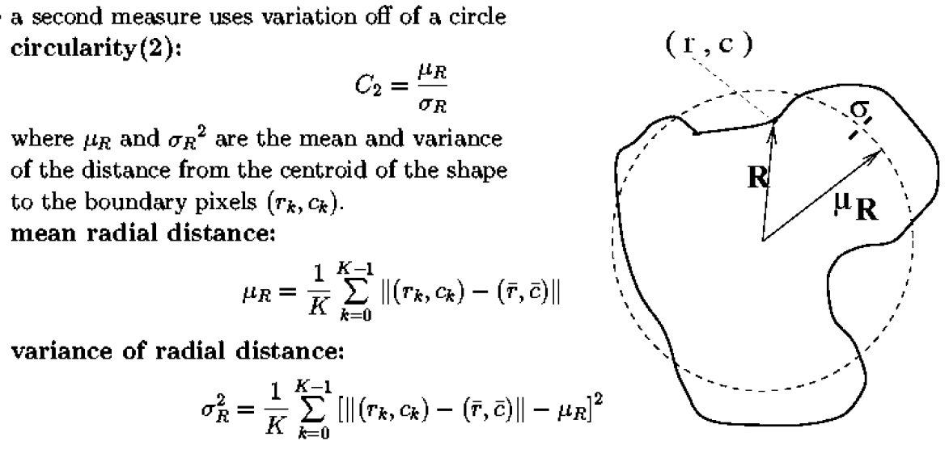
Circularity
[Haralick]
Slide credit: Shapiro & Stockman

Slide 14
Binary image analysis: basic steps (recap)
Convert the image into binary form
  Thresholding
Clean up the thresholded image
  Morphological operators
Extract separate blobs
  Connected components
Describe the blobs with region properties
Slide credit: Kristen Grauman

Slide 15
Matlab
N = hist(Y,M)
L = bwlabel (BW,N);
STATS = regionprops(L,PROPERTIES) ;
  'Area'
  'Centroid'
  'BoundingBox'
  'Orientation‘, …
IM2 = imerode(IM,SE);
IM2 = imdilate(IM,SE);
IM2 = imclose(IM, SE);
IM2 = imopen(IM, SE);
Slide credit: Kristen Grauman

Slide 16
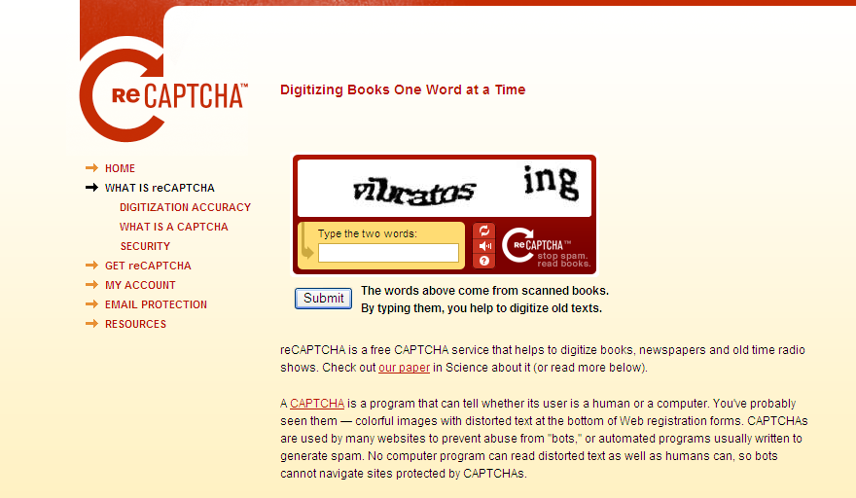
Example using binary image analysis: OCR
[Luis von Ahn et al. http://recaptcha.net/learnmore.html]
Slide credit: Kristen Grauman

Slide 17
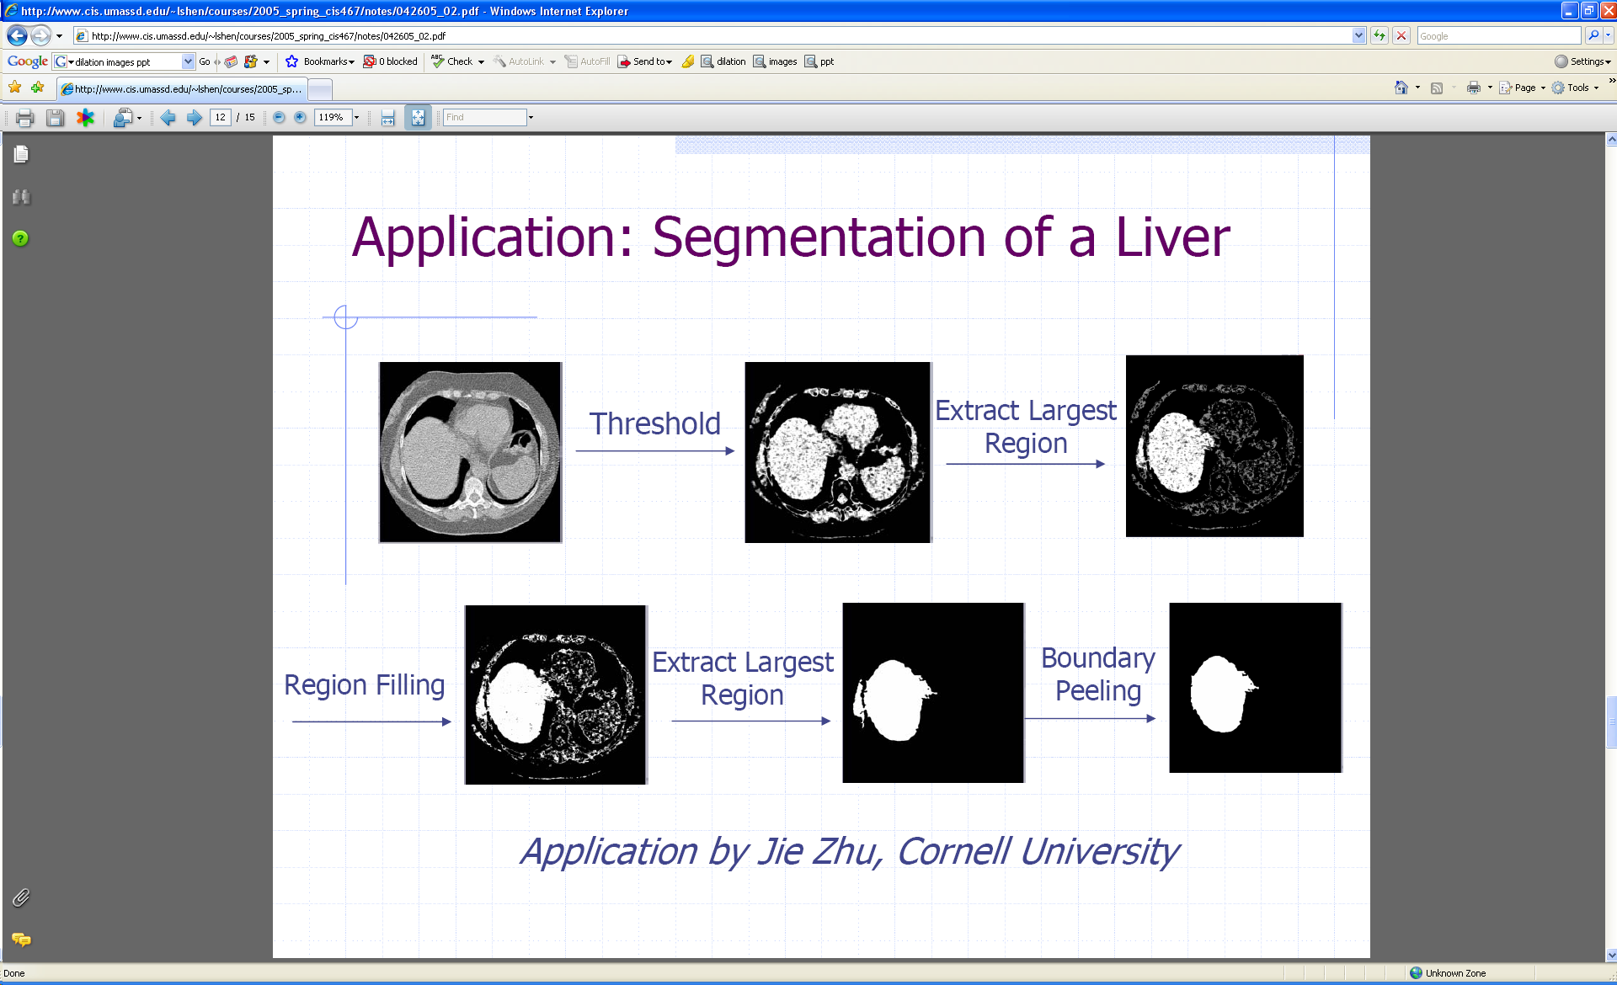
Example using binary image analysis: segmentation of a liver
Slide credit: Li Shen

Slide 18
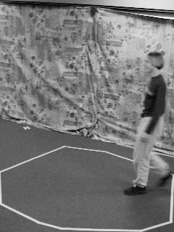
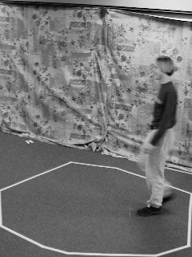
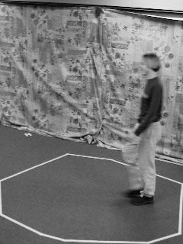
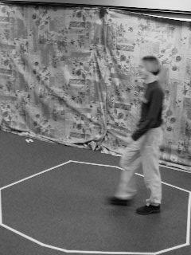
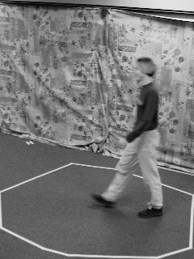
Example using binary image analysis:
Bg subtraction + blob detection
…
Slide credit: Kristen Grauman

Slide 19
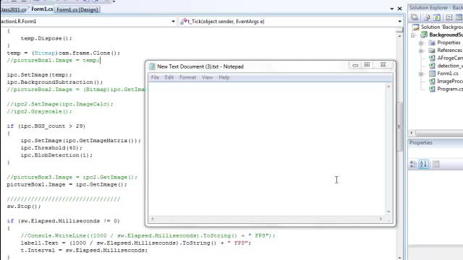
Example using binary image analysis:
Bg subtraction + blob detection
Slide credit: Kristen Grauman

Slide 20
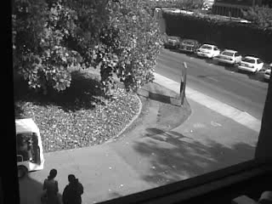
Example using binary image analysis:
Bg subtraction + blob detection
University of Southern California
http://iris.usc.edu/Projects/detect/detection-result.html
Slide credit: Kristen Grauman

Slide 21
Binary images
Pros
  Can be fast to compute, easy to store
  Simple processing techniques available
  Lead to some useful compact shape descriptors
Cons
  Hard to get “clean” silhouettes
  Noise common in realistic scenarios
  Can be too coarse of a representation
  Not 3d
Slide credit: Kristen Grauman

Slide 22
Summary
Operations, tools
Features, representations
Derivative filters
Smoothing, morphology
Thresholding
Matching filters
Connected components
Histograms
Edges, gradients
Blobs/regions
Local patterns
Textures (next)
Color distributions
Slide credit: Kristen Grauman

Slide 23
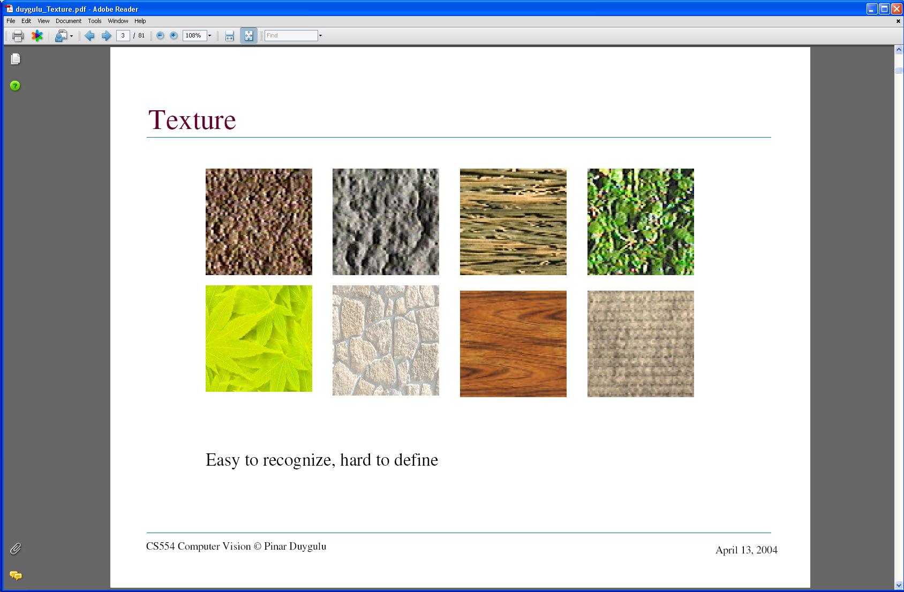
Today: Texture
What defines a texture?
Slide credit: Kristen Grauman

Slide 24



Includes: more regular patterns
Slide credit: Kristen Grauman

Slide 25
Includes: more random patterns
Slide credit: Kristen Grauman

Slide 26
Texture-related tasks
Shape from texture
  Estimate surface orientation or shape from image texture
Slide credit: Kristen Grauman

Slide 27
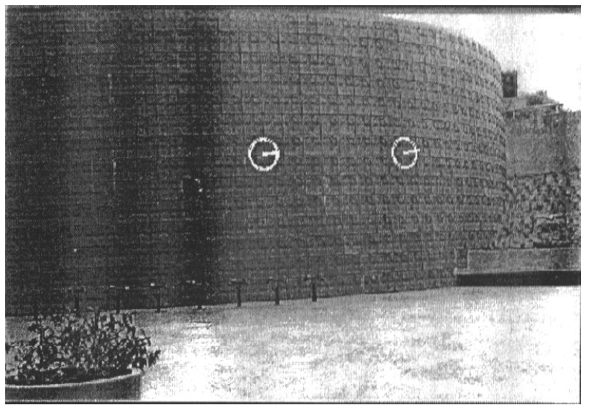
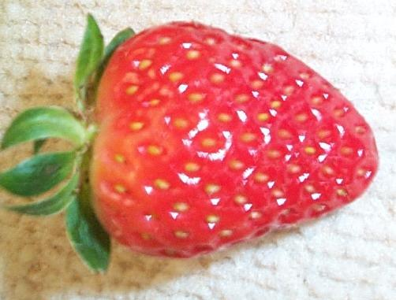
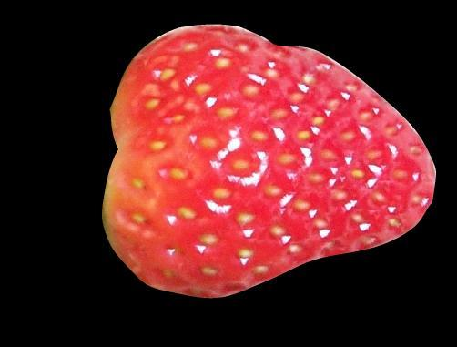
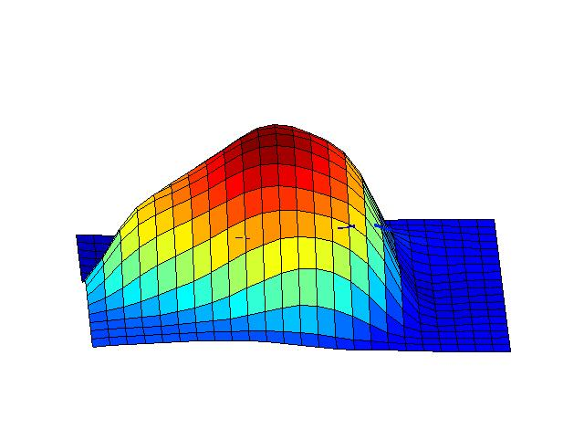
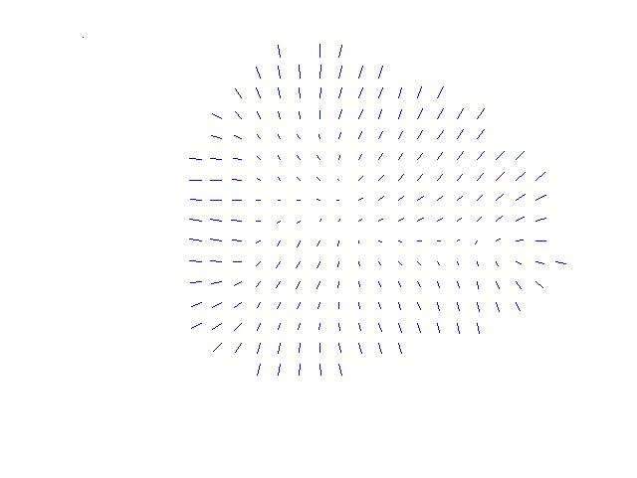
Shape from texture
Use deformation of texture from point to point to estimate surface shape
Pics from A. Loh: http://www.csse.uwa.edu.au/~angie/phdpics1.html
Slide credit: Kristen Grauman

Slide 28
Texture-related tasks
Shape from texture
  Estimate surface orientation or shape from image texture
Segmentation/classification from texture cues
  Analyze, represent texture
  Group image regions with consistent texture
Synthesis
  Generate new texture patches/images given some examples
Slide credit: Kristen Grauman

Slide 29
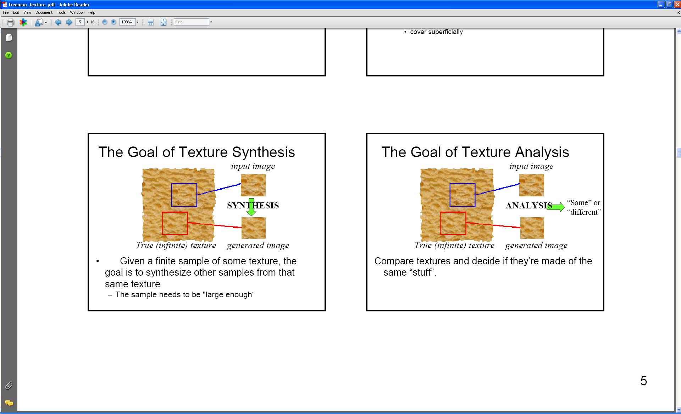
Analysis vs. Synthesis
Why analyze texture?
Slide credit: Kristen Grauman
Images:Bill Freeman, A. Efros

Slide 30
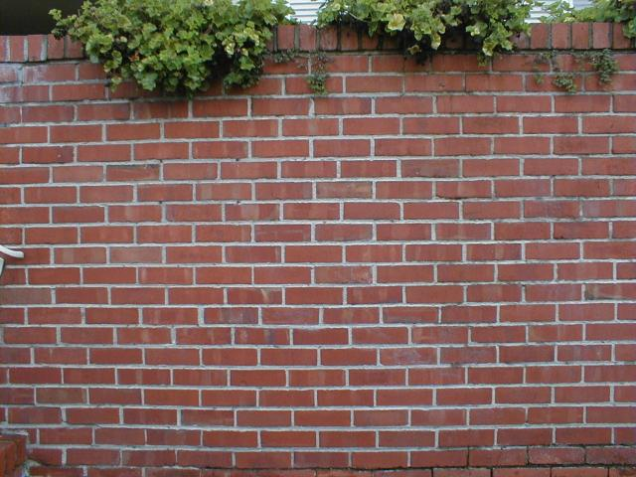
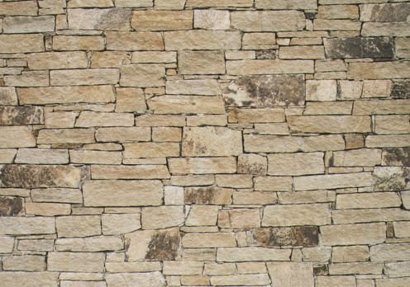
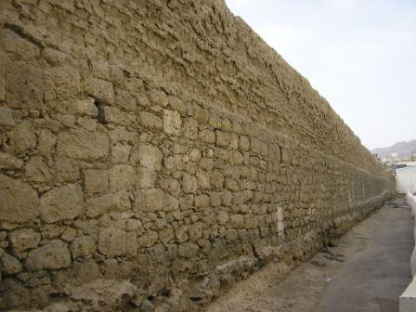
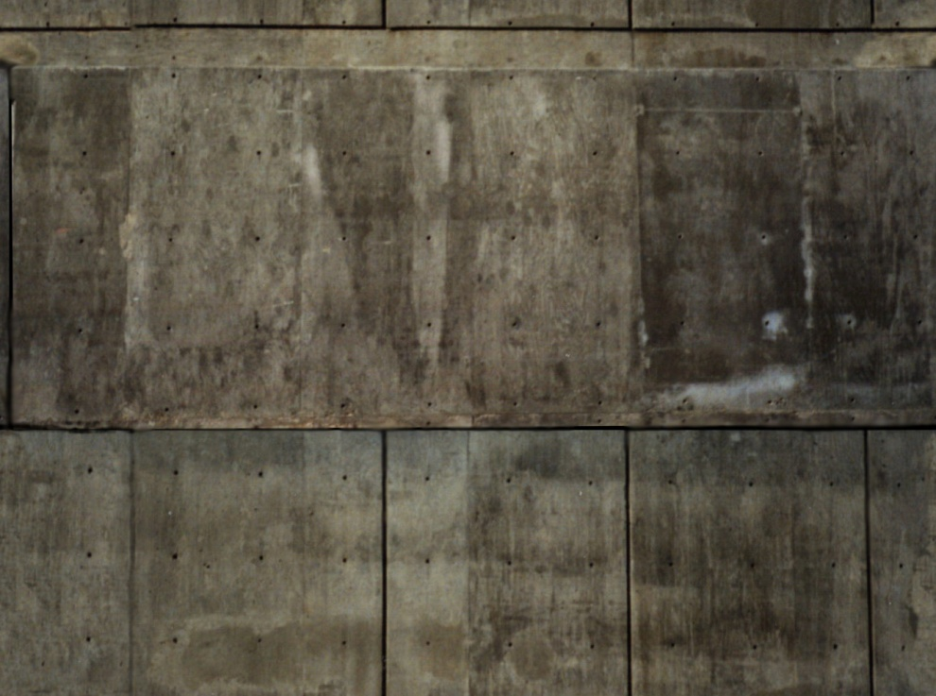
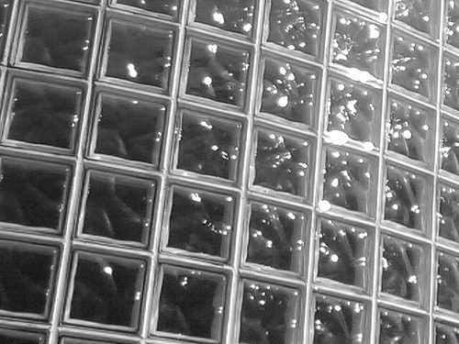
Slide credit: Kristen Grauman

Slide 31
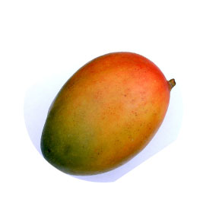
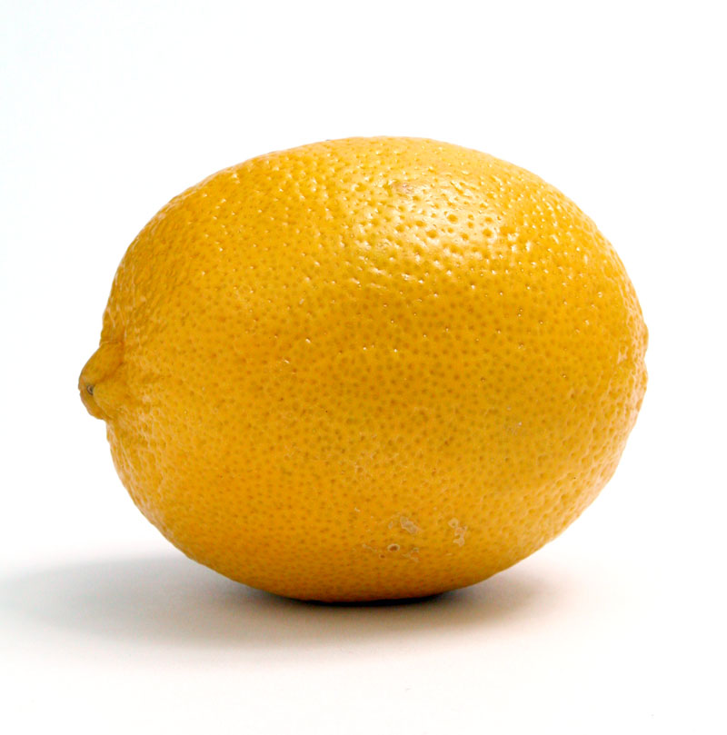
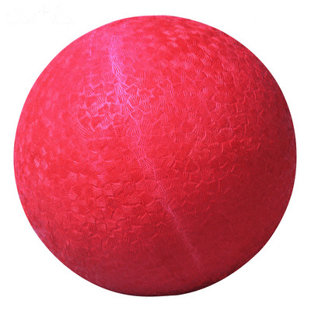
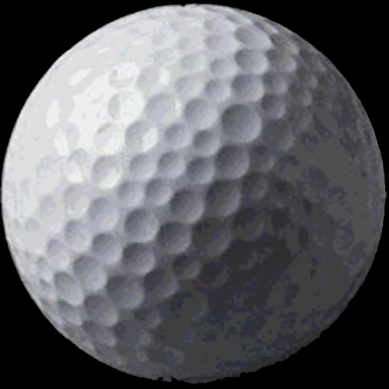
Slide credit: Kristen Grauman

Slide 32
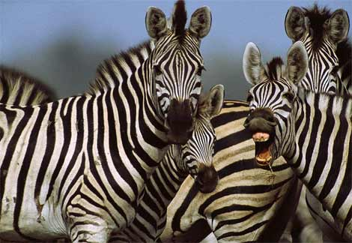
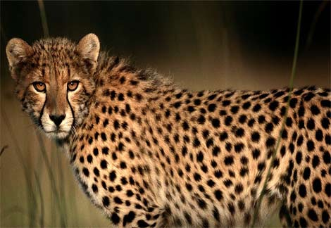
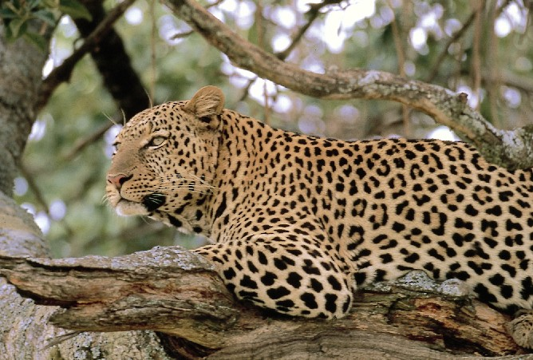
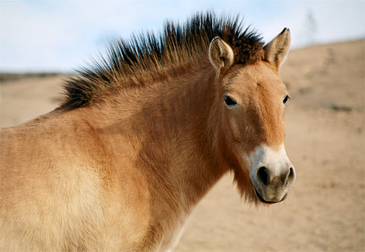
Slide credit: Kristen Grauman
http://animals.nationalgeographic.com/

Slide 33
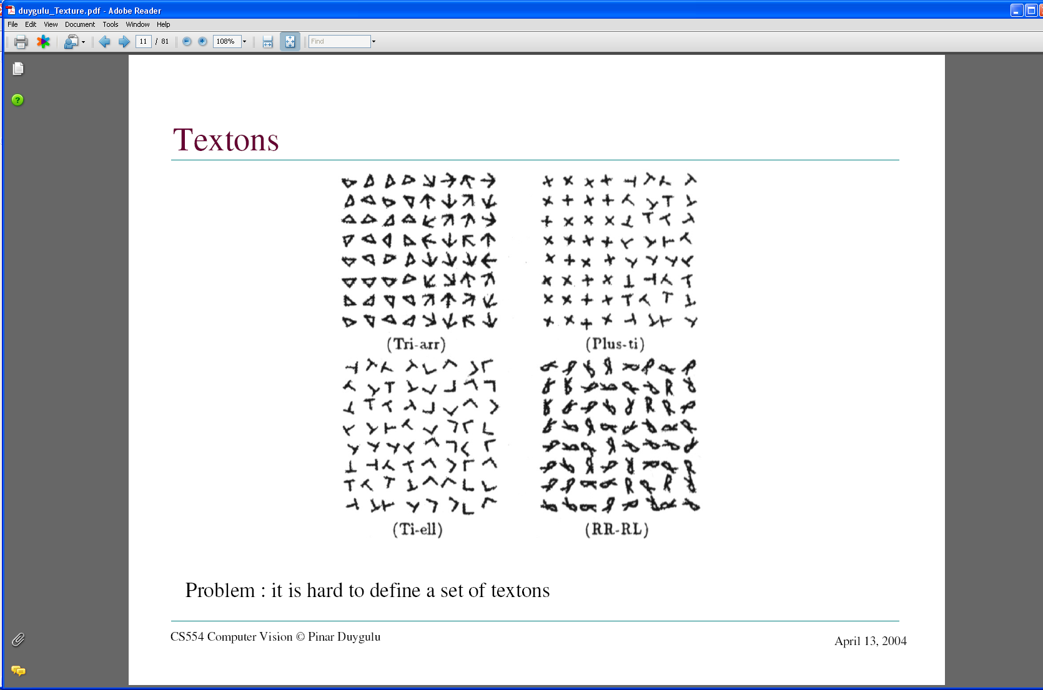
What kind of response will we get with an edge detector for these images?
Slide credit: Kristen Grauman
Images from Malik and Perona, 1990

Slide 34
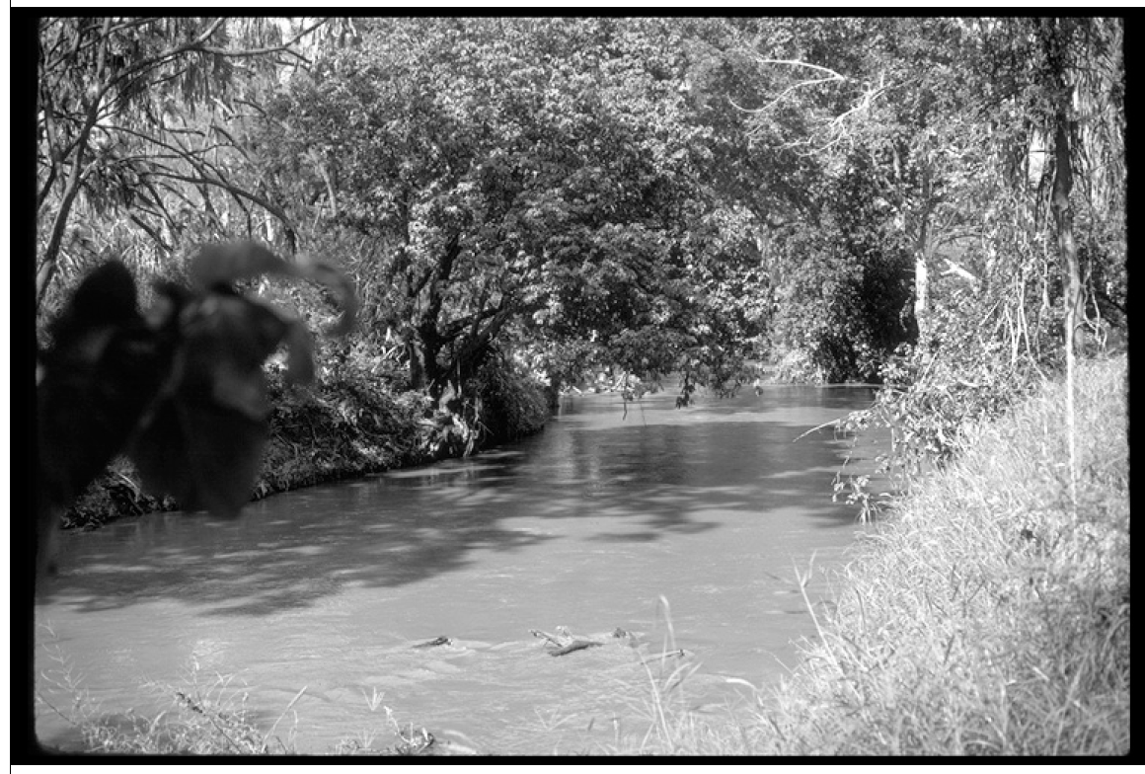
…and for this image?
Slide credit: Kristen Grauman
Image credit: D. Forsyth

Slide 35
Why analyze texture?
Importance to perception:
Often indicative of a material’s properties
Can be important appearance cue, especially if shape is similar across objects
Aim to distinguish between shape, boundaries, and texture
Technically:
Representation-wise, we want a feature one step above “building blocks” of filters, edges.
Slide credit: Kristen Grauman

Slide 36
Psychophysics of texture
Some textures distinguishable with preattentive perception– without scrutiny, eye movements [Julesz 1975]
Same or different?
Slide credit: Kristen Grauman

Slide 37
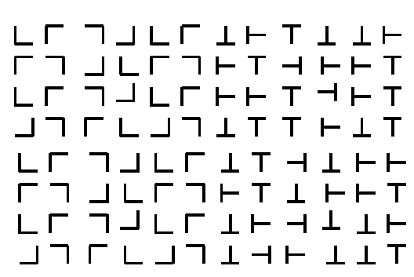
Slide credit: Kristen Grauman

Slide 38
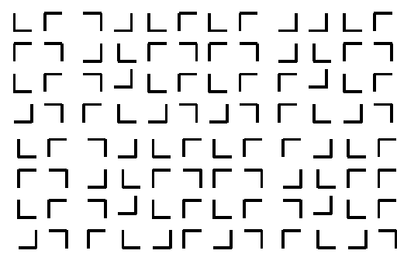
Slide credit: Kristen Grauman

Slide 39
Slide credit: Kristen Grauman

Slide 40
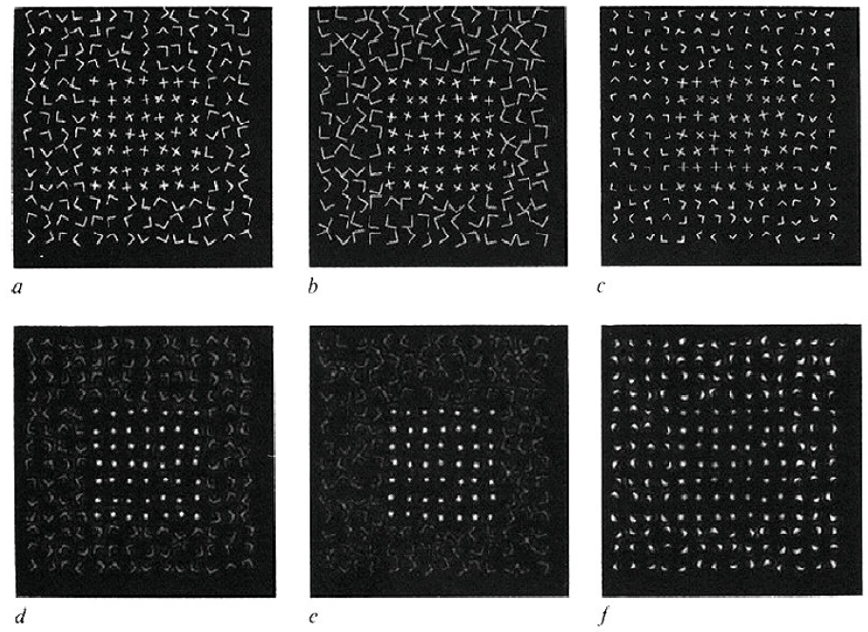
Capturing the local patterns with image measurements
[Bergen & Adelson, Nature 1988]
Scale of patterns influences discriminability
Size-tuned linear filters
Slide credit: Kristen Grauman

Slide 41
Texture representation
Textures are made up of repeated local patterns, so:
  Find the patterns
    Use filters that look like patterns (spots, bars, raw patches…)
    Consider magnitude of response
  Describe their statistics within each local window
    Mean, standard deviation
    Histogram
    Histogram of “prototypical” feature occurrences
Slide credit: Kristen Grauman

Slide 42
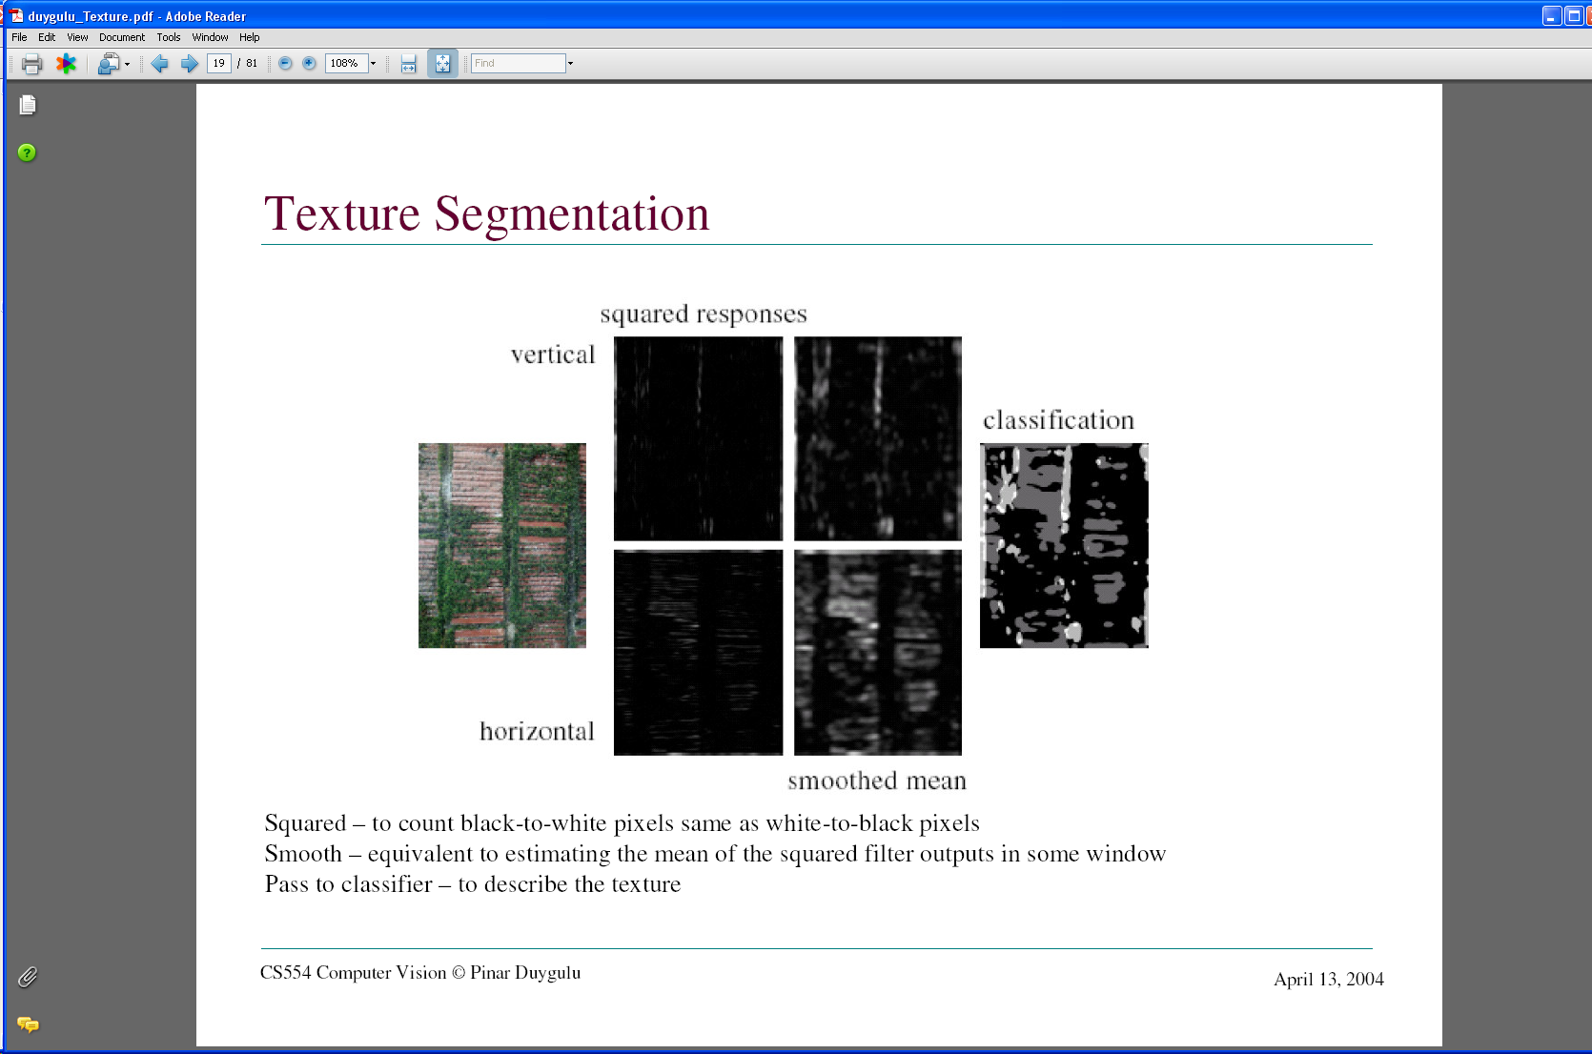
Texture representation: example
 | mean d/dx value | mean d/dy value
Win. #1 | 4 | 10
original image
…
statistics to summarize patterns in small windows
derivative filter responses, squared
Slide credit: Kristen Grauman

Slide 43
Texture representation: example
 | mean d/dx value | mean d/dy value
Win. #1 | 4 | 10
Win.#2 | 18 | 7
original image
…
statistics to summarize patterns in small windows
derivative filter responses, squared
Slide credit: Kristen Grauman

Slide 44
Texture representation: example
 | mean d/dx value | mean d/dy value
Win. #1 | 4 | 10
Win.#2 | 18 | 7
Win.#9 | 20 | 20
original image
…
…
statistics to summarize patterns in small windows
derivative filter responses, squared
Slide credit: Kristen Grauman

Slide 45
Texture representation: example
 | mean d/dx value | mean d/dy value
Win. #1 | 4 | 10
Win.#2 | 18 | 7
Win.#9 | 20 | 20
Dimension 2 (mean d/dy value)
Dimension 1 (mean d/dx value)
…
…
statistics to summarize patterns in small windows
Slide credit: Kristen Grauman

Slide 46
Texture representation: example
Windows with primarily horizontal edges
Both
 | mean d/dx value | mean d/dy value
Win. #1 | 4 | 10
Win.#2 | 18 | 7
Win.#9 | 20 | 20
Dimension 2 (mean d/dy value)
Dimension 1 (mean d/dx value)
…
…
Windows with small gradient in both directions
Windows with primarily vertical edges
statistics to summarize patterns in small windows
Slide credit: Kristen Grauman

Slide 47
Texture representation: example
original image
visualization of the assignment to texture “types”
derivative filter responses, squared
Slide credit: Kristen Grauman

Slide 48
Texture representation: example
 | mean d/dx value | mean d/dy value
Win. #1 | 4 | 10
Win.#2 | 18 | 7
Win.#9 | 20 | 20
Dimension 2 (mean d/dy value)
Far: dissimilar textures
Close: similar textures
Dimension 1 (mean d/dx value)
…
…
statistics to summarize patterns in small windows
Slide credit: Kristen Grauman

Slide 49
Texture representation: example
Dimension 2
Dimension 1
Slide credit: Kristen Grauman
Notes:
49

Slide 50
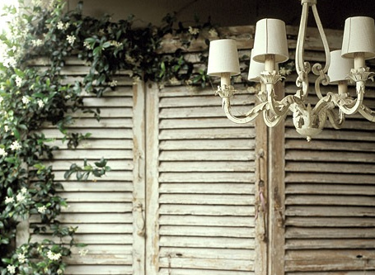
Texture representation: example
Dimension 2
Dimension 1
Distance reveals how dissimilar texture from window a is from texture in window b.
Slide credit: Kristen Grauman
Notes:
50

Slide 51
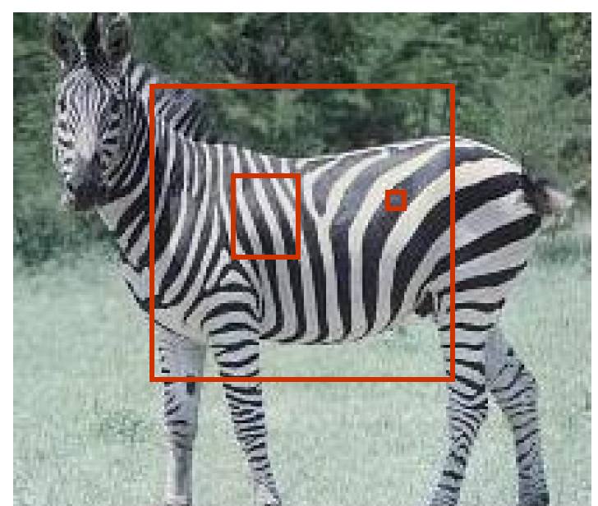
Texture representation: window scale
We’re assuming we know the relevant window size for which we collect these statistics.
Possible to perform scale selection by looking for window scale where texture description not changing.
Slide credit: Kristen Grauman

Slide 52
Filter banks
Our previous example used two filters, and resulted in a 2-dimensional feature vector to describe texture in a window.
  x and y derivatives revealed something about local structure.
We can generalize to apply a collection of multiple (d) filters: a “filter bank”
Then our feature vectors will be d-dimensional.
  still can think of nearness, farness in feature space
Slide credit: Kristen Grauman

Slide 53
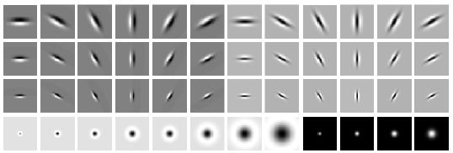
Filter banks
orientations
scales
“Edges”
“Bars”
“Spots”
What filters to put in the bank?
  Typically we want a combination of scales and orientations, different types of patterns.
Matlab code available for these examples: http://www.robots.ox.ac.uk/~vgg/research/texclass/filters.html
Slide credit: Kristen Grauman

Slide 54
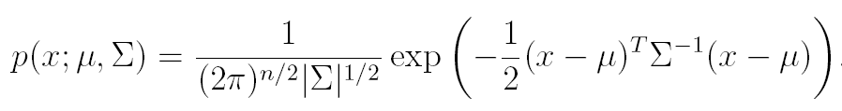
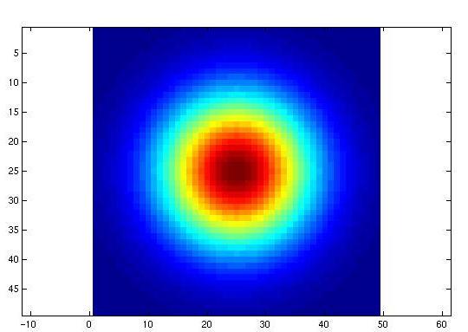
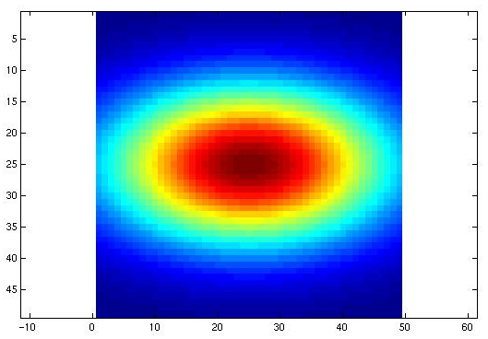

Multivariate Gaussian
Slide credit: Kristen Grauman

Slide 55

Filter bank
Slide credit: Kristen Grauman

Slide 56

Image from http://www.texasexplorer.com/austincap2.jpg
Slide credit: Kristen Grauman

Slide 57

Showing magnitude of responses
Slide credit: Kristen Grauman

Slide 58


Slide credit: Kristen Grauman
Notes:
2

Slide 59


Slide credit: Kristen Grauman
Notes:
3

Slide 60


Slide credit: Kristen Grauman
Notes:
4

Slide 61


Slide credit: Kristen Grauman

Slide 62


Slide credit: Kristen Grauman
Notes:
6

Slide 63


Slide credit: Kristen Grauman
Notes:
7

Slide 64


Slide credit: Kristen Grauman
Notes:
8

Slide 65


Slide credit: Kristen Grauman
Notes:
9

Slide 66


Slide credit: Kristen Grauman
Notes:
10

Slide 67


Slide credit: Kristen Grauman
Notes:
11

Slide 68


Slide credit: Kristen Grauman
Notes:
12

Slide 69


Slide credit: Kristen Grauman
Notes:
13

Slide 70


Slide credit: Kristen Grauman
Notes:
14

Slide 71


Slide credit: Kristen Grauman
Notes:
15

Slide 72


Slide credit: Kristen Grauman
Notes:
16

Slide 73


Slide credit: Kristen Grauman

Slide 74


Slide credit: Kristen Grauman
Notes:
18

Slide 75


Slide credit: Kristen Grauman

Slide 76






You try: Can you match the texture to the response?
Filters
A
B
1
2
C
3
Mean abs responses
Slide credit: Derek Hoiem

Slide 77

Representing texture by mean abs response
Filters
Slide credit: Derek Hoiem
Mean abs responses

Slide 78
[r1, r2, …, r38]
We can form a feature vector from the list of responses at each pixel.
Slide credit: Kristen Grauman

Slide 79
d-dimensional features
Euclidean distance (L₂)
. . .
2d
3d
Slide credit: Kristen Grauman

Slide 80
Example uses of texture in vision: analysis
Slide credit: Kristen Grauman

Slide 81

Classifying materials, “stuff”
Figure by Varma & Zisserman
Slide credit: Kristen Grauman

Slide 82

Texture features for image retrieval
Y. Rubner, C. Tomasi, and L. J. Guibas. The earth mover's distance as a metric for image retrieval. International Journal of Computer Vision, 40(2):99-121, November 2000,
Slide credit: Kristen Grauman

Slide 83


Characterizing scene categories by texture
L. W. Renninger and J. Malik. When is scene identification just texture recognition? Vision Research 44 (2004) 2301–2311
Slide credit: Kristen Grauman

Slide 84

Segmenting aerial imagery by textures
Slide credit: Kristen Grauman
http://www.airventure.org/2004/gallery/images/073104_satellite.jpg

Slide 85
Texture-related tasks
Shape from texture
  Estimate surface orientation or shape from image texture
Segmentation/classification from texture cues
  Analyze, represent texture
  Group image regions with consistent texture
Synthesis
  Generate new texture patches/images given some examples
Slide credit: Kristen Grauman

Slide 86
Texture synthesis
Goal: create new samples of a given texture
Many applications: virtual environments, hole-filling, texturing surfaces
Slide credit: Kristen Grauman

Slide 87


The Challenge
Need to model the whole spectrum: from repeated to stochastic texture
repeated
  Alexei A. Efros and Thomas K. Leung, “Texture Synthesis by Non-parametric Sampling,” Proc. International Conference on Computer Vision (ICCV), 1999.
stochastic
Both?
Slide credit: Kristen Grauman

Slide 88









Markov Chains
Markov Chain
  a sequence of random variables
  is the state of the model at time t
  Markov assumption: each state is dependent only on the previous one
    dependency given by a conditional probability:
  The above is actually a first-order Markov chain
  An N’th-order Markov chain:
Slide credit: Adapted by Devi Parikh from Kristen Grauman
Source S. Seitz

Slide 89

Markov Chain Example: Text
“A dog is a man’s best friend. It’s a dog eat dog world out there.”
a
dog
is
man’s
best
friend
it’s
eat
world
p(dog|a) = ?
out
there
.
a
dog
is
it’s
eat
out
.
best
friend
there
man’s
world
Slide credit: Adapted by Devi Parikh from Steve Seitz

Slide 90
Markov Chain Example: Text
“A dog is a man’s best friend. It’s a dog eat dog world out there.”
a
 | 2/3 |  | 1/3
 |  | 1/3 |  |  |  |  | 1/3 | 1/3
1
 |  |  |  | 1
 |  |  |  |  | 1
 |  |  |  |  |  |  |  |  |  |  | 1
1
 | 1
 |  |  |  |  |  |  |  |  | 1
 |  |  |  |  |  |  |  |  |  | 1
 |  |  |  |  |  |  |  |  |  |  | 1
 |  |  |  |  |  | 1
dog
is
man’s
best
friend
it’s
eat
world
out
there
.
a
dog
is
it’s
eat
out
.
best
friend
there
man’s
world
Slide credit: Steve Seitz

Slide 91



Text synthesis
Create plausible looking poetry, love letters, term papers, etc.
Most basic algorithm
  Build probability histogram
    find all blocks of N consecutive words/letters in training documents
    compute probability of occurrence
  Given words
    compute by sampling from
WE NEED
TO
EAT
CAKE
Slide credit: Steve Seitz

Slide 92
Text synthesis
Results:
  “As I've commented before, really relating to someone involves standing next to impossible.”
  "One morning I shot an elephant in my arms and kissed him.”
  "I spent an interesting evening recently with a grain of salt"
Dewdney, “A potpourri of programmed prose and prosody” Scientific American, 1989.
Slide from Alyosha Efros, ICCV 1999

Slide 93

Synthesizing Computer Vision text
What do we get if we extract the probabilities from a chapter on Linear Filters, and then synthesize new statements?
Check out Yisong Yue’s website implementing text generation: build your own text Markov Chain for a given text corpus. http://www.yisongyue.com/shaney/index.php
Slide credit: Kristen Grauman

Slide 94
Synthesized text
This means we cannot obtain a separate copy of the best studied regions in the sum.
All this activity will result in the primate visual system.
The response is also Gaussian, and hence isn’t bandlimited.
Instead, we need to know only its response to any data vector, we need to apply a low pass filter that strongly reduces the content of the Fourier transform of a very large standard deviation.
It is clear how this integral exist (it is sufficient for all pixels within a 2k +1 × 2k +1 × 2k +1 × 2k + 1 — required for the images separately.
Slide credit: Kristen Grauman

Slide 95

Markov Random Field
A Markov random field (MRF)
  generalization of Markov chains to two or more dimensions.
First-order MRF:
  probability that pixel X takes a certain value given the values of neighbors A, B, C, and D:
A
D
X
B
C
Slide credit: Steve Seitz

Slide 96




Texture Synthesis [Efros & Leung, ICCV 99]
Can apply 2D version of text synthesis
Texture corpus (sample)
Output
Slide from Alyosha Efros, ICCV 1999

Slide 97

Texture synthesis: intuition
Before, we inserted the next word based on existing nearby words…
Now we want to insert pixel intensities based on existing nearby pixel values.
Place we want to insert next
Sample of the texture
(“corpus”)
Distribution of a value of a pixel is conditioned on its neighbors alone.
Slide credit: Kristen Grauman

Slide 98


Synthesizing One Pixel
p
input image
synthesized image
  What is ?
  Find all the windows in the image that match the neighborhood
  To synthesize x
    pick one matching window at random
    assign x to be the center pixel of that window
  An exact neighbourhood match might not be present, so find the best matches using SSD error and randomly choose between them, preferring better matches with higher probability
Slide from Alyosha Efros, ICCV 1999

Slide 99




Neighborhood Window
input
Slide from Alyosha Efros, ICCV 1999

Slide 100









Varying Window Size
Increasing window size
Slide from Alyosha Efros, ICCV 1999

Slide 101



Growing Texture
  Starting from the initial image, “grow” the texture one pixel at a time
Slide from Alyosha Efros, ICCV 1999

Slide 102




Synthesis results
french canvas
rafia weave
Slide from Alyosha Efros, ICCV 1999

Slide 103


Synthesis results
white bread
brick wall
Slide from Alyosha Efros, ICCV 1999

Slide 104


Synthesis results
Slide from Alyosha Efros, ICCV 1999

Slide 105




Failure Cases
Growing garbage
Verbatim copying
Slide from Alyosha Efros, ICCV 1999

Slide 106






Hole Filling
Slide from Alyosha Efros, ICCV 1999

Slide 107




Extrapolation
Slide from Alyosha Efros, ICCV 1999

Slide 108
The Efros & Leung algorithm
  Simple
  Surprisingly good results
  Synthesis is easier than analysis!
  …but very slow
Slide credit: Kristen Grauman

Slide 109
Image Quilting [Efros & Freeman 2001]
non-parametric
sampling
p
B
Input image
Synthesizing a block
Observation: neighbor pixels are highly correlated
Idea: unit of synthesis = block
  Exactly the same but now we want P(B|N(B))
  Much faster: synthesize all pixels in a block at once
Slide from Alyosha Efros, ICCV 1999

Slide 110







block
Input texture
B1
B2
B1
B2
B1
B2
Random placement
of blocks
Neighboring blocks
constrained by overlap
Minimal error
boundary cut
Slide credit: Kristen Grauman

Slide 111








Minimal error boundary
overlapping blocks
vertical boundary
2
_
=
overlap error
min. error boundary
Slide credit: Alyosha Efros

Slide 112




Slide credit: Kristen Grauman

Slide 113




Slide credit: Kristen Grauman

Slide 114
Slide credit: Kristen Grauman

Slide 115




Slide credit: Kristen Grauman

Slide 116


Slide credit: Kristen Grauman

Slide 117





Slide credit: Kristen Grauman

Slide 118
Failures
(Chernobyl
Harvest)
Slide credit: Kristen Grauman

Slide 119

Texture Transfer
Take the texture from one object and “paint” it onto another object
  This requires separating texture and shape
  That’s HARD, but we can cheat
  Assume we can capture shape by boundary and rough shading
Then, just add another constraint when sampling: similarity to underlying image at that spot
Slide credit: Kristen Grauman

Slide 120
parmesan
+
=
rice
+
=
Slide credit: Kristen Grauman

Slide 121



+
=
Slide credit: Kristen Grauman

Slide 122



+
=
Slide credit: Kristen Grauman

Slide 123

(Manual) texture synthesis in the media
Slide credit: Kristen Grauman

Slide 124
(Manual) texture synthesis in the media
Slide credit: Kristen Grauman

Slide 125

http://www.dailykos.com/story/2004/10/27/22442/878
Slide credit: Kristen Grauman

Slide 126


Synthesizing textures when constructing 3d models of archaeological sites
A. Zalesny et al., Realistic Textures for Virtual Anastylosis
Slide credit: Kristen Grauman

Slide 127
Summary
Texture is a useful property that is often indicative of materials, appearance cues
Texture representations attempt to summarize repeating patterns of local structure
Filter banks useful to measure redundant variety of structures in local neighborhood
  Feature spaces can be multi-dimensional
Neighborhood statistics can be exploited to “sample” or synthesize new texture regions
  Example-based technique
Slide credit: Kristen Grauman

Slide 128










So far: features and filters
Transforming and describing images; textures, colors, edges
Slide credit: Kristen Grauman

Slide 129
Questions?
See you Thursday!

