Slide 1
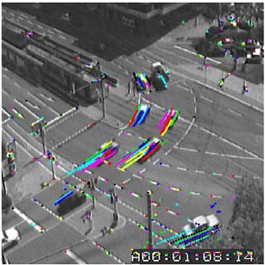


Tracking
Tuesday, November 19
Devi Parikh
Virginia Tech

Slide 2
Announcements
PS5 out last night, due in 2 weeks
PS4 due last night
Project reports due Saturday
  Outline over email
  Questions?

Slide 3
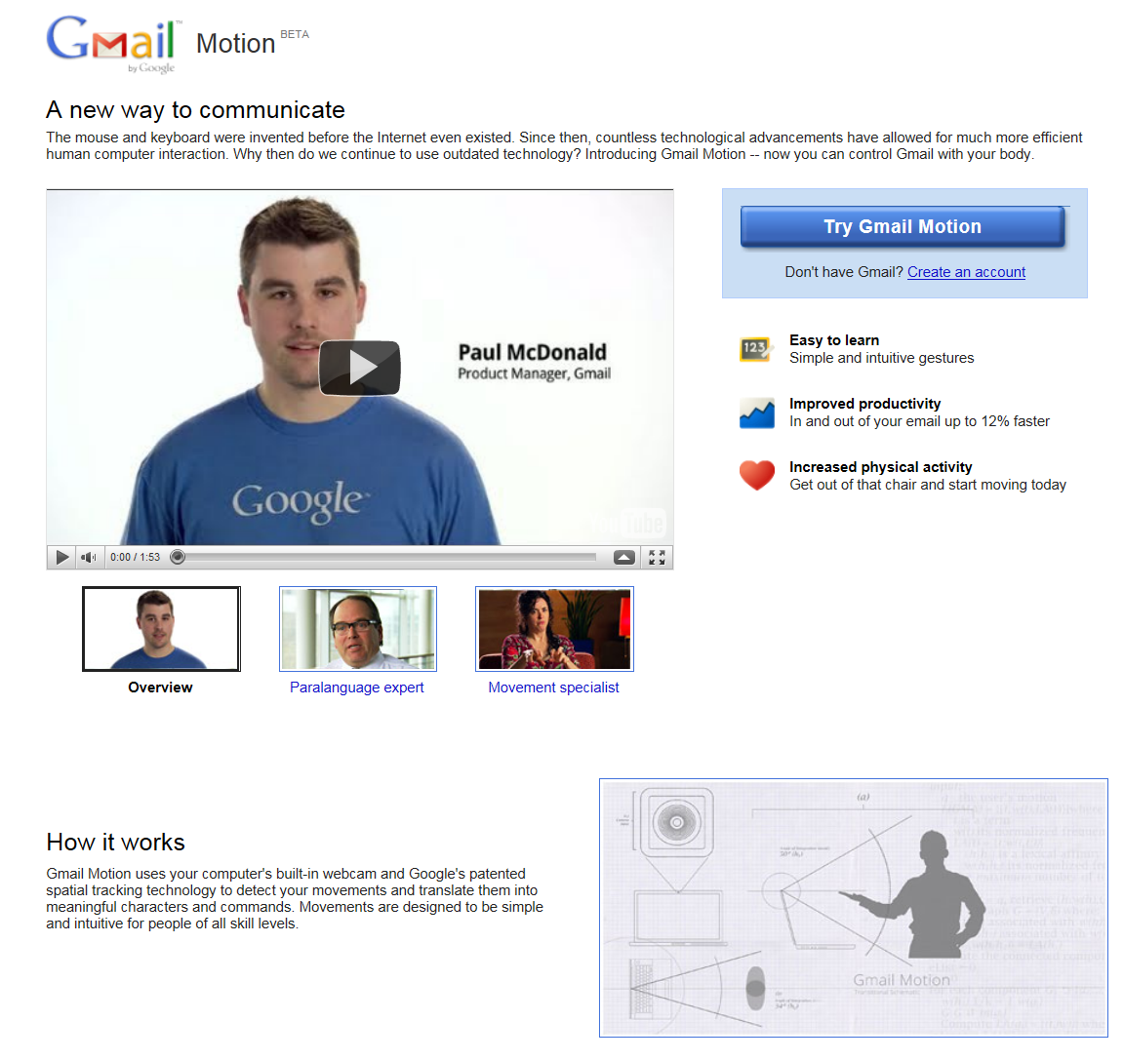
Notes:
http://mail.google.com/mail/help/motion.html

Slide 4
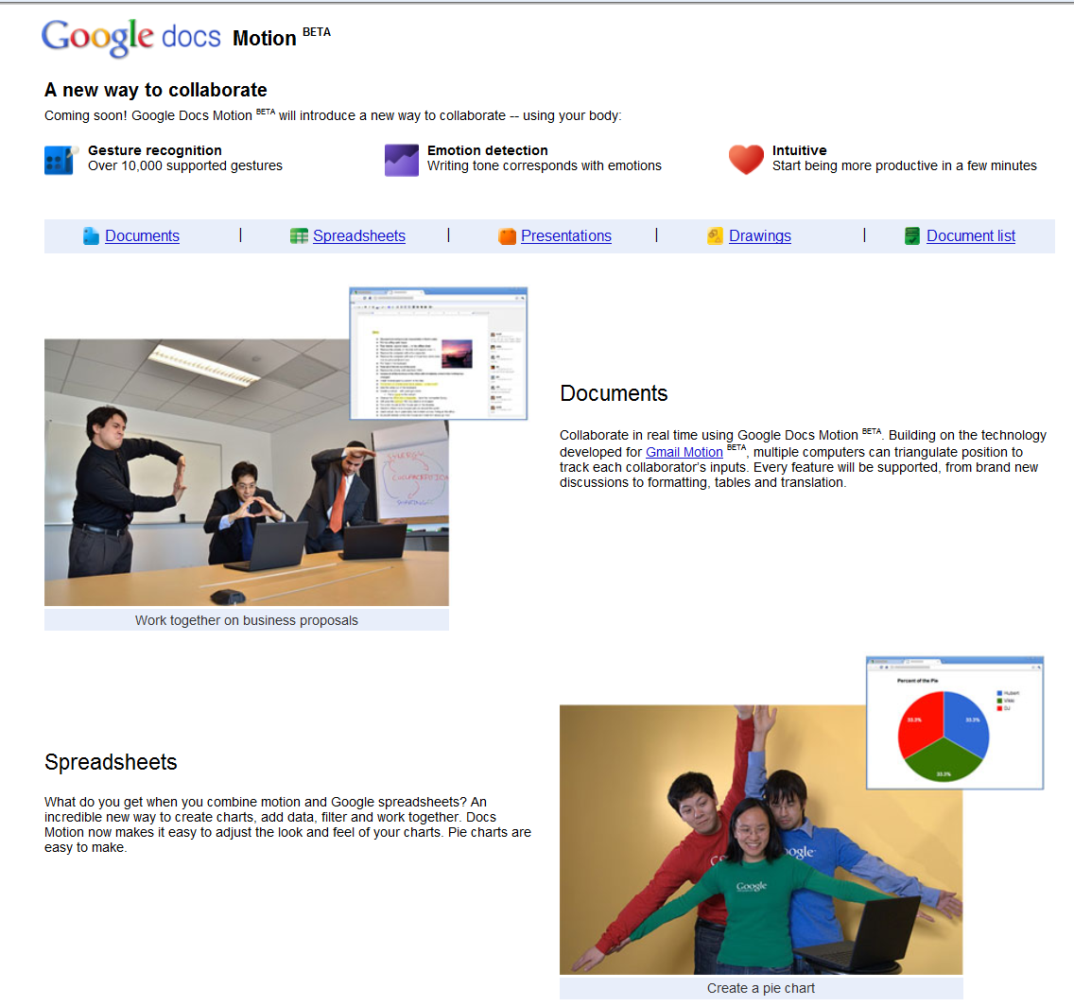

Slide 5
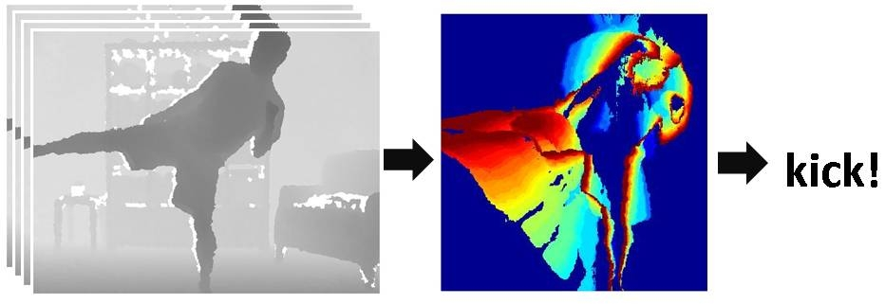
Pset 5
Depth map sequence
Motion History Image
Nearest neighbor action classification with Motion History Images + Hu moments
Kristen Grauman

Slide 6

Motion and perceptual organization
Even “impoverished” motion data can evoke a strong percept
Video from Davis & Bobick

Slide 7
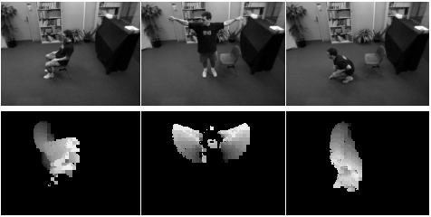
Motion History Images
D(x,y,t): Binary image sequence indicating motion locations
Davis & Bobick 1999: The Representation and Recognition of Action Using Temporal Templates

Slide 8




Image moments
Use to summarize shape given image I(x,y)
Central moments are translation invariant:

Slide 9
Hu moments
Set of 7 moments
Apply to Motion History Image for global space-time “shape” descriptor
Translation and rotation invariant

Slide 10
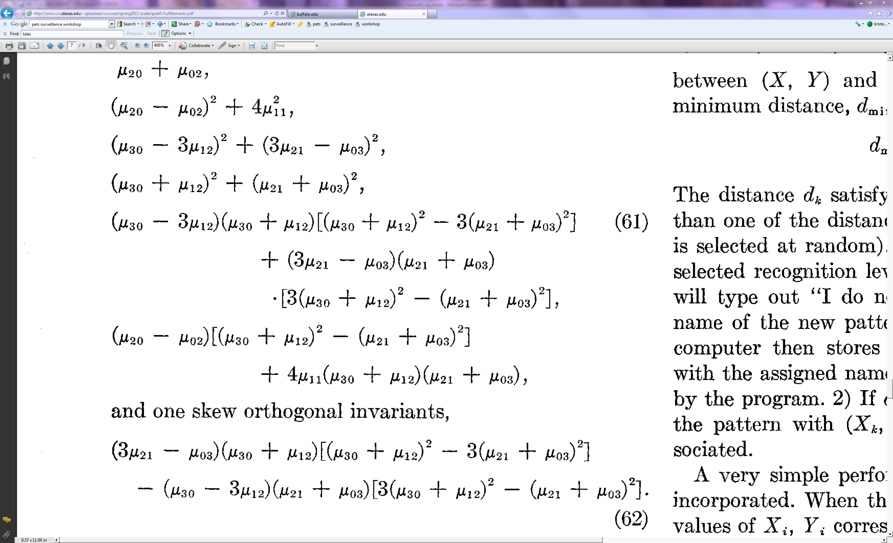
Hu moments

Slide 12
Normalized Euclidean distance
Normalize according to variance in each dimension
What does this do for our distance computation?
Kristen Grauman

Slide 13
Leave-one-out cross validation
Cycle through data points, treating each one as the “test” case in turn, and training with the remaining labeled examples.
Report results over all such test cases

Slide 14
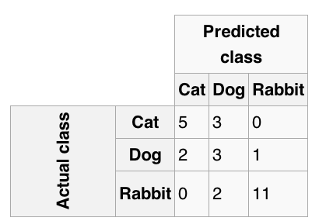
Confusion Matrix

Slide 15
Outline
Today: Tracking
  Tracking as inference
  Linear models of dynamics
  Kalman filters
  General challenges in tracking

Slide 16
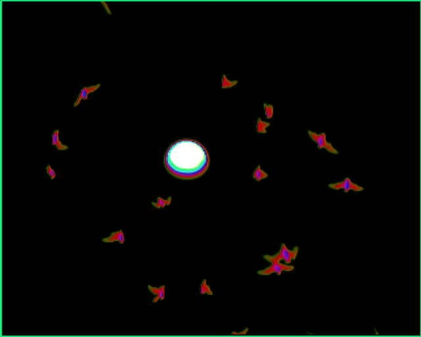
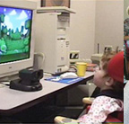
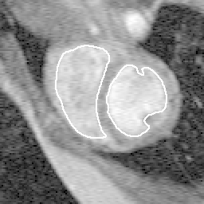
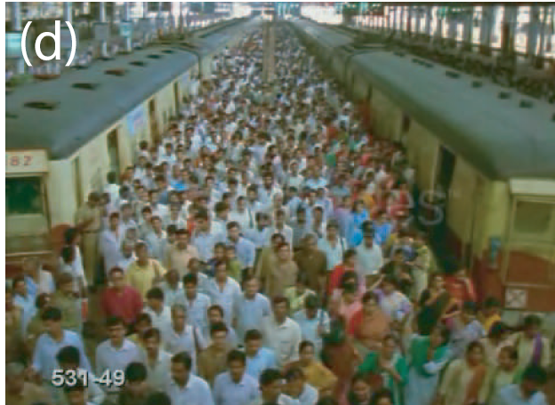
Tracking: some applications
Body pose tracking, activity recognition
Censusing a bat population
Video-based interfaces
Medical apps
Surveillance
Kristen Grauman

Slide 17
Tracking Examples
Soccer: http://www.youtube.com/watch?v=ZqQIItFAnxg
Face: http://www.youtube.com/watch?v=i_bZNVmhJ2o
Body: http://www.youtube.com/watch?v=gRyo-DM2F6E
Eye: http://www.youtube.com/watch?v=NCtYdUEMotg
Gaze: http://www.youtube.com/watch?v=-G6Rw5cU-1c

Slide 18
Further applications
Motion capture
Augmented Reality
Action Recognition
Security, traffic monitoring
Video Compression
Video Summarization
Medical Screening

Slide 19
Why is tracking challenging?
Small, few visual features
Erratic movements, Moving very quickly
Occlusions, leaving and coming back
Surrounding similar-looking objects

Slide 20
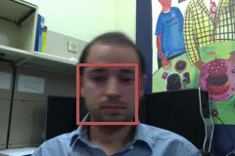
Strategies for tracking
Tracking by repeated detection
  Works well if object is easily detectable (e.g., face or colored glove) and there is only one
  Need some way to link up detections
  Best you can do, if you can’t predict motion

Slide 21
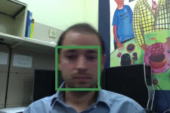
Tracking with dynamics
Key idea: Based on a model of expected motion, predict where objects will occur in next frame, before even seeing the image
  Restrict search for the object
  measurement noise is reduced by trajectory smoothness
  Robustness to missing or weak observations

Slide 22
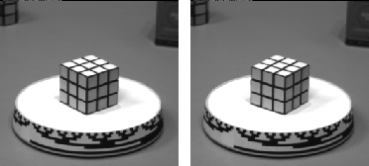
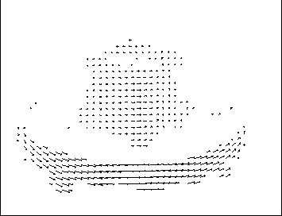
Optical flow for tracking?
If we have more than just a pair of frames, we could compute flow from one to the next:
But flow only reliable for small motions, and we may have occlusions, textureless regions that yield bad estimates anyway…
…
…

Slide 23
Motion estimation techniques
Direct methods
  Directly recover image motion at each pixel from spatio-temporal image brightness variations
  Dense motion fields, but sensitive to appearance variations
  Suitable for video and when image motion is small
Feature-based methods
  Extract visual features (corners, textured areas) and track them over multiple frames
  Sparse motion fields, but more robust tracking
  Suitable when image motion is large (10s of pixels)

Slide 24
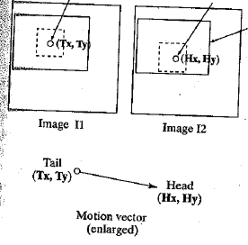
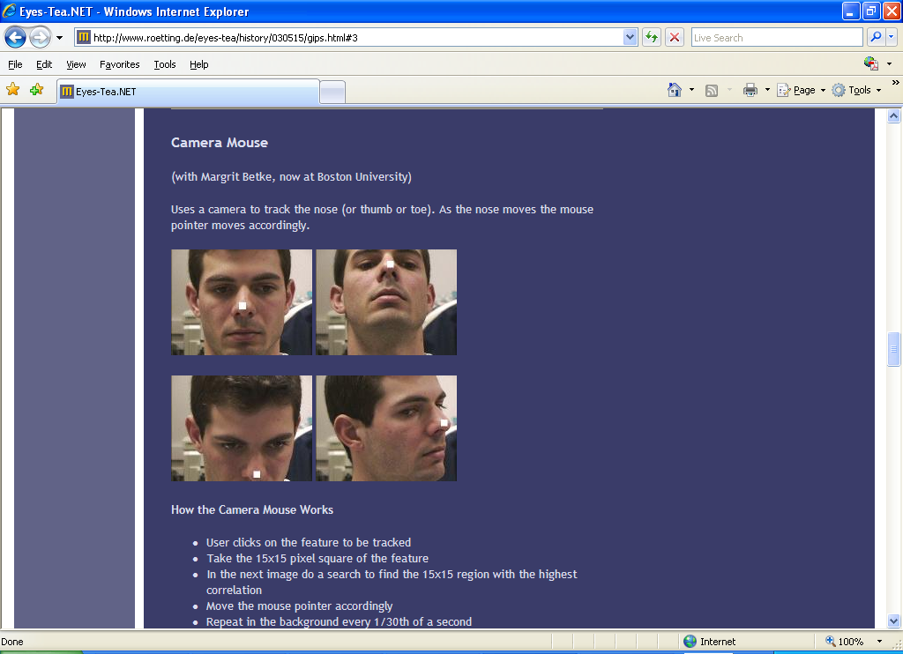
Feature-based matching for motion
Best matching neighborhood
Interesting point
Time t
Time t+1
Search window
Search window is centered at the point where we last saw the feature, in image I1.
Best match = position where we have the highest normalized cross-correlation value.
Kristen Grauman

Slide 25
Example: A Camera Mouse
Video interface: use feature tracking as mouse replacement
User clicks on the feature to be tracked
Take the 15x15 pixel square of the feature
In the next image do a search to find the 15x15 region with the highest correlation
Move the mouse pointer accordingly
Repeat in the background every 1/30th of a second
James Gips and Margrit Betke
http://www.bc.edu/schools/csom/eagleeyes/
Kristen Grauman

Slide 26
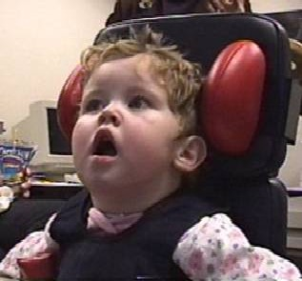
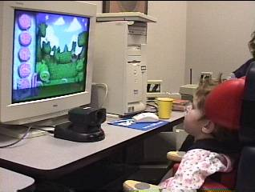
Example: A Camera Mouse
Specialized software for communication, games
James Gips and Margrit Betke
http://www.bc.edu/schools/csom/eagleeyes/
Kristen Grauman

Slide 27
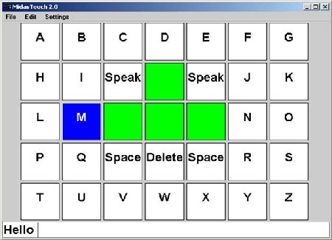
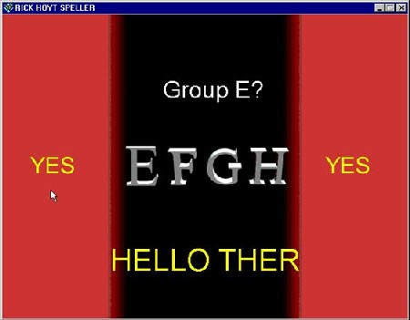
A Camera Mouse
Specialized software for communication, games
James Gips and Margrit Betke
http://www.bc.edu/schools/csom/eagleeyes/
Kristen Grauman

Slide 28
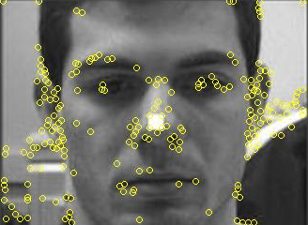
Feature-based matching for motion
For a discrete matching search, what are the tradeoffs of the chosen search window size?
Which patches to track?
  Select interest points – e.g. corners
Where should the search window be placed?
  Near match at previous frame
  More generally, taking into account the expected dynamics of the object
Kristen Grauman

Slide 29
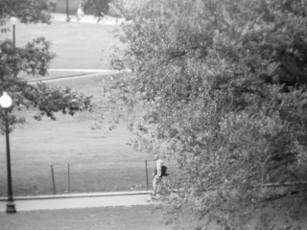
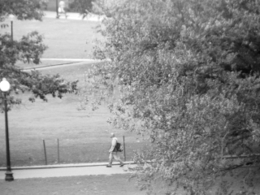
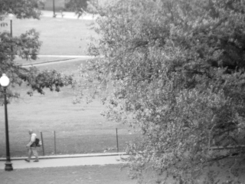

Detection vs. tracking
…
t=1
t=2
t=20
t=21
Kristen Grauman

Slide 30
Detection vs. tracking
…
Detection: We detect the object independently in each frame and can record its position over time, e.g., based on blob’s centroid or detection window coordinates
Kristen Grauman

Slide 31
Detection vs. tracking
…
Tracking with dynamics: We use image measurements to estimate position of object, but also incorporate position predicted by dynamics, i.e., our expectation of object’s motion pattern.
Kristen Grauman

Slide 32
Detection vs. tracking
…
Tracking with dynamics: We use image measurements to estimate position of object, but also incorporate position predicted by dynamics, i.e., our expectation of object’s motion pattern.
Kristen Grauman

Slide 33
Tracking with dynamics
Use model of expected motion to predict where objects will occur in next frame, even before seeing the image.
Intent:
  Do less work looking for the object, restrict the search.
  Get improved estimates since measurement noise is tempered by smoothness, dynamics priors.
Assumption: continuous motion patterns:
  Camera is not moving instantly to new viewpoint
  Objects do not disappear and reappear in different places in the scene
  Gradual change in pose between camera and scene
Kristen Grauman

Slide 34
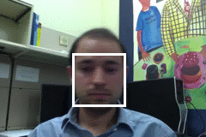
Tracking as inference
The hidden state consists of the true parameters we care about, denoted X.
The measurement is our noisy observation that results from the underlying state, denoted Y.
At each time step, state changes (from X_{t-1} to X_{t} ) and we get a new observation Y_{t}.
Kristen Grauman

Slide 35
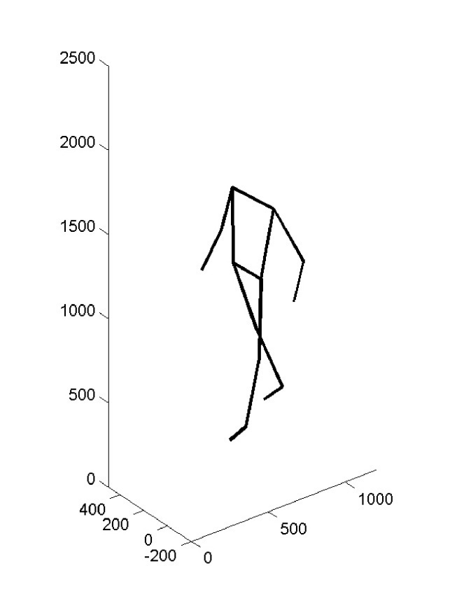
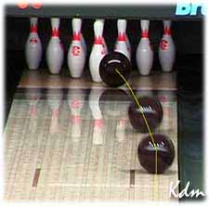
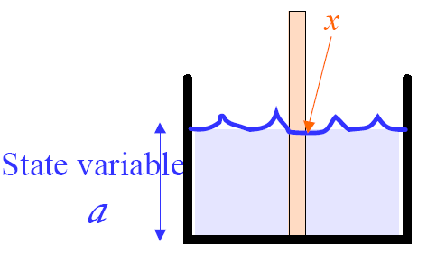
State vs. observation
Hidden state : parameters of interest
Measurement : what we get to directly observe
Kristen Grauman

Slide 36
Tracking as inference
The hidden state consists of the true parameters we care about, denoted X.
The measurement is our noisy observation that results from the underlying state, denoted Y.
At each time step, state changes (from X_{t-1} to X_{t} ) and we get a new observation Y_{t}.
Our goal: recover most likely state X_{t} given
  All observations seen so far.
  Knowledge about dynamics of state transitions.
Kristen Grauman

Slide 37
Tracking as inference: intuition
Time t
Time t+1
Belief
Measurement
Corrected prediction
Kristen Grauman

Slide 38
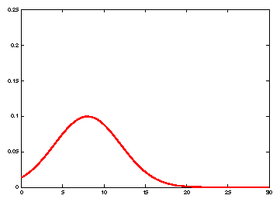
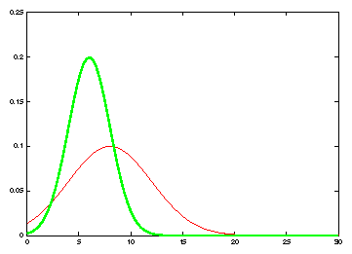
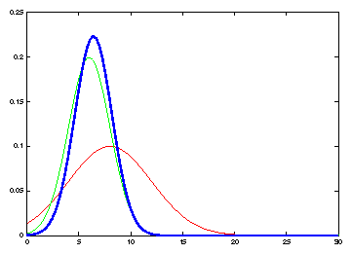
Tracking as inference: intuition
measurement
Belief: prediction
Belief: prediction
Corrected prediction
measurement
old belief
Time t
Time t+1
Kristen Grauman

Slide 39
Independence assumptions
Only immediate past state influences current state
Measurement at time t depends on current state
dynamics model
observation model
Kristen Grauman

Slide 40
Tracking as inference
Prediction:
  Given the measurements we have seen up to this point, what state should we predict?
Correction:
  Now given the current measurement, what state should we predict?
Kristen Grauman

Slide 41
Questions
How to represent the known dynamics that govern the changes in the states?
How to represent relationship between state and measurements, plus our uncertainty in the measurements?
How to compute each cycle of updates?
Representation: We’ll consider the class of linear dynamic models, with associated Gaussian pdfs.
Updates: via the Kalman filter.
Kristen Grauman

Slide 42
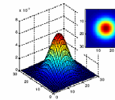
Notation reminder
Random variable with Gaussian probability distribution that has the mean vector μ and covariance matrix Σ.
x and μ are d-dimensional, Σ is d x d.
d=2
d=1
If x is 1-d, we just have one Σ parameter -→ the variance: σ²
Kristen Grauman

Slide 43
Linear dynamic model
Describe the a priori knowledge about
  System dynamics model: represents evolution of state over time.
  Measurement model: at every time step we get a noisy measurement of the state.
n x 1
n x n
n x 1
m x 1
m x n
n x 1
Kristen Grauman

Slide 44
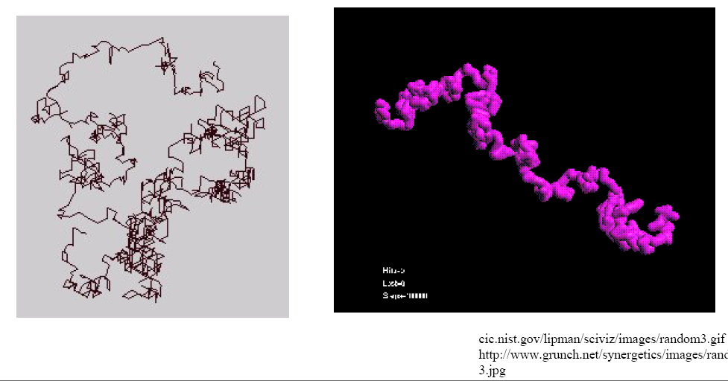
Example: randomly drifting points
Consider a stationary object, with state as position
Position is constant, only motion due to random noise term.
State evolution is described by identity matrix D=I

Slide 45
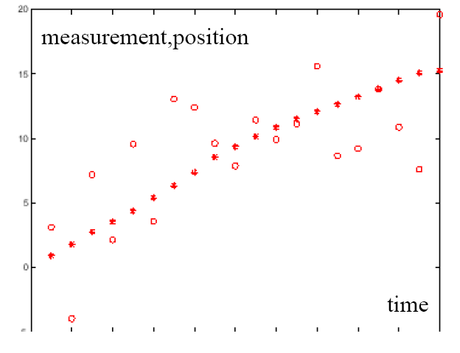
Example: Constant velocity (1D points)
1 d position
1 d position
measurements
states
time
Kristen Grauman

Slide 46
Example: Constant velocity (1D points)
State vector: position p and velocity v
Measurement is position only
Kristen Grauman

Slide 47
Questions
How to represent the known dynamics that govern the changes in the states?
How to represent relationship between state and measurements, plus our uncertainty in the measurements?
How to compute each cycle of updates?
Representation: We’ll consider the class of linear dynamic models, with associated Gaussian pdfs.
Updates: via the Kalman filter.
Kristen Grauman

Slide 48
The Kalman filter
Method for tracking linear dynamical models in Gaussian noise
The predicted/corrected state distributions are Gaussian
  Only need to maintain the mean and covariance
  The calculations are easy
Kristen Grauman

Slide 49
Kalman filter
Know corrected state from previous time step, and all measurements up to the current one →
Predict distribution over next state.
Know prediction of state, and next measurement →
Update distribution over current state.
Receive measurement
Time update
(“Predict”)
Measurement update
(“Correct”)
Mean and std. dev.
of predicted state:
Time advances: t++
Mean and std. dev.
of corrected state:
Kristen Grauman

Slide 50
1D Kalman filter: Prediction
Have linear dynamic model defining predicted state evolution, with noise
Want to estimate predicted distribution for next state
Update the mean:
Update the variance:
Lana Lazebnik

Slide 51
1D Kalman filter: Correction
Have linear model defining the mapping of state to measurements:
Want to estimate corrected distribution given latest meas.:
Update the mean:
Update the variance:
Lana Lazebnik

Slide 52
Prediction vs. correction
What if there is no prediction uncertainty
What if there is no measurement uncertainty
The measurement is ignored!
The prediction is ignored!
Lana Lazebnik

Slide 53
Prediction vs. correction
What if there is no prediction uncertainty?
What if there is no measurement uncertainty?
The measurement is ignored!
The prediction is ignored!
Lana Lazebnik

Slide 54
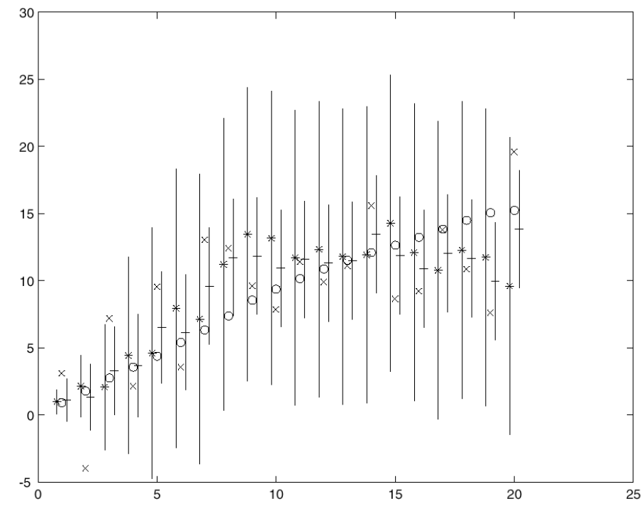
Constant velocity model
Kalman filter processing
o state
x measurement
* predicted mean estimate
+ corrected mean estimate
bars: variance estimates before and after measurements
position
time
Kristen Grauman
Time t
Time t+1

Slide 55
Constant velocity model
Kalman filter processing
o state
x measurement
* predicted mean estimate
+ corrected mean estimate
bars: variance estimates before and after measurements
position
time
Kristen Grauman
Time t
Time t+1

Slide 56
Constant velocity model
Kalman filter processing
o state
x measurement
* predicted mean estimate
+ corrected mean estimate
bars: variance estimates before and after measurements
position
time
Kristen Grauman
Time t
Time t+1

Slide 57
Constant velocity model
Kalman filter processing
o state
x measurement
* predicted mean estimate
+ corrected mean estimate
bars: variance estimates before and after measurements
position
time
Kristen Grauman
Time t
Time t+1

Slide 58
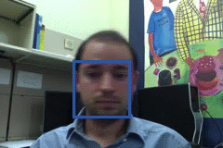
Example: Kalman Filter
Ground Truth
Observation
Correction
Next Frame
Update Location, Velocity, etc.
Prediction

Slide 59
Comparison
Ground Truth
Observation
Correction

Slide 60
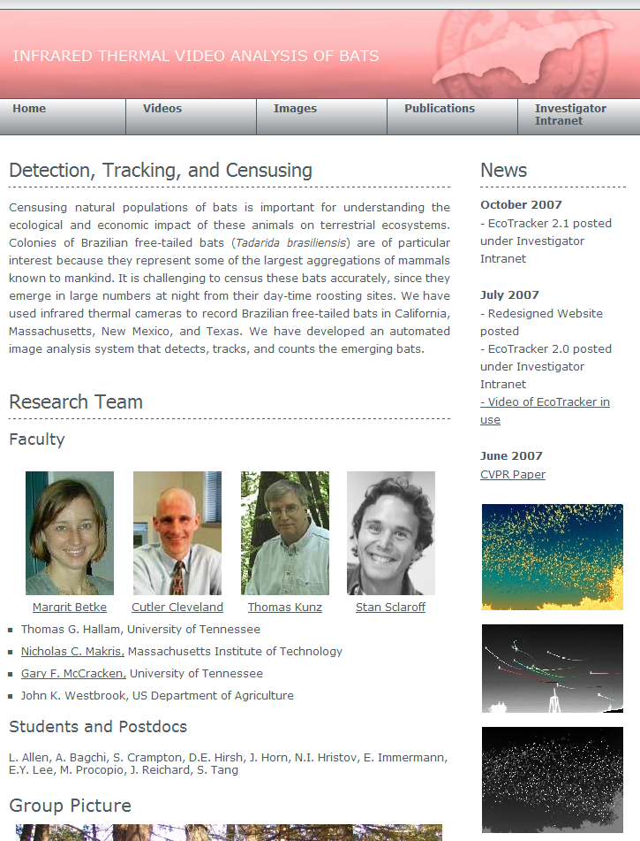
http://www.cs.bu.edu/~betke/research/bats/
Kristen Grauman

Slide 61
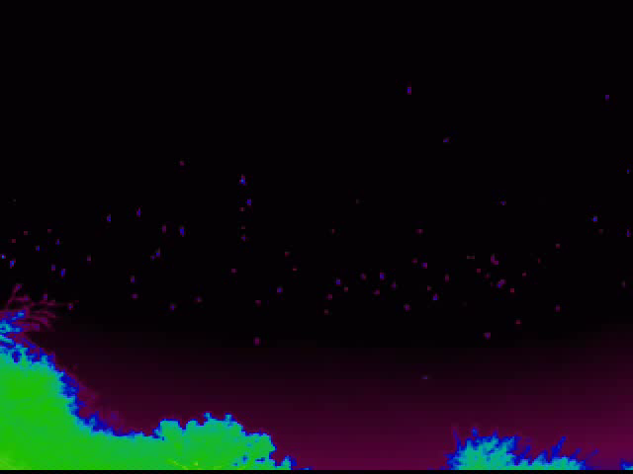
A bat census
http://www.cs.bu.edu/~betke/research/bats/
Kristen Grauman

Slide 62
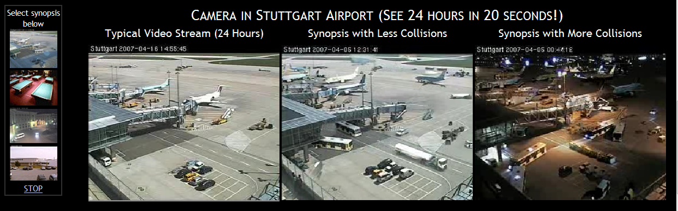
Video synopsis
http://www.vision.huji.ac.il/video-synopsis/
Kristen Grauman
Notes:
http://www.vision.huji.ac.il/video-synopsis/

Slide 63
Tracking: issues
Initialization
  Often done manually
  Background subtraction, detection can also be used
Data association, multiple tracked objects
  Occlusions, clutter

Slide 64
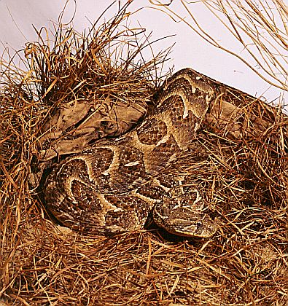
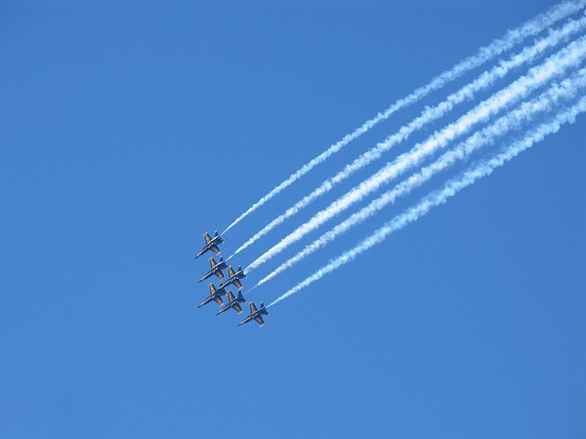
Tracking: issues
Initialization
  Often done manually
  Background subtraction, detection can also be used
Data association, multiple tracked objects
  Occlusions, clutter
  Which measurements go with which tracks?

Slide 65
Tracking: issues
Initialization
  Often done manually
  Background subtraction, detection can also be used
Data association, multiple tracked objects
  Occlusions, clutter
Deformable and articulated objects

Slide 66
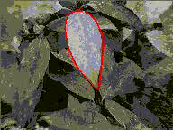
Recall: tracking via deformable contours
Use final contour/model extracted at frame t as an initial solution for frame t+1
Evolve initial contour to fit exact object boundary at frame t+1
Repeat, initializing with most recent frame.
Visual Dynamics Group, Dept. Engineering Science, University of Oxford.

Slide 67
Tracking issues
Initialization
Obtaining observation and dynamics model
Uncertainty of prediction vs. correction
  If the dynamics model is too strong, will end up ignoring the data
  If the observation model is too strong, tracking is reduced to repeated detection
Too strong dynamics model
Too strong observation model

Slide 68
Tracking: issues
Initialization
  Often done manually
  Background subtraction, detection can also be used
Data association, multiple tracked objects
  Occlusions, clutter
Deformable and articulated objects
Constructing accurate models of dynamics
  E.g., Fitting parameters for a linear dynamics model
Drift
  Accumulation of errors over time

Slide 69
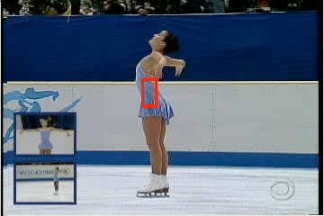
Drift
D. Ramanan, D. Forsyth, and A. Zisserman. Tracking People by Learning their Appearance. PAMI 2007.

Slide 70
Summary
Tracking as inference
  Goal: estimate posterior of object position given measurement
Linear models of dynamics
  Represent state evolution and measurement models
Kalman filters
  Recursive prediction/correction updates to refine measurement
General tracking challenges

Slide 71
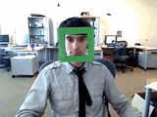
Really Good Face Tracker
http://vision.ucsd.edu/sites/default/files/fast.gif
Slide credit: Devi Parikh

Slide 72
Questions?
See you Thursday!
Slide credit: Devi Parikh

