Slide 1
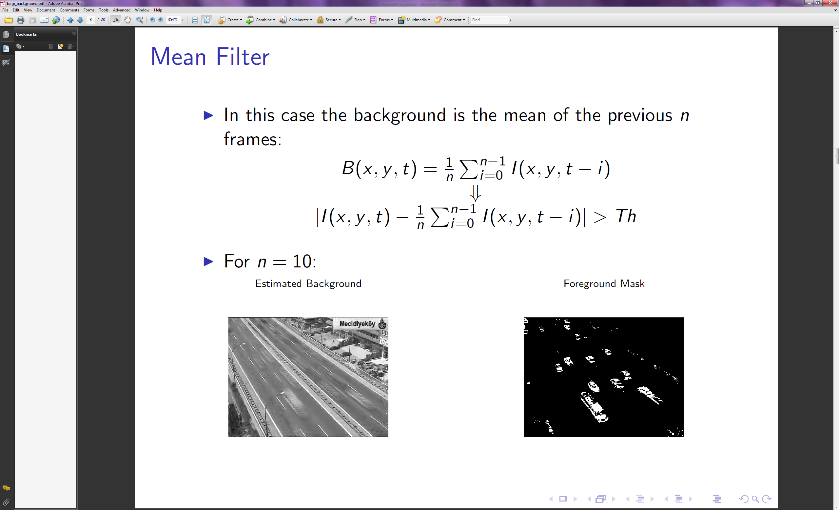
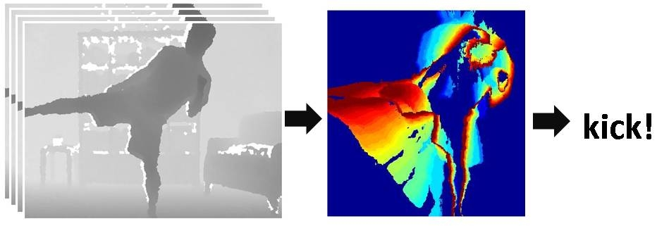
Actions in video
Thursday, November 14th
Devi Parikh
Virginia Tech
Slides borrowed from Kristen Grauman, who borrowed several from others.

Slide 2
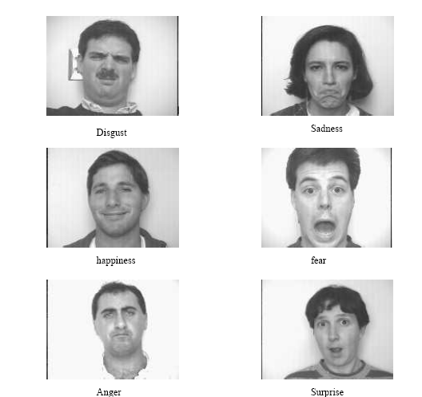
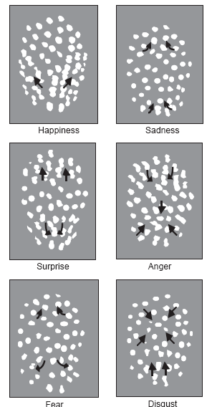
Using optical flow:
recognizing facial expressions
Recognizing Human Facial Expression (1994)
by Yaser Yacoob, Larry S. Davis

Slide 3
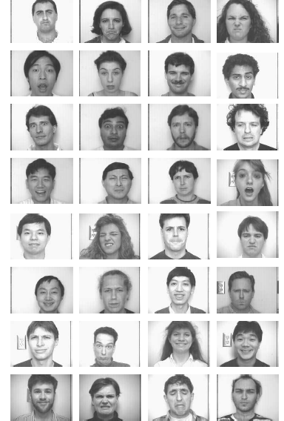
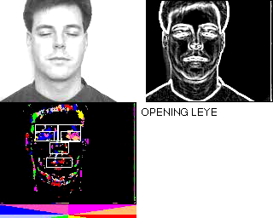
Using optical flow:
recognizing facial expressions

Slide 4
Today
Activity in video
  Background subtraction
  Recognition of actions based on motion patterns
  Research questions

Slide 5
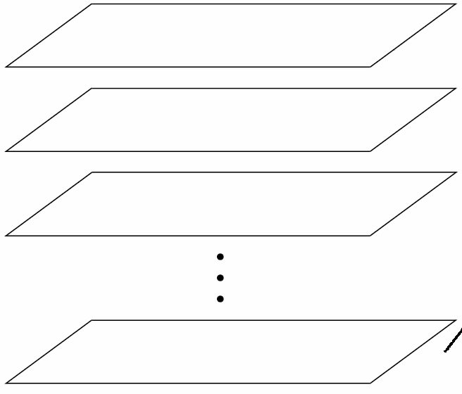
Video as an “Image Stack”
time
255
0
t
Can look at video data as a spatio-temporal volume
  If camera is stationary, each line through time corresponds to a single ray in space
Alyosha Efros, CMU

Slide 6
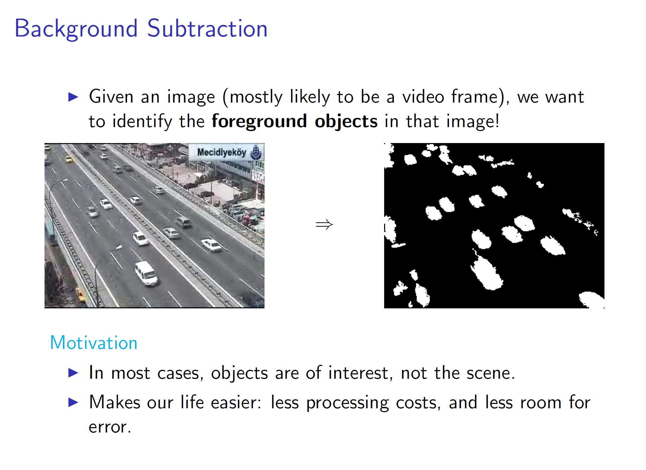
Slide credit: Birgi Tamersoy

Slide 7
Background subtraction
Simple techniques can do ok with static camera
…But hard to do perfectly
Widely used:
  Traffic monitoring (counting vehicles, detecting & tracking vehicles, pedestrians),
  Human action recognition (run, walk, jump, squat),
  Human-computer interaction
  Object tracking

Slide 8
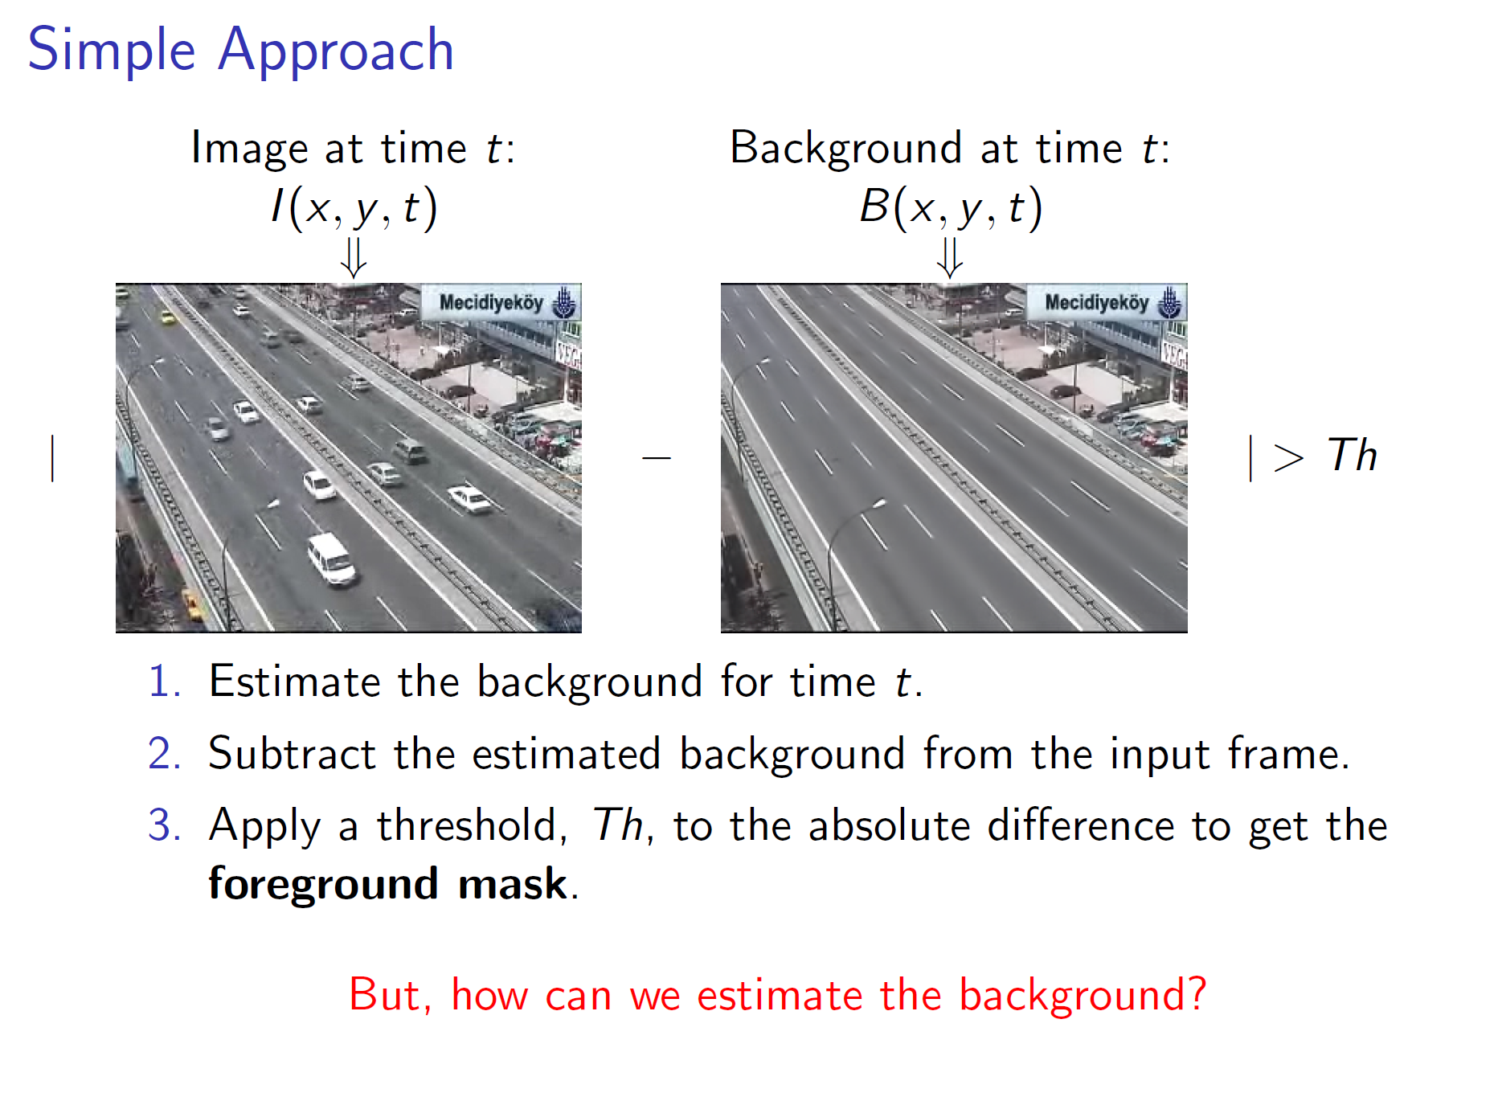
Slide credit: Birgi Tamersoy

Slide 9
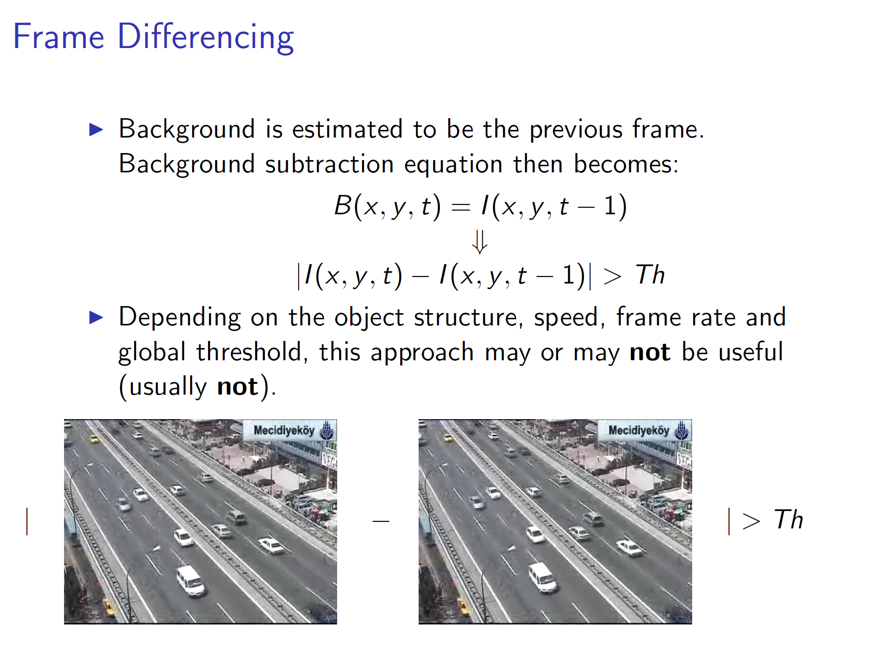
Slide credit: Birgi Tamersoy

Slide 10
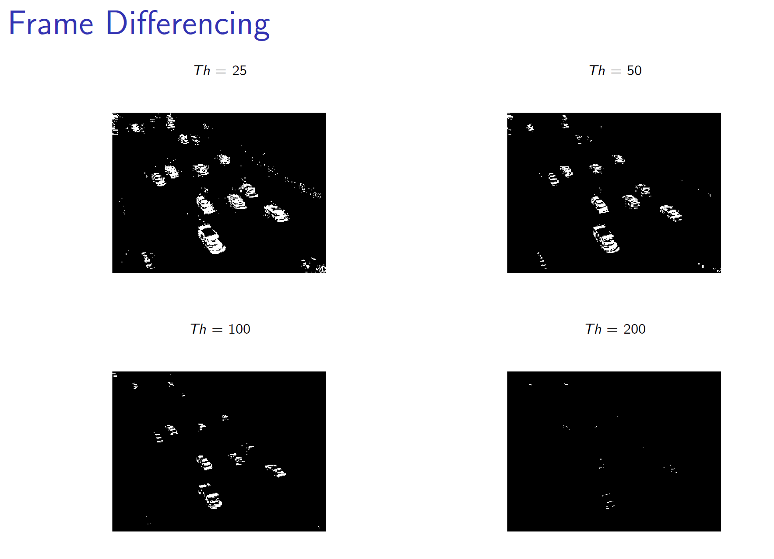
Slide credit: Birgi Tamersoy

Slide 11
Slide credit: Birgi Tamersoy

Slide 12
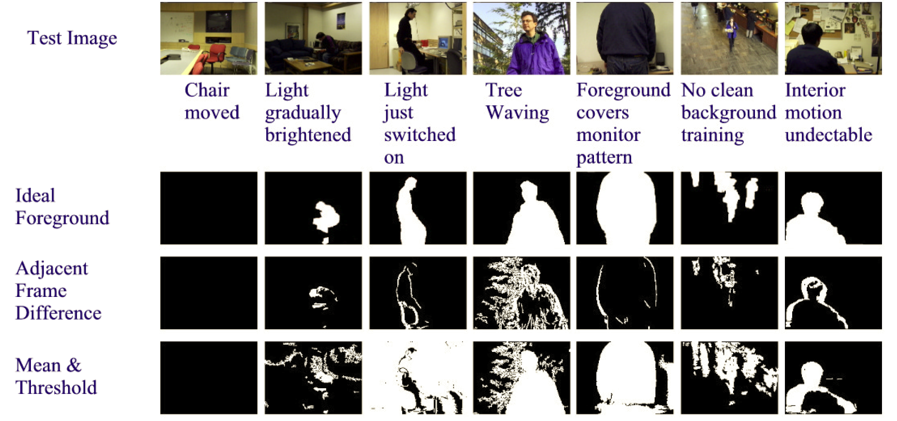
Frame differences vs. background subtraction
Toyama et al. 1999

Slide 13
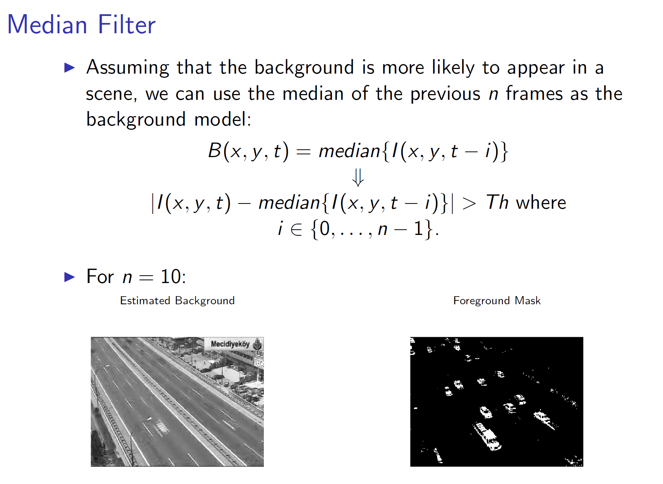
Slide credit: Birgi Tamersoy

Slide 14
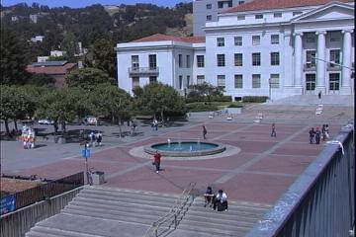
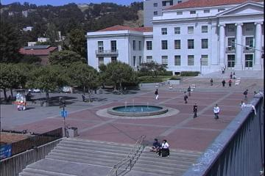
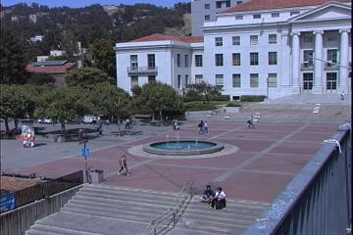



Average/Median Image
Alyosha Efros, CMU

Slide 15
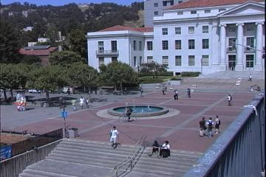


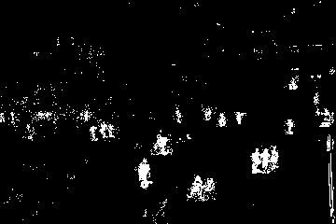
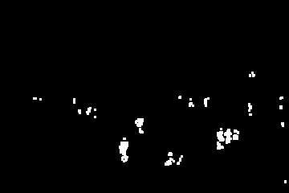
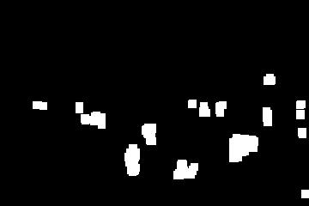
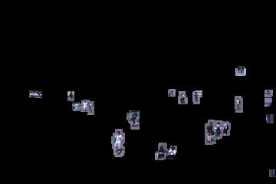
Background Subtraction
-
=
Alyosha Efros, CMU

Slide 16
Pros and cons
Advantages:
Extremely easy to implement and use!
All pretty fast.
Corresponding background models need not be constant, they change over time.
Disadvantages:
Accuracy of frame differencing depends on object speed and frame rate
Median background model: relatively high memory requirements.
Setting global threshold Th…
When will this basic approach fail?
Slide credit: Birgi Tamersoy

Slide 17
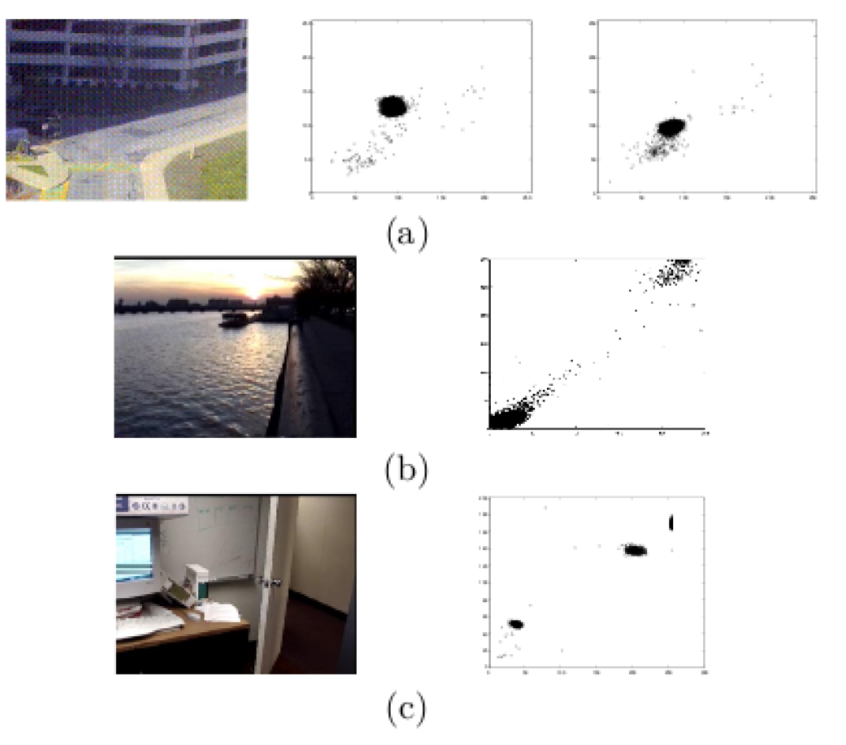
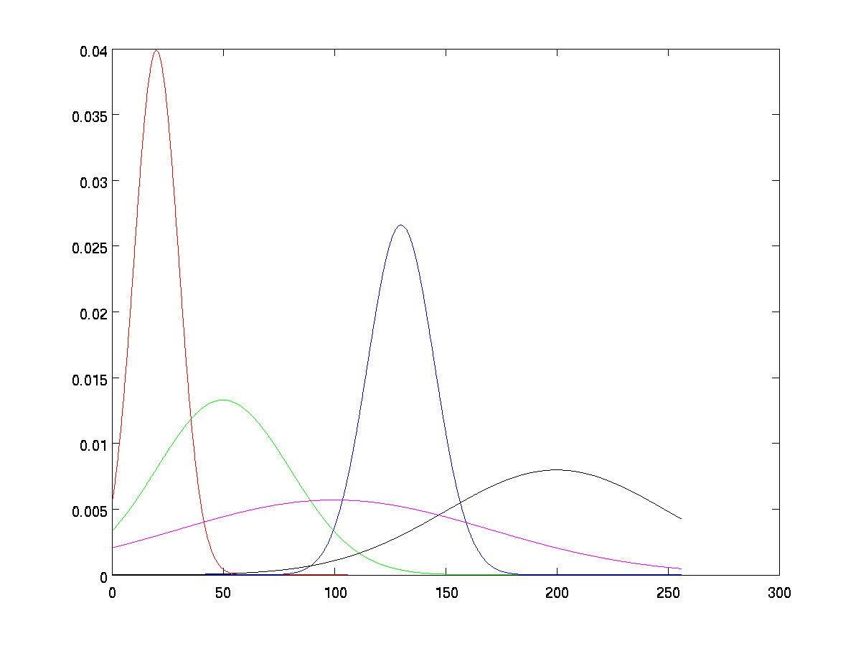
Background mixture models
Idea: model each background pixel with a mixture of Gaussians; update its parameters over time.
Adaptive Background Mixture Models for Real-Time Tracking, Chris Stauer & W.E.L. Grimson

Slide 18
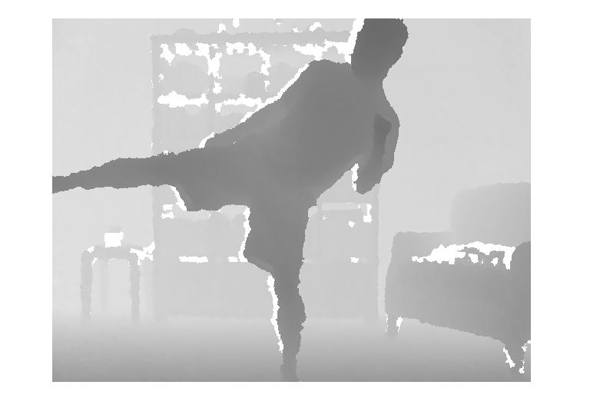
Background subtraction with depth
How can we select foreground pixels based on depth information?

Slide 19
Today
Optical flow wrapup
Activity in video
  Background subtraction
  Recognition of action based on motion patterns
  Research questions

Slide 20
Human activity in video
No universal terminology, but approximately:
“Actions”: atomic motion patterns -- often gesture-like, single clear-cut trajectory, single nameable behavior (e.g., sit, wave arms)
“Activity”: series or composition of actions (e.g., interactions between people)
“Event”: combination of activities or actions (e.g., a football game, a traffic accident)
Adapted from Venu Govindaraju

Slide 21
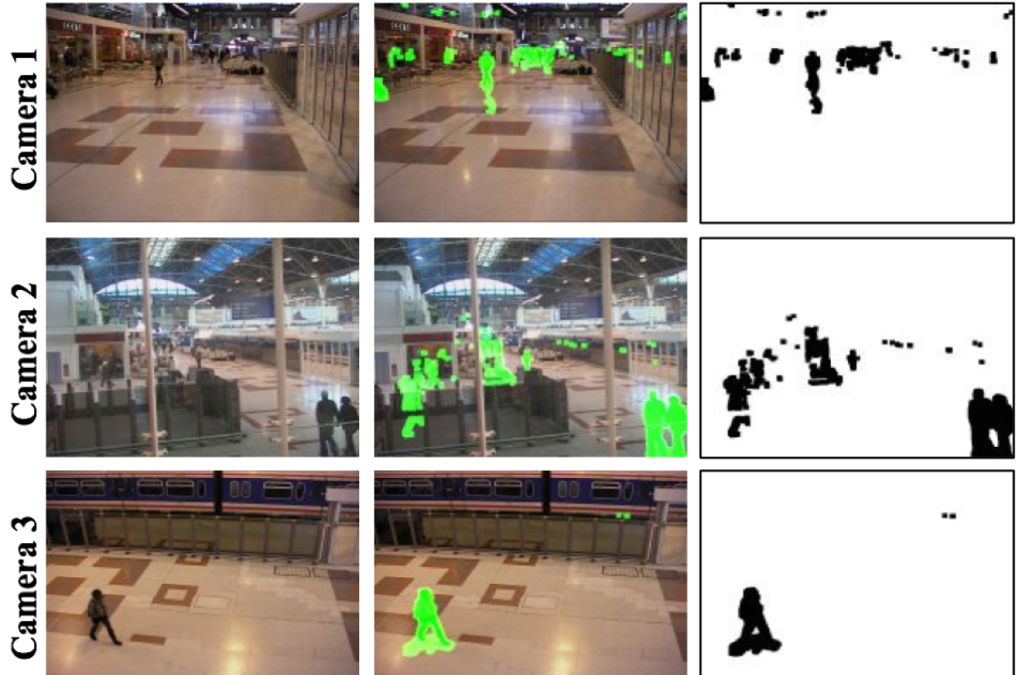
Surveillance
http://users.isr.ist.utl.pt/~etienne/mypubs/Auvinetal06PETS.pdf

Slide 22
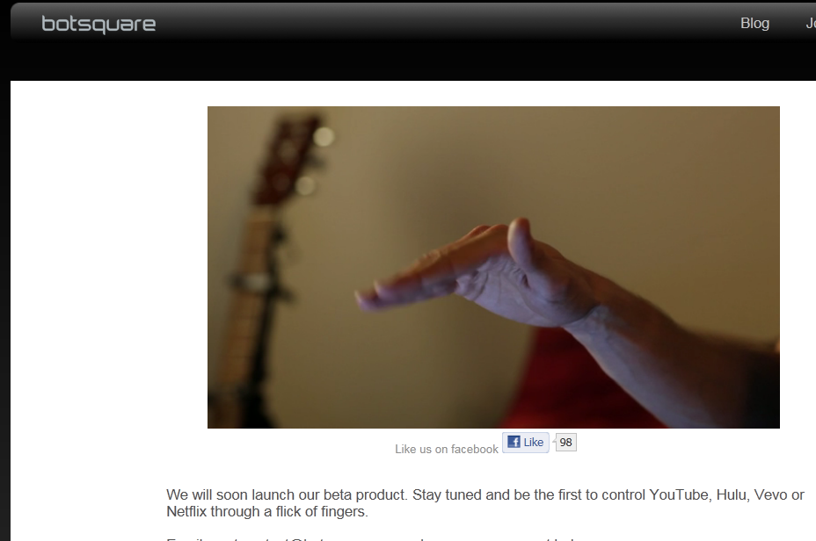
Interfaces
2011

Slide 23
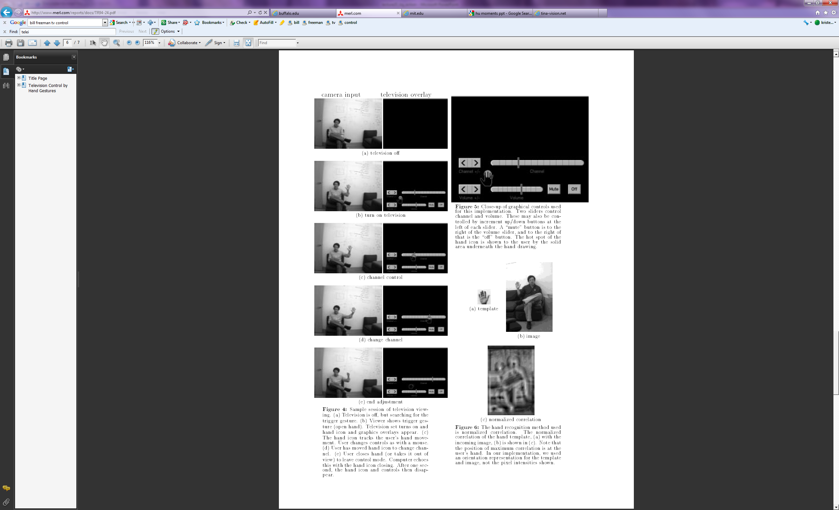
Interfaces
2011
1995
W. T. Freeman and C. Weissman, Television control by hand gestures, International Workshop on Automatic Face- and Gesture- Recognition, IEEE Computer Society, Zurich, Switzerland, June, 1995, pp. 179--183. MERL-TR94-24
Notes:
www.botsquare.com

Slide 24
Human activity in video: basic approaches
Model-based action/activity recognition:
  Use human body tracking and pose estimation techniques, relate to action descriptions (or learn)
  Major challenge: accurate tracks in spite of occlusion, ambiguity, low resolution
Activity as motion, space-time appearance patterns
  Describe overall patterns, but no explicit body tracking
  Typically learn a classifier
  We’ll look at some specific instances…

Slide 25

Motion and perceptual organization
Even “impoverished” motion data can evoke a strong percept

Slide 26
Motion and perceptual organization
Even “impoverished” motion data can evoke a strong percept

Slide 27

Motion and perceptual organization
Even “impoverished” motion data can evoke a strong percept
Video from Davis & Bobick

Slide 28
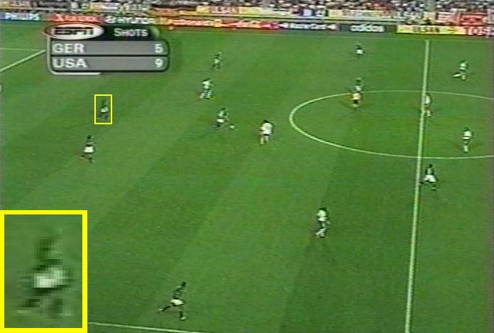
Using optical flow: action recognition at a distance
Features = optical flow within a region of interest
Classifier = nearest neighbors
Challenge: low-res data, not going to be able to track each limb.
The 30-Pixel Man
[Efros, Berg, Mori, & Malik 2003]
http://graphics.cs.cmu.edu/people/efros/research/action/

Slide 29
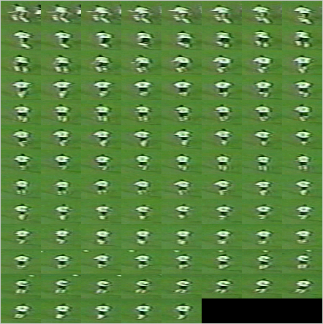
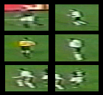
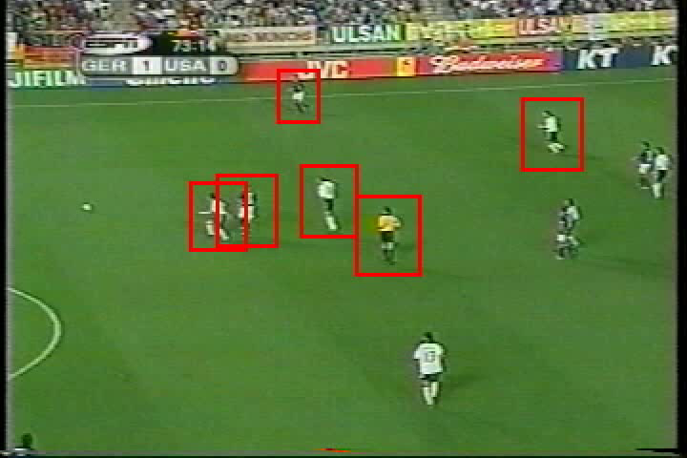
Using optical flow: action recognition at a distance
Correlation-based tracking
Extract person-centered frame window
[Efros, Berg, Mori, & Malik 2003]
http://graphics.cs.cmu.edu/people/efros/research/action/

Slide 30
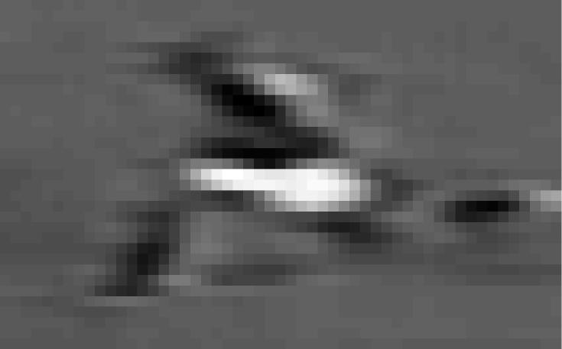
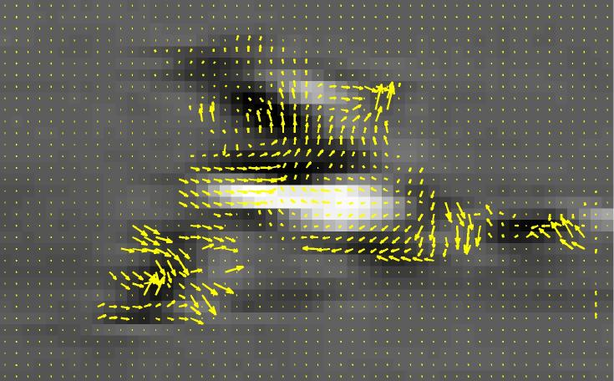
Using optical flow: action recognition at a distance
Extract optical flow to describe the region’s motion.
[Efros, Berg, Mori, & Malik 2003]
http://graphics.cs.cmu.edu/people/efros/research/action/

Slide 31
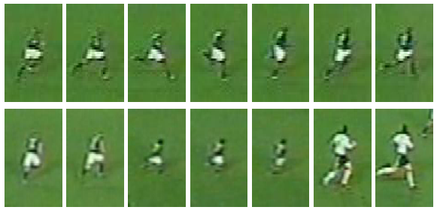
Using optical flow: action recognition at a distance
Input
Sequence
Matched
Frames
Use nearest neighbor classifier to name the actions occurring in new video frames.
[Efros, Berg, Mori, & Malik 2003]
http://graphics.cs.cmu.edu/people/efros/research/action/

Slide 32
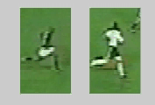
Using optical flow:
action recognition at a distance
Input
Sequence
Matched NN
Frame
Use nearest neighbor classifier to name the actions occurring in new video frames.
[Efros, Berg, Mori, & Malik 2003]
http://graphics.cs.cmu.edu/people/efros/research/action/

Slide 33

Do as I do: motion retargeting
[Efros, Berg, Mori, & Malik 2003]
http://graphics.cs.cmu.edu/people/efros/research/action/

Slide 34
Motion and perceptual organization
Even “impoverished” motion data can evoke a strong percept
Video from Davis & Bobick

Slide 35
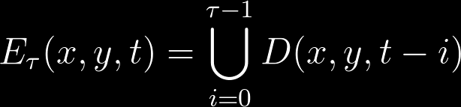
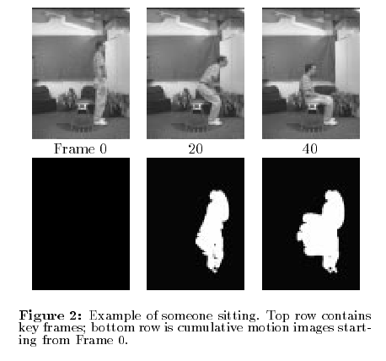
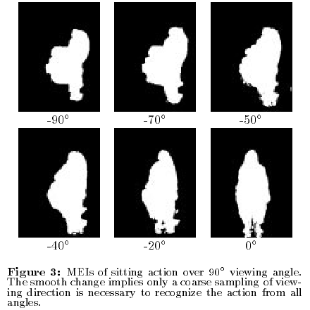
Motion Energy Images
D(x,y,t): Binary image sequence indicating motion locations
Davis & Bobick 1999: The Representation and Recognition of Action Using Temporal Templates

Slide 36
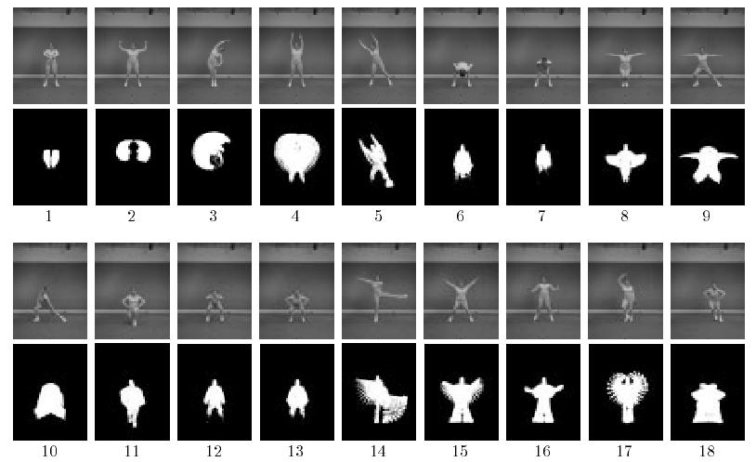
Motion Energy Images
Davis & Bobick 1999: The Representation and Recognition of Action Using Temporal Templates

Slide 37
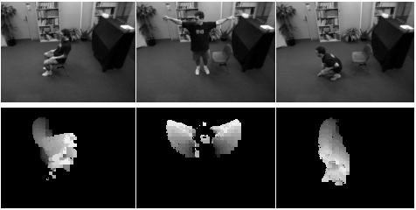
Motion History Images
Davis & Bobick 1999: The Representation and Recognition of Action Using Temporal Templates

Slide 38




Image moments
Use to summarize shape given image I(x,y)
Central moments are translation invariant:

Slide 39
Hu moments
Set of 7 moments
Apply to Motion History Image for global space-time “shape” descriptor
Translation and rotation invariant

Slide 40
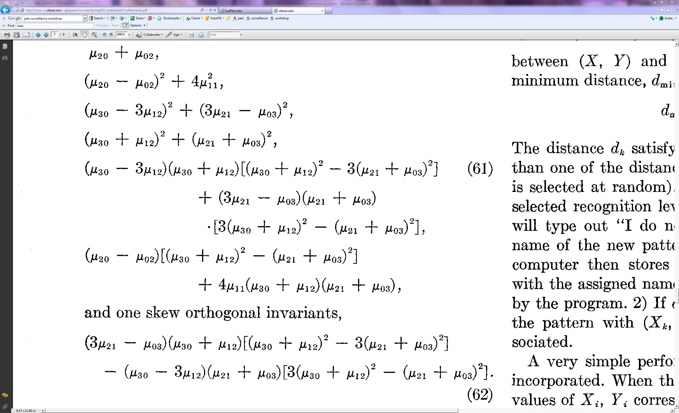
Hu moments

Slide 42
PS5
Depth map sequence
Motion History Image
Nearest neighbor action classification with Motion History Images + Hu moments

Slide 43
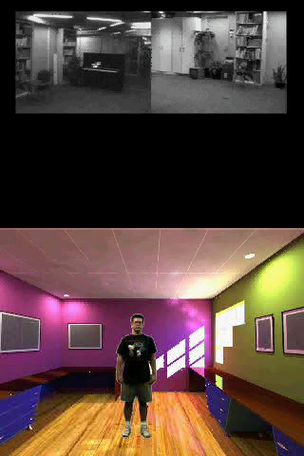
Action Recognition using MHI

Slide 44
Summary
Background subtraction:
  Essential low-level processing tool to segment moving objects from static camera’s video
Action recognition:
  Increasing attention to actions as motion and appearance patterns
  For instrumented/constrained environments, relatively simple techniques allow effective gesture or action recognition

Slide 45
Actions in video
Research questions
Slides borrowed from Derek Hoiem

Slide 46

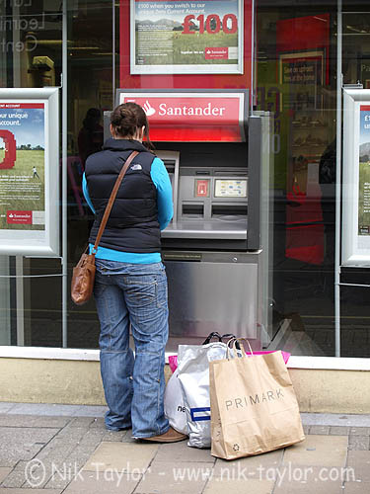
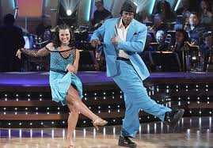
What is an action?
Action: a transition from one state to another
Who is the actor?
How is the state of the actor changing?
What (if anything) is being acted on?
How is that thing changing?
What is the purpose of the action (if any)?

Slide 47
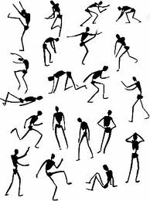
How do we represent actions?
Categories
  Walking, hammering, dancing, skiing, sitting down, standing up, jumping
Poses
Nouns and Predicates
<man, swings, hammer>
<man, hits, nail, w/ hammer>

Slide 48
What is the purpose of action recognition?
To describe
  http://www.youtube.com/watch?v=y4F_b4lbJ-Q
To predict
http://www.youtube.com/watch?v=LQm25nW6aZw

Slide 49
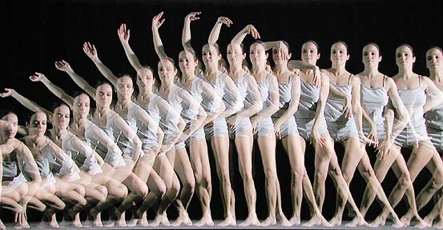


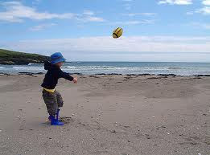
How can we identify actions?
Motion
Pose
Held Objects
Nearby Objects

Slide 50
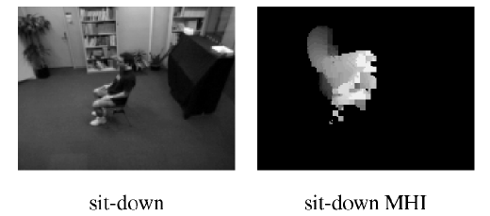
Representing Motion
Optical Flow with Motion History
Bobick Davis 2001
Notes:
Values reflect magnitude and recentness of movements

Slide 51
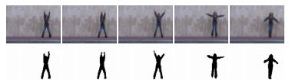
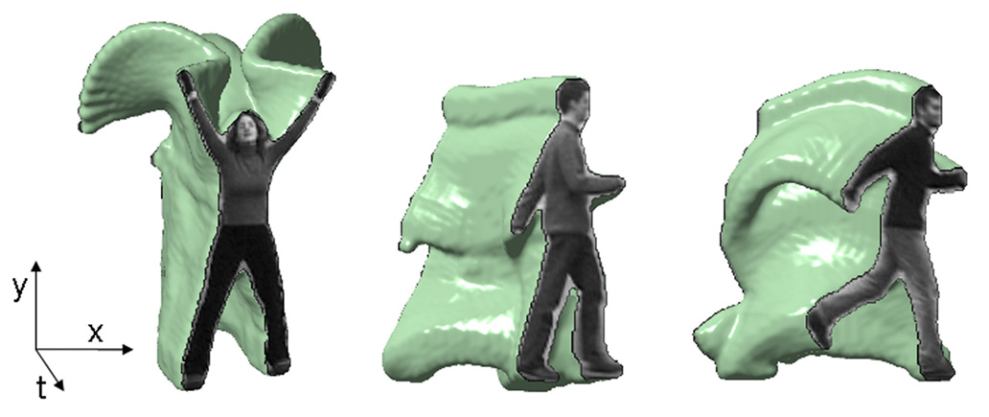
Representing Motion
Space-Time Volumes
Blank et al. 2005

Slide 52

Representing Motion
Optical Flow with Split Channels
Efros et al. 2003

Slide 53

Representing Motion
Tracked Points
Matikainen et al. 2009
Notes:
Point tracks reflect long-term motions

Slide 54

Representing Motion
Space-Time Interest Points
Corner detectors in space-time
Laptev 2005
Notes:
Detect interest points in time and position

Slide 55

Representing Motion
Space-Time Interest Points
Laptev 2005
Notes:
Detect interest points in time and position

Slide 56
Examples of Action Recognition Systems
Feature-based classification
Recognition using pose and objects

Slide 57

Action recognition as classification
Retrieving actions in movies, Laptev and Perez, 2007

Slide 58





Remember image categorization…
Training
Training Labels
Training Images
Image Features
Classifier Training
Trained Classifier
Testing
Image Features
Trained Classifier
Prediction
Outdoor
Test Image

Slide 59

Remember spatial pyramids….
Compute histogram in each spatial bin

Slide 60

Features for Classifying Actions
Spatio-temporal pyramids
  Image Gradients
  Optical Flow

Slide 61

Features for Classifying Actions
Spatio-temporal interest points
Corner detectors in space-time
Descriptors based on Gaussian derivative filters over x, y, time

Slide 62


Classification
Boosted stubs for pyramids of optical flow, gradient
Nearest neighbor for STIP

Slide 63


Searching the video for an action
Detect keyframes using a trained HOG detector in each frame
Classify detected keyframes as positive (e.g., “drinking”) or negative (“other”)

Slide 64

Accuracy in searching video
With keyframe detection
Without keyframe detection

Slide 65




“Talk on phone”
“Get out of car”
Learning realistic human actions from movies, Laptev et al. 2008

Slide 66


Approach
Space-time interest point detectors
Descriptors
  HOG, HOF
Pyramid histograms (3x3x2)
SVMs with Chi-Squared Kernel
Spatio-Temporal Binning
Interest Points

Slide 67


Results

Slide 68



Action Recognition using Pose and Objects
Modeling Mutual Context of Object and Human Pose in Human-Object Interaction Activities, B. Yao and Li Fei-Fei, 2010
Slide Credit: Yao/Fei-Fei

Slide 69


Human-Object Interaction
Holistic image based classification
Integrated reasoning
Human pose estimation
Head
Right-arm
Left-arm
Torso
Right-leg
Left-leg
Slide Credit: Yao/Fei-Fei

Slide 70

Human-Object Interaction
Holistic image based classification
Integrated reasoning
Human pose estimation
Object detection
Tennis racket
Slide Credit: Yao/Fei-Fei

Slide 71

Human-Object Interaction
Holistic image based classification
Integrated reasoning
Human pose estimation
Object detection
Action categorization
Head
Right-arm
Left-arm
Tennis racket
Torso
Right-leg
Left-leg
HOI activity: Tennis Forehand
Slide Credit: Yao/Fei-Fei

Slide 72


Human pose estimation & Object detection
Human pose estimation is challenging.
Difficult part appearance
Self-occlusion
Image region looks like a body part
Felzenszwalb & Huttenlocher, 2005
Ren et al, 2005
Ramanan, 2006
Ferrari et al, 2008
Yang & Mori, 2008
Andriluka et al, 2009
Eichner & Ferrari, 2009
Slide Credit: Yao/Fei-Fei

Slide 73
Human pose estimation & Object detection
Human pose estimation is challenging.
Felzenszwalb & Huttenlocher, 2005
Ren et al, 2005
Ramanan, 2006
Ferrari et al, 2008
Yang & Mori, 2008
Andriluka et al, 2009
Eichner & Ferrari, 2009
Slide Credit: Yao/Fei-Fei

Slide 74
Human pose estimation & Object detection
Facilitate
Given the object is detected.
Slide Credit: Yao/Fei-Fei

Slide 75
Human pose estimation & Object detection
Object detection is challenging
Small, low-resolution, partially occluded
Image region similar to detection target
Viola & Jones, 2001
Lampert et al, 2008
Divvala et al, 2009
Vedaldi et al, 2009
Slide Credit: Yao/Fei-Fei

Slide 76
Human pose estimation & Object detection
Object detection is challenging
Viola & Jones, 2001
Lampert et al, 2008
Divvala et al, 2009
Vedaldi et al, 2009
Slide Credit: Yao/Fei-Fei

Slide 77
Human pose estimation & Object detection
Facilitate
Given the pose is estimated.
Slide Credit: Yao/Fei-Fei

Slide 78

Human pose estimation & Object detection
Mutual Context
Slide Credit: Yao/Fei-Fei

Slide 79


















Learning Results
Cricket defensive shot
Cricket bowling
Croquet shot
Slide Credit: Yao/Fei-Fei

Slide 80


















Learning Results
Tennis forehand
Tennis serve
Volleyball smash
Slide Credit: Yao/Fei-Fei

Slide 81






Dataset and Experiment Setup
Sport data set: 6 classes
180 training (supervised with object and part locations) & 120 testing images
Tasks:
Object detection;
Pose estimation;
Activity classification.
Cricket defensive shot
Cricket bowling
Croquet shot
Tennis forehand
Tennis serve
Volleyball smash
[Gupta et al, 2009]
Slide Credit: Yao/Fei-Fei

Slide 82
Dataset and Experiment Setup
Sport data set: 6 classes
180 training (supervised with object and part locations) & 120 testing images
Tasks:
Object detection;
Pose estimation;
Activity classification.
Cricket defensive shot
Cricket bowling
Croquet shot
Tennis forehand
Tennis serve
Volleyball smash
[Gupta et al, 2009]
Slide Credit: Yao/Fei-Fei

Slide 83
Dataset and Experiment Setup
Sport data set: 6 classes
180 training & 120 testing images
Tasks:
Object detection;
Pose estimation;
Activity classification.
Cricket defensive shot
Cricket bowling
Croquet shot
Tennis forehand
Tennis serve
Volleyball smash
[Gupta et al, 2009]
Slide Credit: Yao/Fei-Fei

Slide 84
Dataset and Experiment Setup
Sport data set: 6 classes
180 training & 120 testing images
Tasks:
Object detection;
Pose estimation;
Activity classification.
Cricket defensive shot
Cricket bowling
Croquet shot
Tennis forehand
Tennis serve
Volleyball smash
[Gupta et al, 2009]
Slide Credit: Yao/Fei-Fei

Slide 85










Activity Classification Results
Cricket shot
Tennis forehand
Our model
Gupta et al, 2009
Bag-of-words
SIFT+SVM
Slide Credit: Yao/Fei-Fei

Slide 86

More results
Joint
Independent
Joint
Independent

Slide 87
Take-home messages
Action recognition is an open problem.
  How to define actions?
  How to infer them?
  What are good visual cues?
  How do we incorporate higher level reasoning?

Slide 88
Take-home messages
Some work done, but it is just the beginning of exploring the problem. So far…
  Actions are mainly categorical
  Most approaches are classification using simple features (spatial-temporal histograms of gradients or flow, s-t interest points, SIFT in images)
  Just a couple works on how to incorporate pose and objects
  Not much idea of how to reason about long-term activities or to describe video sequences

Slide 89
Questions?
See you Tuesday!
Slide credit: Devi Parikh

