Slide 1
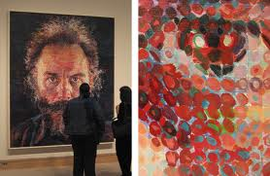
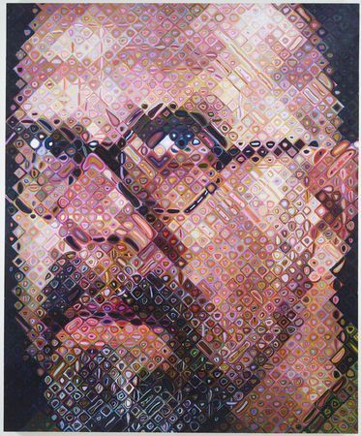
Face Recognition and Feature Subspaces
11/07/13
Lucas by Chuck Close
Chuck Close, self portrait
Devi Parikh
Virginia Tech
Slides borrowed from Derek Hoiem, who borrowed some slides from Lana Lazebnik, Silvio Savarese, Fei-Fei Li

Slide 2
This class: face recognition
Two methods: “Eigenfaces” and “Fisherfaces”
  Feature subspaces: PCA and FLD
Look at results from recent vendor test
Look at interesting findings about human face recognition

Slide 3
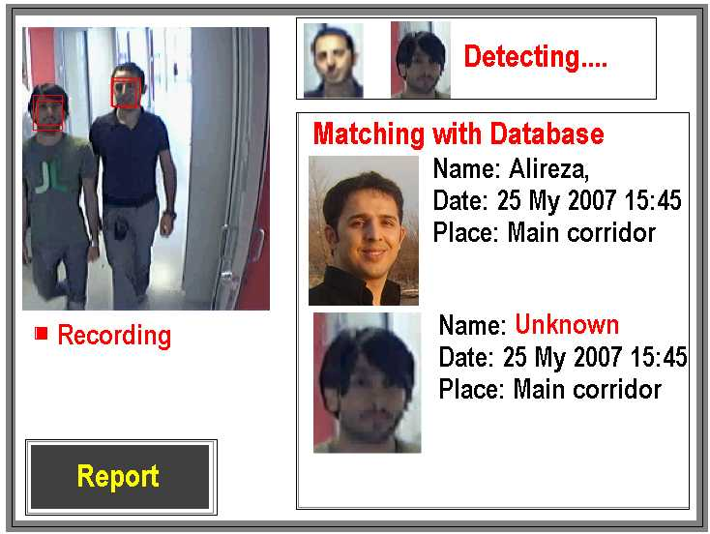
Applications of Face Recognition
Surveillance

Slide 4
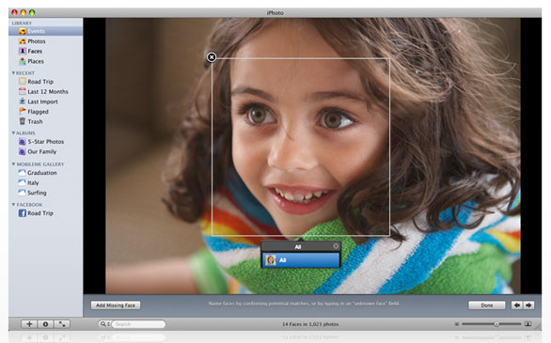
Applications of Face Recognition
Album organization: iPhoto 2009
http://www.apple.com/ilife/iphoto/

Slide 5
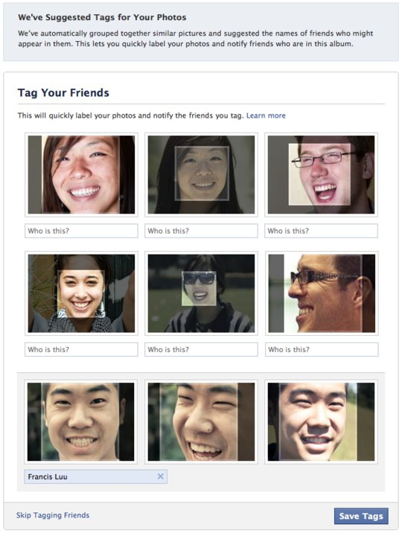
Facebook friend-tagging with auto-suggest

Slide 6

Face recognition: once you’ve detected and cropped a face, try to recognize it
Detection
Recognition
“Sally”

Slide 7
Face recognition: overview
Typical scenario: few examples per face, identify or verify test example
What’s hard: changes in expression, lighting, age, occlusion, viewpoint
Basic approaches (all nearest neighbor)
  Project into a new subspace (or kernel space) (e.g., “Eigenfaces”=PCA)
  Measure face features
  Make 3d face model, compare shape+appearance (e.g., AAM)

Slide 8
Typical face recognition scenarios
Verification: a person is claiming a particular identity; verify whether that is true
  E.g., security
Closed-world identification: assign a face to one person from among a known set
General identification: assign a face to a known person or to “unknown”

Slide 9
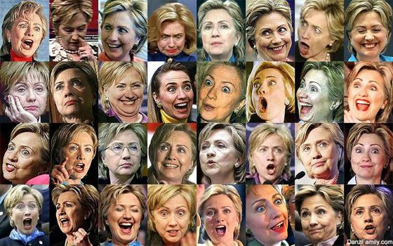
What makes face recognition hard?
Expression

Slide 10




What makes face recognition hard?
Lighting

Slide 11
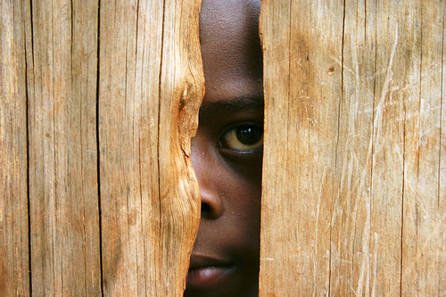
What makes face recognition hard?
Occlusion

Slide 12
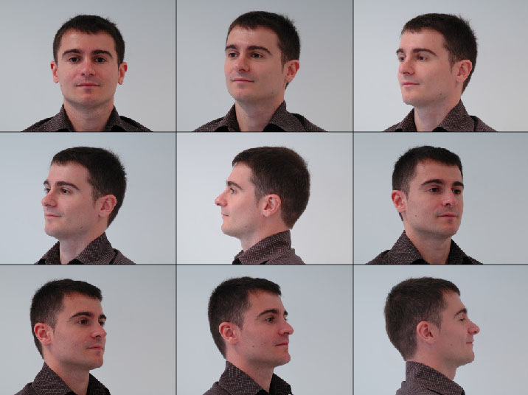
What makes face recognition hard?
Viewpoint

Slide 13

Simple idea for face recognition
Treat face image as a vector of intensities
Recognize face by nearest neighbor in database

Slide 14
The space of all face images
When viewed as vectors of pixel values, face images are extremely high-dimensional
  100x100 image = 10,000 dimensions
  Slow and lots of storage
But very few 10,000-dimensional vectors are valid face images
We want to effectively model the subspace of face images

Slide 15
The space of all face images
Eigenface idea: construct a low-dimensional linear subspace that best explains the variation in the set of face images

Slide 16
Principal Component Analysis (PCA)
Given: N data points x₁, … ,x_{N} in R^{d}
We want to find a new set of features that are linear combinations of original ones:
u(x_{i}) = u^{T}(x_{i} – µ)
(µ: mean of data points)
Choose unit vector u in R^{d} that captures the most data variance
Forsyth & Ponce, Sec. 22.3.1, 22.3.2

Slide 17
Principal Component Analysis
Direction that maximizes the variance of the projected data:
N
Maximize
subject to ||u||=1
Projection of data point
N
1/N
Covariance matrix of data = XX^{T}
The direction that maximizes the variance is the eigenvector associated with the largest eigenvalue of Σ

Slide 18
Implementation issue
Covariance matrix is huge (M² for M pixels)
But typically # examples << M
Simple trick
  X is MxN matrix of normalized training data
  Solve for eigenvectors u of X^{T}X instead of XX^{T}
    X^{T}Xu = lu
    XX^{T}Xu = lXu
    (XX^{T})Xu = l(Xu).
  Then Xu is eigenvector of covariance XX^{T}
  Need to normalize each vector of Xu into unit length

Slide 19
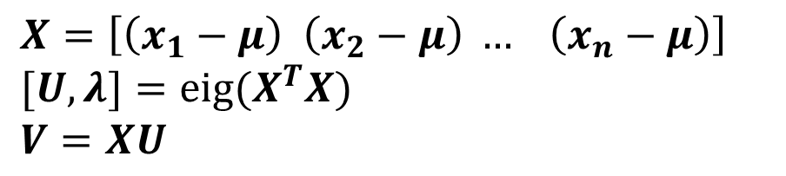

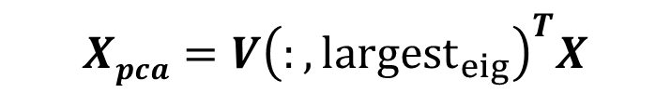
Eigenfaces (PCA on face images)
Compute the principal components (“eigenfaces”) of the covariance matrix
Keep K eigenvectors with largest eigenvalues
Represent all face images in the dataset as linear combinations of eigenfaces
  Perform nearest neighbor on these coefficients
$$X=\left[\left(x_{1}−μ\right) \left(x_{2}−μ\right) … \left(x_{n}−μ\right)\right]$$
$$[U, λ]={eig(X}^{T}X)$$
$$V=XU$$
$$V=V(:, largest_eig)$$
$$Xpca=V{\left(:, {largest}_{eig}\right)}^{T}X$$
M. Turk and A. Pentland, Face Recognition using Eigenfaces, CVPR 1991

Slide 20
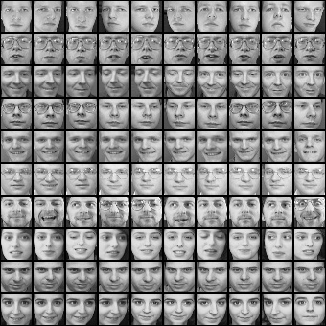
Eigenfaces example
Training images
x₁,…,x_{N}

Slide 21
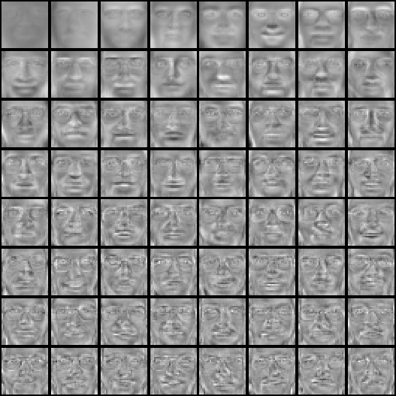
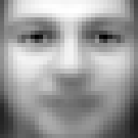
Eigenfaces example
Top eigenvectors: u₁,…u_{k}
Mean: μ

Slide 22

Visualization of eigenfaces
Principal component (eigenvector) u_{k}
μ + 3σ_{k}u_{k}
μ – 3σ_{k}u_{k}

Slide 23

Representation and reconstruction
Face x in “face space” coordinates:
=

Slide 24

Representation and reconstruction
Face x in “face space” coordinates:
Reconstruction:
=
=
+
^
x
=
µ + w₁u₁+w₂u₂+w₃u₃+w₄u₄+ …

Slide 25
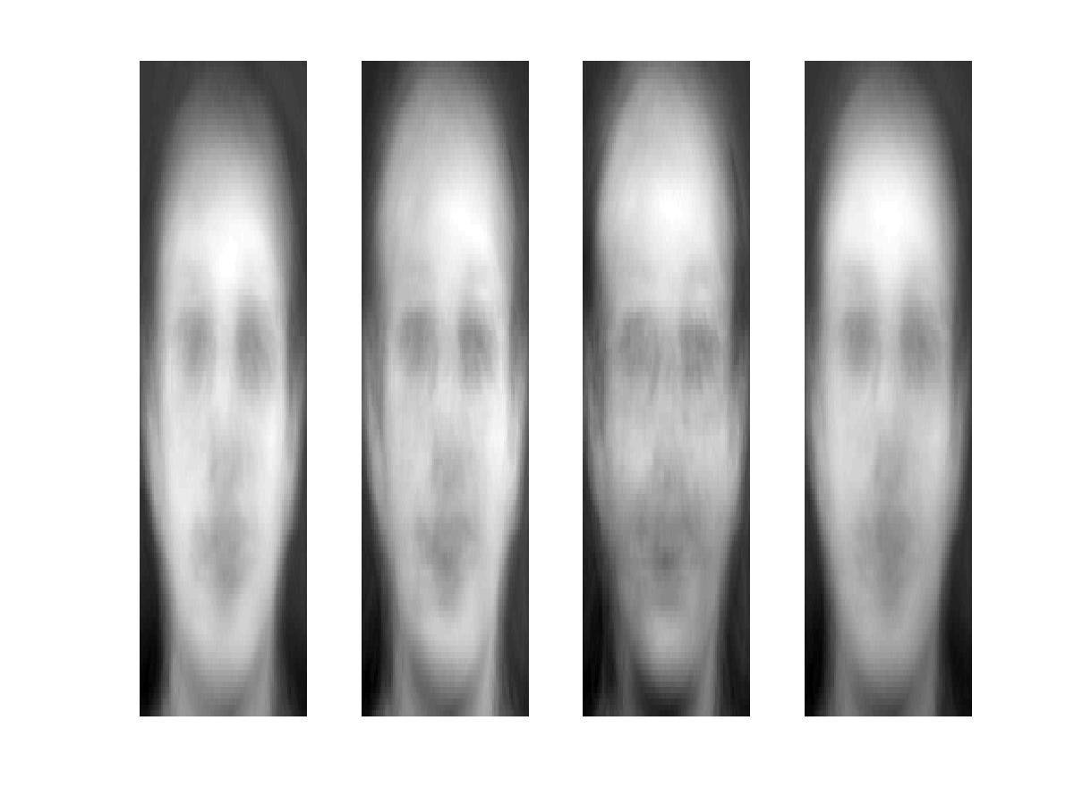
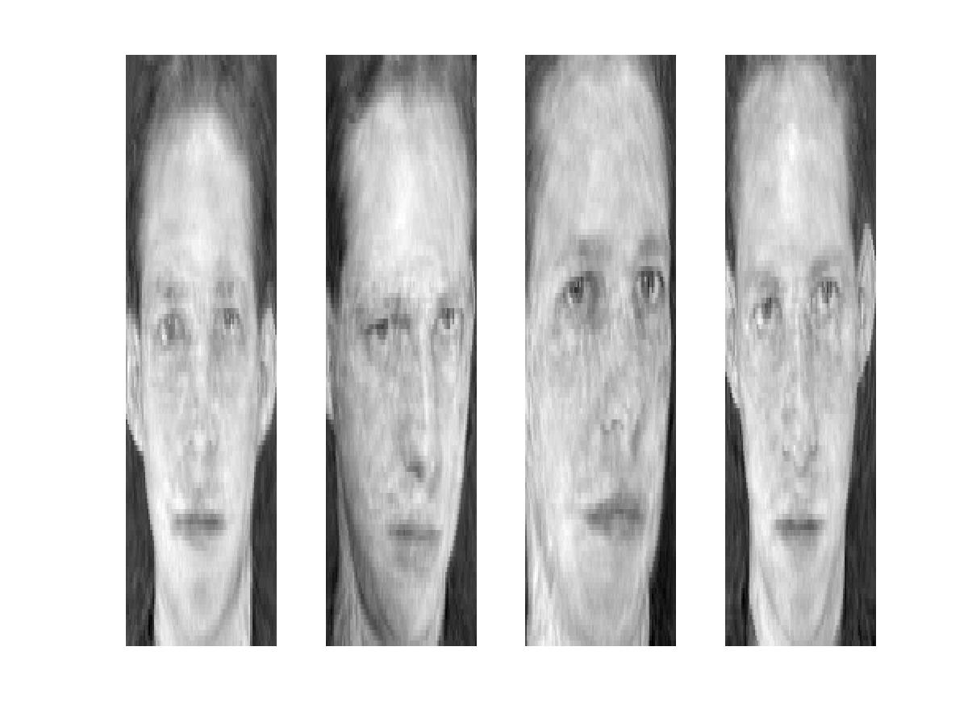
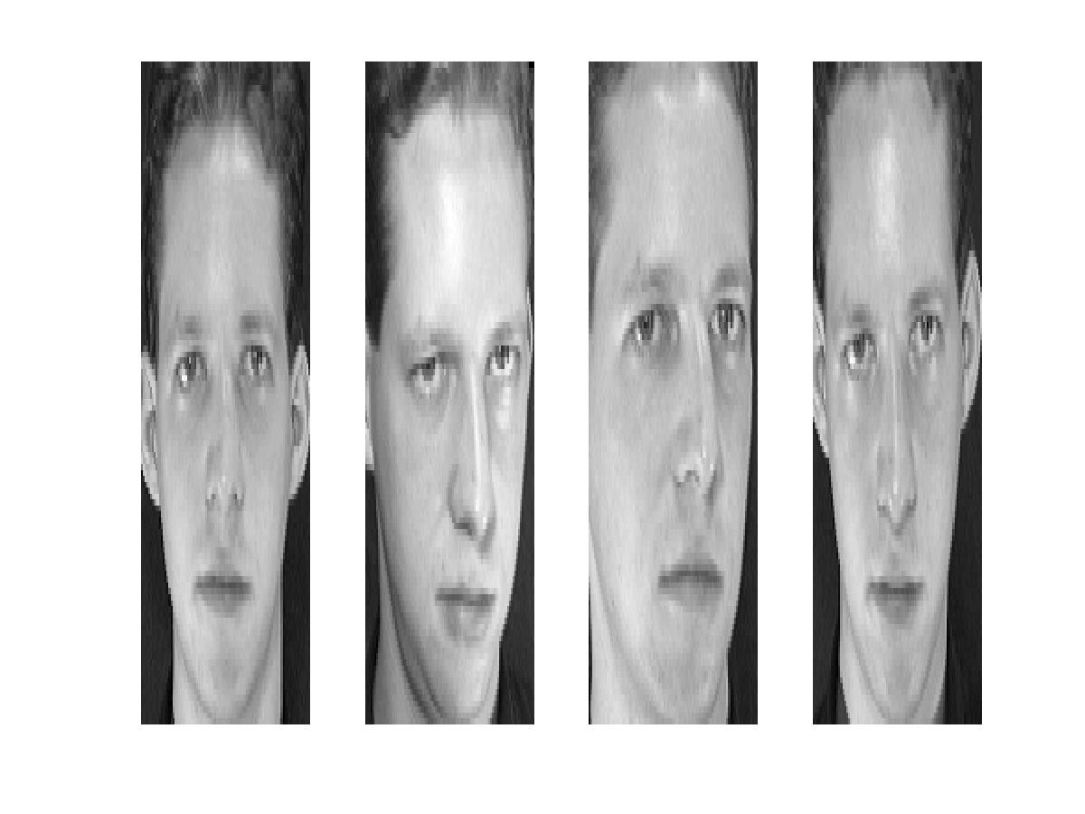
Reconstruction
P = 4
P = 200
P = 400
After computing eigenfaces using 400 face images from ORL face database

Slide 26
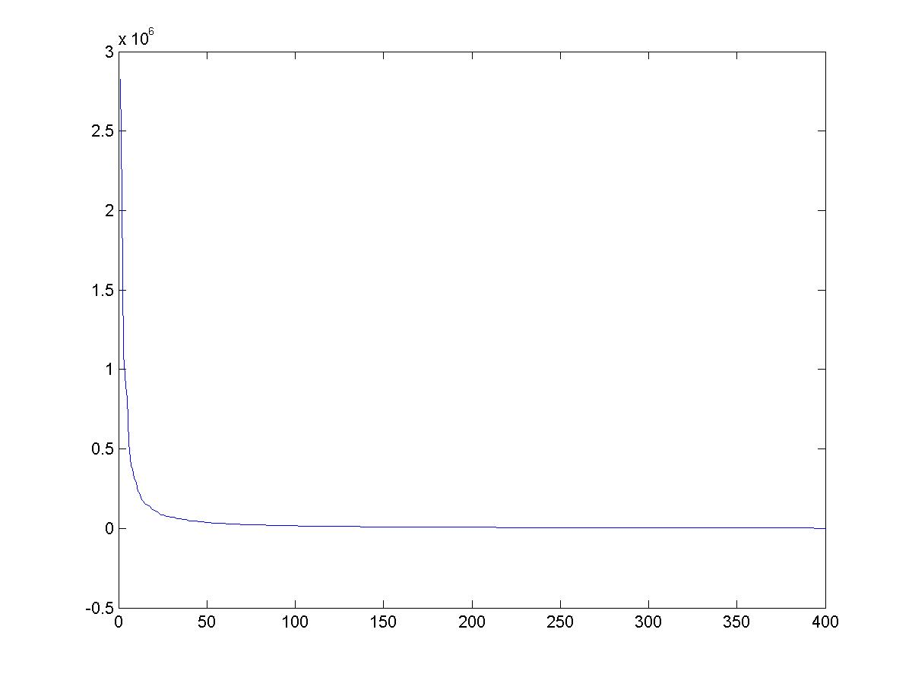
Eigenvalues (variance along eigenvectors)

Slide 27
Note
Preserving variance (minimizing MSE) does not necessarily lead to qualitatively good reconstruction.
P = 200

Slide 28
Recognition with eigenfaces
Process labeled training images
Find mean µ and covariance matrix Σ
Find k principal components (eigenvectors of Σ) u₁,…u_{k}
Project each training image x_{i} onto subspace spanned by principal components:
(w_{i1},…,w_{ik}) = (u₁^{T}(x_{i} – µ), … , u_{k}^{T}(x_{i} – µ))
Given novel image x
Project onto subspace:
(w₁,…,w_{k}) = (u₁^{T}(x – µ), … , u_{k}^{T}(x – µ))
Optional: check reconstruction error x – x to determine whether image is really a face
Classify as closest training face in k-dimensional subspace
^
M. Turk and A. Pentland, Face Recognition using Eigenfaces, CVPR 1991

Slide 29
PCA
General dimensionality reduction technique
Preserves most of variance with a much more compact representation
  Lower storage requirements (eigenvectors + a few numbers per face)
  Faster matching
What are the problems for face recognition?

Slide 30
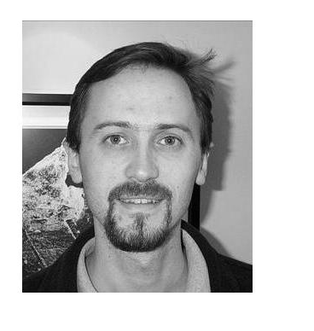
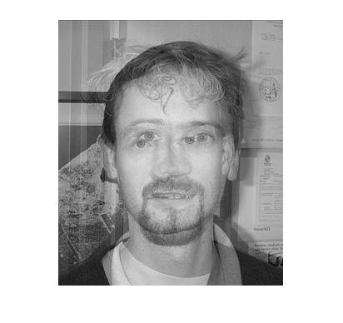
Limitations
Global appearance method: not robust to misalignment, background variation

Slide 31
Limitations
The direction of maximum variance is not always good for classification

Slide 32
A more discriminative subspace: FLD
Fisher Linear Discriminants → “Fisher Faces”
PCA preserves maximum variance
FLD preserves discrimination
  Find projection that maximizes scatter between classes and minimizes scatter within classes
Reference: Eigenfaces vs. Fisherfaces, Belheumer et al., PAMI 1997

Slide 33
Comparing with PCA

Slide 34
Variables
N Sample images:
c classes:
Average of each class:
Average of all data:

Slide 35
Scatter Matrices
Scatter of class i:
Within class scatter:
Between class scatter:

Slide 36
Illustration
x2
Within class scatter
x1
Between class scatter

Slide 37
Mathematical Formulation
After projection
  Between class scatter
  Within class scatter
Objective
Solution: Generalized Eigenvectors
Rank of W_{opt} is limited
  Rank(S_{B}) <= |C|-1
  Rank(S_{W}) <= N-C

Slide 38
Illustration
x2
x1

Slide 39

Recognition with FLD
Use PCA to reduce dimensions to N-C
Compute within-class and between-class scatter matrices for PCA coefficients
Solve generalized eigenvector problem
Project to FLD subspace (c-1 dimensions)
Classify by nearest neighbor
$$W^{T}opt=W^{T}fldW^{T}pca$$
Note: x in step 2 refers to PCA coef; x in step 4 refers to original data

Slide 40
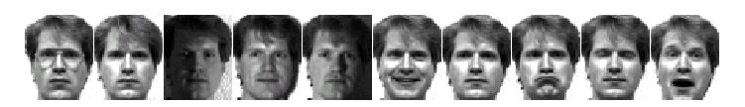
Results: Eigenface vs. Fisherface
Input: 160 images of 16 people
Train: 159 images
Test: 1 image
Variation in Facial Expression, Eyewear, and Lighting
With glasses
Without glasses
3 Lighting conditions
5 expressions
Reference: Eigenfaces vs. Fisherfaces, Belheumer et al., PAMI 1997

Slide 41
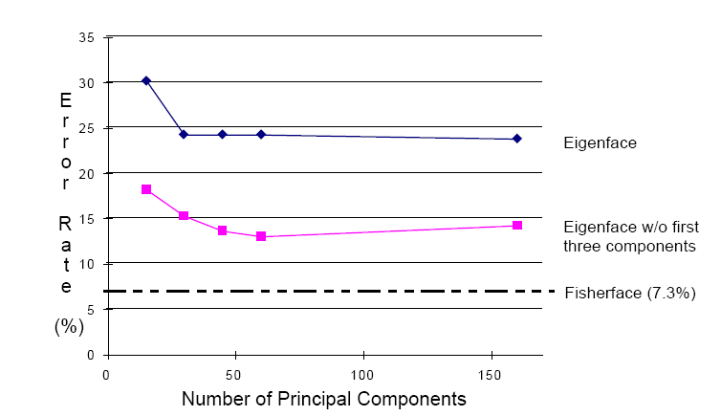
Eigenfaces vs. Fisherfaces
Reference: Eigenfaces vs. Fisherfaces, Belheumer et al., PAMI 1997

Slide 42
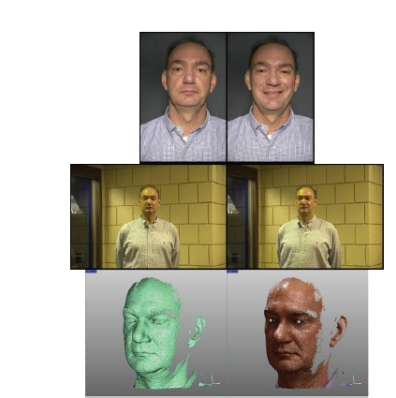
Large scale comparison of methods
FRVT 2006 Report
Not much (or any) information available about methods, but gives idea of what is doable

Slide 43
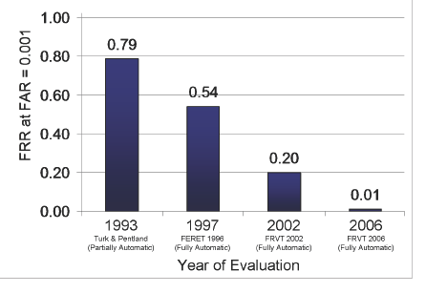
FVRT Challenge
Frontal faces
  FVRT2006 evaluation
False Rejection Rate at False Acceptance Rate = 0.001

Slide 44
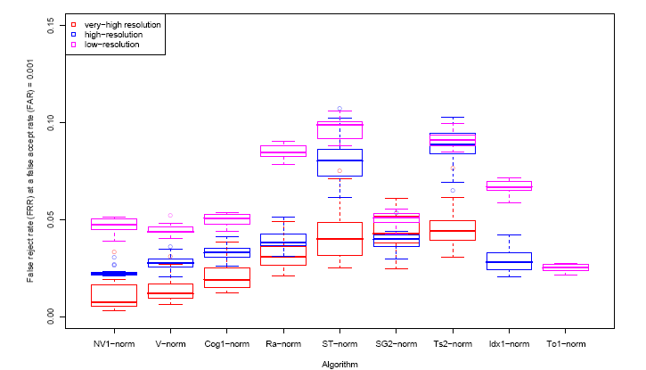
FVRT Challenge
Frontal faces
  FVRT2006 evaluation: controlled illumination

Slide 45
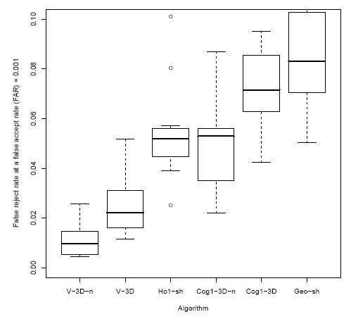
FVRT Challenge
Frontal faces
  FVRT2006 evaluation: uncontrolled illumination

Slide 46
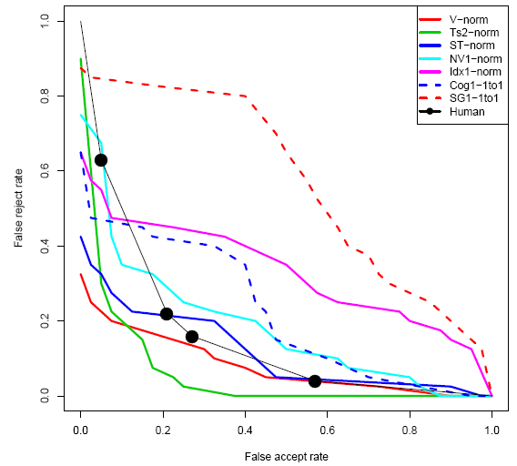
FVRT Challenge
Frontal faces
  FVRT2006 evaluation: computers win!

Slide 47
Face recognition by humans
Face recognition by humans: 20 results (2005)
Slides by Jianchao Yang

Slide 48
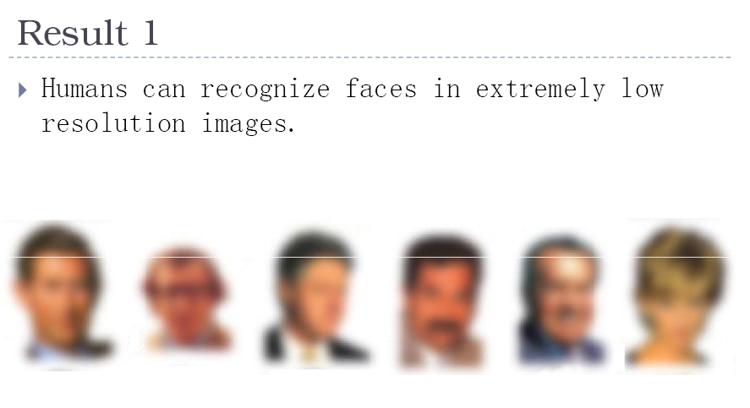

Slide 49
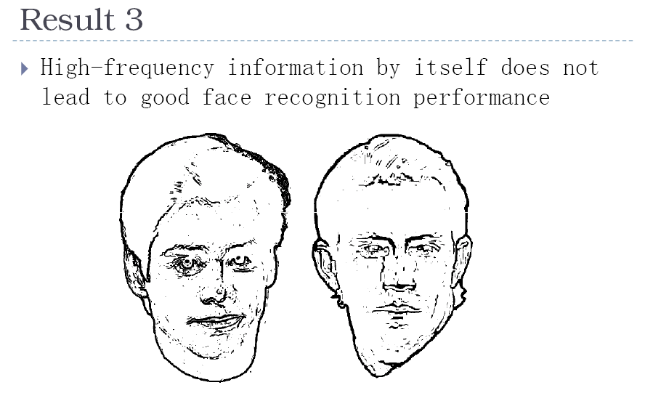

Slide 50
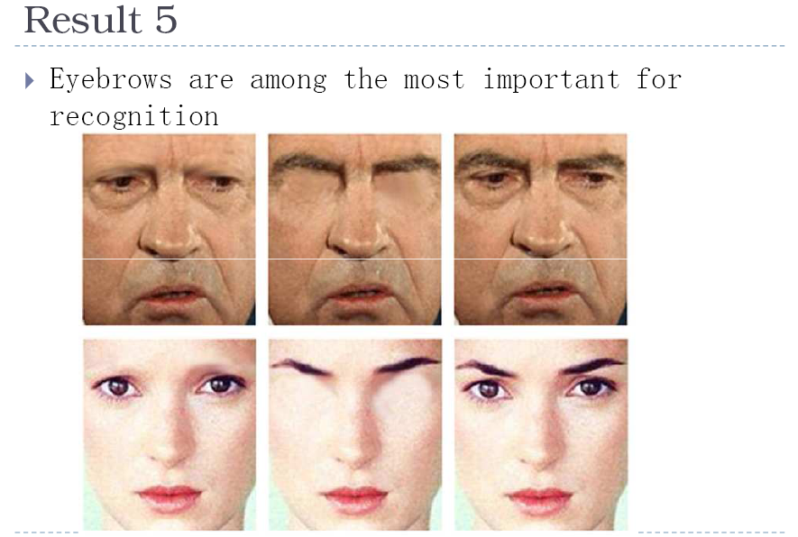

Slide 51
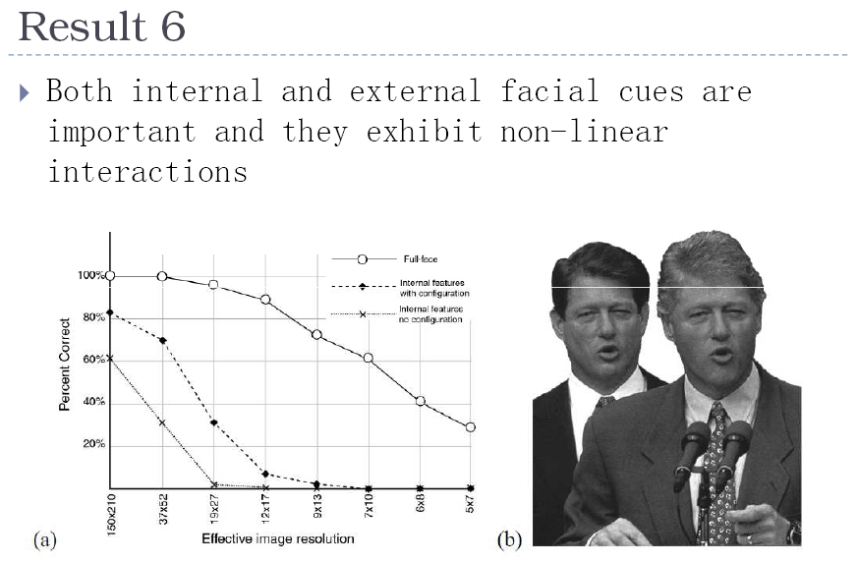

Slide 52
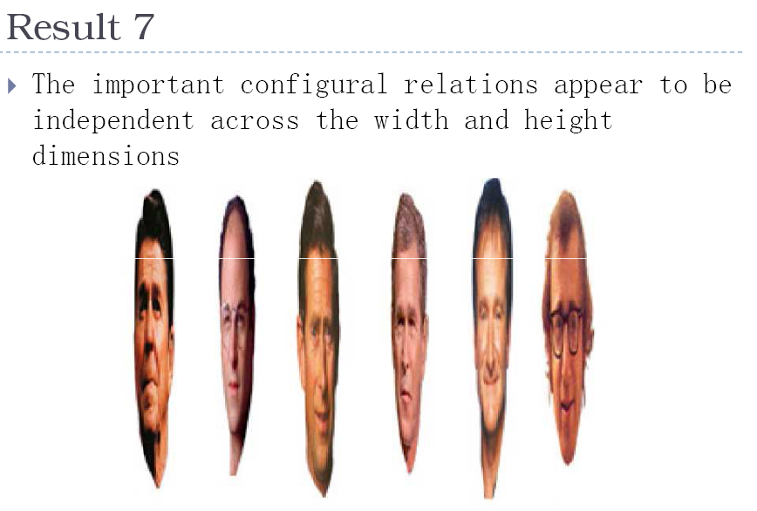

Slide 53
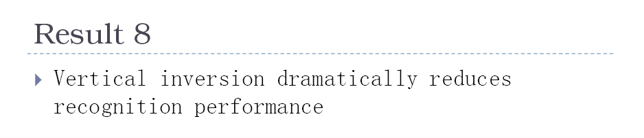
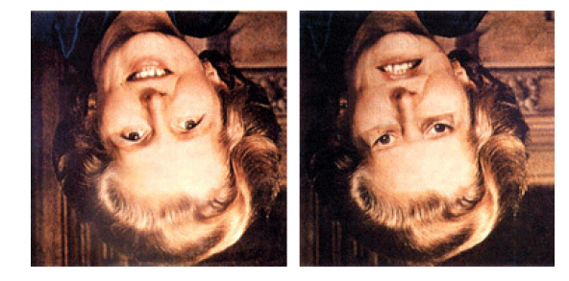
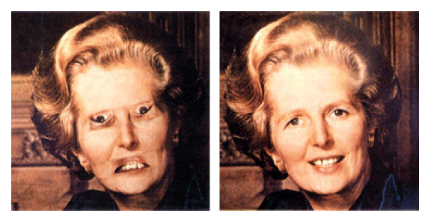

Slide 54
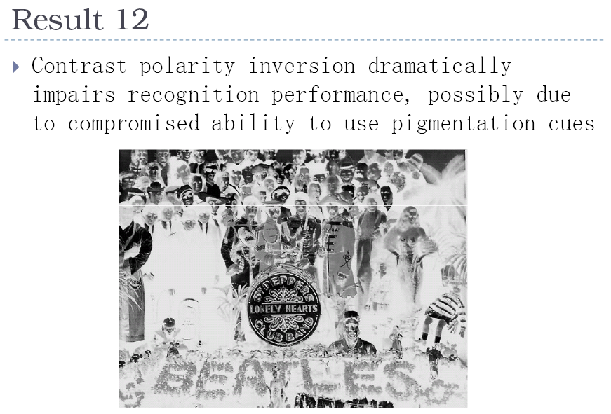
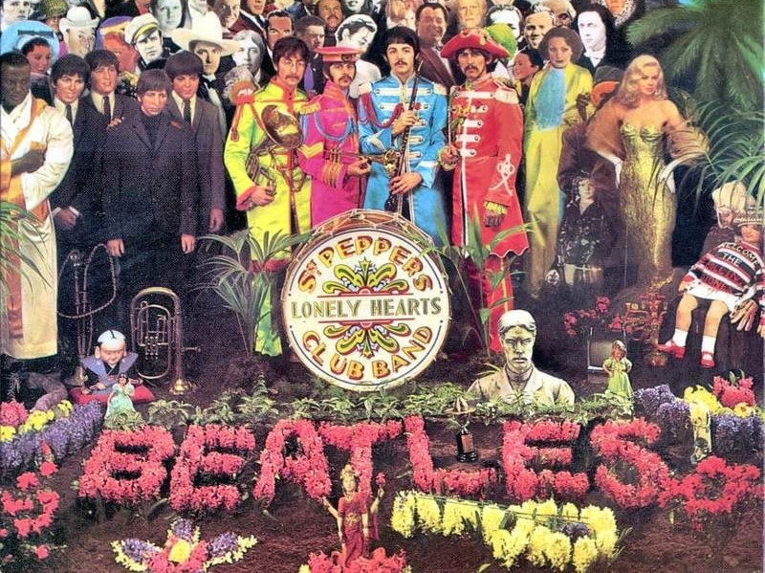

Slide 55
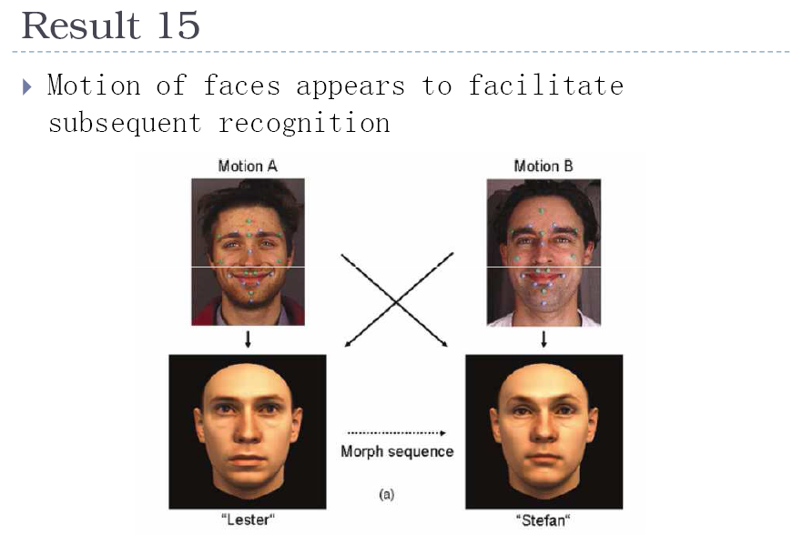

Slide 56
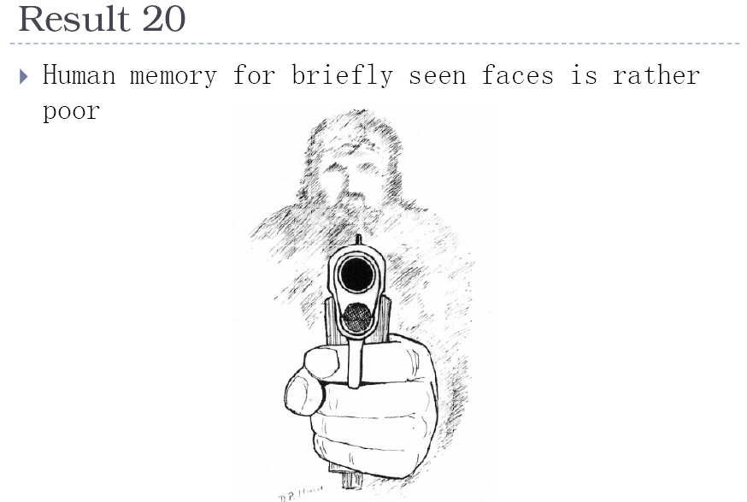

Slide 57
Things to remember
PCA is a generally useful dimensionality reduction technique
  But not ideal for discrimination
FLD better for discrimination, though only ideal under Gaussian data assumptions
Computer face recognition works very well under controlled environments – still room for improvement in general conditions

Slide 58
Next class
Video processing

Slide 59
Questions?
See you Tuesday!
Slide credit: Devi Parikh

