Slide 1
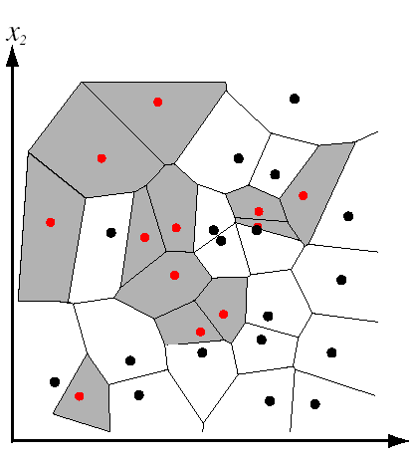


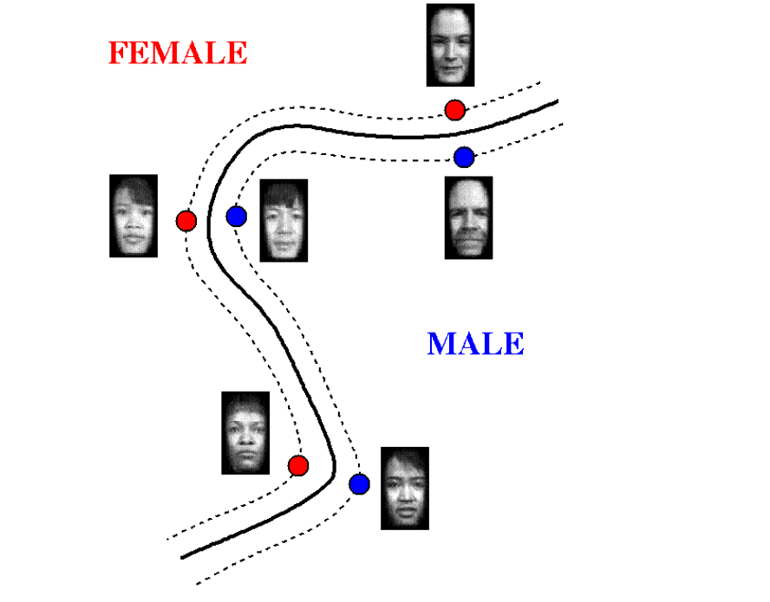
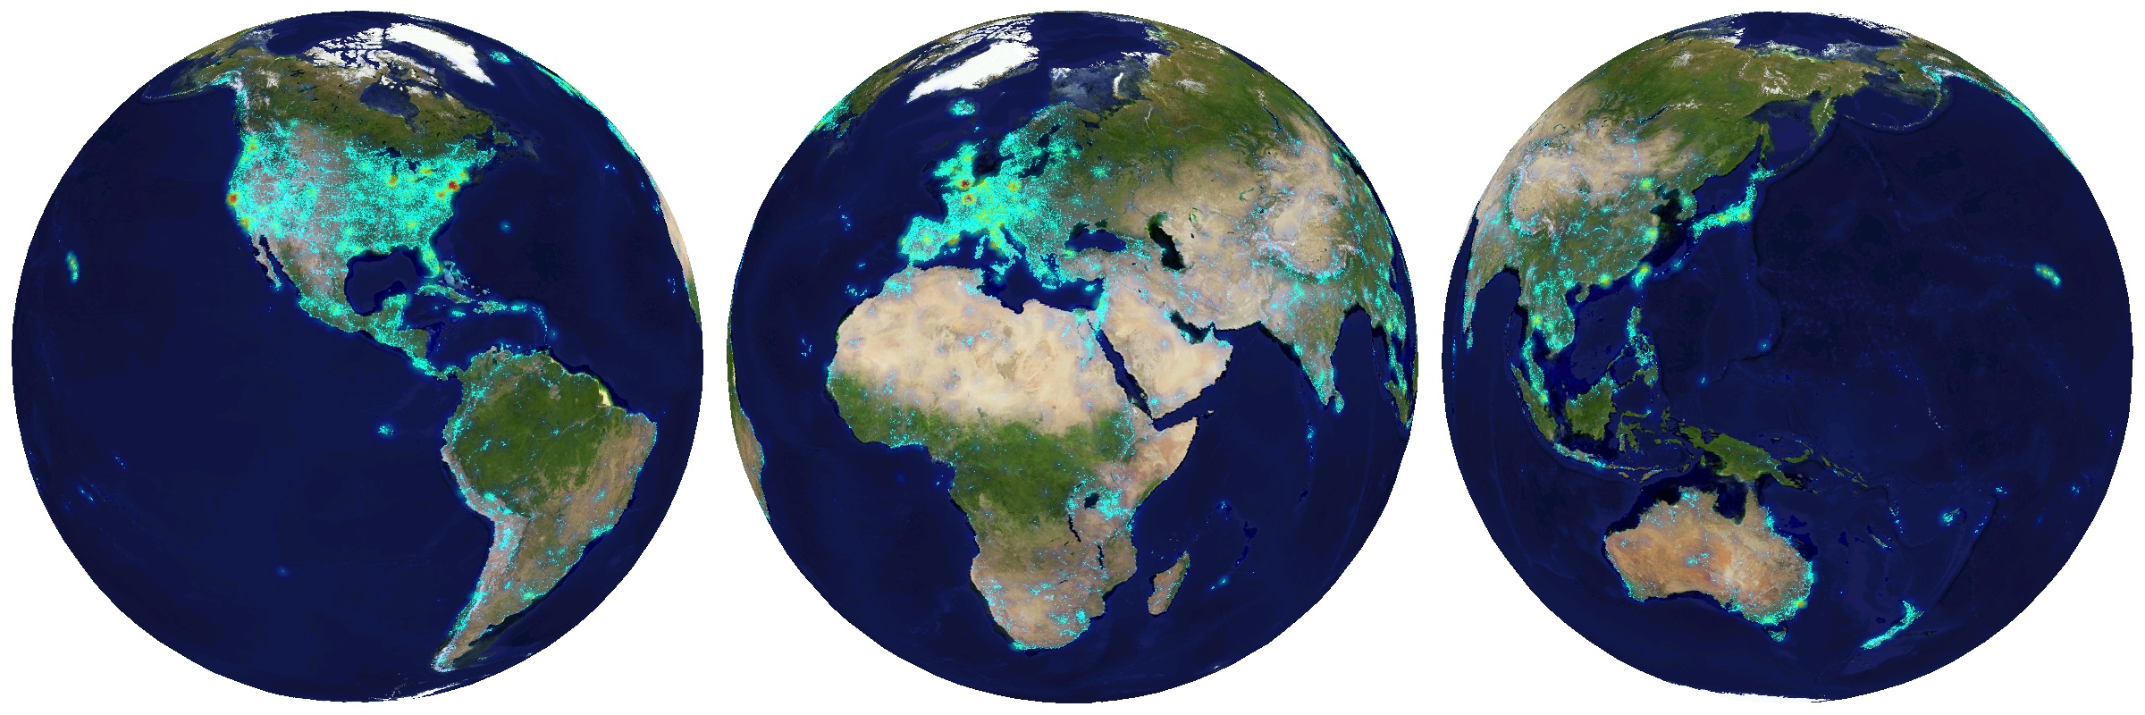
Discriminative classifiers for image recognition
Thursday, October 31st 2013
Devi Parikh
Virginia Tech
These slides have been borrowed from Kristen Grauman, who borrowed some from others.

Slide 2
Outline
Last time: window-based generic object detection
  basic pipeline
  face detection with boosting as case study

Slide 3


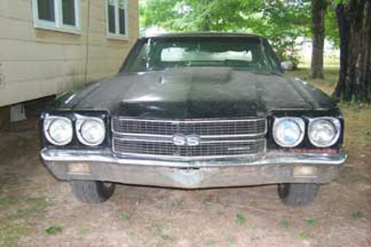
Generic category recognition: representation choice
Window-based
Part-based

Slide 4
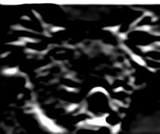
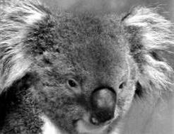
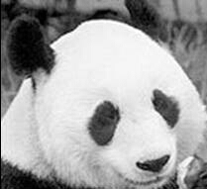
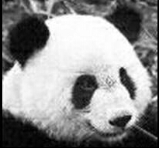
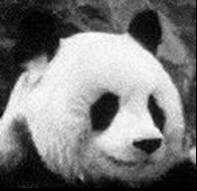
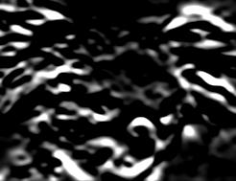

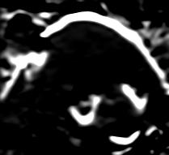
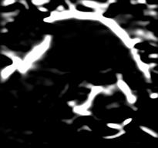
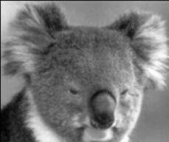
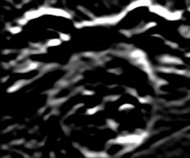
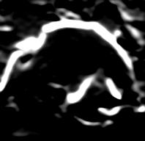
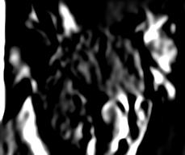
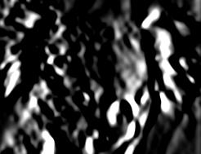
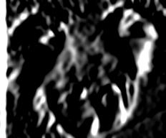
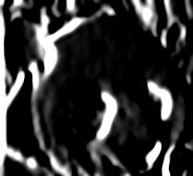
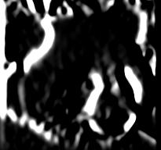
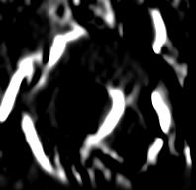
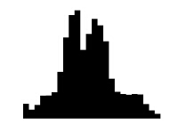

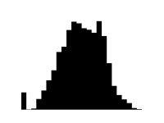



Window-based models
Building an object model
Consider edges, contours, and (oriented) intensity gradients
Kristen Grauman

Slide 5
Window-based models
Building an object model
Consider edges, contours, and (oriented) intensity gradients
Summarize local distribution of gradients with histogram
  Locally orderless: offers invariance to small shifts and rotations
  Contrast-normalization: try to correct for variable illumination
Kristen Grauman

Slide 6
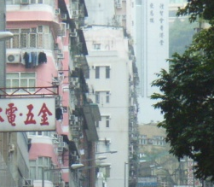

Window-based models
Building an object model
Given the representation, train a binary classifier
Car/non-car Classifier
Yes, car.
No, not a car.
Kristen Grauman

Slide 7


Window-based models
Generating and scoring candidates
Car/non-car Classifier
Kristen Grauman

Slide 8
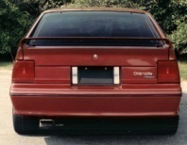
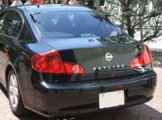

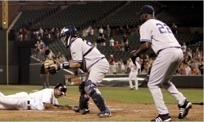
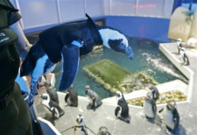
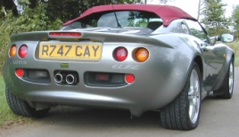
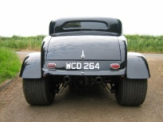

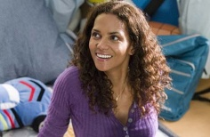


Window-based object detection: recap
Training:
Obtain training data
Define features
Define classifier
Given new image:
Slide window
Score by classifier
Training examples
Car/non-car Classifier
Feature extraction
Kristen Grauman

Slide 9

Viola-Jones detector: summary
A seminal approach to real-time object detection
Training is slow, but detection is very fast
Key ideas
  Integral images for fast feature evaluation
P. Viola and M. Jones. Rapid object detection using a boosted cascade of simple features. CVPR 2001.
P. Viola and M. Jones. Robust real-time face detection. IJCV 57(2), 2004.

Slide 10

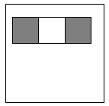
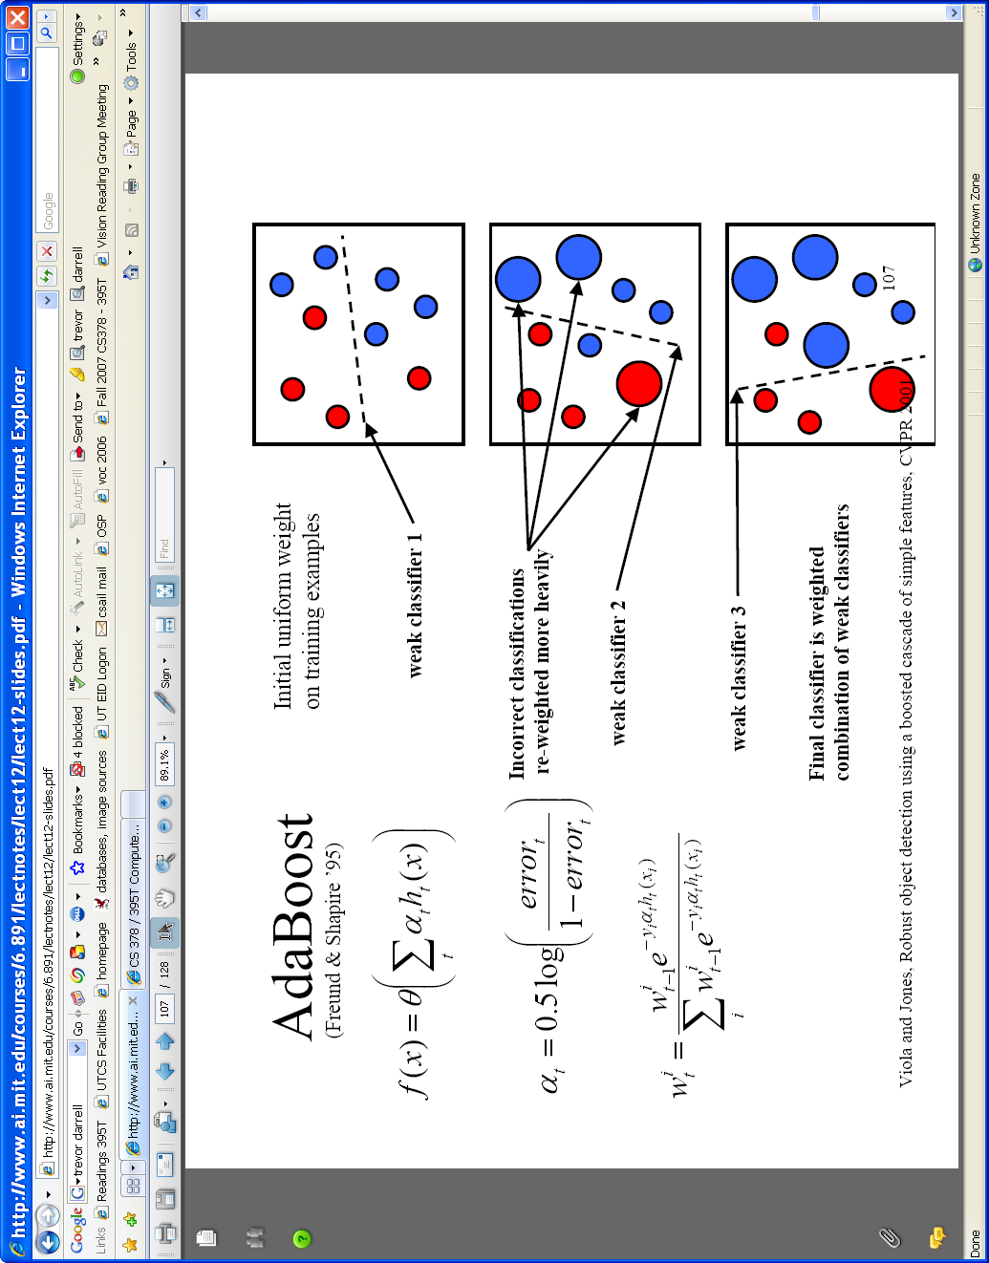
Viola-Jones detector: summary
A seminal approach to real-time object detection
Training is slow, but detection is very fast
Key ideas
  Integral images for fast feature evaluation
  Boosting for feature selection
P. Viola and M. Jones. Rapid object detection using a boosted cascade of simple features. CVPR 2001.
P. Viola and M. Jones. Robust real-time face detection. IJCV 57(2), 2004.

Slide 11
Viola-Jones detector: summary
A seminal approach to real-time object detection
Training is slow, but detection is very fast
Key ideas
  Integral images for fast feature evaluation
  Boosting for feature selection
  Attentional cascade of classifiers for fast rejection of non-face windows
P. Viola and M. Jones. Rapid object detection using a boosted cascade of simple features. CVPR 2001.
P. Viola and M. Jones. Robust real-time face detection. IJCV 57(2), 2004.

Slide 12
Boosting intuition
Weak
Classifier 1
Slide credit: Paul Viola

Slide 13
Boosting illustration
Weights
Increased

Slide 14
Boosting illustration
Weak
Classifier 2

Slide 15
Boosting illustration
Weights
Increased

Slide 16
Boosting illustration
Weak
Classifier 3

Slide 17
Boosting illustration
Final classifier is
a combination of weak classifiers

Slide 18
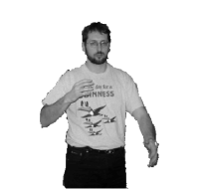


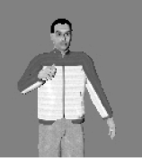




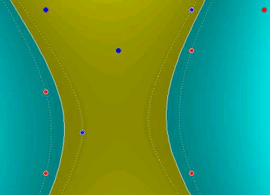
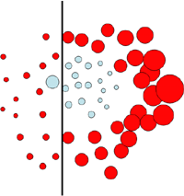
Discriminative classifier construction
Nearest neighbor
Neural networks
10⁶ examples
Shakhnarovich, Viola, Darrell 2003
Berg, Berg, Malik 2005...
LeCun, Bottou, Bengio, Haffner 1998
Rowley, Baluja, Kanade 1998
…
Support Vector Machines
Boosting
Conditional Random Fields
Guyon, Vapnik
Heisele, Serre, Poggio, 2001,…
Viola, Jones 2001, Torralba et al. 2004, Opelt et al. 2006,…
McCallum, Freitag, Pereira 2000; Kumar, Hebert 2003
…
Slide adapted from Antonio Torralba

Slide 19
Outline
Last time: window-based generic object detection
  basic pipeline
  face detection with boosting as case study
Today: discriminative classifiers for image recognition
  nearest neighbors (+ scene match app)
  support vector machines (+ gender, person app)

Slide 20
Nearest Neighbor classification
Assign label of nearest training data point to each test data point
Black = negative
Red = positive
Novel test example
Closest to a positive example from the training set, so classify it as positive.
from Duda et al.
Voronoi partitioning of feature space
for 2-category 2D data

Slide 21
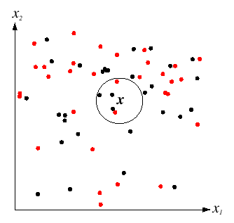
K-Nearest Neighbors classification
For a new point, find the k closest points from training data
Labels of the k points “vote” to classify
k = 5
Black = negative
Red = positive
If query lands here, the 5 NN consist of 3 negatives and 2 positives, so we classify it as negative.
Source: D. Lowe

Slide 22
A nearest neighbor recognition example

Slide 23
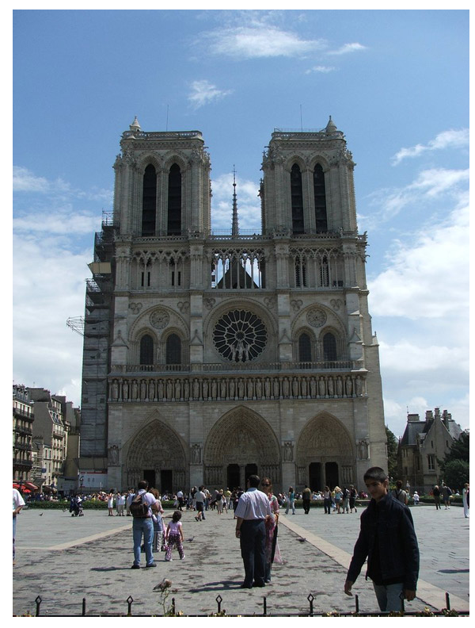
Where in the World?
[Hays and Efros. im2gps: Estimating Geographic Information from a Single Image. CVPR 2008.]
Slides: James Hays

Slide 24
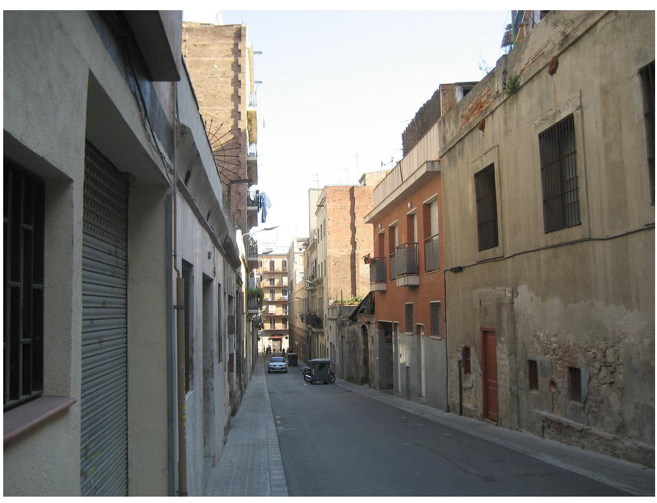
Where in the World?
Slides: James Hays

Slide 25

Where in the World?
Slides: James Hays

Slide 26
6+ million geotagged photos by 109,788 photographers
Annotated by Flickr users
Slides: James Hays

Slide 27
6+ million geotagged photos by 109,788 photographers
Annotated by Flickr users
Slides: James Hays

Slide 28
Which scene properties are relevant?

Slide 29

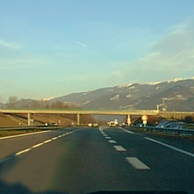
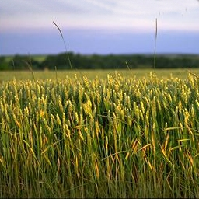
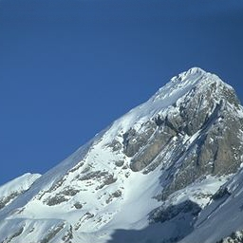
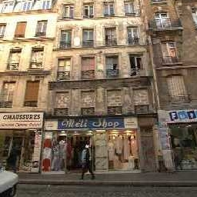
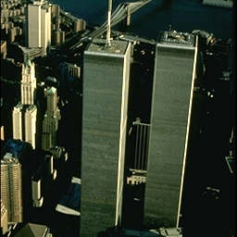
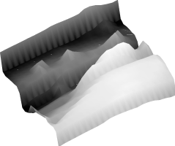

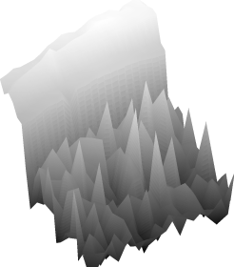
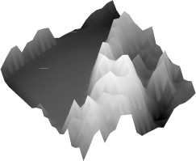
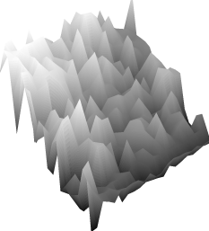
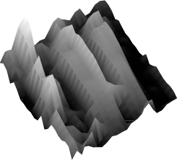
Spatial Envelope Theory of Scene Representation
Oliva & Torralba (2001)
A scene is a single surface that can be
represented by global (statistical) descriptors
Slide Credit: Aude Olivia

Slide 30

Global texture: capturing the “Gist” of the scene
Capture global image properties while keeping some spatial information
Gist descriptor
Oliva & Torralba IJCV 2001, Torralba et al. CVPR 2003

Slide 31
Which scene properties are relevant?
Gist scene descriptor
Color Histograms - L*A*B* 4x14x14 histograms
Texton Histograms – 512 entry, filter bank based
Line Features – Histograms of straight line stats

Slide 32

Scene Matches
Slides: James Hays
[Hays and Efros. im2gps: Estimating Geographic Information from a Single Image. CVPR 2008.]

Slide 33


Slides: James Hays

Slide 34

Scene Matches
Slides: James Hays
[Hays and Efros. im2gps: Estimating Geographic Information from a Single Image. CVPR 2008.]

Slide 35

Slides: James Hays
[Hays and Efros. im2gps: Estimating Geographic Information from a Single Image. CVPR 2008.]

Slide 36

Scene Matches
Slides: James Hays
[Hays and Efros. im2gps: Estimating Geographic Information from a Single Image. CVPR 2008.]

Slide 37


Slides: James Hays
[Hays and Efros. im2gps: Estimating Geographic Information from a Single Image. CVPR 2008.]

Slide 38

The Importance of Data
[Hays and Efros. im2gps: Estimating Geographic Information from a Single Image. CVPR 2008.]
Slides: James Hays

Slide 39

Feature Performance
Slides: James Hays

Slide 40
Nearest neighbors: pros and cons
Pros:
  Simple to implement
  Flexible to feature / distance choices
  Naturally handles multi-class cases
  Can do well in practice with enough representative data
Cons:
  Large search problem to find nearest neighbors
  Storage of data
  Must know we have a meaningful distance function

Slide 41
Outline
Discriminative classifiers
  Boosting (last time)
  Nearest neighbors
  Support vector machines

Slide 42
Linear classifiers

Slide 43
Lines in R²
Let

Slide 44
Lines in R²
Let

Slide 45
Lines in R²
Let

Slide 46
Lines in R²
Let
distance from point to line

Slide 47
Lines in R²
Let
distance from point to line

Slide 48
Linear classifiers
Find linear function to separate positive and negative examples
Which line
is best?

Slide 49
Support Vector Machines (SVMs)
Discriminative classifier based on optimal separating line (for 2d case)
Maximize the margin between the positive and negative training examples

Slide 50
Support vector machines
Want line that maximizes the margin.
wx+b=1
wx+b=0
wx+b=-1
For support, vectors,
Support vectors
Margin
C. Burges, A Tutorial on Support Vector Machines for Pattern Recognition, Data Mining and Knowledge Discovery, 1998

Slide 51
Support vector machines
Want line that maximizes the margin.
wx+b=1
wx+b=0
wx+b=-1
For support, vectors,
Distance between point and line:
For support vectors:
Support vectors
Margin M

Slide 52
Support vector machines
Want line that maximizes the margin.
wx+b=1
wx+b=0
wx+b=-1
For support, vectors,
Distance between point and line:
Therefore, the margin is 2 / ||w||
Support vectors
Margin M

Slide 53
Finding the maximum margin line
Maximize margin 2/||w||
Correctly classify all training data points:
Quadratic optimization problem:
Minimize
Subject to y_{i}(w·x_{i}+b) ≥ 1
C. Burges, A Tutorial on Support Vector Machines for Pattern Recognition, Data Mining and Knowledge Discovery, 1998

Slide 54
Finding the maximum margin line
Solution:
learned
weight
Support
vector
C. Burges, A Tutorial on Support Vector Machines for Pattern Recognition, Data Mining and Knowledge Discovery, 1998

Slide 55
Finding the maximum margin line
Solution:
b = y_{i} – w·x_{i} (for any support vector)
Classification function:
If f(x) < 0, classify as negative,
if f(x) > 0, classify as positive
C. Burges, A Tutorial on Support Vector Machines for Pattern Recognition, Data Mining and Knowledge Discovery, 1998

Slide 56
Questions
What if the features are not 2d?
What if the data is not linearly separable?
What if we have more than just two categories?

Slide 57
Questions
What if the features are not 2d?
  Generalizes to d-dimensions – replace line with “hyperplane”
What if the data is not linearly separable?
What if we have more than just two categories?

Slide 58
Person detection with HoG’s & linear SVM’s
Map each grid cell in the input window to a histogram counting the gradients per orientation.
Train a linear SVM using training set of pedestrian vs. non-pedestrian windows.
Code available: http://pascal.inrialpes.fr/soft/olt/
Dalal & Triggs, CVPR 2005

Slide 59

Person detection with HoG’s & linear SVM’s
Histograms of Oriented Gradients for Human Detection, Navneet Dalal, Bill Triggs, International Conference on Computer Vision & Pattern Recognition - June 2005
http://lear.inrialpes.fr/pubs/2005/DT05/

Slide 60
Questions
What if the features are not 2d?
What if the data is not linearly separable?
What if we have more than just two categories?

Slide 61
Non-linear SVMs
Datasets that are linearly separable with some noise work out great:
But what are we going to do if the dataset is just too hard?
How about… mapping data to a higher-dimensional space:
0
x
0
x
x²
0
x

Slide 62
Non-linear SVMs: feature spaces
General idea: the original input space can be mapped to some higher-dimensional feature space where the training set is separable:
Φ: x → φ(x)
Slide from Andrew Moore’s tutorial: http://www.autonlab.org/tutorials/svm.html

Slide 63
The “Kernel Trick”
The linear classifier relies on dot product between vectors K(x_{i},x_{j})=x_{i}^{T}x_{j}
If every data point is mapped into high-dimensional space via some transformation Φ: x → φ(x), the dot product becomes:
K(x_{i},x_{j})= φ(x_{i}) ^{T}φ(x_{j})
A kernel function is similarity function that corresponds to an inner product in some expanded feature space.
Slide from Andrew Moore’s tutorial: http://www.autonlab.org/tutorials/svm.html

Slide 64
Example
2-dimensional vectors x=[x₁ x₂];
let K(x_{i},x_{j})=(1 + x_{i}^{T}x_{j})²
Need to show that K(x_{i},x_{j})= φ(x_{i}) ^{T}φ(x_{j}):
K(x_{i},x_{j})=(1 + x_{i}^{T}x_{j})²,
= 1+ x_{i1}²x_{j1}² + 2 x_{i1}x_{j1} x_{i2}x_{j2}+ x_{i2}²x_{j2}² + 2x_{i1}x_{j1} + 2x_{i2}x_{j2}
= [1 x_{i1}² √2 x_{i1}x_{i2} x_{i2}² √2x_{i1} √2x_{i2}]^{T}
[1 x_{j1}² √2 x_{j1}x_{j2} x_{j2}² √2x_{j1} √2x_{j2}]
= φ(x_{i}) ^{T}φ(x_{j}),
where φ(x) = [1 x₁² √2 x₁x₂ x₂² √2x₁ √2x₂]
from Andrew Moore’s tutorial: http://www.autonlab.org/tutorials/svm.html

Slide 65
Nonlinear SVMs
The kernel trick: instead of explicitly computing the lifting transformation φ(x), define a kernel function K such that
K(x_{i} , x_{jj}) = φ(x_{i} ) · φ(x_{j})
This gives a nonlinear decision boundary in the original feature space:

Slide 66
Examples of kernel functions
Linear:
Gaussian RBF:
Histogram intersection:

Slide 67

SVMs for recognition
Define your representation for each example.
Select a kernel function.
Compute pairwise kernel values between labeled examples
Use this “kernel matrix” to solve for SVM support vectors & weights.
To classify a new example: compute kernel values between new input and support vectors, apply weights, check sign of output.

Slide 68

Example: learning gender with SVMs
Moghaddam and Yang, Learning Gender with Support Faces, TPAMI 2002.
Moghaddam and Yang, Face & Gesture 2000.

Slide 69


Face alignment processing
Processed faces
Moghaddam and Yang, Learning Gender with Support Faces, TPAMI 2002.

Slide 70
Learning gender with SVMs
Training examples:
  1044 males
  713 females
Experiment with various kernels, select Gaussian RBF

Slide 71
Support Faces
Moghaddam and Yang, Learning Gender with Support Faces, TPAMI 2002.

Slide 72

Moghaddam and Yang, Learning Gender with Support Faces, TPAMI 2002.

Slide 73
Gender perception experiment:
How well can humans do?
Subjects:
  30 people (22 male, 8 female)
  Ages mid-20’s to mid-40’s
Test data:
  254 face images
  Low res (6 males, 4 females)
  High res versions
Task:
  Classify as male or female, forced choice
  No time limit
Moghaddam and Yang, Face & Gesture 2000.

Slide 74

Gender perception experiment:
How well can humans do?
Error
Error
Moghaddam and Yang, Face & Gesture 2000.

Slide 75

Human vs. Machine
SVMs performed better than any single human test subject, at either resolution

Slide 76

Hardest examples for humans
Moghaddam and Yang, Face & Gesture 2000.

Slide 77
Questions
What if the features are not 2d?
What if the data is not linearly separable?
What if we have more than just two categories?

Slide 78
Multi-class SVMs
Achieve multi-class classifier by combining a number of binary classifiers
One vs. all
  Training: learn an SVM for each class vs. the rest
  Testing: apply each SVM to test example and assign to it the class of the SVM that returns the highest decision value
One vs. one
  Training: learn an SVM for each pair of classes
  Testing: each learned SVM “votes” for a class to assign to the test example

Slide 79
SVMs: Pros and cons
Pros
  Many publicly available SVM packages:
  http://www.kernel-machines.org/software
  http://www.csie.ntu.edu.tw/~cjlin/libsvm/
  Kernel-based framework is very powerful, flexible
  Often a sparse set of support vectors – compact at test time
  Work very well in practice, even with very small training sample sizes
Cons
  No “direct” multi-class SVM, must combine two-class SVMs
  Can be tricky to select best kernel function for a problem
  Computation, memory
    During training time, must compute matrix of kernel values for every pair of examples
    Learning can take a very long time for large-scale problems
Adapted from Lana Lazebnik

Slide 80
Coming up
Part-based models
Face recognition

Slide 81
Questions?
See you Tuesday!
Slide credit: Devi Parikh

