Slide 1
Stereo Vision and
Structure from Motion
10/17/13
Computer Vision
ECE 5554
Virginia Tech
Devi Parikh
These slides have been borrowed from Derek Hoiem, who adapted many of them from Lana Lazebnik, Silvio Saverese, Steve Seitz, and took many figures from Hartley & Zisserman

Slide 2
Multi-View Geometry
Last time: Epipolar geometry
  Relates cameras from two positions
Stereo depth estimation
  Recover depth from two images
Structure from motion
  Multiple views

Slide 3
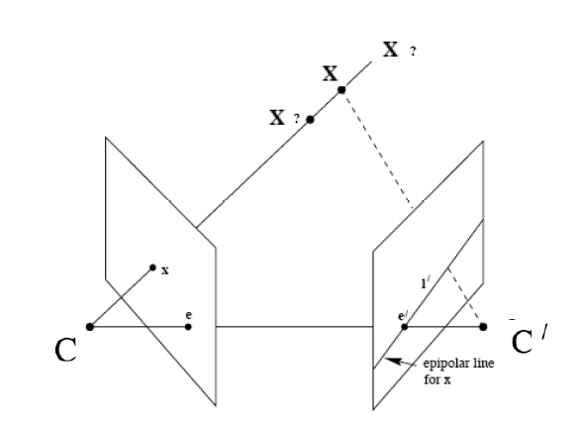
Recap: Epipoles
Point x in left image corresponds to epipolar line l’ in right image
Epipolar line passes through the epipole (the intersection of the cameras’ baseline with the image plane

Slide 4

Recap: Epipolar geometry
Epipolar Line
Epipolar Plane
Epipole
Baseline
Epipole
Notes:
4

Slide 5



Example: converging cameras
Figure from Hartley & Zisserman
Notes:
5

Slide 6

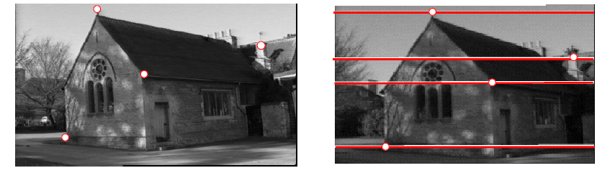
Example: parallel cameras
Figure from Hartley & Zisserman
Notes:
6

Slide 7



Recap: Fundamental Matrix
Fundamental matrix maps from a point in one image to a line in the other
If x and x’ correspond to the same 3d point X:

Slide 8
Recap: Automatic Estimation of F
Assume we have matched points x x’ with outliers
8-Point Algorithm for Recovering F
Correspondence Relation
Normalize image coordinates
RANSAC with 8 points
  Randomly sample 8 points
  Compute F via least squares
  Enforce by SVD
  Repeat and choose F with most inliers
De-normalize:

Slide 9
Recap
We can get projection matrices P and P’ up to a projective ambiguity (see HZ p. 255-256)
Code:
function P = vgg_P_from_F(F)
[U,S,V] = svd(F);
e = U(:,3);
P = [-vgg_contreps(e)*F e];
See HZ p. 255-256

Slide 10



Moving on to stereo…
Fuse a calibrated binocular stereo pair to produce a depth image
image 1
image 2
Dense depth map
Many of these slides adapted from Steve Seitz and Lana Lazebnik

Slide 11

Basic stereo matching algorithm
For each pixel in the first image
  Find corresponding epipolar line in the right image
  Search along epipolar line and pick the best match
  Triangulate the matches to get depth information
Simplest case: epipolar lines are scanlines
  When does this happen?

Slide 12
Simplest Case: Parallel images
Image planes of cameras are parallel to each other and to the baseline
Camera centers are at same height
Focal lengths are the same

Slide 13
Simplest Case: Parallel images
Image planes of cameras are parallel to each other and to the baseline
Camera centers are at same height
Focal lengths are the same
Then, epipolar lines fall along the horizontal scan lines of the images

Slide 14
Simplest Case: Parallel images
Epipolar constraint:
R = I t = (T, 0, 0)
x
x’
t
The y-coordinates of corresponding points are the same

Slide 15
Depth from disparity
X
z
x
x’
f
f
O
Baseline
B
O’
Disparity is inversely proportional to depth.

Slide 16
Stereo image rectification

Slide 17
Stereo image rectification
Reproject image planes onto a common plane parallel to the line between camera centers
Pixel motion is horizontal after this transformation
Two homographies (3x3 transform), one for each input image reprojection
C. Loop and Z. Zhang. Computing Rectifying Homographies for Stereo Vision. IEEE Conf. Computer Vision and Pattern Recognition, 1999.

Slide 18
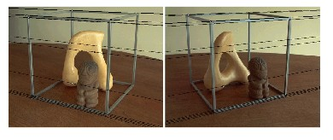
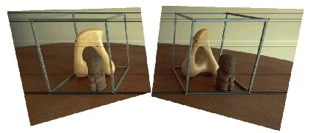
Rectification example

Slide 19
Basic stereo matching algorithm
If necessary, rectify the two stereo images to transform epipolar lines into scanlines
For each pixel x in the first image
  Find corresponding epipolar scanline in the right image
  Search the scanline and pick the best match x’
  Compute disparity x-x’ and set depth(x) = fB/(x-x’)

Slide 20


Correspondence search
Left
Right
scanline
Matching cost
disparity
Slide a window along the right scanline and compare contents of that window with the reference window in the left image
Matching cost: SSD or normalized correlation

Slide 21
Correspondence search
Left
Right
scanline
SSD

Slide 22
Correspondence search
Left
Right
scanline
Norm. corr

Slide 23


Effect of window size
W = 3
W = 20
Smaller window
  + More detail
  More noise
Larger window
  + Smoother disparity maps
  Less detail
  Fails near boundaries
Notes:
smaller window: more detail, more noise
bigger window: less noise, more detail

Slide 24


Failures of correspondence search
Textureless surfaces
Occlusions, repetition
Non-Lambertian surfaces, specularities

Slide 25

Results with window search
Data
Window-based matching
Ground truth

Slide 26
How can we improve window-based matching?
So far, matches are independent for each point
What constraints or priors can we add?

Slide 27
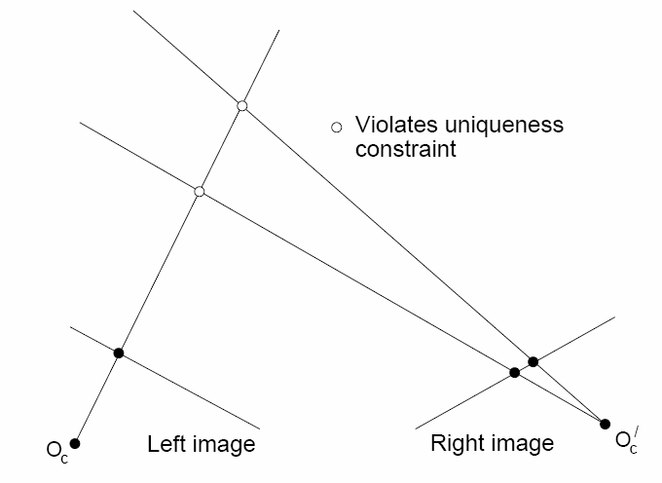
Stereo constraints/priors
Uniqueness
  For any point in one image, there should be at most one matching point in the other image

Slide 28
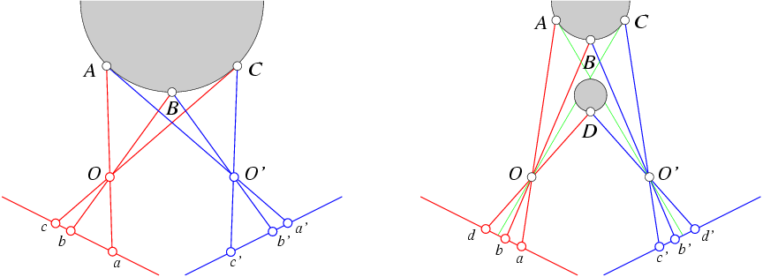
Stereo constraints/priors
Uniqueness
  For any point in one image, there should be at most one matching point in the other image
Ordering
  Corresponding points should be in the same order in both views

Slide 29
Stereo constraints/priors
Uniqueness
  For any point in one image, there should be at most one matching point in the other image
Ordering
  Corresponding points should be in the same order in both views
Ordering constraint doesn’t hold

Slide 30
Priors and constraints
Uniqueness
  For any point in one image, there should be at most one matching point in the other image
Ordering
  Corresponding points should be in the same order in both views
Smoothness
  We expect disparity values to change slowly (for the most part)

Slide 31
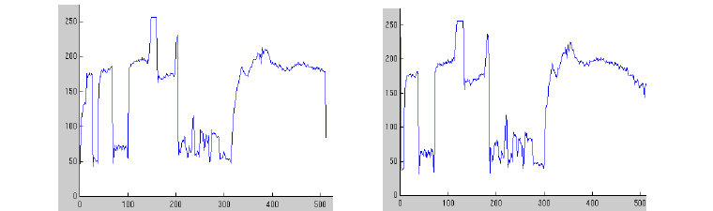
Scanline stereo
Try to coherently match pixels on the entire scanline
Different scanlines are still optimized independently
Left image
Right image
intensity

Slide 32
Stereo matching as energy minimization
I₁
I₂
D
W₁(i )
W₂(i+D(i ))
D(i )
Energy functions of this form can be minimized using graph cuts
  Y. Boykov, O. Veksler, and R. Zabih, Fast Approximate Energy Minimization via Graph Cuts, PAMI 2001

Slide 33

Many of these constraints can be encoded in an energy function and solved using graph cuts
Before
Graph cuts
Ground truth
  Y. Boykov, O. Veksler, and R. Zabih, Fast Approximate Energy Minimization via Graph Cuts, PAMI 2001
    For the latest and greatest: http://www.middlebury.edu/stereo/

Slide 34
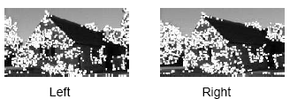
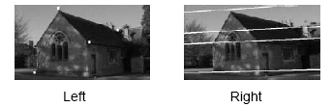
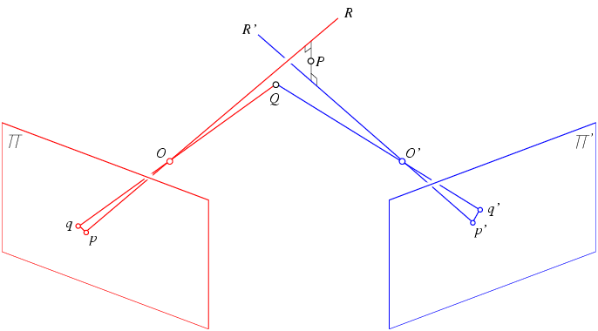
Recap: stereo with calibrated cameras
Given image pair, R, T
Detect some features
Compute essential matrix E
Match features using the epipolar and other constraints
Triangulate for 3d structure

Slide 35
Uncalibrated case
What if we don’t know the camera parameters?

Slide 36
How to calibrate the camera?

Slide 37
Calibrating the Camera
Method 3: Weak calibration
  Using corresponding points between two images

Slide 38

Calibrating the Camera
Method 1: Use an object (calibration grid) with known geometry
  Correspond image points to 3d points
  Get least squares solution (or non-linear solution)

Slide 39
Linear method
Solve using linear least squares
Ax=0 form

Slide 40
Calibration with linear method
Advantages: easy to formulate and solve
Disadvantages
  Doesn’t tell you camera parameters
  Doesn’t model radial distortion
  Can’t impose constraints, such as known focal length
  Doesn’t minimize projection error
Non-linear methods are preferred
  Define error as difference between projected points and measured points
  Minimize error using Newton’s method or other non-linear optimization

Slide 41
Calibrating the Camera
Method 2: Use vanishing points
  Find vanishing points corresponding to orthogonal directions
Vertical vanishing
point
(at infinity)
Vanishing
line
Vanishing
point
Vanishing
point

Slide 42
Calibration by orthogonal vanishing points
Intrinsic camera matrix
  Use orthogonality as a constraint
  Model K with only f, u₀, v₀
What if you don’t have three finite vanishing points?
  Two finite VP: solve f, get valid u₀, v₀ closest to image center
  One finite VP: u₀, v₀ is at vanishing point; can’t solve for f
For vanishing points

Slide 43
Calibration by orthogonal vanishing points
Intrinsic camera matrix
  Use orthogonality as a constraint
  Model K with only f, u₀, v₀
For vanishing points

Slide 44
Calibration by vanishing points
Intrinsic camera matrix
Rotation matrix
  Set directions of vanishing points
    e.g., X₁ = [1, 0, 0]
  Each VP provides one column of R
  Special properties of R
    inv(R)=R^{T}
    Each row and column of R has unit length

Slide 45
Today
  Recap: epipolar constraint
  Stereo image rectification
  Stereo solutions
    Computing correspondences
    Non-geometric stereo constraints
  Calibration
  Structure from Motion
  Example stereo and SfM applications

Slide 46
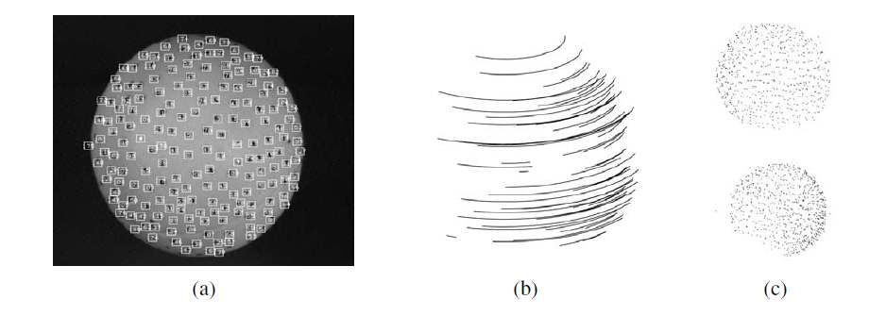
Structure from motion

Slide 47
Structure from motion
Projective structure from motion
Affine structure from motion

Slide 48
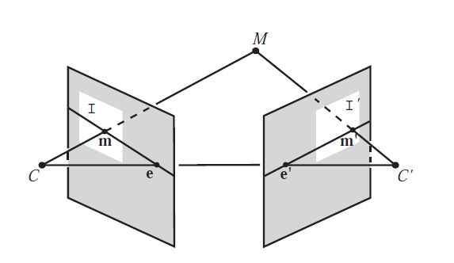
Triangulation: Linear Solution
Generally, rays C→x and C’→x’ will not exactly intersect
Can solve via SVD, finding a least squares solution to a system of equations
X
x
x'
Further reading: HZ p. 312-313

Slide 49
Triangulation: Linear Solution
Given P, P’, x, x’
Precondition points and projection matrices
Create matrix A
[U, S, V] = svd(A)
X = V(:, end)
Pros and Cons
Works for any number of corresponding images
Not projectively invariant
Code: http://www.robots.ox.ac.uk/~vgg/hzbook/code/vgg_multiview/vgg_X_from_xP_lin.m

Slide 50
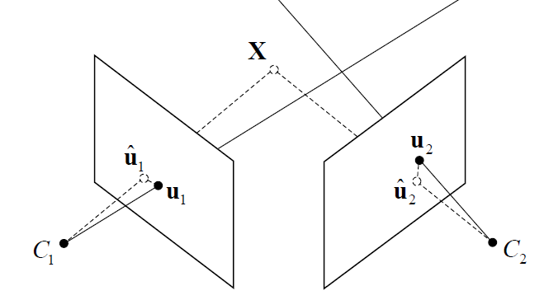




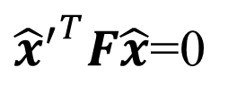
Triangulation: Non-linear Solution
Minimize projected error while satisfying
${{\hat{x}}^{′}}^{T}F\hat{x}$=0
$$cost\left(X\right)=dist{\left(x,\hat{x}\right)}^{2}+dist{\left(x′,\hat{x}′\right)}^{2}$$
$$x′$$
$$\hat{x}$$
$$x$$
$${\hat{x}}^{′}$$
Figure source: Robertson and Cipolla (Chpt 13 of Practical Image Processing and Computer Vision)

Slide 51
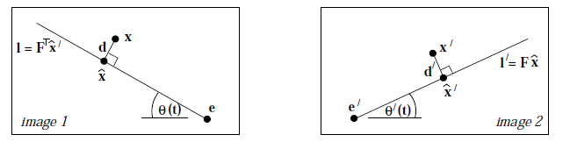

Triangulation: Non-linear Solution
Minimize projected error while satisfying
Solution is a 6-degree polynomial of t, minimizing
${{\hat{x}}^{′}}^{T}F\hat{x}$=0
$$cost\left(X\right)=dist{\left(x,\hat{x}\right)}^{2}+dist{\left(x′,\hat{x}′\right)}^{2}$$
Further reading: HZ p. 318

Slide 52
Projective structure from motion
Given: m images of n fixed 3D points
x_{ij} = P_{i} X_{j} , i = 1,… , m, j = 1, … , n
Problem: estimate m projection matrices P_{i} and n 3D points X_{j} from the mn corresponding 2D points x_{ij}
X_{j}
x_{1j}
x_{3j}
x_{2j}
P₁
P₃
Slides from Lana Lazebnik
P₂

Slide 53
Projective structure from motion
Given: m images of n fixed 3D points
x_{ij} = P_{i} X_{j} , i = 1,… , m, j = 1, … , n
Problem: estimate m projection matrices P_{i} and n 3D points X_{j} from the mn corresponding points x_{ij}
With no calibration info, cameras and points can only be recovered up to a 4x4 projective transformation Q:
X → QX, P → PQ⁻¹
We can solve for structure and motion when
2mn >= 11m +3n – 15
For two cameras, at least 7 points are needed

Slide 54
Auto-calibration
Auto-calibration: determining intrinsic camera parameters directly from uncalibrated images
For example, we can use the constraint that a moving camera has a fixed intrinsic matrix
  Compute initial projective reconstruction and find 3D projective transformation matrix Q such that all camera matrices are in the form P_{i} = K [R_{i} | t_{i}]
Can use constraints on the form of the calibration matrix, such as zero skew

Slide 55
Structure from motion under orthographic projection
3D Reconstruction of a Rotating Ping-Pong Ball
Reasonable choice when
  Change in depth of points in scene is much smaller than distance to camera
  Cameras do not move towards or away from the scene
C. Tomasi and T. Kanade. Shape and motion from image streams under orthography:
A factorization method. IJCV, 9(2):137-154, November 1992.

Slide 56

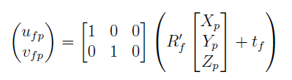
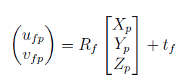

Orthographic projection for rotated/translated camera
x
a₂
a₁
X

Slide 57
Affine structure from motion
Affine projection is a linear mapping + translation in inhomogeneous coordinates
We are given corresponding 2D points (x) in several frames
We want to estimate the 3D points (X) and the affine parameters of each camera (A)
If assume world origin is at centroid of 3D points, can eliminate t
x
a₂
X
Projection of
world origin
a₁

Slide 58
Suppose we know 3D points and affine camera parameters …
then, we can compute the observed 2d positions of each point
3D Points (3xn)
Camera Parameters (2mx3)
2D Image Points (2mxn)

Slide 59
What if we instead observe corresponding 2d image points?
Can we recover the camera parameters and 3d points?
cameras (2 m)
points (n)
What rank is the matrix of 2D points?
Notes:
The measurement matrix D = MS must have rank 3!

Slide 60
Factorizing the measurement matrix
AX
Source: M. Hebert

Slide 61
Factorizing the measurement matrix
Singular value decomposition of D:
Source: M. Hebert

Slide 62
Factorizing the measurement matrix
Singular value decomposition of D:
Source: M. Hebert

Slide 63
Factorizing the measurement matrix
Obtaining a factorization from SVD:
Source: M. Hebert

Slide 64
Factorizing the measurement matrix
Obtaining a factorization from SVD:
Source: M. Hebert

Slide 65
Affine ambiguity
The decomposition is not unique. We get the same D by using any 3×3 matrix C and applying the transformations A → AC, X →C⁻¹X
That is because we have only an affine transformation and we have not enforced any Euclidean constraints (like forcing the image axes to be perpendicular, for example)
Source: M. Hebert

Slide 66
Eliminating the affine ambiguity
Orthographic: image axes are perpendicular and of unit length
a₁ · a₂ = 0
x
|a₁|² = |a₂|² = 1
a₂
a₁
X
Source: M. Hebert

Slide 67
Solve for orthographic constraints
Solve for L = CC^{T}
Recover C from L by Cholesky decomposition: L = CC^{T}
Update A and X: A = AC, X = C⁻¹X
Three equations for each image i
where
~
~

Slide 68
Algorithm summary
Given: m images and n tracked features x_{ij}
For each image i, center the feature coordinates
Construct a 2m × n measurement matrix D:
  Column j contains the projection of point j in all views
  Row i contains one coordinate of the projections of all the n points in image i
Factorize D:
  Compute SVD: D = U W V^{T}
  Create U₃ by taking the first 3 columns of U
  Create V₃ by taking the first 3 columns of V
  Create W₃ by taking the upper left 3 × 3 block of W
Create the motion (affine) and shape (3D) matrices:
  A = U₃W₃^{½} and X = W₃^{½} V₃^{T}
Eliminate affine ambiguity
Source: M. Hebert

Slide 69
Today
  Recap: epipolar constraint
  Stereo image rectification
  Stereo solutions
    Computing correspondences
    Non-geometric stereo constraints
  Calibration
  Structure from Motion
  Example stereo and SfM applications

Slide 70
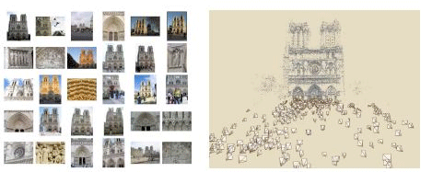
Photo synth
Noah Snavely, Steven M. Seitz, Richard Szeliski, "Photo tourism: Exploring photo collections in 3D," SIGGRAPH 2006
http://photosynth.net/

Slide 71
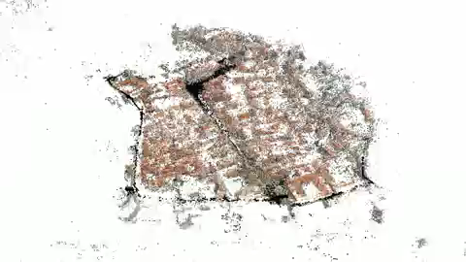
3D from multiple images
Building Rome in a Day: Agarwal et al. 2009

Slide 72
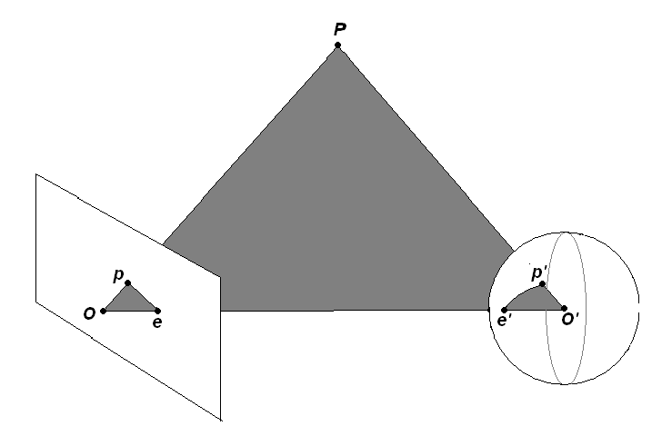
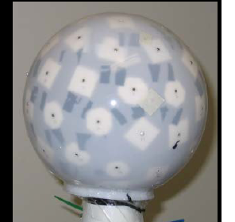
An audio camera & epipolar geometry
Adam O' Donovan, Ramani Duraiswami and Jan Neumann Microphone Arrays as Generalized Cameras for Integrated Audio Visual Processing, IEEE Conference on Computer Vision and Pattern Recognition (CVPR), Minneapolis, 2007
Spherical microphone array

Slide 73
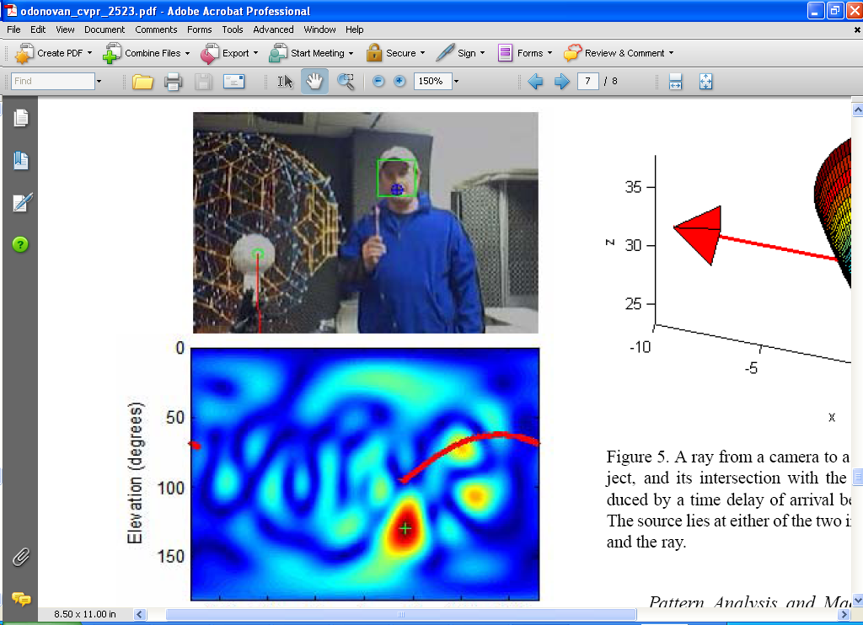
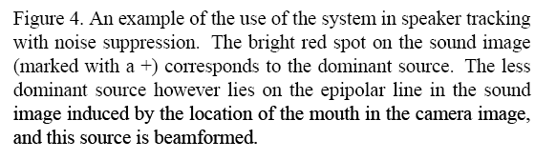
An audio camera & epipolar geometry

Slide 74
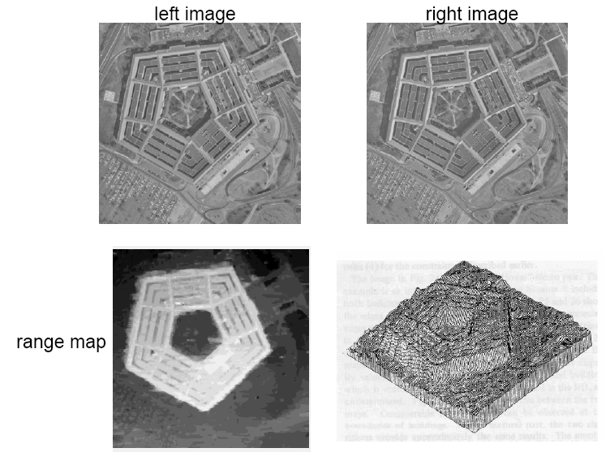

Slide 75
Stereo in machine vision systems
Left : The Stanford cart sports a single camera moving in discrete increments along a straight line and providing multiple snapshots of outdoor scenes
Right : The INRIA mobile robot uses three cameras to map its environment
Forsyth & Ponce
Notes:
75

Slide 76
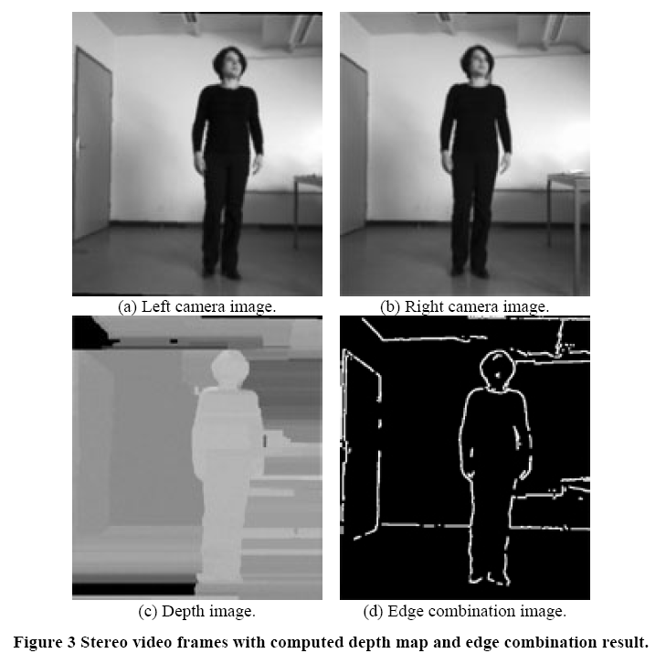
Depth for segmentation
Edges in disparity in conjunction with image edges enhances contours found
Danijela Markovic and Margrit Gelautz, Interactive Media Systems Group, Vienna University of Technology

Slide 77
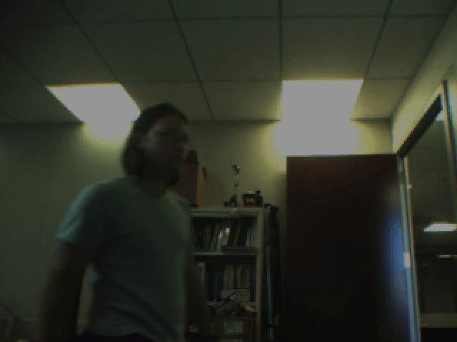
Model-based body tracking, stereo input
David Demirdjian, MIT Vision Interface Group
http://people.csail.mit.edu/demirdji/movie/artic-tracker/turn-around.m1v

Slide 78
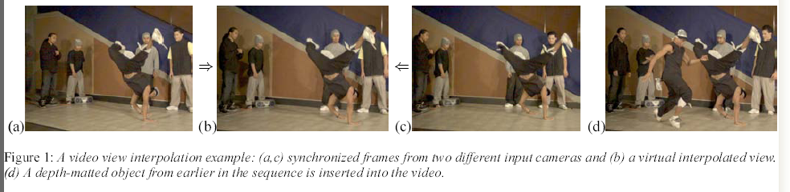
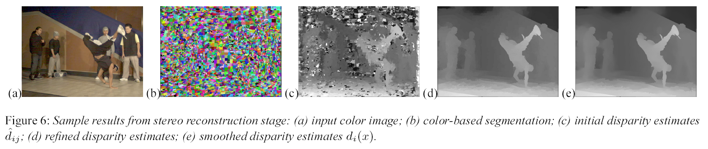
Virtual viewpoint video
C. Zitnick et al, High-quality video view interpolation using a layered representation, SIGGRAPH 2004.

Slide 79

Virtual viewpoint video
http://research.microsoft.com/IVM/VVV/

Slide 80
From Next class
Recognition

Slide 81
Questions?
See you Tuesday!
Slide credit: Devi Parikh

