Slide 1
Image formation
Thursday October 10th 2013
Devi Parikh
Virginia Tech
Disclaimer: Most slides have been borrowed from Kristen Grauman and Derek Hoiem, who may have borrowed some of them from others. Any time a slide did not already have a credit on it, I have credited it to Kristen or Derek. So there is a chance some of these credits are inaccurate.

Slide 2
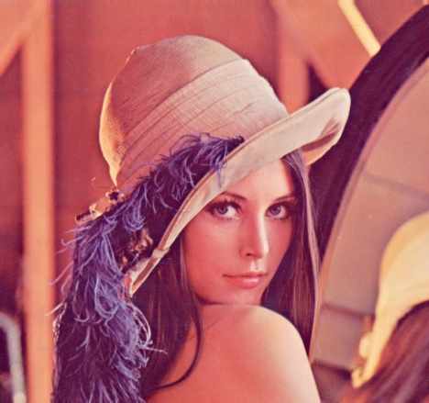
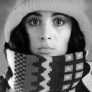

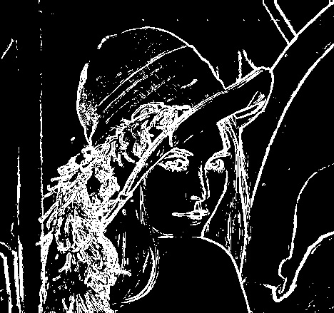
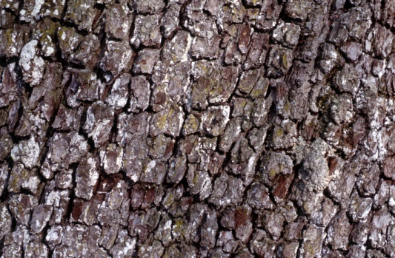

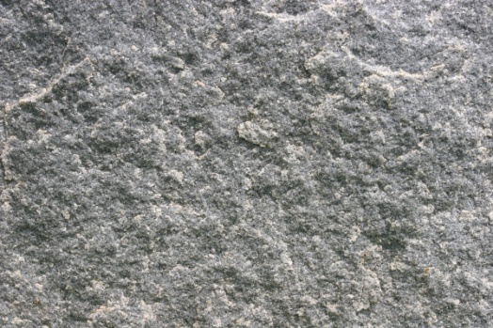
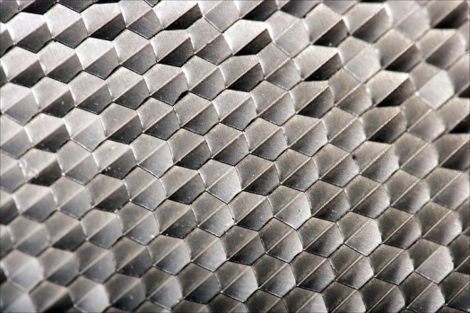
Recap: Features and filters
Transforming and describing images; textures, colors, edges
Kristen Grauman

Slide 3
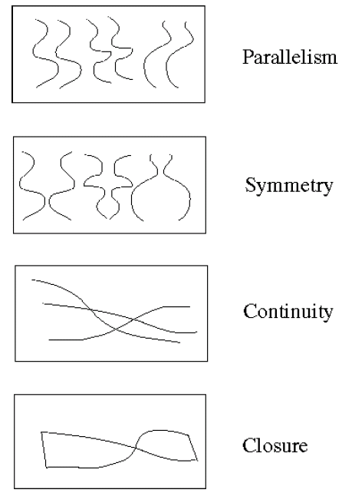
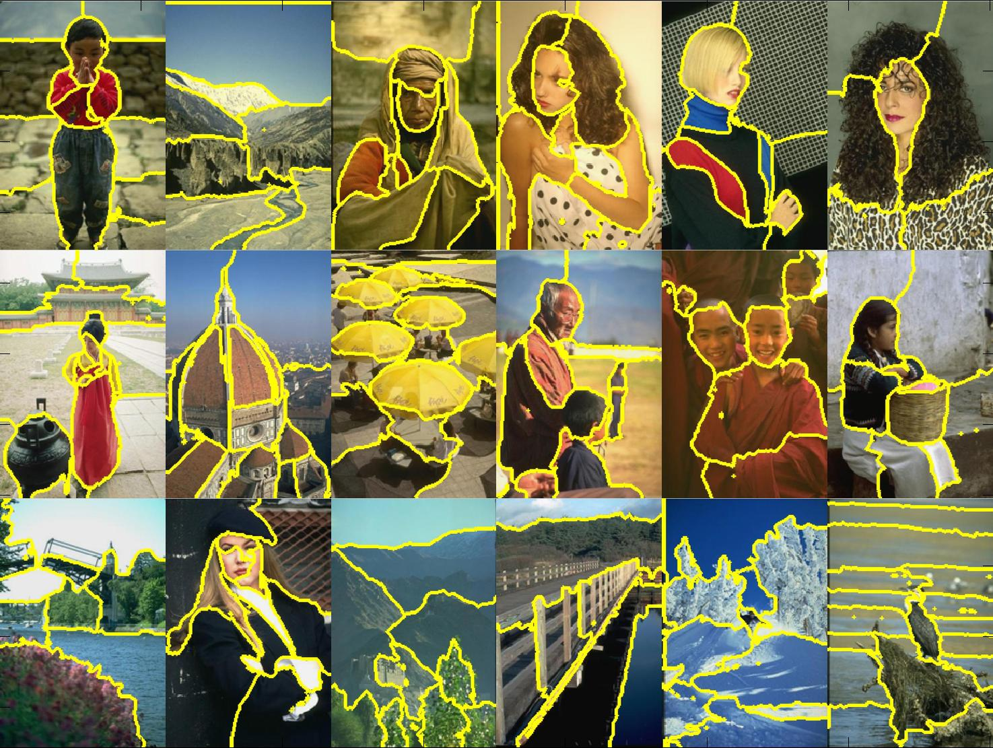
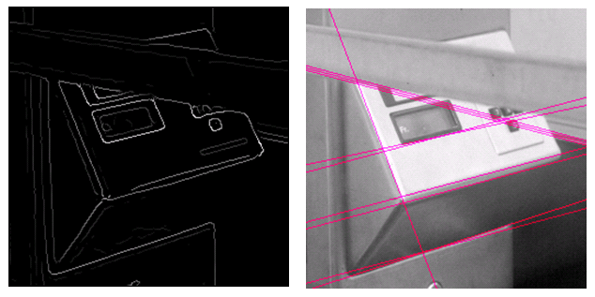
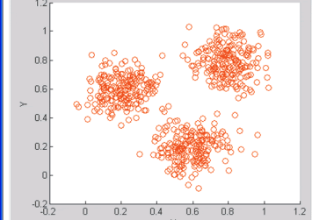
Recap: Grouping & fitting
Clustering, segmentation, fitting; what parts belong together?
[fig from Shi et al]
Kristen Grauman

Slide 4
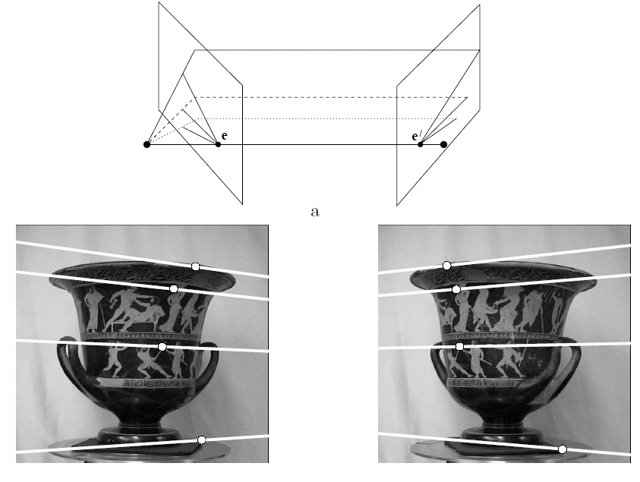
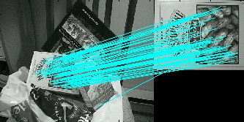
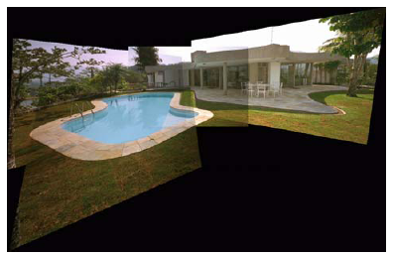
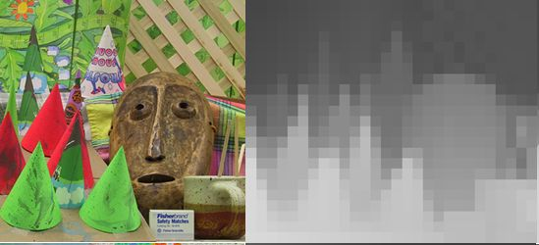
Multiple views
Multi-view geometry, matching, invariant features, stereo vision
Lowe
Hartley and Zisserman
Kristen Grauman

Slide 5
Plan
Today:
  Local feature matching btwn views (recap)
  Image formation, geometry of a single view
Tuesday: Multiple views and epipolar geometry
Thursday: Approaches for stereo correspondence
Slide source: Kristen Grauman

Slide 6
Previously
Local invariant features
  Detection of interest points
    Harris corner detection
    Scale invariant blob detection: LoG
  Description of local patches
    SIFT : Histograms of oriented gradients
  Matching descriptors
Slide source: Kristen Grauman

Slide 7



Local features: main components
Detection: Identify the interest points
Description:Extract vector feature descriptor surrounding each interest point.
Matching: Determine correspondence between descriptors in two views
Kristen Grauman

Slide 8
Recall: Corners as distinctive interest points
Slide source: Devi Parikh

Slide 9

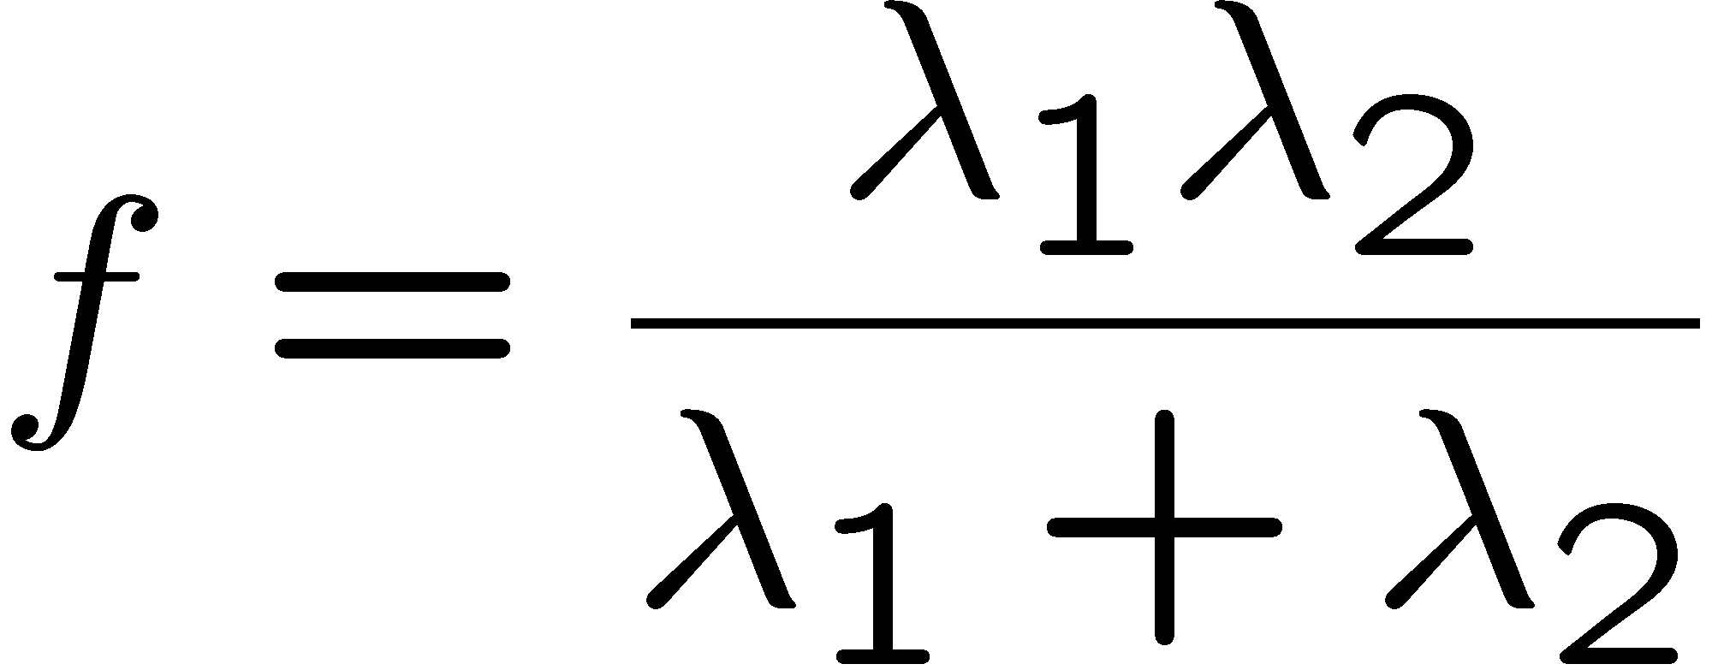
Recall: Corners as distinctive interest points
“edge”:
“corner”:
“flat” region
λ₁ >> λ₂
λ₁ and λ₂ are large,
λ₁ ~ λ₂;
λ₁ and λ₂ are small;
λ₂ >> λ₁
One way to score the cornerness:
Slide source: Kristen Grauman

Slide 10

Harris Detector: Steps
Slide source: Kristen Grauman

Slide 11

Harris Detector: Steps
Compute corner response f
Slide source: Kristen Grauman

Slide 12

Harris Detector: Steps
Slide source: Kristen Grauman

Slide 13


Blob detection in 2D: scale selection
Laplacian-of-Gaussian = “blob” detector
filter scales
img2
Slide source: Kristen Grauman
img1
img3

Slide 14
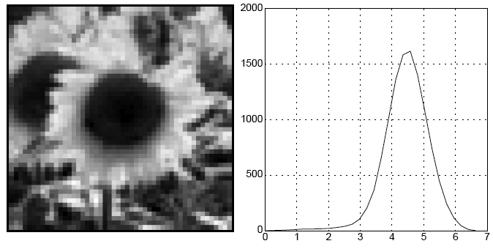
Blob detection in 2D
We define the characteristic scale as the scale that produces peak of Laplacian response
characteristic scale
Slide credit: Lana Lazebnik

Slide 15

Example
Original image at ¾ the size
Kristen Grauman

Slide 16
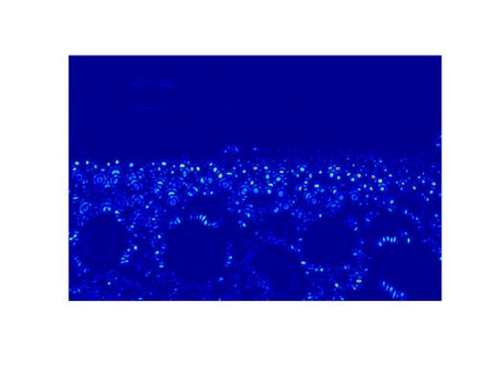
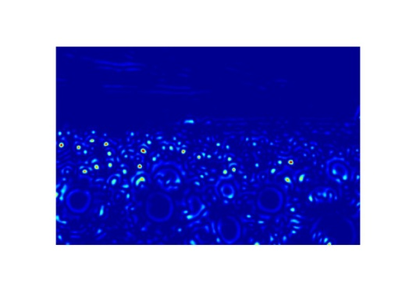

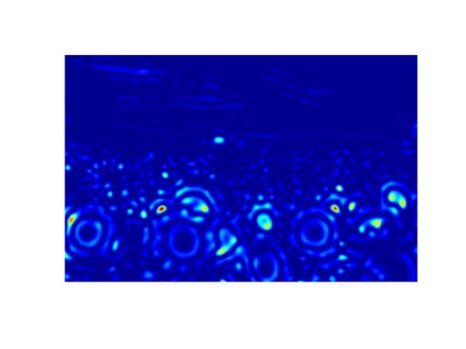
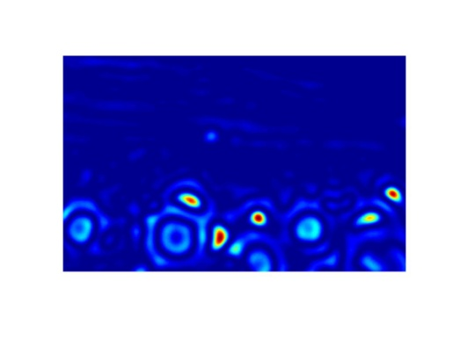
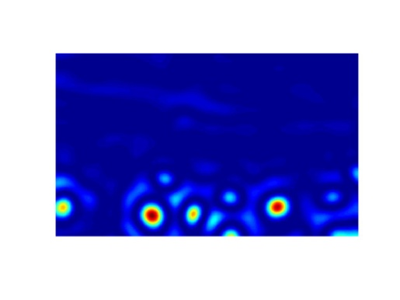
Scale invariant interest points
Interest points are local maxima in both position and scale.
σ5
σ4
scale
σ3
σ2
⇒ List of
(x, y, σ)
σ1
Squared filter response maps
Kristen Grauman

Slide 17
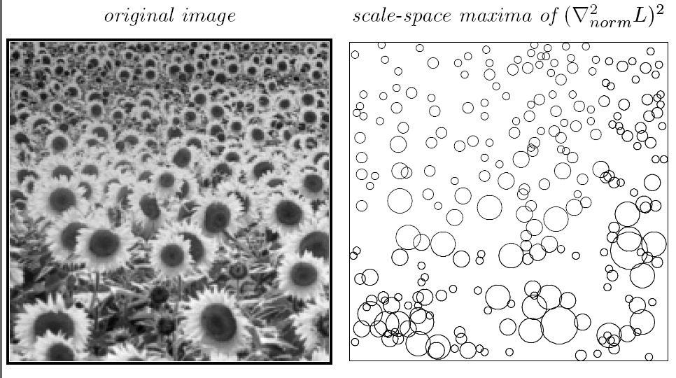
Scale-space blob detector: Example
T. Lindeberg. Feature detection with automatic scale selection. IJCV 1998.
Slide source: Kristen Grauman

Slide 18
Local features: main components
Detection: Identify the interest points
Description:Extract vector feature descriptor surrounding each interest point.
Matching: Determine correspondence between descriptors in two views
Kristen Grauman

Slide 19

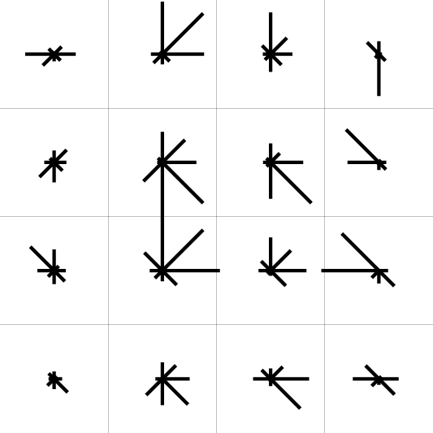
SIFT descriptor [Lowe 2004]
Use histograms to bin pixels within sub-patches according to their orientation.
0
2
π
Why subpatches?
Why does SIFT have some illumination invariance?
Kristen Grauman

Slide 20


Making descriptor rotation invariant
CSE 576: Computer Vision
Rotate patch according to its dominant gradient orientation
This puts the patches into a canonical orientation.
Image from Matthew Brown

Slide 21


SIFT descriptor [Lowe 2004]
Extraordinarily robust matching technique
  Can handle changes in viewpoint
    Up to about 60 degree out of plane rotation
  Can handle significant changes in illumination
    Sometimes even day vs. night (below)
  Fast and efficient—can run in real time
  Lots of code available
    http://people.csail.mit.edu/albert/ladypack/wiki/index.php/Known_implementations_of_SIFT
Steve Seitz

Slide 22
SIFT properties
Invariant to
  Scale
  Rotation
Partially invariant to
  Illumination changes
  Camera viewpoint
  Occlusion, clutter
Slide source: Kristen Grauman

Slide 23
Local features: main components
Detection: Identify the interest points
Description:Extract vector feature descriptor surrounding each interest point.
Matching: Determine correspondence between descriptors in two views
Kristen Grauman

Slide 24
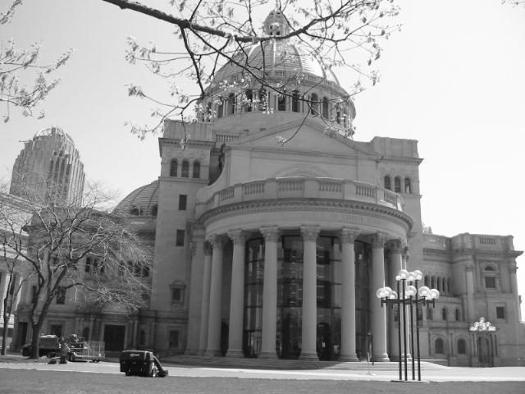
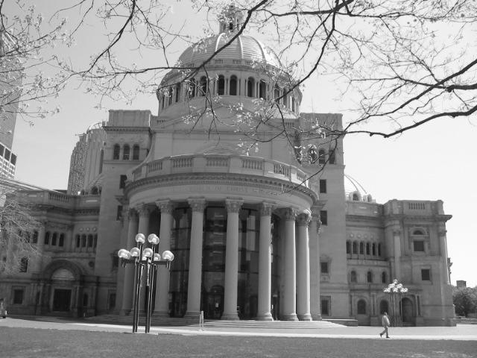
Matching local features
Kristen Grauman

Slide 25
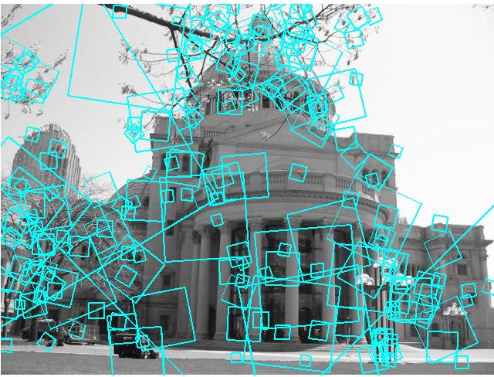
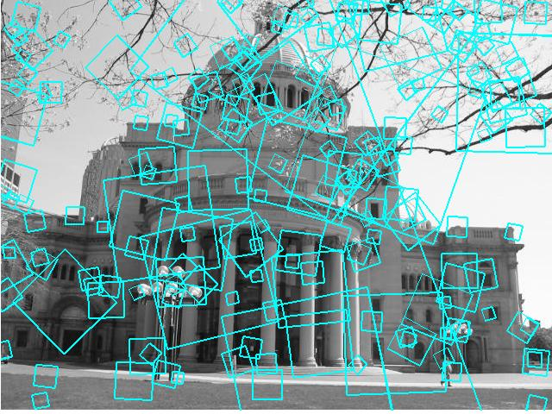
Matching local features
?
Image 1
Image 2
To generate candidate matches, find patches that have the most similar appearance (e.g., lowest SSD)
Simplest approach: compare them all, take the closest (or closest k, or within a thresholded distance)
Kristen Grauman

Slide 26
Ambiguous matches
?
?
?
?
Image 1
Image 2
At what SSD value do we have a good match?
To add robustness to matching, can consider ratio : distance to best match / distance to second best match
If low, first match looks good.
If high, could be ambiguous match.
Kristen Grauman

Slide 27
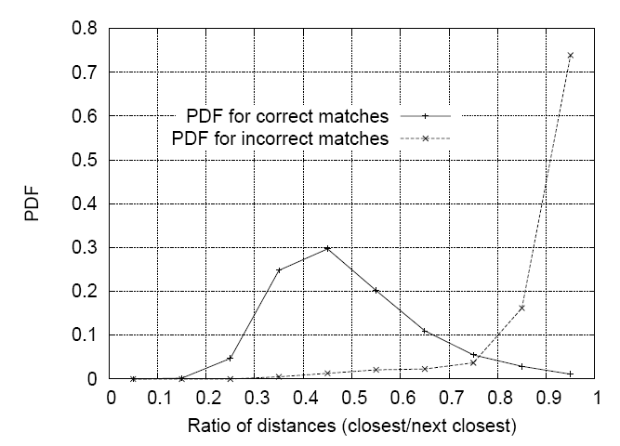
Matching SIFT Descriptors
Nearest neighbor (Euclidean distance)
Threshold ratio of nearest to 2nd nearest descriptor
Lowe IJCV 2004
Derek Hoiem

Slide 28


Recap: robust feature-based alignment
Source: L. Lazebnik

Slide 29

Recap: robust feature-based alignment
Extract features
Source: L. Lazebnik

Slide 30
Recap: robust feature-based alignment
Extract features
Compute putative matches
Source: L. Lazebnik

Slide 31
Recap: robust feature-based alignment
Extract features
Compute putative matches
Loop:
  Hypothesize transformation T (small group of putative matches that are related by T)
Source: L. Lazebnik

Slide 32
Recap: robust feature-based alignment
Extract features
Compute putative matches
Loop:
  Hypothesize transformation T (small group of putative matches that are related by T)
  Verify transformation (search for other matches consistent with T)
Source: L. Lazebnik

Slide 33

Recap: robust feature-based alignment
Extract features
Compute putative matches
Loop:
  Hypothesize transformation T (small group of putative matches that are related by T)
  Verify transformation (search for other matches consistent with T)
Source: L. Lazebnik

Slide 34
Applications of local invariant features
Wide baseline stereo
Motion tracking
Panoramas
Mobile robot navigation
3D reconstruction
Recognition
…
Kristen Grauman

Slide 35
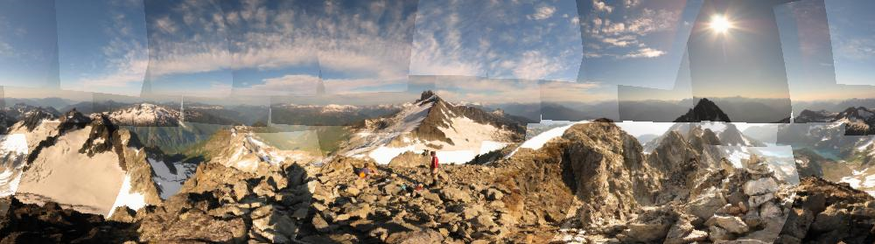
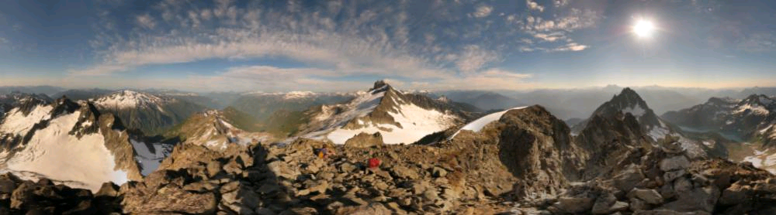
Automatic mosaicing
http://www.cs.ubc.ca/~mbrown/autostitch/autostitch.html
Kristen Grauman

Slide 36
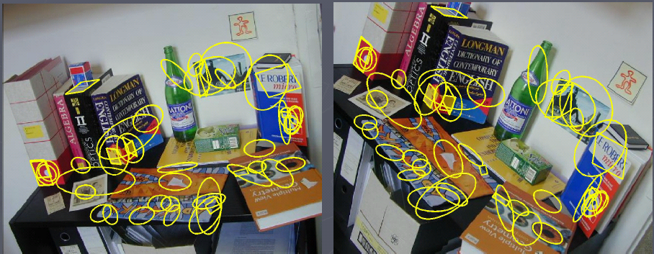
Wide baseline stereo
[Image from T. Tuytelaars ECCV 2006 tutorial]
Kristen Grauman

Slide 37
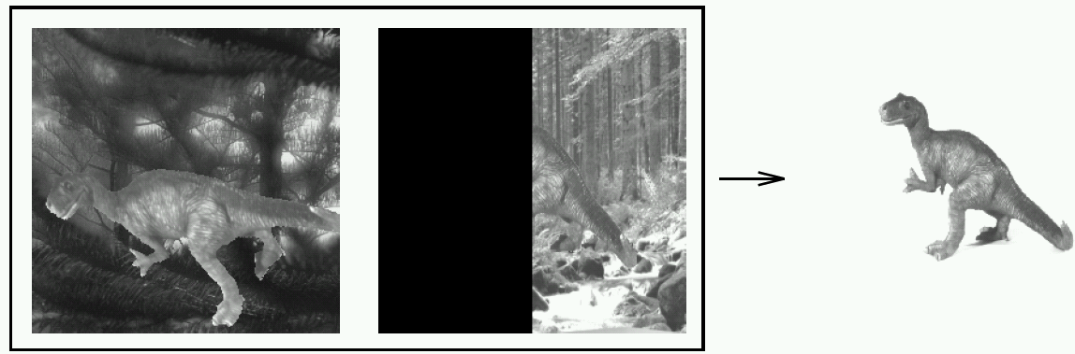


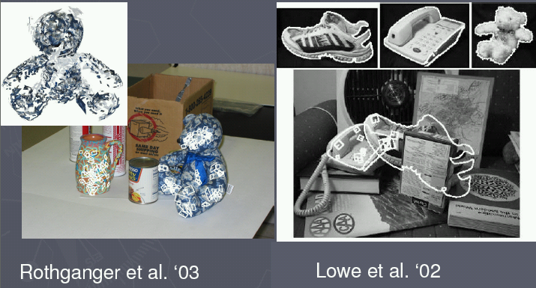
Recognition of specific objects, scenes
Schmid and Mohr 1997
Sivic and Zisserman, 2003
Rothganger et al. 2003
Lowe 2002
Kristen Grauman

Slide 38
Plan
Today:
  Local feature matching btwn views (wrap-up)
  Image formation, geometry of a single view
Tuesday: Multiple views and epipolar geometry
Thursday: Approaches for stereo correspondence
Kristen Grauman

Slide 39
Image formation
How are objects in the world captured in an image?
Kristen Grauman

Slide 40
Physical parameters of image formation
Geometric
  Type of projection
  Camera pose
Optical
  Sensor’s lens type
  focal length, field of view, aperture
Photometric
  Type, direction, intensity of light reaching sensor
  Surfaces’ reflectance properties
Kristen Grauman

Slide 41
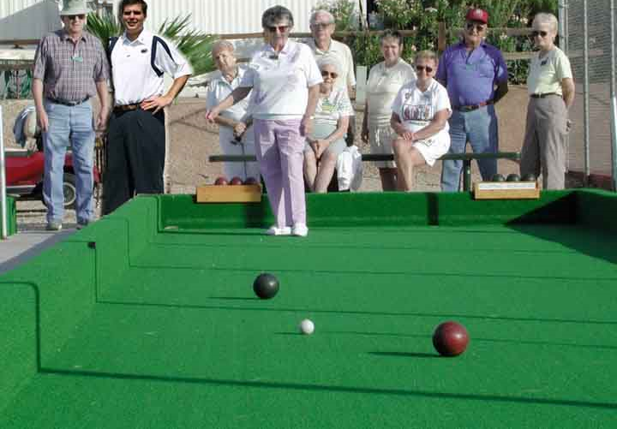
Single-view Geometry
How tall is this woman?
How high is the camera?
What is the camera rotation?
What is the focal length of the camera?
Which ball is closer?
Slide source: Derek Hoiem

Slide 42
Today’s class
Mapping between image and world coordinates
  Pinhole camera model
  Projective geometry
    Vanishing points and lines
  Projection matrix
Slide source: Derek Hoiem

Slide 43
Image formation
Let’s design a camera
  Idea 1: put a piece of film in front of an object
  Do we get a reasonable image?
Slide source: Seitz

Slide 44
Pinhole camera
Idea 2: add a barrier to block off most of the rays
  This reduces blurring
  The opening known as the aperture
Slide source: Seitz
Notes:
Q: How does this transform the image? A: It gets inverted

Slide 45

Pinhole camera
f
c
f = focal length
c = center of the camera
Figure from Forsyth

Slide 46
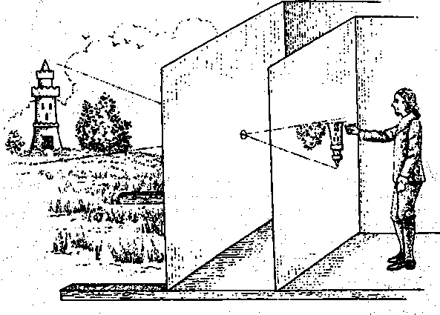
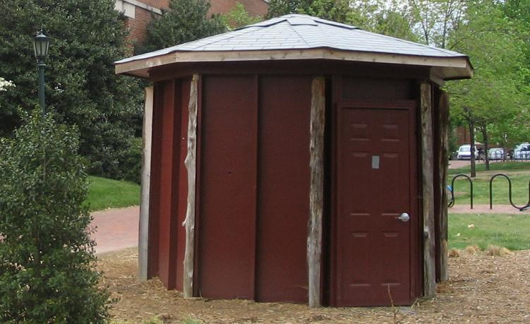
Camera obscura: the pre-camera
First idea: Mo-Ti, China (470BC to 390BC)
First built: Alhacen, Iraq/Egypt (965 to 1039AD)
Illustration of Camera Obscura
Freestanding camera obscura at UNC Chapel Hill
Photo by Seth Ilys
Slide source: Derek Hoiem

Slide 47
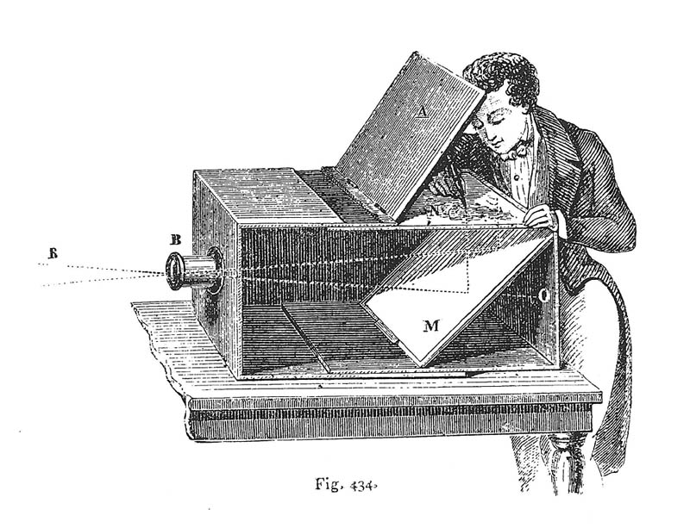
Camera Obscura used for Tracing
Lens Based Camera Obscura, 1568
Slide source: Derek Hoiem

Slide 48
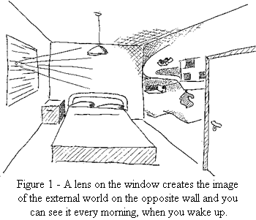
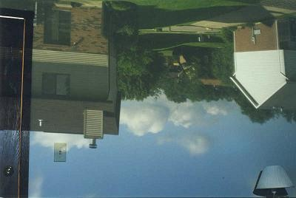
Camera obscura at home
http://blog.makezine.com/archive/2006/02/how_to_room_sized_camera_obscu.html
Sketch from http://www.funsci.com/fun3_en/sky/sky.htm
Slide source: Kristen Grauman

Slide 49
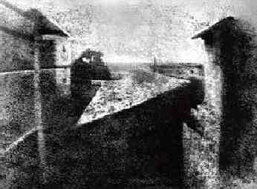
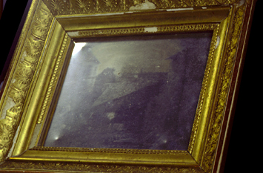
First Photograph
Oldest surviving photograph
  Took 8 hours on pewter plate
Photograph of the first photograph
Joseph Niepce, 1826
Stored at UT Austin
Niepce later teamed up with Daguerre, who eventually created Daguerrotypes
Slide source: Derek Hoiem

Slide 50
Dimensionality Reduction Machine (3D to 2D)
3D world
2D image
Slide source: Derek Hoiem
Figures © Stephen E. Palmer, 2002

Slide 51

Projection can be tricky…
Slide source: Seitz
Slide source: Derek Hoiem

Slide 52
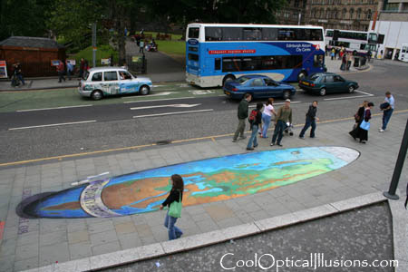
Projection can be tricky…
Slide source: Seitz
Making of 3D sidewalk art: http://www.youtube.com/watch?v=3SNYtd0Ayt0
Slide source: Derek Hoiem

Slide 53
Projective Geometry
What is lost?
Length
Who is taller?
Which is closer?
Slide source: Derek Hoiem

Slide 54
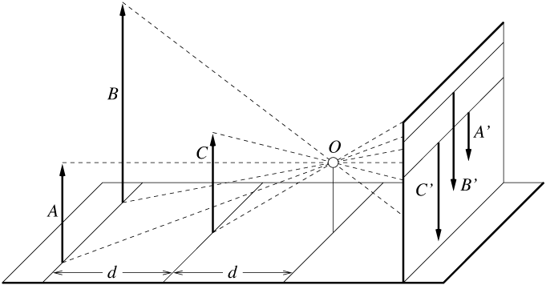
Length is not preserved
A’
C’
B’
Figure by David Forsyth

Slide 55
Projective Geometry
What is lost?
Length
Angles
Parallel?
Perpendicular?
Slide source: Derek Hoiem

Slide 56
Projective Geometry
What is preserved?
Straight lines are still straight
Slide source: Derek Hoiem

Slide 57
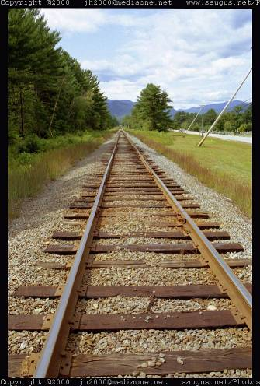
Vanishing points and lines
Parallel lines in the world intersect in the image at a “vanishing point”
Slide source: Derek Hoiem
Notes:
Go to board, sketch out various properties of vanishing points/lines

Slide 58
Vanishing points and lines
Vanishing Point
Vanishing Point
o
o
Vanishing Line
The projections of parallel 3D lines intersect at a vanishing point
The projection of parallel 3D planes intersect at a vanishing line
If a set of parallel 3D lines are also parallel to a particular plane, their vanishing point will lie on the vanishing line of the plane
Not all lines that intersect are parallel
Vanishing point <-> 3D direction of a line
Vanishing line <-> 3D orientation of a surface
Slide source: Derek Hoiem
Notes:
Go to board, sketch out various properties of vanishing points/lines
Parallel lines intersect at a point
The intersection of red lines and blue lines form a parallelogram
Sets of parallel lines on the same plane form a vanishing line
Sets of parallel planes form a vanishing line
Not all lines that intersect are parallel

Slide 59
Vanishing points and lines
Vertical vanishing
point
(at infinity)
Vanishing
line
Vanishing
point
Vanishing
point
Slide from Efros, Photo from Criminisi

Slide 60
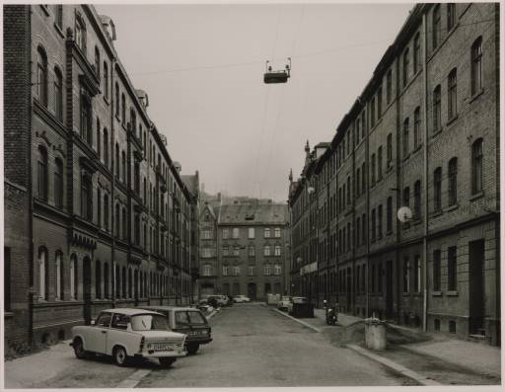
Vanishing points and lines
Photo from online Tate collection
Slide source: Derek Hoiem
Notes:
Where are the vanishing points? Do buildings on left and buildings on right have the same vanishing line? Which way is the camera tilted?

Slide 61
Note on estimating vanishing points
Use multiple lines for better accuracy
… but lines will not intersect at exactly the same point in practice
One solution: take mean of intersecting pairs
… bad idea!
Instead, minimize angular differences
Slide source: Derek Hoiem
Notes:
Go to board, sketch out various properties of vanishing points/lines

Slide 62

Vanishing objects
Slide source: Derek Hoiem

Slide 63
Projection: world coordinates→image coordinates
.
Optical Center (u₀, v₀)
.
.
f
Z
Y
.
v
Camera Center (t_{x}, t_{y}, t_{z})
u
Slide source: Adapted by Devi Parikh from Derek Hoiem

Slide 64




Homogeneous coordinates
Conversion
Converting to homogeneous coordinates
homogeneous image
coordinates
homogeneous scene
coordinates
Converting from homogeneous coordinates
Slide source: Derek Hoiem
Notes:
Append coordinate with value 1; proportional coordinate system

Slide 65
Homogeneous coordinates
Invariant to scaling
Point in Cartesian is ray in Homogeneous
Homogeneous Coordinates
Cartesian Coordinates
Slide source: Derek Hoiem
Notes:
Q: Suppose we have a point in Cartesian coordinates. What is that in homogeneous coordinates? A: a ray

Slide 66
Basic geometry in homogeneous coordinates
Line equation: ax + by + c = 0
Append 1 to pixel coordinate to get homogeneous coordinate
Line given by cross product of two points
Intersection of two lines given by cross product of the lines
Slide source: Derek Hoiem

Slide 67
Another problem solved by homogeneous coordinates
Intersection of parallel lines
  Cartesian: (Inf, Inf)
  Homogeneous: (1, 1, 0)
  Cartesian: (Inf, Inf)
Homogeneous: (1, 2, 0)
Slide source: Derek Hoiem
Notes:
Parallel lines intersect at different infinities

Slide 68

Projection matrix
Slide Credit: Saverese
R,T
j_{w}
k_{w}
O_{w}
i_{w}
x: Image Coordinates: (u,v,1)
K: Intrinsic Matrix (3x3)
R: Rotation (3x3)
t: Translation (3x1)
X: World Coordinates: (X,Y,Z,1)
Slide source: Derek Hoiem
Notes:
We can use homogeneous coordinates to write camera matrix in linear form.

Slide 69
Interlude: where has Derek used this stuff?
Slide source: Derek Hoiem

Slide 70
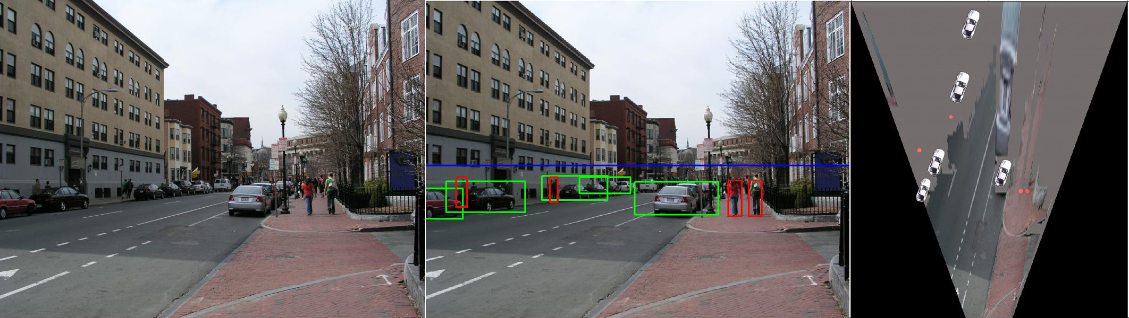
When has Derek used this stuff?
Object Recognition (CVPR 2006)
Slide source: Derek Hoiem

Slide 71
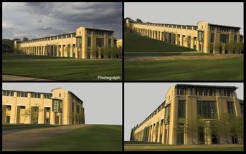
When has Derek used this stuff?
Single-view reconstruction (SIGGRAPH 2005)
Slide source: Derek Hoiem

Slide 72
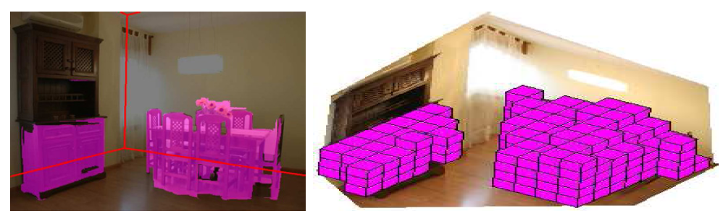
When has Derek used this stuff?
Getting spatial layout in indoor scenes (ICCV 2009)
Slide source: Derek Hoiem

Slide 73
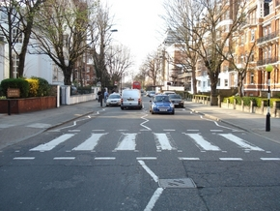
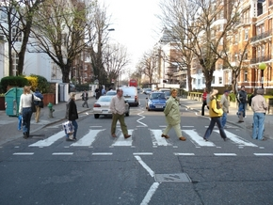
When has Derek used this stuff?
Inserting photographed objects into images (SIGGRAPH 2007)
Original
Created
Slide source: Derek Hoiem

Slide 74
When has Derek used this stuff?
Inserting synthetic objects into images: http://vimeo.com/28962540
Slide source: Derek Hoiem

Slide 75

Slide source: Derek Hoiem

Slide 76

Slide source: Derek Hoiem

Slide 77
Pinhole Camera Model
x: Image Coordinates: (u,v,1)
K: Intrinsic Matrix (3x3)
R: Rotation (3x3)
t: Translation (3x1)
X: World Coordinates: (X,Y,Z,1)

Slide 78
Projection matrix
Intrinsic Assumptions
Unit aspect ratio
Optical center at (0,0)
No skew
Extrinsic Assumptions
No rotation
Camera at (0,0,0)
K
Slide Credit: Saverese
Notes:
Work through equations for u and v on board

Slide 79
Remove assumption: known optical center
Intrinsic Assumptions
Unit aspect ratio
No skew
Extrinsic Assumptions
No rotation
Camera at (0,0,0)
Slide source: Derek Hoiem

Slide 80
Remove assumption: square pixels
Intrinsic Assumptions
No skew
Extrinsic Assumptions
No rotation
Camera at (0,0,0)
Slide source: Derek Hoiem

Slide 81
Remove assumption: non-skewed pixels
Intrinsic Assumptions
Extrinsic Assumptions
No rotation
Camera at (0,0,0)
Note: different books use different notation for parameters
Slide source: Derek Hoiem

Slide 82
Oriented and Translated Camera
R
j_{w}
t
k_{w}
O_{w}
i_{w}
Slide source: Derek Hoiem

Slide 83
Allow camera translation
Intrinsic Assumptions
Extrinsic Assumptions
No rotation
Slide source: Derek Hoiem

Slide 84
3D Rotation of Points
Slide Credit: Saverese
Rotation around the coordinate axes, counter-clockwise:
p’
γ
y
p
z
Slide source: Derek Hoiem

Slide 85
Allow camera rotation
Slide source: Derek Hoiem

Slide 86
Degrees of freedom
5
6
Slide source: Derek Hoiem
Notes:
How many known points are needed to estimate this?

Slide 87
Vanishing Point = Projection from Infinity
Slide source: Derek Hoiem

Slide 88
Orthographic Projection
Special case of perspective projection
  Distance from the COP to the image plane is infinite
  Also called “parallel projection”
  What’s the projection matrix?
Image
World
Slide by Steve Seitz

Slide 89




Orthographic projection
Given camera at constant distance from scene
World points projected along rays parallel to optical access
Slide source: Kristen Grauman

Slide 90
Scaled Orthographic Projection
Special case of perspective projection
  Object dimensions are small compared to distance to camera
  Also called “weak perspective”
  What’s the projection matrix?
Image
World
Slide by Steve Seitz

Slide 91

Example
Far field: object appearance doesn’t change as objects translate
Near field: object appearance changes as objects translate
Slide source: Derek Hoiem

Slide 92


Beyond Pinholes: Radial Distortion
Common in wide-angle lenses or for special applications (e.g., security)
Creates non-linear terms in projection
Usually handled by through solving for non-linear terms and then correcting image
Corrected Barrel Distortion
Image from Martin Habbecke
Slide source: Derek Hoiem

Slide 93
Things to remember
Vertical vanishing
point
(at infinity)
Vanishing points and vanishing lines
Pinhole camera model and camera projection matrix
Homogeneous coordinates
Vanishing
line
Vanishing
point
Vanishing
point
Slide source: Derek Hoiem

Slide 94
Next time
Geometry of two views
scene point
image plane
optical center
Slide source: Kristen Grauman

Slide 95
Questions?
See you Tuesday!
Slide credit: Devi Parikh

