Slide 1
ECE 5984: Introduction to
Machine Learning
Topics:
  (Finish) Regression
  Model selection, Cross-validation
  Error decomposition
  Bias-Variance Tradeoff
Readings: Barber 17.1, 17.2
Dhruv Batra
Virginia Tech

Slide 2
Administrativia
HW1
  Solutions available
Project Proposal
  Due: Tue 02/24, 11:55 pm
  <=2pages, NIPS format
  Show Igor’s proposal
HW2
  Due: Friday 03/06, 11:55pm
  Implement linear regression, Naïve Bayes, Logistic Regression

Slide 3
Recap of last time

Slide 4
Regression

Slide 5
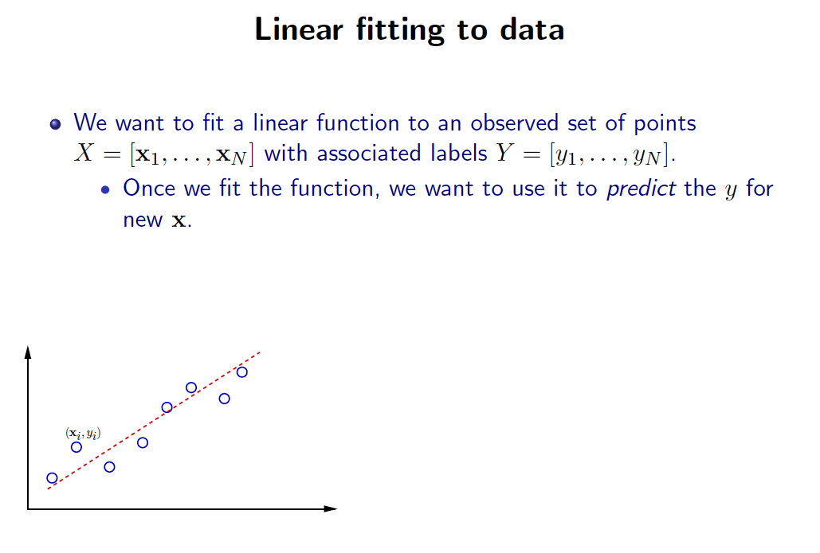
Slide Credit: Greg Shakhnarovich

Slide 6
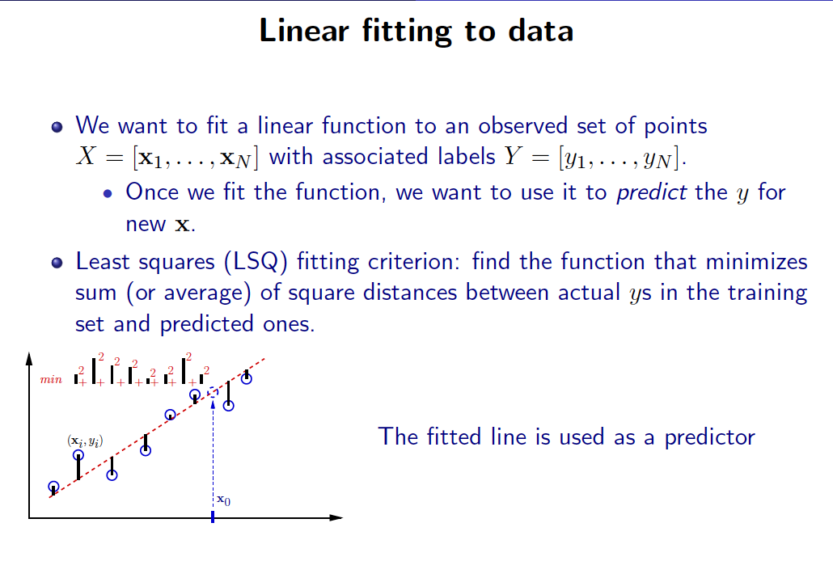
Slide Credit: Greg Shakhnarovich

Slide 7
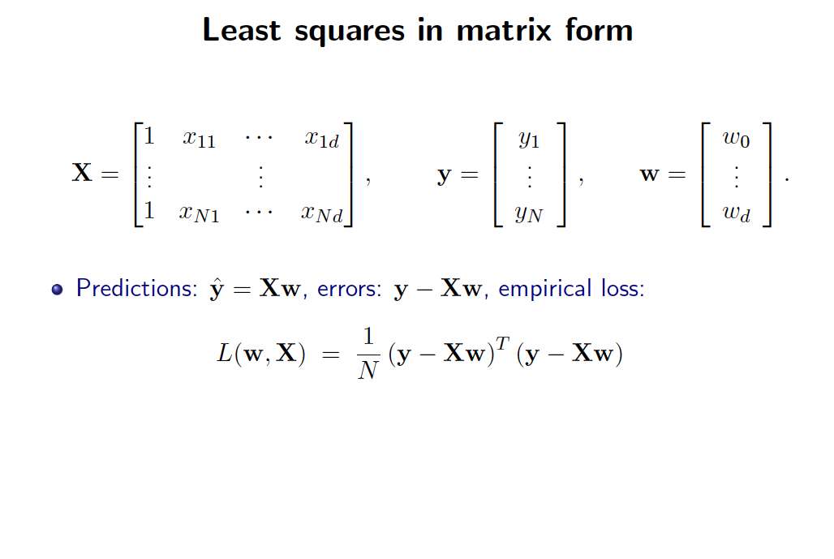
Slide Credit: Greg Shakhnarovich

Slide 8
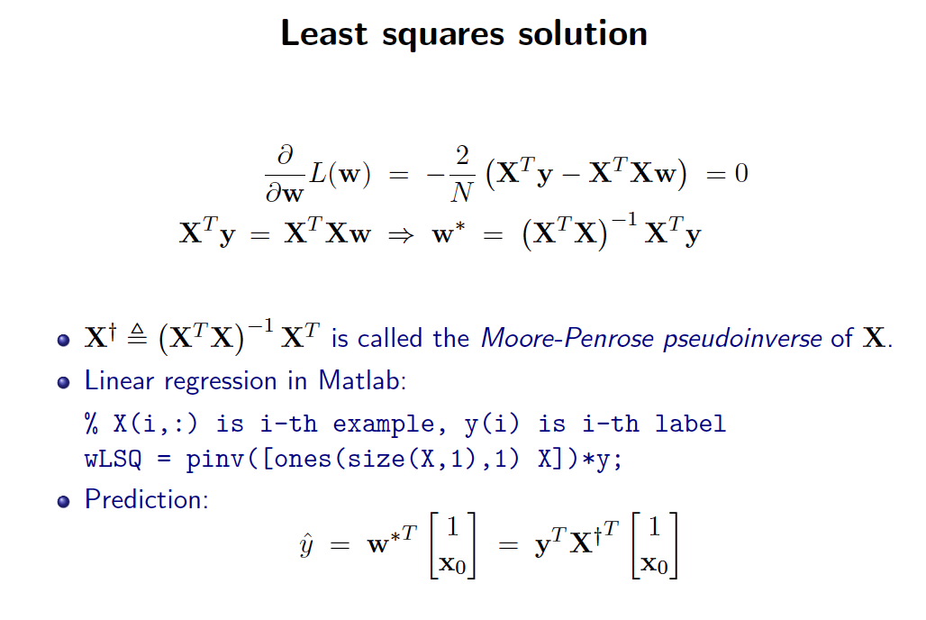
Slide Credit: Greg Shakhnarovich

Slide 9
But, why?
Why sum squared error???
Gaussians, Watson, Gaussians…

Slide 10
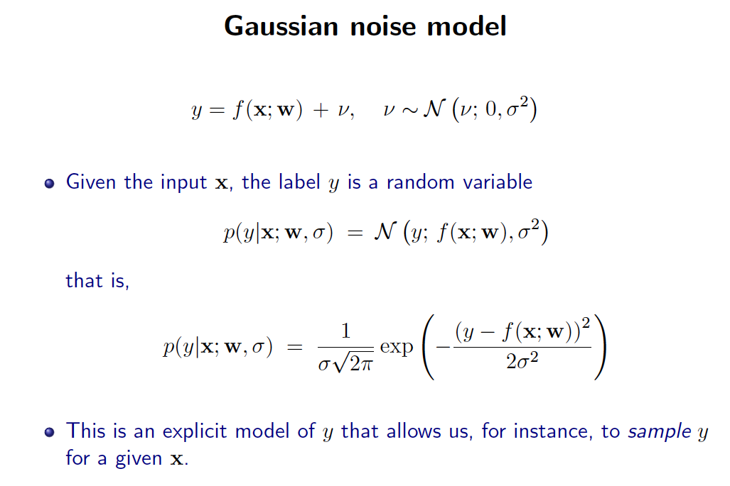
Slide Credit: Greg Shakhnarovich

Slide 11
Is OLS Robust?
Demo
  http://www.calpoly.edu/~srein/StatDemo/All.html
Bad things happen when the data does not come from your model!
How do we fix this?

Slide 12
Robust Linear Regression
y ~ Lap(w’x, b)
On paper

Slide 13
Plan for Today
(Finish) Regression
  Bayesian Regression
  Different prior vs likelihood combination
  Polynomial Regression
Error Decomposition
  Bias-Variance
  Cross-validation

Slide 14
Robustify via Prior
Ridge Regression
y ~ N(w’x, σ²)
w ~ N(0, t²I)
P(w | x,y) =

Slide 15
Summary
Likelihood | Prior | Name
Gaussian | Uniform | Least Squares
Gaussian | Gaussian | Ridge Regression
Gaussian | Laplace | Lasso
Laplace | Uniform | Robust Regression
Student | Uniform | Robust Regression

Slide 16
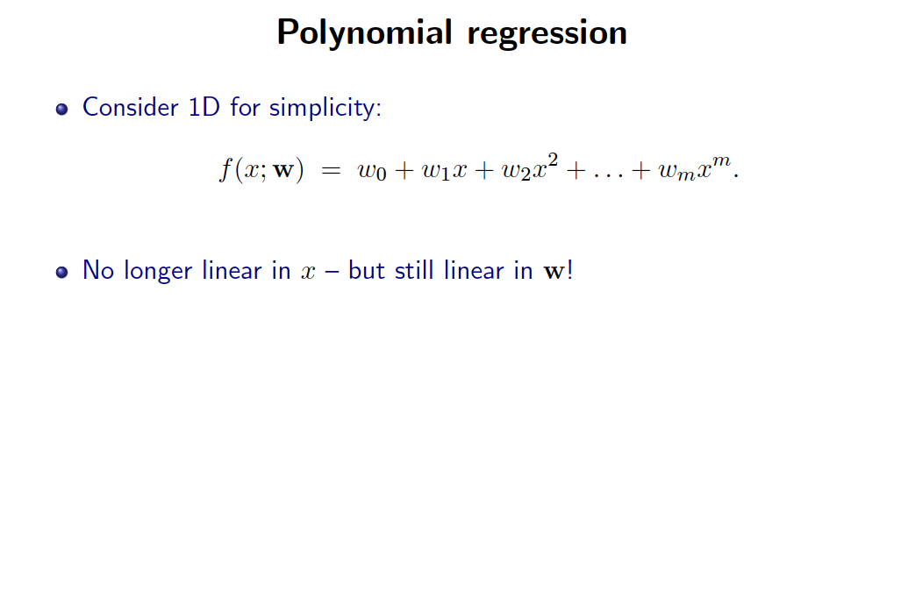
Slide Credit: Greg Shakhnarovich

Slide 17
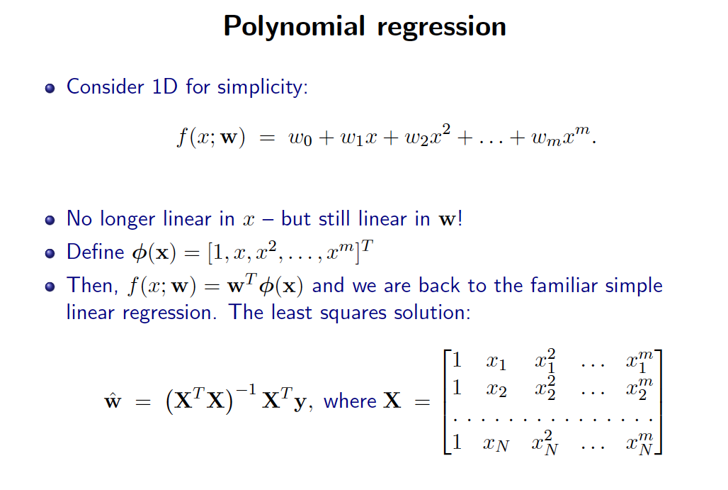
Slide Credit: Greg Shakhnarovich

Slide 18
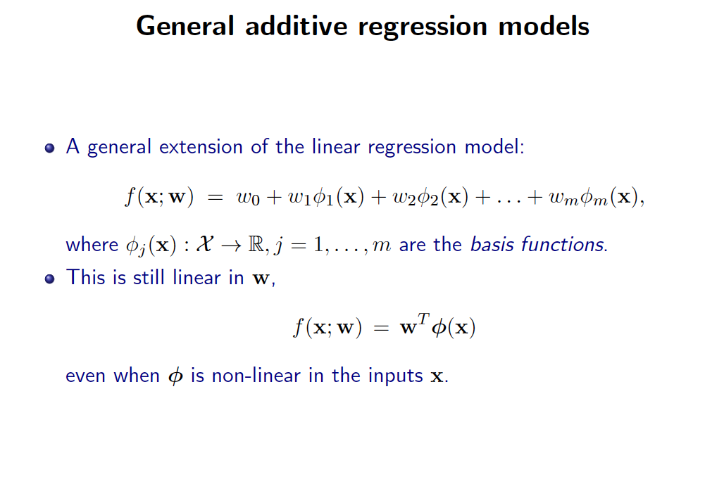
Slide Credit: Greg Shakhnarovich

Slide 19
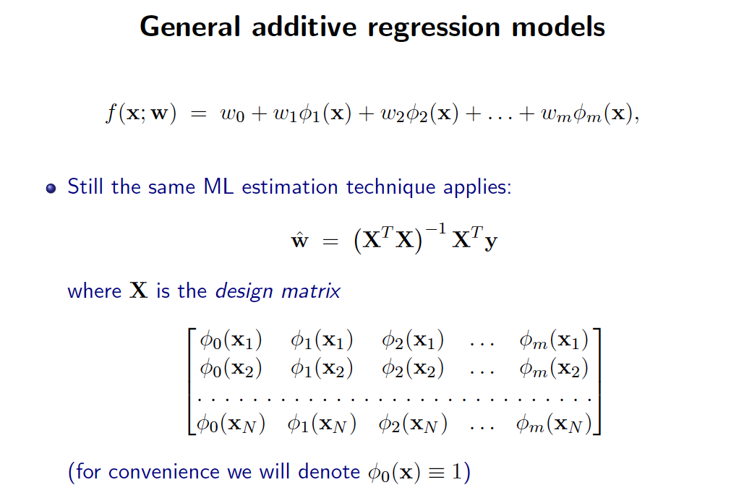
Slide Credit: Greg Shakhnarovich

Slide 20
Example
Demo
  http://www.princeton.edu/~rkatzwer/PolynomialRegression/

Slide 21
What you need to know
Linear Regression
  Model
  Least Squares Objective
  Connections to Max Likelihood with Gaussian Conditional
  Robust regression with Laplacian Likelihood
  Ridge Regression with priors
  Polynomial and General Additive Regression

Slide 22
New Topic: Model Selection and Error Decomposition

Slide 23
Example for Regression
Demo
  http://www.princeton.edu/~rkatzwer/PolynomialRegression/
How do we pick the hypothesis class?

Slide 24
Model Selection
How do we pick the right model class?
Similar questions
  How do I pick magic hyper-parameters?
  How do I do feature selection?

Slide 25
Errors
Expected Loss/Error
Training Loss/Error
Validation Loss/Error
Test Loss/Error
Reporting Training Error (instead of Test) is CHEATING
Optimizing parameters on Test Error is CHEATING

Slide 26
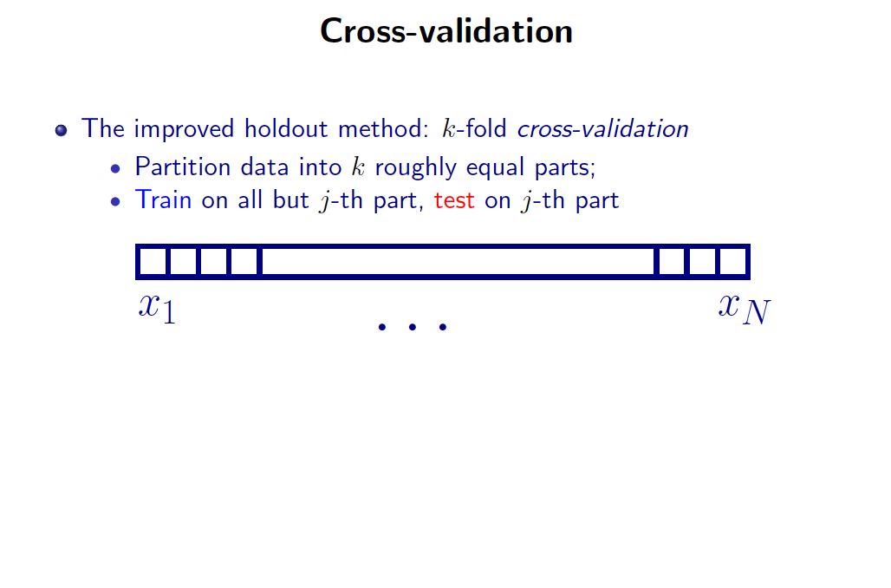
Slide Credit: Greg Shakhnarovich

Slide 27
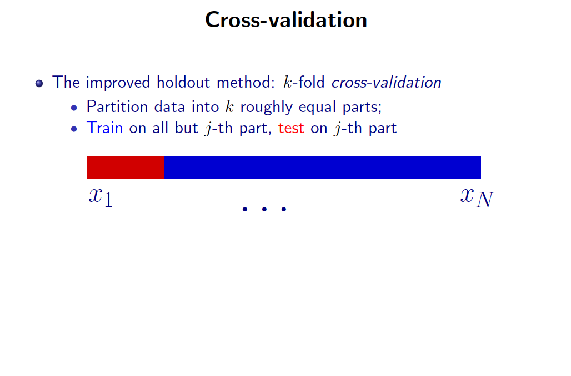
Slide Credit: Greg Shakhnarovich

Slide 28
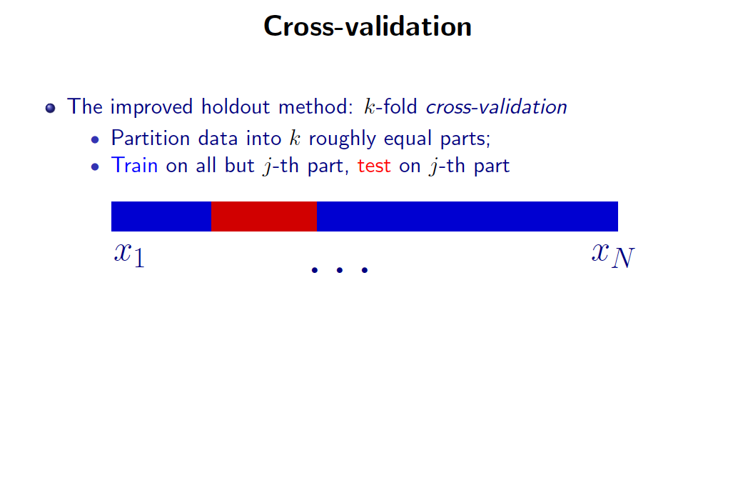
Slide Credit: Greg Shakhnarovich

Slide 29
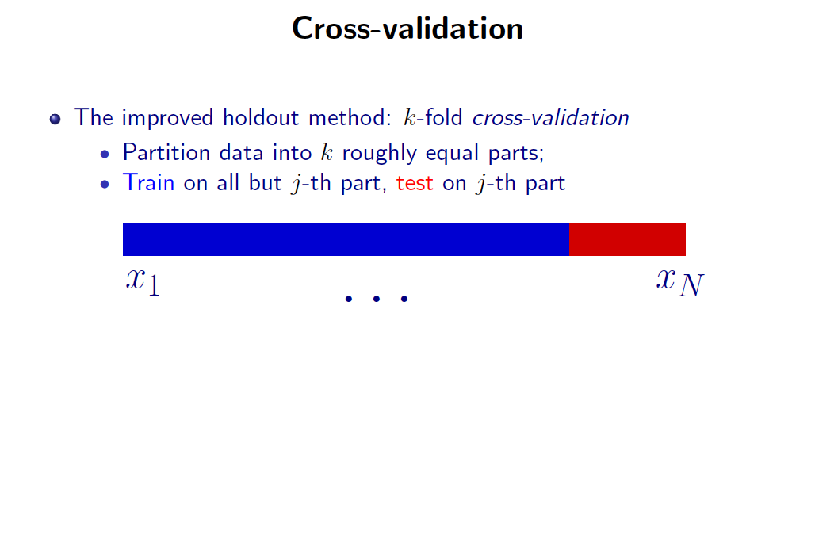
Slide Credit: Greg Shakhnarovich

Slide 30
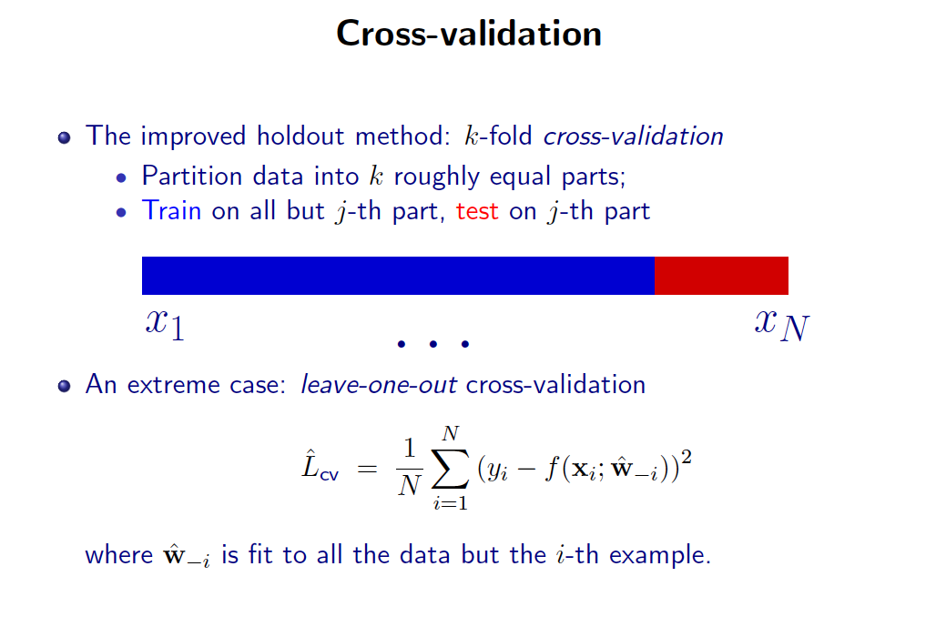
Slide Credit: Greg Shakhnarovich

Slide 31
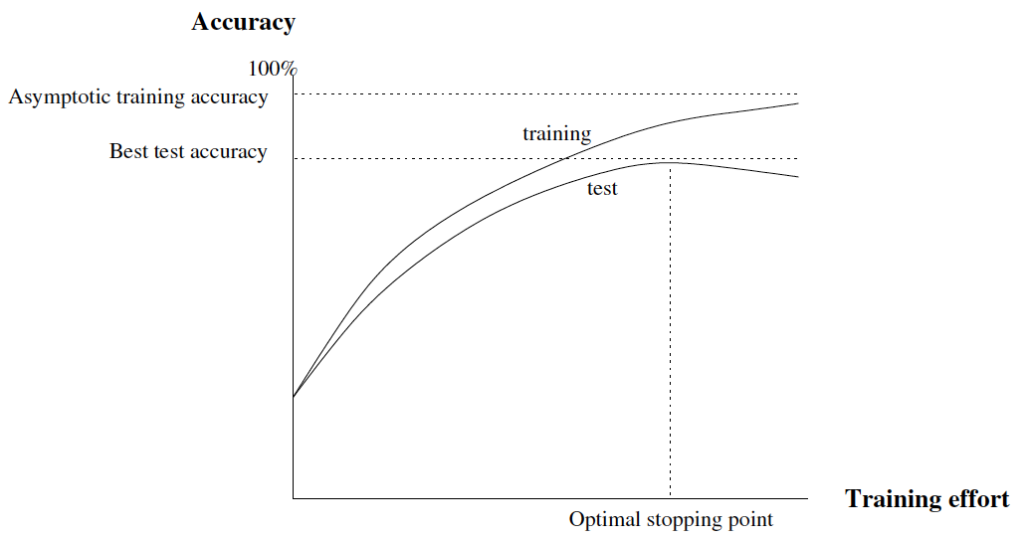
Typical Behavior
a

Slide 32
Overfitting
Overfitting: a learning algorithm overfits the training data if it outputs a solution w when there exists another solution w’ such that:
Slide Credit: Carlos Guestrin

Slide 33
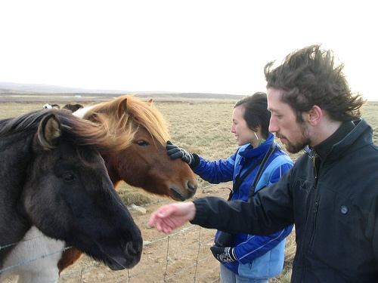
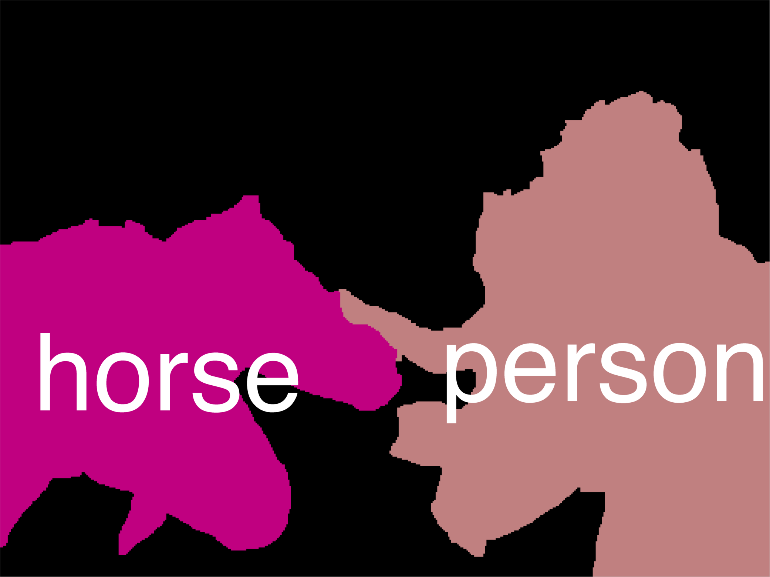
Error Decomposition
Reality
Modeling Error
model class
Estimation
Error
Optimization
Error

Slide 34
Error Decomposition
Reality
Modeling Error
Estimation
Error
Optimization
Error
model class

Slide 35
Error Decomposition
Modeling Error
Reality
model class
Higher-Order
Potentials
Estimation
Error
Optimization
Error

Slide 36
Error Decomposition
Approximation/Modeling Error
  You approximated reality with model
Estimation Error
  You tried to learn model with finite data
Optimization Error
  You were lazy and couldn’t/didn’t optimize to completion
(Next time) Bayes Error
  Reality just sucks

