Slide 1
ECE 5984: Introduction to
Machine Learning
Topics:
  Probability Review
  Statistical Estimation (MLE)
Readings: Barber 8.1, 8.2
Dhruv Batra
Virginia Tech

Slide 2
Administrativia
HW1
  Due on Sun 02/15, 11:55pm
  http://inclass.kaggle.com/c/VT-ECE-Machine-Learning-HW1

Slide 3
Project
Groups of 1-3
  we prefer teams of 2
Deliverables:
  Project proposal (NIPS format): 2 page, due Feb 24
  Midway presentations (in class)
  Final report: webpage with results

Slide 4
Proposal
2 Page (NIPS format)
  http://nips.cc/Conferences/2013/PaperInformation/StyleFiles
Necessary Information:
  Project title
  Project idea.
    This should be approximately two paragraphs.
  Data set details
    Ideally existing dataset. No data-collection projects.
  Software
    Which libraries will you use?
    What will you write?
  Papers to read.
    Include 1-3 relevant papers. You will probably want to read at least one of them before submitting your proposal.
  Teammate
    Will you have a teammate? If so, what’s the break-down of labor? Maximum team size is 3 students.
  Mid-sem Milestone
    What will you complete by the project milestone due date? Experimental results of some kind are expected here.

Slide 5
Project
Rules
  Must be about machine learning
  Must involve real data
    Use your own data or take from class website
  Can apply ML to your own research.
    Must be done this semester.
  OK to combine with other class-projects
    Must declare to both course instructors
    Must have explicit permission from BOTH instructors
    Must have a sufficient ML component
  Using libraries
    No need to implement all algorithms
    OK to use standard SVM, MRF, Decision-Trees, etc libraries
    More thought+effort => More credit

Slide 6
Project
Main categories
  Application/Survey
    Compare a bunch of existing algorithms on a new application domain of your interest
  Formulation/Development
    Formulate a new model or algorithm for a new or old problem
  Theory
    Theoretically analyze an existing algorithm
Support
  List of ideas, pointers to dataset/algorithms/code
    https://filebox.ece.vt.edu/~s15ece5984/project.html
    We will mentor teams and give feedback.

Slide 7
Administrativia
HW1
  Due on Sun 02/15, 11:55pm
  http://inclass.kaggle.com/c/VT-ECE-Machine-Learning-HW1
Project Proposal
  Due: Tue 02/24, 11:55 pm
  <=2pages, NIPS format

Slide 8
Procedural View
Training Stage:
  Raw Data → x (Feature Extraction)
  Training Data { (x,y) } → f (Learning)
Testing Stage
  Raw Data → x (Feature Extraction)
  Test Data x → f(x) (Apply function, Evaluate error)

Slide 9
Statistical Estimation View
Probabilities to rescue:
  x and y are random variables
  D = (x₁,y₁), (x₂,y₂), …, (x_{N},y_{N}) ~ P(X,Y)
IID: Independent Identically Distributed
  Both training & testing data sampled IID from P(X,Y)
  Learn on training set
  Have some hope of generalizing to test set

Slide 10
Plan for Today
Review of Probability
  Discrete vs Continuous Random Variables
  PMFs vs PDF
  Joint vs Marginal vs Conditional Distributions
  Bayes Rule and Prior
Statistical Learning / Density Estimation
  Maximum Likelihood
  Maximum A Posteriori
  Bayesian Estimation
We will discuss simple examples (like coin toss), but these SAME concepts will apply to sophisticated problems.

Slide 11
Probability
The world is a very uncertain place
30 years of Artificial Intelligence and Database research danced around this fact
And then a few AI researchers decided to use some ideas from the eighteenth century
Slide Credit: Andrew Moore

Slide 12
Probability
A is non-deterministic event
  Can think of A as a boolean-valued variable
Examples
  A = your next patient has cancer
  A = Rafael Nada wins French Open 2015

Slide 13
Interpreting Probabilities
What does P(A) mean?
Frequentist View
  limit N→∞ #(A is true)/N
  limiting frequency of a repeating non-deterministic event
Bayesian View
  P(A) is your “belief” about A
Market Design View
  P(A) tells you how much you would bet

Slide 14
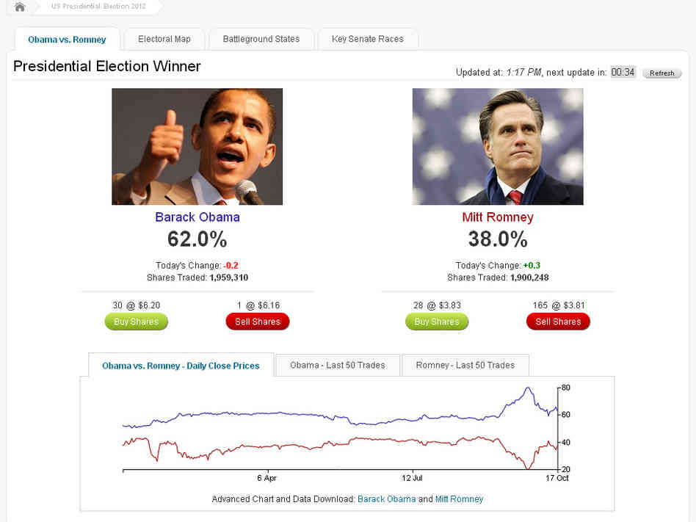
Image Credit: Intrade / NPR

Slide 15
Slide Credit: Andrew Moore

Slide 16
Axioms of Probability
0<= P(A) <= 1
P(empty-set) = 0
P(everything) = 1
P(A or B) = P(A) + P(B) – P(A and B)

Slide 17
Interpreting the Axioms
0<= P(A) <= 1
P(empty-set) = 0
P(everything) = 1
P(A or B) = P(A) + P(B) – P(A and B)
Image Credit: Andrew Moore

Slide 18
Interpreting the Axioms
0<= P(A) <= 1
P(empty-set) = 0
P(everything) = 1
P(A or B) = P(A) + P(B) – P(A and B)
Image Credit: Andrew Moore

Slide 19
Interpreting the Axioms
0<= P(A) <= 1
P(empty-set) = 0
P(everything) = 1
P(A or B) = P(A) + P(B) – P(A and B)
Image Credit: Andrew Moore

Slide 20
Interpreting the Axioms
0<= P(A) <= 1
P(empty-set) = 0
P(everything) = 1
P(A or B) = P(A) + P(B) – P(A and B)
Image Credit: Andrew Moore

Slide 21
Concepts
Sample Space
  Space of events
Random Variables
  Mapping from events to numbers
  Discrete vs Continuous
Probability
  Mass vs Density

Slide 22
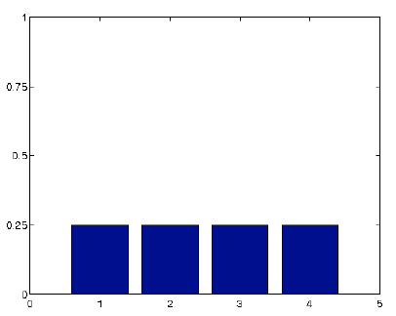
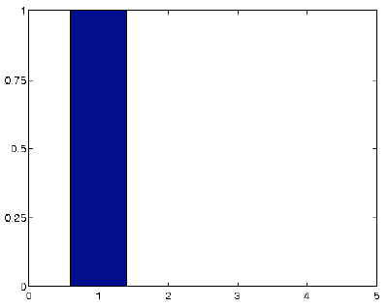
Discrete Random Variables
discrete random variable
sample space of possible outcomes,
which may be finite or countably infinite
or Val(X)
outcome of sample of discrete random variable
probability distribution (probability mass function)
shorthand used when no ambiguity
uniform distribution
Slide Credit: Erik Suddherth
degenerate distribution

Slide 23
Continuous Random Variables
On board

Slide 24
Concepts
Expectation
Variance

Slide 25
Most Important Concepts
Marginal distributions / Marginalization
Conditional distribution / Chain Rule
Bayes Rule

Slide 26
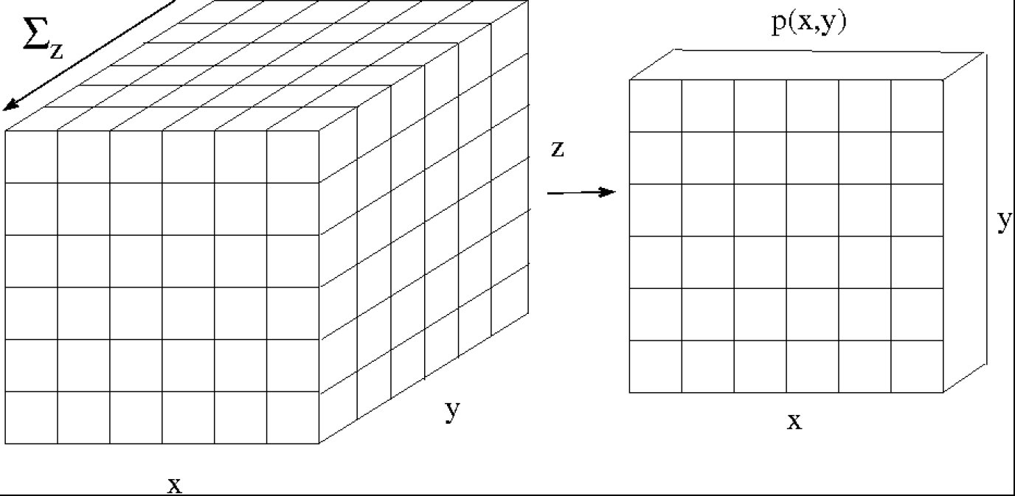
Joint Distribution

Slide 27
Marginalization
Marginalization
  Events: P(A) = P(A and B) + P(A and not B)
  Random variables

Slide 28
Marginal Distributions
Slide Credit: Erik Suddherth

Slide 29
Conditional Probabilities
P(Y=y | X=x)
What do you believe about Y=y, if I tell you X=x?
P(Rafael Nadal wins French Open 2015)?
What if I tell you:
  He has won the French Open 9/10 he has played there
  Novak Djokovic is ranked 1; just won Australian Open
  I offered a similar analysis last year and Nadal won

Slide 30
Conditional Probabilities
P(A | B) = In worlds that where B is true,
fraction where A is true
Example
  H: “Have a headache”
  F: “Coming down with Flu”

Slide 31
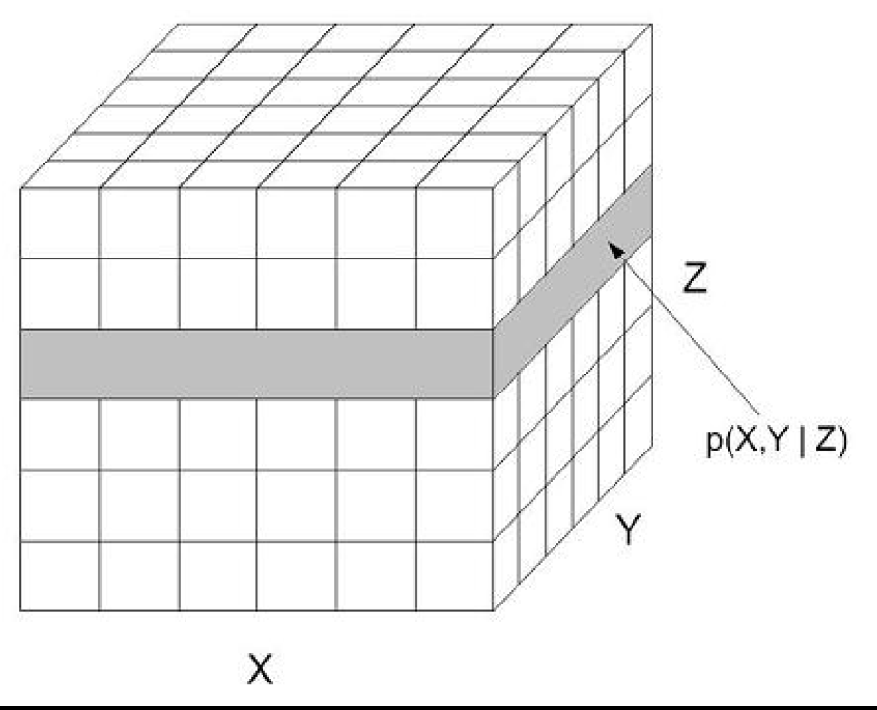
Conditional Distributions
Slide Credit: Erik Sudderth

Slide 32
Conditional Probabilities
Definition
Corollary: Chain Rule

Slide 33
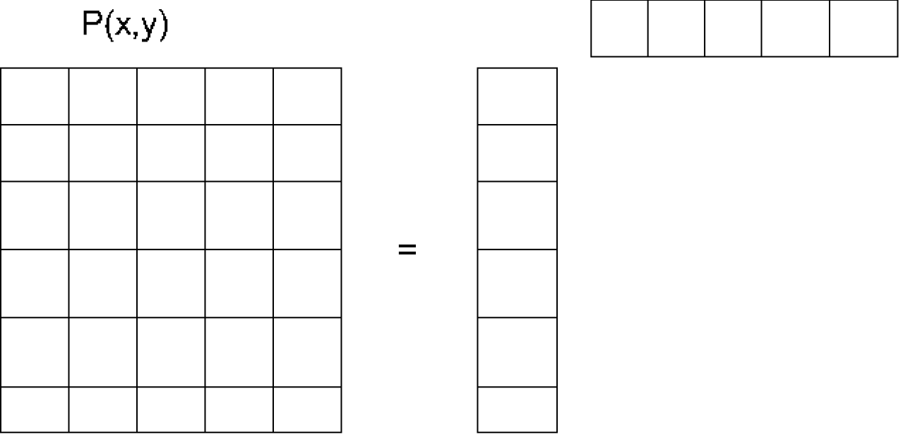
Independent Random Variables
Slide Credit: Erik Sudderth

Slide 34
Marginal Independence
Sets of variables X, Y
X is independent of Y
  Shorthand: P Ⱶ (X ⊥ Y)
Proposition: P satisfies (X ⊥ Y) if and only if
  P(X=x,Y=y) = P(X=x) P(Y=y), ∀x∈Val(X), y∈Val(Y)

Slide 35
Conditional independence
Sets of variables X, Y, Z
X is independent of Y given Z if
  Shorthand: P Ⱶ (X ⊥ Y | Z)
  For P Ⱶ (X ⊥ Y |∅), write P Ⱶ (X ⊥ Y)
Proposition: P satisfies (X ⊥ Y | Z) if and only if
  P(X,Y|Z) = P(X|Z) P(Y|Z), ∀x∈Val(X), y∈Val(Y), z∈Val(Z)

Slide 36
Concept
Bayes Rules
  Simple yet fundamental
Image Credit: Andrew Moore

Slide 37
Bayes Rule
Simple yet profound
  Using Bayes Rules doesn’t make your analysis Bayesian!
Concepts:
  Likelihood
    How much does a certain hypothesis explain the data?
  Prior
    What do you believe before seeing any data?
  Posterior
    What do we believe after seeing the data?

Slide 38
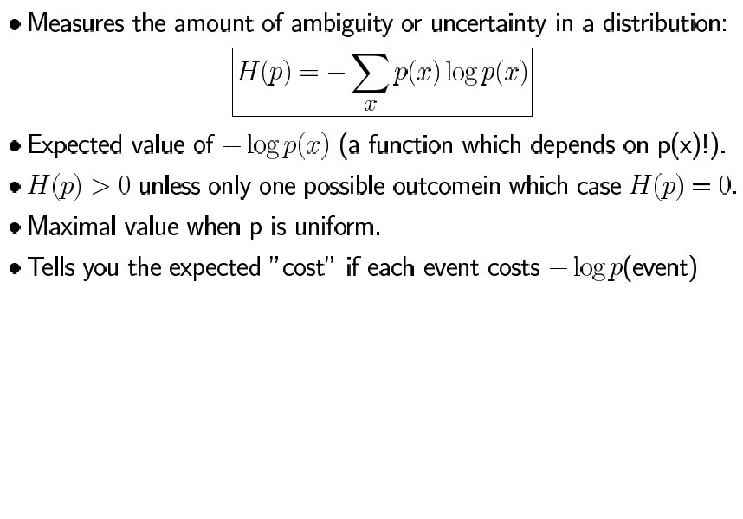
Entropy
Slide Credit: Sam Roweis

Slide 39
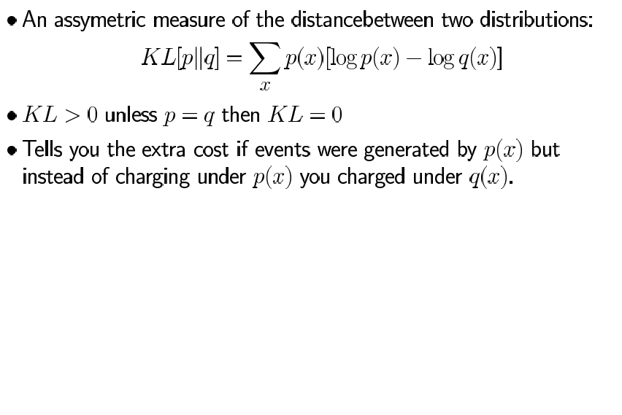
KL-Divergence / Relative Entropy
Slide Credit: Sam Roweis

Slide 40
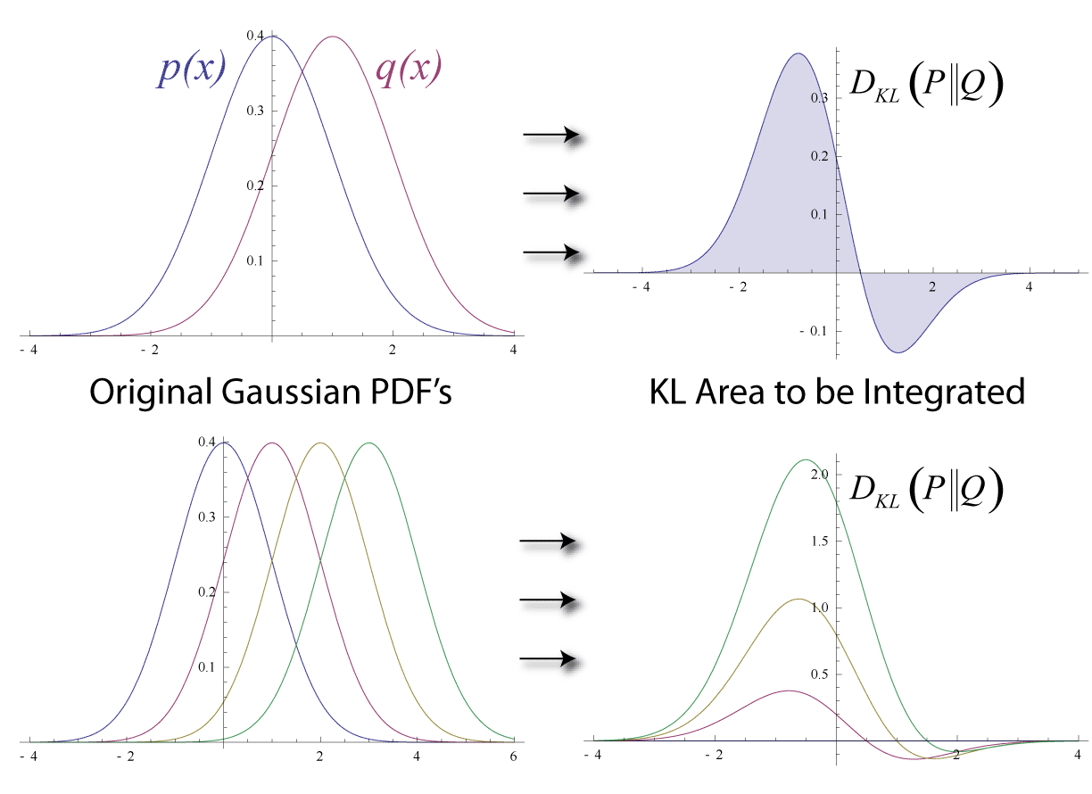
KL-Divergence / Relative Entropy
a
Image Credit: Wikipedia

Slide 41
KL-Divergence / Relative Entropy
a
Image Credit: Wikipedia

Slide 42
End of Prob. Review
Start of Estimation

