Slide 1
ECE 5984: Introduction to
Machine Learning
Topics:
  Supervised Learning
    Measuring performance
  Nearest Neighbour
Readings: Barber 14 (kNN)
Dhruv Batra
Virginia Tech

Slide 2

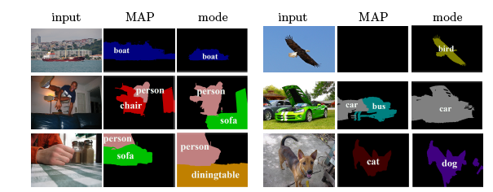
TA: Qing Sun
PhD candidate at ECE department
Research work/interest:
  Diverse outputs based on structured probabilistic models
  Structured-output prediction

Slide 3
Recap from last time

Slide 4
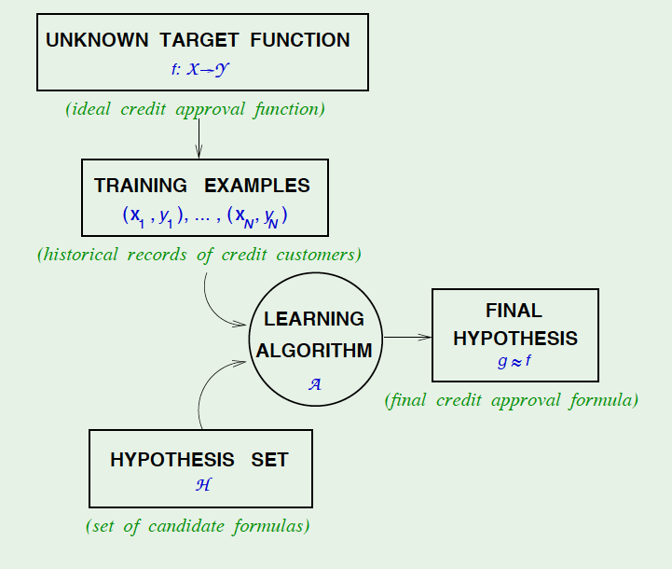
Slide Credit: Yaser Abu-Mostapha

Slide 5
Nearest Neighbour
Demo 1
  http://cgm.cs.mcgill.ca/~soss/cs644/projects/perrier/Nearest.html
Demo 2
  http://www.cs.technion.ac.il/~rani/LocBoost/

Slide 6
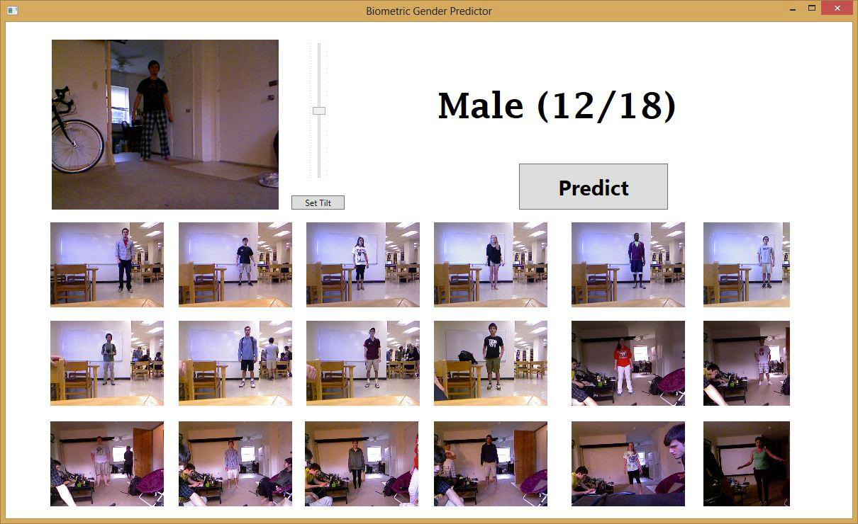
Spring 2013 Projects
Gender Classification from body proportions
  Igor Janjic & Daniel Friedman, Juniors

Slide 7
Plan for today
Supervised/Inductive Learning
  (A bit more on) Loss functions
Nearest Neighbour
  Common Distance Metrics
  Kernel Classification/Regression
  Curse of Dimensionality

Slide 8
Loss/Error Functions
How do we measure performance?
Regression:
  L₂ error
Classification:
  #misclassifications
  Weighted misclassification via a cost matrix
  For 2-class classification:
    True Positive, False Positive, True Negative, False Negative
  For k-class classification:
    Confusion Matrix
ROC curves
  http://psych.hanover.edu/JavaTest/SDT/ROC.html

Slide 9
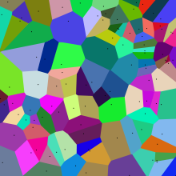
Nearest Neighbours
Image Credit: Wikipedia

Slide 10
Instance/Memory-based Learning
Four things make a memory based learner:
A distance metric
How many nearby neighbors to look at?
A weighting function (optional)
How to fit with the local points?
Slide Credit: Carlos Guestrin

Slide 11
1-Nearest Neighbour
Four things make a memory based learner:
A distance metric
  Euclidean (and others)
How many nearby neighbors to look at?
  1
A weighting function (optional)
  unused
How to fit with the local points?
  Just predict the same output as the nearest neighbour.
Slide Credit: Carlos Guestrin

Slide 12
k-Nearest Neighbour
Four things make a memory based learner:
A distance metric
  Euclidean (and others)
How many nearby neighbors to look at?
  k
A weighting function (optional)
  unused
How to fit with the local points?
  Just predict the average output among the nearest neighbours.
Slide Credit: Carlos Guestrin

Slide 13
1-NN for Regression
Here, this is the closest datapoint
Here, this is the closest datapoint
Here, this is the closest datapoint
Here, this is the closest datapoint
y
x
Figure Credit: Carlos Guestrin

Slide 14
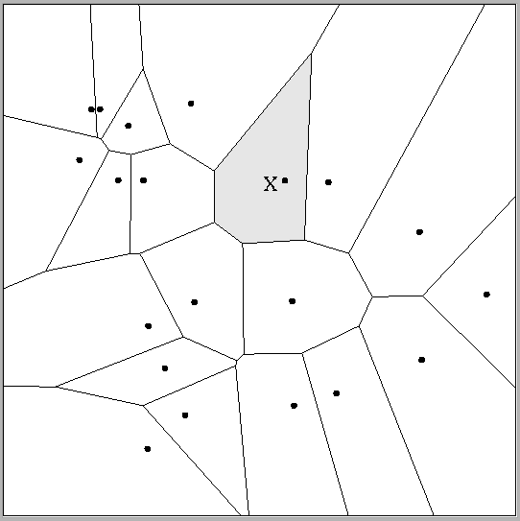
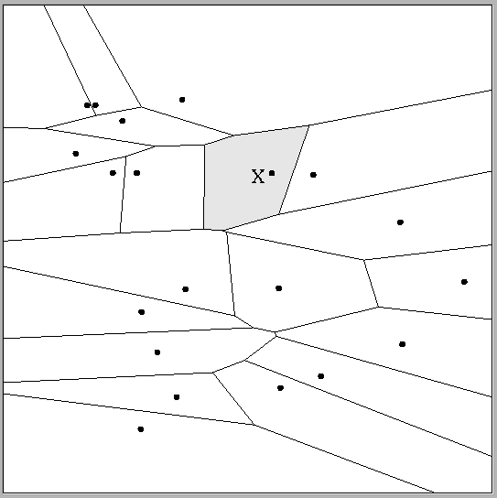
Multivariate distance metrics
Suppose the input vectors x₁, x₂, …x_{N} are two dimensional:
x₁ = ( x₁₁ , x₁₂ ) , x₂ = ( x₂₁ , x₂₂ ) , …x_{N} = ( x_{N1} , x_{N2} ).
One can draw the nearest-neighbor regions in input space.
 | Dist(x_{i},x_{j}) =(x_{i1} – x_{j1})²+(3x_{i2} – 3x_{j2})²
Dist(x_{i},x_{j}) = (x_{i1} – x_{j1})² + (x_{i2} – x_{j2})²
The relative scalings in the distance metric affect region shapes
Slide Credit: Carlos Guestrin

Slide 15
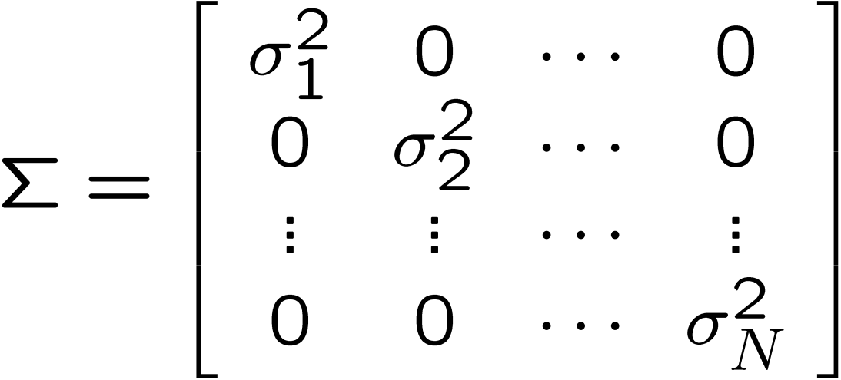
Euclidean distance metric
Or equivalently,
where
A
Slide Credit: Carlos Guestrin

Slide 16
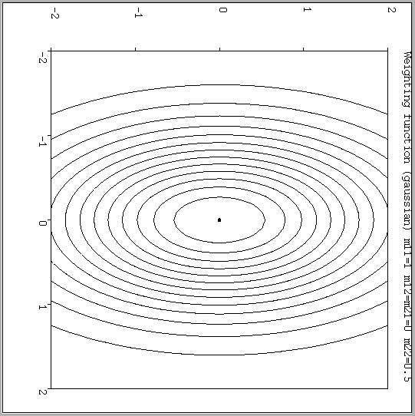
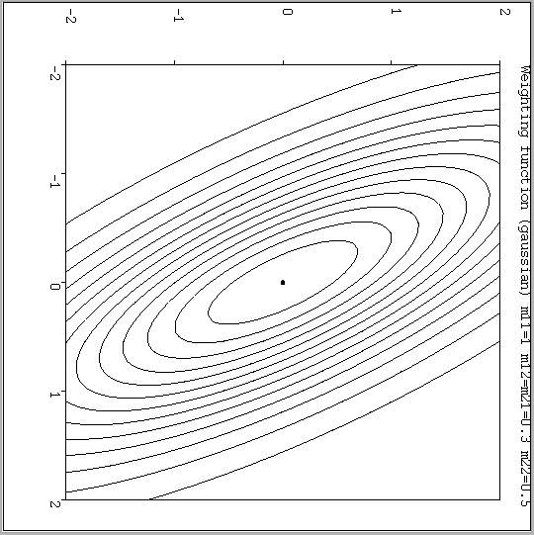
Notable distance metrics
(and their level sets)
Scaled Euclidian (L₂)
Mahalanobis
(non-diagonal A)
Slide Credit: Carlos Guestrin

Slide 17
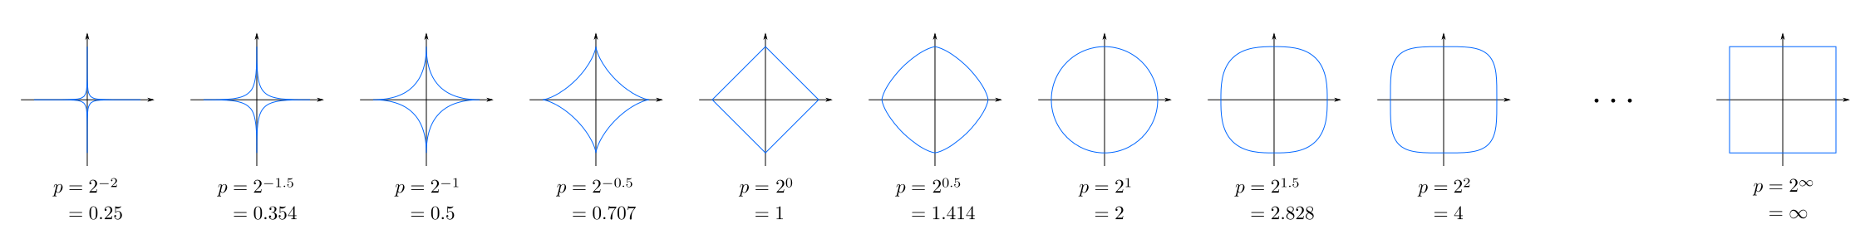
Minkowski distance
Image Credit: By Waldir (Based on File:MinkowskiCircles.svg)
[CC BY-SA 3.0 (http://creativecommons.org/licenses/by-sa/3.0)], via Wikimedia Commons

Slide 18
Notable distance metrics
(and their level sets)
Scaled Euclidian (L₂)
L₁ norm (absolute)
Mahalanobis
(non-diagonal A)
Slide Credit: Carlos Guestrin
L_{inf} (max) norm

Slide 19
Parametric vs Non-Parametric Models
Does the capacity (size of hypothesis class) grow with size of training data?
  Yes = Non-Parametric Models
  No = Parametric Models
Example
  http://www.theparticle.com/applets/ml/nearest_neighbor/

Slide 20
Weighted k-NNs
Neighbors are not all the same

Slide 21
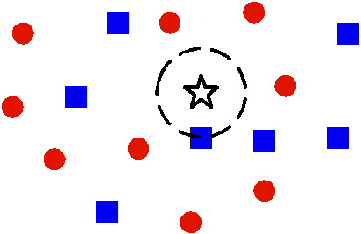
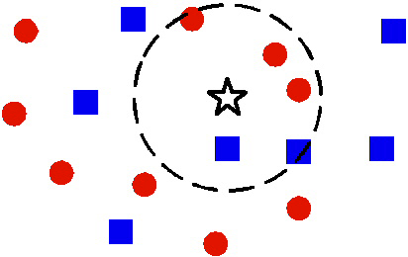
1 vs k Nearest Neighbour
Image Credit: Ying Wu

Slide 22
1 vs k Nearest Neighbour
Image Credit: Ying Wu

Slide 23
1-NN for Regression
Here, this is the closest datapoint
Here, this is the closest datapoint
Here, this is the closest datapoint
Here, this is the closest datapoint
y
x
Figure Credit: Carlos Guestrin

Slide 24
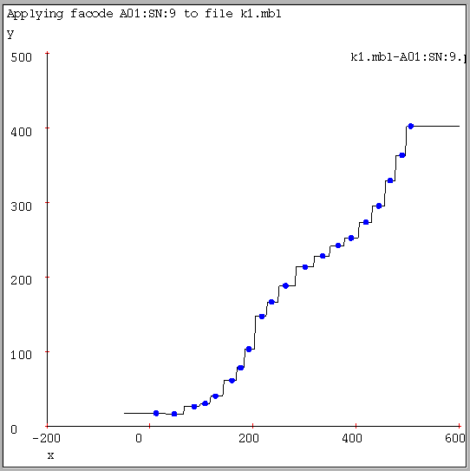
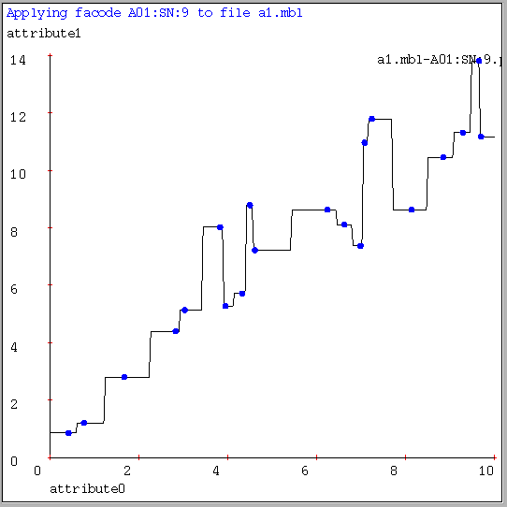
1-NN for Regression
Often bumpy (overfits)
Figure Credit: Andrew Moore

Slide 25
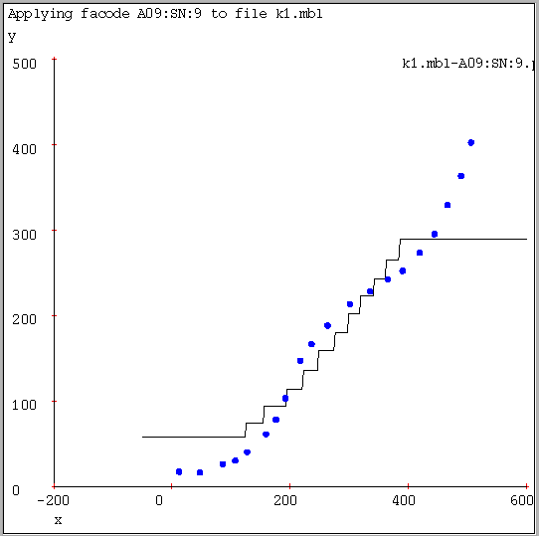
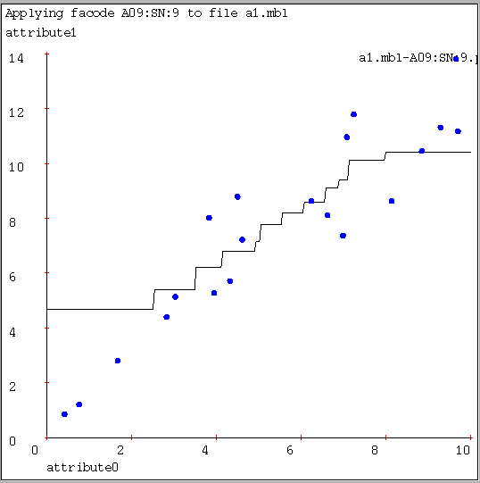
9-NN for Regression
Often bumpy (overfits)
Figure Credit: Andrew Moore

Slide 26
Kernel Regression/Classification
Four things make a memory based learner:
A distance metric
  Euclidean (and others)
How many nearby neighbors to look at?
  All of them
A weighting function (optional)
  w_{i} = exp(-d(x_{i}, query)² / σ²)
  Nearby points to the query are weighted strongly, far points weakly. The σ parameter is the Kernel Width. Very important.
How to fit with the local points?
  Predict the weighted average of the outputs
  predict = Σw_{i}y_{i} / Σw_{i}
Slide Credit: Carlos Guestrin

