Slide 1
ECE 5984: Introduction to
Machine Learning
Topics:
  Expectation Maximization
    For GMMs
    For General Latent Model Learning
Readings: Barber 20.1-20.3
Dhruv Batra
Virginia Tech

Slide 2
Administrativia
Poster Presentation:
  May 8 1:30-4:00pm
  310 Kelly Hall: ICTAS Building
  Print poster (or bunch of slides)
  Format:
    Portrait
    Eg. 2 feet (width) x 4 feet (height)
  Less text, more pictures.
Best Project Prize!

Slide 3
Recap of Last Time

Slide 4
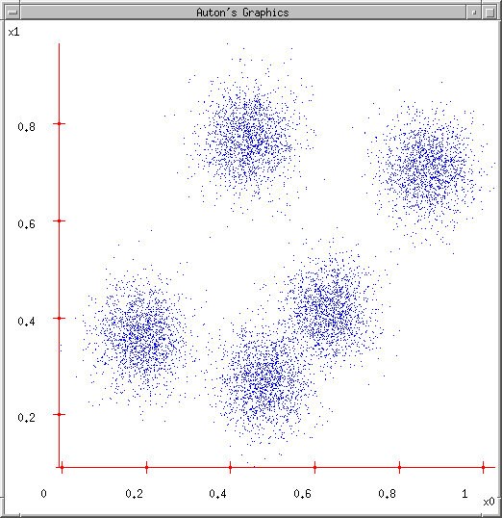
Some Data
Slide Credit: Carlos Guestrin

Slide 5
K-means
Ask user how many clusters they’d like. (e.g. k=5)
Slide Credit: Carlos Guestrin

Slide 6
K-means
Ask user how many clusters they’d like. (e.g. k=5)
Randomly guess k cluster Center locations
Slide Credit: Carlos Guestrin

Slide 7
K-means
Ask user how many clusters they’d like. (e.g. k=5)
Randomly guess k cluster Center locations
Each datapoint finds out which Center it’s closest to. (Thus each Center “owns” a set of datapoints)
Slide Credit: Carlos Guestrin

Slide 8
K-means
Ask user how many clusters they’d like. (e.g. k=5)
Randomly guess k cluster Center locations
Each datapoint finds out which Center it’s closest to.
Each Center finds the centroid of the points it owns
Slide Credit: Carlos Guestrin

Slide 9
K-means
Ask user how many clusters they’d like. (e.g. k=5)
Randomly guess k cluster Center locations
Each datapoint finds out which Center it’s closest to.
Each Center finds the centroid of the points it owns…
…and jumps there
…Repeat until terminated!
Slide Credit: Carlos Guestrin

Slide 10
K-means
Randomly initialize k centers
  μ⁽⁰⁾ = μ₁⁽⁰⁾,…, μ_{k}⁽⁰⁾
Assign:
  Assign each point i∈{1,…n} to nearest center:
Recenter:
  μ_{j} becomes centroid of its points
Slide Credit: Carlos Guestrin

Slide 11
K-means as Co-ordinate Descent
Optimize objective function:
Fix μ, optimize a (or C)
Slide Credit: Carlos Guestrin

Slide 12
K-means as Co-ordinate Descent
Optimize objective function:
Fix a (or C), optimize μ
Slide Credit: Carlos Guestrin

Slide 13



Object
Bag of ‘words’
Fei-Fei Li

Slide 14
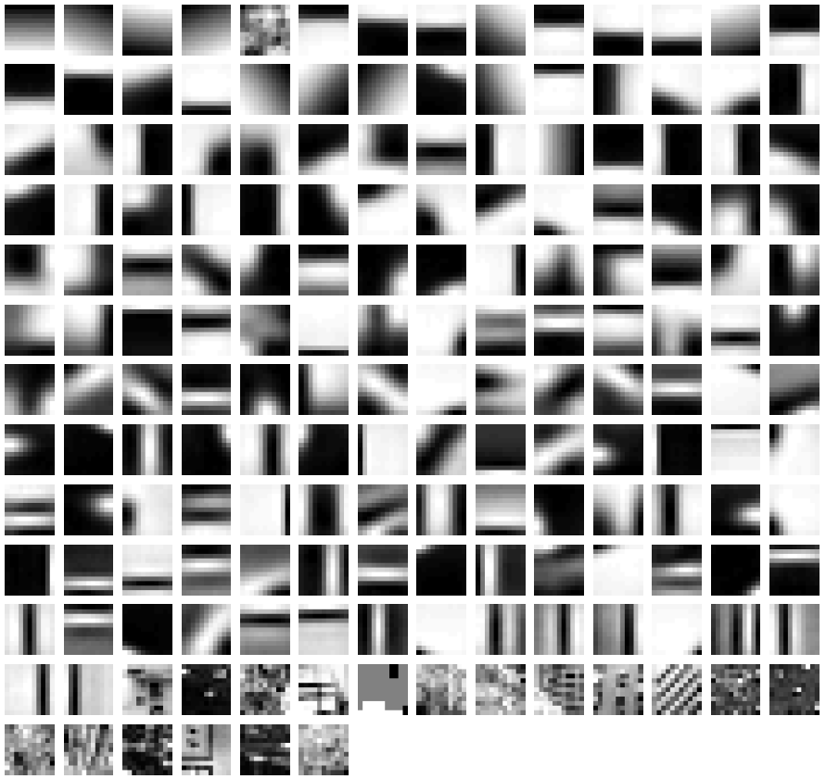
Clustered Image Patches
Fei-Fei et al. 2005

Slide 15
(One) bad case for k-means
Clusters may overlap
Some clusters may be “wider” than others
GMM to the rescue!
Slide Credit: Carlos Guestrin

Slide 16
GMM
Figure Credit: Kevin Murphy

Slide 17
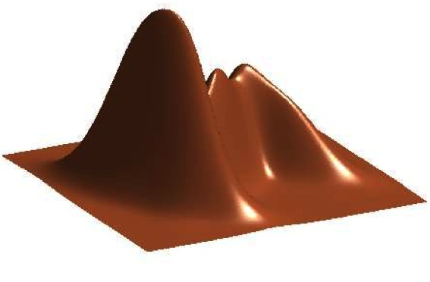
GMM
Figure Credit: Kevin Murphy

Slide 18
K-means vs GMM
K-Means
  http://home.deib.polimi.it/matteucc/Clustering/tutorial_html/AppletKM.html
GMM
  http://www.socr.ucla.edu/applets.dir/mixtureem.html

Slide 19
Hidden Data Causes Problems #1
Fully Observed (Log) Likelihood factorizes
Marginal (Log) Likelihood doesn’t factorize
All parameters coupled!

Slide 20
Hidden Data Causes Problems #2
Identifiability
Figure Credit: Kevin Murphy

Slide 21
Hidden Data Causes Problems #3
Likelihood has singularities if one Gaussian “collapses”

Slide 22
Special case: spherical Gaussians and hard assignments
If P(X|Z=k) is spherical, with same σ for all classes:
If each x_{i} belongs to one class C(i) (hard assignment), marginal likelihood:
M(M)LE same as K-means!!!
Slide Credit: Carlos Guestrin

Slide 23
The K-means GMM assumption
There are k components
Component i has an associated mean vector μ_{ι}
μ₂
μ₁
μ₃
Slide Credit: Carlos Guestrin

Slide 24
The K-means GMM assumption
There are k components
Component i has an associated mean vector μ_{ι}
Each component generates data from a Gaussian with mean m_{i} and covariance matrix σ²Ι
Each data point is generated according to the following recipe:
μ₂
μ₁
μ₃
Slide Credit: Carlos Guestrin

Slide 25
The K-means GMM assumption
There are k components
Component i has an associated mean vector μ_{ι}
Each component generates data from a Gaussian with mean m_{i} and covariance matrix σ²Ι
Each data point is generated according to the following recipe:
Pick a component at random: Choose component i with probability P(y=i)
μ₂
Slide Credit: Carlos Guestrin

Slide 26
The K-means GMM assumption
There are k components
Component i has an associated mean vector μ_{ι}
Each component generates data from a Gaussian with mean m_{i} and covariance matrix σ²Ι
Each data point is generated according to the following recipe:
Pick a component at random: Choose component i with probability P(y=i)
Datapoint ∼ Ν(μ_{ι}, σ²Ι )
μ₂
x
Slide Credit: Carlos Guestrin

Slide 27
The General GMM assumption
There are k components
Component i has an associated mean vector μ_{ι}
Each component generates data from a Gaussian with mean m_{i} and covariance matrix Σ_{i}
Each data point is generated according to the following recipe:
Pick a component at random: Choose component i with probability P(y=i)
Datapoint ∼ Ν(μ_{ι}, Σ_{i} )
μ₂
μ₁
μ₃
Slide Credit: Carlos Guestrin

Slide 28
K-means vs GMM
K-Means
  http://home.deib.polimi.it/matteucc/Clustering/tutorial_html/AppletKM.html
GMM
  http://www.socr.ucla.edu/applets.dir/mixtureem.html

Slide 29
EM
Expectation Maximization [Dempster ‘77]
Often looks like “soft” K-means
Extremely general
Extremely useful algorithm
  Essentially THE goto algorithm for unsupervised learning
Plan
  EM for learning GMM parameters
  EM for general unsupervised learning problems

Slide 30
EM for Learning GMMs
Simple Update Rules
  E-Step: estimate P(z_{i} = j | x_{i})
  M-Step: maximize full likelihood weighted by posterior

Slide 31
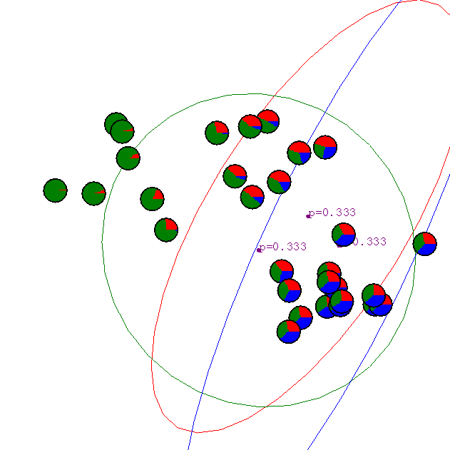
Gaussian Mixture Example: Start
Slide Credit: Carlos Guestrin

Slide 32
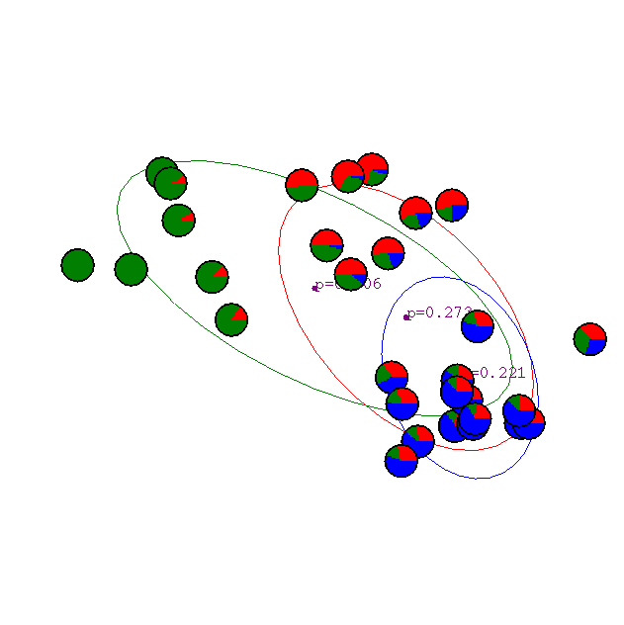
After 1st iteration
Slide Credit: Carlos Guestrin

Slide 33

After 2nd iteration
Slide Credit: Carlos Guestrin

Slide 34

After 3rd iteration
Slide Credit: Carlos Guestrin

Slide 35

After 4th iteration
Slide Credit: Carlos Guestrin

Slide 36

After 5th iteration
Slide Credit: Carlos Guestrin

Slide 37

After 6th iteration
Slide Credit: Carlos Guestrin

Slide 38

After 20th iteration
Slide Credit: Carlos Guestrin

