Slide 1
ECE 5984: Introduction to
Machine Learning
Topics:
  Unsupervised Learning: Kmeans, GMM, EM
Readings: Barber 20.1-20.3
Dhruv Batra
Virginia Tech

Slide 2
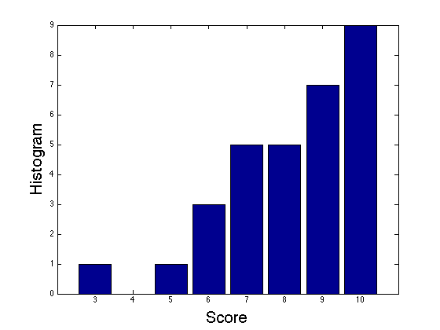
Midsem Presentations Graded
Mean 8/10 = 80%
  Min: 3
  Max: 10

Slide 3
Tasks
Supervised Learning
x
Classification
y
Discrete
x
Regression
y
Continuous
Unsupervised Learning
x
Clustering
c
Discrete ID
x
Dimensionality
Reduction
z
Continuous

Slide 4
Unsupervised Learning
Learning only with X
  Y not present in training data
Some example unsupervised learning problems:
  Clustering / Factor Analysis
  Dimensionality Reduction / Embeddings
  Density Estimation with Mixture Models

Slide 5
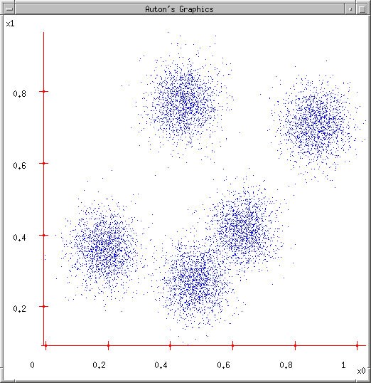
New Topic: Clustering
Slide Credit: Carlos Guestrin
5

Slide 6
Synonyms
Clustering
Vector Quantization
Latent Variable Models
Hidden Variable Models
Mixture Models
Algorithms:
  K-means
  Expectation Maximization (EM)

Slide 7
Some Data
Slide Credit: Carlos Guestrin

Slide 8
K-means
Ask user how many clusters they’d like. (e.g. k=5)
Slide Credit: Carlos Guestrin

Slide 9
K-means
Ask user how many clusters they’d like. (e.g. k=5)
Randomly guess k cluster Center locations
Slide Credit: Carlos Guestrin

Slide 10
K-means
Ask user how many clusters they’d like. (e.g. k=5)
Randomly guess k cluster Center locations
Each datapoint finds out which Center it’s closest to. (Thus each Center “owns” a set of datapoints)
Slide Credit: Carlos Guestrin

Slide 11
K-means
Ask user how many clusters they’d like. (e.g. k=5)
Randomly guess k cluster Center locations
Each datapoint finds out which Center it’s closest to.
Each Center finds the centroid of the points it owns
Slide Credit: Carlos Guestrin

Slide 12
K-means
Ask user how many clusters they’d like. (e.g. k=5)
Randomly guess k cluster Center locations
Each datapoint finds out which Center it’s closest to.
Each Center finds the centroid of the points it owns…
…and jumps there
…Repeat until terminated!
Slide Credit: Carlos Guestrin

Slide 13
K-means
Randomly initialize k centers
  μ⁽⁰⁾ = μ₁⁽⁰⁾,…, μ_{k}⁽⁰⁾
Assign:
  Assign each point i∈{1,…n} to nearest center:
Recenter:
  μ_{j} becomes centroid of its points
Slide Credit: Carlos Guestrin

Slide 14
K-means
Demo
  http://www.kovan.ceng.metu.edu.tr/~maya/kmeans/
  http://home.deib.polimi.it/matteucc/Clustering/tutorial_html/AppletKM.html

Slide 15
What is K-means optimizing?
Objective F(μ,C): function of centers μ and point allocations C:
  1-of-k encoding
Optimal K-means:
  min_{μ}min_{a} F(μ,a)

Slide 16
Coordinate descent algorithms
Want: min_{a} min_{b} F(a,b)
Coordinate descent:
  fix a, minimize b
  fix b, minimize a
  repeat
Converges!!!
  if F is bounded
  to a (often good) local optimum
    as we saw in applet (play with it!)
K-means is a coordinate descent algorithm!
Slide Credit: Carlos Guestrin

Slide 17
K-means as Co-ordinate Descent
Optimize objective function:
Fix μ, optimize a (or C)
Slide Credit: Carlos Guestrin

Slide 18
K-means as Co-ordinate Descent
Optimize objective function:
Fix a (or C), optimize μ
Slide Credit: Carlos Guestrin

Slide 19
One important use of K-means
Bag-of-word models in computer vision

Slide 20
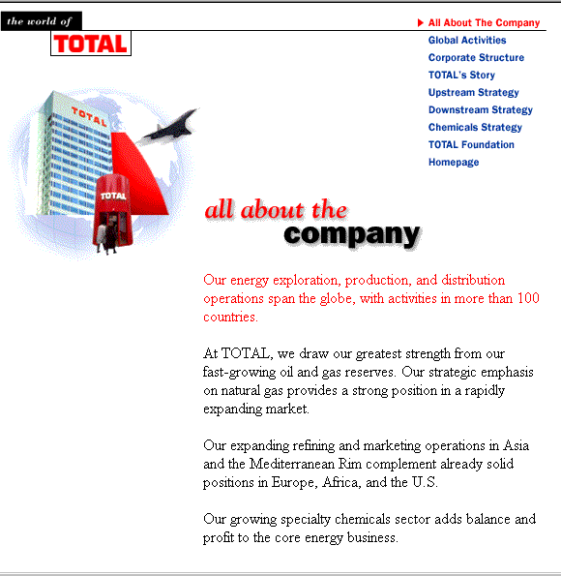
Bag of Words model
aardvark 0
about 2
all 2
Africa 1
apple 0
anxious 0
...
gas 1
...
oil 1
…
Zaire 0
Slide Credit: Carlos Guestrin

Slide 21
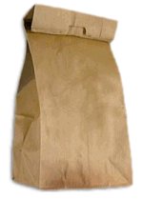


Object
Bag of ‘words’
Fei-Fei Li

Slide 22


Fei-Fei Li

Slide 23
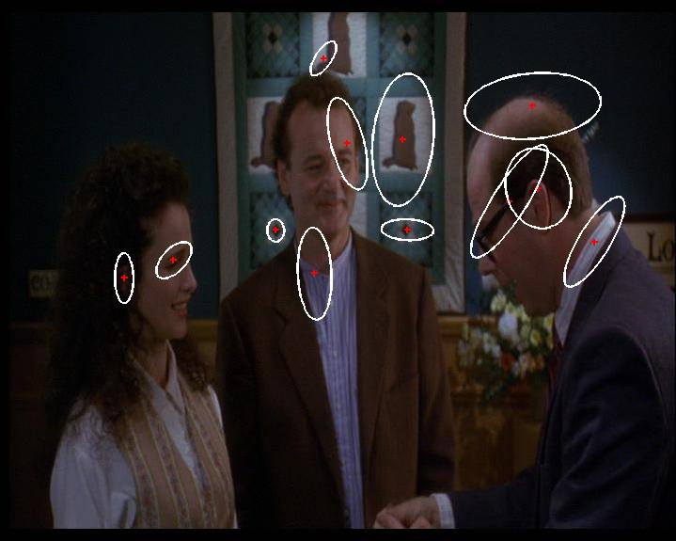
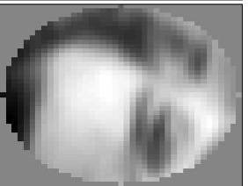
Interest Point Features
Compute SIFT descriptor
[Lowe’99]
Normalize patch
Detect patches
[Mikojaczyk and Schmid ’02]
[Matas et al. ’02]
[Sivic et al. ’03]
Slide credit: Josef Sivic

Slide 24
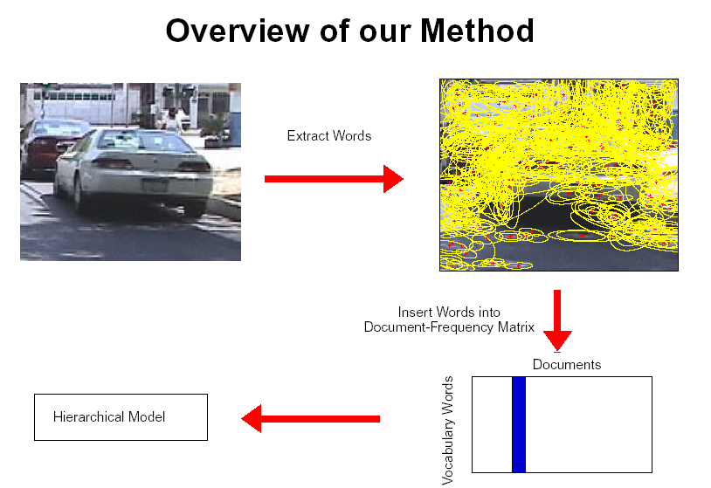
Patch Features
…
Slide credit: Josef Sivic

Slide 25
dictionary formation
…
Slide credit: Josef Sivic

Slide 26
Clustering (usually k-means)
…
Vector quantization
Slide credit: Josef Sivic

Slide 27
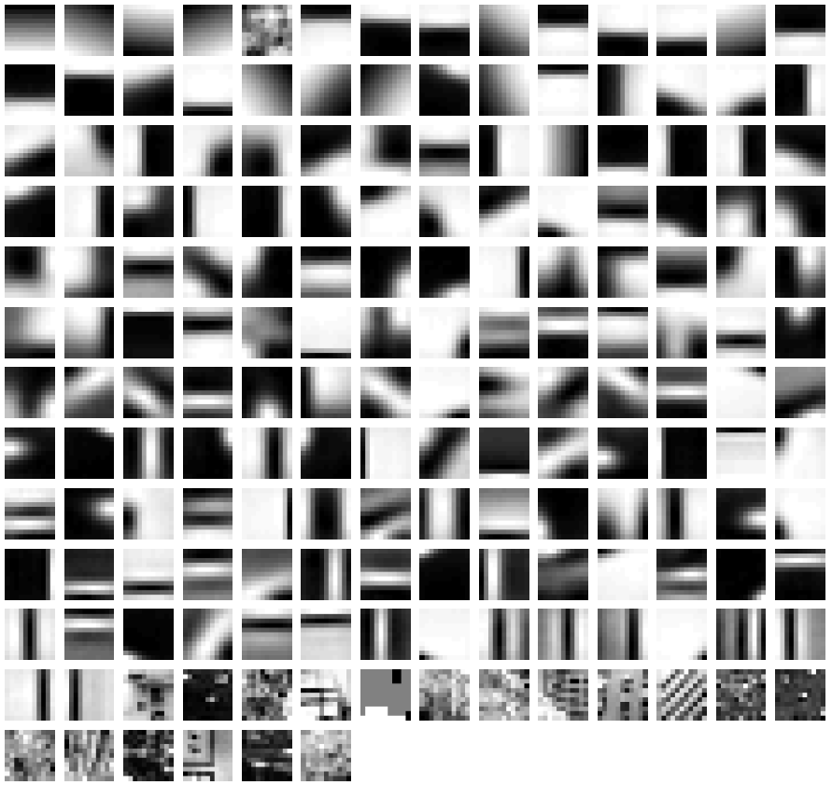
Clustered Image Patches
Fei-Fei et al. 2005

Slide 28
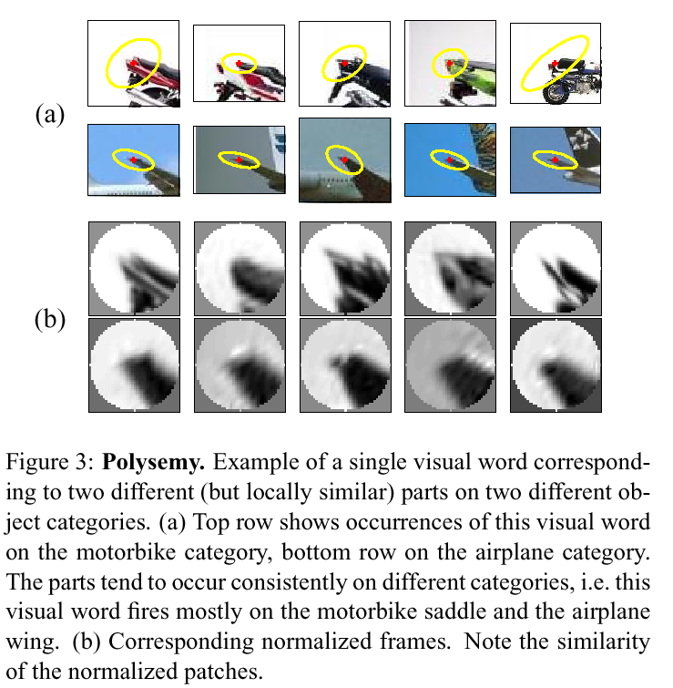
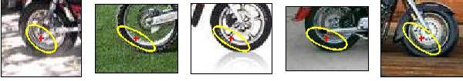
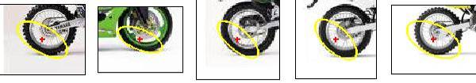
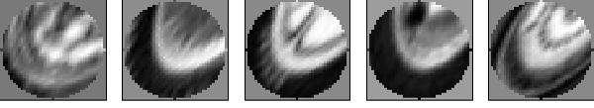
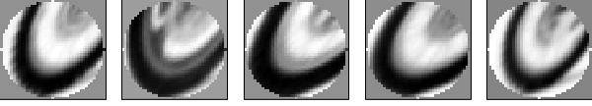
Visual synonyms and polysemy
Visual Polysemy. Single visual word occurring on different (but locally similar) parts on different object categories.
Visual Synonyms. Two different visual words representing a similar part of an object (wheel of a motorbike).
Andrew Zisserman
Notes:
e.g. bank for polysemy
e.g. ** for synonym

Slide 29
Image representation
frequency
…..
codewords
Fei-Fei Li

Slide 30
(One) bad case for k-means
Clusters may overlap
Some clusters may be “wider” than others
GMM to the rescue!
Slide Credit: Carlos Guestrin

Slide 31
GMM
Figure Credit: Kevin Murphy

Slide 32
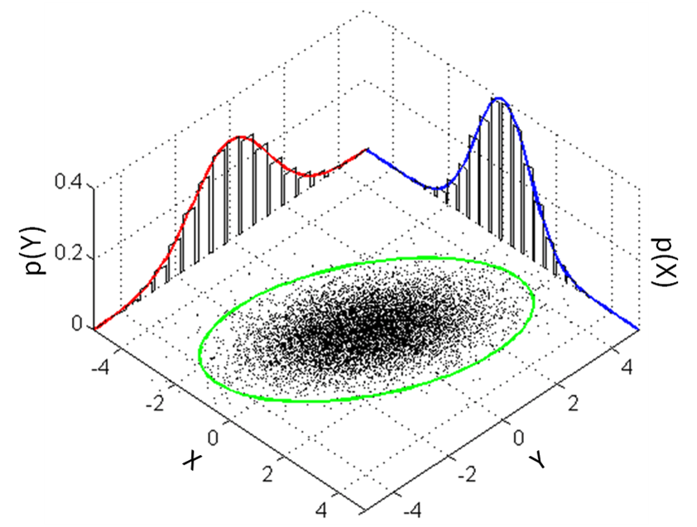
Recall Multi-variate Gaussians

Slide 33
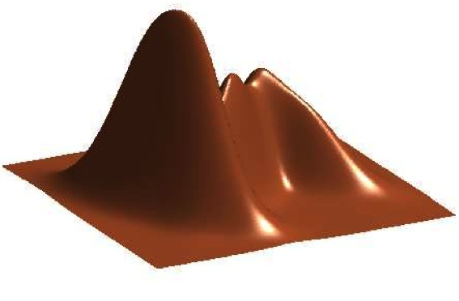
GMM
Figure Credit: Kevin Murphy

Slide 34
Hidden Data Causes Problems #1
Fully Observed (Log) Likelihood factorizes
Marginal (Log) Likelihood doesn’t factorize
All parameters coupled!

Slide 35
GMM vs Gaussian Joint Bayes Classifier
On Board
  Observed Y vs Unobserved Z
  Likelihood vs Marginal Likelihood

Slide 36
Hidden Data Causes Problems #2
Figure Credit: Kevin Murphy

Slide 37
Hidden Data Causes Problems #2
Identifiability
Figure Credit: Kevin Murphy

Slide 38
Hidden Data Causes Problems #3
Likelihood has singularities if one Gaussian “collapses”

Slide 39
Special case: spherical Gaussians and hard assignments
If P(X|Z=k) is spherical, with same σ for all classes:
If each x_{i} belongs to one class C(i) (hard assignment), marginal likelihood:
M(M)LE same as K-means!!!
Slide Credit: Carlos Guestrin

Slide 40
The K-means GMM assumption
There are k components
Component i has an associated mean vector μ_{ι}
μ₂
μ₁
μ₃
Slide Credit: Carlos Guestrin

Slide 41
The K-means GMM assumption
There are k components
Component i has an associated mean vector μ_{ι}
Each component generates data from a Gaussian with mean m_{i} and covariance matrix σ²Ι
Each data point is generated according to the following recipe:
μ₂
μ₁
μ₃
Slide Credit: Carlos Guestrin

Slide 42
The K-means GMM assumption
There are k components
Component i has an associated mean vector μ_{ι}
Each component generates data from a Gaussian with mean m_{i} and covariance matrix σ²Ι
Each data point is generated according to the following recipe:
Pick a component at random: Choose component i with probability P(y=i)
μ₂
Slide Credit: Carlos Guestrin

Slide 43
The K-means GMM assumption
There are k components
Component i has an associated mean vector μ_{ι}
Each component generates data from a Gaussian with mean m_{i} and covariance matrix σ²Ι
Each data point is generated according to the following recipe:
Pick a component at random: Choose component i with probability P(y=i)
Datapoint ∼ Ν(μ_{ι}, σ²Ι )
μ₂
x
Slide Credit: Carlos Guestrin

Slide 44
The General GMM assumption
    There are k components
Component i has an associated mean vector m_{i}
Each component generates data from a Gaussian with mean m_{i} and covariance matrix Σ_{i}
Each data point is generated according to the following recipe:
Pick a component at random: Choose component i with probability P(y=i)
Datapoint ~ N(m_{i}, Σ_{i} )
μ₂
μ₁
μ₃
Slide Credit: Carlos Guestrin

Slide 45
K-means vs GMM
K-Means
  http://home.deib.polimi.it/matteucc/Clustering/tutorial_html/AppletKM.html
GMM
  http://www.socr.ucla.edu/applets.dir/mixtureem.html

