Slide 1
ECE 5984: Introduction to
Machine Learning
Topics:
  Ensemble Methods: Bagging, Boosting
Readings: Murphy 16.4; Hastie 16
Dhruv Batra
Virginia Tech

Slide 2
Administrativia
HW3
  Due: April 14, 11:55pm
  You will implement primal & dual SVMs
  Kaggle competition: Higgs Boson Signal vs Background classification
  https://inclass.kaggle.com/c/2015-Spring-vt-ece-machine-learning-hw3
  https://www.kaggle.com/c/higgs-boson

Slide 3
Administrativia
Project Mid-Sem Spotlight Presentations
  9 remaining
  Resume in class on April 20th
  Format
    5 slides (recommended)
    4 minute time (STRICT) + 1-2 min Q&A
  Content
    Tell the class what you’re working on
    Any results yet?
    Problems faced?
  Upload slides on Scholar

Slide 4
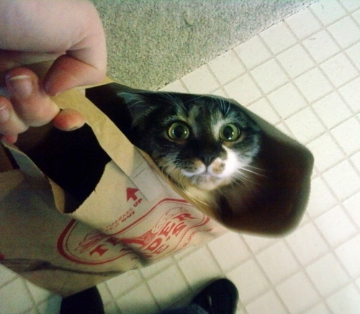
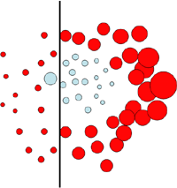
New Topic: Ensemble Methods
Bagging
Boosting
Image Credit: Antonio Torralba

Slide 5
Synonyms
Ensemble Methods
Learning Mixture of Experts/Committees
Boosting types
  AdaBoost
  L2Boost
  LogitBoost
  <Your-Favorite-keyword>Boost

Slide 6
A quick look back
So far you have learnt
Regression
  Least Squares
  Robust Least Squares
Classification
  Linear
    Naïve Bayes
    Logistic Regression
    SVMs
  Non-linear
    Decision Trees
    Neural Networks
    K-NNs

Slide 7
Recall Bias-Variance Tradeoff
Demo
  http://www.princeton.edu/~rkatzwer/PolynomialRegression/

Slide 8
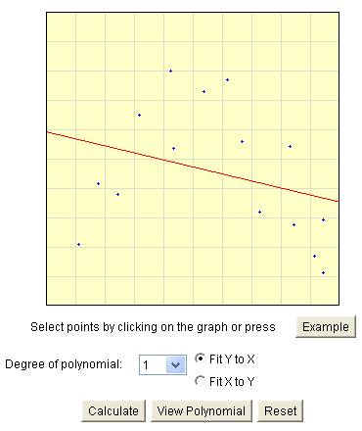
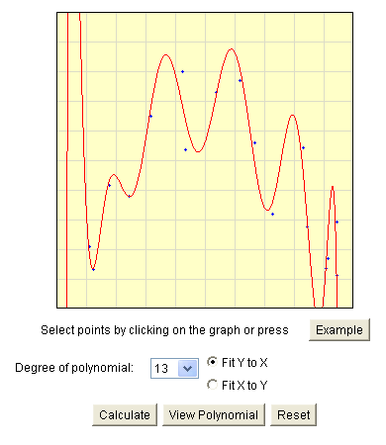
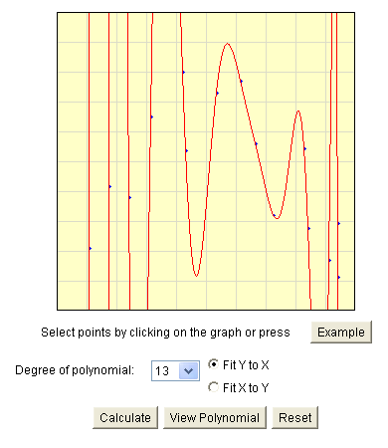
Bias-Variance Tradeoff
Choice of hypothesis class introduces learning bias
  More complex class → less bias
  More complex class → more variance
Slide Credit: Carlos Guestrin

Slide 9
Fighting the bias-variance tradeoff
Simple (a.k.a. weak) learners
  e.g., naïve Bayes, logistic regression, decision stumps (or shallow decision trees)
  Good: Low variance, don’t usually overfit
  Bad: High bias, can’t solve hard learning problems
Sophisticated learners
  Kernel SVMs, Deep Neural Nets, Deep Decision Trees
  Good: Low bias, have the potential to learn with Big Data
  Bad: High variance, difficult to generalize
Can we make combine these properties
  In general, No!!
  But often yes…
Slide Credit: Carlos Guestrin

Slide 10
Voting (Ensemble Methods)
Instead of learning a single classifier,
learn many classifiers
Output class: (Weighted) vote of each classifier
  Classifiers that are most “sure” will vote with more conviction
With sophisticated learners
  Uncorrelated errors → expected error goes down
  On average, do better than single classifier!
  Bagging
With weak learners
  each one good at different parts of the input space
  On average, do better than single classifier!
  Boosting

Slide 11
Bagging
Bagging = Bootstrap Averaging
  On board
  Bootstrap Demo
    http://wise.cgu.edu/bootstrap/

Slide 12
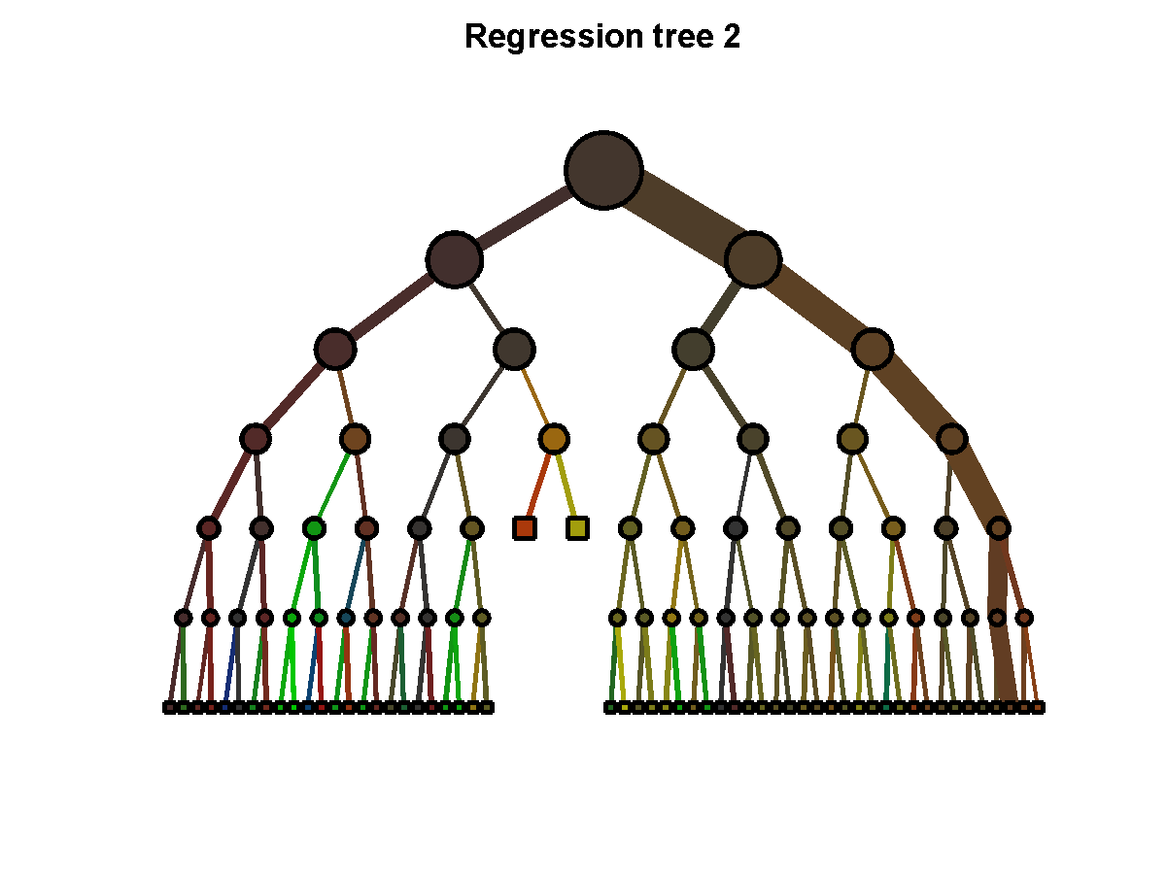
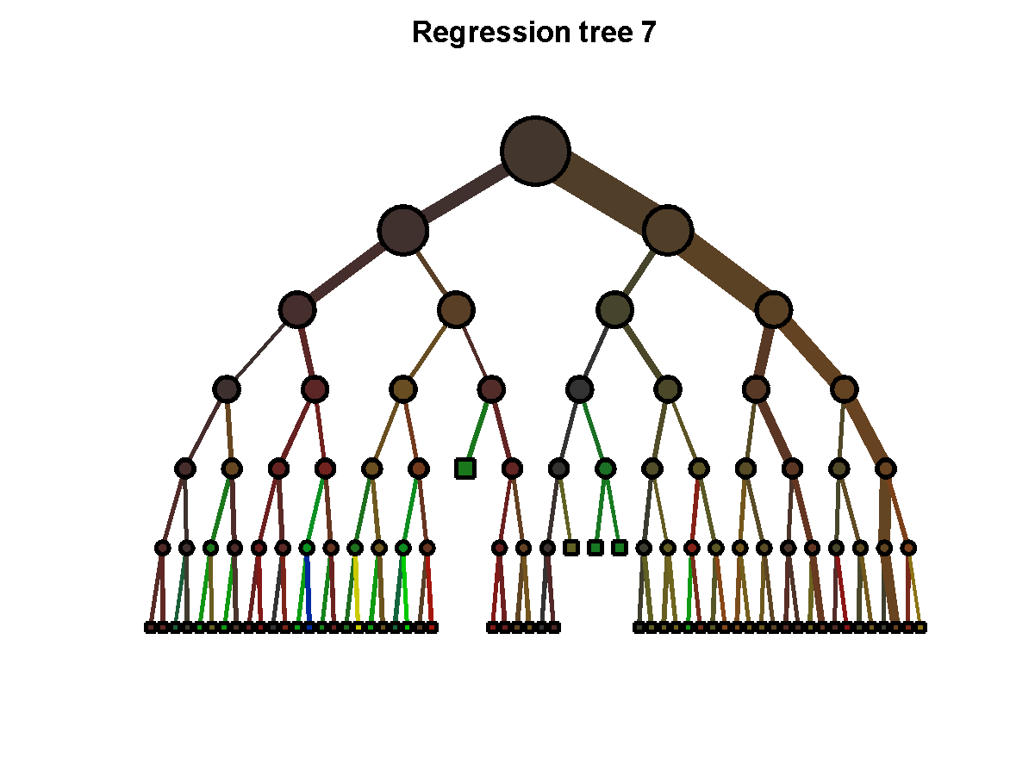
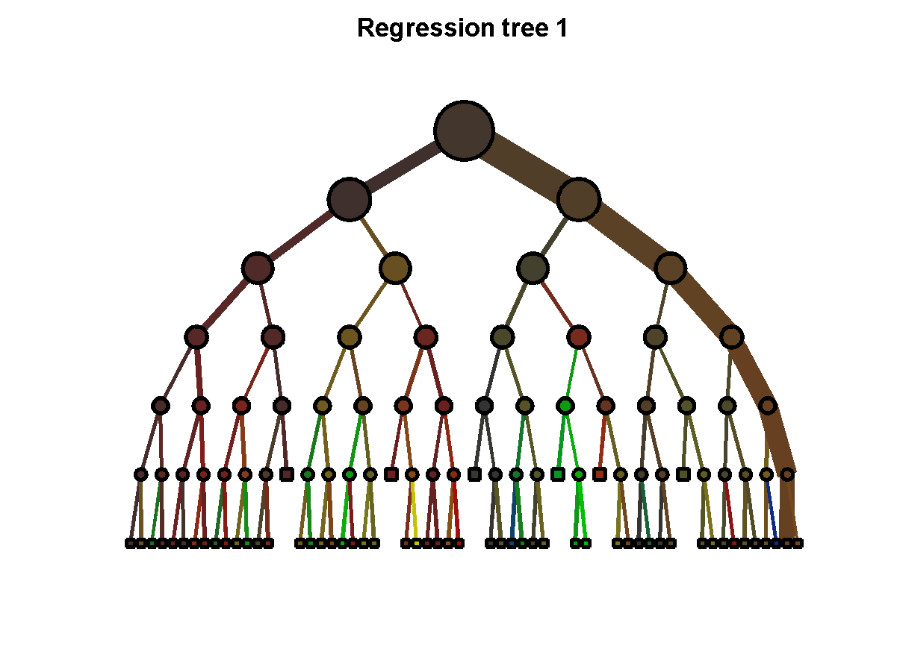
Decision Forests
…
…
Learn many trees & Average Outputs
Will formally visit this in Bagging lecture

Slide 13
Boosting
[Schapire, 1989]
Pick a class of weak learners
You have a black box that picks best weak learning
  unweighted sum
  weighted sum
On each iteration t
  Compute error for each point
  Update weight of each training example based on it’s error.
  Learn a hypothesis – h_{t}
  A strength for this hypothesis – α_{t}
Final classifier:

Slide 14
Boosting
Demo
  Matlab demo by Antonio Torralba
  http://people.csail.mit.edu/torralba/shortCourseRLOC/boosting/boosting.html

Slide 15
Types of Boosting
Loss Name | Loss Formula | Boosting Name
Regression: Squared Loss |  | L2Boosting
Regression: Absolute Loss |  | Gradient Boosting
Classification: Exponential Loss |  | AdaBoost
Classification: Log/Logistic Loss |  | LogitBoost

Slide 16
L2 Boosting
Algorithm
  On Board
Loss Name | Loss Formula | Boosting Name
Regression: Squared Loss |  | L2Boosting

Slide 17
Adaboost
Algorithm
  You will derive in HW4!
Guaranteed to achieve zero training error
  With infinite rounds of boosting (assuming no label noise)
  Need to do early stopping
Loss Name | Loss Formula | Boosting Name
Classification: Exponential Loss |  | AdaBoost

Slide 18
What you should know
Voting/Ensemble methods
Bagging
  How to sample
  Under what conditions is error reduced
Boosting
  General outline
  L2Boosting derivation
  Adaboost derivation

Slide 19
Learning Theory
Probably Approximately Correct (PAC) Learning
What does it formally mean to learn?

Slide 20
Learning Theory
We have explored many ways of learning from data
But…
  How good is our classifier, really?
  How much data do I need to make it “good enough”?
Slide Credit: Carlos Guestrin

Slide 21
A simple setting…
Classification
  N data points
  Finite space H of possible hypothesis
    e.g. dec. trees of depth d
A learner finds a hypothesis h that is consistent with training data
  Gets zero error in training – error_{train}(h) = 0
What is the probability that h has more than ε true error?
  error_{true}(h) ≥ ε
Slide Credit: Carlos Guestrin

Slide 22
Generalization error in finite hypothesis spaces [Haussler ’88]
Theorem:
  Hypothesis space H finite
  dataset D with N i.i.d. samples
  0 < ε < 1
For any learned hypothesis h that is consistent on the training data:
Even if h makes zero errors in training data, may make errors in test
Slide Credit: Carlos Guestrin

Slide 23
Using a PAC bound
Typically, 2 use cases:
  1: Pick ε and δ, give you N
  2: Pick N and δ, give you ε
Slide Credit: Carlos Guestrin

Slide 24
Haussler ‘88 bound
Strengths:
  Holds for all (finite) H
  Holds for all data distributions
Weaknesses
  Consistent classifier
  Finite hypothesis space
Slide Credit: Carlos Guestrin

Slide 25
Generalization bound for |H| hypothesis
Theorem:
  Hypothesis space H finite
  dataset D with N i.i.d. samples
  0 < ε < 1
For any learned hypothesis h:
Slide Credit: Carlos Guestrin

Slide 26
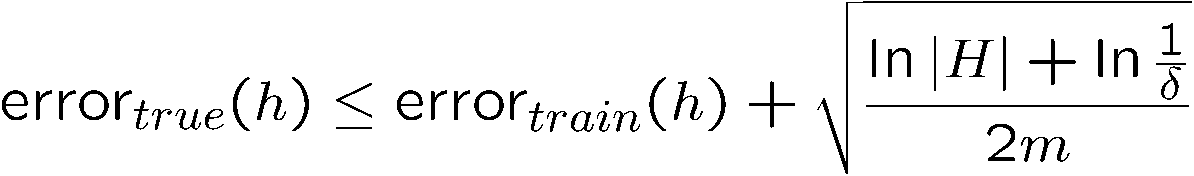
PAC bound and Bias-Variance tradeoff
or, after moving some terms around,
with probability at least 1-δ:
Important: PAC bound holds for all h,
but doesn’t guarantee that algorithm finds best h!!!
Slide Credit: Carlos Guestrin

