Slide 1

ECE 5984:
Introduction to Machine Learning
Dhruv Batra
Virginia Tech

Slide 2
ECE 4424 / 5424G (CS 5824): Introduction to Machine Learning
Dhruv Batra
Virginia Tech

Slide 3
ECE 4424 / 5424G (CS 5824):
Machine Learning / Advanced Machine Learning
Dhruv Batra
Virginia Tech

Slide 4
ECE 5984:
Introduction to Machine Learning
Dhruv Batra
Virginia Tech

Slide 5
Quotes
“If you were a current computer science student what area would you start studying heavily?”
  Answer: Machine Learning.
  “The ultimate is computers that learn”
  Bill Gates, Reddit AMA
“Machine learning is the next Internet”
  Tony Tether, Director, DARPA
“Machine learning is today’s discontinuity”
  Jerry Yang, CEO, Yahoo
Slide Credit: Pedro Domingos, Tom Mitchel, Tom Dietterich

Slide 6
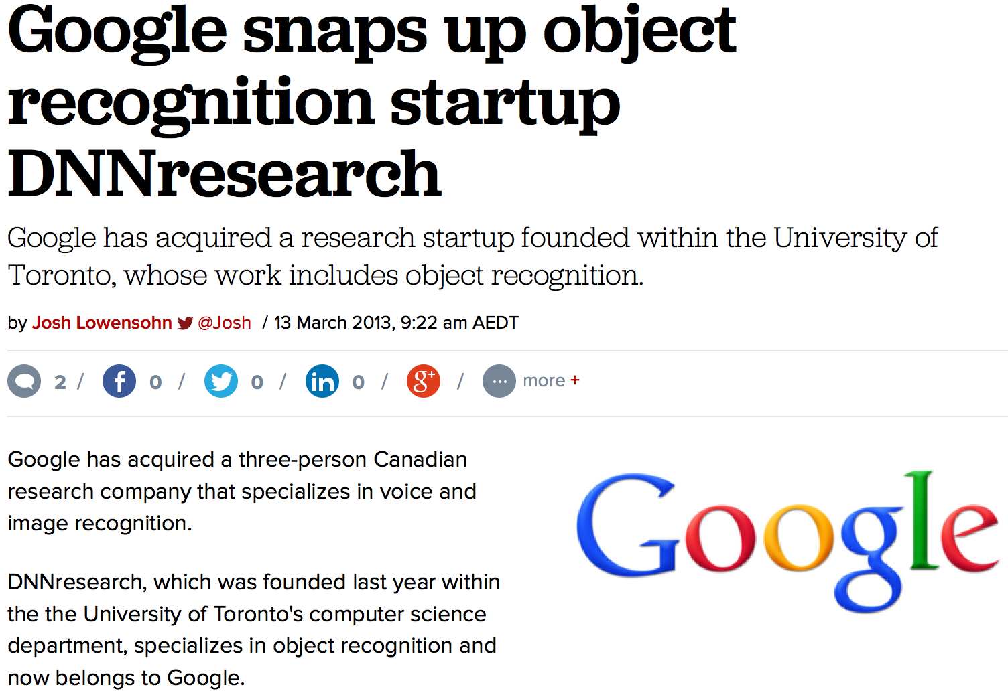
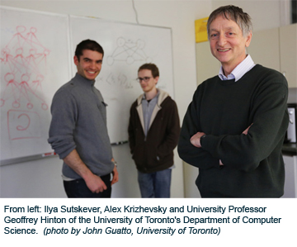
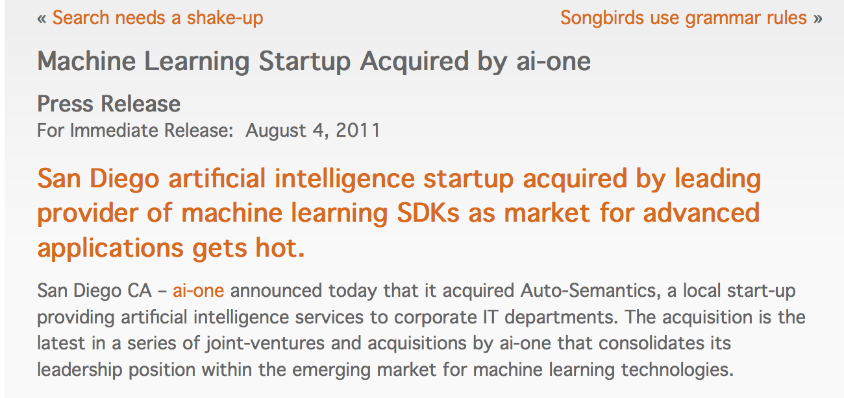
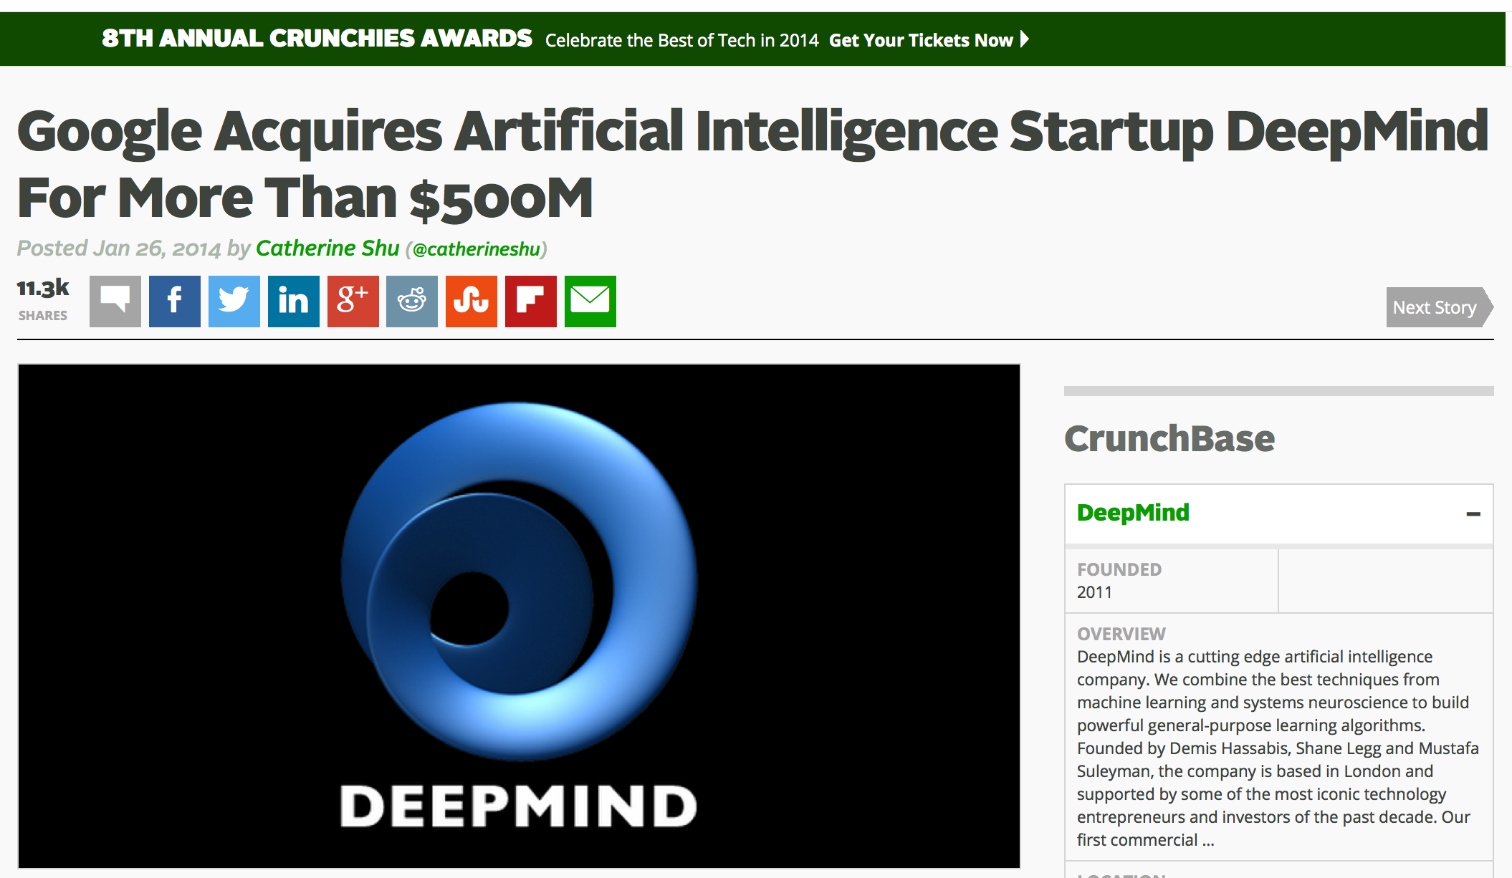
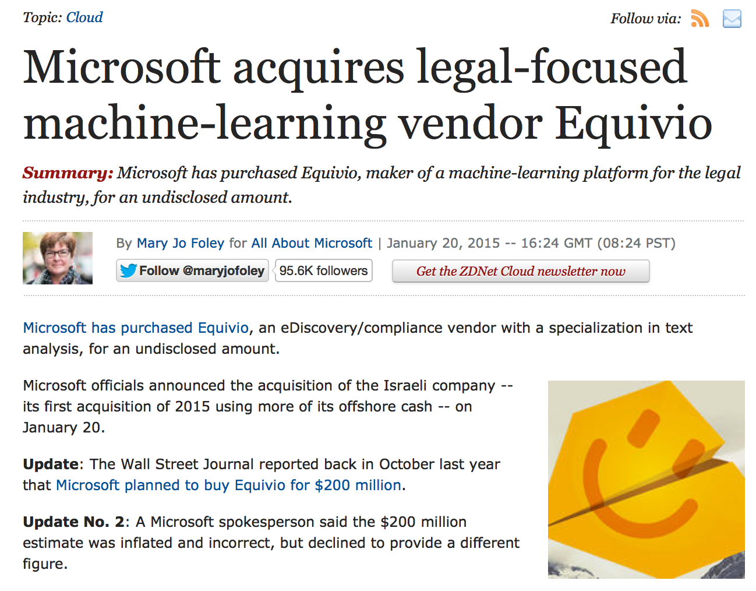
Acquisitions

Slide 7
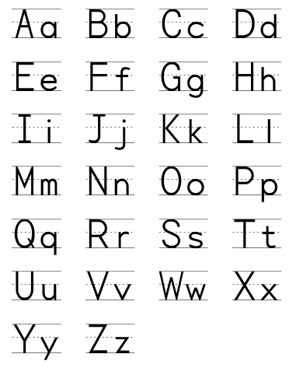
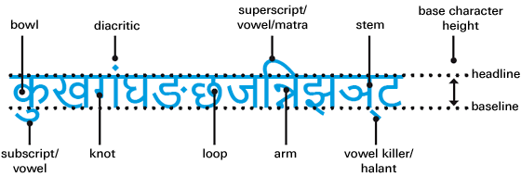
What is Machine Learning?
Let’s say you want to solve Character Recognition
Hard way: Understand handwriting/characters
Image Credit: http://www.linotype.com/6896/devanagari.html

Slide 8
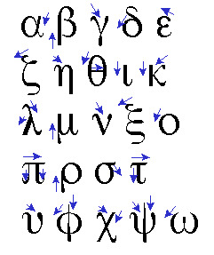
What is Machine Learning?
Let’s say you want to solve Character Recognition
Hard way: Understand handwriting/characters
  Latin
  Devanagri
  Symbols: http://detexify.kirelabs.org/classify.html

Slide 9
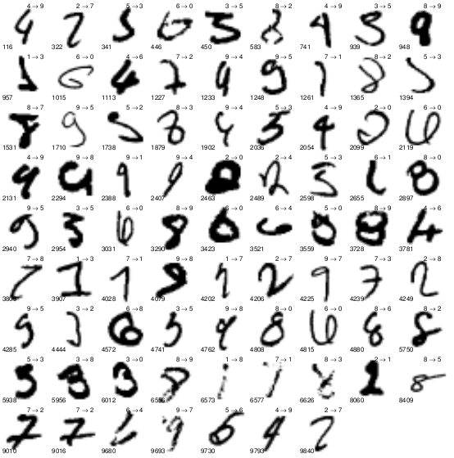
What is Machine Learning?
Let’s say you want to solve Character Recognition
Hard way: Understand handwriting/characters
Lazy way: Throw data!

Slide 10

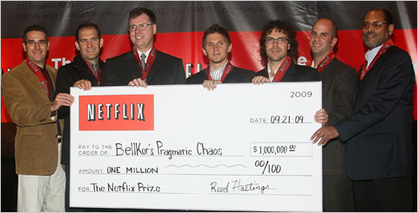
Example: Netflix Challenge
Goal: Predict how a viewer will rate a movie
10% improvement = 1 million dollars
Slide Credit: Yaser Abu-Mostapha

Slide 11
Example: Netflix Challenge
Goal: Predict how a viewer will rate a movie
10% improvement = 1 million dollars
Essence of Machine Learning:
  A pattern exists
  We cannot pin it down mathematically
  We have data on it
Slide Credit: Yaser Abu-Mostapha

Slide 12
Comparison
Traditional Programming
Machine Learning
Data
Computer
Output
Program
Data
Computer
Program
Output
Slide Credit: Pedro Domingos, Tom Mitchel, Tom Dietterich
Notes:
Compare with Sorting

Slide 13
What is Machine Learning?
“the acquisition of knowledge or skills through experience, study, or by being taught.”

Slide 14
What is Machine Learning?
[Arthur Samuel, 1959]
  Field of study that gives computers
  the ability to learn without being explicitly programmed
[Kevin Murphy] algorithms that
  automatically detect patterns in data
  use the uncovered patterns to predict future data or other outcomes of interest
[Tom Mitchell] algorithms that
  improve their performance (P)
  at some task (T)
  with experience (E)

Slide 15
What is Machine Learning?
If you are a Scientist
If you are an Engineer / Entrepreneur
  Get lots of data
  Machine Learning
  ???
  Profit!
Machine
Learning
Data
Understanding

Slide 16
Why Study Machine Learning?
Engineering Better Computing Systems
Develop systems
  too difficult/expensive to construct manually
  because they require specific detailed skills/knowledge
  knowledge engineering bottleneck
Develop systems
  that adapt and customize themselves to individual users.
  Personalized news or mail filter
  Personalized tutoring
Discover new knowledge from large databases
  Medical text mining (e.g. migraines to calcium channel blockers to magnesium)
  data mining
Slide Credit: Ray Mooney

Slide 17
Why Study Machine Learning?
Cognitive Science
Computational studies of learning may help us understand learning in humans
  and other biological organisms.
  Hebbian neural learning
    “Neurons that fire together, wire together.”
Slide Credit: Ray Mooney

Slide 18
Why Study Machine Learning?
The Time is Ripe
Algorithms
  Many basic effective and efficient algorithms available.
Data
  Large amounts of on-line data available.
Computing
  Large amounts of computational resources available.
Slide Credit: Ray Mooney

Slide 19
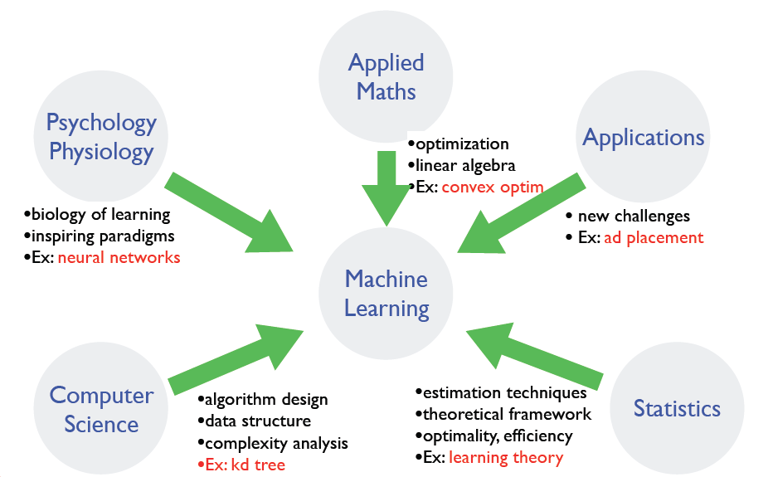
Where does ML fit in?
Slide Credit: Fei Sha

Slide 20
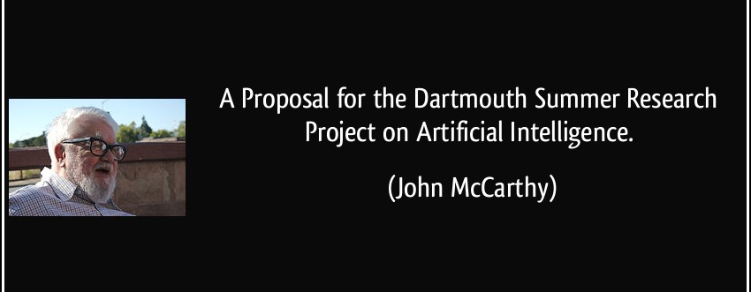
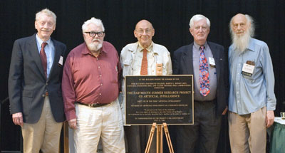
A Brief History of AI

Slide 21
A Brief History of AI
“We propose that a 2 month, 10 man study of artificial intelligence be carried out during the summer of 1956 at Dartmouth College in Hanover, New Hampshire.”
The study is to proceed on the basis of the conjecture that every aspect of learning or any other feature of intelligence can in principle be so precisely described that a machine can be made to simulate it.
An attempt will be made to find how to make machines use language, form abstractions and concepts, solve kinds of problems now reserved for humans, and improve themselves.
We think that a significant advance can be made in one or more of these problems if a carefully selected group of scientists work on it together for a summer.”

Slide 22
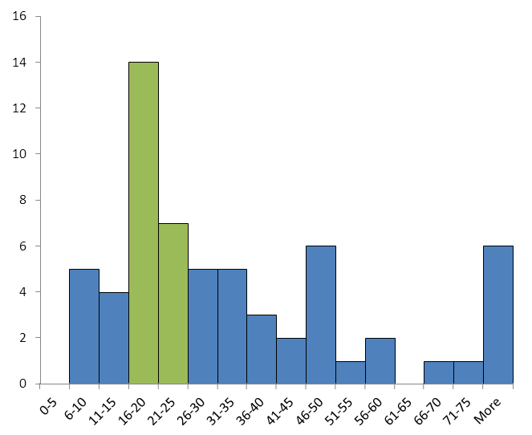
AI Predictions: Experts
Image Credit: http://intelligence.org/files/PredictingAI.pdf

Slide 23
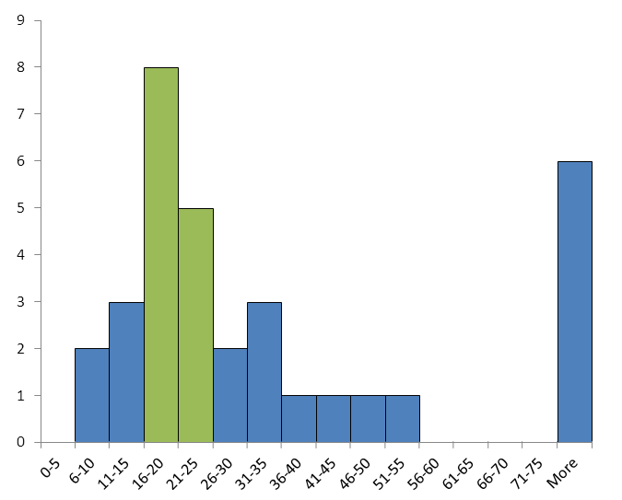
AI Predictions: Non-Experts
Image Credit: http://intelligence.org/files/PredictingAI.pdf

Slide 24
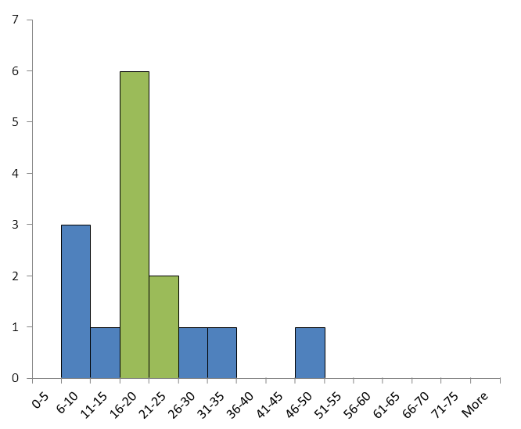
AI Predictions: Failed
Image Credit: http://intelligence.org/files/PredictingAI.pdf

Slide 25
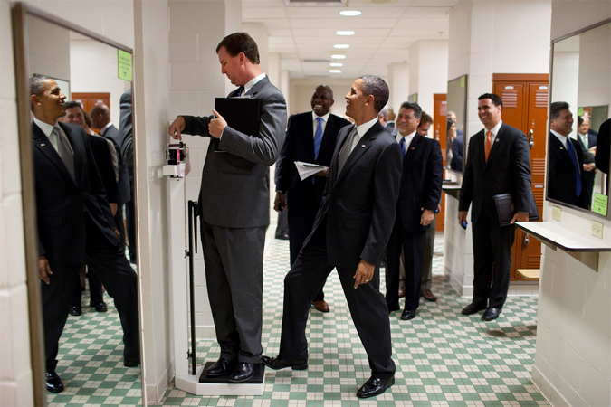
Why is AI hard?
Slide Credit: http://karpathy.github.io/2012/10/22/state-of-computer-vision/

Slide 26

What humans see
Slide Credit: Larry Zitnick

Slide 27
What computers see
243 | 239 | 240 | 225 | 206 | 185 | 188 | 218 | 211 | 206 | 216 | 225
242 | 239 | 218 | 110 | 67 | 31 | 34 | 152 | 213 | 206 | 208 | 221
243 | 242 | 123 | 58 | 94 | 82 | 132 | 77 | 108 | 208 | 208 | 215
235 | 217 | 115 | 212 | 243 | 236 | 247 | 139 | 91 | 209 | 208 | 211
233 | 208 | 131 | 222 | 219 | 226 | 196 | 114 | 74 | 208 | 213 | 214
232 | 217 | 131 | 116 | 77 | 150 | 69 | 56 | 52 | 201 | 228 | 223
232 | 232 | 182 | 186 | 184 | 179 | 159 | 123 | 93 | 232 | 235 | 235
232 | 236 | 201 | 154 | 216 | 133 | 129 | 81 | 175 | 252 | 241 | 240
235 | 238 | 230 | 128 | 172 | 138 | 65 | 63 | 234 | 249 | 241 | 245
237 | 236 | 247 | 143 | 59 | 78 | 10 | 94 | 255 | 248 | 247 | 251
234 | 237 | 245 | 193 | 55 | 33 | 115 | 144 | 213 | 255 | 253 | 251
248 | 245 | 161 | 128 | 149 | 109 | 138 | 65 | 47 | 156 | 239 | 255
190 | 107 | 39 | 102 | 94 | 73 | 114 | 58 | 17 | 7 | 51 | 137
23 | 32 | 33 | 148 | 168 | 203 | 179 | 43 | 27 | 17 | 12 | 8
17 | 26 | 12 | 160 | 255 | 255 | 109 | 22 | 26 | 19 | 35 | 24
Slide Credit: Larry Zitnick

Slide 28
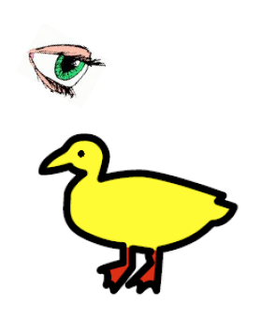
“I saw her duck”
Image Credit: Liang Huang

Slide 29

“I saw her duck”
Image Credit: Liang Huang

Slide 30
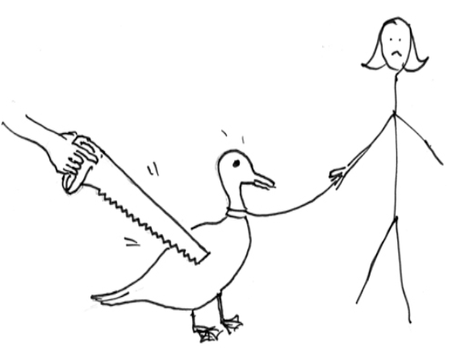
“I saw her duck”
Image Credit: Liang Huang

Slide 31
“I saw her duck with a telescope…”
Image Credit: Liang Huang

Slide 32
We’ve come a long way…
What is Jeopardy?
  http://youtu.be/Xqb66bdsQlw?t=53s
Challenge:
  http://youtu.be/_429UIzN1JM
Watson Demo:
  http://youtu.be/WFR3lOm_xhE?t=22s
Explanation
  http://youtu.be/d_yXV22O6n4?t=4s
Future: Automated operator, doctor assistant, finance
Notes:
First link is dead.

Slide 33
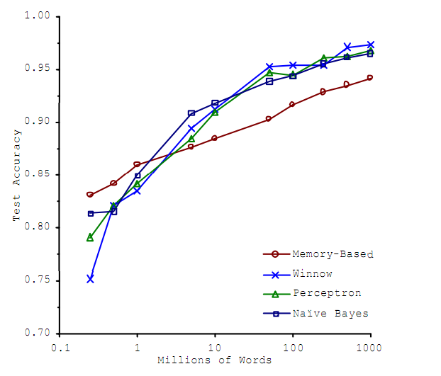
Why are things working today?
More compute power
More data
Better algorithms
/models
Better
Accuracy
Amount of Training Data
Figure Credit: Banko & Brill, 2011

Slide 34
ML in a Nutshell
Tens of thousands of machine learning algorithms
  Hundreds new every year
Decades of ML research oversimplified:
  All of Machine Learning:
  Learn a mapping from input to output f: X → Y
  X: emails, Y: {spam, notspam}
Slide Credit: Pedro Domingos

Slide 35
ML in a Nutshell
Input: x (images, text, emails…)
Output: y (spam or non-spam…)
(Unknown) Target Function
  f: X → Y (the “true” mapping / reality)
Data
  (x₁,y₁), (x₂,y₂), …, (x_{N},y_{N})
Model / Hypothesis Class
  g: X → Y
  y = g(x) = sign(w^{T}x)

Slide 36
ML in a Nutshell
Every machine learning algorithm has three components:
  Representation / Model Class
  Evaluation / Objective Function
  Optimization
Slide Credit: Pedro Domingos

Slide 37
Representation / Model Class
Decision trees
Sets of rules / Logic programs
Instances
Graphical models (Bayes/Markov nets)
Neural networks
Support vector machines
Model ensembles
Etc.
Slide Credit: Pedro Domingos

Slide 38
Evaluation / Objective Function
Accuracy
Precision and recall
Squared error
Likelihood
Posterior probability
Cost / Utility
Margin
Entropy
K-L divergence
Etc.
Slide Credit: Pedro Domingos

Slide 39
Optimization
Discrete/Combinatorial optimization
  greedy search
  Graph algorithms (cuts, flows, etc)
Continuous optimization
  Convex/Non-convex optimization
  Linear programming

Slide 40
Types of Learning
Supervised learning
  Training data includes desired outputs
Unsupervised learning
  Training data does not include desired outputs
Weakly or Semi-supervised learning
  Training data includes a few desired outputs
Reinforcement learning
  Rewards from sequence of actions

Slide 41
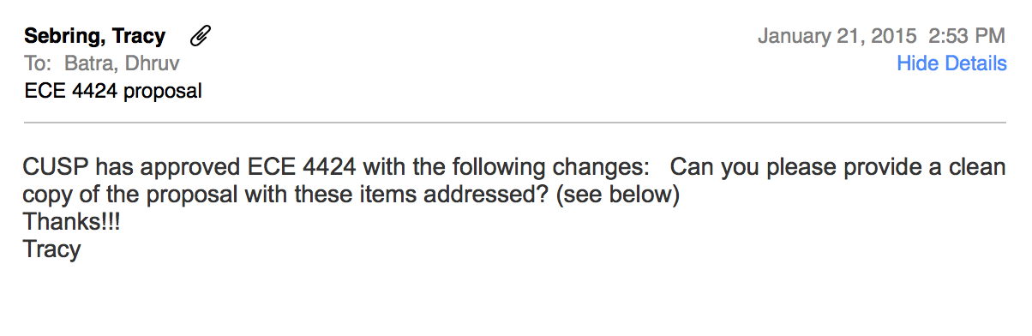
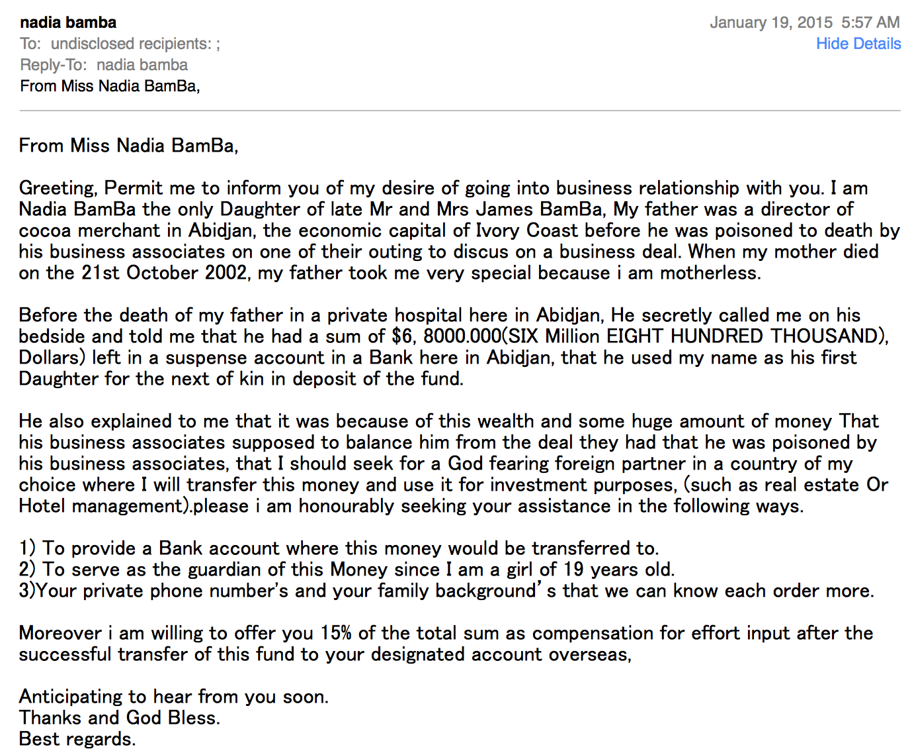
Spam vs Regular Email
vs

Slide 42
Intuition
Spam Emails
  a lot of words like
    “money”
    “free”
    “bank account”
    “viagara” ... in a single email
Regular Emails
  word usage pattern is more spread out
Slide Credit: Fei Sha

Slide 43
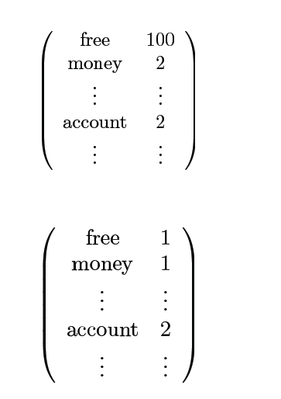
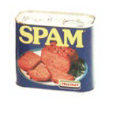
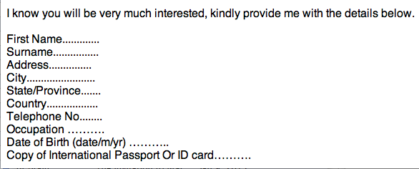
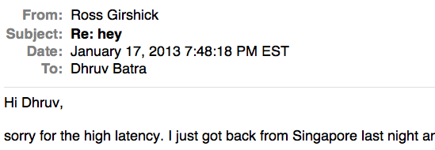
Simple Strategy: Let us count!
This is X
Slide Credit: Fei Sha

Slide 44
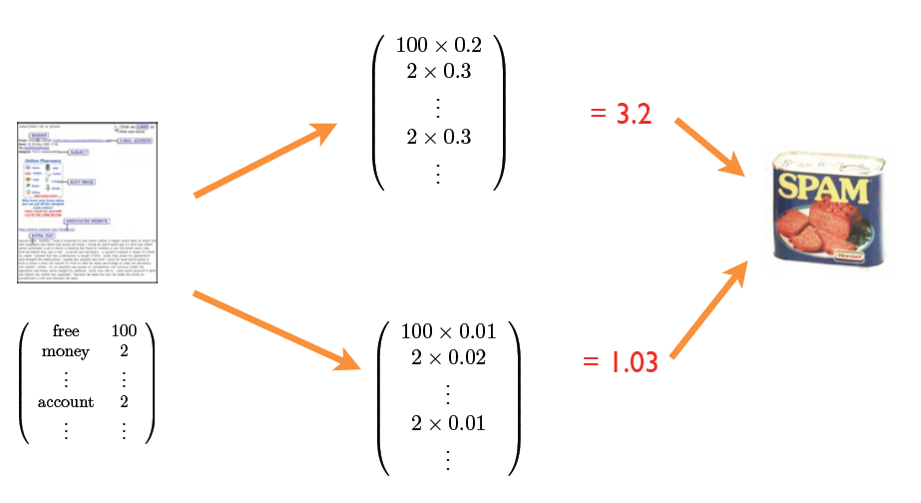
Final Procedure
Confidence / performance guarantee?
Why linear combination?
Why these words?
Where do the weights come from?
Slide Credit: Fei Sha

Slide 45
Types of Learning
Supervised learning
  Training data includes desired outputs
Unsupervised learning
  Training data does not include desired outputs
Weakly or Semi-supervised learning
  Training data includes a few desired outputs
Reinforcement learning
  Rewards from sequence of actions

Slide 46
Tasks
Supervised Learning
x
Classification
y
Discrete
x
Regression
y
Continuous
Unsupervised Learning
x
Clustering
y
Discrete ID
x
Dimensionality
Reduction
y
Continuous

Slide 47
Supervised Learning
Classification
x
Classification
y
Discrete

Slide 48
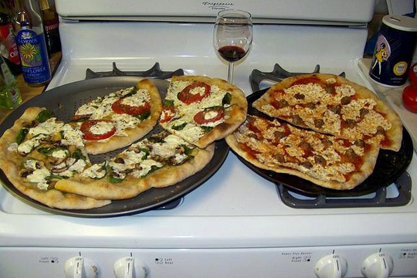
Image Classification
Im2tags; Im2text
http://deeplearning.cs.toronto.edu/
Pizza
Wine
Stove

Slide 49

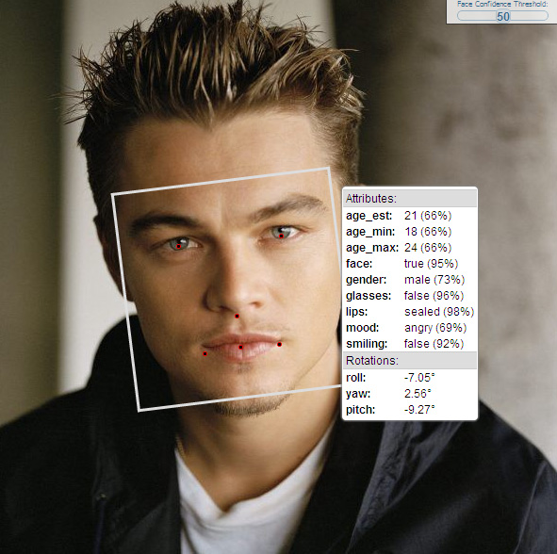
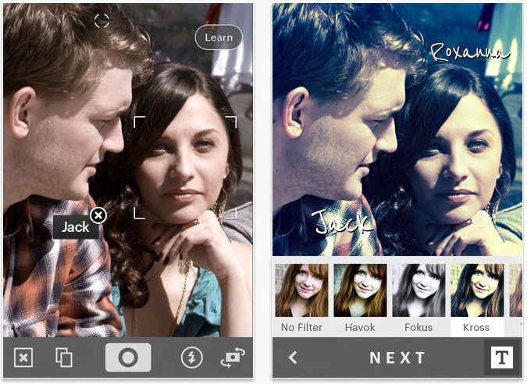
Face Recognition
http://developers.face.com/tools/
Slide Credit: Noah Snavely
49

Slide 50
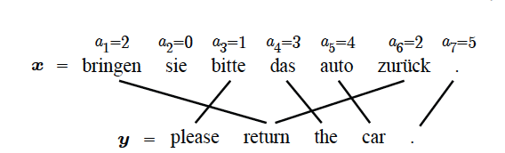
Machine Translation
Figure Credit: Kevin Gimpel

Slide 51
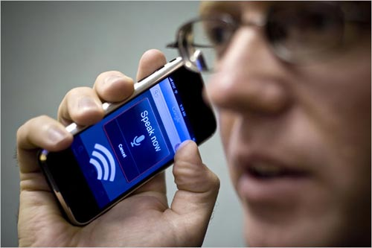
Speech Recognition
Slide Credit: Carlos Guestrin

Slide 52
Speech Recognition
Rick Rashid speaks Mandarin
  http://youtu.be/Nu-nlQqFCKg?t=7m30s

Slide 53
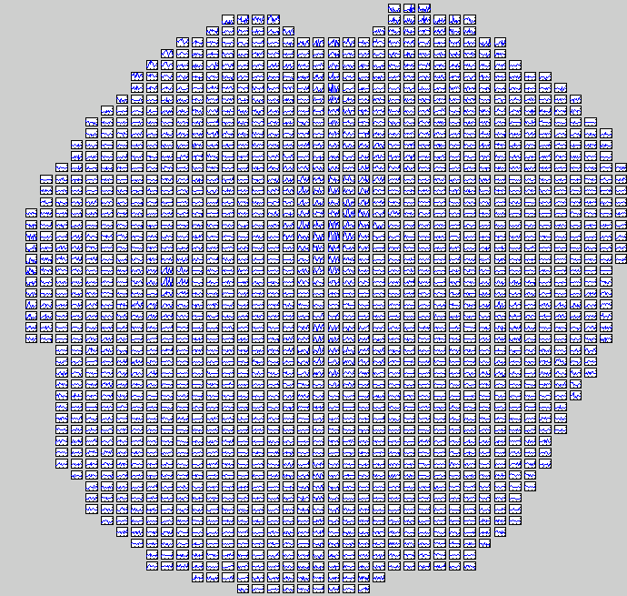
Reading a noun (vs verb)
[Rustandi et al., 2005]
Slide Credit: Carlos Guestrin
53

Slide 54
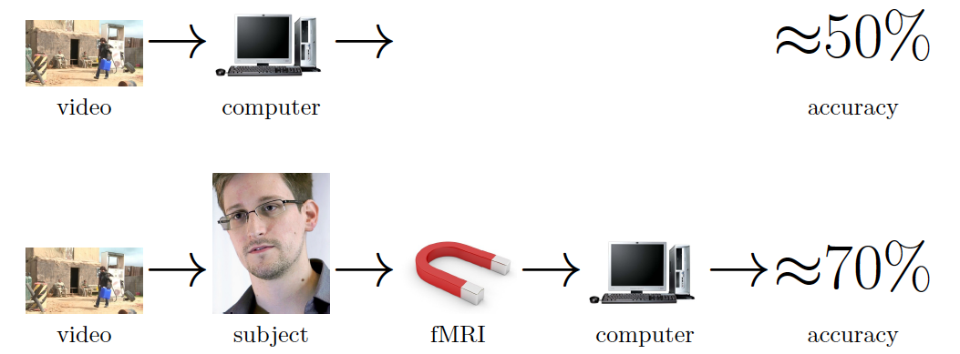
Seeing is worse than believing
[Barbu et al. ECCV14]
Image Credit: Barbu et al.

Slide 55
Supervised Learning
Regression
x
Regression
y
Continuous

Slide 56
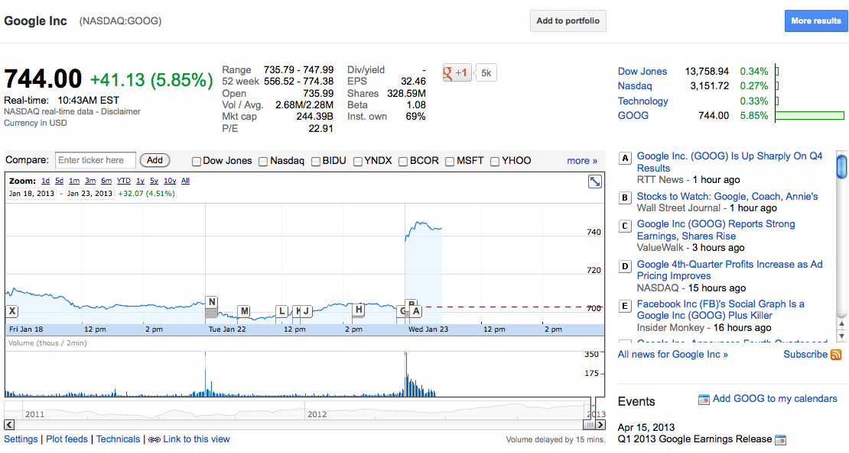
Stock market
56

Slide 57
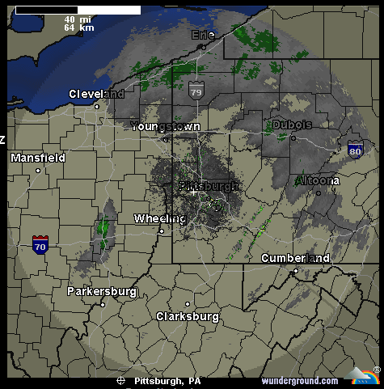
Weather prediction
Temperature
Slide Credit: Carlos Guestrin
57

Slide 58
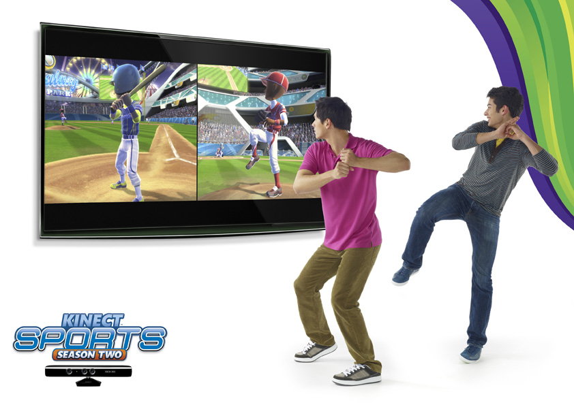
Pose Estimation
Slide Credit: Noah Snavely

Slide 59
Pose Estimation
2010: (Project Natal) Kinect
  http://www.youtube.com/watch?v=r5-zZDSsgFg
2012: Kinect One
  http://youtu.be/Hi5kMNfgDS4?t=28s
2013: Leap Motion
  http://youtu.be/gby6hGZb3ww

Slide 60
Tasks
Supervised Learning
x
Classification
y
Discrete
x
Regression
y
Continuous
Unsupervised Learning
x
Clustering
y
Discrete ID
x
Dimensionality
Reduction
y
Continuous

Slide 61
Unsupervised Learning
Clustering
Unsupervised Learning
Y not provided
x
Clustering
y
Discrete

Slide 62
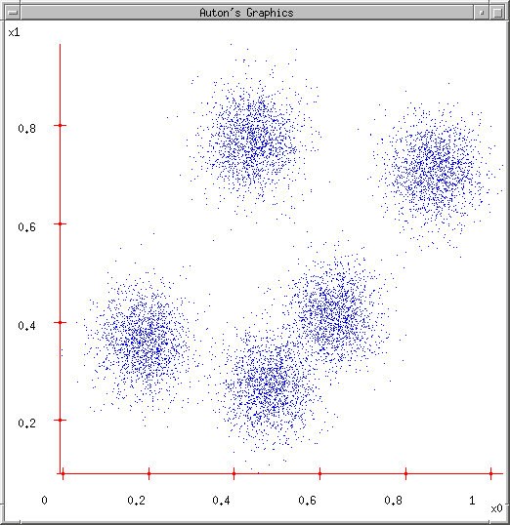
Clustering Data: Group similar things
Slide Credit: Carlos Guestrin
62

Slide 63
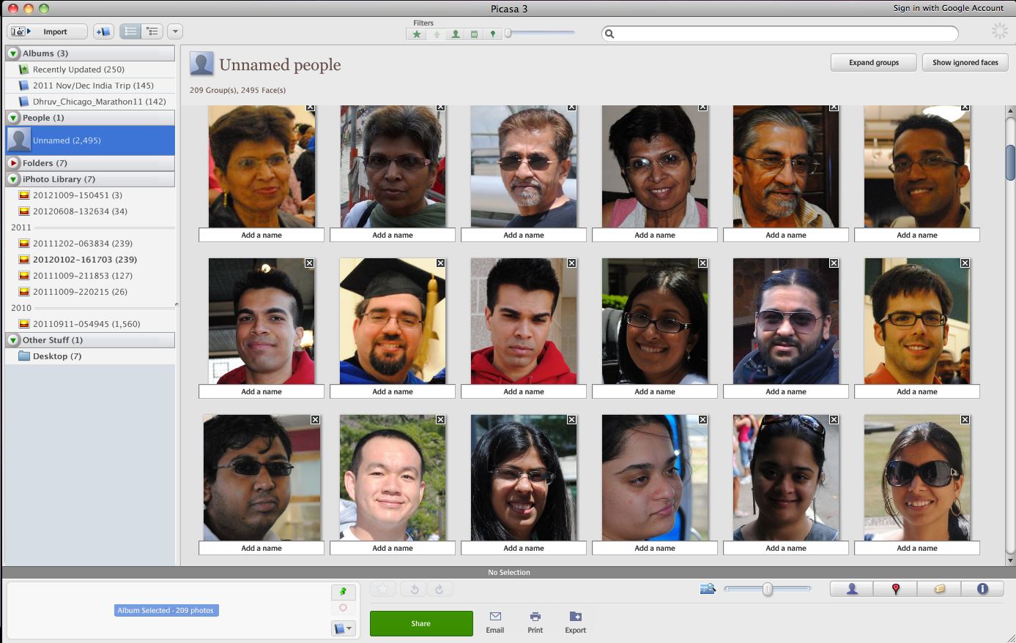
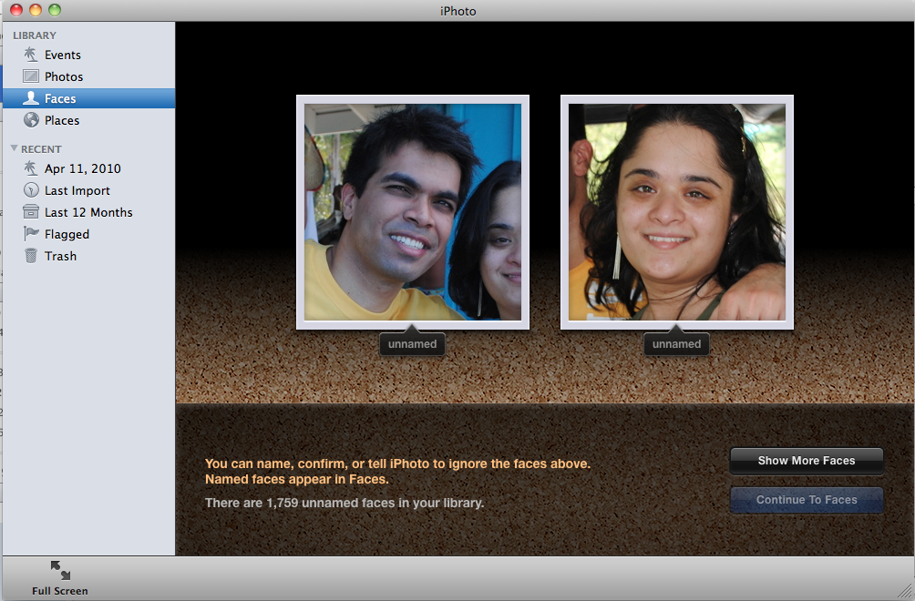
Face Clustering
iPhoto
Picassa

Slide 64
Embedding
Visualizing x

Slide 65
Unsupervised Learning
Dimensionality Reduction / Embedding
Unsupervised Learning
Y not provided
x
Clustering
y
Continuous

Slide 66
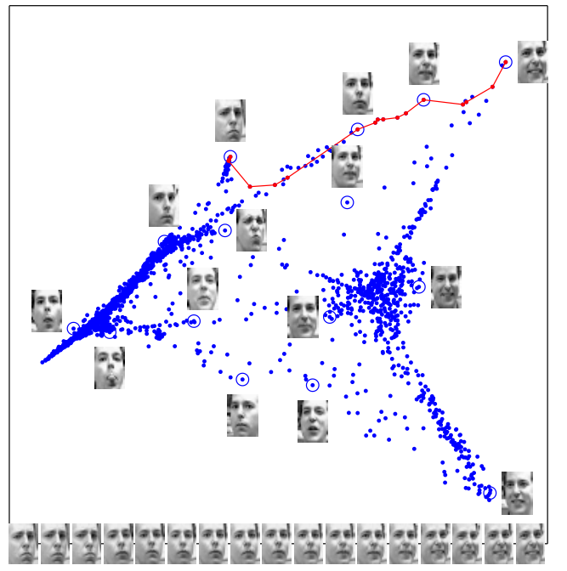
Embedding images
Images have thousands or millions of pixels.
Can we give each image a coordinate,
such that similar images are near each other?
Slide Credit: Carlos Guestrin
66
[Saul & Roweis ‘03]

Slide 67
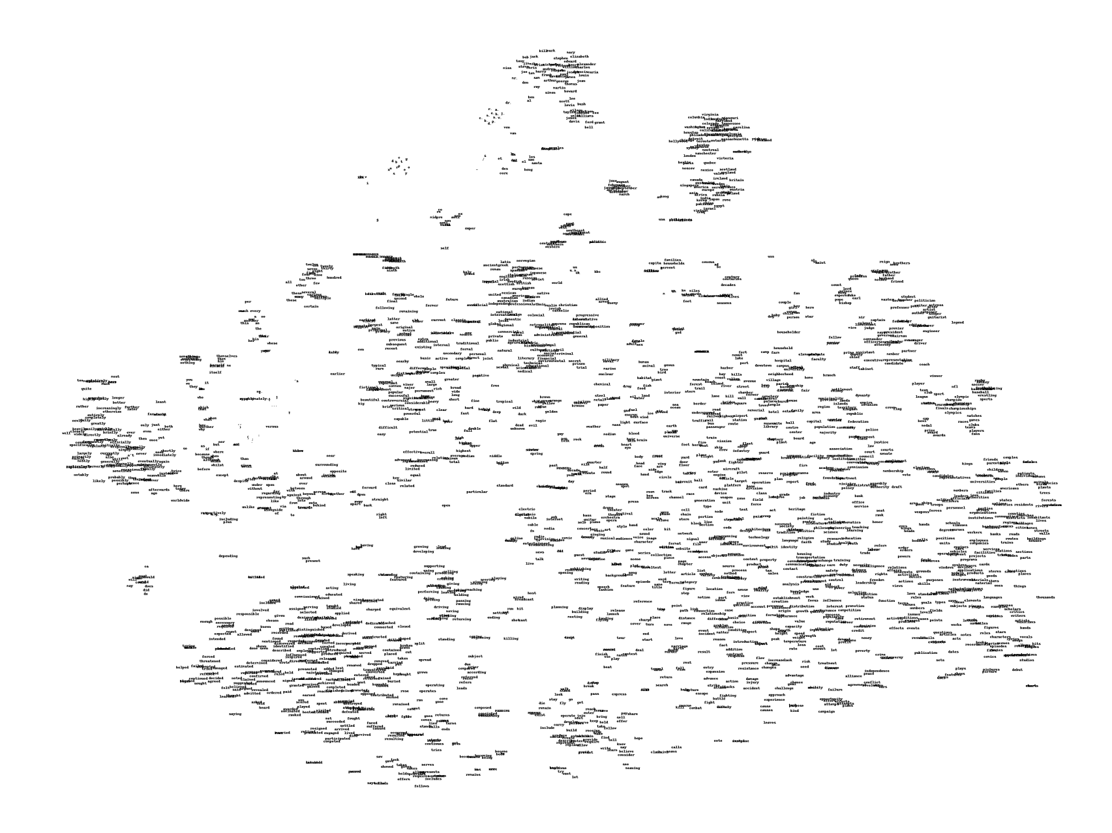
Embedding words
Slide Credit: Carlos Guestrin
67
[Joseph Turian]

Slide 68
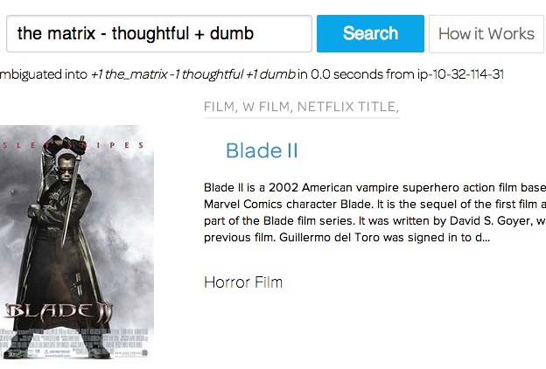
ThisPlusThat.me
Image Credit:
http://insightdatascience.com/blog/thisplusthat_a_search_engine_that_lets_you_add_words_as_vectors.html

Slide 69
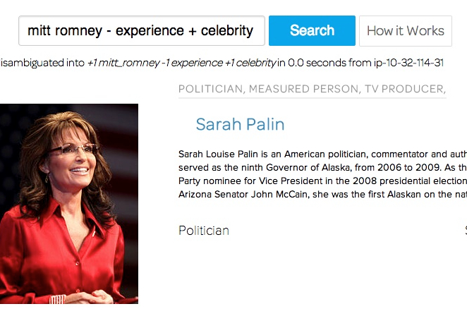
ThisPlusThat.me
Image Credit:
http://insightdatascience.com/blog/thisplusthat_a_search_engine_that_lets_you_add_words_as_vectors.html

Slide 70
Reinforcement Learning
Learning from feedback
x
Reinforcement Learning
y
Actions

Slide 71
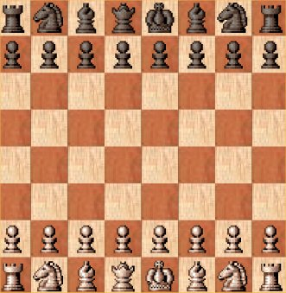
Reinforcement Learning: Learning to act
There is only one “supervised” signal at the end of the game.
But you need to make a move at every step
RL deals with “credit assignment”
Slide Credit: Fei Sha

Slide 72
Learning to act
Reinforcement learning
An agent
  Makes sensor observations
  Must select action
  Receives rewards
    positive for “good” states
    negative for “bad” states
Towel Folding
  http://youtu.be/gy5g33S0Gzo

Slide 73
Course Information
Instructor: Dhruv Batra
  dbatra@vt
  Office Hours: Fri 3-4pm
  Location: 468 Whittemore
TA: TBD

Slide 74
Syllabus
Basics of Statistical Learning
    Loss functions, MLE, MAP, Bayesian estimation, bias-variance tradeoff, overfitting, regularization, cross-validation
Supervised Learning
    Nearest Neighbour, Naïve Bayes, Logistic Regression, Support Vector Machines, Kernels, Neural Networks, Decision Trees
    Ensemble Methods: Bagging, Boosting
Unsupervised Learning
    Clustering: k-means, Gaussian mixture models, EM
    Dimensionality reduction: PCA, SVD, LDA
Advanced Topics
    Weakly-supervised and semi-supervised learning
    Reinforcement learning
    Probabilistic Graphical Models: Bayes Nets, HMM
    Applications to Vision, Natural Language Processing

Slide 75
Syllabus
You will learn about the methods you heard about
But we are not teaching “how to use a toolbox”
You will understand algorithms, theory, applications, and implementations
It’s going to be FUN and HARD WORK ☺

Slide 76
Prerequisites
Probability and Statistics
  Distributions, densities, Moments, typical distributions
Calculus and Linear Algebra
  Matrix multiplication, eigenvalues, positive semi-definiteness, multivariate derivates…
Algorithms
  Dynamic programming, basic data structures, complexity (NP-hardness)…
Programming
  Matlab for HWs. Your language of choice for project.
  NO CODING / COMPILATION SUPPORT
Ability to deal with abstract mathematical concepts
We provide some background, but the class will be fast paced

Slide 77
Textbook
No required book.
  We will assign readings from online/free books, papers, etc
Reference Books:
  [On Library Reserve]
  Machine Learning: A Probabilistic Perspective
  Kevin Murphy
  [Free PDF from author’s webpage]
  Bayesian reasoning and machine learning
  David Barber
  http://web4.cs.ucl.ac.uk/staff/D.Barber/pmwiki/pmwiki.php?n=Brml.HomePage
  Pattern Recognition and Machine Learning
  Chris Bishop

Slide 78
Grading
4 homeworks (40%)
  First one goes out Jan 28
    Start early, Start early, Start early, Start early, Start early, Start early, Start early, Start early, Start early, Start early
Final project (25%)
  Details out around Feb 9
  Projects done individually, or groups of two students
Midterm (10%)
  Date TBD in class
Final (20%)
  TBD
Class Participation (5%)
  Contribute to class discussions on Scholar
  Ask questions, answer questions

Slide 79
Re-grading Policy
Homework assignments and midterm
  Within 1 week of receiving grades: see me
  No change after that.
Reasons are not accepted for re-grading
  I cannot graduate if my GPA is low or if I fail this class.
  I need to upgrade my grade to maintain/boost my GPA.
  This is the last course I have taken before I graduate.
  I have a deadline before the homework/project/midterm.
  I have done well in other courses / I am a great programmer/theoretician

Slide 80
Spring 2013 Grades
A
A-
B+
B
B-

Slide 81
Fall 2013 Grades
A
A-
B+
B
B-
C

Slide 82
Homeworks
Homeworks are hard, start early!
  Due in 2 weeks via Scholar (Assignments tool)
  Theory + Implementation
  Kaggle Competitions:
    http://inclass.kaggle.com/c/vt-ece-machine-learning-perception-hw-3
“Free” Late Days
  5 late days for the semester
    Use for HW, project proposal/report
    Cannot use for HW0, midterm or final exam, or poster session
  After free late days are used up:
    25% penalty for each late day

Slide 83
HW0
Out today; due Monday (1/23)
  Available on scholar
Grading
  Does not count towards grade.
  BUT Pass/Fail.
  <=75% means that you might not be prepared for the class
Topics
  Probability
  Linear Algebra
  Calculus
  Ability to prove

Slide 84
Project
Goal
  Chance to explore Machine Learning
  Can combine with other classes
    get permission from both instructors; delineate different parts
  Extra credit for shooting for a publication
Main categories
  Application/Survey
    Compare a bunch of existing algorithms on a new application domain of your interest
  Formulation/Development
    Formulate a new model or algorithm for a new or old problem
  Theory
    Theoretically analyze an existing algorithm

Slide 85
Project
For graduate students [5424G]
    Encouraged to apply ML to your research (aerospace, mechanical, UAVs, computational biology…)
    Must be done this semester. No double counting.
For undergraduate students [4424]
    Chance to implement something
    No research necessary. Can be an implementation/comparison project.
    E.g. write an iphone app (predict activity from GPS/gyro data).
Support
  We will give a list of ideas, points to dataset/algorithms/code
  Mentor teams and give feedback.

Slide 86
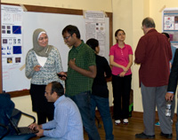
Spring 2013 Projects
Poster/Demo Session

Slide 87
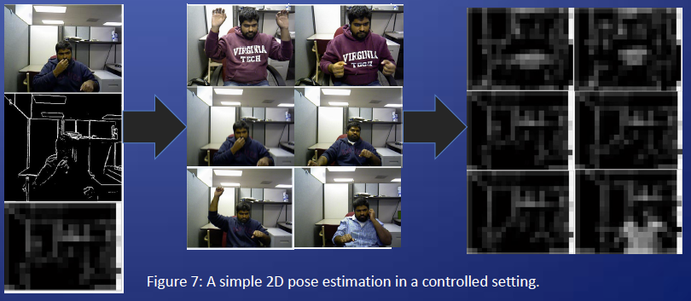
Spring 2013 Projects
Gesture Activated Interactive Assistant
  Gordon Christie & Ujwal Krothpalli, Grad Students
  http://youtu.be/VFPAHY7th9A?t=42s

Slide 88
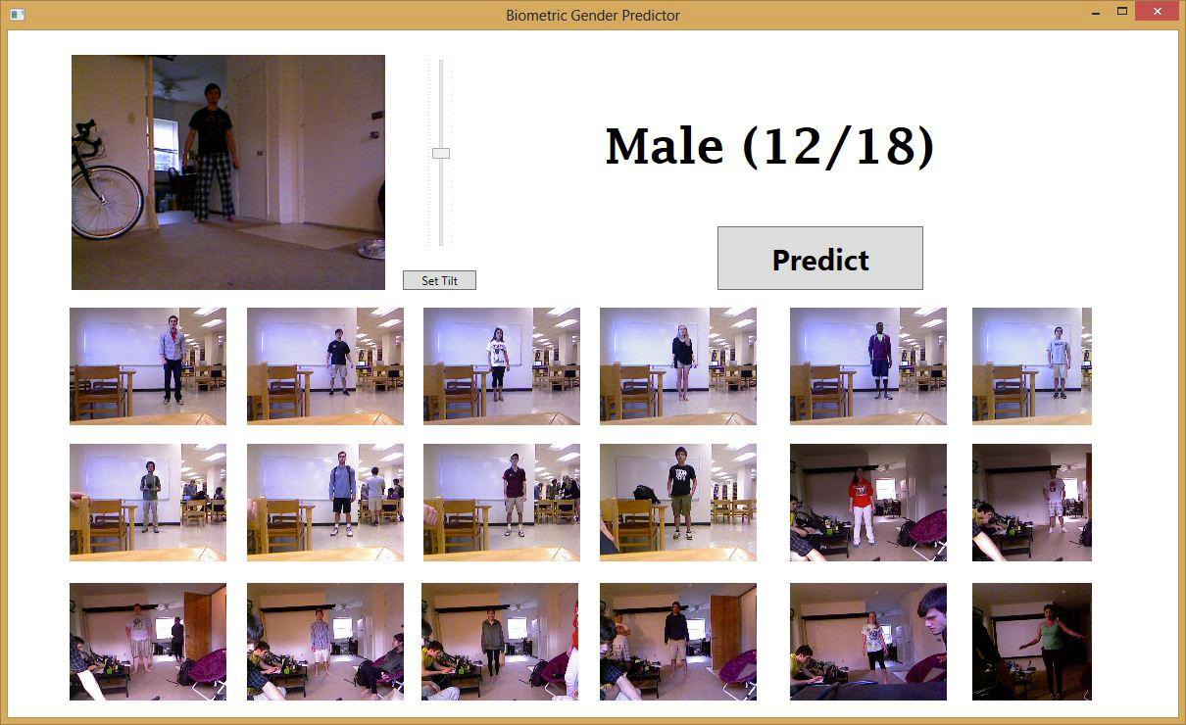
Spring 2013 Projects
Gender Classification from body proportions
  Igor Janjic & Daniel Friedman, Juniors

Slide 89
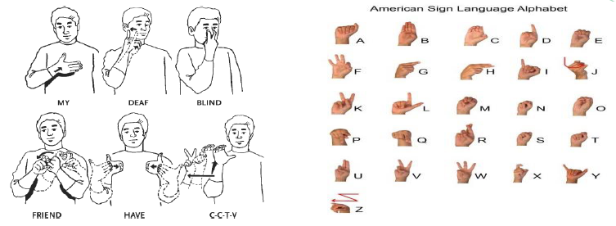
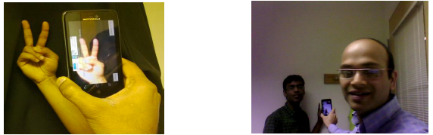
Spring 2013 Projects
American Sign Language Detection
  Vireshwar Kumar & Dhiraj Amuru, Grad Students

Slide 90
Collaboration Policy
Collaboration
  Only on HW and project (not allowed in exams & HW0).
  You may discuss the questions
  Each student writes their own answers
  Write on your homework anyone with whom you collaborate
  Each student must write their own code for the programming part
Zero tolerance on plagiarism
  Neither ethical nor in your best interest
  Always credit your sources
  Don’t cheat. We will find out.

Slide 91
Waitlist / Audit / Sit in
Waitlist
  Do HW0. Come to first few classes.
  Let’s see how many people drop.
  Remember: Offered again next year.
Audit
  Can’t audit Special Studies.
  Once we get a permanent number:
  Do enough work (your choice) to get 50% grade.
Sitting in
  Talk to instructor.

Slide 92
Communication Channels
Primary means of communication -- Scholar Forum
  No direct emails to Instructor unless private information
  Instructor can mark/provide answers to everyone
  Class participation credit for answering questions!
  No posting answers. We will monitor.
Class websites:
  https://scholar.vt.edu/portal/site/s15ece5984
  https://filebox.ece.vt.edu/~s15ece5984/
Office Hours

Slide 93
How to do well in class?
Come to class!
  Sit in front; ask question
  This is the most important thing you can do
One point
  No laptops or screens in class

Slide 94
Other Relevant Classes
Intro to Artificial Intelligence (CS 5804)
  Instructor: Bert Huang
  Offered: Spring
Convex Optimization (ECE 5734)
  Instructor: MH Farhood
  Offered: Spring
Data Analytics (CS 5526)
  Instructor: Naren Ramakrishnan
  Offered: Spring
Advanced Machine Learning (ECE 6504)
  Instructor: Dhruv Batra
  Offered: Spring
Computer Vision (ECE 5554)
  Instructor: Devi Parikh
  Offered: Fall
Advanced Computer Vision (ECE 6504)
  Instructor: Devi Parikh
  Offered: Spring

Slide 95
Todo
HW0
  Due Friday 11:55pm
Readings
  Probability Refresher: Barber Chap 1
  Overview of ML: Barber Section 13.1

Slide 96

Welcome

