Slide 1
ECE 5984: Introduction to
Machine Learning
Topics:
  SVM
    Multi-class SVMs
  Neural Networks
    Multi-layer Perceptron
Readings: Barber 17.5, Murphy 16.5
Dhruv Batra
Virginia Tech

Slide 2
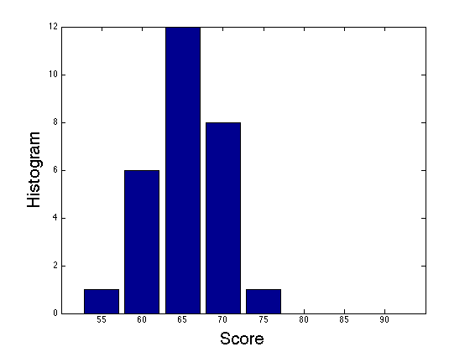
HW2 Graded
Mean 66/61 = 108%
  Min: 47
  Max: 75

Slide 3
Administrativia
HW3
  Due: in 2 weeks
  You will implement primal & dual SVMs
  Kaggle competition: Higgs Boson Signal vs Background classification
  https://inclass.kaggle.com/c/2015-Spring-vt-ece-machine-learning-hw3
  https://www.kaggle.com/c/higgs-boson

Slide 4
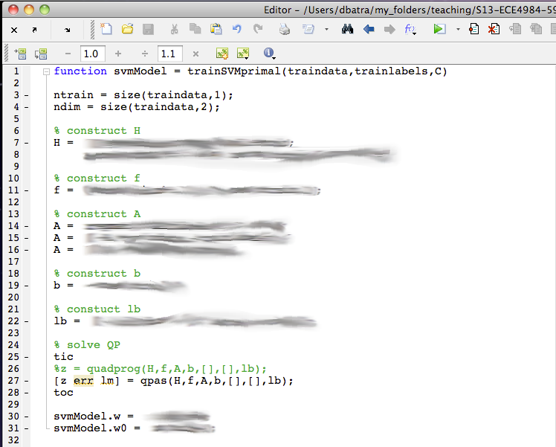
Administrativia

Slide 5
Administrativia
Project Mid-Sem Spotlight Presentations
  Friday: 5-7pm, Whittemore 654
  5 slides (recommended)
  4 minute time (STRICT) + 1-2 min Q&A
  Tell the class what you’re working on
  Any results yet?
  Problems faced?
  Upload slides on Scholar

Slide 6
Recap of Last Time

Slide 7
Linear classifiers – Which line is better?
w.x = ∑_{j} w^{(j)} x^{(j)}

Slide 8
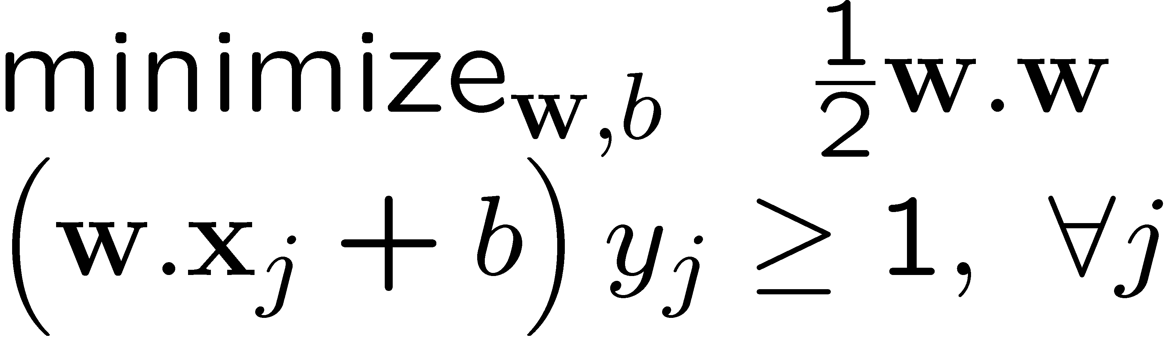
Dual SVM derivation (1) – the linearly separable case
Slide Credit: Carlos Guestrin

Slide 9
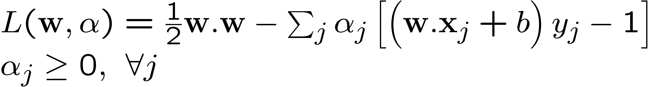
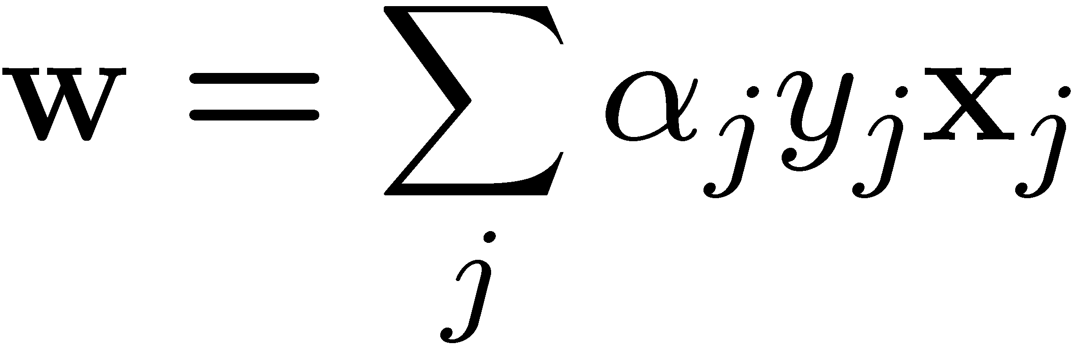
Dual SVM derivation (1) – the linearly separable case
Slide Credit: Carlos Guestrin

Slide 10
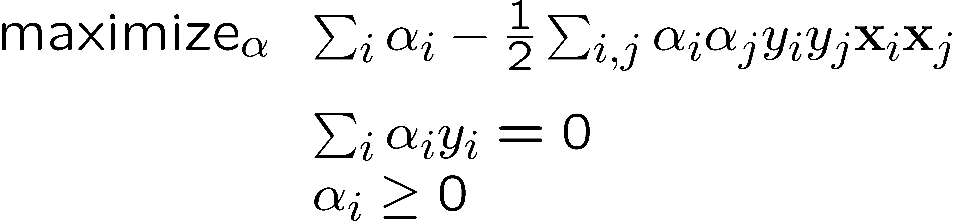
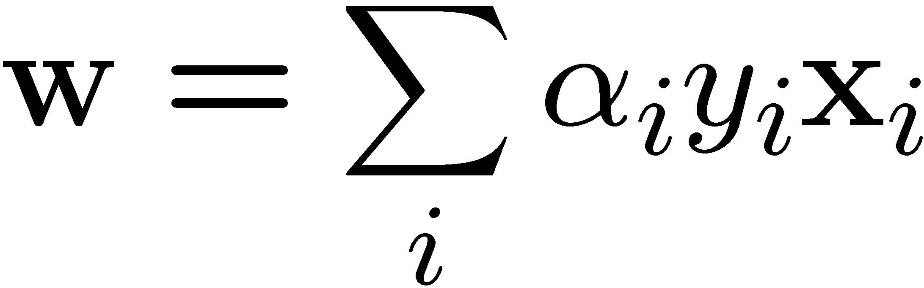
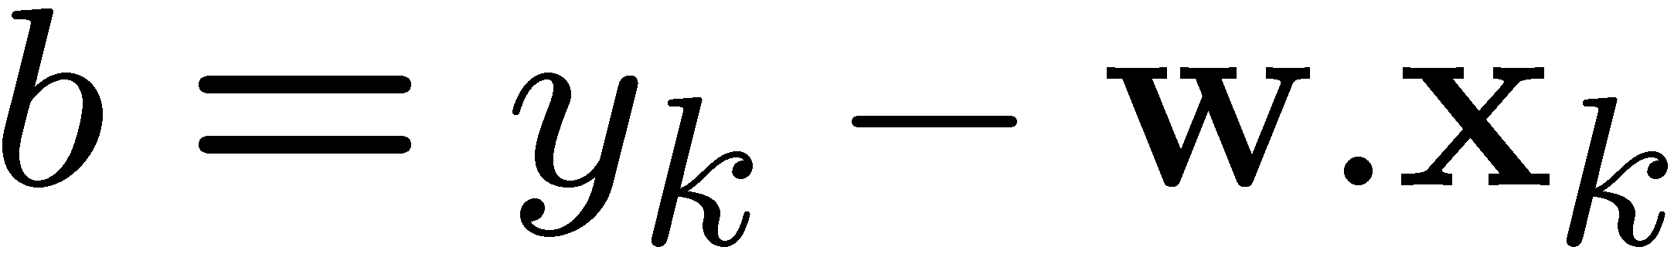
Dual SVM formulation – the linearly separable case
Slide Credit: Carlos Guestrin

Slide 11
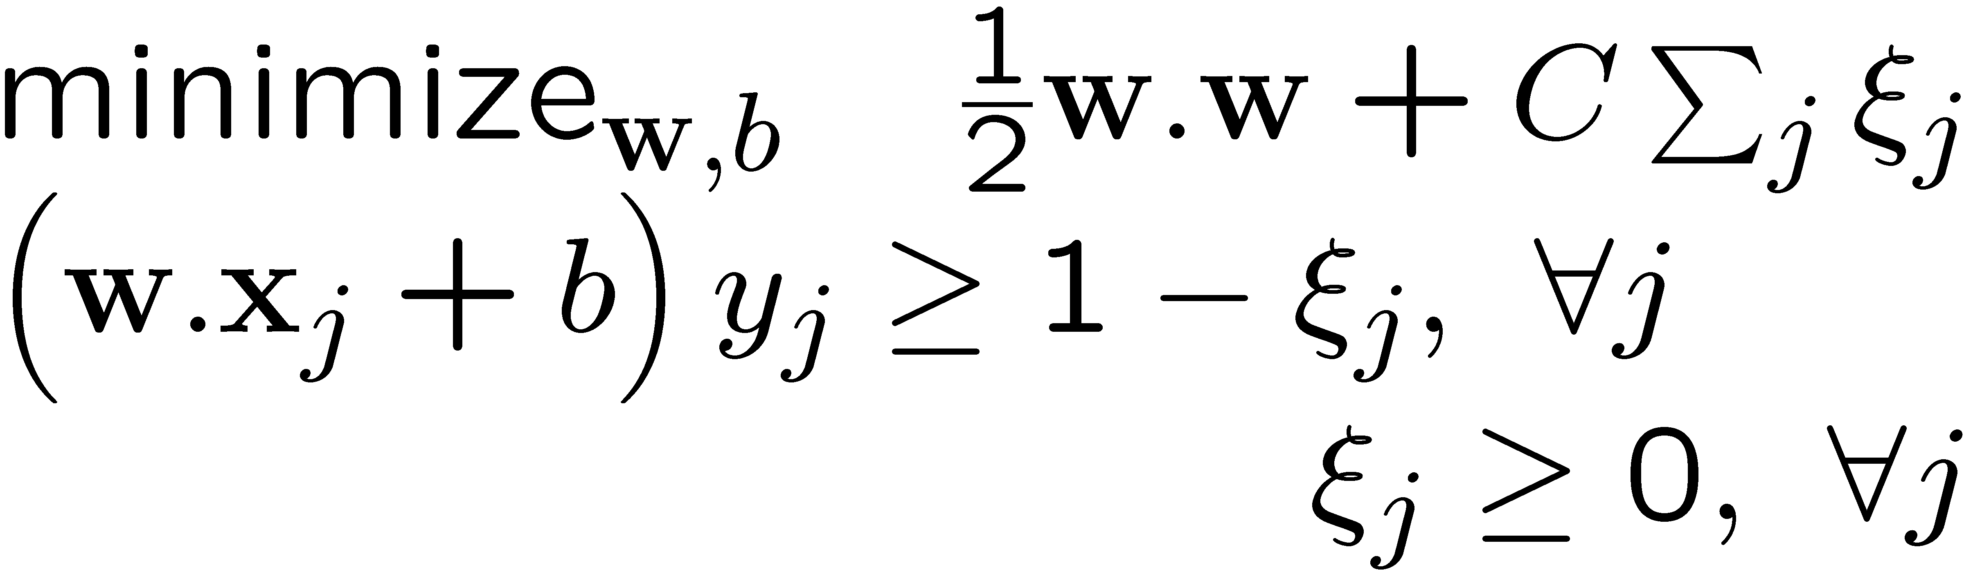
Dual SVM formulation – the non-separable case
Slide Credit: Carlos Guestrin

Slide 12
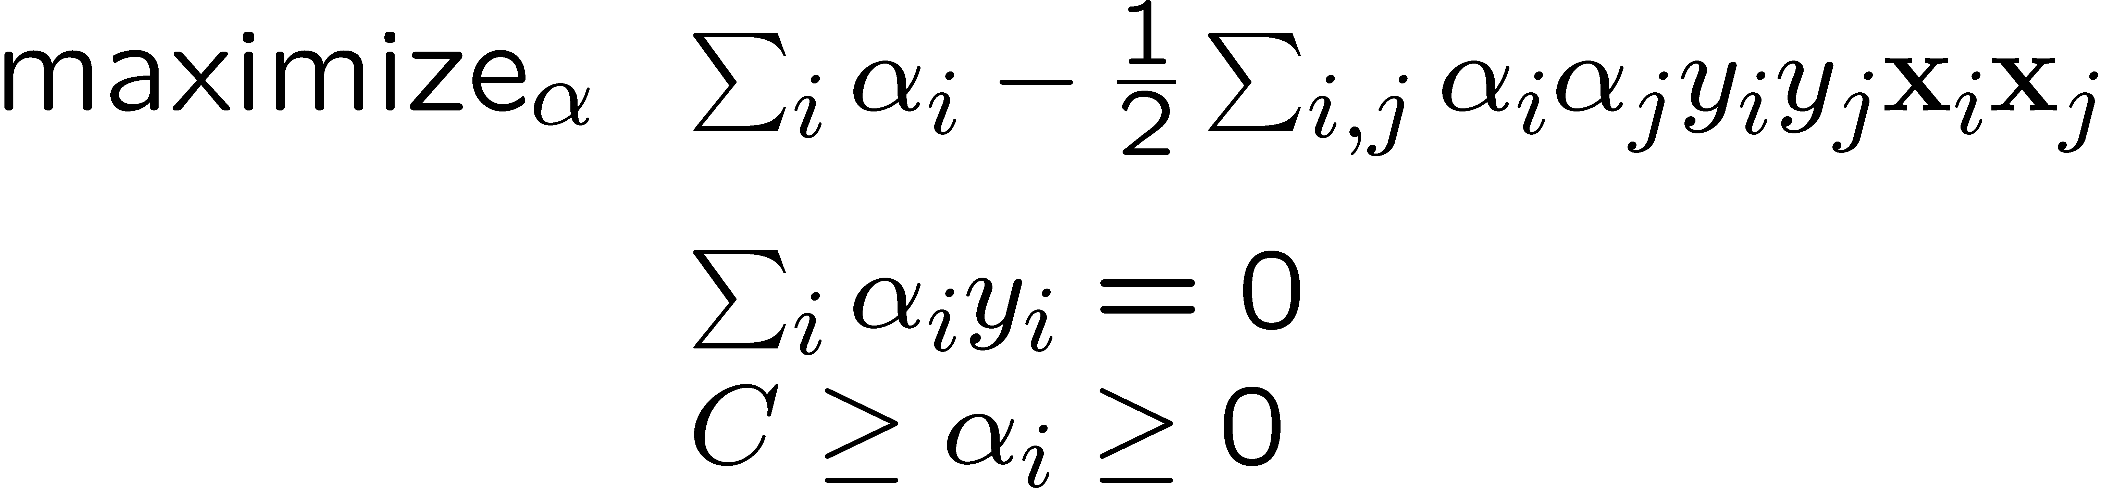
Dual SVM formulation – the non-separable case
Slide Credit: Carlos Guestrin

Slide 13
Why did we learn about the dual SVM?
Builds character!
Exposes structure about the problem
There are some quadratic programming algorithms that can solve the dual faster than the primal
The “kernel trick”!!!
Slide Credit: Carlos Guestrin

Slide 14
Dual SVM interpretation: Sparsity
w.x + b = +1
w.x + b = 0
w.x + b = -1
margin 2γ
Slide Credit: Carlos Guestrin

Slide 15
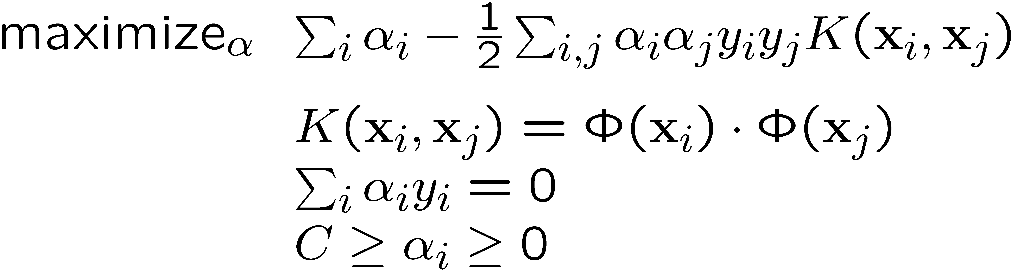
Dual formulation only depends on dot-products, not on w!

Slide 16
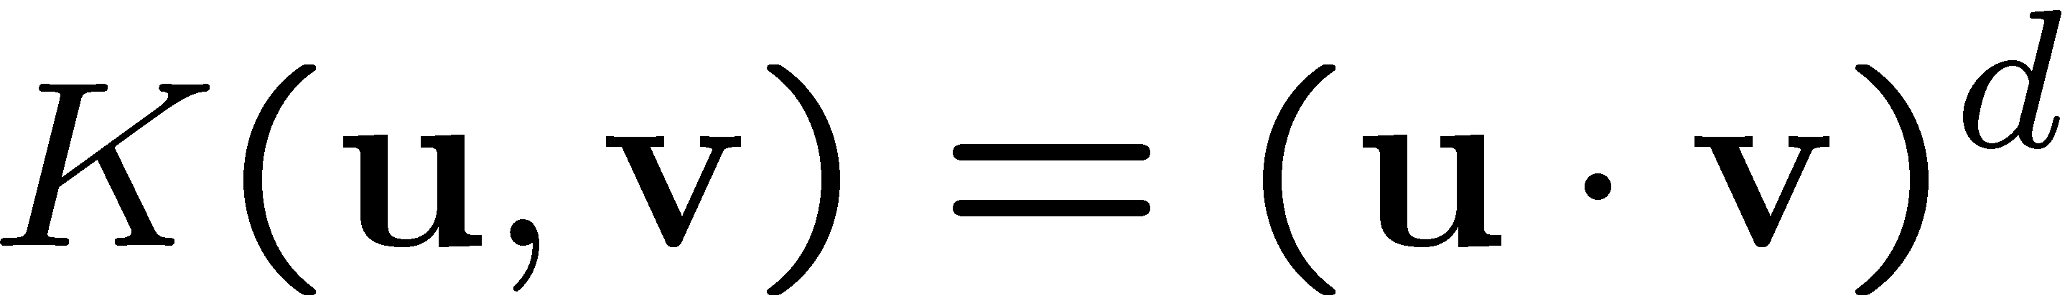
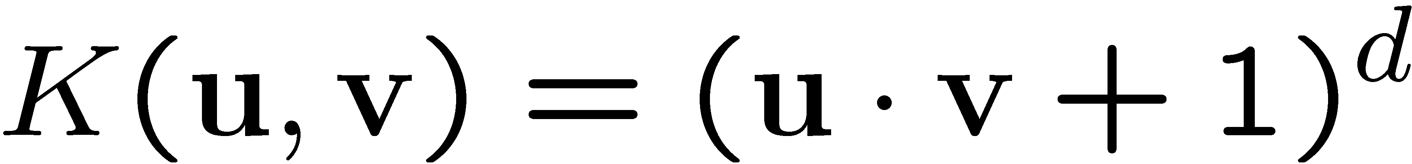
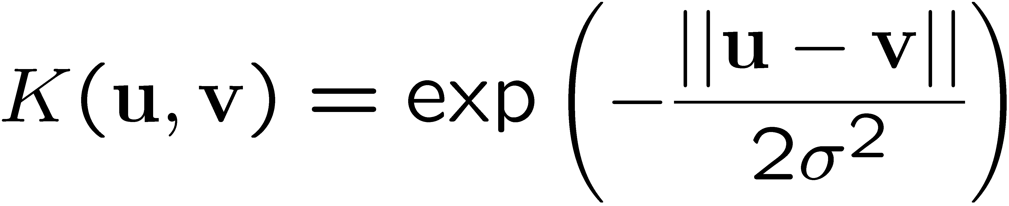
Common kernels
Polynomials of degree d
Polynomials of degree up to d
Gaussian kernel / Radial Basis Function
Sigmoid
2
Slide Credit: Carlos Guestrin

Slide 17
Plan for Today
SVMs
  Multi-class
Neural Networks

Slide 18
What about multiple classes?
Slide Credit: Carlos Guestrin

Slide 19
One against All (Rest)
y2 Not y2
Learn N classifiers:
y1
Not y1
Noty3 y3
Slide Credit: Carlos Guestrin

Slide 20
One against One
Learn N-choose-2 classifiers:
y2 y1
y1 y3
y2 y3
Slide Credit: Carlos Guestrin

Slide 21
Problems
Image Credit: Kevin Murphy

Slide 22
Learn 1 classifier: Multiclass SVM
Simultaneously learn 3 sets of weights
Slide Credit: Carlos Guestrin

Slide 23
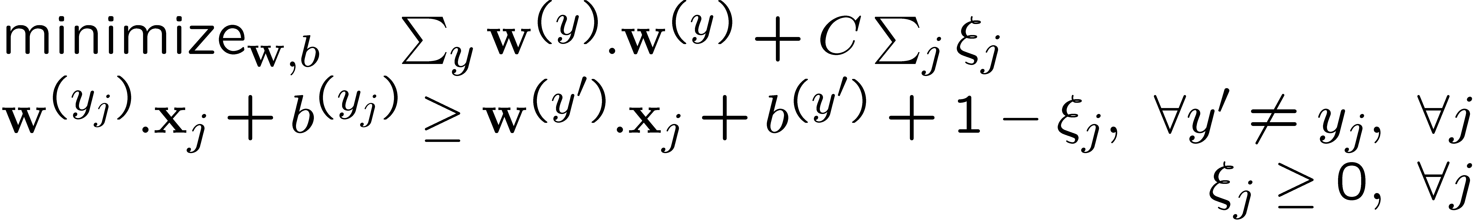
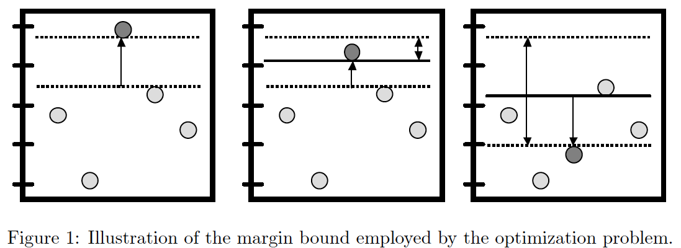
Learn 1 classifier: Multiclass SVM
Slide Credit: Carlos Guestrin

Slide 24
Not linearly separable data
Some datasets are not linearly separable!
  http://www.eee.metu.edu.tr/~alatan/Courses/Demo/AppletSVM.html

Slide 25
Addressing non-linearly separable data – Option 1, non-linear features
Choose non-linear features, e.g.,
  Typical linear features: w₀ + ∑_{i} w_{i} x_{i}
  Example of non-linear features:
    Degree 2 polynomials, w₀ + ∑_{i} w_{i} x_{i} + ∑_{ij} w_{ij} x_{i} x_{j}
Classifier h_{w}(x) still linear in parameters w
  As easy to learn
  Data is linearly separable in higher dimensional spaces
  Express via kernels
Slide Credit: Carlos Guestrin

Slide 26
Addressing non-linearly separable data – Option 2, non-linear classifier
Choose a classifier h_{w}(x) that is non-linear in parameters w, e.g.,
  Decision trees, neural networks,…
More general than linear classifiers
But, can often be harder to learn (non-convex optimization required)
Often very useful (outperforms linear classifiers)
In a way, both ideas are related
Slide Credit: Carlos Guestrin

Slide 27
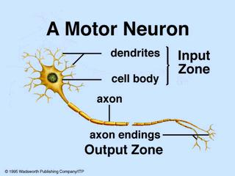
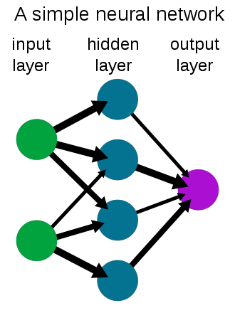
New Topic: Neural Networks

Slide 28
Synonyms
Neural Networks
Artificial Neural Network (ANN)
Feed-forward Networks
Multilayer Perceptrons (MLP)
Types of ANN
  Convolutional Nets
  Autoencoders
  Recurrent Neural Nets
[Back with a new name]: Deep Nets / Deep Learning

Slide 29
Biological Neuron

Slide 30
Artificial “Neuron”
Perceptron (with step function)
Logistic Regression (with sigmoid)

Slide 31
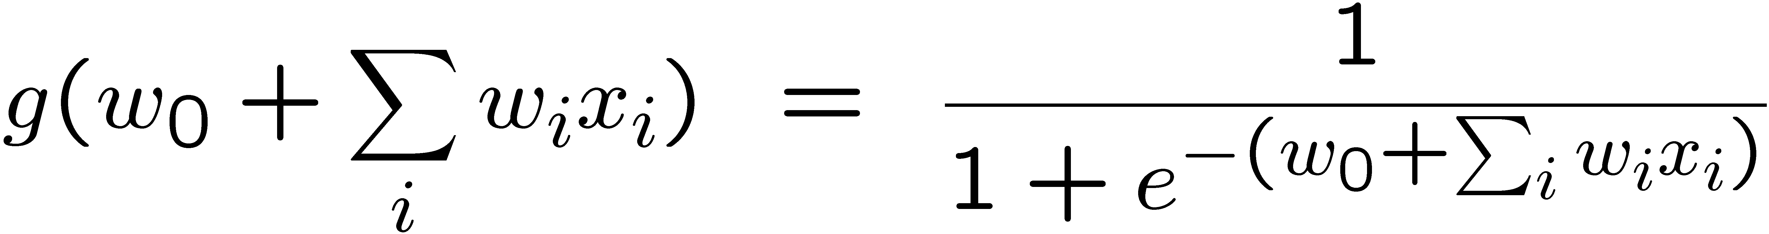
Sigmoid
w₀=2, w₁=1
w₀=0, w₁=1
w₀=0, w₁=0.5
Slide Credit: Carlos Guestrin

Slide 32
Many possible response functions
Linear
Sigmoid
Exponential
Gaussian
…

Slide 33
Limitation
A single “neuron” is still a linear decision boundary
What to do?

Slide 34
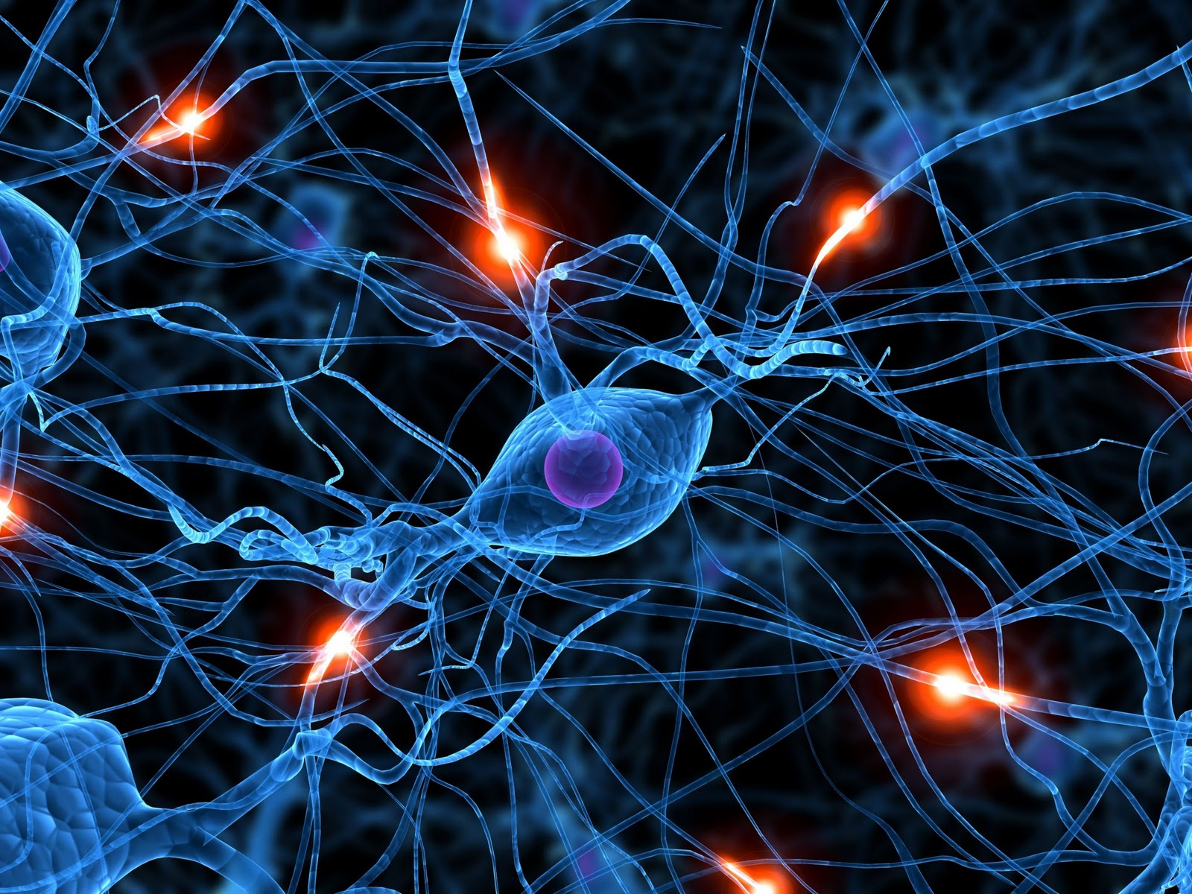

Slide 35
Limitation
A single “neuron” is still a linear decision boundary
What to do?
Idea: Stack a bunch of them together!

Slide 36
Hidden layer
1-hidden layer (or 3-layer network):
  On board

Slide 37
Neural Nets
Best performers on OCR
  http://yann.lecun.com/exdb/lenet/index.html
NetTalk
  Text to Speech system from 1987
  http://youtu.be/tXMaFhO6dIY?t=45m15s
Rick Rashid speaks Mandarin
  http://youtu.be/Nu-nlQqFCKg?t=7m30s

Slide 38
Universal Function Approximators
Theorem
  3-layer network with linear outputs can uniformly approximate any continuous function to arbitrary accuracy, given enough hidden units [Funahashi ’89]

Slide 39
Neural Networks
Demo
  http://neuron.eng.wayne.edu/bpFunctionApprox/bpFunctionApprox.html

