Slide 1
Global and high-level image descriptions
Present by Yao Pan

Slide 2
Low-level descriptor
Pixel
Patch
Mathematical transformation (Laplace,Gauss) of pixel and patch(SIFT,GIST…)
Notes:
It’s like understanding 26 alphabeta does not enable you to understand english

Slide 3
Object Recognition Scene classification
High Level Task:
Semantic Gap
Low Level
image feature
Pixel intensity, gradient

Slide 4
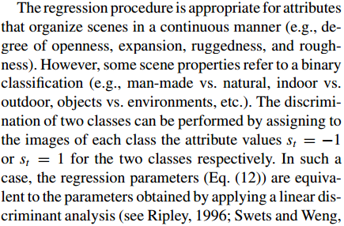
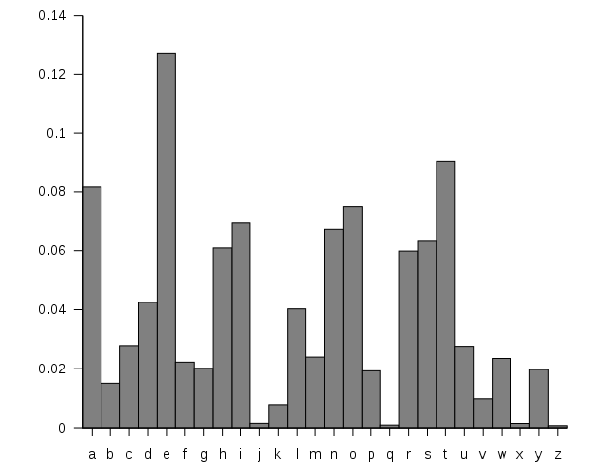
Analogy to text analysis
We want to classify which author write this article?
Or what type of content(science, politics, entertainment)?
Meaning group
Sentence
phrase
word
Letter frequency
Letter frequency
Notes:
It’s like understanding 26 alphabeta does not enable you to understand english
We don’t count the letter frequency to tell whether this paragraph is written by someone or not.

Slide 5
Modeling the shape of the scene: a Holistic Representation of the Spatial Envelope A. Oliva and A. Torralba. IJCV 2001 Eﬃcient Object Category Recognition Using Classemes Lorenzo Torresani, Martin Szummer, Andrew Fitzgibbon. ECCV 2010 Objects as Attributes for Scene Classification Li-Jia Li*, Hao Su*, Yongwhan Lim, Li Fei-Fei. ECCV 2010 Object Bank: A High-Level Image Representation for Scene Classiﬁcation & Semantic Feature Sparsiﬁcation L-J. Li, H. Su, E. Xing, L. Fei-Fei. NIPS 2010
Overview
Notes:
Some researchers tries to jump out of the existing framework and propose some global and high-level descriptors to bridge the semantic gap

Slide 6
Modeling the shape of the scene: a Holistic Representation of the Spatial Envelope
A. Oliva and A. Torralba. IJCV 2001

Slide 7
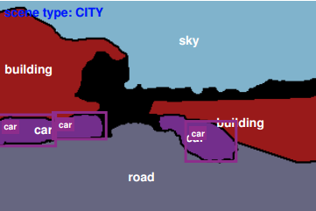
Modeling the shape of the scene: a Holistic Representation of the Spatial Envelope
Motivation
Scene Categorization
One way of doing this is: segment and detect the objects in the picture. Classify the scene according to which objects the picutre contains.
But, segmentation and object detection are hard problems.
Picture from: J. Yao, S. Fidler and R. Urtasun
Notes:
This strategy works in some cases but the problem is
Is there any way to get round this problem?

Slide 8
Modeling the shape of the scene: a Holistic Representation of the Spatial Envelope
Motivation
Experiment in Cognitive Psychology
Mary C.Potter, 1975, science
Subjects were presented a target scene picture or a scene name beforehand
Then they were presented a sequence of pictures at rates up to 8 per second. They were asked to press the button when they saw the target.
Detection rate are surprising high (more than 90%).

Slide 9
Modeling the shape of the scene: a Holistic Representation of the Spatial Envelope
Motivation
Subsequent experiment implies that object information might be ignored during rapid categorization of scene.
Human are using some holistic visual features(spatial layout, spatial structure, shape of scene...).
In this paper, the author terms them as Spatial Envelope.
Scenes belonging to same category share similar spatial structure that can be extracted without segmentating the image.

Slide 10
Modeling the shape of the scene: a Holistic Representation of the Spatial Envelope
Approach
What is scene?
Traditionally: unconstrained configuration of objects.
In this paper: treat it as an individual object.

Slide 11
Modeling the shape of the scene: a Holistic Representation of the Spatial Envelope
What exactly is spatial envelope?
Spatial Envelope Properties
Naturalness
Straight horizontal and vertical line in man-made scene vs. textured zone of natural landscape.
Openness
Roughness
Expansion
Ruggedness
Finding a low-dimensional scene space that scenes of same category are projected together.
Notes:
5 dimensional space scene is clustered in that space
To get a more intuitive understanding of these properites

Slide 12
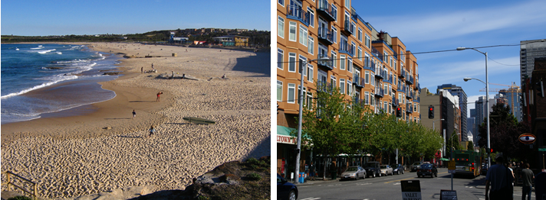
Modeling the shape of the scene: a Holistic Representation of the Spatial Envelope
Naturalness
Natural vs. man-made
Slides credit: scene understanding seminar
Notes:
Man-made: More horizontal or vertical straight line

Slide 13
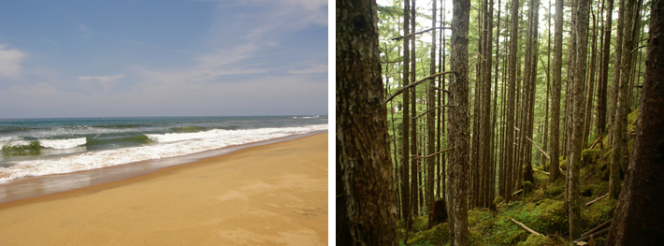
Modeling the shape of the scene: a Holistic Representation of the Spatial Envelope
Openness
Decrease as number of boundary increases
Slides credit: scene understanding seminar
Notes:
5 dimensional space scene is clustered in that space

Slide 14
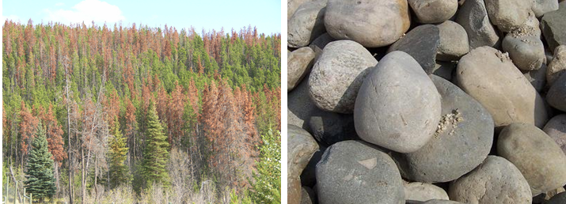
Modeling the shape of the scene: a Holistic Representation of the Spatial Envelope
Roughness
Size of elements at each spatial scale
Slides credit: scene understanding seminar
Notes:
Roughness: 粗糙
5 dimensional space scene is clustered in that space

Slide 15
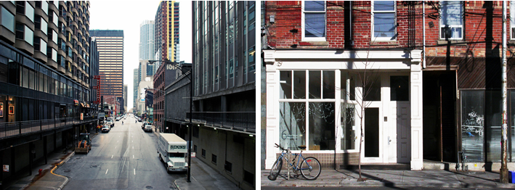
Modeling the shape of the scene: a Holistic Representation of the Spatial Envelope
Expansion(mainly for man-made scene)
A ﬂat view of a building would have a low degree of Expansion. A street with long vanishing lines would have a high degree of Expansion.
Slides credit: scene understanding seminar
Notes:
If you are familiar with painting
Painting before middle ages flat
Renaissance
A ﬂat view of a building would have a low degree of Expansion.
On the contrary, a street with long vanishing lines
would have a high degree of Expansion

Slide 16
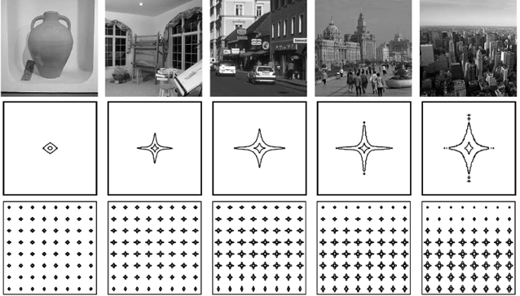
Modeling the shape of the scene: a Holistic Representation of the Spatial Envelope
Expansion
Follow up:
Depth estimation from image structure A. Torralba, A. Oliva, 2003
Notes:
Flat

Slide 17
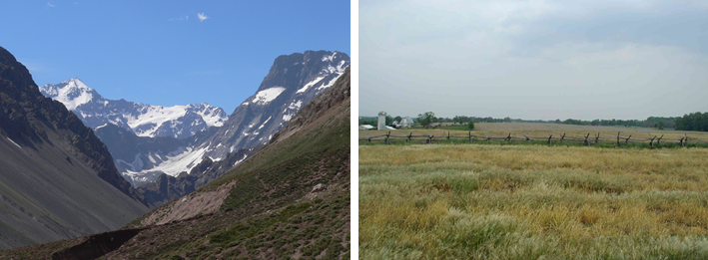
Modeling the shape of the scene: a Holistic Representation of the Spatial Envelope
Ruggedness (mainly for natural scene)
Deviation of ground relative to horizon
Slides credit: scene understanding seminar
Notes:
A rugged environment produces
oblique contours in the picture and hides the horizon
line

Slide 18
Modeling the shape of the scene: a Holistic Representation of the Spatial Envelope
Approach
How to translate these abstract concept to computable mathematical values?
Discrete Fourier transform(DFT)
Windowed DFT
PCA

Slide 19
Modeling the shape of the scene: a Holistic Representation of the Spatial Envelope
Approach
Discrete Fourier transform(DFT)
DFT of an image:
Where i(x,y) is the intensity distribution
Notes:
What is the Fourier transform of an image? Repeated pattern

Slide 20
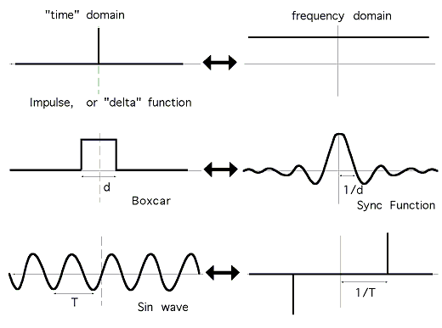
Modeling the shape of the scene: a Holistic Representation of the Spatial Envelope
What is the fourier transform of an image?
Fourier transform of signal
Fourier transform of an image
Original image
Fourier transform(amplitude spectrum)
Notes:
What is the Fourier transform of an image? Repeated pattern
原点： original point
Bright color in frequency image is
Around center: high frequency
Brightness means gradient

Slide 21
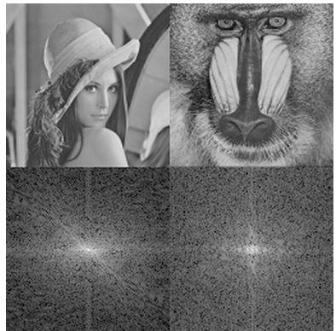
Modeling the shape of the scene: a Holistic Representation of the Spatial Envelope
Fourier transform of an image
Polar form:
Original points represent DC(zeros frequency)
Notes:
What is the Fourier transform of an image? Repeated pattern

Slide 22
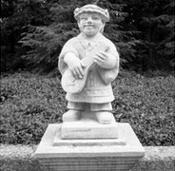
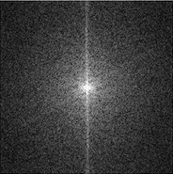
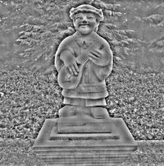
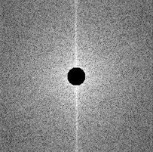
Modeling the shape of the scene: a Holistic Representation of the Spatial Envelope
Fourier transform of an image
Keep low frequency only
Lost image detail
Keep high frequency only
Lost gradient
Notes:
What is the Fourier transform of an image? Repeated pattern

Slide 23
Modeling the shape of the scene: a Holistic Representation of the Spatial Envelope
Approach
Different scene categories have different spectral signatures
Amplitude captures roughness
Orientation captures dominant edges
Notes:
What is the Fourier transform of an image? Repeated pattern

Slide 24
Modeling the shape of the scene: a Holistic Representation of the Spatial Envelope
Experiment
8 categories.
Natural: Coast, Country, Forest, Mountain
Man-made: Highway, Street, Close-up, Tall building
Choose 400 target images from database with first 7 neighbors for each.
Neighbors are define as Euclidean distance between attributes

Slide 25
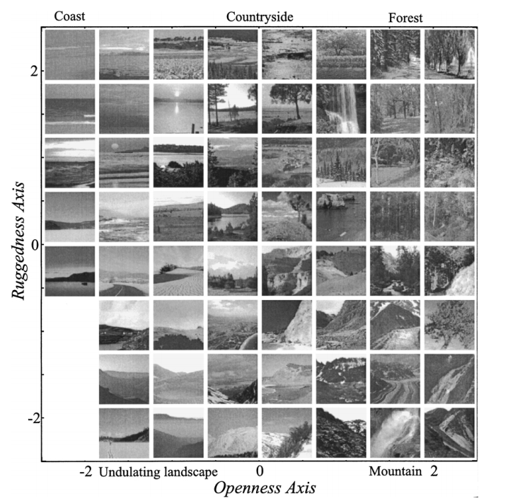
Modeling the shape of the scene: a Holistic Representation of the Spatial Envelope

Slide 26
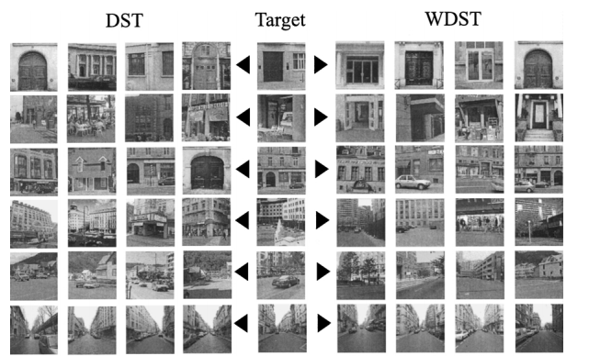
Modeling the shape of the scene: a Holistic Representation of the Spatial Envelope
Experiment
Scenes were considered correctly recognized when at least 4 neighbors having same category membership.

Slide 27
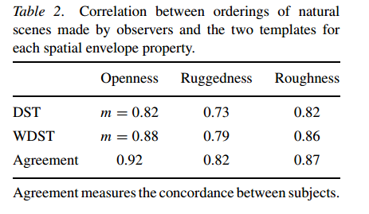
Modeling the shape of the scene: a Holistic Representation of the Spatial Envelope
Experiment

Slide 28
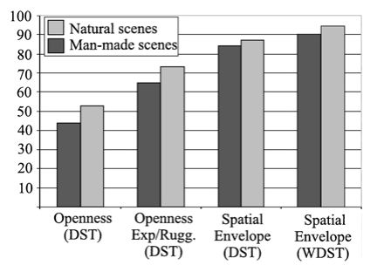
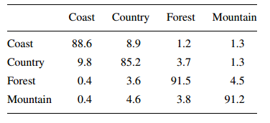
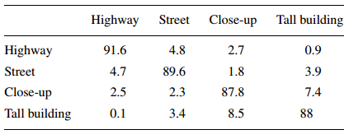
Modeling the shape of the scene: a Holistic Representation of the Spatial Envelope
Experiment
Confusion matrix for natural scene
Confusion matrix for man-made scene
Average Accuracy:
WDST: 92%
DST: 86%

Slide 29
Modeling the shape of the scene: a Holistic Representation of the Spatial Envelope
Limitation
Primarily for man-made vs. natural differences.
Coarse-grained classification

Slide 30
Eﬃcient Object Category Recognition Using Classemes Lorenzo Torresani, Martin Szummer, Andrew Fitzgibbon

Slide 31
Eﬃcient Object Category Recognition Using Classemes
Motivation
Large-scale object category recognition
Requirement:
Novel category
Zero-shot learning: Possible category does not appear in training example. Countless object category, it is impossible to cover all in training dataset.
Compact descriptor
Disk vs. memory
Simple classifier
Notes:
The reason zero-shot learning is extrememly important in computer vision is there are
tens of thousands of objects which we might want a computer to recognize.

Slide 32
Eﬃcient Object Category Recognition Using Classemes
Motivation
Existing system:
Attribute approach
Categories are described by a set of boolean attributes
 | Has beak | Has tail | Near water
duck | √ | × | √
Drawback：Need human to label the training data.
Some categories are hard to extract attribute.

Slide 33
Eﬃcient Object Category Recognition Using Classemes
Approach
Classeme
Represent object as a combination of other object classes (classeme) to which they are related.
These classeme are extracted automatically and do not necessarily contain semantic meaning.
Notes:
One interesting experiment the author should conduct is how the choose of category influence the final result.
Whether this algorithm is sensitive to this.

Slide 34
Eﬃcient Object Category Recognition Using Classemes
Approach
Classeme Learning
Choose a set of category label from Large Scale Concept Ontology for Multimedia. C=2659 categories in total
Learn a One-versus-all classifier (by Multiple Kernel learning)
For image x, it is represented as a vector
To achieve compactness, vector is not stored in double precision, but quantized to Q levels (1bit to 4 bit).
After getting the representation, apply classification method such as SVM…
Notes:
One interesting experiment the author should conduct is how the choose of category influence the final result.
Whether this algorithm is sensitive to this.

Slide 35
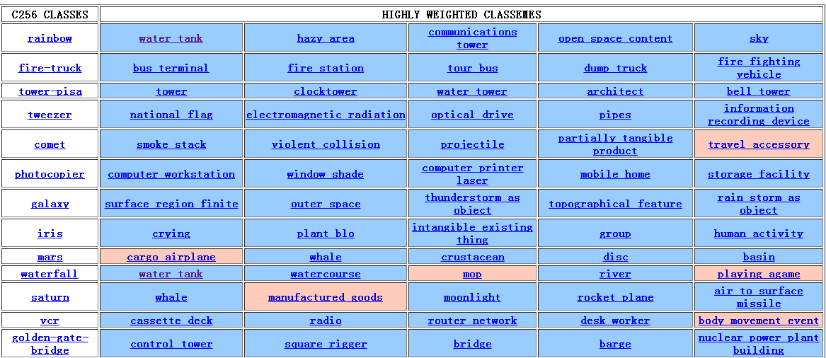
Eﬃcient Object Category Recognition Using Classemes
Approach
Notes:
Note:
1. to reiterate: the goal of the paper is not to assign semantic meaning to the classes -- this page is intended only for exploration of the algorithm behaviour. Look not at the labels of the classemes, but at the images returned on clicking them.
2. blue cells have high positive weights, red cells high negative weights
this table is for a 1-vs-all SVM classifier trained on each C256 category, with binary classemes (329 bytes per image). The short table in the paper is for 1-vs-all lp-Beta.
this list is sorted by C256 accuracy, from highest to lowest, but...

Slide 36
Eﬃcient Object Category Recognition Using Classemes
Approach
sky
crying
Get 150 training images for each classeme from bing.com image search engine

Slide 37
Experiment 1: Multiclass classification
Dataset: Caltech256
256 categories, 30608 images.
Competitor:
multiclass SVM
Neural network
Decision forests
Nearest neighour
LP-β
Combine multiple complementary features(color based, shape based, texture based) and learn the weights for different features.
Notes:
Difficult lies in intra-class variation.
No single descriptor have the same discriminative power for all classes

Slide 38
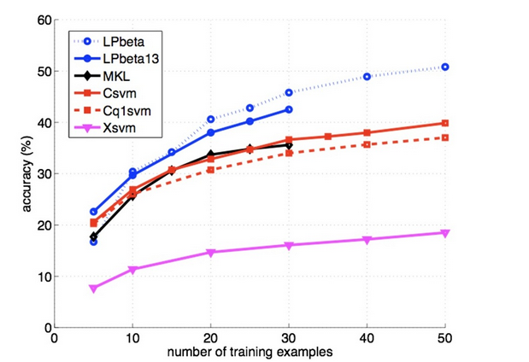
Experiment 1: Multiclass classification
Accuracy comparison
Accuracy：
36% versus 42%
But much faster speed
Notes:
Tradeoff between accuracy and speed
Time and space

Slide 39
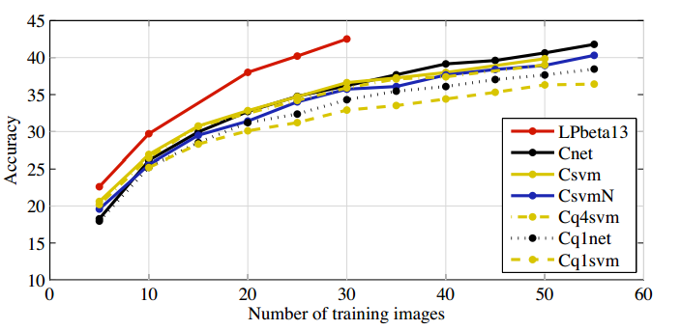
Experiment 1: Multiclass classification
Accuracy comparison
Notes:
Tradeoff between accuracy and speed
Time and space

Slide 40
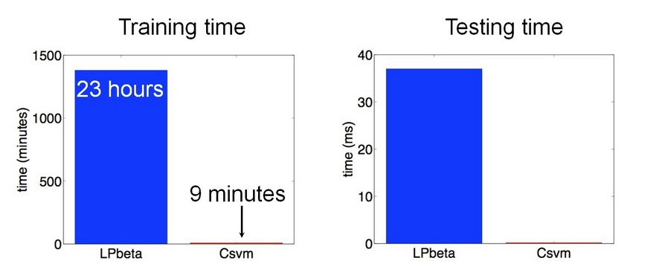
Experiment 1: Multiclass classification
Speed comparison
Over two orders of magnitude faster!

Slide 41
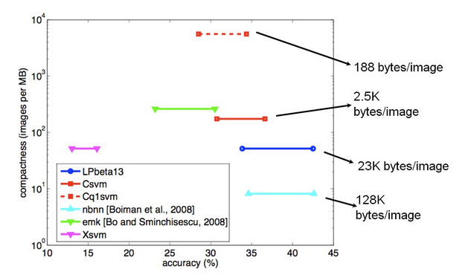
Experiment 1: Multiclass classification
Compactness comparison
Over two orders of magnitude faster!

Slide 42
Objects as Attributes for Scene Classification Li-Jia Li*, Hao Su*, Yongwhan Lim, Li Fei-Fei Object Bank: A High-Level Image Representation for Scene Classiﬁcation & Semantic Feature Sparsiﬁcation L-J. Li, H. Su, E. Xing, L. Fei-Fei.

Slide 43
Motivation
More of a action recognition instead of scene?

Slide 44
Object Recognition Scene classification
High Level Task:
Semantic Gap
Low Level
image feature
Pixel intensity, gradient

Slide 45
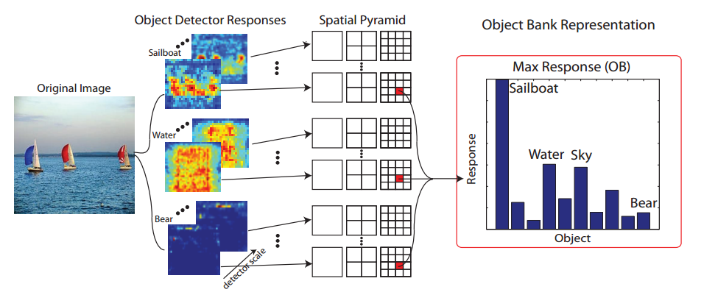
Approach
After we get OB representation for each image, we can use any machine learning method for the classification.
(In this paper, SVM and Logistic regression are chosen).

Slide 46
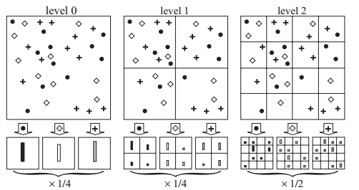
Approach
Spatial pyramid representation
Beyond Bags of Features: Spatial Pyramid Matching for Recognizing Natural Scene Categories.
S. Lazebnik, C. Schmid and J. Ponce

Slide 47
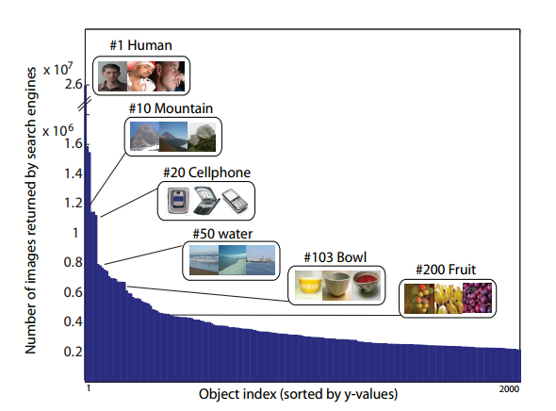
Implementation Detail
How to choose the object bank? From where? How many?
Choose the most frequent object from popular dataset (LabelMe, ESP, ImageNet, Flickr) and find their intersection.
Finally result in 200 objects.
Notes:
a small proportion of objects occurs
much more frequently than the majority

Slide 48
Implementation Detail
The large object number brings the problem of dimension curve.
In this paper, N=200 object detector, computer response on S=12 scales, L=3 spatial pyramid level. So the total response for each image is:
200*12*(1+4+16)≈50000 dimensions
The second paper mainly deals with the computation problem.
Notes:
a small proportion of objects occurs
much more frequently than the majority

Slide 49
Experiment
Datasets:
15-Scene: 15 natural scene classese
LabelMe: 9 classes
MIT Indoor: 67 indoor scenes
UIUC sports: 8 complex event classes
Notes:
a small proportion of objects occurs
much more frequently than the majority

Slide 50
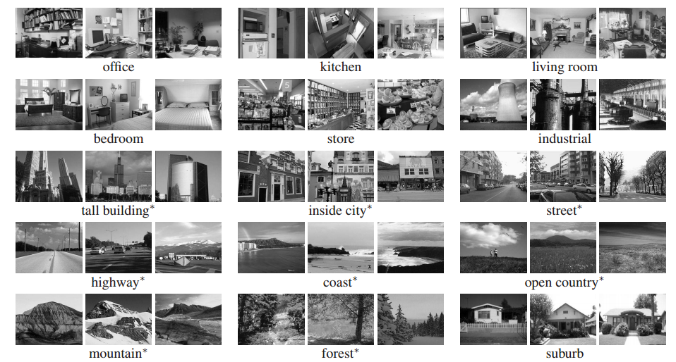
Experiment
15-Scene

Slide 51
Experiment
LabelMe: 9 categories
beach, mountain, bathroom, church, garage, ofﬁce, sail, street, forest

Slide 52
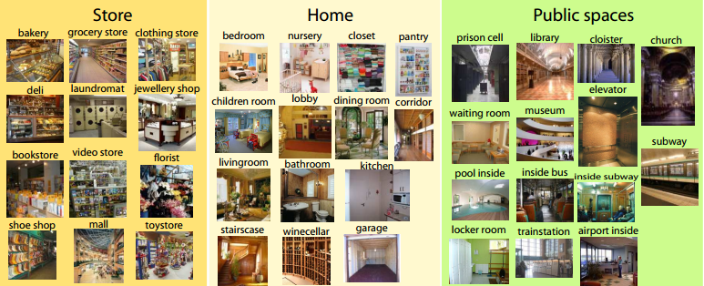
Experiment
MIT indoor(67 categories):
Notes:
a small proportion of objects occurs
much more frequently than the majority

Slide 53
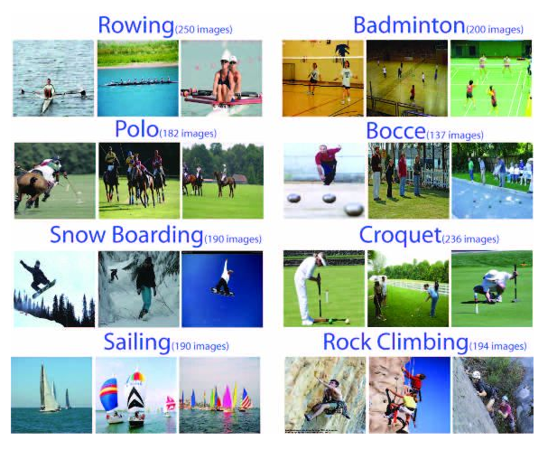
Experiment
UIUC sports(8 categories):
Notes:
a small proportion of objects occurs
much more frequently than the majority

Slide 54
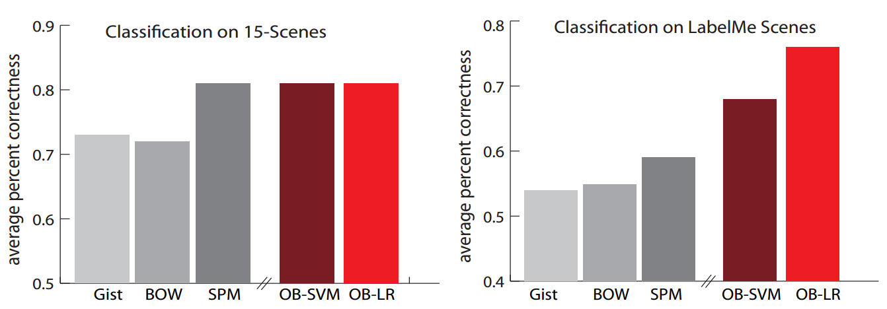
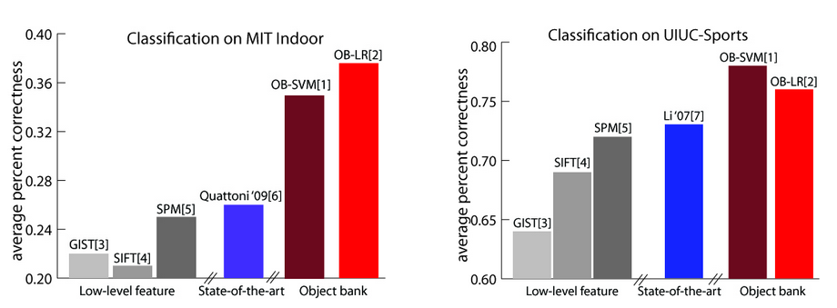
Experiment
Notes:
More performance gain on the latter two dataset.

Slide 55
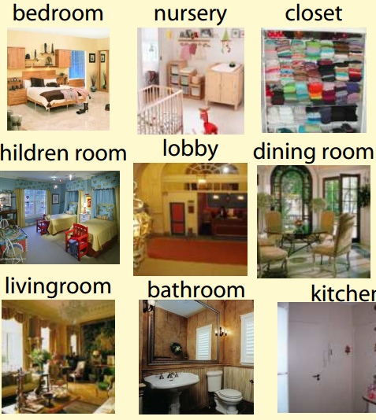
Experiment
More performance gain on MIT indoor and UIUC sports datasets because these two are more complex.
Similar texture(low-level) but different objects(semantic information)
Confirm the effectiveness of object-bank in high-level task.
Notes:
More performance gain on the latter two dataset.

Slide 56
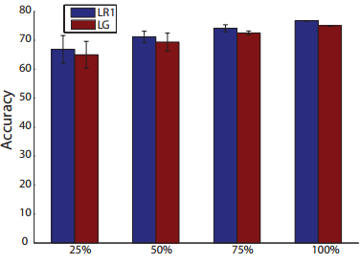
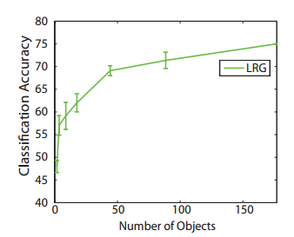
Experiment
Accuracy with growing object bank
Classiﬁcation performance continuously increases when more objects are incorporated in the OB representation.
Notes:
From the figure, the curve is not saturate. It means adding more object can further improve the performance.

Slide 57
Experiment
Comparison with classeme in object recognition
 | OB | Classeme
Caltech256 | 39% | 36%
Not fair because classeme is proposed for speed

Slide 58
Efficiency comparison of Classeme and Object bank
Dataset: 50 images randomly selected from Caltech256.
 | Classeme | Object bank | Spatial envelope
Feature extraction per image | 0.4s | 7.2s | 0.1s
Feature descriptor size | 12KB for continuous 626byte for binary | 236KB | 2KB
What if we binary the continuous value of object bank?

Slide 59
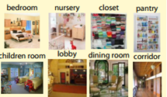
Spatial Envelope on MIT indoor
Dataset: A subset of MIT indoor which contains 8 categories
 | Average classification accuracy | By chance
Spatial envelope | 17.5% | 12.5%

Slide 60
Retrospect
Spatial envelope(2001): Ignore object information
For coarse-grained scene. Fast scene recognition.
Classemes(2010), Object bank(2010): Utilize object information.
For fine-grained scene or object categories. Increase in accuracy.

Slide 61
Acknowledge
Dr. Devi Parikh

Slide 62
Questions?

