Slide 1
Action Recognition
ECE6504
Xiao Lin

Slide 2
Outline
Introduction
Static Image: “…From Pose and Appearance “
Video: “…Discriminative Space-Time Neighborhood…”
Experiments

Slide 3
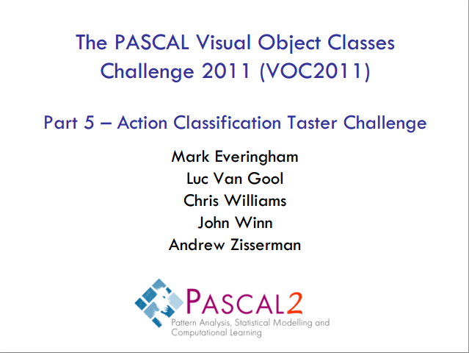

Slide 4
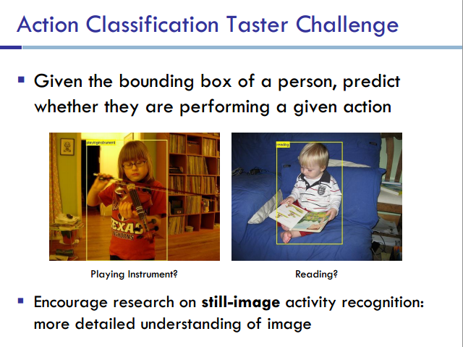

Slide 5
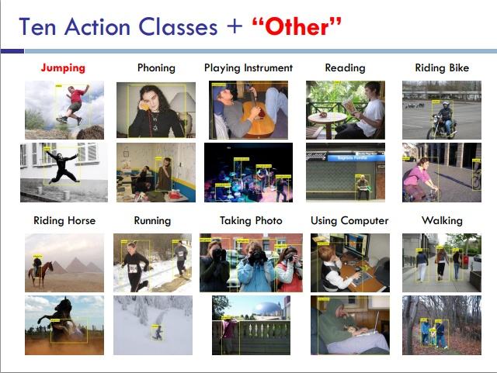

Slide 6
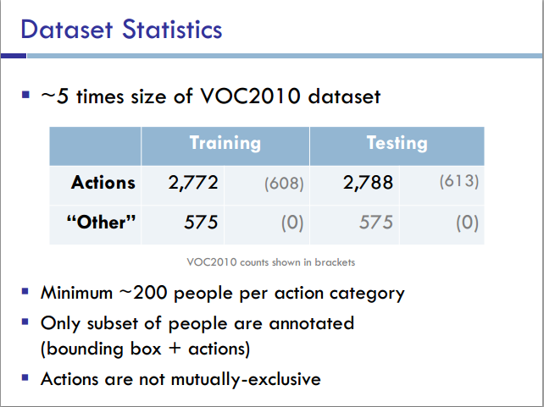

Slide 7
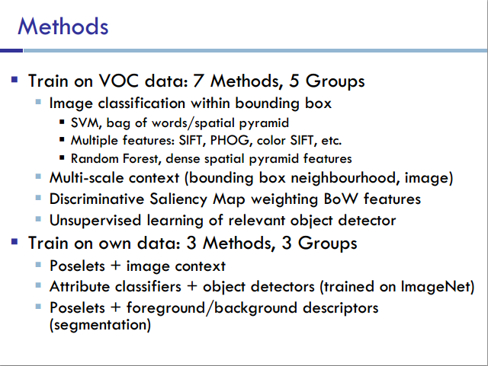

Slide 8
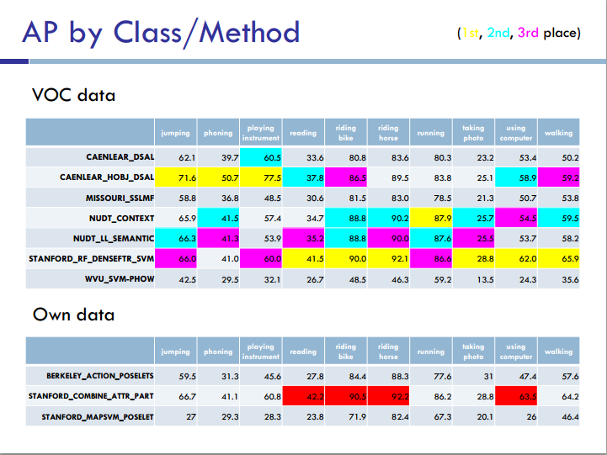

Slide 9
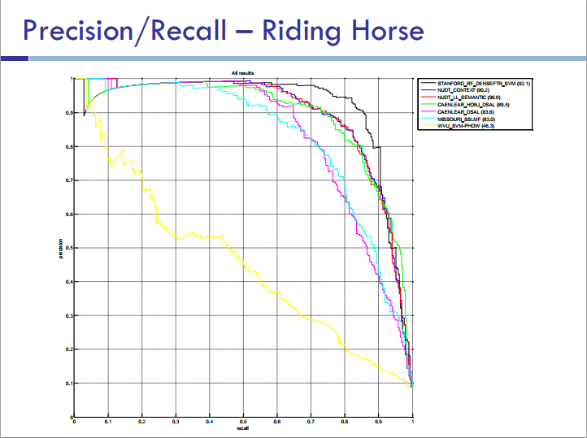

Slide 10
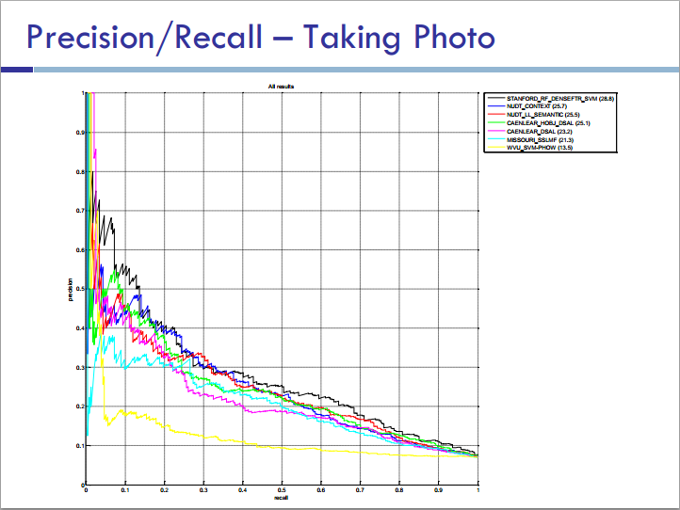

Slide 11
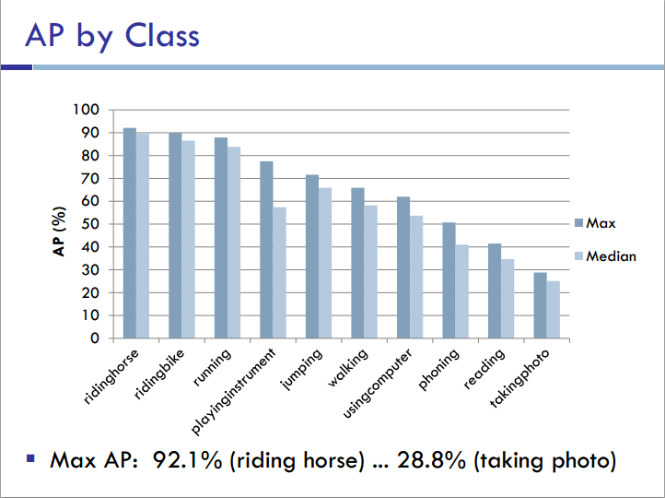

Slide 12
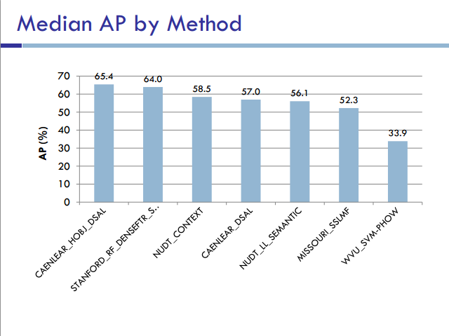

Slide 13



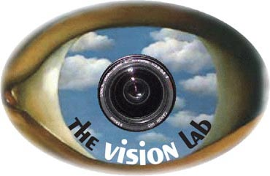

Modeling Temporal Structure of Decomposable Motion Segments for Activity Classification
Juan Carlos Niebles
Chih-Wei Chen
Li
Fei-Fei
Computer Science Dept.
Stanford University

Slide 14
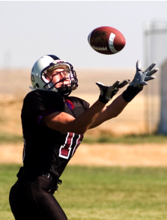
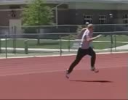
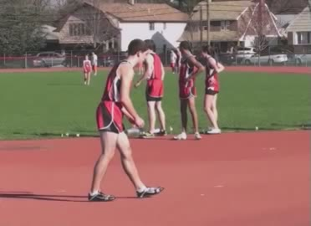
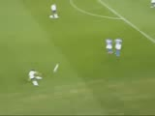
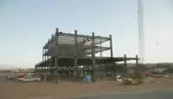
Activity landscape
Activities
Events
Long term event
Snapshot
Atomic action
Construction of a building
Catch
Run
High Jump
Football
10⁻¹
10⁰
10¹
10³
10⁷⁻⁸
Thurau & Hlavac, 2008
Gupta et al, 2009
Ikizler & Duygulu, 2009
Ikizler-Cinbis et al, 2009
Yao & Fei-Fei 2010a,b
Yang, Wang and Mori, 2010
Bobick & Davis, 2001
Efros et al, 2003
Schuldt et al, 2004
Alper & Shah, 2005
Dollar et al, 2005
Blank et al, 2005
Niebles et al, 2006
Laptev et al, 2008
Wang & Mori, 2008
Rodriguez et al, 2008
Wang & Mori, 2009
Gupta et al, 2009
Liu et al, 2009
Marszalek et al, 2009
Ramanan & Forsyth, 2003
Laxton et al, 2007
Ikizler & Forsyth, 2008
Gupta et al, 2009
Choi & Savarese, 2009
Sridhar et al, 2010
Kuettel, 2010

Slide 15

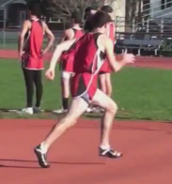
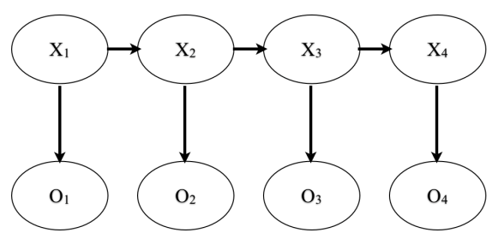
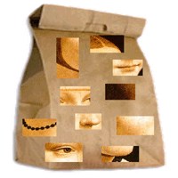
Activity landscape
Activities
Events
Long term event
Snapshot
Atomic action
10⁻¹
10⁰
10¹
10³
10⁷⁻⁸
Temporal Scale (seconds)
Possible approaches:
Pose-based recognition
HMM, CRF
Bag of features
  Computationally intensive
  Simple action recognition: Fails when actions are complex
Ferrari et al 2008
Ramanan & Forsyth 2003
Nazli & Forsyth 2008
[…]
Laptev et al 2008
Niebles et al 2006
Liu et al 2009
Sminchisescu 2006
Blank et al 2005
Efros et al 2003 […]

Slide 16
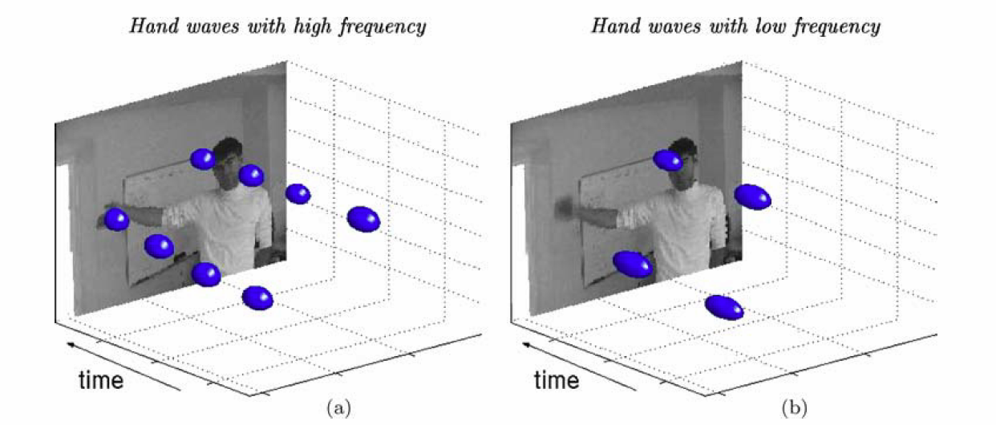
Spatial Temporal Features
Laptev, Ivan. "On space-time interest points." IJCV, 2005

Slide 17
Activity landscape – related datasets
Activities
Events
Long term event
Snapshot
Atomic action
10⁻¹
10⁰
10¹
10³
10⁷⁻⁸
Temporal Scale (seconds)
Actions in still images
[Ikizler 2009]
PPMI
[Yao & Fei-Fei 2010]
UIUC Sports
[Li & Fei-Fei 2007]
KTH
[Schuldt et al 2004]
Hollywood
[Laptev et al 2008]
UCF Sports
[Rodriguez et al 2008]
Ballet
[Yang et al 2009]
New
Olympic Sports
Dataset

Slide 18
Outline
Introduction
Static Image: “…From Pose and Appearance “
Video: “…Discriminative Space-Time Neighborhood…”
Experiments

Slide 19
Action Recognition from a Distributed Representation of Pose and Appearance
Subhransu Maji¹, Lubomir Bourdev², and Jitendra Malik¹
University of California, at Berkeley¹
Adobe Systems, Inc. San Jose, CA²
CVPR 2011

Slide 20
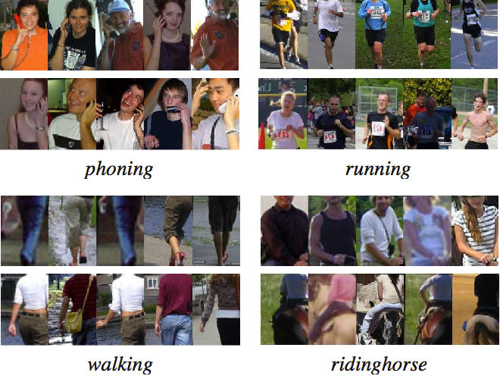
Problem Setting
PASCAL VOC 2010 static image action classification challenge
Additional training data used

Slide 21
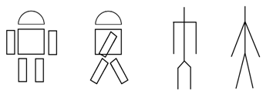
Motivation
Recovering the stick figures is hard…
  Resolution
  Clothing
  Some parts not visible

Slide 22
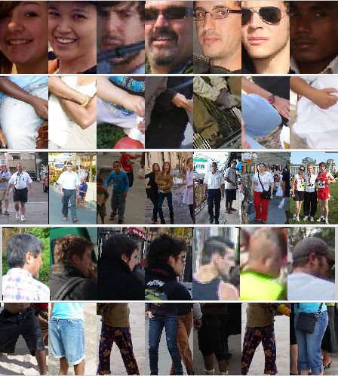
Motivation
Poselets
  Easy to detect
Poselets: Body Part Detectors Trained Using 3D Human Pose Annotations. L. Bourdev and J. Malik. ICCV 2009.
Notes:
Poselets: easy to detect, good

Slide 23
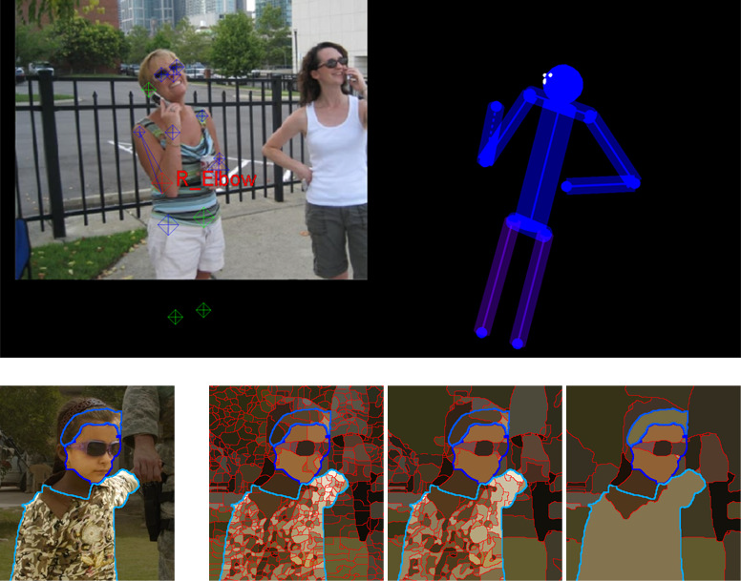
Motivation
Poselets
  Good at predicting pose
Poselets: Body Part Detectors Trained Using 3D Human Pose Annotations. L. Bourdev and J. Malik. ICCV 2009.

Slide 24
Motivation
Classic
Image
X
Action
Pose
Yang, W., Wang, Y., & Mori, G. “Recognizing human actions from still images with latent poses”. CVPR 2010.
Image
Poselets
Action
Pose
This paper
Image
X
Action
Poselets

Slide 25
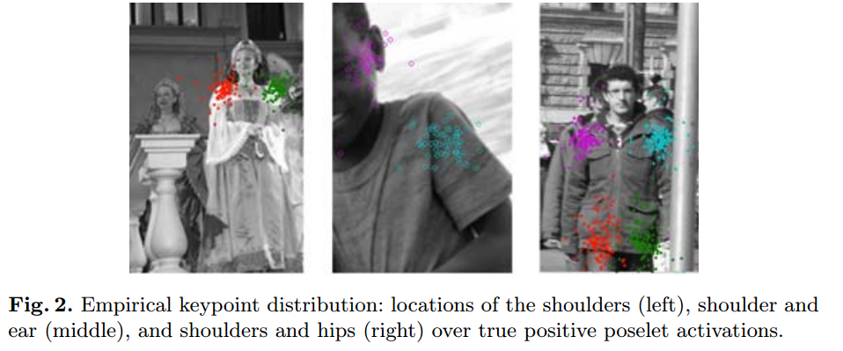
Approach
Poselets for action recognition
  Based on 2D pose, because of training data
Bourdev, L., Maji, S., Brox, T., & Malik, J. (2010). Detecting people using mutually consistent poselet activations. ECCV 2010

Slide 26
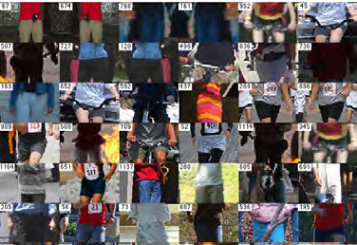

Approach
Poselets for action recognition
  Discriminativeness
    Bad

Slide 27
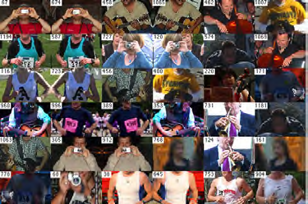

Approach
Poselets for action recognition
  Discriminativeness
    Good

Slide 28
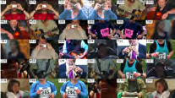
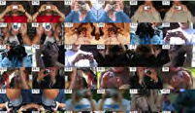
Approach
Poselets for action recognition
  Category specific, query within the category

Slide 29
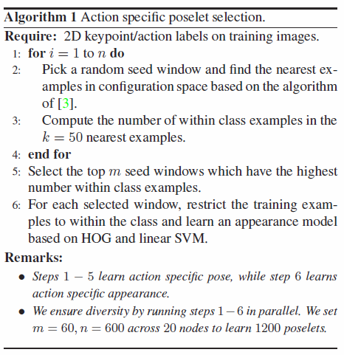
Approach
Poselets for action recognition

Slide 30
Approach
Poselets for action recognition
  4 scales: 96x64, 64x64, 64x96, 128x64
  300 poselets per scale
  1200 in all

Slide 31
Approach
Poselet activation vector
  Fits a model to predict bounding box of human
  Predicted bounding box overlap with given bounding box > α
  Sum up all such scores for each poselet
  1200 poselets -> 1200 dimension vector

Slide 32
Approach
Poselet activation vector to score
  function actionscore = pav2action(pav,W,W2)
  numactions = size(W,2);
  actionscore = zeros(numactions,1);
  for i=1:numactions
  score = pav*W(1:end-1,i) + W(end,i);
  actionscore(i) = 1./(1+exp(-(score*W2(i,1) + W2(i,2))));
  end
  end

Slide 33
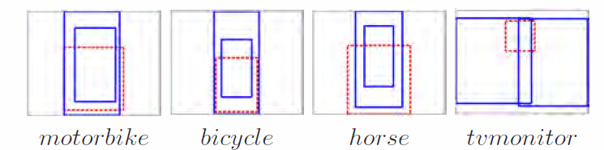
Approach
Object activation vector
  Fits a model to predict bounding box of human
  Predicted bounding box overlap with given bounding box > α
  Sum up all such scores for each object

Slide 34
Approach
Centext-based rescoring: consider the action of other people in the image
  Highest score of all other people on each action
  Linear SVM
  On playing instrument and running

Slide 35
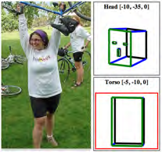
Experiments
Data
  H3D
  PASCAL VOC 2010 + Head & Torso Yaw labeling

Slide 36
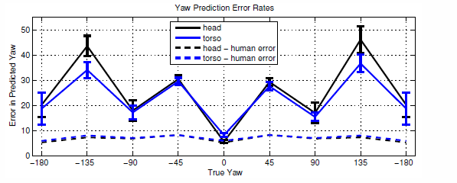
Experiments
Yaw prediction
  Close on frontal views

Slide 37
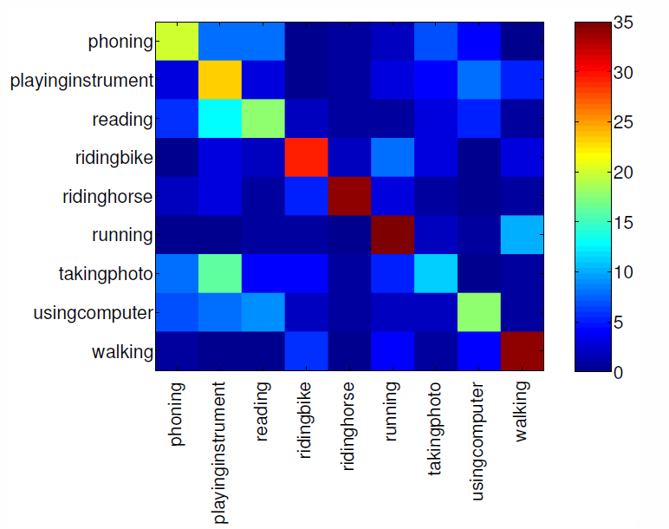
Experiments
Action prediction: confusion matrix

Slide 38
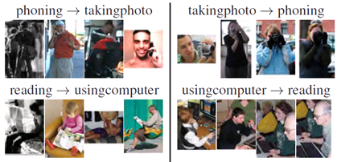
Experiments
Confusions

Slide 39
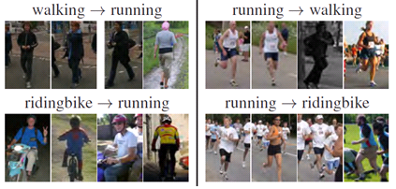
Experiments
Confusions

Slide 40
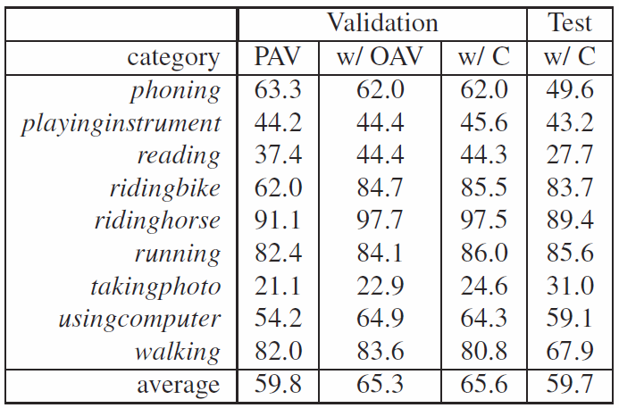
Experiments
Average Precision

Slide 41
Discussions
Pros
  An interesting use of poselets
Cons
  Manually selecting objects that are action-specific

Slide 42
Outline
Introduction
Static Image: “…From Pose and Appearance “
Video: “…Discriminative Space-Time Neighborhood…”
Experiments

Slide 43
Learning a Hierarchy of Discriminative Space-Time Neighborhood Features for Human Action Recognition
Adriana Kovashka and Kristen Grauman
University of Texas at Austin
CVPR 2010

Slide 44
Motivation
Spatial temporal interest point representations are too “local” some of the times
  Motion trajectories
  Before-after relationships
Solutions to the above problem suffer from other problems
  Sensitive to spatial temporal shifts
  Unknown spatial temporal scales

Slide 45
Spatial Temporal Features
Laptev, Ivan. "On space-time interest points." IJCV, 2005

Slide 46
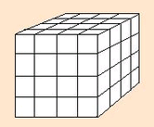
Motivation
Sensitive to spatial temporal shifts

Slide 47
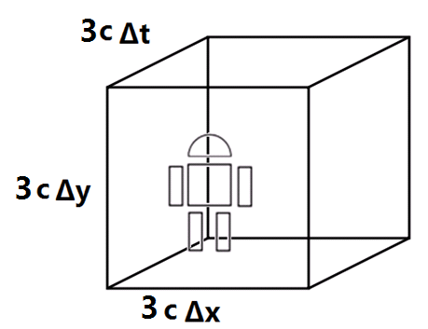
Motivation
  Unknown spatial temporal scales

Slide 48
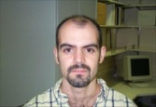

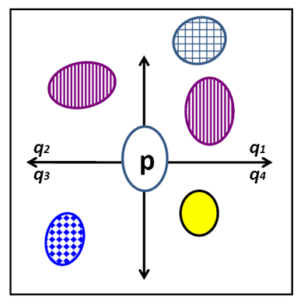
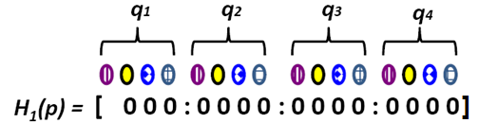

Local features may not produce good matches…
Local features:
Lazebnik et al., BMVC 2004, Sivic & Zisserman, CVPR 2004, Agarwal & Triggs, ECCV 2006, Pantofaru et al., Beyond Patches Wkshp 2006, Quack et al., ICCV 2007
Semi-local features:
Our proximity distribution descriptor:
By Yong Jae Lee and Kristen Grauman, “Foreground Focus: Finding Meaningful Features in Unlabeled Images”, BMVC 2008

Slide 49
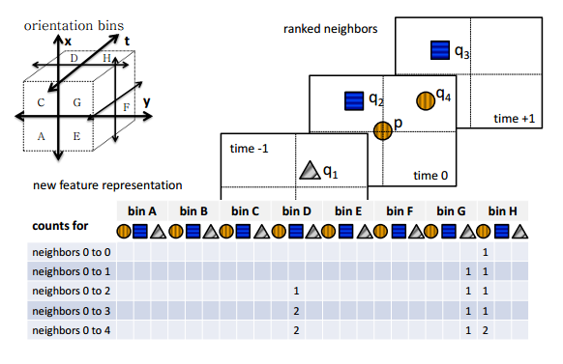
Approach

Slide 50
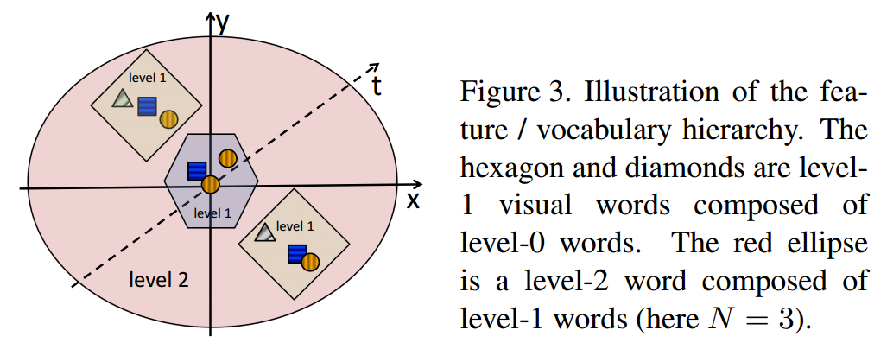
Approach
Hierarchical
  Recursively to generate multiple levels

Slide 51
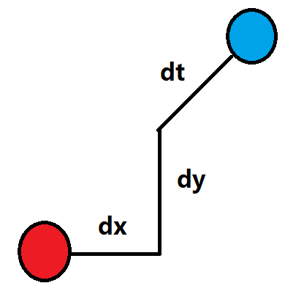
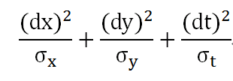
Approach
Weighted Euclidean distance
  Sample different weights as well

Slide 52
Approach
M weight settings
L+1 levels of Bag of Words histograms
ML+1 Bag of Words histograms per feature type
F different ways to extract features (HoG, HoF, HoG3D etc.)
FML+F histograms for Multiple Kernel Learning (MKL), which assign weights to each “channel” (histogram)
SVM for actual classification

Slide 53
Experiments
Data:
  KTH human action recognition
    Standard partition, average recognition rate per class
  UCF sports
    Leave-one-out cross validation
Different parameters for different datasets

Slide 54
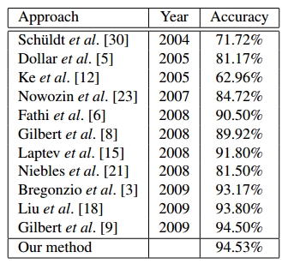
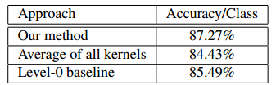
Experiments
Recognition performance
  Left: KTH; Right: UCF
[32] | 85.6%
[29] | 69.2% *
[33] | 79.3% *
*Not directly comparable

Slide 55
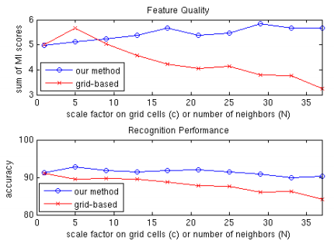
Experiments
Sensitivity to parameters: Nearest-neighbor vs. uniformly scaled 3x3x3 grid cube

Slide 56
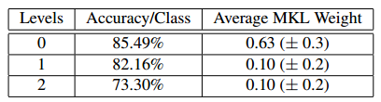
Experiments
Contribution of higher level vocabularies (>0)

Slide 57

Experiments
Most discriminative level-1 words for hand waving and riding horse

Slide 58
Discussions
Pros
  A sounding extension of Lee et al. ’s work to 2+1D
  Estimates spatial and temporal scales of actions
Cons
  Relies too much on clustering and classification algorithms, lacks an intuitive explanation
  Parameters

Slide 59
Outline
Introduction
Static Image: “…From Pose and Appearance “
Video: “…Discriminative Space-Time Neighborhood…”
Experiments

Slide 60
Action Recognition Based on Poselets
See demo

Slide 61
Action Recognition Based on Poselets
Good frontal face performance
Limited variability and Strong confusion
  Maybe better with object detectors

