Slide 1
Object Proposals
ECE-6504
Neelima Chavali 02-07-13

Slide 2
Roadmap
Roadmap
Introduction
Motivation
Paper 1:
  Problem statement
  Overview of Approach
  Experiments and Results
Paper 2
Comments
Questions

Slide 3
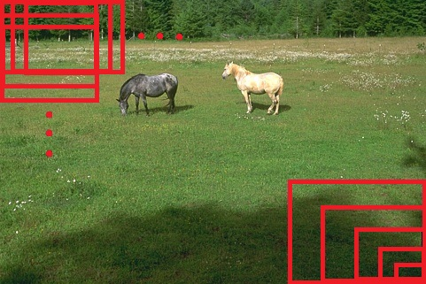
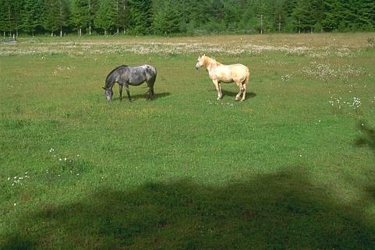
Introduction
Object class detection
State-of-the-art detectors follow sliding-window paradigm
Horse, Dog, Cat, Car, Train…

Slide 4
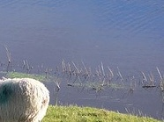


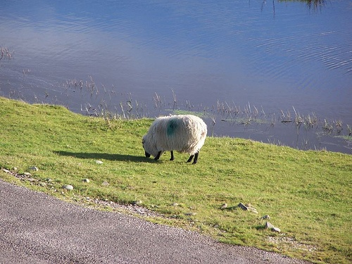
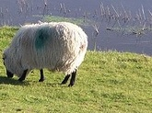

Motivation
Are all windows equally likely to have an object in them?

Slide 5
What is an Object?
-Bogdan Alexe, Thomas Deselaers, Vittorio Ferrari
Computer Vision Laboratory, ETH Zurich
Paper 1

Slide 6
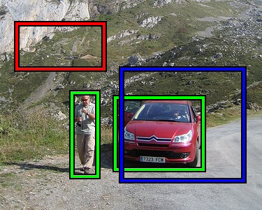
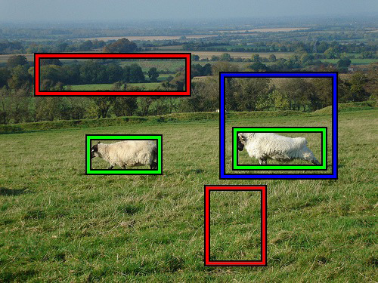
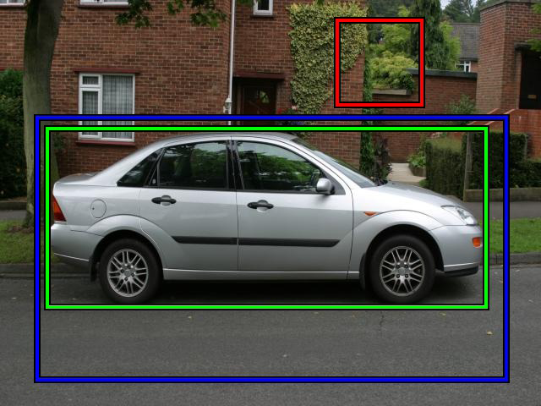
Problem statement
A class-generic object detector.
Quantify how likely it is for an image to contain an object of any class(objectness).

Slide 7
Overview of Approach
Assumptions about generic object properties
Image cues
Learning cues
Bayesian Cue Integration
Notes:
Assumptions about objects:
(a) a well-defined closed boundary
in space; (b) a different appearance from their surroundings
[23, 25]; (c) sometimes it is unique within the image
and stands out as salient [2, 13, 17, 19].
(a) We design an objectness measure and explicitly train it to distinguish windows containing an object from background windows. This measure combines in a Bayesian framework several image cues based on the above characteristics.
(b) We present a new cue (sec. 2.4) and demonstrate it outperforms traditional saliency [17] for detecting objects in the challenging PASCAL VOC 07 dataset [7]. We also show that the combined objectness measure performs better than any cue alone.
(c) We show how to use objectness as a location prior for modern class-specific object detectors [4, 10, 32]. We demonstrate an algorithm to greatly reduce the number of evaluated windows with only minor loss in detection performance.

Slide 8
Object properties
3 Characteristics of Object
  Closed boundary
  Different appearance
  Sometimes unique or salient

Slide 9
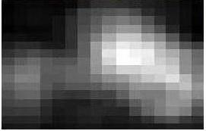
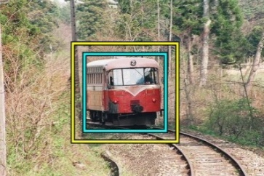
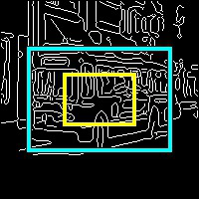
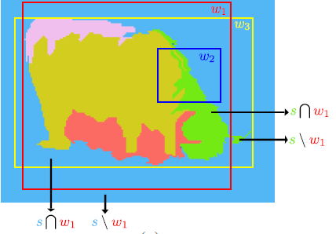
Calculating objectness
Compute P(obj|window)
Feature candidates(all real valued functios of a window):
  Color Contrast
  Edge Density (near border)
  Superpixels Straddling
  Multi-scale Saliency
Learning: Naïve Bayes

Slide 10
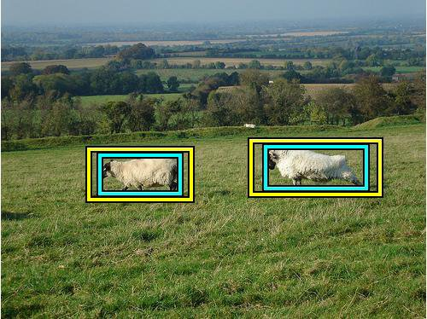
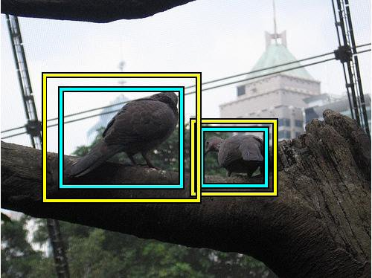
Color Contrast (CC)
Measure of “different appearance” of an object
Expand window by θ_{CC} in all directions.
CC Cue: Chi-square distance of LAB Histograms
Cyan: Considered Window; Yellow: Expanded Window

Slide 11
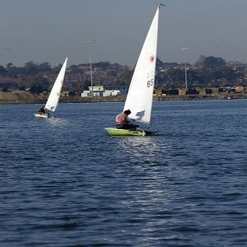
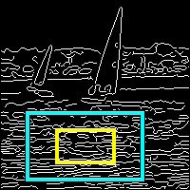
Edge Density (ED)
Measure of “closed boundary” of an object
Shrink window by θ_{ED} in all directions.
ED Cue: Number of “on” pixels in Canny detector, normalized by perimeter of shrunken window.

Slide 12
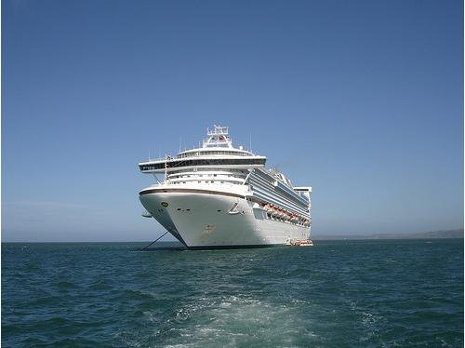
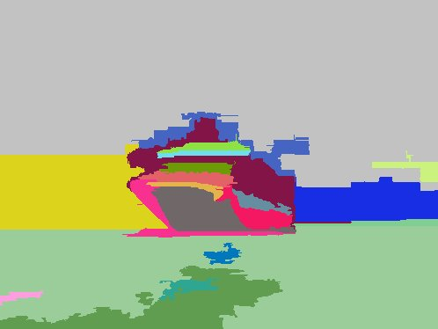
Superpixels Straddling (SS)
Captures “closed boundary” characteristic
Felzenszwalb-Huttenlocher segmentation at scale θ_{SS}
Intuitively: each superpixel s is either in or out of a window w; penalize for straddling: min(|s∩w|,|s\w|) / |w|.
1-Sum over superpixels straddling
w
s \ w
s ∩ w

Slide 13
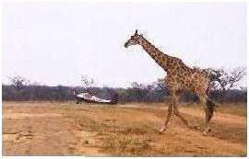
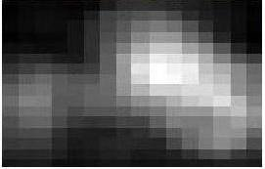
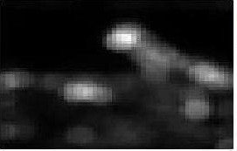
Multi-scale Saliency (MS)
Measures “uniqueness” of an object window
Out-of-the-box saliency detector due to Hou et al.
Density = fraction of pixels above a threshold θ_{MS}
MS Cue: sum of saliencies of pixels above θ_{MS}, multiplied by density.
Multiple scales → Multiple cues
Input Image
Scale 1
Scale 2

Slide 14
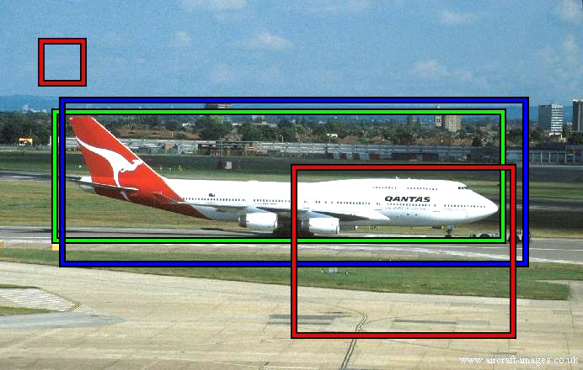
Learning Details
  Generate windows uniformly
  Positive example if intersection / union > 0.5; negative otherwise
  One learning method for CC, ED and SS, another method for MS.

Slide 15
Testing Images
Build a classifier to distinguish between positive and negative examples
Use Naïve Bayes model to train the classifier.
In a test image sample any number T of windows from MS.
Calculate remaining cues for the sample.
Feed the cues to the classifier to get P(obj|cues).

Slide 16
Experimental setup
Evaluate all the images of the PASCAL VOC 07 dataset
Evaluate performance on DR/STN curves.
Evaluate MS vs other methods; single cues vs baselines; cue combinations vs SS.
Evaluate speeding up of class-specific detectors

Slide 17
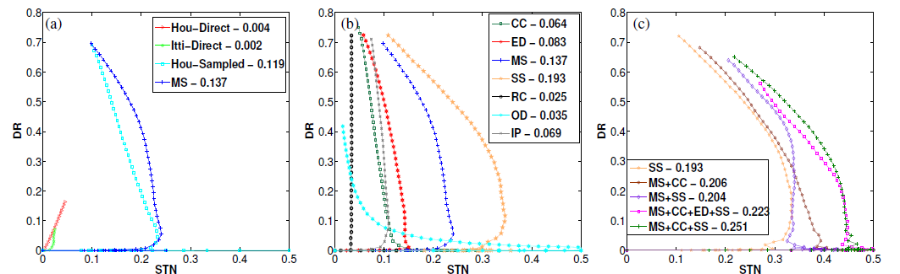
Results

Slide 18
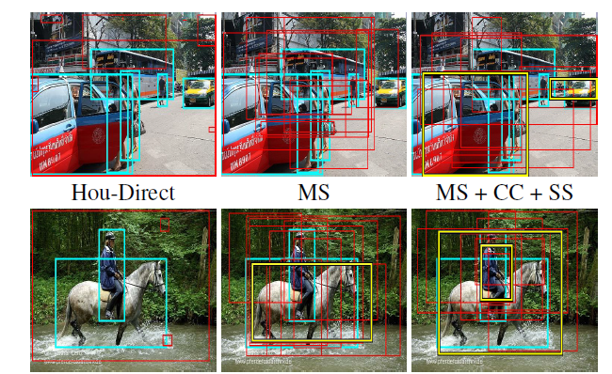
Results

Slide 19
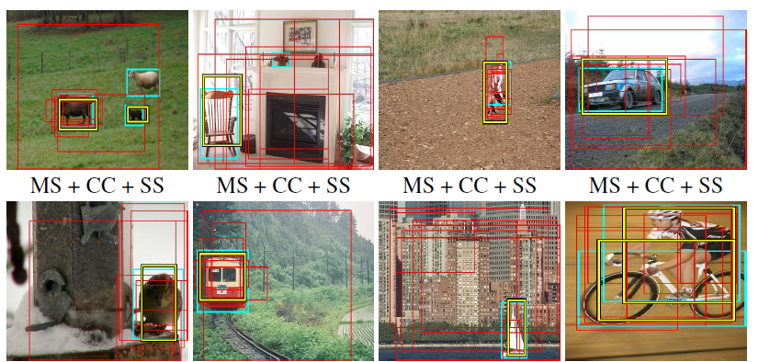
Results

Slide 20
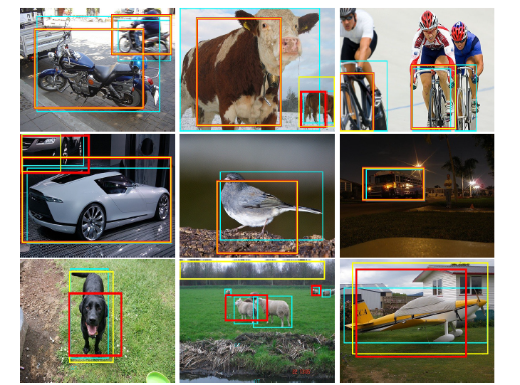

Evaluation: class specific detection

Slide 21
Conclusions
Can efficiently pre-filter object windows for all classes, and drive attention towards plausible windows.
Superpixels are a fairly powerful cue, and outperform more complex saliency methods.

Slide 22
Category Independent Object Proposals- Ian Endres, Derek HOiem
Paper 2:

Slide 23
Problem statement
Provide a small pool/bag of regions for an image, that are likely to contain every object in the image, regardless of category.
Rank these regions such that the top-ranked regions are likely to be good segmentations of different objects

Slide 24
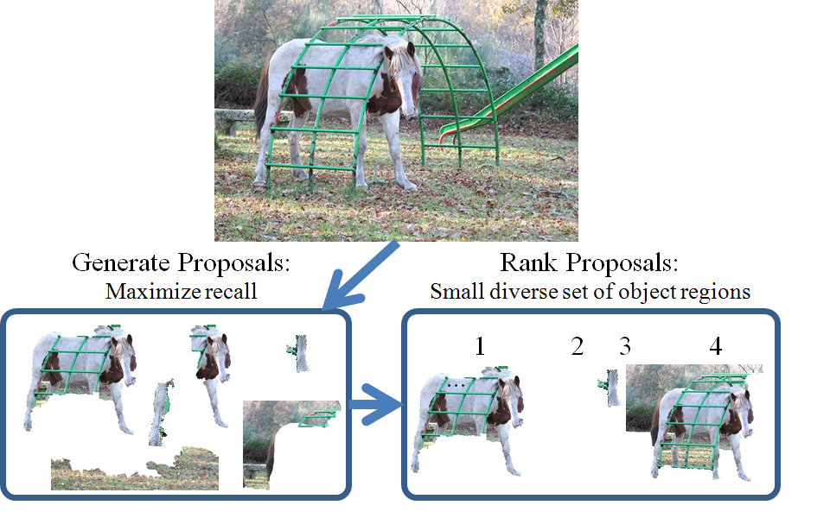
Overview of Approach
Proposing Regions:
  Hierarchical Segmentation
  Seeding
  Identifying Proposals
Ranking Proposals

Slide 25
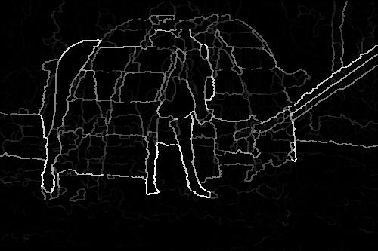
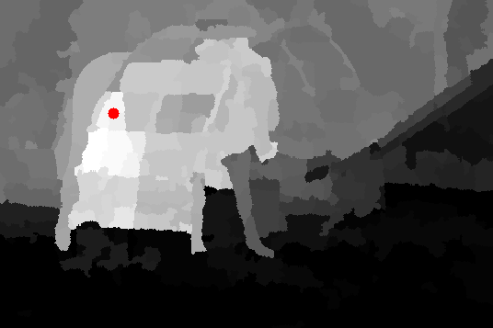
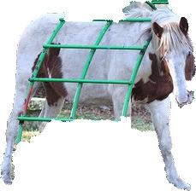
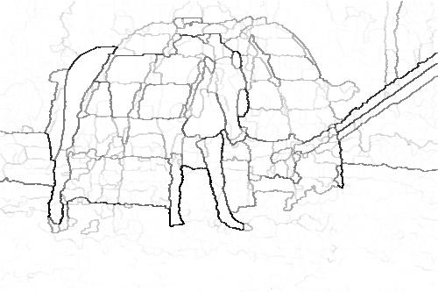
Generating Proposals
1. Hierarchical Segmentation & Seed selection
2. Compute affinities for seed
5. Change parameters
Repeat
4. Compute proposal
3. Super pixel affinities
+
Affinities
Occlusion Boundaries

Slide 26
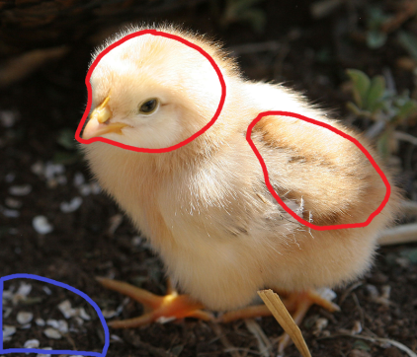
Region Affinity
Learned from pairs of regions belonging to an object
  Computed between the seed and each region of the hierarchy
  Features: color and texture similarity, boundary crossings, layout agreement

Slide 27


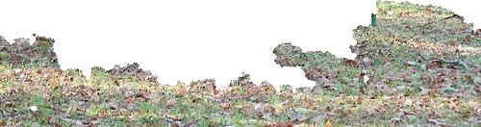
Ranking Proposals
Appearance scores
Generated
Ranking
w^{T} X₁
1.
w^{T} X₂
Sort
scores
2.
w^{T} X₃
3.
w^{T} X₄
4.

Slide 28
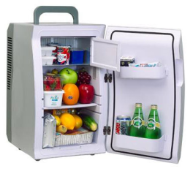

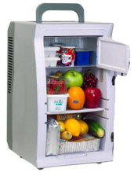


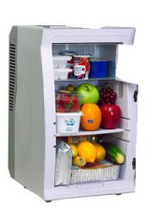

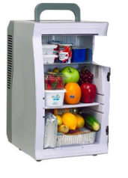

Lacks Diversity
But in an image with many objects, one object may dominate
1
…
20
2
…
50
…
3
100
…
4
150

Slide 29
Encouraging Diversity
Suppress regions with high overlap with previous proposals
1
…
20
2
…
3
50
4
…
…
100
10

Slide 30
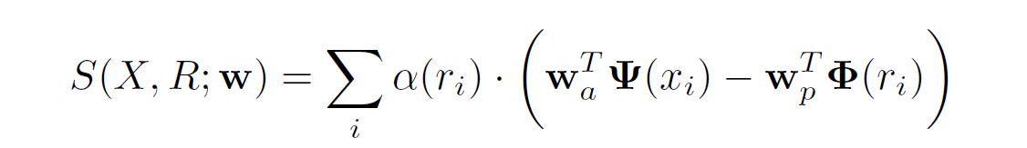
Ranking as Structured Prediction
Find the max scoring ordering of proposals
Greedily add proposals with best overall score
Learn the parameters of the scoring function using slack –rescale method with loss penalty
Appearance score
Overlap penalty
Gives higher weight to higher ranked proposals
Overall score

Slide 31
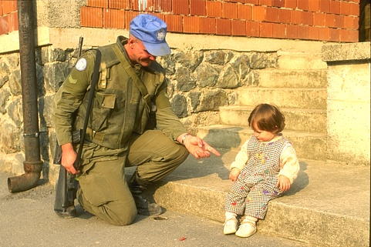
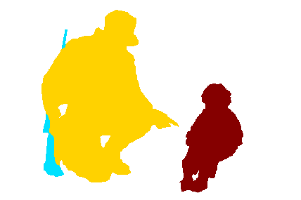
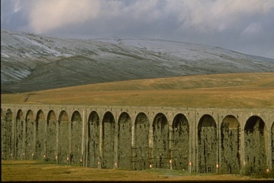
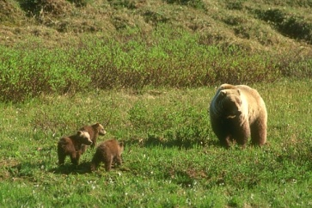
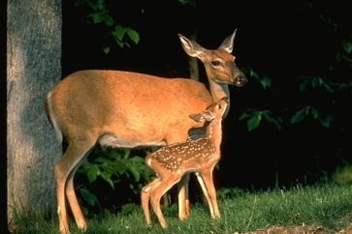
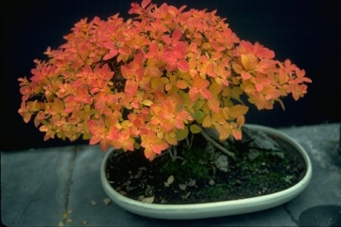
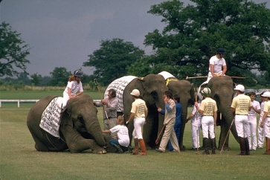
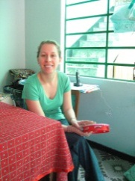
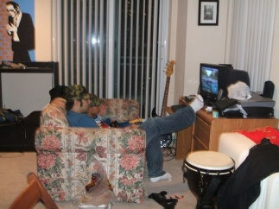
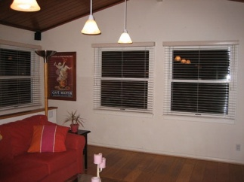
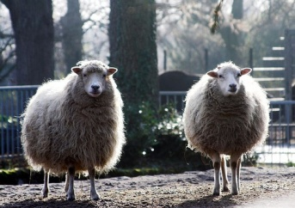
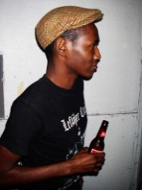
Experimental Setup
Train on 200 BSDS images
Test 1: 100 BSDS images
Test 2: 512 Images from Pascal 2008 Seg. Val.

Slide 32






Qualitative Results
(Rank, % overlap)
BSDS
Pascal
Notes:
32

Slide 33

Features

Slide 34

Proposal quality

Slide 35

Recalling Pascal Categories

Slide 36

Ranking performance
Ours: 80%
180 proposals
Standard: 80%
70,000 proposals
(merge 2 adjacent regions)
Ours: 53%
18 proposals
Standard: 53%
3000 proposals

Slide 37
Questions?

